Slide 1
Bits, Characters, C Strings and structs
Based on Chapter 22 of C++ How to Program, 10/e

Slide 4
22.1 Introduction
We now discuss structures, their near equivalent with classes, and the manipulation of bits, characters and C strings.
Many of the techniques we present here are included for the benefit of those who will work with legacy C and C++ code.
Like a class, C++ structures may contain access specifiers, member functions, constructors and destructors.
The only differences between structures and classes in C++ is that structure members default to public access and class members default to private access when no access specifiers are used, and that structures default to public inheritance, whereas classes default to private inheritance.

Slide 5
22.1 Introduction (cont.)
Our presentation of structures here is typical of the legacy C code and early C++ code you’ll see in industry.
We present a high-performance card shuffling and dealing simulation in which we use structure objects containing C++ string objects to represent the cards.

Slide 6
22.1 Introduction (cont.)
We discuss the bitwise operators that allow you to access and manipulate the individual bits in bytes of data.
We also present bitfields—special structures that can be used to specify the exact number of bits a variable occupies in memory.
These bit-manipulation techniques are common in programs that interact directly with hardware devices that have limited memory.

Slide 7
22.1 Introduction (cont.)
The chapter finishes with examples of many character and C string-manipulation functions—some of which are designed to process blocks of memory as arrays of bytes.
The detailed C string treatment in this chapter is mostly for reasons of legacy code support and because there are still remnants of C string use in C++, such as command-line arguments (Appendix F).
New development should use C++ string objects rather than C strings.

Slide 8
22.2 Structure Definitions
Consider the following structure definition:
struct Card { string face; string suit; }; // end struct Card
Keyword struct introduces the definition for structure Card.
The identifier Card is the structure name and is used in C++ to declare variables of the structure type (in C, the type name of the preceding structure is struct Card).
Card’s definition contains two string members—face and suit.

Slide 9
22.2 Structure Definitions (cont.)
The following declarations
Card oneCard;
Card deck[52];
Card* cardPtr;
declare oneCard to be a structure variable of type Card, deck to be an array with 52 elements of type Card and cardPtr to be a pointer to a Card structure.
Variables of a given structure type can also be declared by placing a comma-separated list of the variable names between the closing brace of the structure definition and the semicolon that ends the structure definition.

Slide 10
22.2 Structure Definitions (cont.)
For example, the preceding declarations could have been incorporated into the Card structure definition as follows:
struct Card
{
string face;
string suit;
} oneCard, deck[52], * cardPtr;

Slide 11
22.2 Structure Definitions (cont.)
Structure members are not necessarily stored in consecutive bytes of memory.
Sometimes there are “holes” in a structure, because some computers store specific data types only on certain memory boundaries for performance reasons, such as half-word, word or double-word boundaries.
A word is a standard memory unit used to store data in a computer—usually two, four or eight bytes and typically eight bytes on today’s popular 64-bit systems.

Slide 12
22.2 Structure Definitions (cont.)
Consider the following structure definition in which structure objects sample1 and sample2 of type Example are declared:
struct Example { char c; int i; } sample1, sample2;
A computer with two-byte words might require that each of the members of Example be aligned on a word boundary (i.e., at the beginning of a word—this is machine dependent).

Slide 13
22.2 Structure Definitions (cont.)
Figure 22.1 shows a sample storage alignment for an object of type Example that has been assigned the character 'a' and the integer 97 (the bit representations of the values are shown).
If the members are stored beginning at word boundaries, there is a one-byte hole (byte 1 in the figure) in the storage for objects of type Example.
The value in the one-byte hole is undefined.
If the values in sample1 and sample2 are in fact equal, the structure objects might not be equal, because the undefined one-byte holes are not likely to contain identical values.

Slide 17
22.3 typedef
Keyword typedef provides a mechanism for creating synonyms (or aliases) for previously defined data types.
Names for structure types are often defined with typedef to more readable type names.
For example, the statement
typedef Card* CardPtr;
defines the new type name CardPtr as a synonym for type Card*.
Creating a new name with typedef does not create a new type; typedef simply creates a new type name that can then be used in the program as an alias for an existing type name.

Slide 18
22.4 Example: Card Shuffling and Dealing Simulation
The card shuffling and dealing program in Figs. 22.2–22.4 is similar to the one described in Exercise 9.23.
This program represents the deck of cards as an array of structures.
The constructor (lines 12–27 of Fig. 22.3) initializes the array in order with character strings representing Ace through King of each suit.

Slide 19
22.6 Example: Card Shuffling and Dealing Simulation (cont.)
Function shuffle implements the shuffling algorithm.
The function loops through all 52 cards (subscripts 0 to 51).
For each card, a number between 0 and 51 is picked randomly.
Next, the current Card and the randomly selected Card are swapped in the array.
A total of 52 swaps are made in a single pass of the entire array, and the arrayis shuffled.
Because the Card structures were swapped in place in the array, the dealing algorithm implemented in function deal requires only one pass of the arrayto deal the shuffled cards.

Slide 22
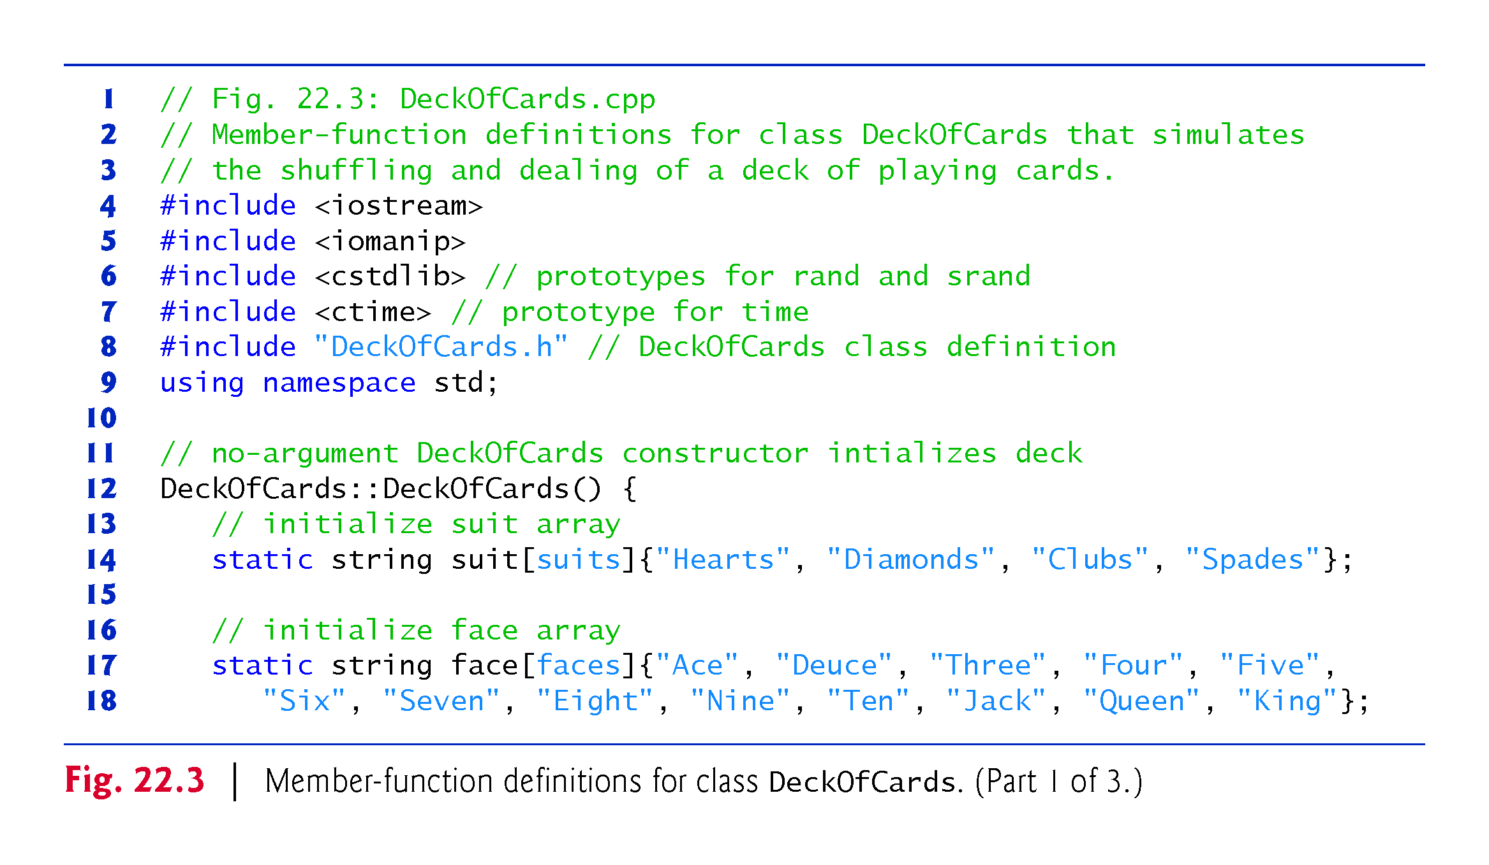

Slide 24
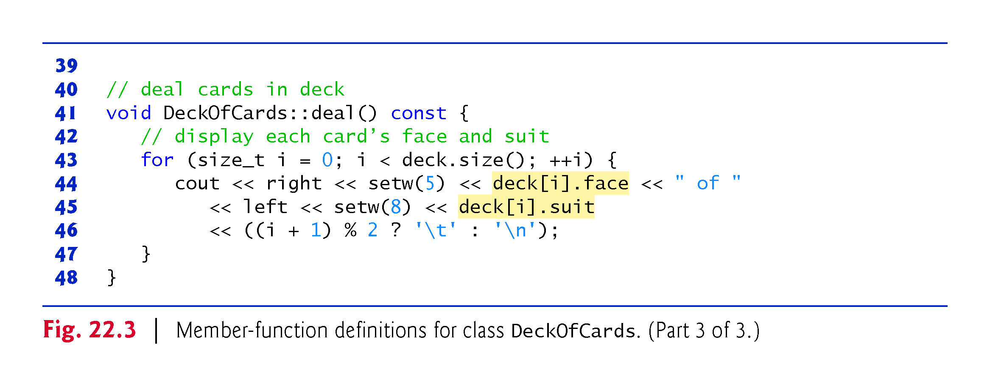

Slide 25
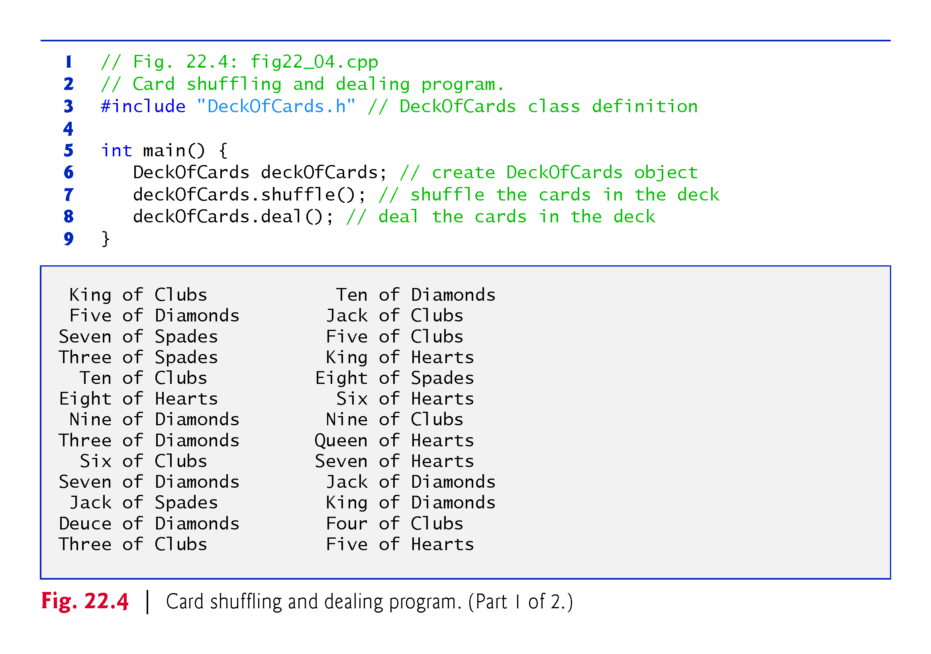

Slide 26
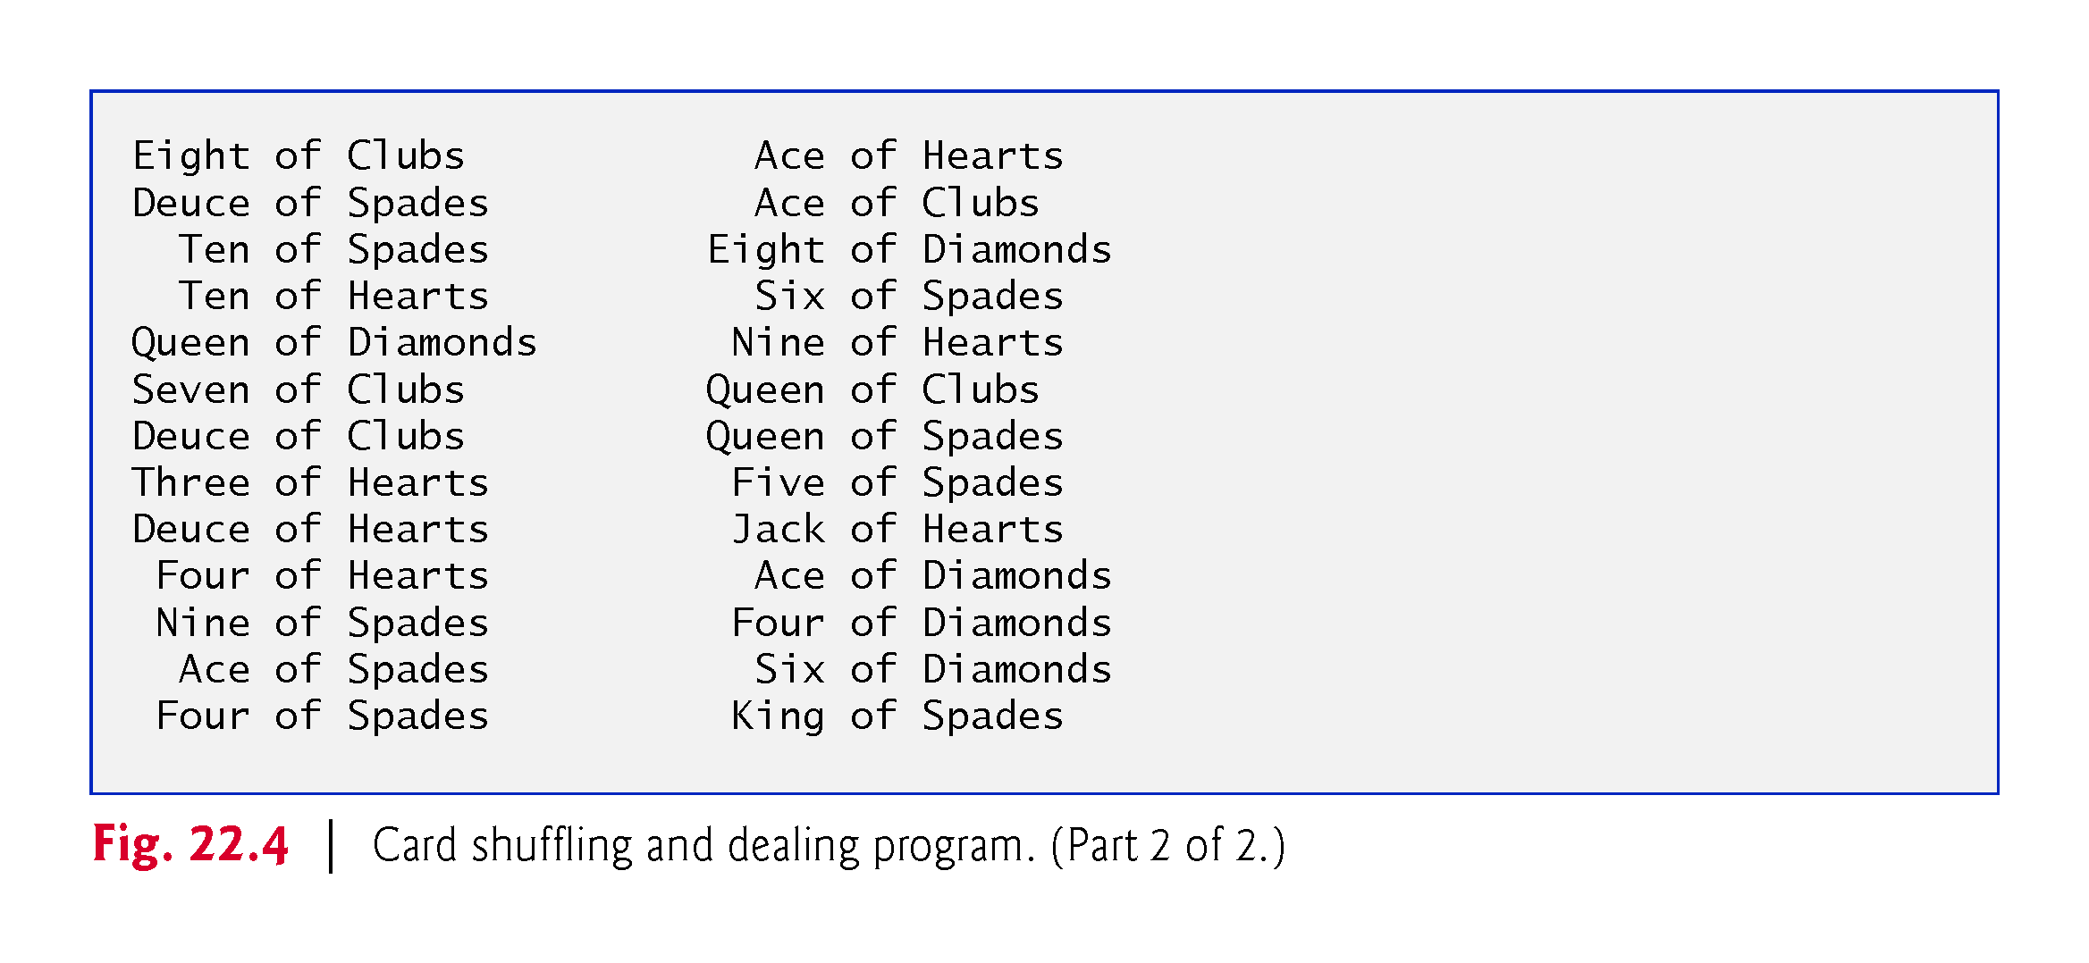

Slide 27
22.5 Bitwise Operators
C++ provides extensive bit-manipulation capabilities for getting down to the so-called “bits-and-bytes” level.
Operating systems, test-equipment software, networking software and many other kinds of software require that you communicate “directly with the hardware.”
We introduce each of the bitwise operators, and we discuss how to save memory by using bit fields.

Slide 28
22.5 Bitwise Operators (cont.)
All data is represented internally by computers as sequences of bits.
Each bit can assume the value 0 or the value 1.
On most systems, a sequence of eight bits, each of which forms a byte—the standard storage unit for a variable of type char.
Other data types are stored in larger numbers of bytes.
Bitwise operators are used to manipulate the bits of integral operands (char, short, int and long; both signed and unsigned).
Normally the bitwise operators are used with unsigned integers.

Slide 30
22.5 Bitwise Operators (cont.)
The bitwise operator discussions in this section show the binary representations of the integer operands.
For a detailed explanation of the binary (also called base-2) number system, see Appendix D, Number Systems.
Because of the machine-dependent nature of bitwise manipulations, some of these programs might not work on your system without modification.
The bitwise operators are: bitwise AND (&), bitwise inclusive OR (|), bitwise exclusive OR (^), left shift (<<), right shift (>>) and bitwise complement (~)—also known as the one’s complement.

Slide 31
22.5 Bitwise Operators (cont.)
The bitwise AND, bitwise inclusive OR and bitwise exclusive OR operators compare their two operands bit by bit.
The bitwise AND operator sets each bit in the result to 1 if the corresponding bit in both operands is 1.
The bitwise inclusive OR operator sets each bit in the result to 1 if the corresponding bit in either (or both) operand(s) is 1.
The bitwise exclusive OR operator sets each bit in the result to 1 if the corresponding bit in either operand—but not both—is 1.

Slide 32
22.5 Bitwise Operators (cont.)
The left-shift operator shifts the bits of its left operand to the left by the number of bits specified in its right operand.
The right-shift operator shifts the bits in its left operand to the right by the number of bits specified in its right operand.
The bitwise complement operator sets all 0 bits in its operand to 1 in the result and sets all 1 bits in its operand to 0 in the result.
The bitwise operators are summarized in Fig. 22.5.

Slide 33
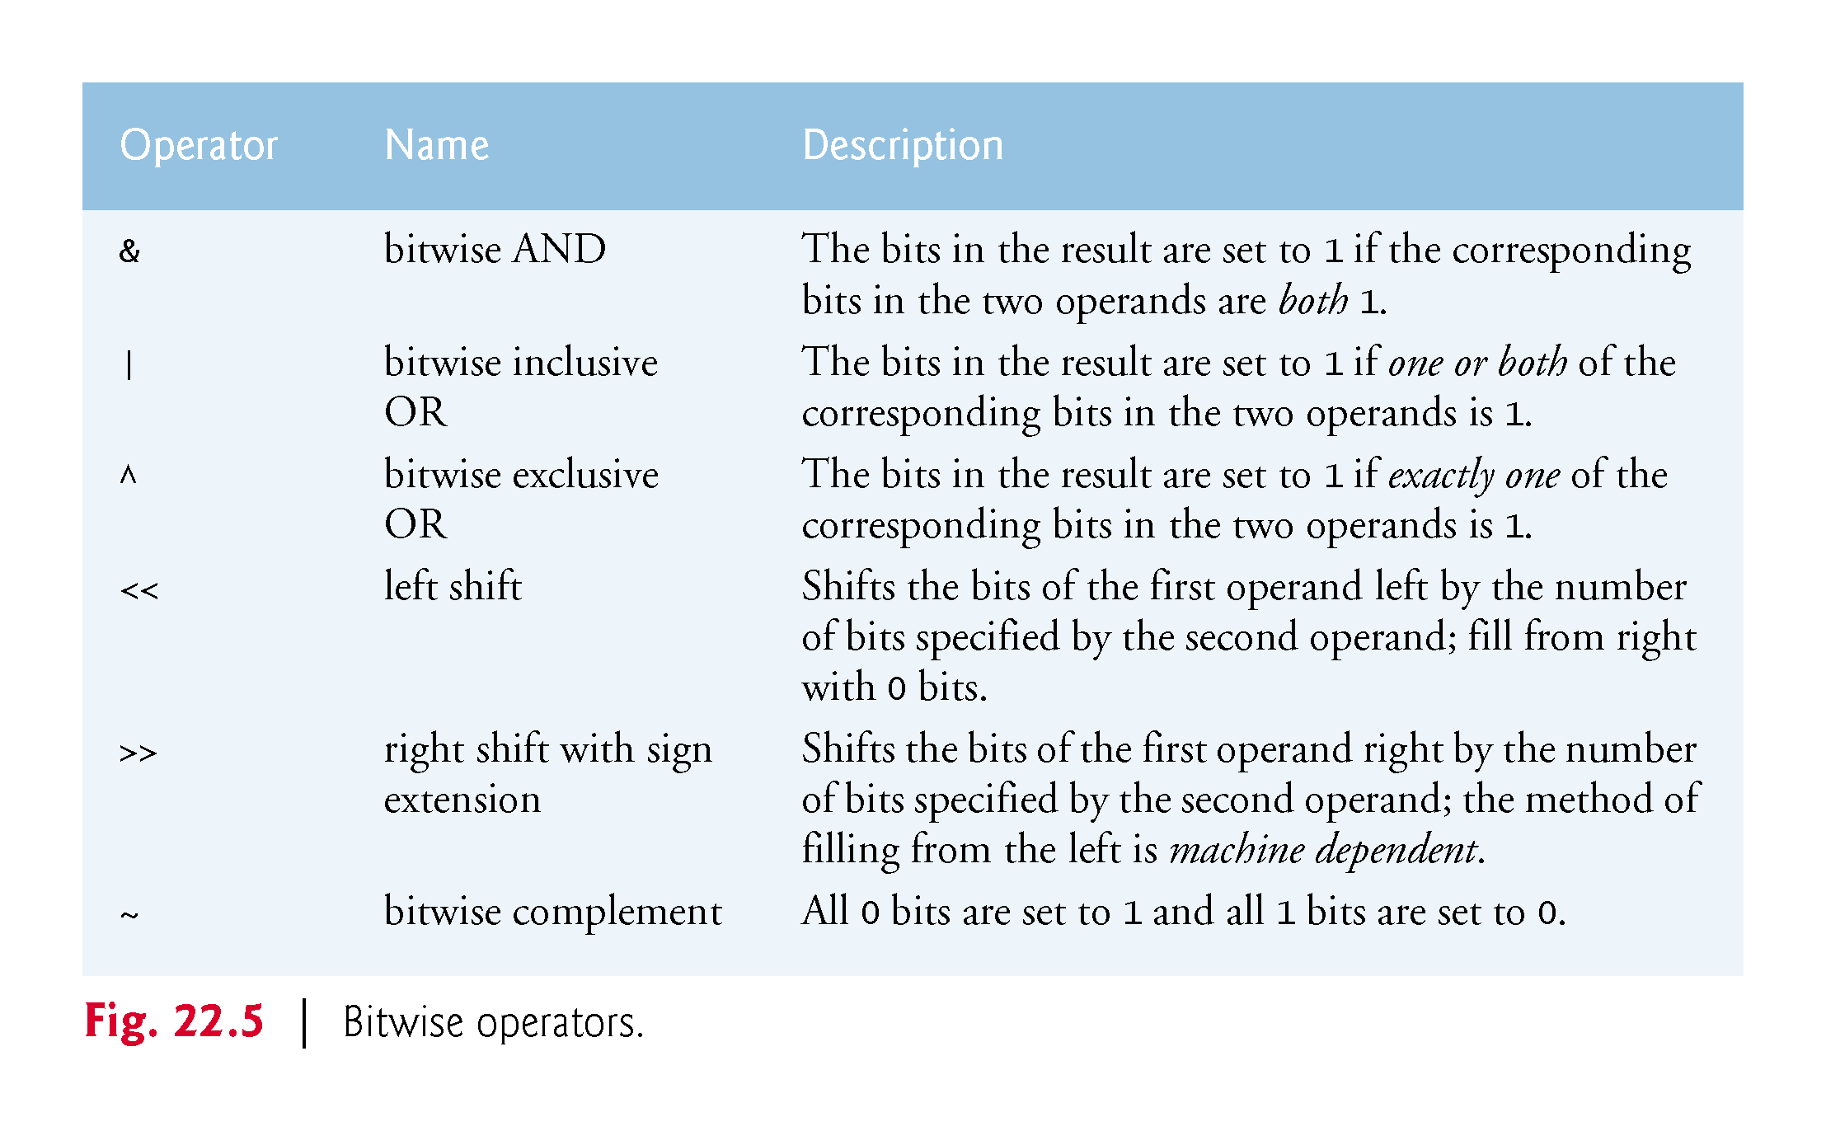

Slide 34
22.5 Bitwise Operators (cont.)
When using the bitwise operators, it’s useful to illustrate their precise effects by printing values in their binary representation.
The program of Fig. 22.6 prints an unsigned integer in its binary representation in groups of eight bits each.

Slide 38
22.5 Bitwise Operators (cont.)
Function displayBits (lines 18–35) uses the bitwise AND operator to combine variable value with constant MASK.
Often, the bitwise AND operator is used with an operand called a mask—an integer value with specific bits set to 1.
Masks are used to hide some bits in a value while selecting other bits.
In displayBits, line 20 initializes constant MASK the value 1 << SHIFT.

Slide 39
22.5 Bitwise Operators (cont.)
The value of constant SHIFT was calculated in line 19 with the expression
8 * sizeof(unsigned) - 1
which multiplies the number of bytes an unsigned object requires in memory by 8 (the number of bits in a byte) to get the total number of bits required to store an unsigned object, then subtracts 1.
The bit representation of 1 << SHIFT on a computer that represents unsigned objects in four bytes of memory is
10000000 00000000 00000000 00000000
The left-shift operator shifts the value 1 from the low-order (rightmost) bit to the high-order (leftmost) bit in MASK, and fills in 0 bits from the right.

Slide 40
22.5 Bitwise Operators (cont.)
Line 26 prints a 1 or a 0 for the current leftmost bit of variable value.
Assume that variable value contains 65000 (00000000 00000000 11111101 11101000).
When value and MASK are combined using &, all the bits except the high-order bit in variable value are “masked off” (hidden), because any bit “ANDed” with 0 yields 0.
If the leftmost bit is 1, value & MASK evaluates to
00000000 00000000 11111101 11101000 (value) 10000000 00000000 00000000 00000000 (MASK) ----------------------------------- 00000000 00000000 00000000 00000000 (value & MASK)
which is interpreted as false, and 0 is printed.
Then line 27 shifts variable value left by one bit with the expression value <<= 1 (i.e., value = value << 1).
These steps are repeated for each bit variable value.

Slide 41
22.5 Bitwise Operators (cont.)
Eventually, a bit with a value of 1 is shifted into the leftmost bit position, and the bit manipulation is as follows:
11111101 11101000 00000000 00000000 (value) 10000000 00000000 00000000 00000000 (MASK) ----------------------------------- 10000000 00000000 00000000 00000000 (value & MASK)
Because both left bits are 1s, the expression’s result is nonzero (true) and 1 is printed.
Figure 22.7 summarizes the results of combining two bits with the bitwise AND operator.

Slide 42
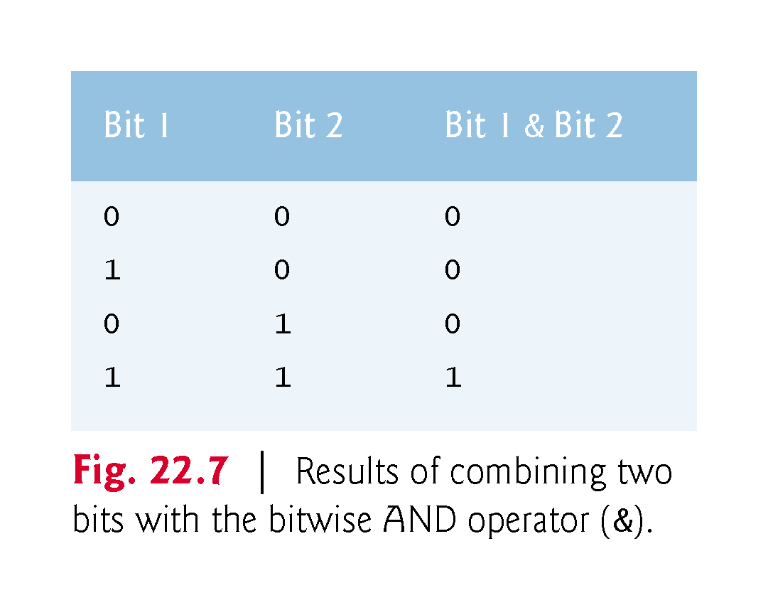

Slide 44
22.5 Bitwise Operators (cont.)
The program of Fig. 22.8 demonstrates the bitwise AND operator, the bitwise inclusive OR operator, the bitwise exclusive OR operator and the bitwise complement operator.
Function displayBits prints the unsigned integer values.

Slide 45
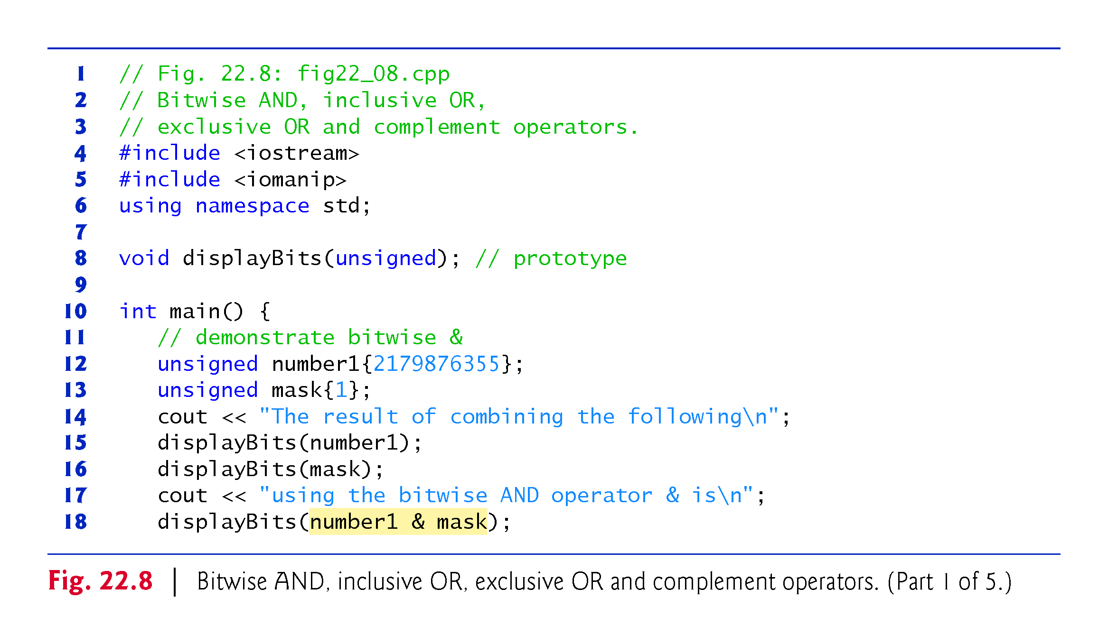

Slide 47
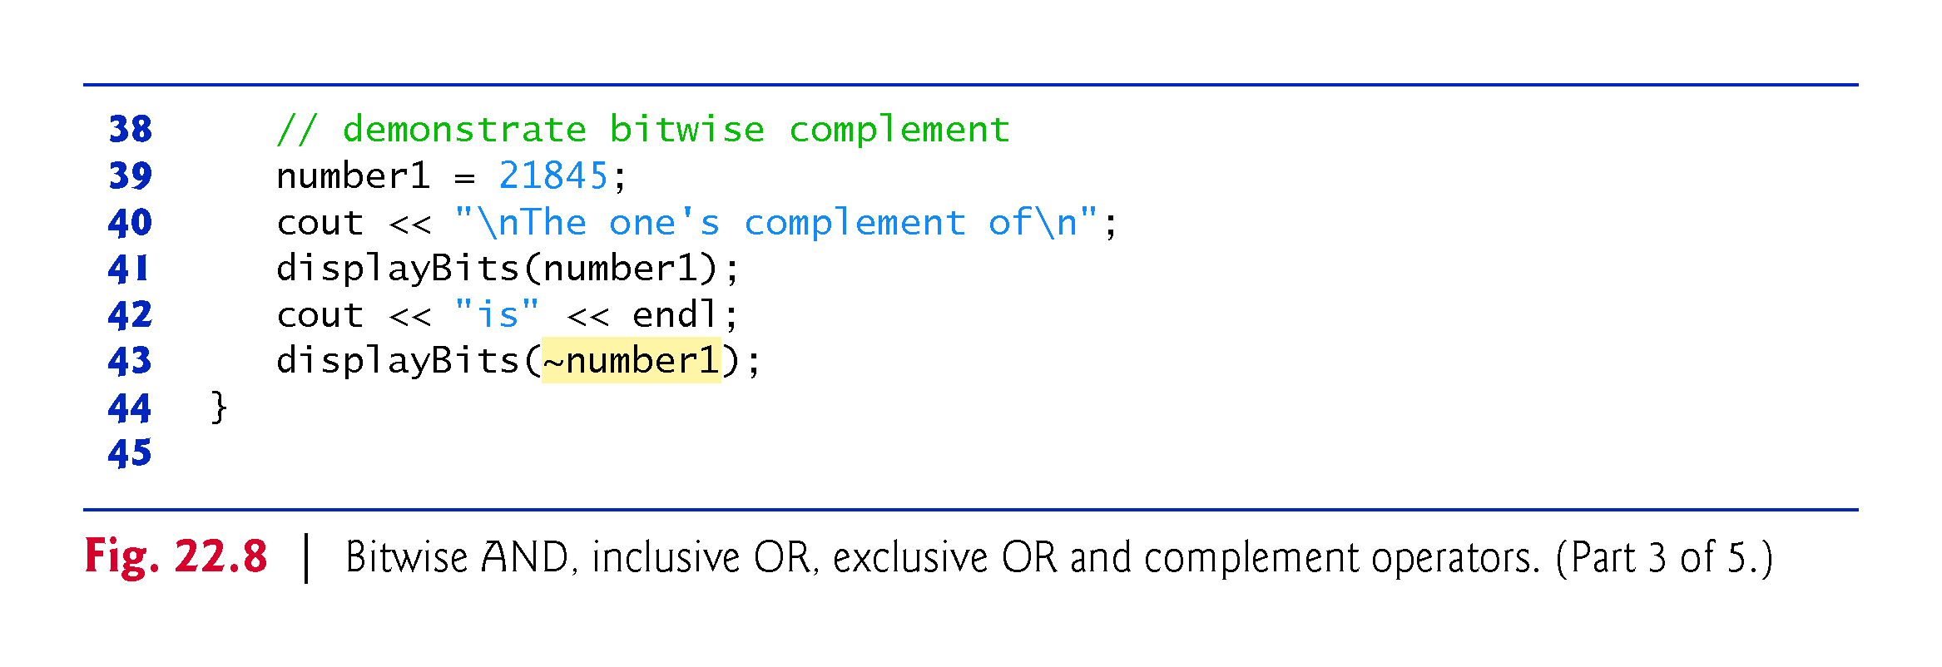

Slide 49
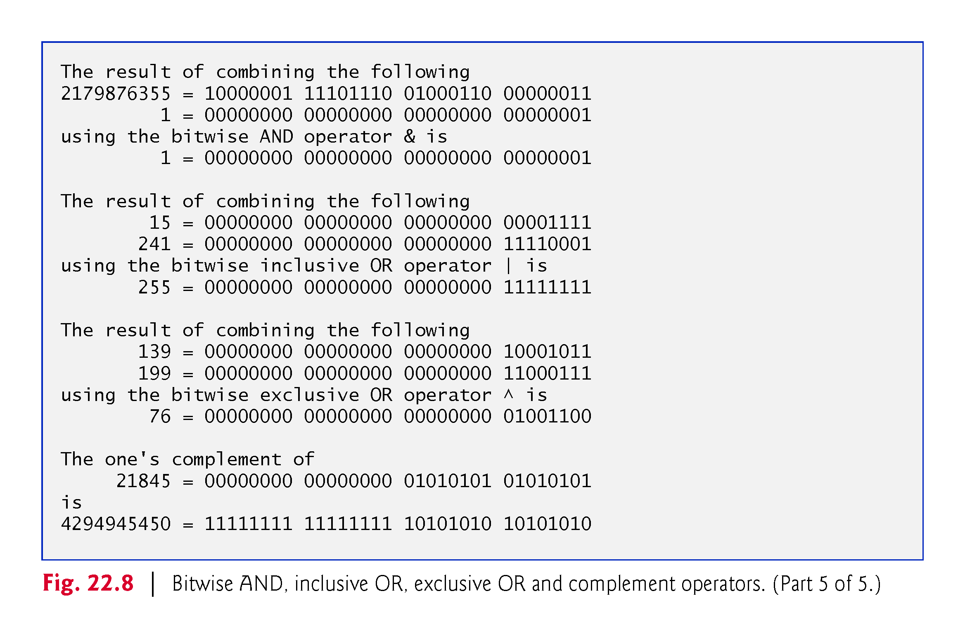

Slide 50
22.5 Bitwise Operators (cont.)
In Fig. 22.8, line 12 assigns 2179876355 (10000001 11101110 01000110 00000011) to variable number1, and line 14 assigns 1 (00000000 00000000 00000000 00000001) to variable mask.
When mask and number1 are combined using the bitwise AND operator (&) in the expression number1 & mask (line 18), the result is 00000000 00000000 00000000 00000001.
All the bits except the low-order bit in variable number1 are “masked off” (hidden) by “ANDing” with constant MASK.

Slide 51
22.5 Bitwise Operators (cont.)
The bitwise inclusive OR operator is used to set specific bits to 1 in an operand.
In Fig. 22.8, line 21 assigns 15 (00000000 00000000 00000000 00001111) to variable number1, and line 22 assigns 241 (00000000 00000000 00000000 11110001) to variable setBits.
When number1 and setBits are combined using the bitwise inclusive OR operator in the expression number1 | setBits (line 27), the result is 255 (00000000 00000000 00000000 11111111).
Figure 22.9 summarizes the results of combining two bits with the bitwise inclusive-OR operator.

Slide 53
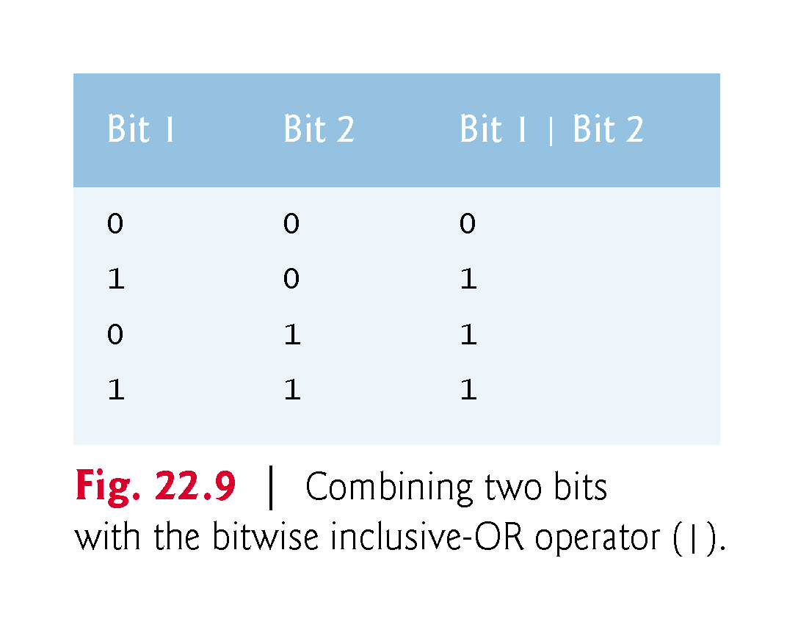

Slide 54
22.5 Bitwise Operators (cont.)
The bitwise exclusive OR operator (^) sets each bit in the result to 1 if exactly one of the corresponding bits in its two operands is 1.
In Fig. 22.8, lines 30–32 assign variables number1 and number2 the values 139 (00000000 00000000 00000000 10001011) and 199 (00000000 00000000 00000000 11000111), respectively.
When these variables are combined with the bitwise exclusive-OR operator in the expression number1 ^ number2 (line 36), the result is 00000000 00000000 00000000 01001100.
Figure 22.10 summarizes the results of combining two bits with the bitwise exclusive OR operator.

Slide 55
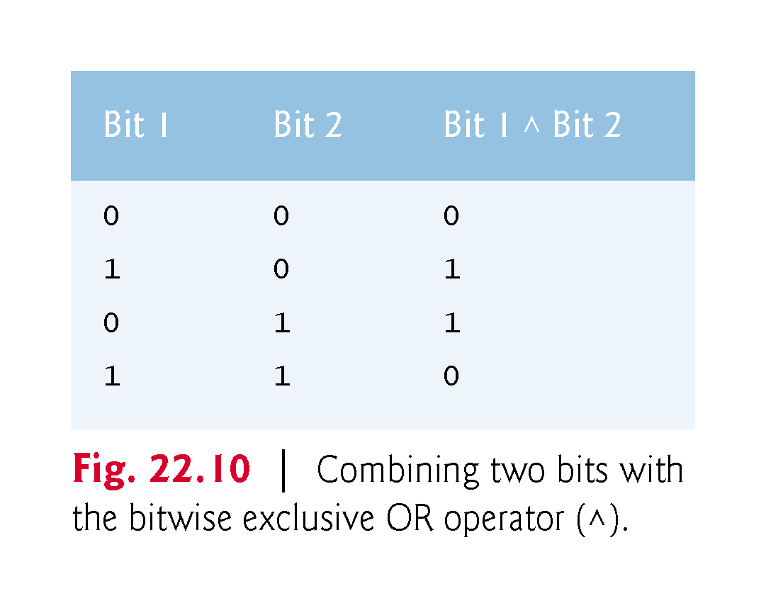

Slide 56
22.5 Bitwise Operators (cont.)
The bitwise complement operator (~) sets all 1 bits in its operand to 0 in the result and sets all 0 bits to 1 in the result—otherwise referred to as “taking the one’s complement of the value.”
In Fig. 22.8, line 39 assigns variable number1 the value 21845 (00000000 00000000 01010101 01010101).
When the expression ~number1 evaluates, the result is (11111111 11111111 10101010 10101010).
Figure 22.11 demonstrates the left-shift operator (<<) and the right-shift operator (>>).
Function displayBits prints the unsigned integer values.

Slide 57
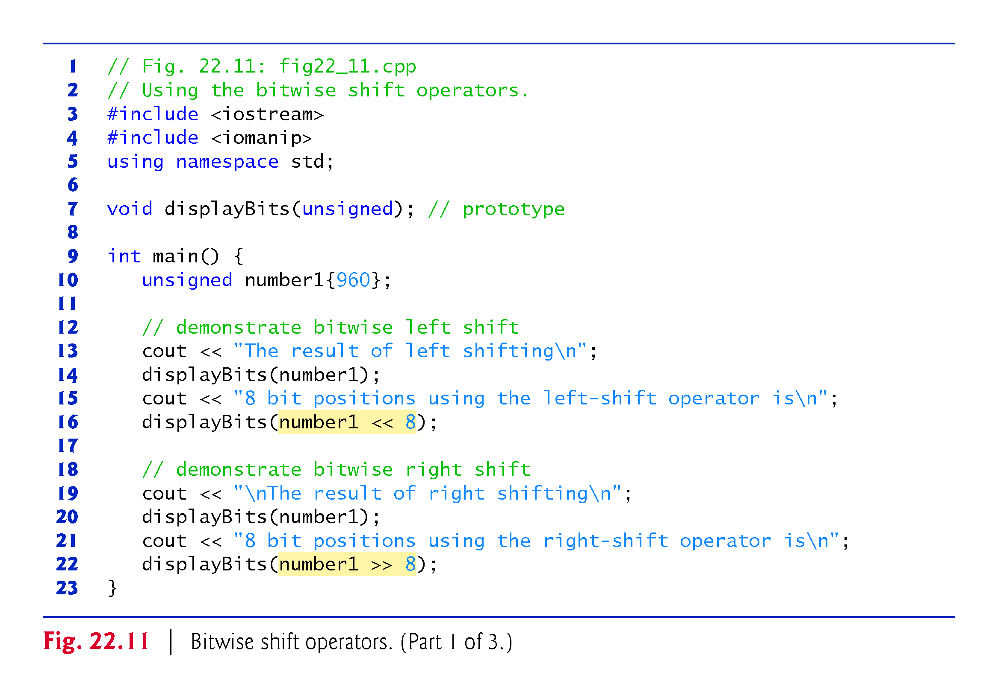

Slide 59
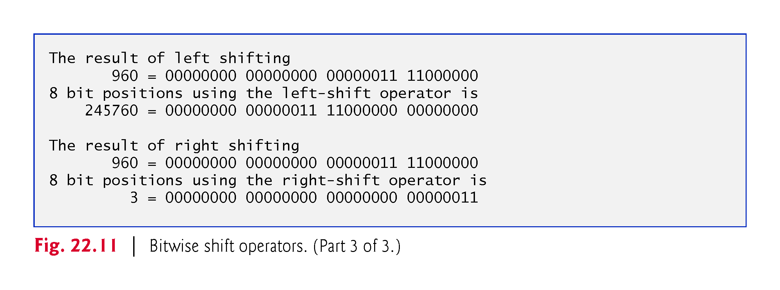

Slide 60
22.5 Bitwise Operators (cont.)
The left-shift operator (<<) shifts the bits of its left operand to the left by the number of bits specified in its right operand.
Bits vacated to the right are replaced with 0s; bits shifted off the left are lost.
In Fig. 22.11, line 10 initializes variable number1 the value 960 (00000000 00000000 00000011 11000000).
The result of left-shifting variable number1 eight bits in the expression number1 << 8 (line 16) is 245760 (00000000 00000011 11000000 00000000).

Slide 61
22.5 Bitwise Operators (cont.)
The right-shift operator (>>) shifts the bits of its left operand to the right by the number of bits specified in its right operand.
Performing a right shift on an unsigned integer causes the vacated bits at the left to be replaced by 0s; bits shifted off the right are lost.
In the program of Fig. 22.11, the result of right-shifting number1 in the expression number1 >> 8 (line 22) is 3 (00000000 00000000 00000000 00000011).

Slide 64
22.5 Bitwise Operators (cont.)
Each bitwise operator (except the bitwise complement operator) has a corresponding assignment operator.
These bitwise assignment operators are shown in Fig. 22.12; they’re used in a similar manner to the arithmetic assignment operators introduced in Chapter 4.

Slide 65
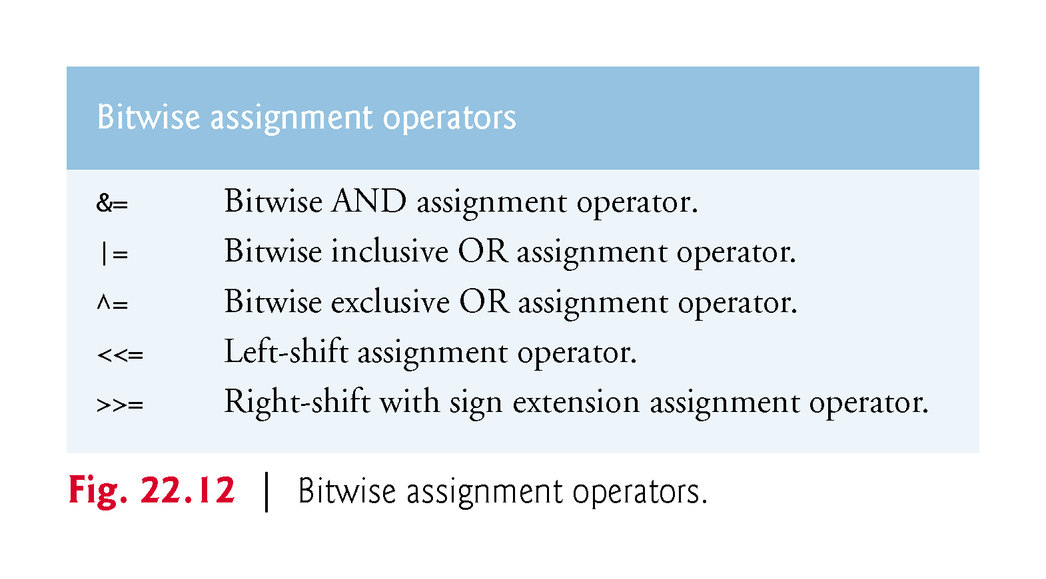

Slide 66
22.5 Bitwise Operators (cont.)
Figure 22.13 shows the precedence and associativity of the operators introduced up to this point in the text.
They’re shown top to bottom in decreasing order of precedence.

Slide 67
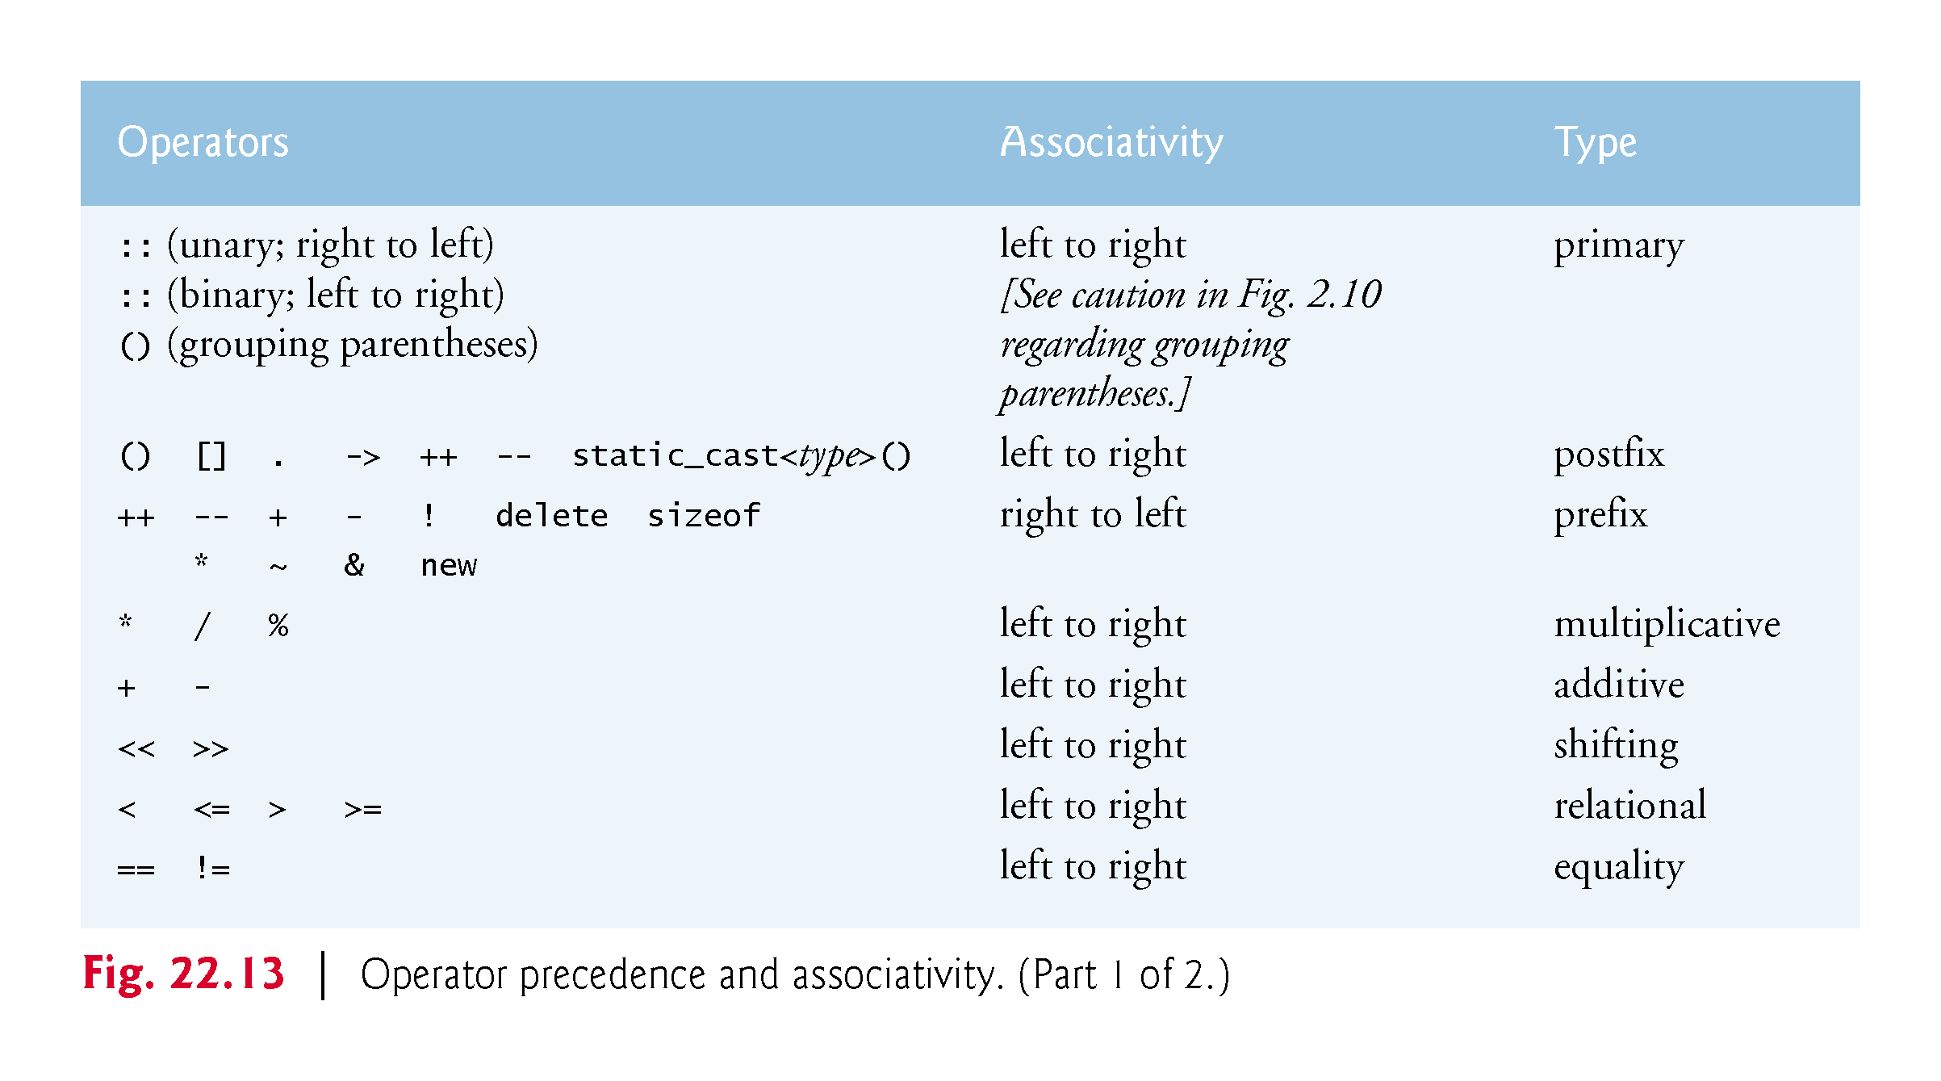

Slide 68
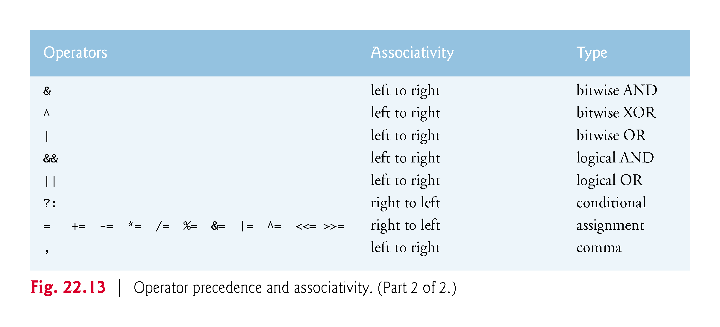

Slide 69
22.5 Bitwise Operators (cont.)
C++14 Binary Literals
As of C++14, you may now include binary literals in your source code.
To do so, precede a sequence of 1s and 0s with 0b or 0B.
For example, you can define a 32-bit mask like the one we used in the displayBits functions of this section’s examples as
0b10000000'00000000'00000000'00000000
The preceding literal also uses C++14’s single-quote character to separate groups of digits for readability.

Slide 70
22.6 Bit Fields
C++ provides the ability to specify the number of bits in which an integral type or enum type member of a class or a structure is stored.
Such a member is referred to as a bit field.
Bit fields enable better memory utilization by storing data in the minimum number of bits required.
Bit field members must be declared as an integral or enum type.

Slide 72
22.6 Bit Fields (cont.)
Consider the following structure definition:
struct BitCard { unsigned face : 4; unsigned suit : 2; unsigned color : 1; };
The definition contains three unsigned bit fields—face, suit and color—used to represent a card from a deck of 52 cards.
A bit field is declared by following an integral type or enum type member with a colon (:) and an integer constant representing the width of the bit field (i.e., the number of bits in which the member is stored).
The width must be an integer constant.
The preceding structure definition indicates that member face is stored in four bits, member suit in two bits and member color in one bit.

Slide 73
22.6 Bit Fields (cont.)
The number of bits is based on the desired range of values for each structure member.
Member face stores values between 0 (Ace) and 12 (King)—four bits can store a value between 0 and 15.
Member suit stores values between 0 and 3 (0 = Diamonds, 1 = Hearts, 2 = Clubs, 3 = Spades)—two bits can store a value between 0 and 3.
Finally, member color stores either 0 (Red) or 1 (Black)—1 bit can store either 0 or 1.

Slide 74
22.6 Bit Fields (cont.)
The program in Figs. 22.14–22.16 creates array deck containing BitCard structures (line 23 of Fig. 22.14).
The constructor inserts the 52 cards in the deck array, and function deal prints the 52 cards.
Notice that bit fields are accessed exactly as any other structure member is (lines 12–14 and 22–27 of Fig. 22.15).
The member color is included as a means of indicating the card color.

Slide 76
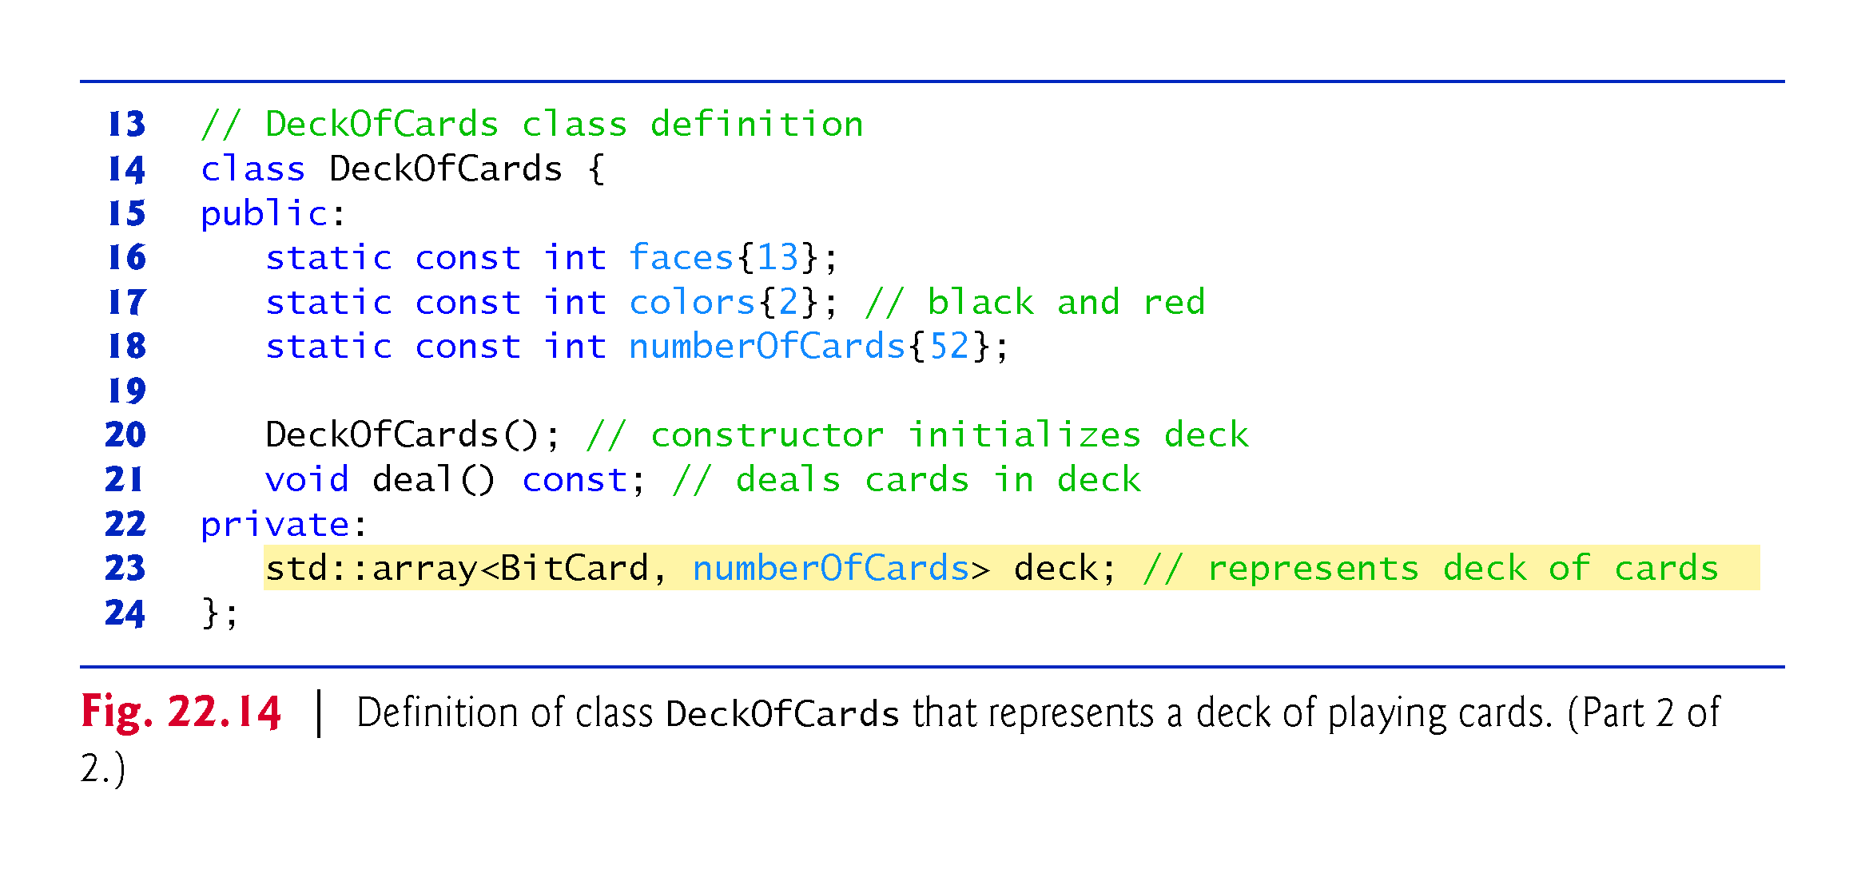

Slide 78
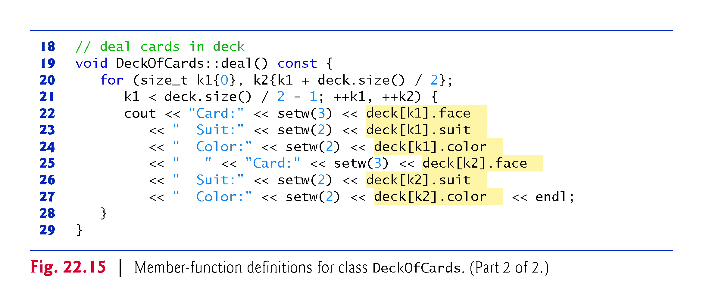

Slide 79
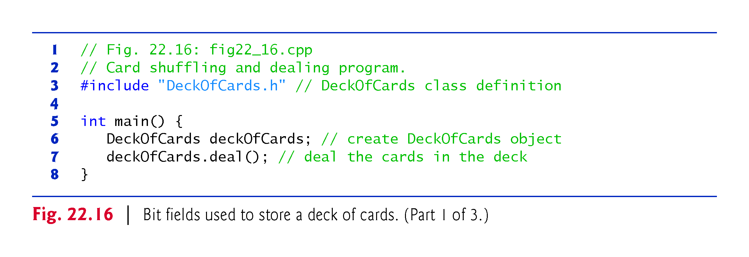

Slide 80
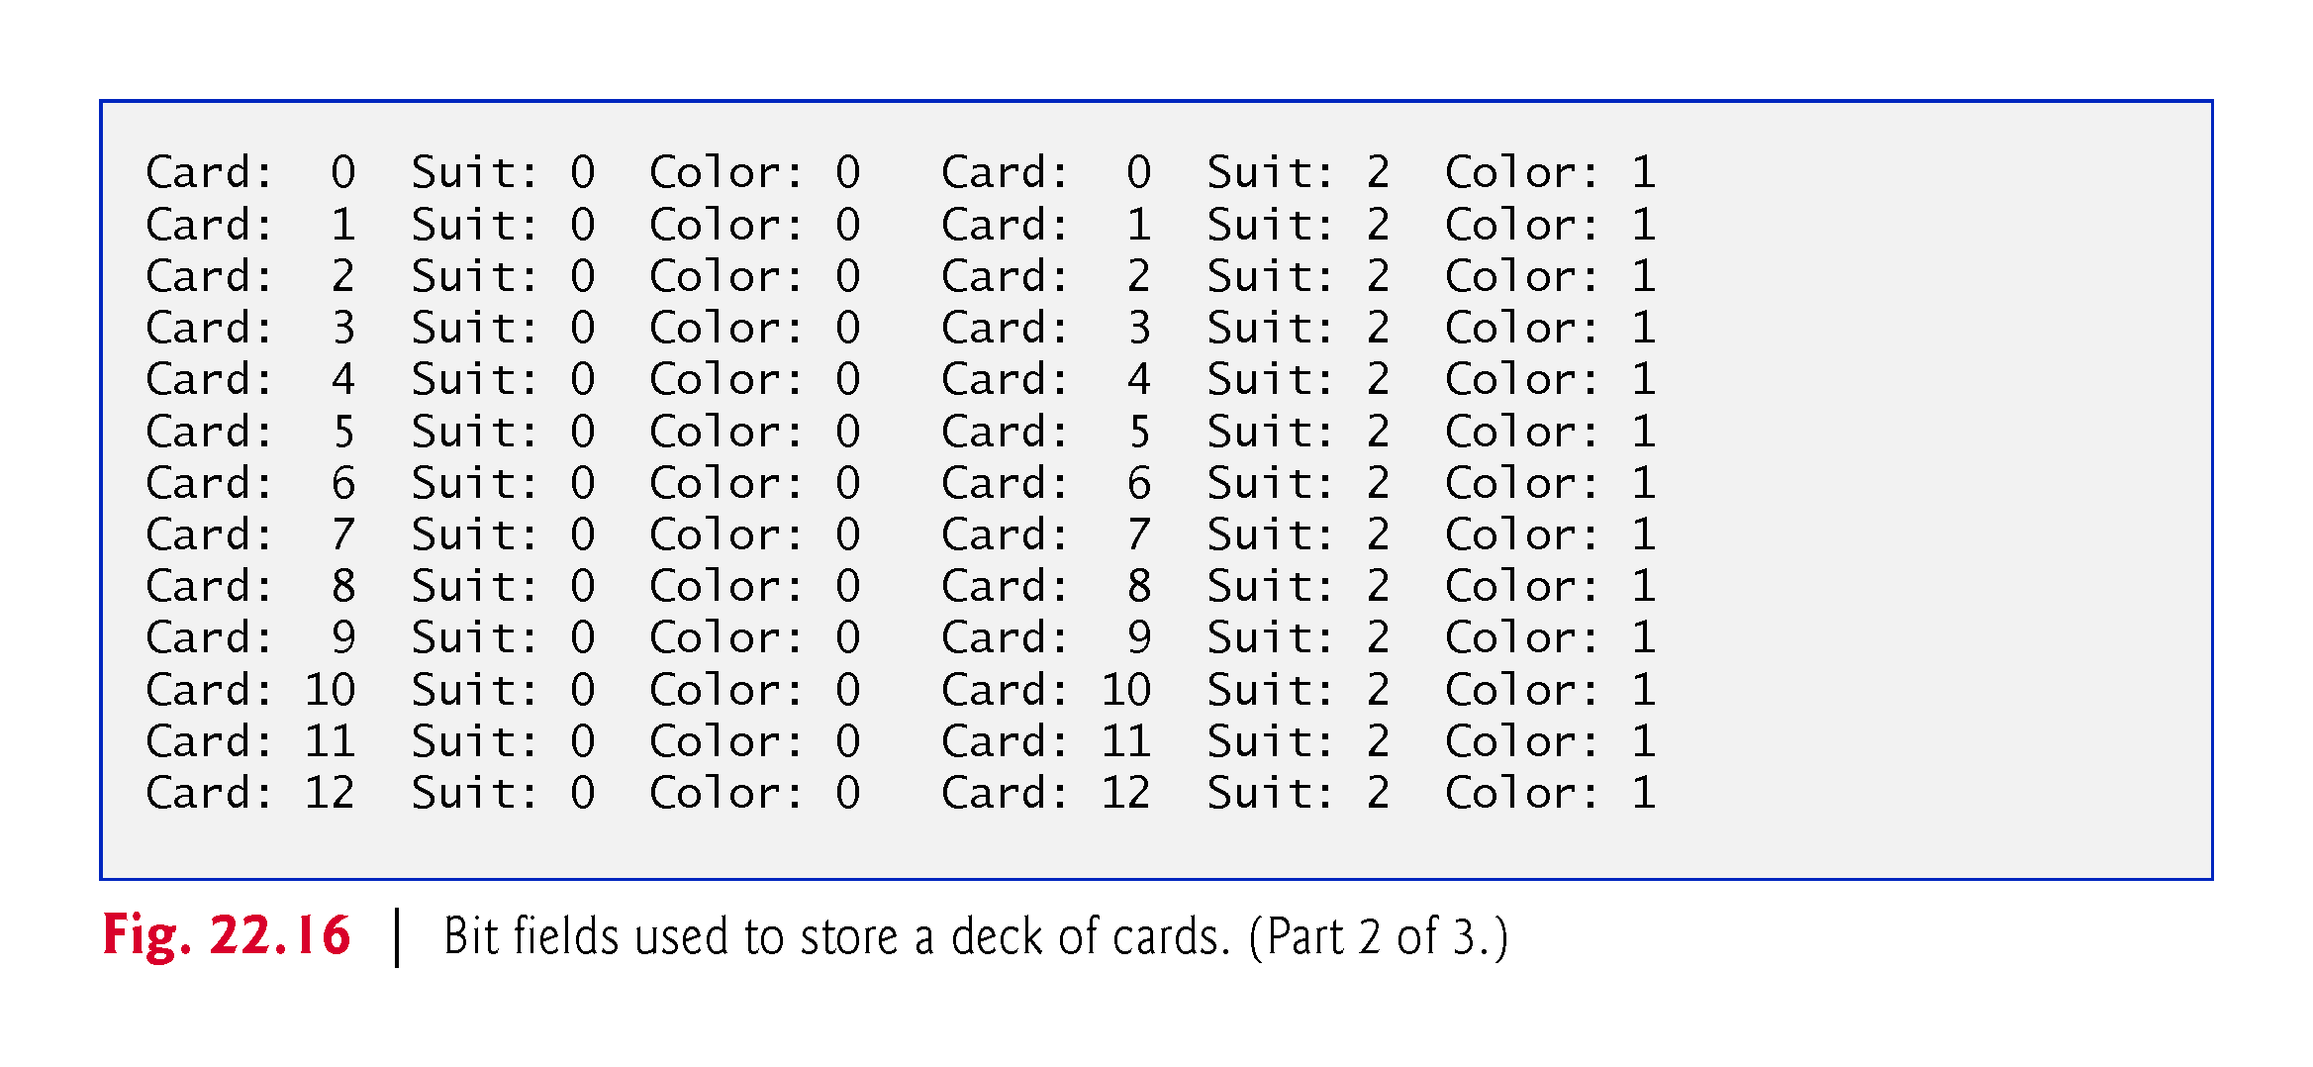

Slide 81
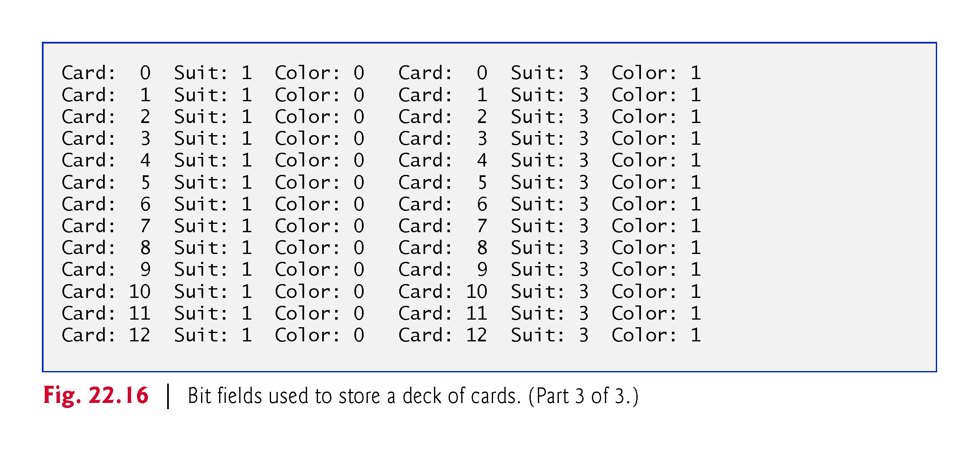

Slide 82
22.6 Bit Fields (cont.)
It’s possible to specify an unnamed bit field, in which case the field is used as padding in the structure.
For example, the structure definition uses an unnamed three-bit field as padding—nothing can be stored in those three bits.
Member b is stored in another storage unit.
struct Example { unsigned a : 13; unsigned : 3; // align to next storage-unit boundary unsigned b : 4; }; // end struct Example

Slide 83
22.6 Bit Fields (cont.)
An unnamed bit field with a zero width is used to align the next bit field on a new storage-unit boundary.
For example, the structure definition
struct Example { unsigned a : 13; unsigned : 0; // align to next storage-unit boundary unsigned b : 4; }; // end struct Example
uses an unnamed 0-bit field to skip the remaining bits (as many as there are) of the storage unit in which a is stored and align b on the next storage-unit boundary.

Slide 87
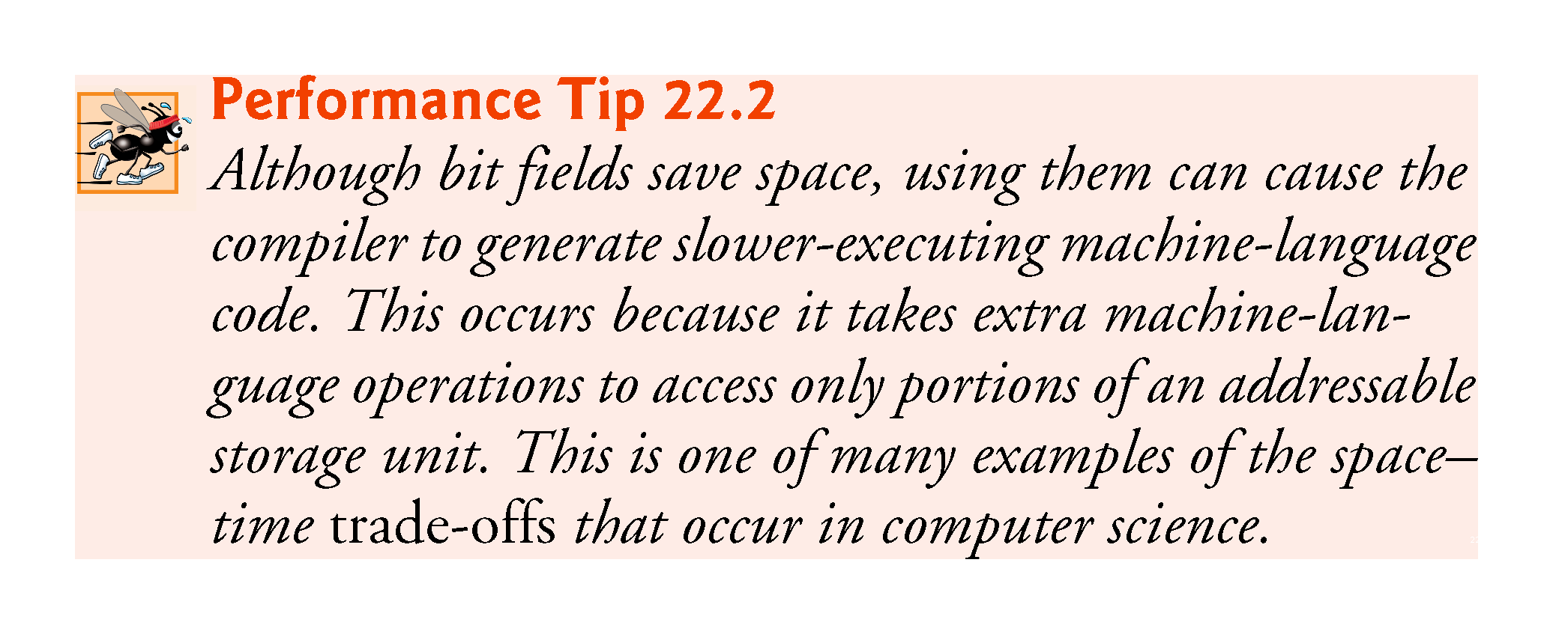

Slide 88
22.7 Character-Handling Library
Most data is entered into computers as characters—including letters, digits and various special symbols.
In this section, we discuss C++’s capabilities for examining and manipulating individual characters.
In the remainder of the chapter, we continue the discussion of character-string manipulation that we began in Chapter 8.

Slide 89
22.7 Character-Handling Library (cont.)
The character-handling library includes several functions that perform useful tests and manipulations of character data.
Each function receives a character—represented as an int—or EOF as an argument.
Characters are often manipulated as integers.
Remember that EOF normally has the value –1 and that some hardware architectures do not allow negative values to be stored in char variables.
Therefore, the character-handling functions manipulate characters as integers.

Slide 90
22.7 Character-Handling Library (cont.)
Figure 22.17 summarizes the functions of the character-handling library.
When using functions from the character-handling library, include the <cctype> header.

Slide 92
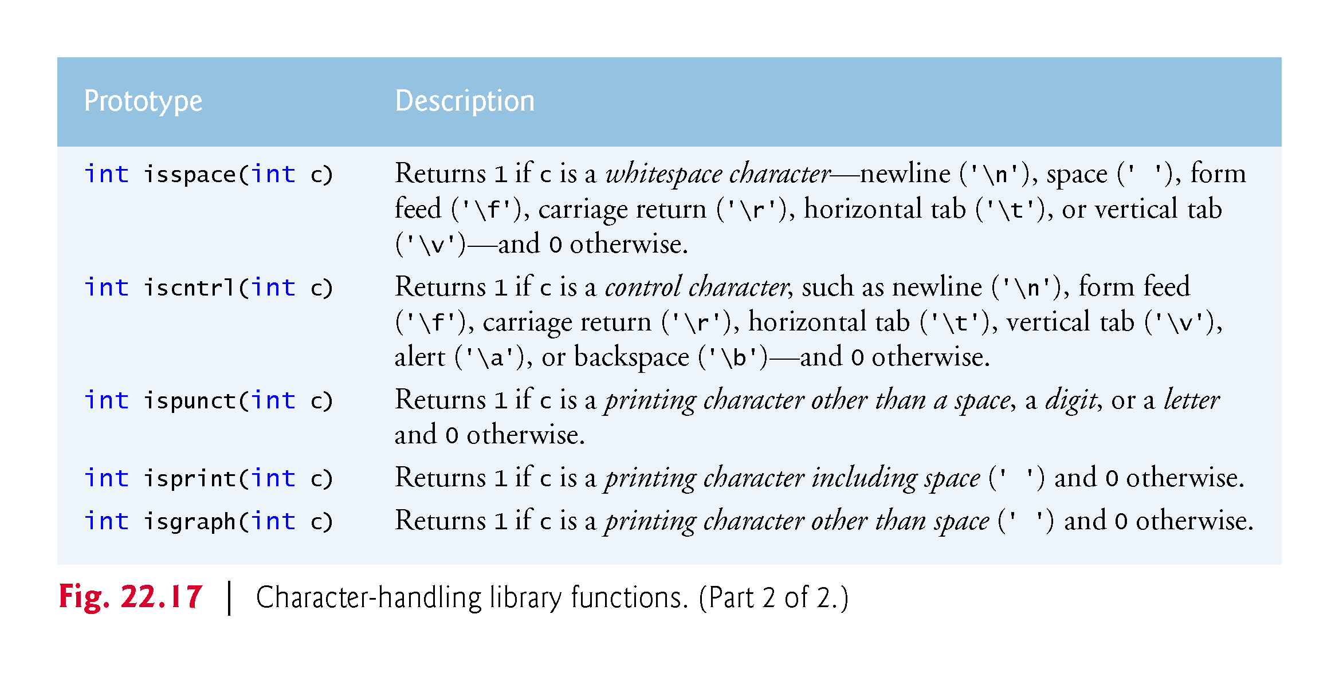

Slide 93
22.7 Character-Handling Library (cont.)
Figure 22.18 demonstrates functions isdigit, isalpha, isalnum and isxdigit.
Function isdigit determines whether its argument is a digit (0–9).
Function isalpha determines whether its argument is an uppercase letter (A-Z) or a lowercase letter (a–z).
Function isalnum determines whether its argument is an uppercase letter, a lowercase letter or a digit.
Function isxdigit determines whether its argument is a hexadecimal digit (A–F, a–f, 0–9).

Slide 94
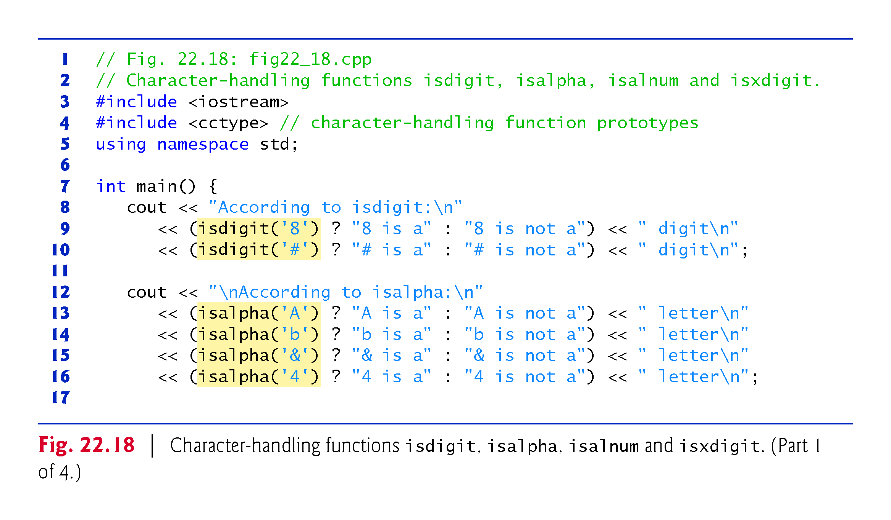

Slide 95
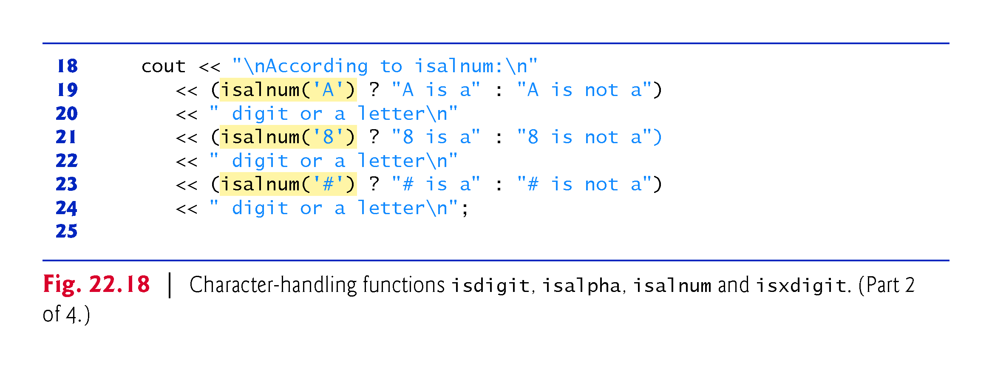

Slide 96
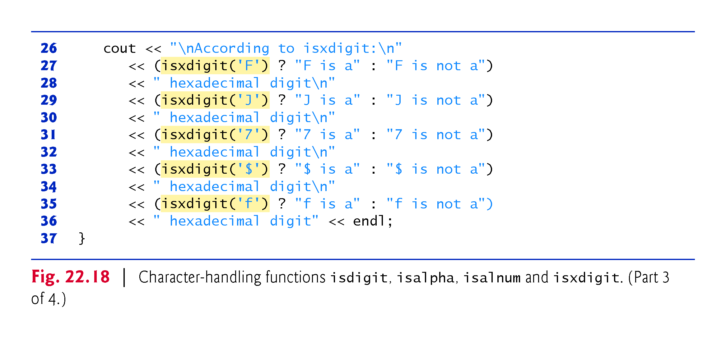

Slide 98
22.7 Character-Handling Library (cont.)
Figure 22.18 uses the conditional operator (?:) with each function to determine whether the string " is a " or the string " is not a " should be printed in the output for each character tested.
For example, line 9 indicates that if '8' is a digit—i.e., if isdigit returns a true (nonzero) value—the string "8 is a " is printed.
If '8' is not a digit (i.e., if isdigit returns 0), the string "8 is not a " is printed.
Figure 22.19 demonstrates functions islower, isupper, tolower and toupper.

Slide 99
22.7 Character-Handling Library (cont.)
Function islower determines whether its argument is a lowercase letter (a–z).
Function isupper determines whether its argument is an uppercase letter (A–Z).
Function tolower converts an uppercase letter to lowercase and returns the lowercase letter—if the argument is not an uppercase letter, tolower returns the argument value unchanged.
Function toupper converts a lowercase letter to uppercase and returns the uppercase letter—if the argument is not a lowercase letter, toupper returns the argument value unchanged.

Slide 100
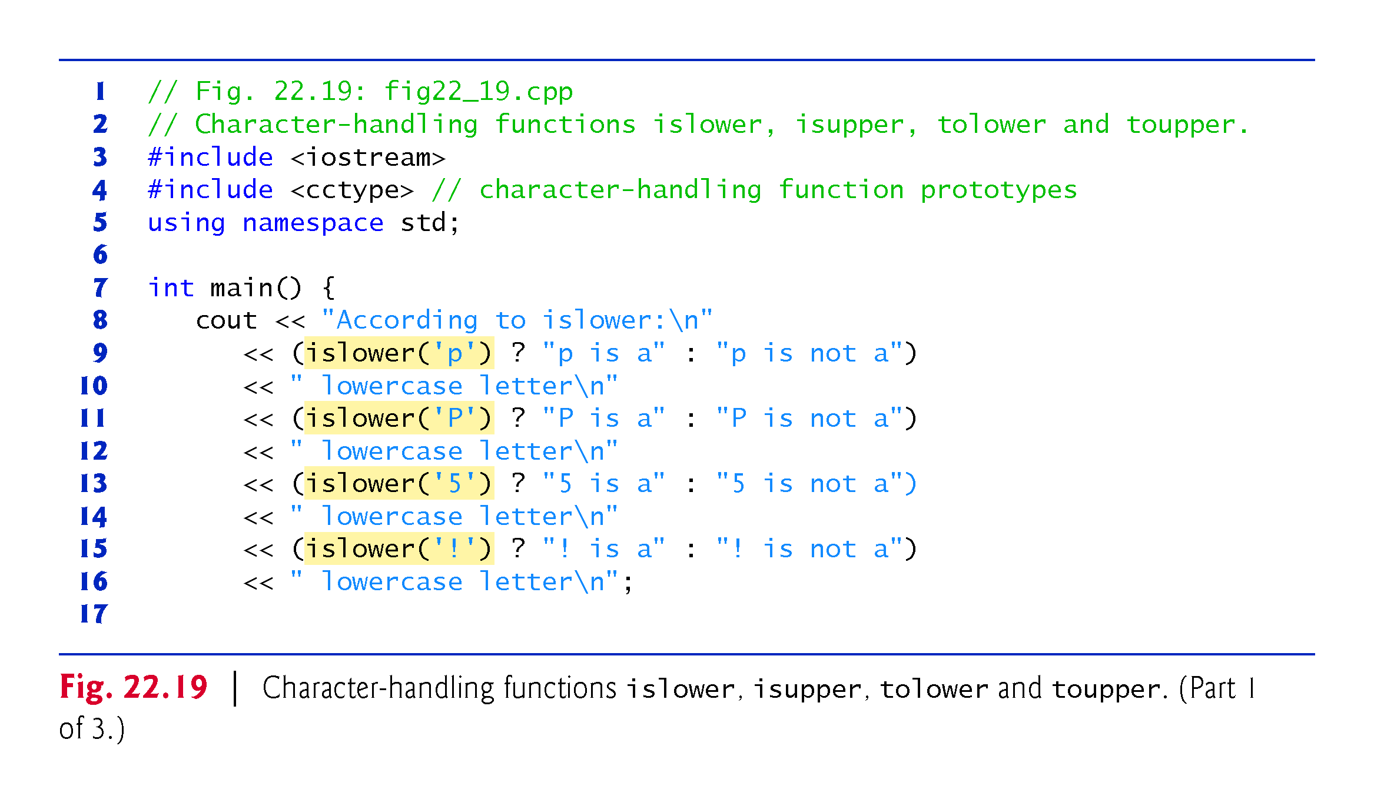

Slide 101
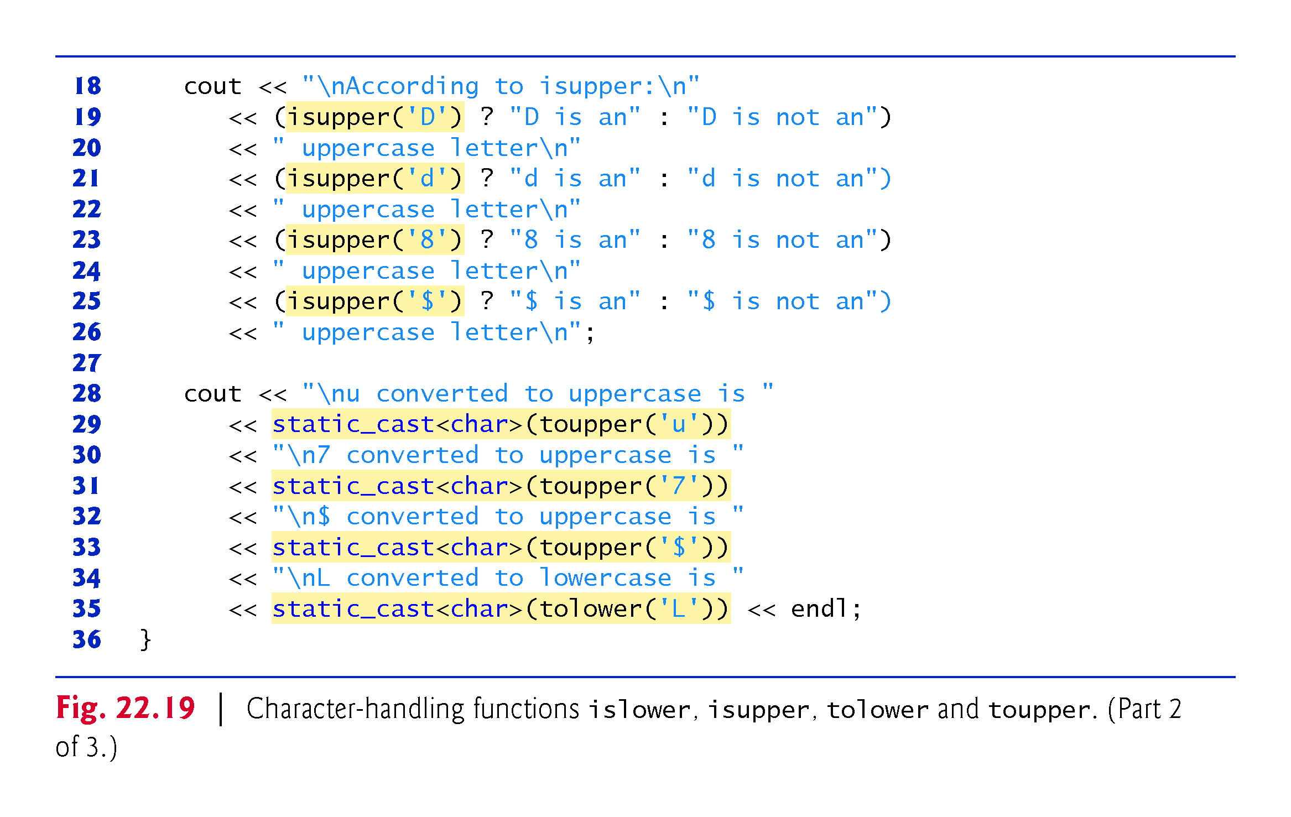

Slide 102
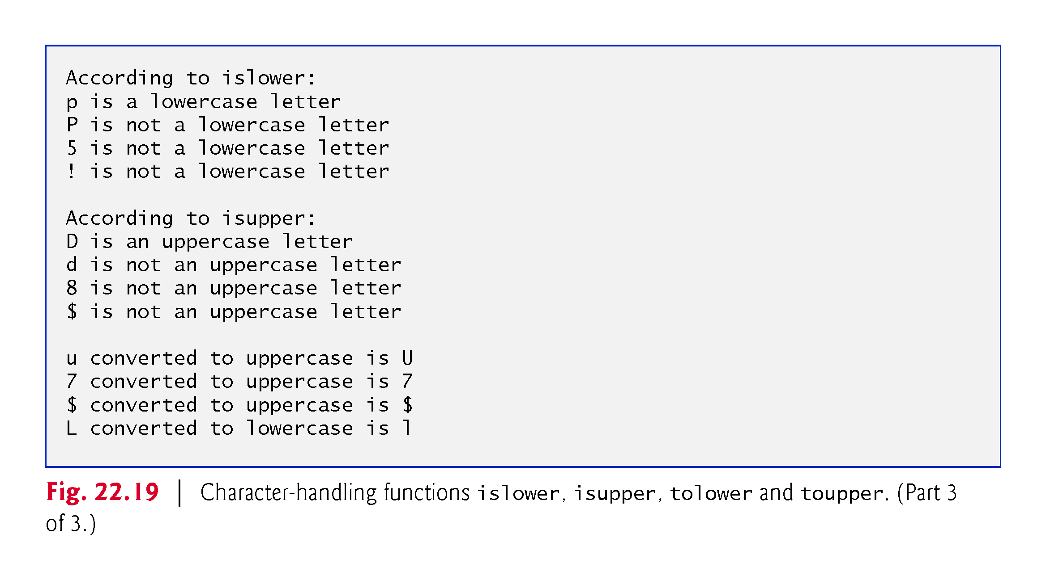

Slide 103
22.7 Character-Handling Library (cont.)
Figure 22.20 demonstrates functions isspace, iscntrl, ispunct, isprint and isgraph.
Function isspace determines whether its argument is a whitespace character, such as space (' '), form feed ('\f'), newline ('\n'), carriage return ('\r'), horizontal tab ('\t') or vertical tab ('\v').
Function iscntrl determines whether its argument is a control character such as horizontal tab ('\t'), vertical tab ('\v'), form feed ('\f'), alert ('\a'), backspace ('\b'), carriage return ('\r') or newline ('\n').
Function ispunct determines whether its argument is a printing character other than a space, digit or letter, such as $, #, (,), [,], {, }, ;, : or %.
Function isprint determines whether its argument is a character that can be displayed on the screen (including the space character).
Function isgraph tests for the same characters as isprint, but the space character is not included.

Slide 105
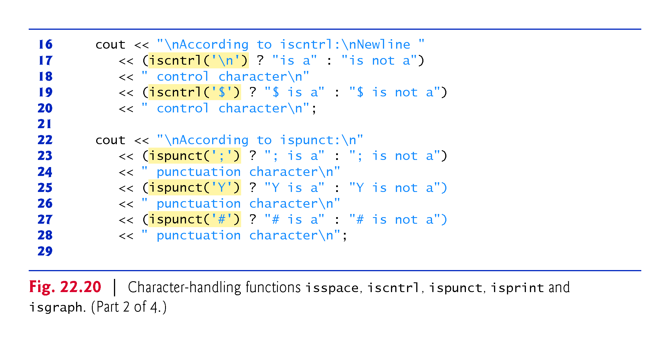

Slide 106
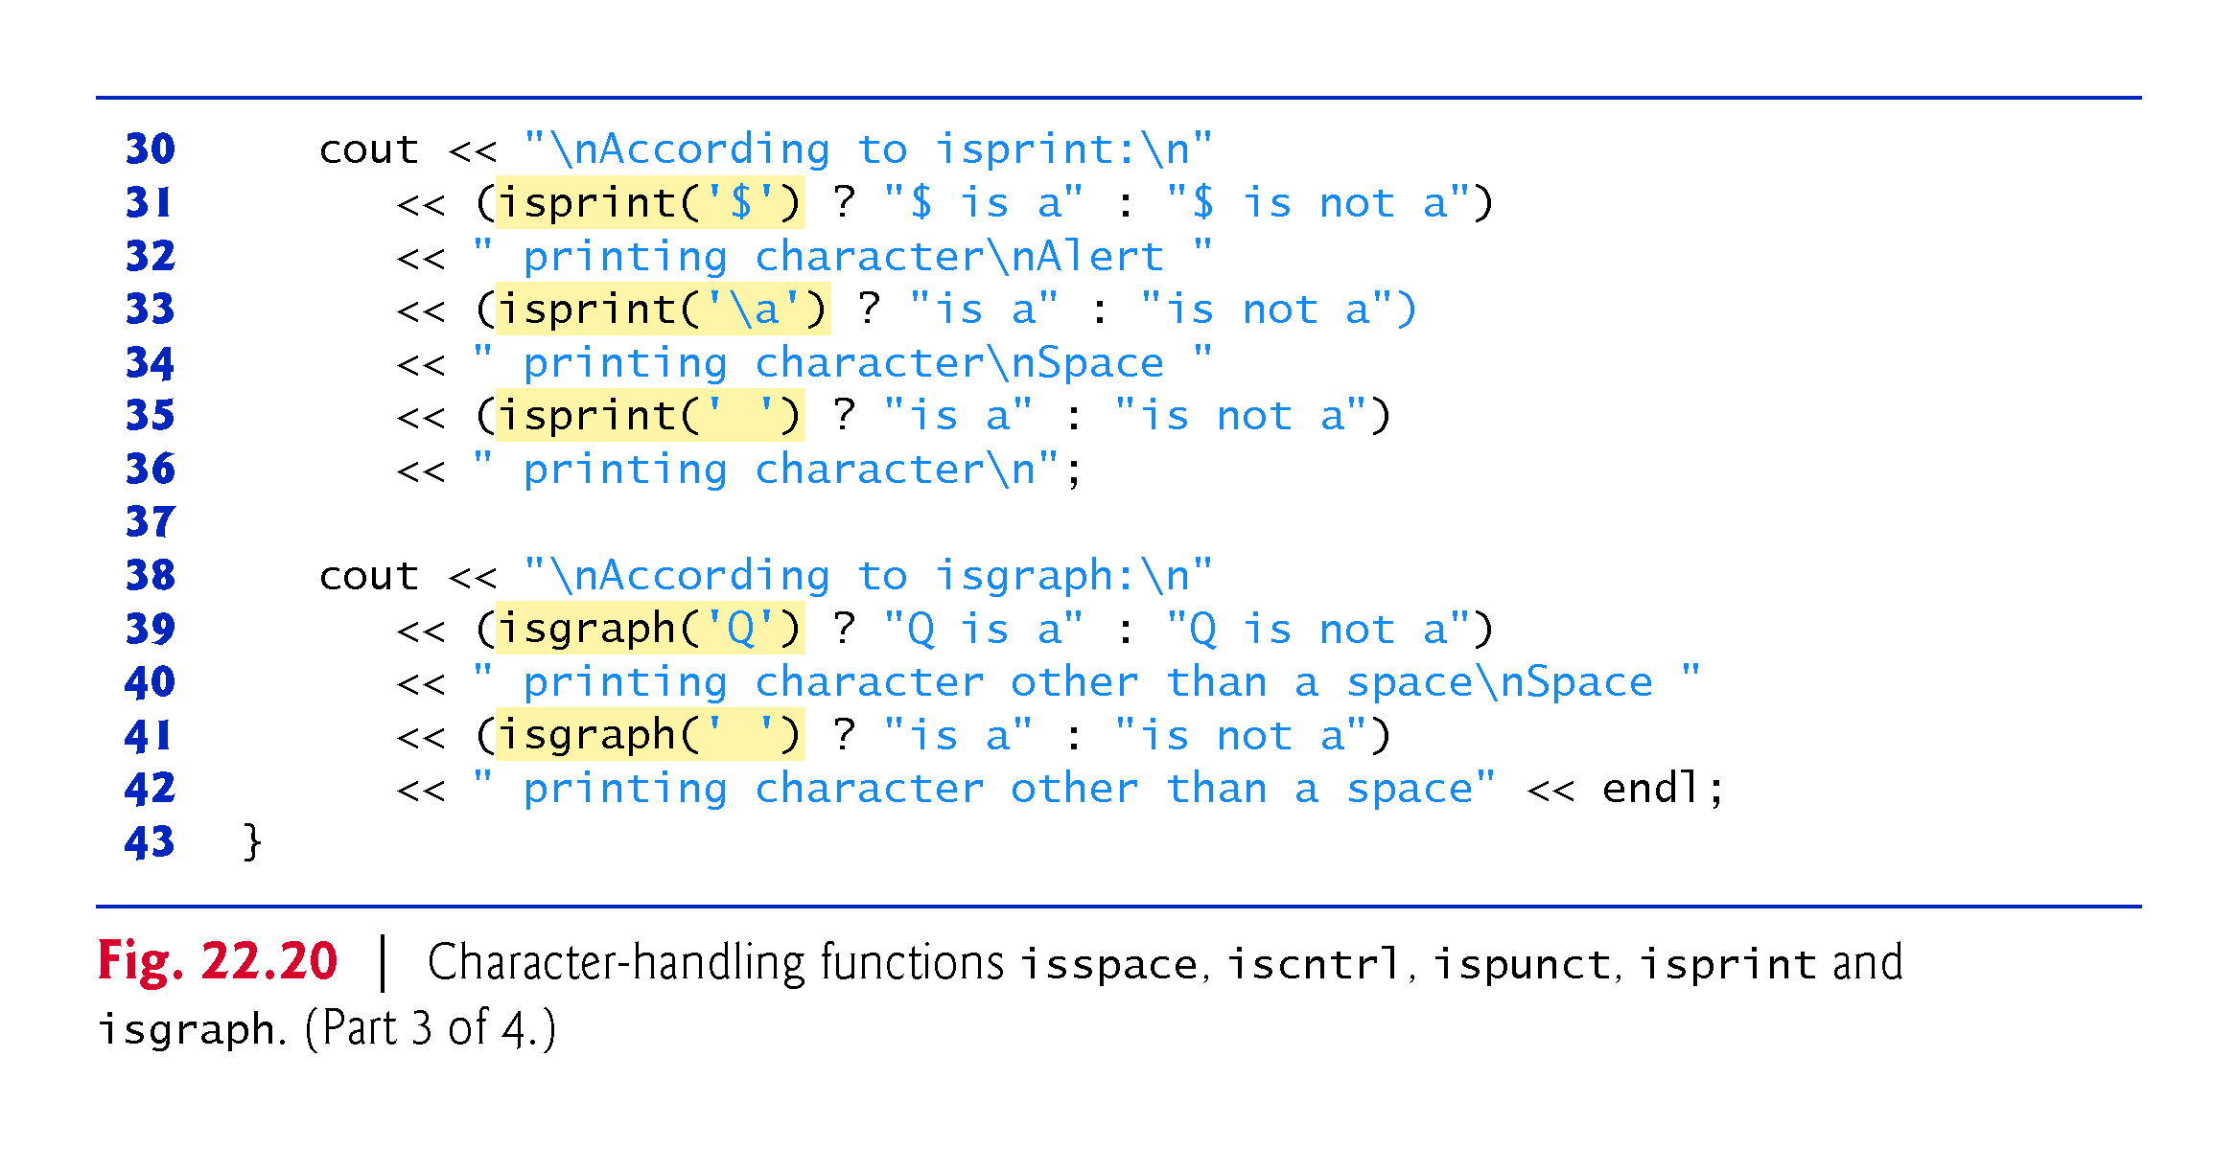

Slide 107
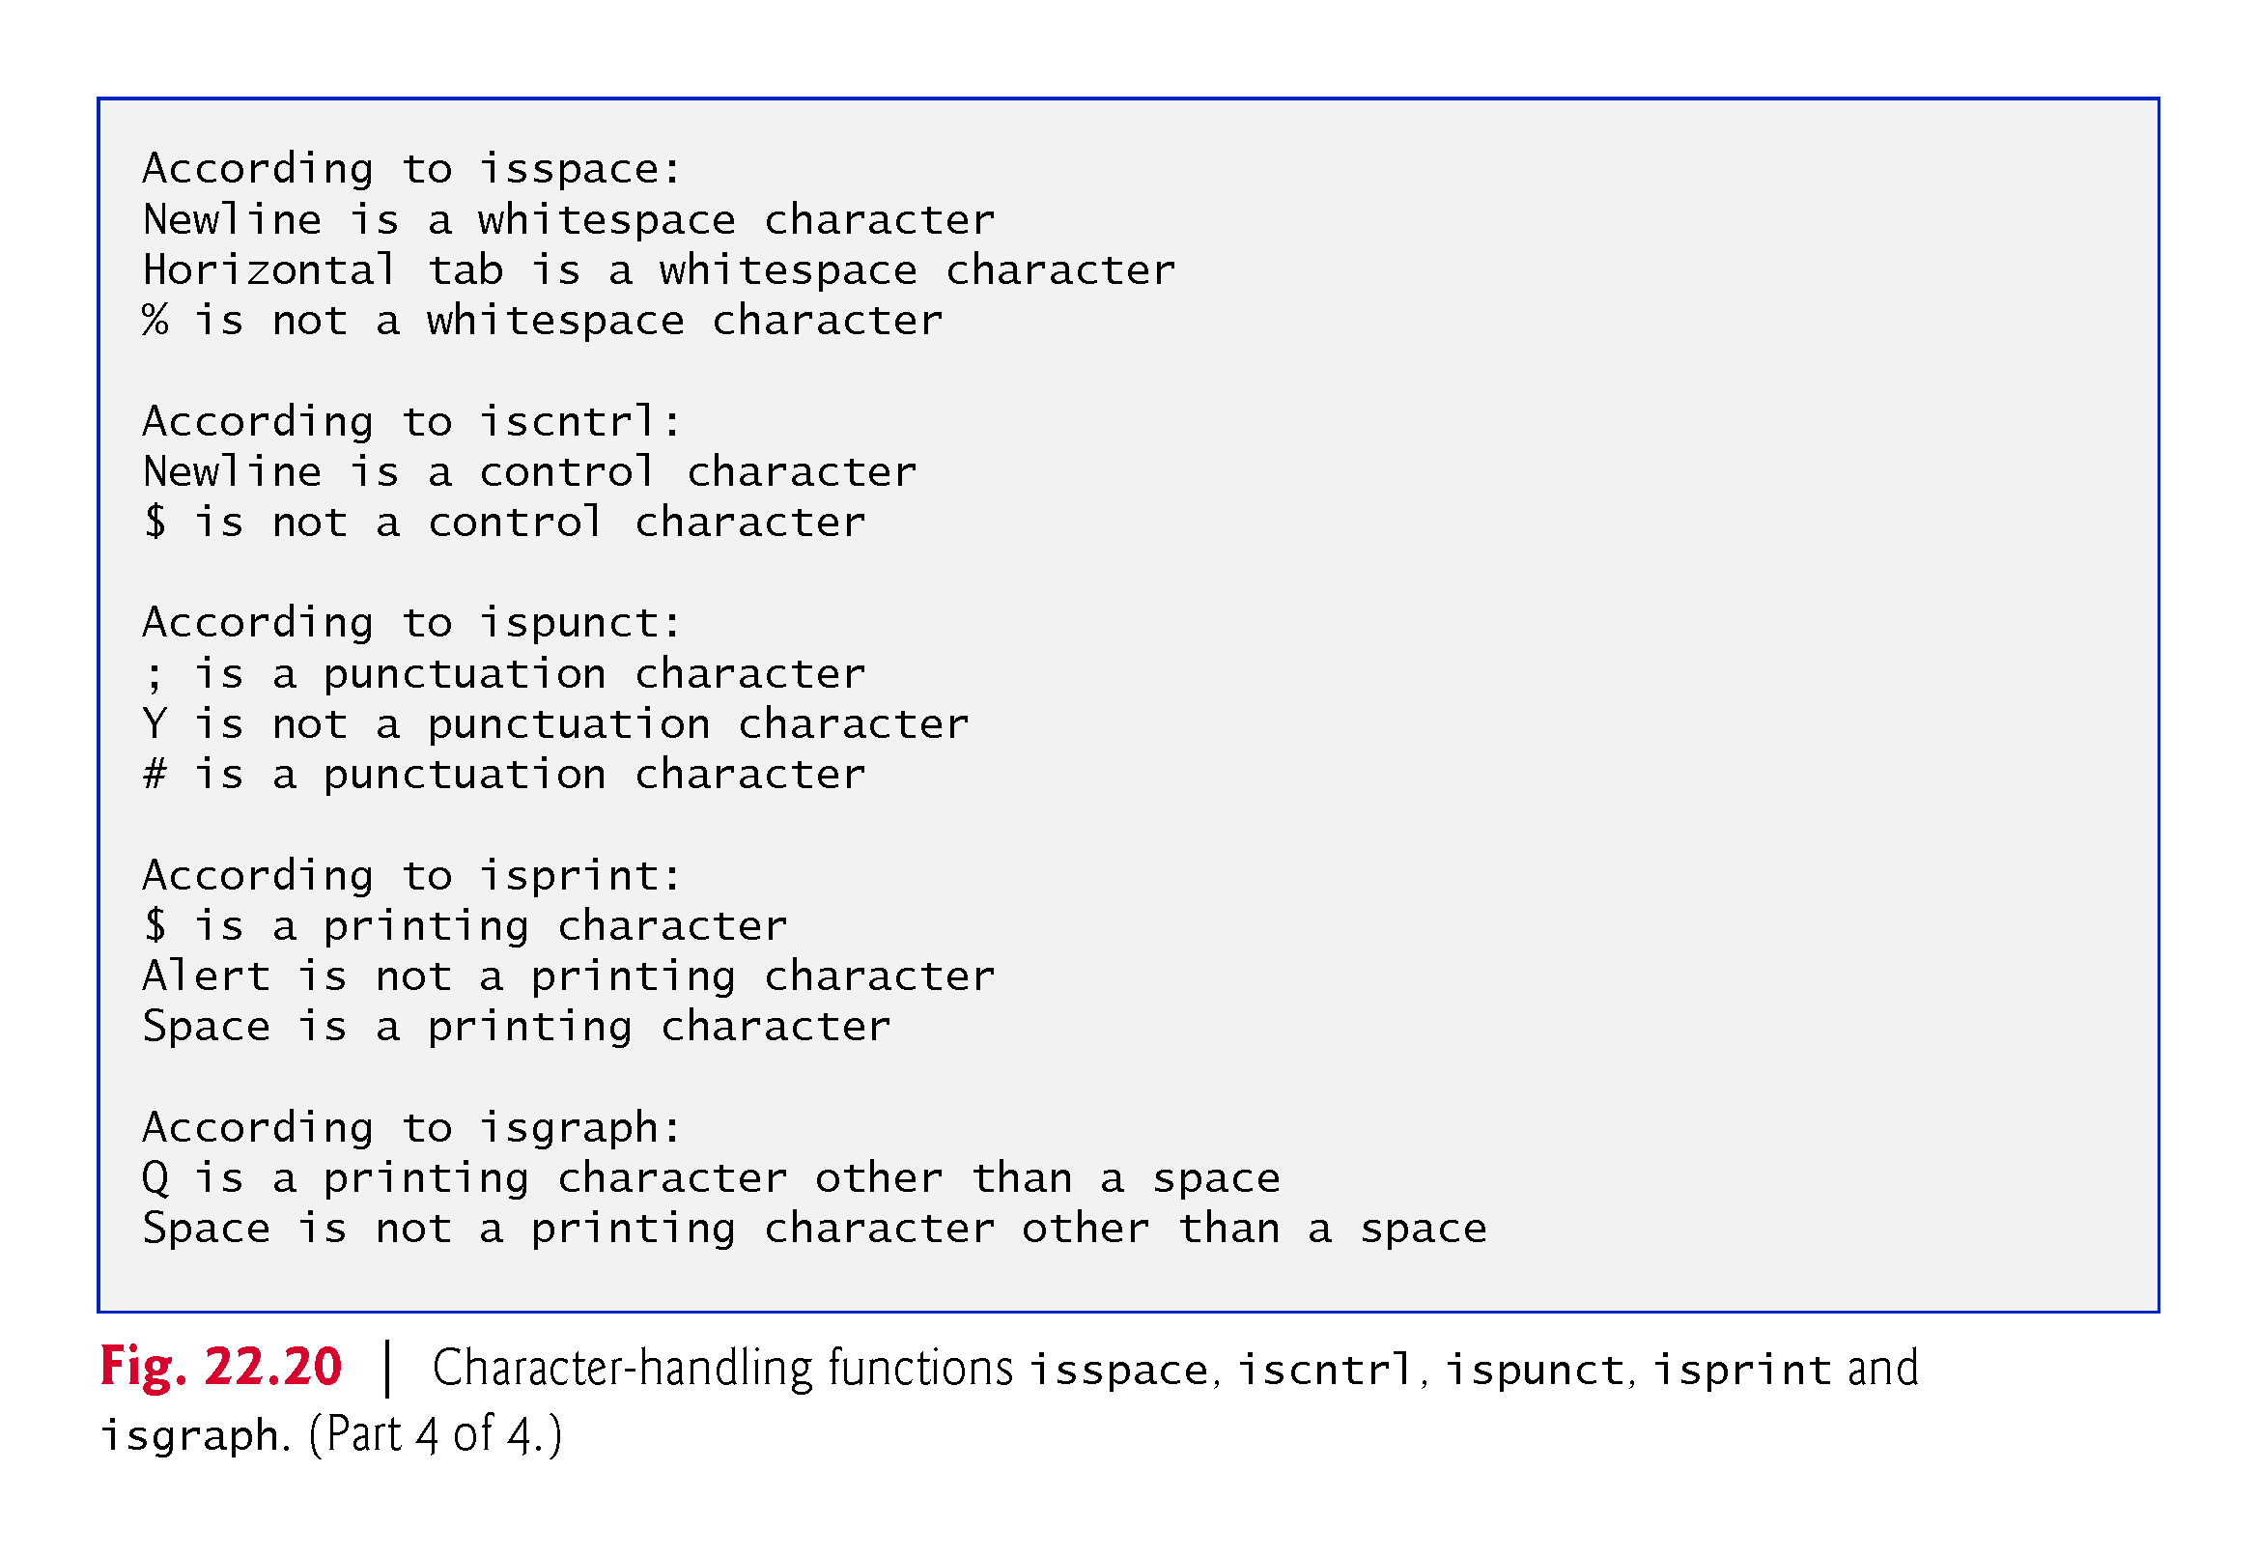

Slide 108
22.8 C-String Manipulation Functions
The string-handling library provides any useful functions for manipulating string data, comparing strings, searching strings for characters and other strings, tokenizing strings (separating strings into logical pieces such as the separate words in a sentence) and determining the length of strings.
This section presents some common string-manipulation functions of the string-handling library (from the C++ standard library).
The functions are summarized in Fig. 22.21; then each is used in a live-code example.
The prototypes for these functions are located in header <cstring>.

Slide 112
22.8 C-String Manipulation Functions (cont.)
Several functions in Fig. 22.21 contain parameters with data type size_t.
This type is defined in the header <cstring> to be an unsigned integral type such as unsigned int or unsigned long.

Slide 114
22.8 C-String Manipulation Functions (cont.)
Function strcpy copies its second argument—a string—into its first argument—a character array that must be large enough to store the string and its terminating null character, (which is also copied).
Function strncpy is much like strcpy, except that strncpy specifies the number of characters to be copied from the string into the array.
Function strncpy does not necessarily copy the terminating null character of its second argument—a terminating null character is written only if the number of characters to be copied is at least one more than the length of the string.

Slide 116
22.8 C-String Manipulation Functions (cont.)
Figure 22.22 uses strcpy (line 12) to copy the entire string in array x into array y and uses strncpy (line 18) to copy the first 14 characters of array x into array z.
Line 19 appends a null character ('\0') to array z, because the call to strncpy in the program does not write a terminating null character.
(The third argument is less than the string length of the second argument plus one.)

Slide 119
22.8 C-String Manipulation Functions (cont.)
Function strcat appends its second argument (a string) to its first argument (a character array containing a string).
The first character of the second argument replaces the null character ('\0') that terminates the string in the first argument.
You must ensure that the array used to store the first string is large enough to store the combination of the first string, the second string and the terminating null character (copied from the second string).
Function strncat appends a specified number of characters from the second string to the first string and appends a terminating null character to the result.
The program of Fig. 22.23 demonstrates function strcat (lines 14 and 24) and function strncat (line 19).

Slide 120
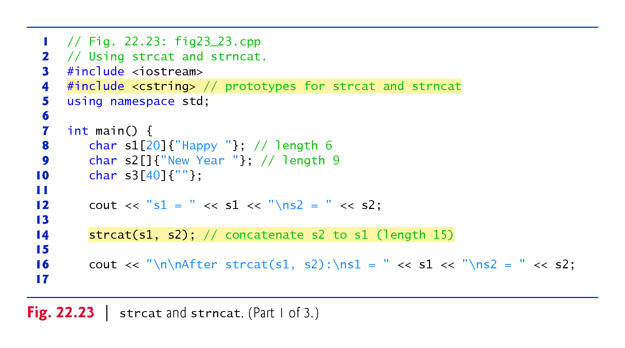

Slide 121
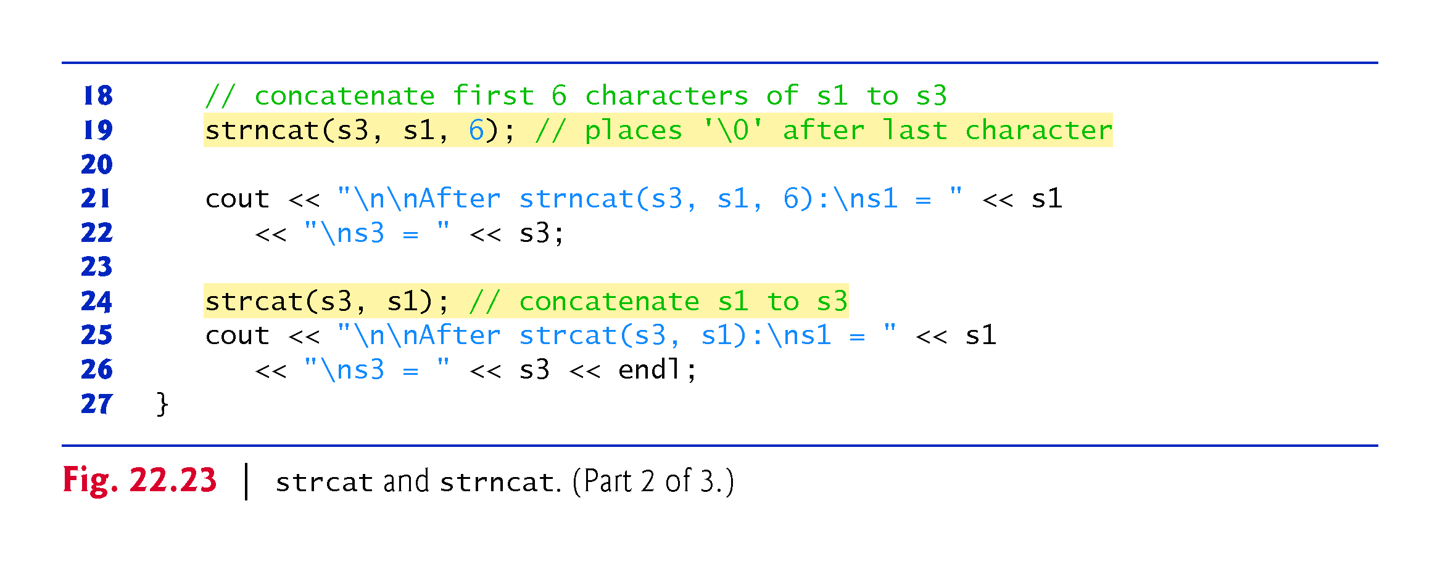

Slide 122
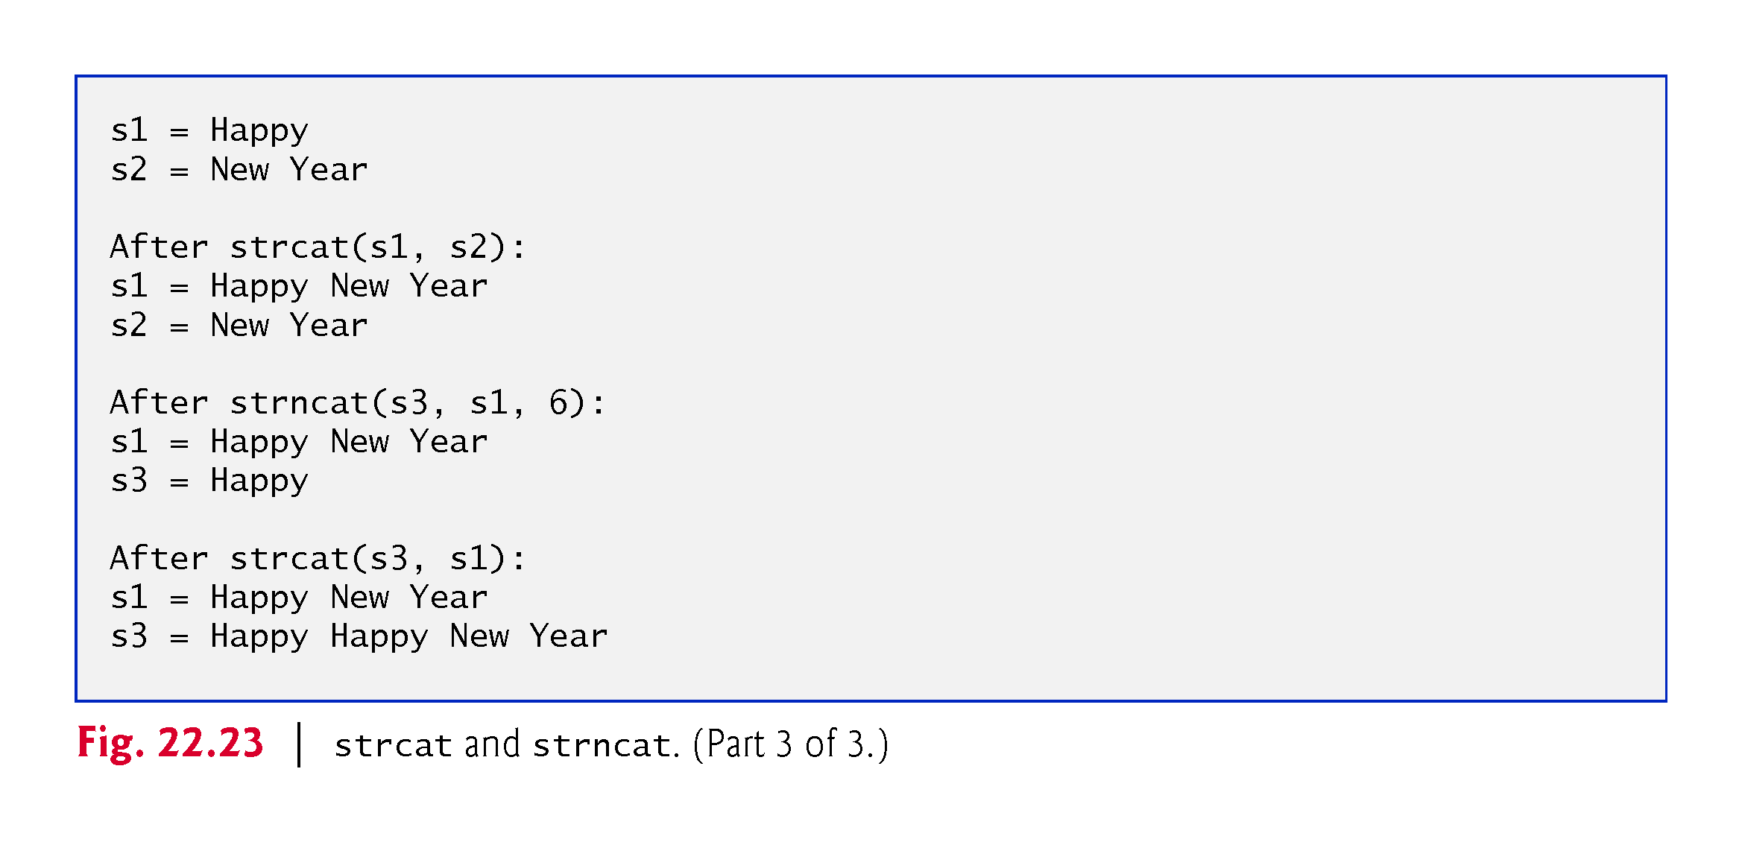

Slide 123
22.8 C-String Manipulation Functions (cont.)
Figure 22.24 compares three strings using strcmp (lines 14–16) and strncmp (lines 19–21).
Function strcmp compares its first string argument with its second string argument character by character.
The function returns zero if the strings are equal, a negative value if the first string is less than the second string and a positive value if the first string is greater than the second string.
Function strncmp is equivalent to strcmp, except that strncmp compares up to a specified number of characters.
Function strncmp stops comparing characters if it reaches the null character in one of its string arguments.
The program prints the integer value returned by each function call.

Slide 125
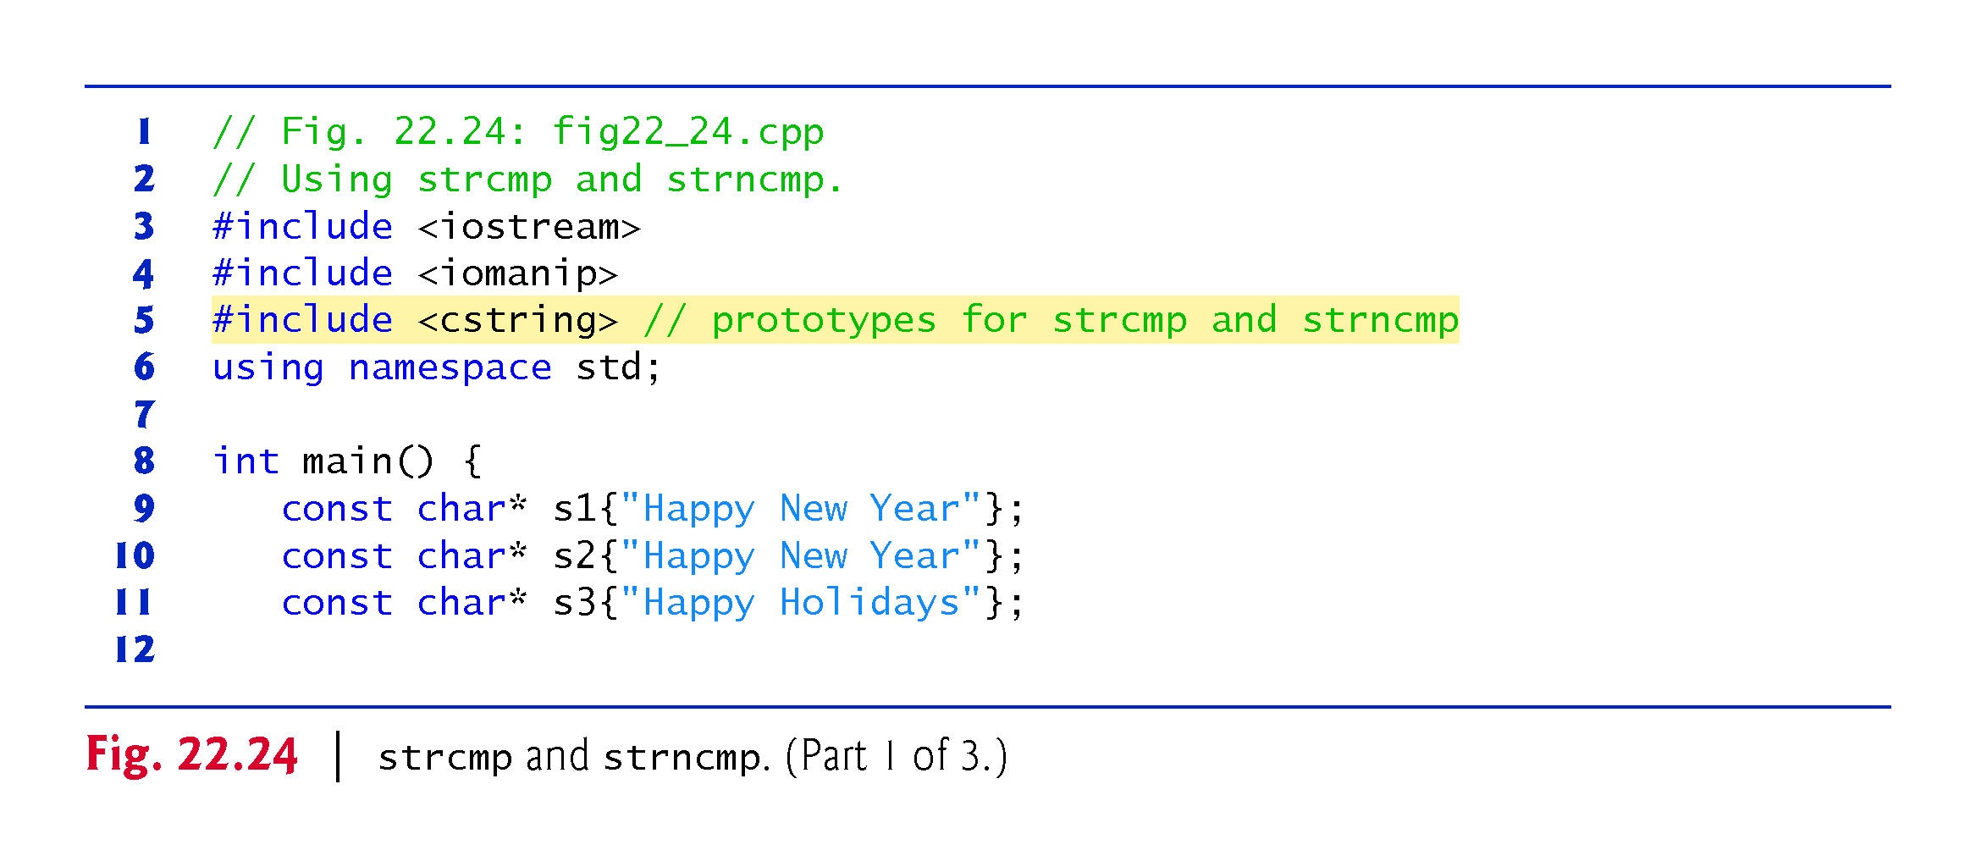

Slide 126
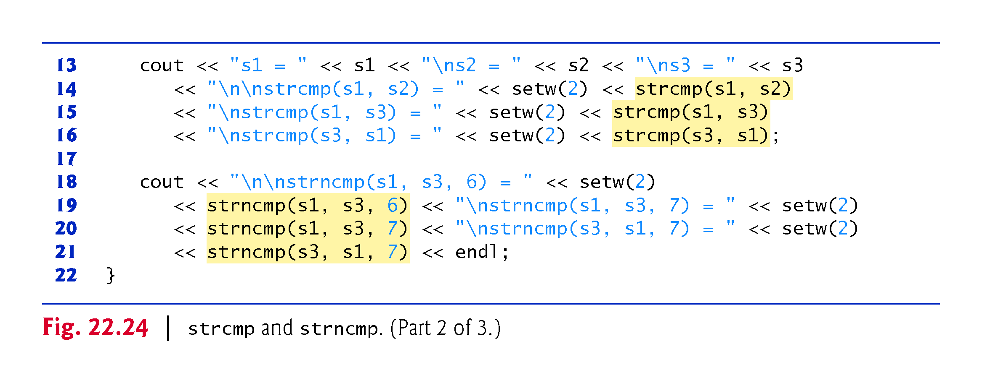

Slide 127
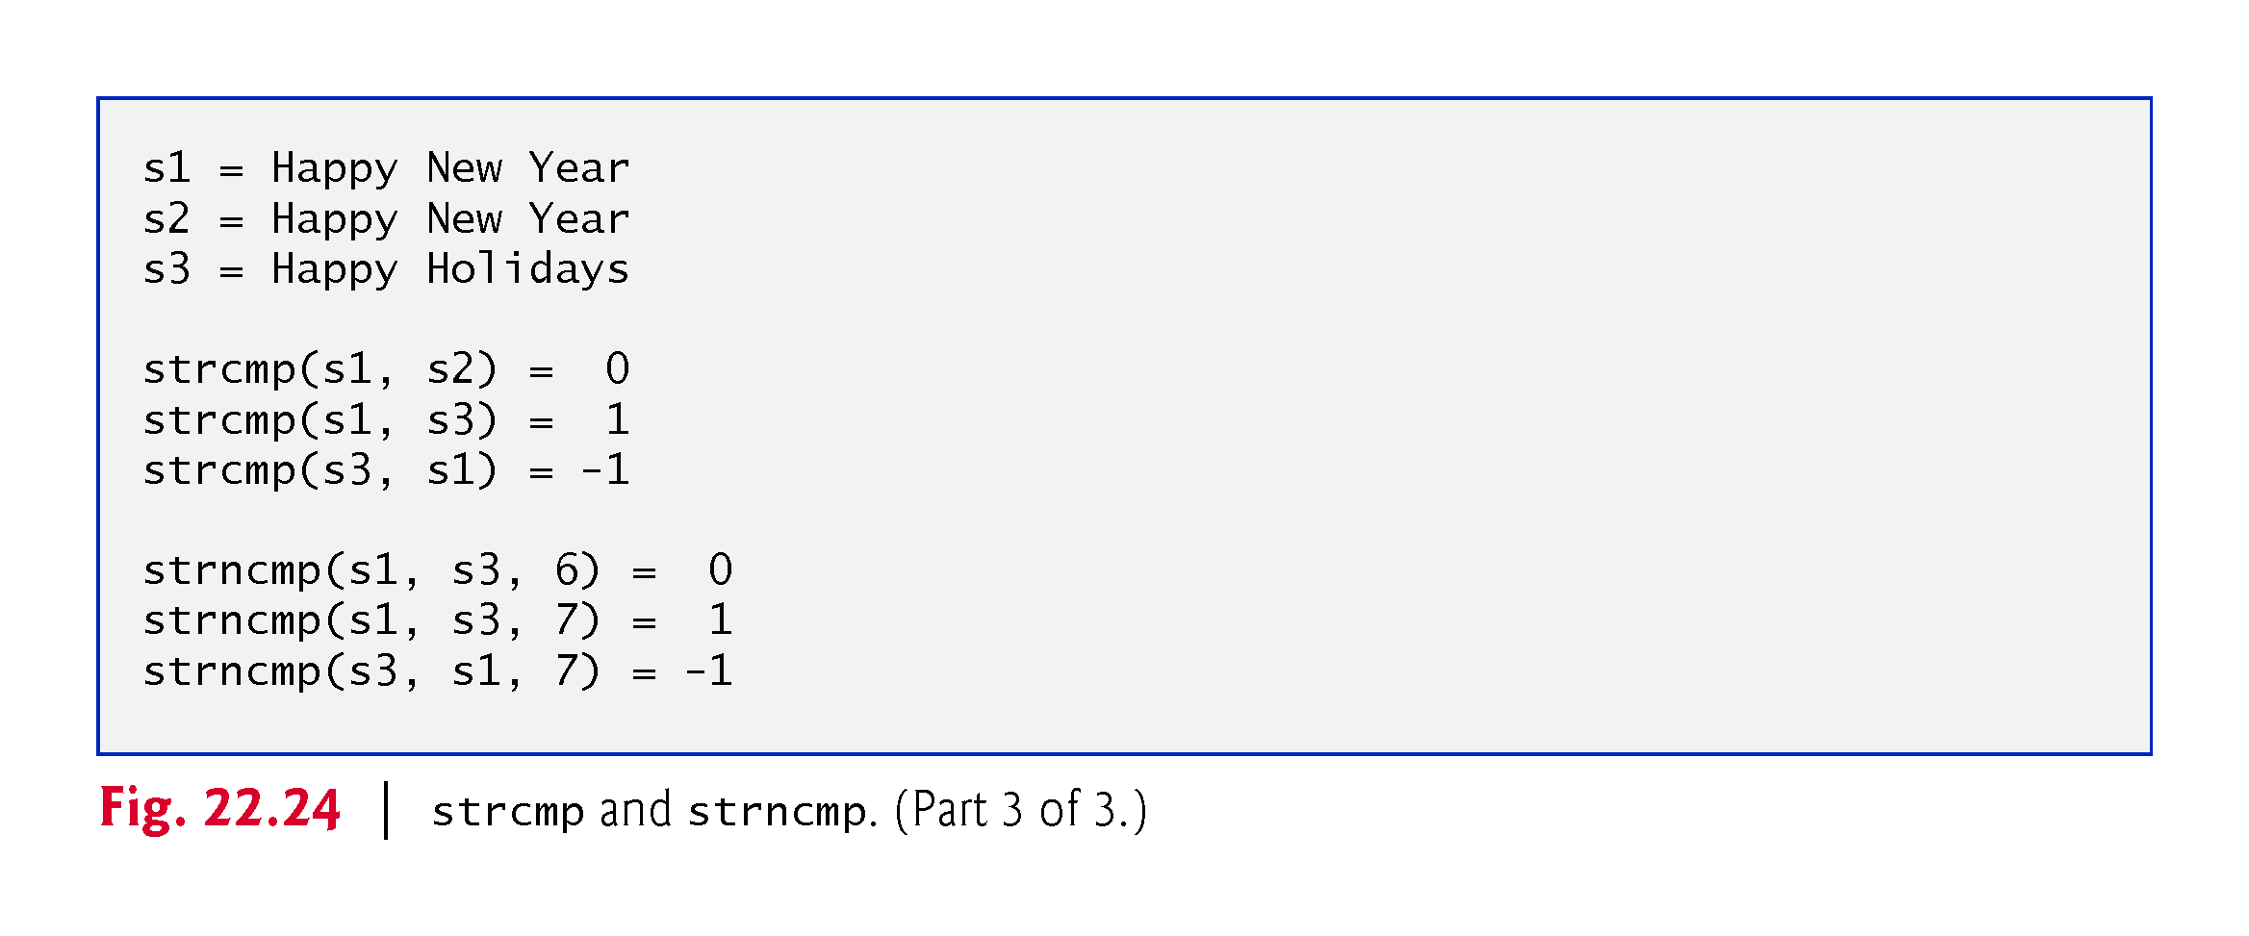

Slide 128
22.8 C-String Manipulation Functions (cont.)
To understand what it means for one string to be “greater than” or “less than” another, consider the process of alphabetizing last names.
You’d, no doubt, place “Jones” before “Smith,” because the first letter of “Jones” comes before the first letter of “Smith” in the alphabet.
But the alphabet is more than just a list of 26 letters—it’s an ordered list of characters.
Each letter occurs in a specific position within the list.
“Z” is more than just a letter of the alphabet; “Z” is specifically the 26th letter of the alphabet.

Slide 129
22.8 C-String Manipulation Functions (cont.)
How does the computer know that one letter “comes before” another?
All characters are represented inside the computer as numeric codes; when the computer compares two strings, it actually compares the numeric codes of the characters in the strings.

Slide 130
22.8 C-String Manipulation Functions (cont.)
Function strtok breaks a string into a series of tokens.
A token is a sequence of characters separated by delimiting characters (usually spaces or punctuation marks).
For example, in a line of text, each word can be considered a token, and the spaces separating the words can be considered delimiters.
Multiple calls to strtok are required to break a string into tokens (assuming that the string contains more than one token).

Slide 131
22.8 C-String Manipulation Functions (cont.)
The first call to strtok contains two arguments, a string to be tokenized and a string containing characters that separate the tokens (i.e., delimiters).
Line 14 in Fig. 22.25 assigns to tokenPtr a pointer to the first token in sentence.
The second argument, " ", indicates that tokens in sentence are separated by spaces.
Function strtok searches for the first character in sentence that is not a delimiting character (space).
This begins the first token.
The function then finds the next delimiting character in the string and replaces it with a null ('\0') character.
This terminates the current token.

Slide 132
22.8 C-String Manipulation Functions (cont.)
Function strtok saves (in a static variable) a pointer to the next character following the token in sentence and returns a pointer to the current token.
Subsequent calls to strtok to continue tokenizing sentence contain NULL as the first argument (line 19).
The NULL argument indicates that the call to strtok should continue tokenizing from the location in sentence saved by the last call to strtok.
Function strtok maintains this saved information in a manner that is not visible to you.
If no tokens remain when strtok is called, strtok returns NULL.

Slide 133
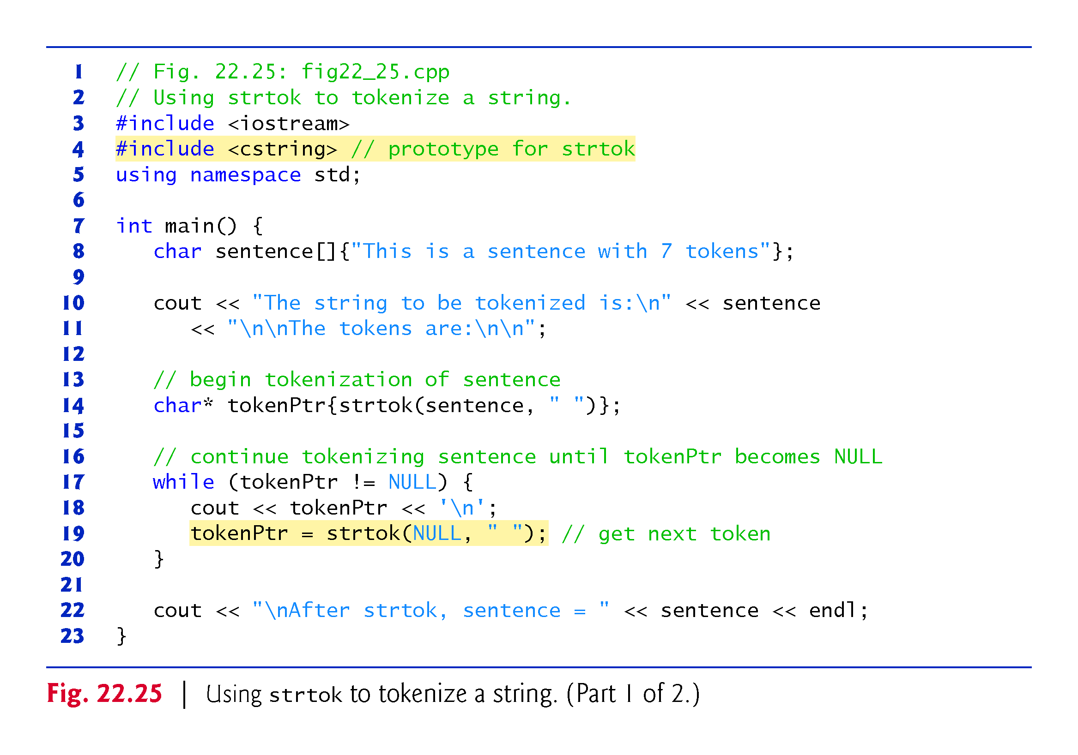

Slide 136
22.8 C-String Manipulation Functions (cont.)
Function strlen takes a string as an argument and returns the number of characters in the string—the terminating null character is not included in the length.
The length is also the index of the null character.
The program of Fig. 22.26 demonstrates function strlen.

Slide 137
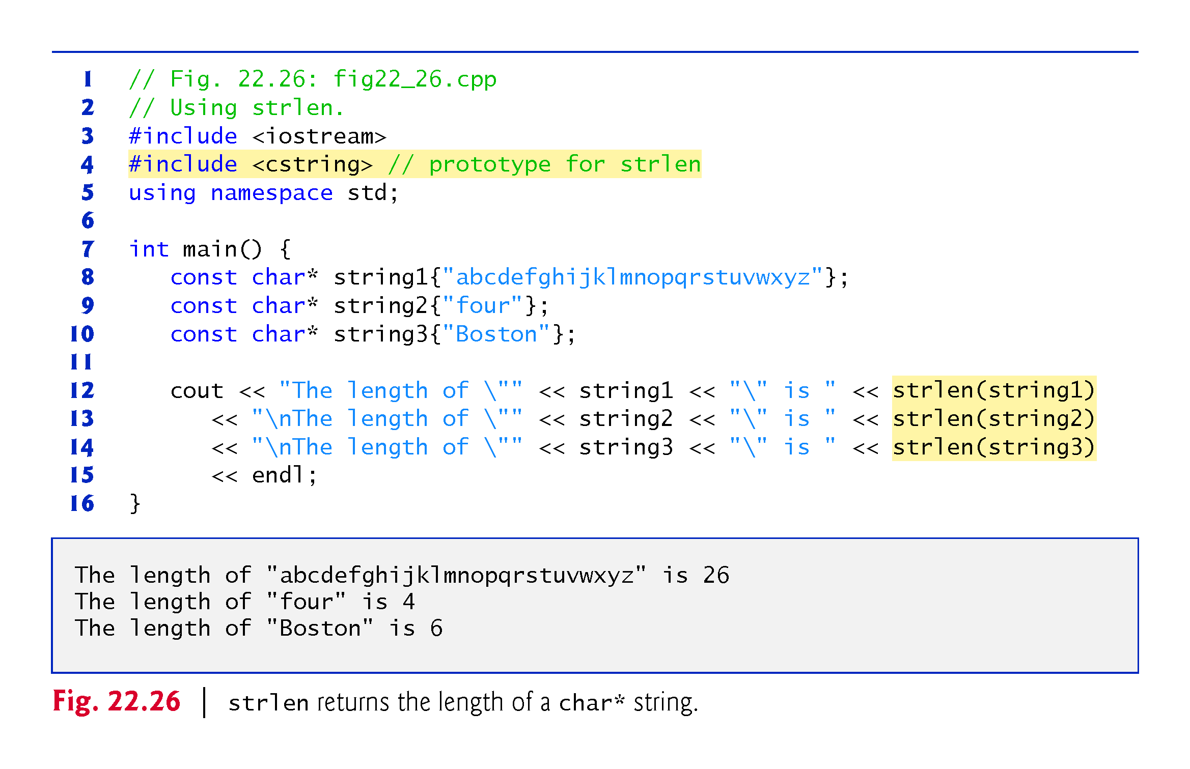

Slide 138
22.9 C String-Conversion Functions
In Section 22.10, we discussed several of C++’s most popular C string-manipulation functions.
In the next several sections, we cover the remaining functions, including functions for converting strings to numeric values, functions for searching strings and functions for manipulating, comparing and searching blocks of memory.
This section presents the C string-conversion functions from the general-utilities library <cstdlib>.
These functions convert C strings to integer and floating-point values.
In new code, C++ programmers typically use the string stream processing capabilities (Chapter 21) to perform such conversions.
Figure 22.27 summarizes the C string-conversion functions.
When using functions from the general-utilities library, include the <cstdlib> header.

Slide 141
22.9 C String-Conversion Functions (cont.)
Function atof (Fig. 22.28, line 8) converts its argument—a string that represents a floating-point number—to a double value.
The function returns the double value.
If the string cannot be converted—for example, if the first character of the string is not a digit—function atof returns zero.

Slide 142
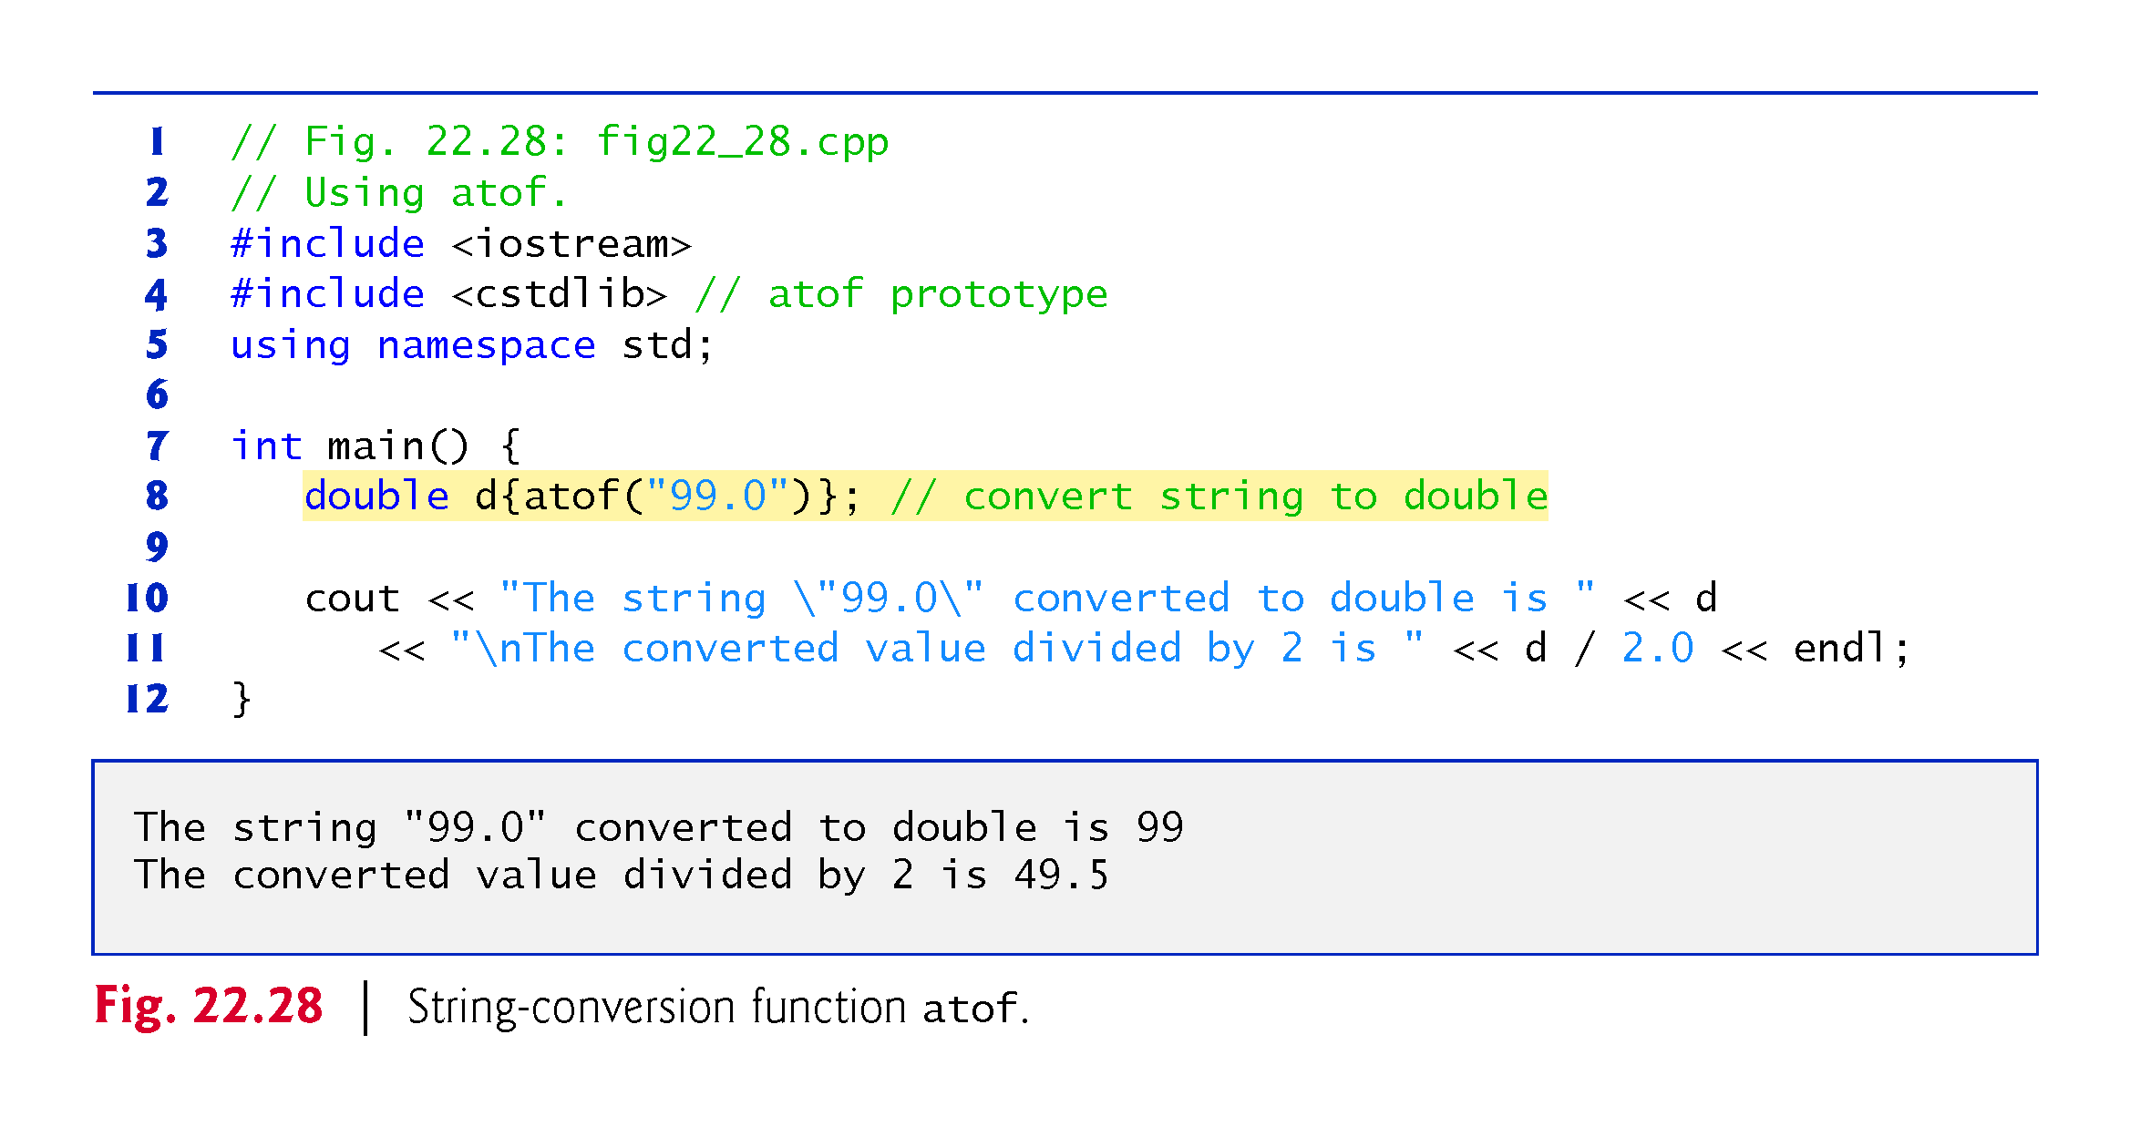

Slide 143
22.9 C String-Conversion Functions (cont.)
Function atoi (Fig. 22.29, line 8) converts its argument—a string of digits that represents an integer—to an int value.
The function returns the int value.
If the string cannot be converted, function atoi returns zero.

Slide 144
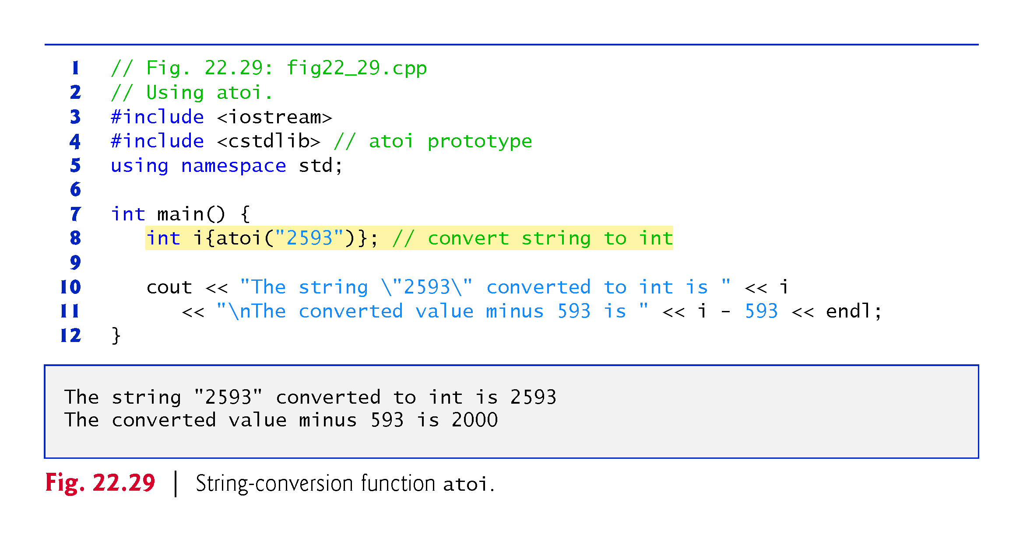

Slide 145
22.9 C String-Conversion Functions (cont.)
Function atol (Fig. 22.30, line 8) converts its argument—a string of digits representing a long integer—to a long value.
The function returns the long value.
If the string cannot be converted, function atol returns zero.
If int and long are both stored in four bytes, function atoi and function atol work identically.

Slide 146
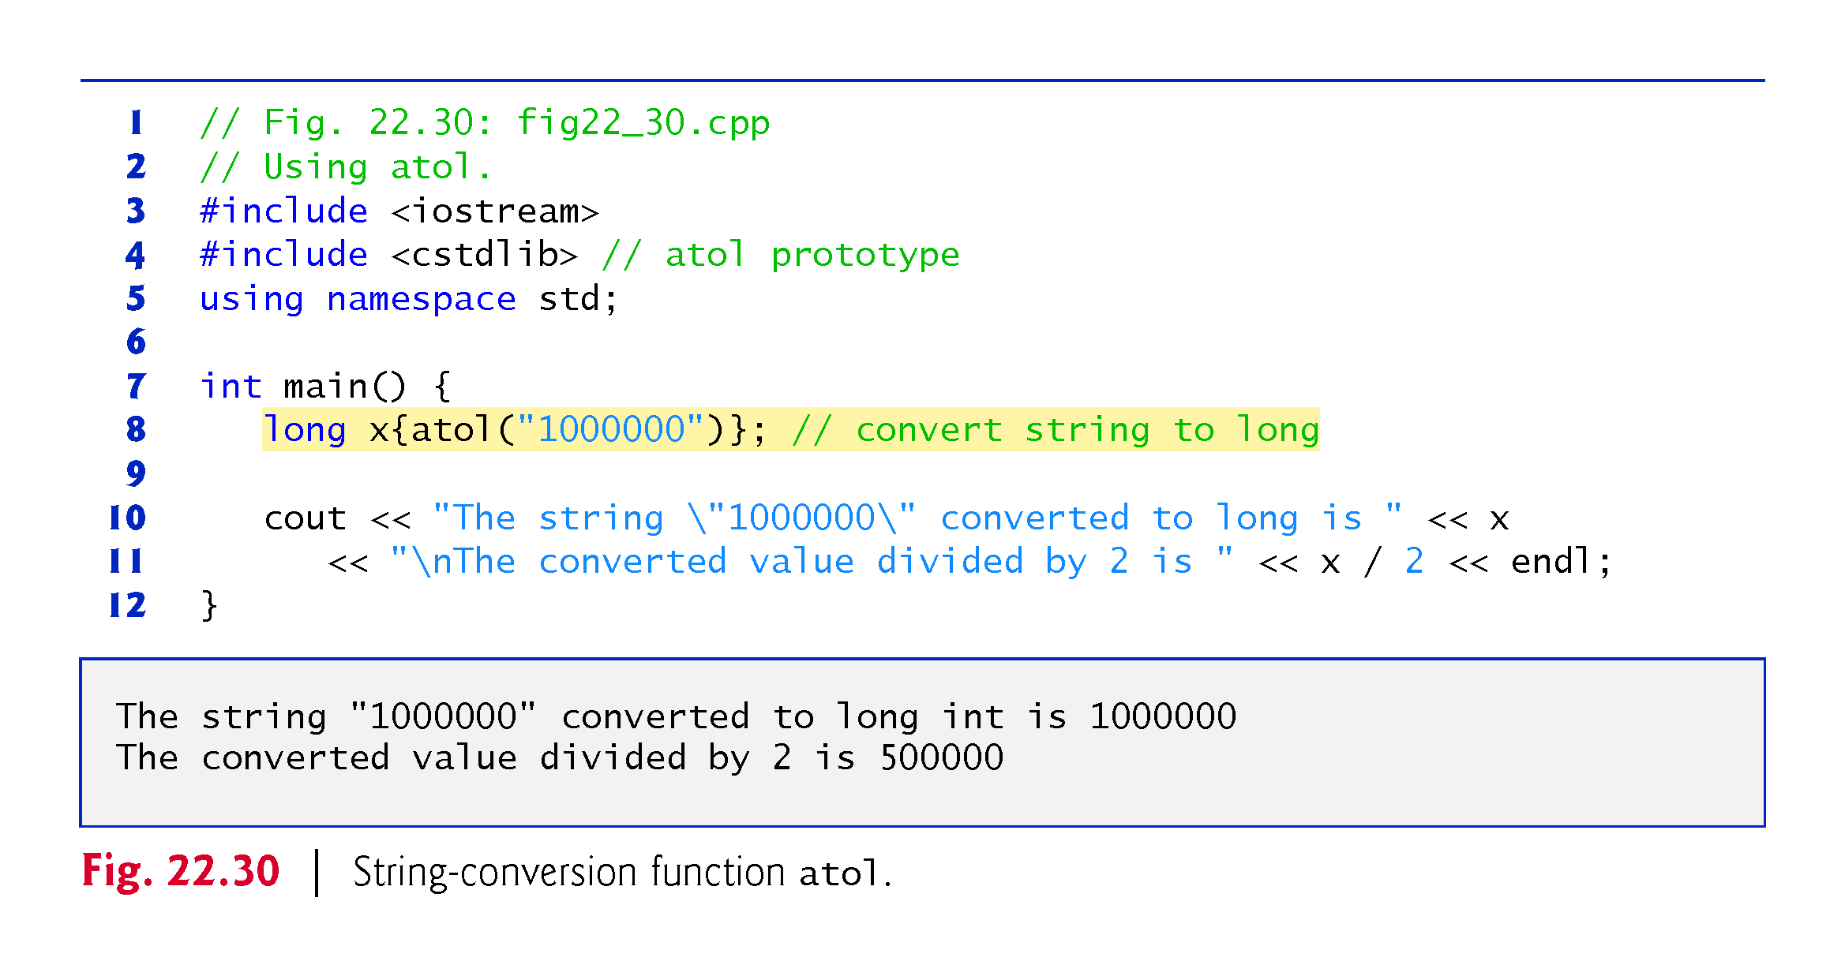

Slide 147
22.9 C String-Conversion Functions (cont.)
Function strtod (Fig. 22.31) converts a sequence of characters representing a floating-point value to double.
Function strtod receives two arguments—a string (char*) and the address of a char* pointer (i.e., a char**).
The string contains the character sequence to be converted to double.
The second argument enables strtod to modify a char* pointer in the calling function, such that the pointer points to the location of the first character after the converted portion of the string.
Line 11 indicates that d is assigned the double value converted from string and that stringPtr is assigned the location of the first character after the converted value (51.2) in string.

Slide 149
22.9 C String-Conversion Functions (cont.)
Function strtol (Fig. 22.32) converts to long a sequence of characters representing an integer.
The function receives a string (char*), the address of a char* pointer and an integer.
The string contains the character sequence to convert.
The second argument is assigned the location of the first character after the converted portion of the string.
The integer specifies the base of the value being converted.

Slide 150
22.9 C String-Conversion Functions (cont.)
Line 11 indicates that x is assigned the long value converted from string and that remainderPtr is assigned the location of the first character after the converted value (-1234567) in string1.
Using a null pointer for the second argument causes the remainder of the string to be ignored.
The third argument, 0, indicates that the value to be converted can be in octal (base 8), decimal (base 10) or hexadecimal (base 16).
This is determined by the initial characters in the string—0 indicates an octal number, 0x indicates hexadecimal and a number from 1–9 indicates decimal.

Slide 151
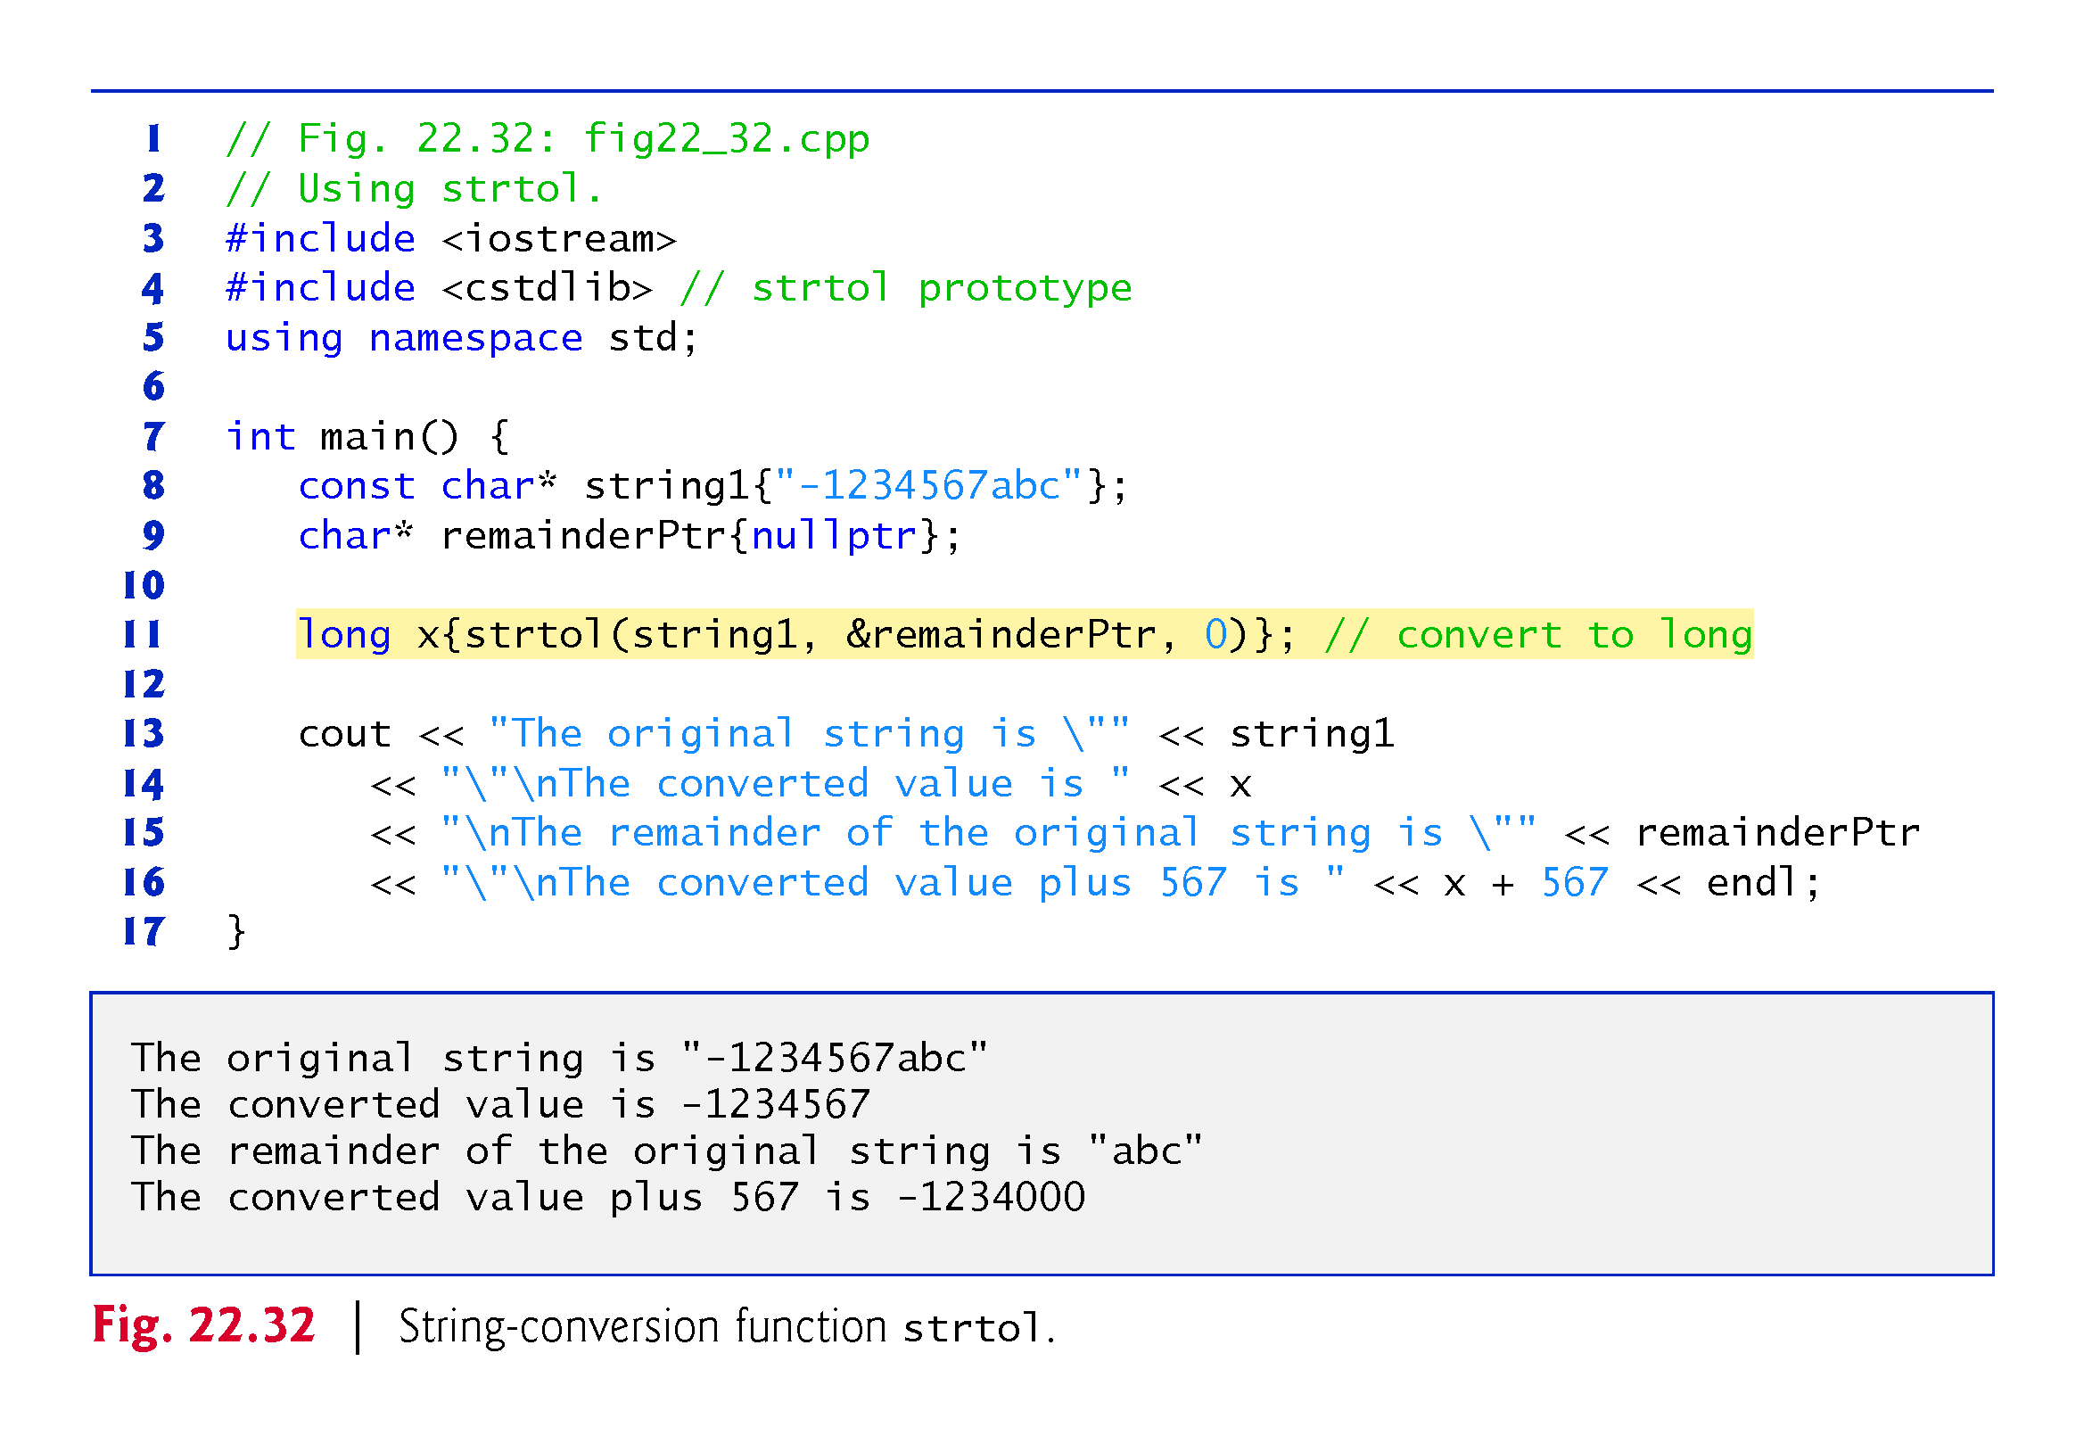

Slide 152
22.9 C String-Conversion Functions (cont.)
Function strtoul (Fig. 22.33) converts to unsigned long a sequence of characters representing an unsigned long integer.
The function works identically to strtol.
Line 12 indicates that x is assigned the unsigned long value converted from string and that remainderPtr is assigned the location of the first character after the converted value (1234567) in string1.
The third argument, 0, indicates that the value to be converted can be in octal, decimal or hexadecimal format, depending on the initial characters.

Slide 153
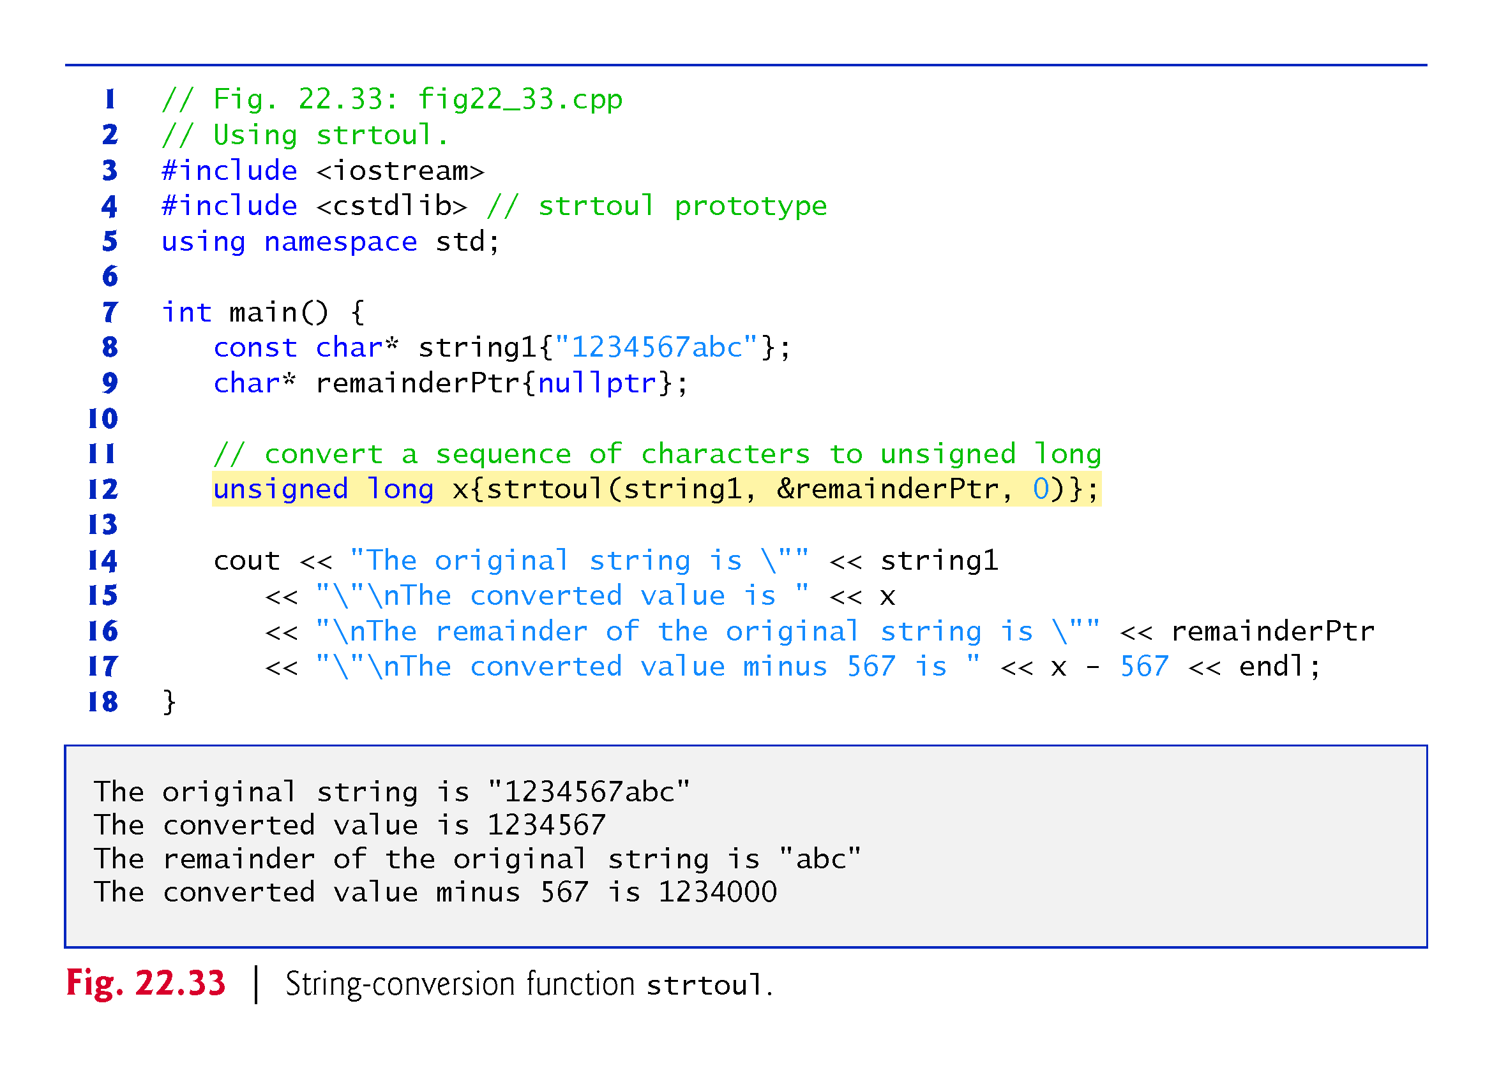

Slide 154
22.10 Search Functions of the C String-Handling Library
This section presents the functions of the string-handling library used to search strings for characters and other strings.
The functions are summarized in Fig. 22.34.
Functions strcspn and strspn specify return type size_t.
Type size_t is a type defined by the standard as the integral type of the value returned by operator sizeof.

Slide 157
22.10 Search Functions of the C String-Handling Library (cont.)
Function strchr searches for the first occurrence of a character in a string.
If the character is found, strchr returns a pointer to the character in the string; otherwise, strchr returns a null pointer.
The program of Fig. 22.35 uses strchr (lines 13 and 23) to search for the first occurrences of 'a' and 'z' in the string "This is a test".

Slide 160
22.10 Search Functions of the C String-Handling Library (cont.)
Function strcspn (Fig. 22.36, line 14) determines the length of the initial part of the string in its first argument that does not contain any characters from the string in its second argument.
The function returns the length of the segment.

Slide 161
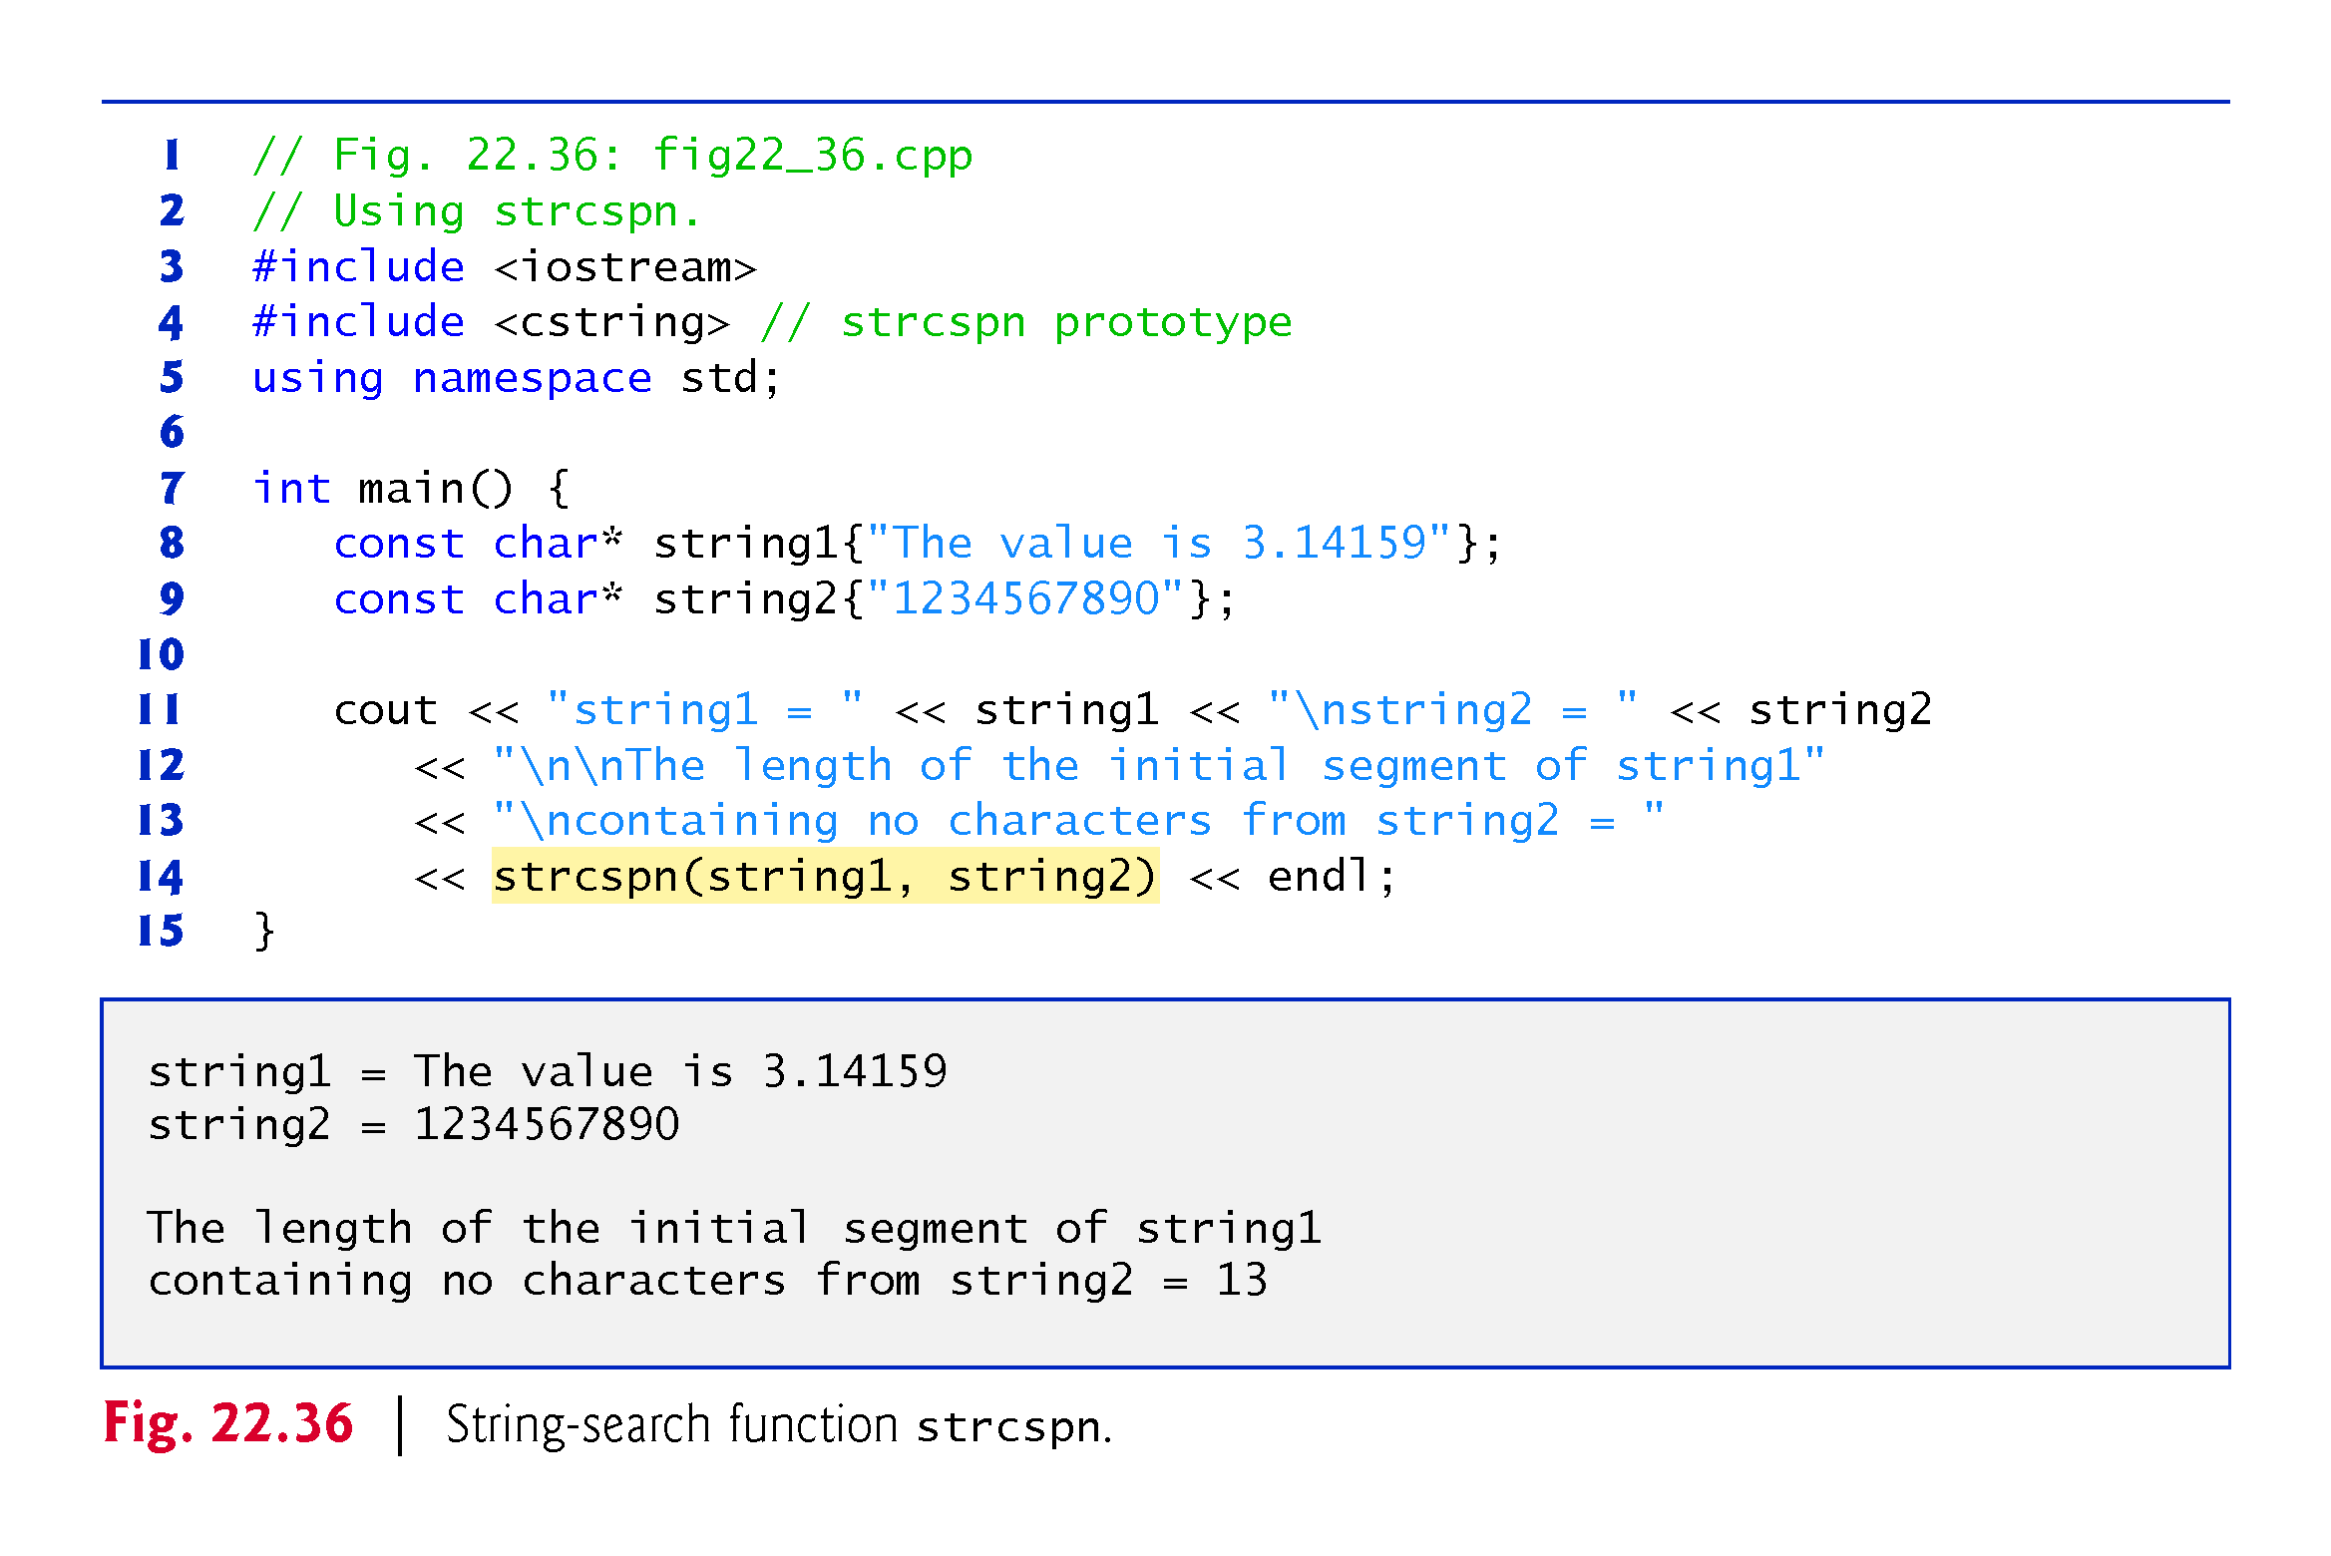

Slide 162
22.10 Search Functions of the C String-Handling Library (cont.)
Function strpbrk searches for the first occurrence in its first string argument of any character in its second string argument.
If a character from the second argument is found, strpbrk returns a pointer to the character in the first argument; otherwise, strpbrk returns a null pointer.
Line 12 of Fig. 22.37 locates the first occurrence in string1 of any character from string2.

Slide 164
22.10 Search Functions of the C String-Handling Library (cont.)
Function strrchr searches for the last occurrence of the specified character in a string.
If the character is found, strrchr returns a pointer to the character in the string; otherwise, strrchr returns 0.
Line 14 of Fig. 22.38 searches for the last occurrence of the character 'z' in the string "A zoo has many animals including zebras".

Slide 165
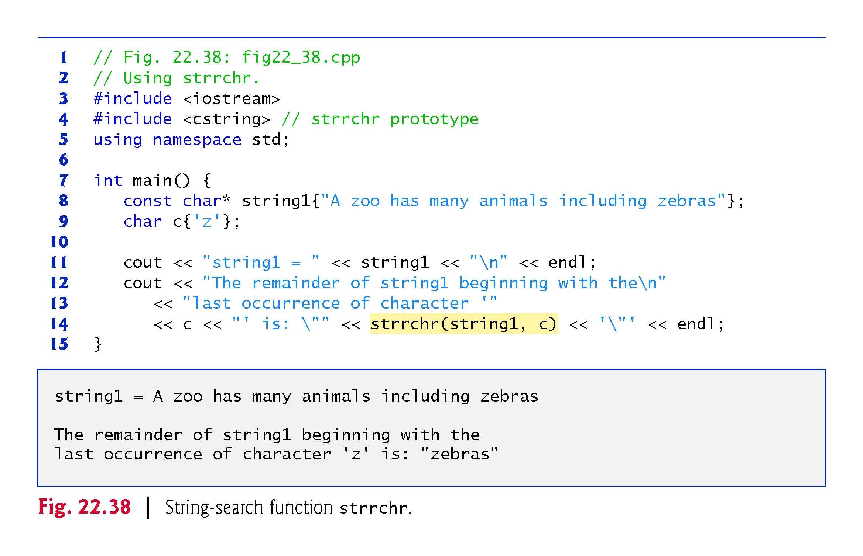

Slide 166
22.10 Search Functions of the C String-Handling Library (cont.)
Function strspn (Fig. 22.39, line 14) determines the length of the initial part of the string in its first argument that contains only characters from the string in its second argument.
The function returns the length of the segment.

Slide 167
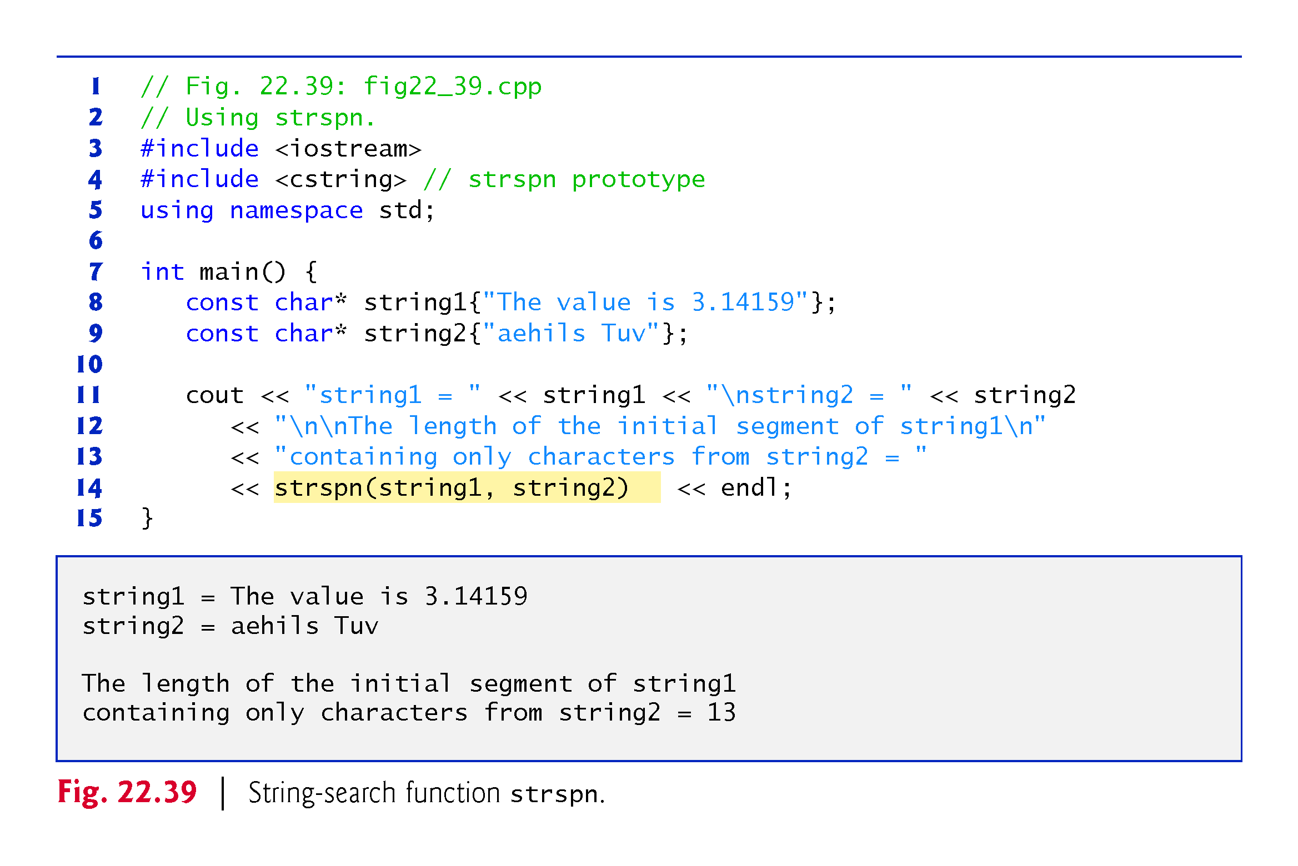

Slide 168
22.10 Search Functions of the C String-Handling Library (cont.)
Function strstr searches for the first occurrence of its second string argument in its first string argument.
If the second string is found in the first string, a pointer to the location of the string in the first argument is returned; otherwise, it returns 0.
Line 14 of Fig. 22.40 uses strstr to find the string "def" in the string "abcdefabcdef".

Slide 169
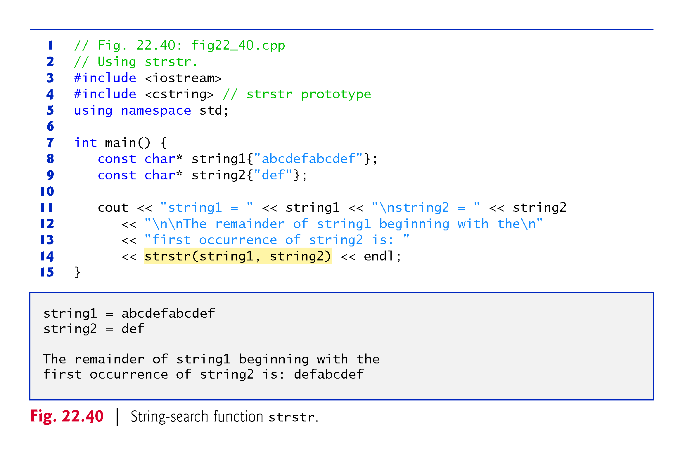

Slide 170
22.11 Memory Functions of the C String-Handling Library
The string-handling library functions presented in this section facilitate manipulating, comparing and searching blocks of memory.
The functions treat blocks of memory as arrays of bytes.
These functions can manipulate any block of data.
Figure 22.41 summarizes the memory functions of the string-handling library.
In the function discussions, “object” refers to a block of data.

Slide 173
22.11 Memory Functions of the C String-Handling Library (cont.)
The pointer parameters to these functions are declared void*.
In Chapter 8, we saw that a pointer to any data type can be assigned directly to a pointer of type void*.
For this reason, these functions can receive pointers to any data type.
Because a void* pointer cannot be dereferenced, each function receives a size argument that specifies the number of characters (bytes) the function will process.
For simplicity, the examples in this section manipulate character arrays (blocks of characters).

Slide 174
22.11 Memory Functions of the C String-Handling Library (cont.)
Function memcpy copies a specified number of characters (bytes) from the object pointed to by its second argument into the object pointed to by its first argument.
The function can receive a pointer to any type of object.
The result of this function is undefined if the two objects overlap in memory (i.e., are parts of the same object).
The program of Fig. 22.42 uses memcpy (line 13) to copy the string in array s2 to array s1.

Slide 175
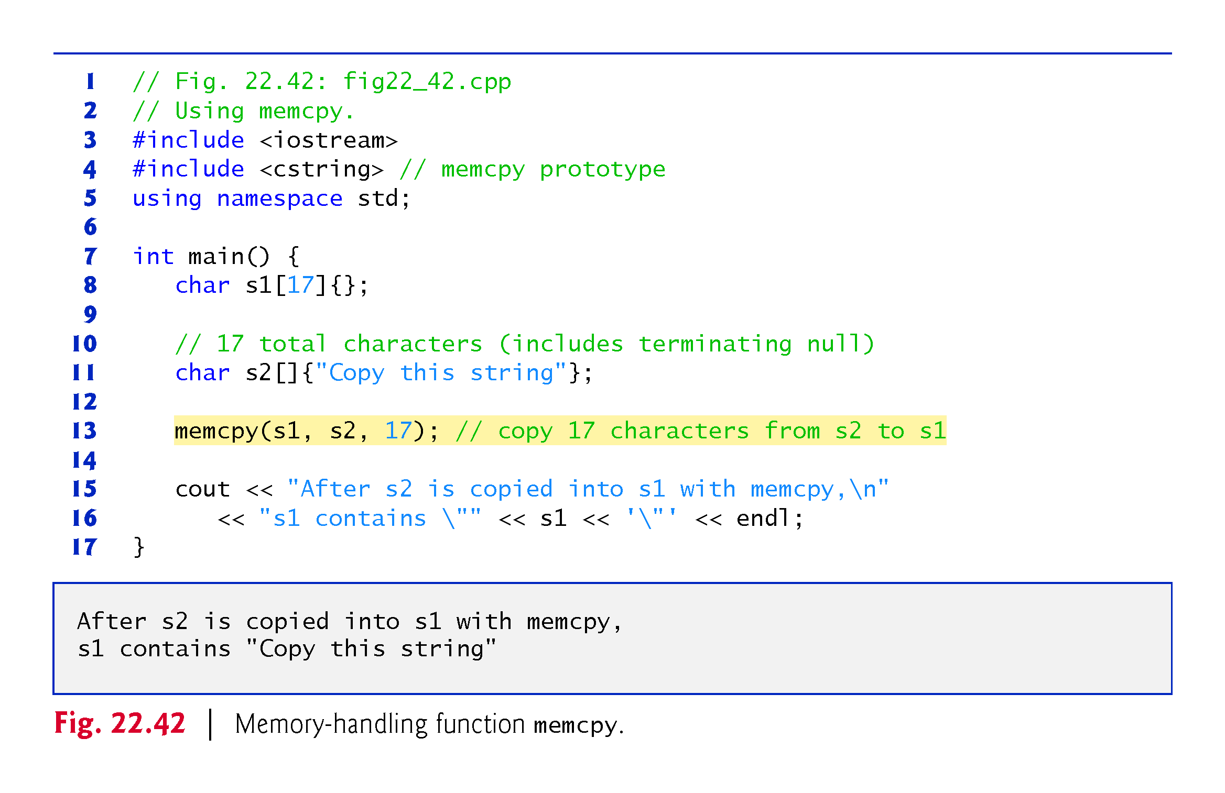

Slide 176
22.11 Memory Functions of the C String-Handling Library (cont.)
Function memmove, like memcpy, copies a specified number of bytes from the object pointed to by its second argument into the object pointed to by its first argument.
Copying is performed as if the bytes were copied from the second argument to a temporary array of characters, then copied from the temporary array to the first argument.
This allows characters from one part of a string to be copied into another part of the same string.
Fig. 22.43 uses memmove (line 12) to copy the last 10 bytes of array x into the first 10 bytes of array x.

Slide 179
22.11 Memory Functions of the C String-Handling Library (cont.)
Function memcmp (Fig. 22.44, lines 13–15) compares the specified number of characters of its first argument with the corresponding characters of its second argument.
The function returns a value greater than zero if the first argument is greater than the second argument, zero if the arguments are equal, and a value less than zero if the first argument is less than the second argument.

Slide 182
22.11 Memory Functions of the C String-Handling Library (cont.)
Function memchr searches for the first occurrence of a byte, represented as unsigned char, in the specified number of bytes of an object.
If the byte is found in the object, a pointer to it is returned; otherwise, the function returns a null pointer.
Line 12 of Fig. 22.45 searches for the character (byte) 'r' in the string "This is a string".

Slide 184
22.11 Memory Functions of the C String-Handling Library (cont.)
Function memset copies the value of the byte in its second argument into a specified number of bytes of the object pointed to by its first argument.
Line 12 in Fig. 22.46 uses memset to copy 'b' into the first 7 bytes of string1.

