Slide 1
Operator Overloading; Class string
Based on Chapter 10 of C++ How to Program, 10/e

Slide 2
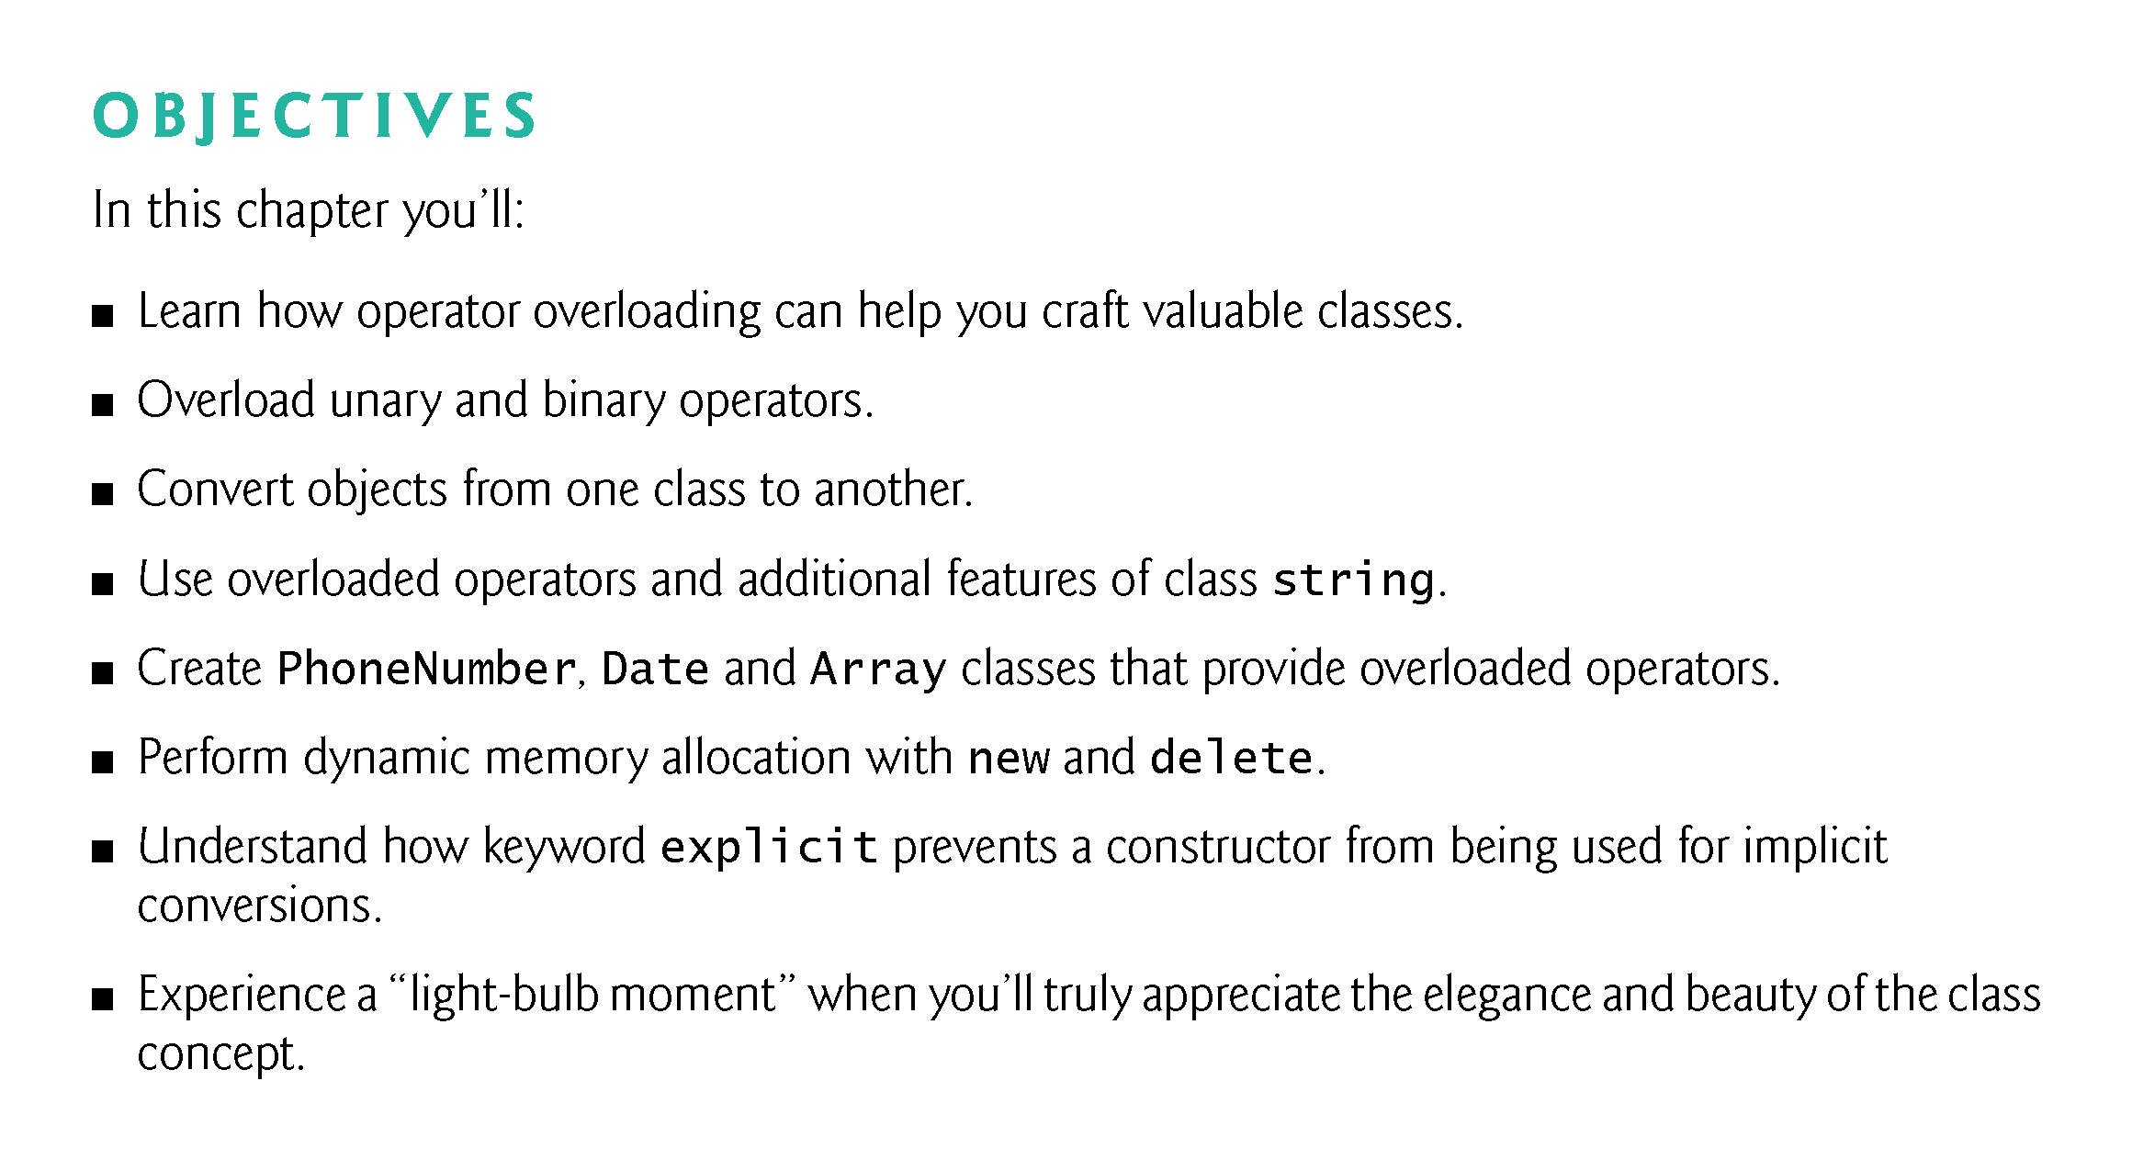

Slide 3
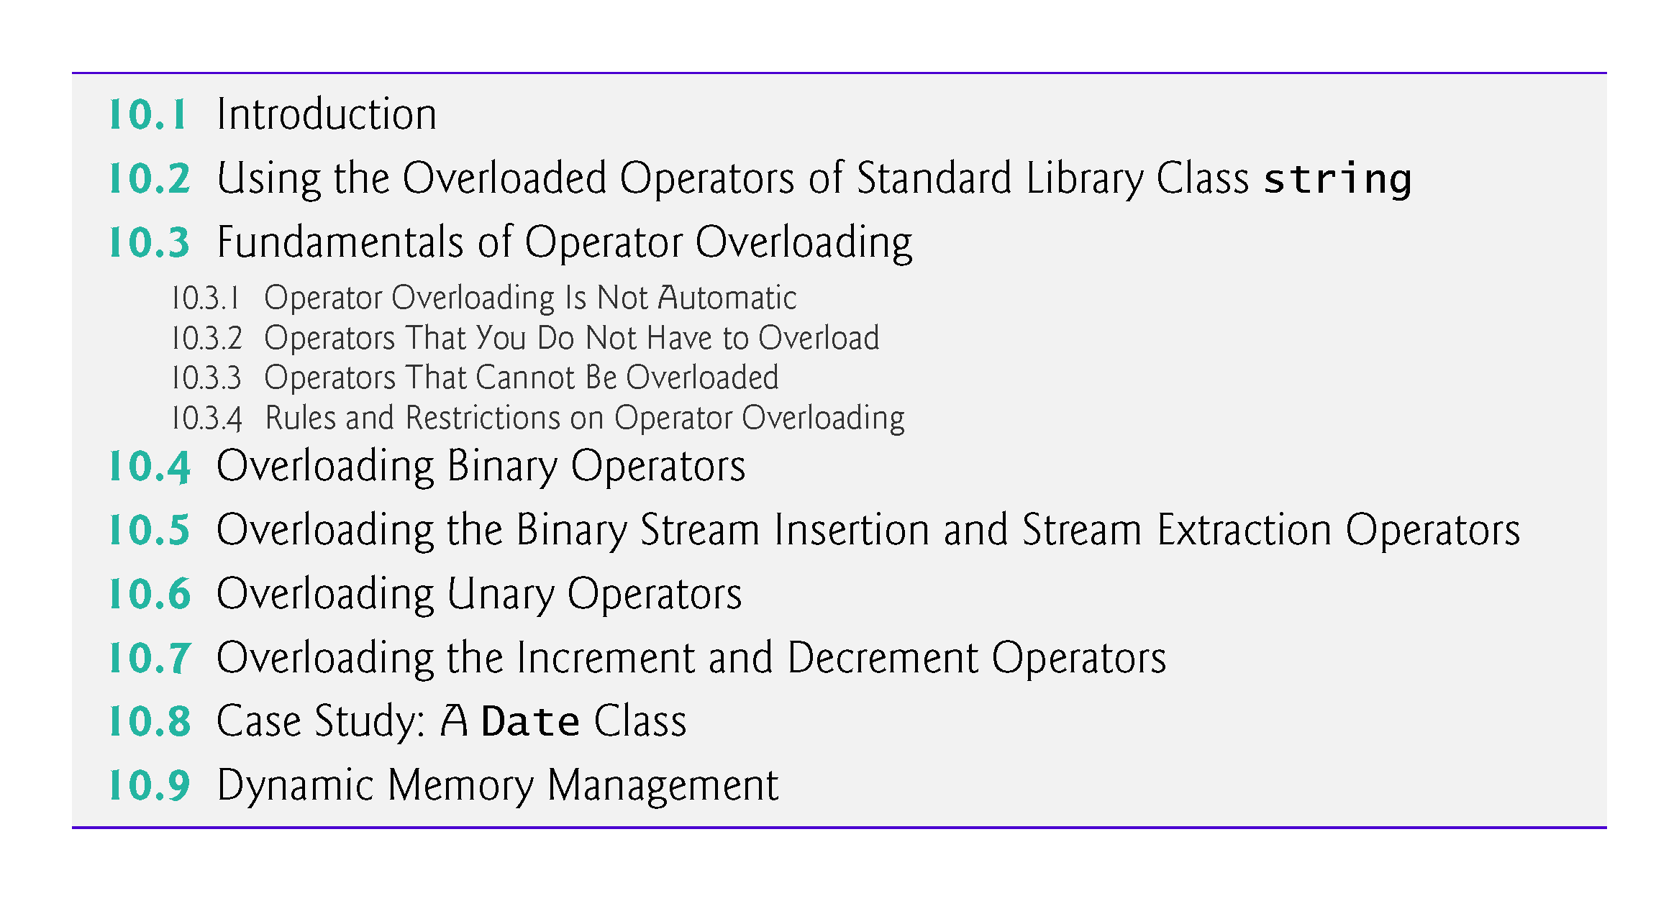

Slide 4
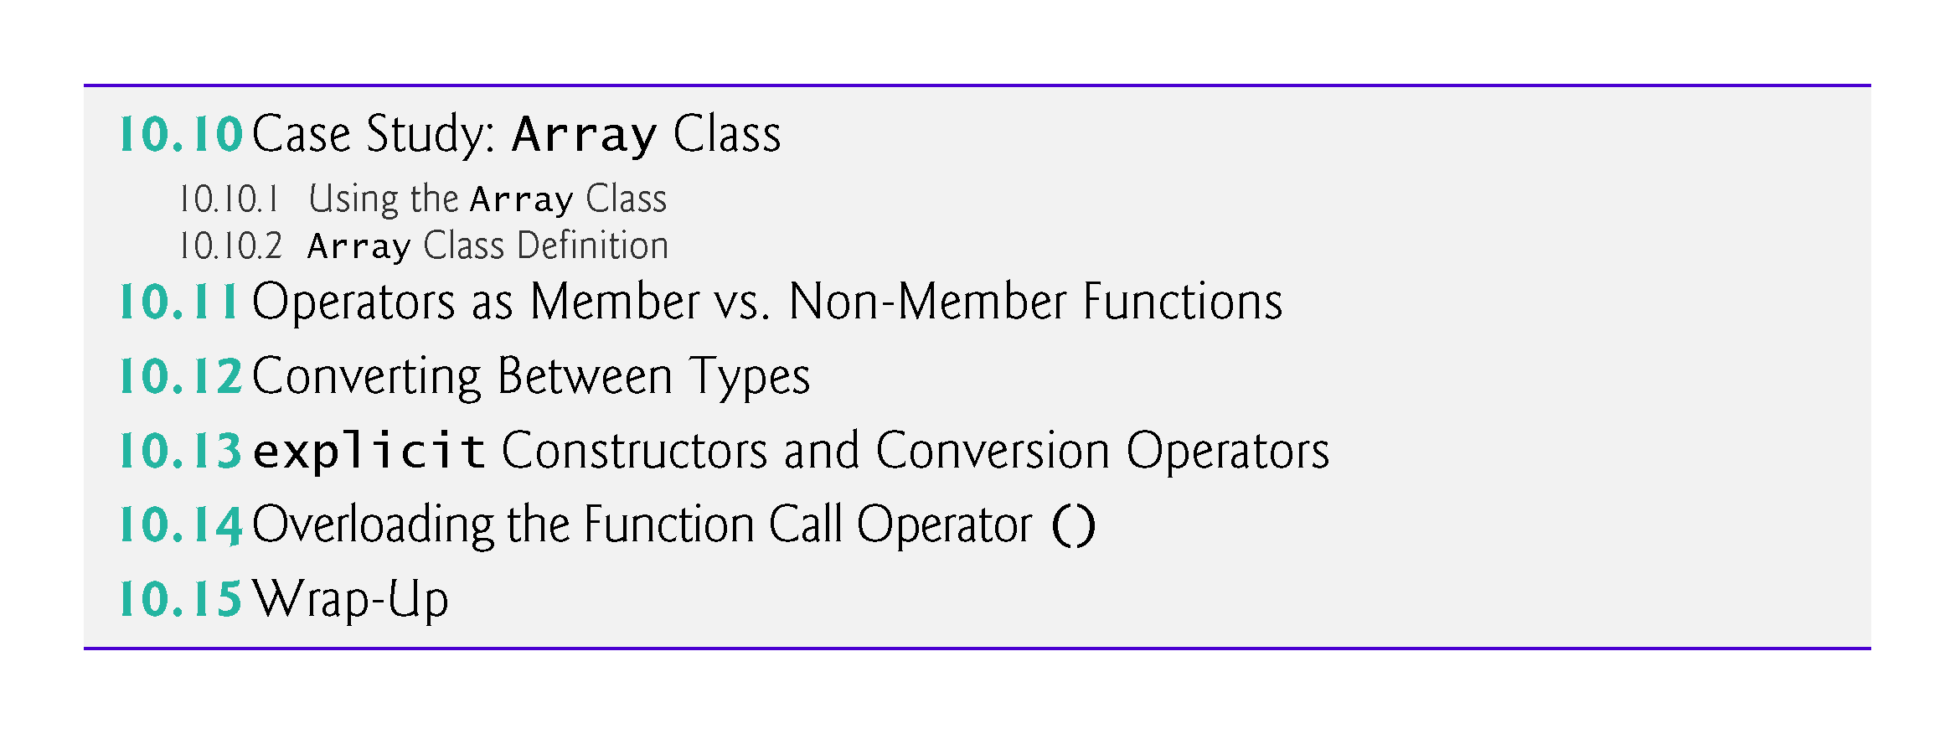

Slide 5
10.1 Introduction
This chapter shows how to enable C++’s operators to work with class objects—a process called operator overloading
One example of an overloaded operator built into C++ is <<, which is used both as the stream insertion operator and as the bitwise left-shift operator (which is discussed in Chapter 22).
Similarly, >> also is overloaded; it’s used both as
  the stream extraction operator—defined via operator overloading in the C++ Standard Library—and
  the bitwise right-shift operator—defined as part of the C++ language.

Slide 6
10.2 Using the Overloaded Operators of Standard Library Class string
Figure 10.1 demonstrates many of class string’s overloaded operators and several other useful member functions, including empty, substr and at.
Function empty determines whether a string is empty, function substr (for “substring”) returns a string that’s a portion of an existing string and function at returns the character at a specific index in a string (after checking that the index is in range).
Chapter 21 presents class string in detail.

Slide 7
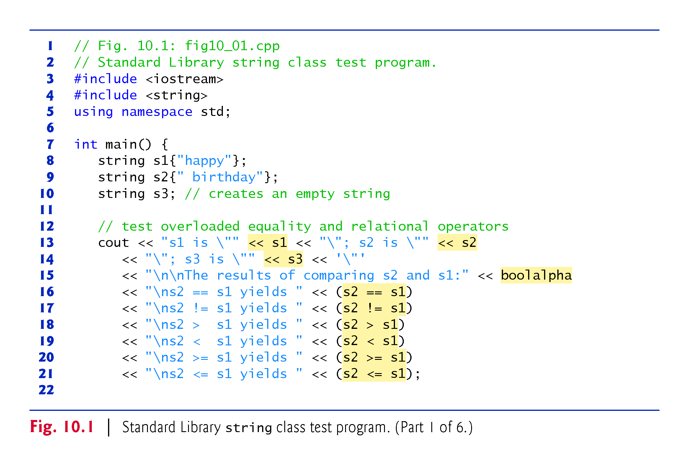

Slide 8
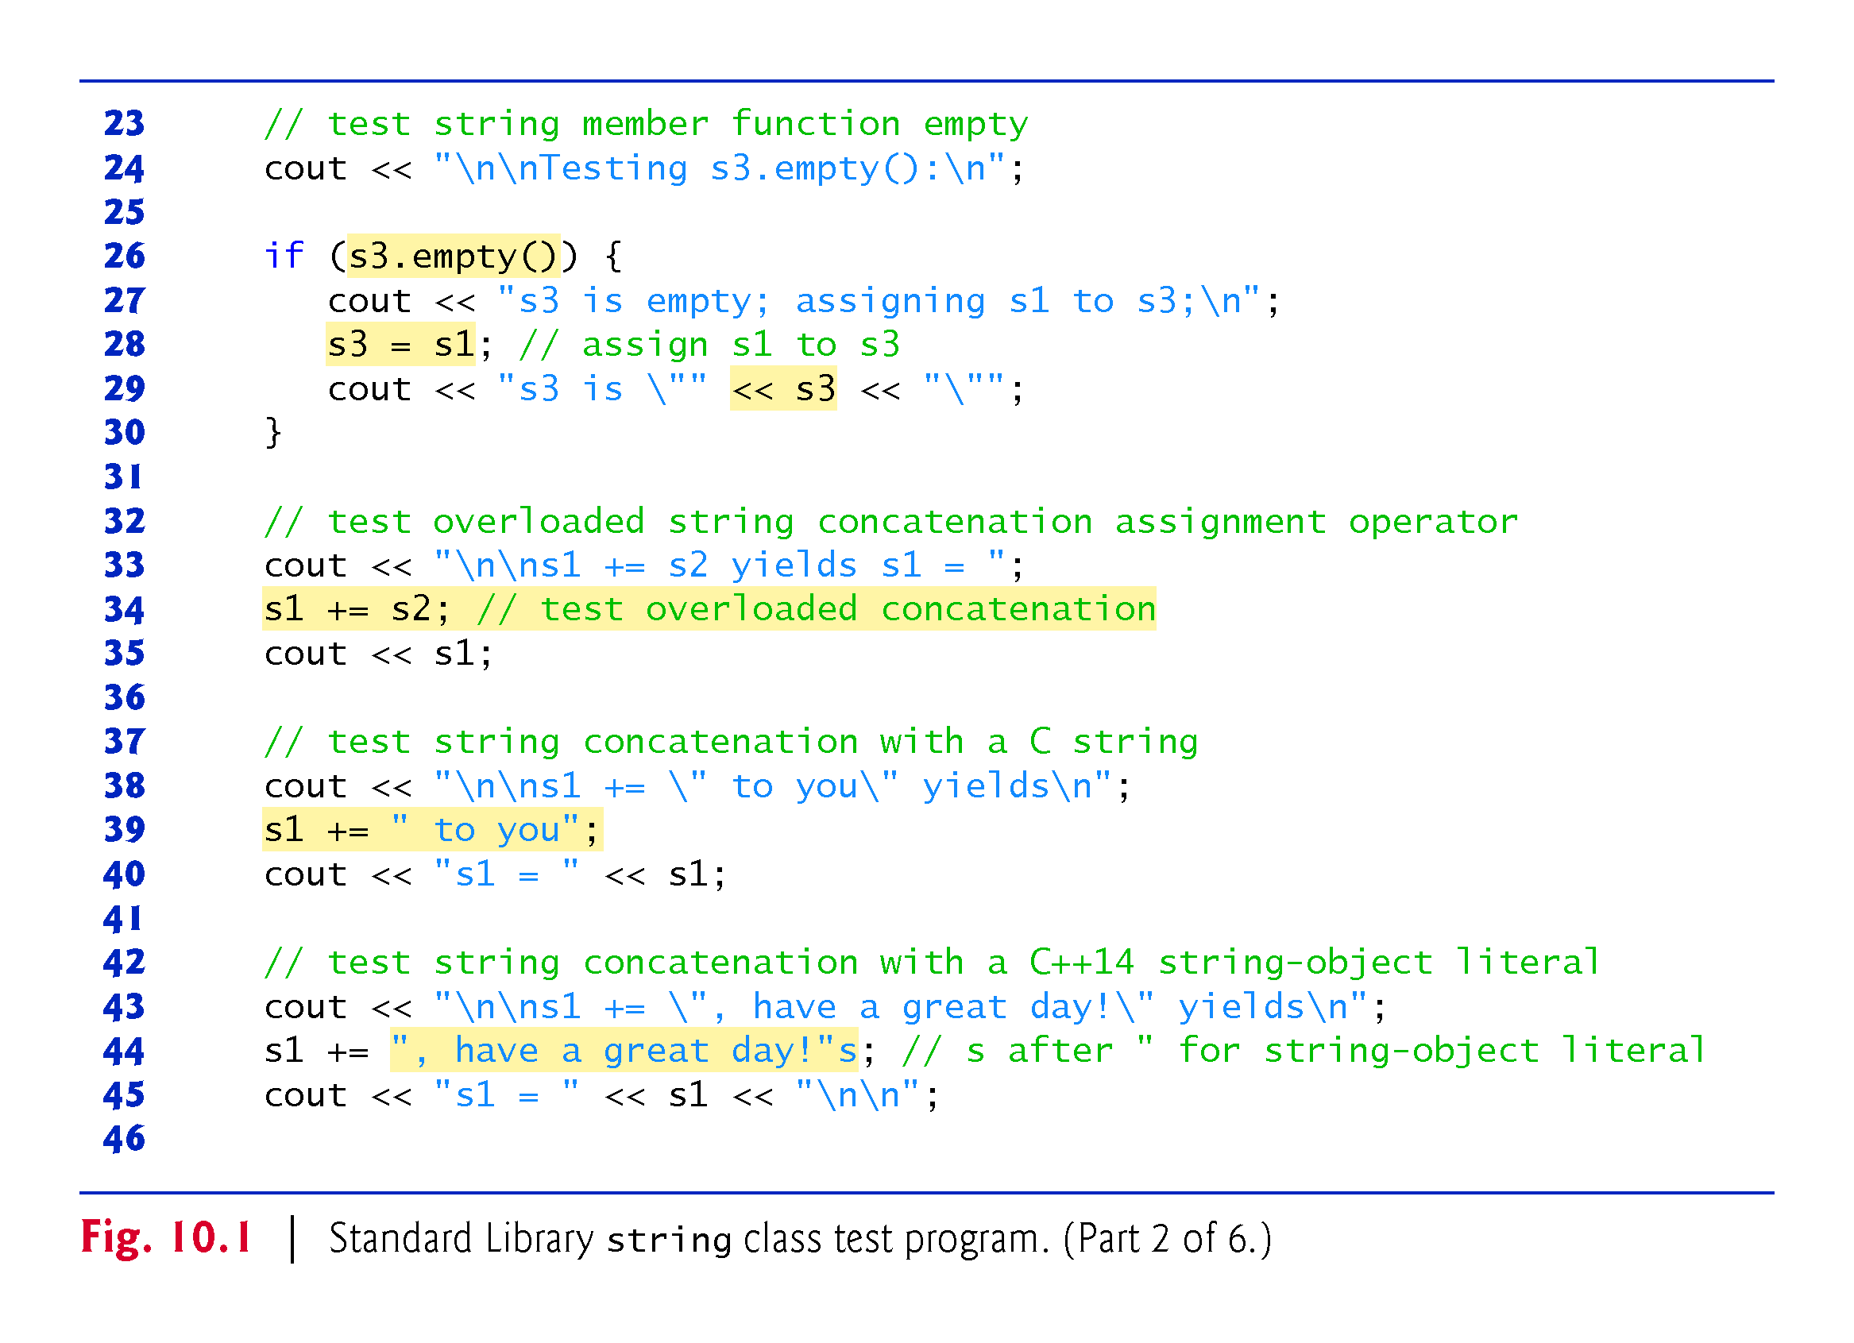

Slide 9
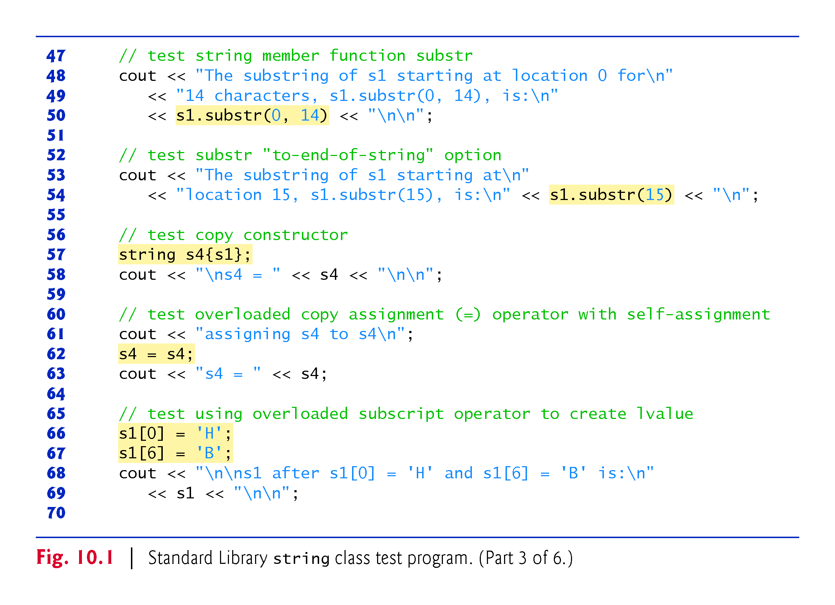

Slide 10
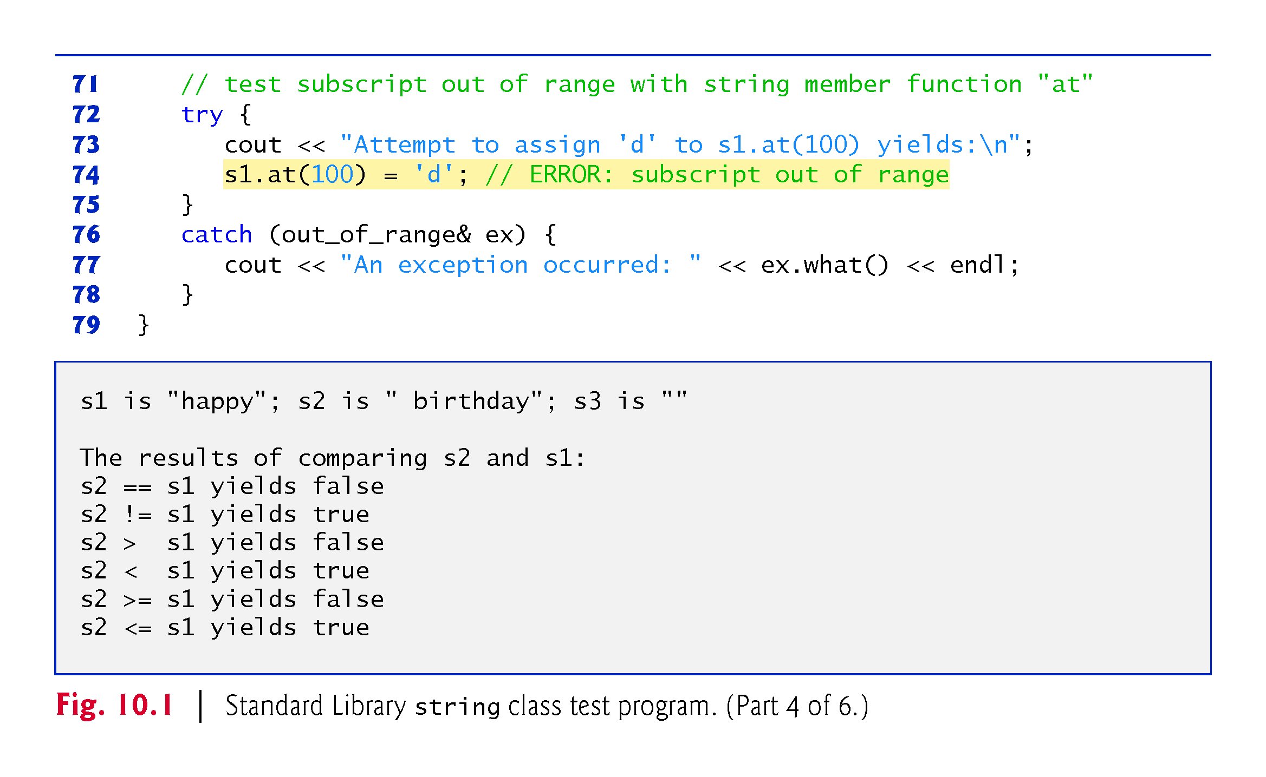

Slide 11
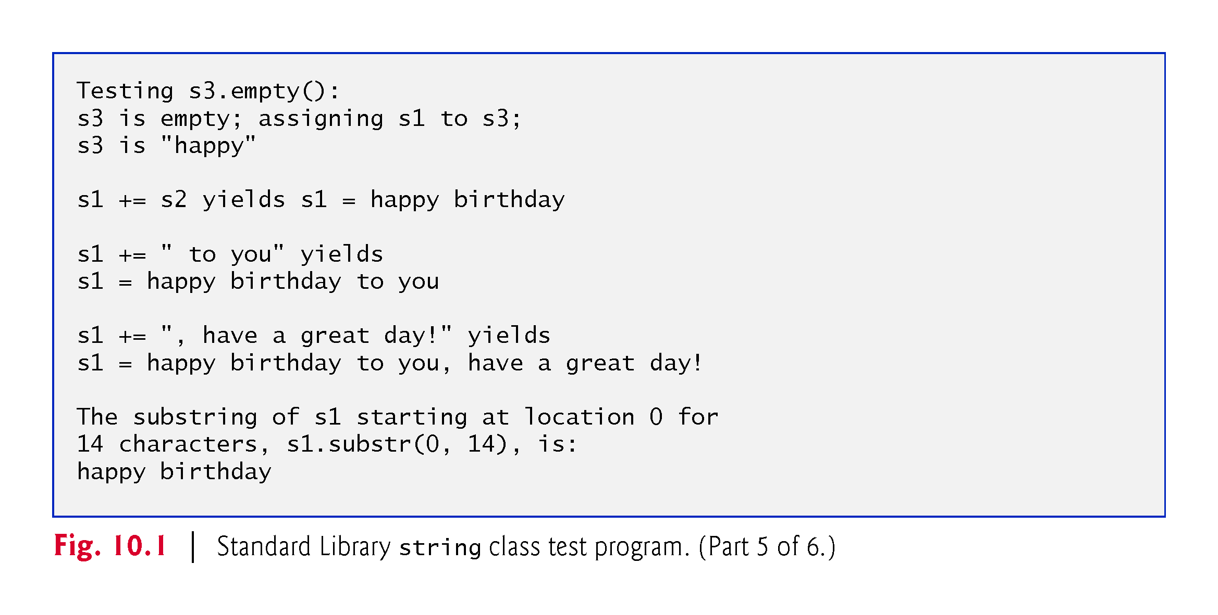

Slide 12
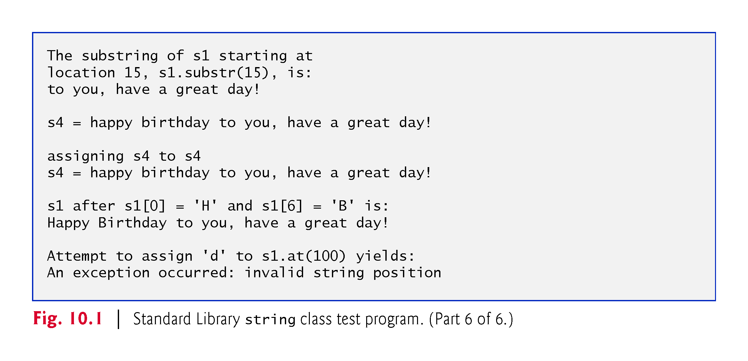

Slide 13
10.2 Using the Overloaded Operators of Standard Library Class string (cont.)
Class string’s overloaded equality and relational operators perform lexicographical comparisons (i.e., like a dictionary ordering) using the numerical values of the characters (see Appendix B, ASCII Character Set) in each string.
Class string provides member function empty to determine whether a string is empty
  Returns true if the string is empty; otherwise, it returns false.
Class string’s overloaded += operator performs string concatenation.
  A string literal can be appended to a string object by using operator +=

Slide 14
10.2 Using the Overloaded Operators of Standard Library Class string (cont.)
Class string provides member function substr to return a portion of a string as a string object.
  The call to substr in line 50 obtains a 14-character substring (specified by the second argument) of s1 starting at position 0 (specified by the first argument).
  The call to substr in line 54 obtains a substring starting from position 15 of s1.
  When the second argument is not specified, substr returns the remainder of the string on which it’s called.
Class string’s overloaded [] operator can create lvalues that enable new characters to replace existing characters in s1.
  Class string’s overloaded [] operator does not perform any bounds checking.

Slide 15
10.2 Using the Overloaded Operators of Standard Library Class string (cont.)
Class string does provide bounds checking in its member function at, which throws an exception if its argument is an invalid subscript.
  If the subscript is valid, function at returns the character at the specified location as a modifiable lvalue or a nonmodifiable lvalue (e.g., a const reference), depending on the context in which the call appears.

Slide 16
10.3 Fundamentals of Operator Overloading
Overloaded operators provide a concise notation for manipulating string objects.
You can use operators with your own user-defined types as well.
Although C++ does not allow new operators to be created, it does allow most existing operators to be overloaded so that, when they’re used with objects, they have meaning appropriate to those objects.

Slide 17
10.3.1 Operator Overloading Is Not Automatic
Operator overloading is not automatic—you must write operator-overloading functions to perform the desired operations.
An operator is overloaded by writing a non-static member function definition or non-member function definition as you normally would, except that the function name starts with the keyword operator followed by the symbol for the operator being overloaded.
  For example, the function name operator+ would be used to overload the addition operator (+) for use with objects of a particular class (or enum).
When operators are overloaded as member functions, they must be non-static, because they must be called on an object of the class and operate on that object.

Slide 18
10.3.2 Operators That You Do Not Have to Overload
To use an operator on class objects, you must define overloaded operator functions for that class—with three exceptions.
  The assignment operator (=) may be used with most classes to perform memberwise assignment of the data members—each data member is assigned from the assignment’s “source” object (on the right) to the “target” object (on the left).
    Memberwise assignment is dangerous for classes with pointer members, so we’ll explicitly overload the assignment operator for such classes.
  The address operator (&) returns a pointer to the object; this operator also can be overloaded.
  The comma operator evaluates the expression to its left then the expression to its right, and returns the value of the latter expression.

Slide 19
10.3.3 Operators That Cannot Be Overloaded
Most of C++’s operators can be overloaded.
Figure 10.2 shows the operators that cannot be overloaded.

Slide 20
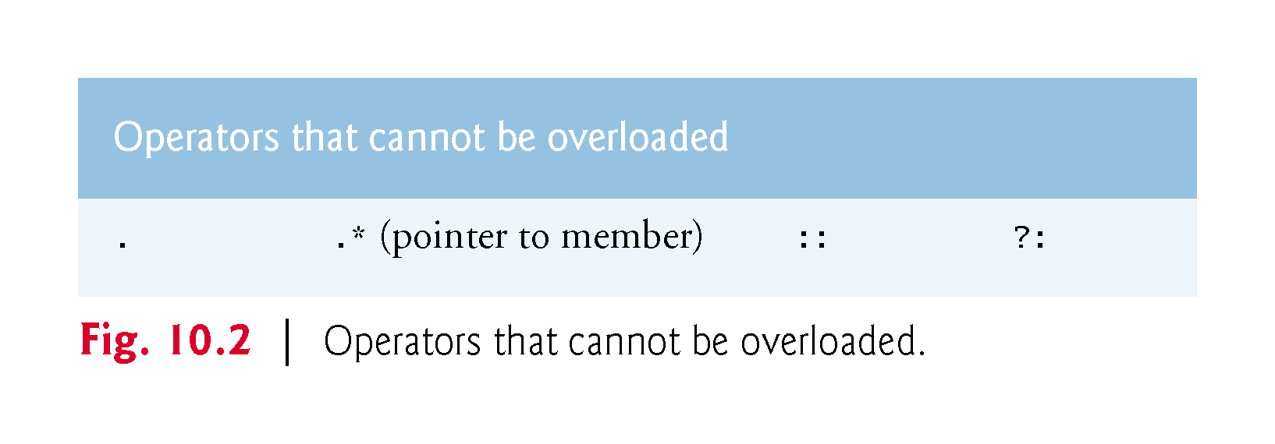

Slide 21
10.3.4 Rules and Restrictions on Operator Overloading
An operator’s precedence cannot be changed by overloading.
  However, parentheses can be used to force the order of evaluation of overloaded operators in an expression.
An operator’s associativity cannot be changed by overloading
  if an operator normally associates from left to right, then so do all of its overloaded versions.
An operator’s “arity” (that is, the number of operands an operator takes) cannot be change
  overloaded unary operators remain unary operators; overloaded binary operators remain binary operators. Operators &, *, + and - all have both unary and binary versions; these unary and binary versions can be separately overloaded.

Slide 22
10.3.4 Rules and Restrictions on Operator Overloading
Only existing operators can be overloaded.
You cannot overload operators how an operator works for fundamental type values
  For example, you cannot make the + operator subtract two ints. Operator overloading works only with objects of user-defined types or with a mixture of an object of a user-defined type and an object of a fundamental type.

Slide 23
10.3.4 Rules and Restrictions on Operator Overloading
Related operators, like + and +=, must be overloaded separately.
When overloading (), [], -> or any of the assignment operators, the operator overloading function must be declared as a class member.
  For all other overloadable operators, the operator overloading functions can be member functions or non-member functions.

Slide 24
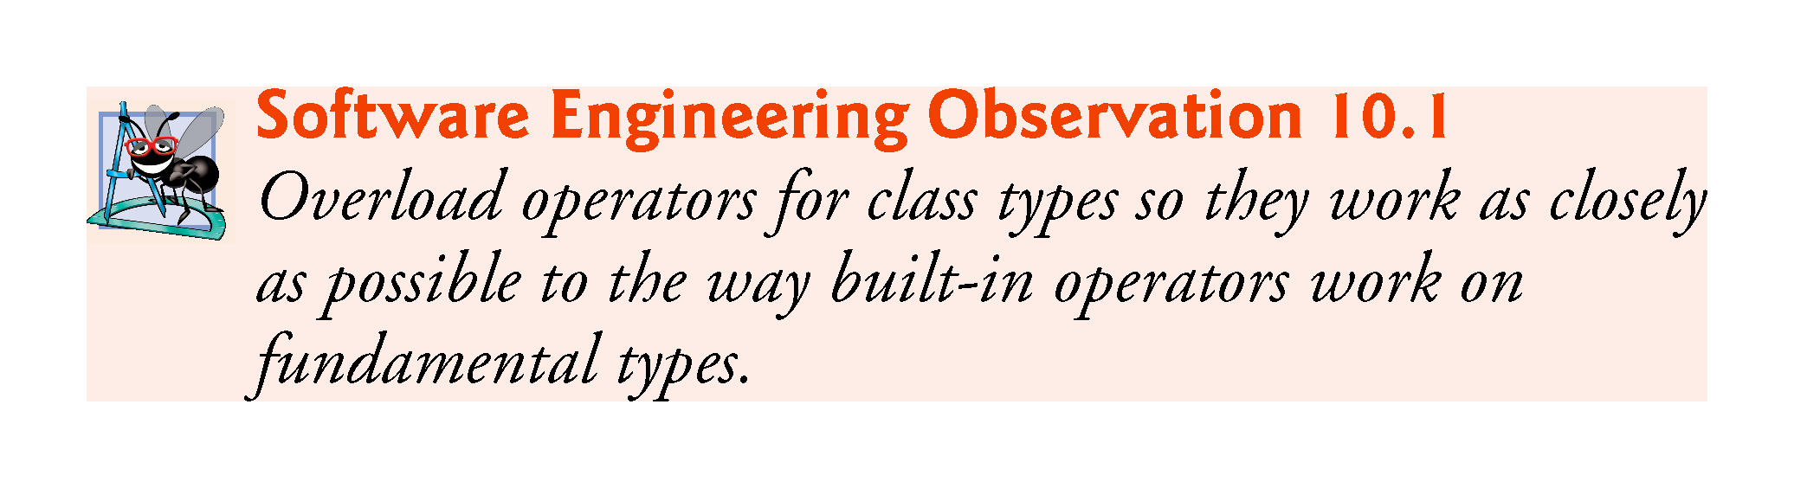

Slide 25
10.4 Overloading Binary Operators
A binary operator can be overloaded as a non-static member function with one parameter or as a non-member function with two parameters (one of those parameters must be either a class object or a reference to a class object).
As a non-member function, binary operator < must take two arguments—one of which must be an object (or a reference to an object) of the class.

Slide 26
10.5 Overloading the Binary Stream Insertion and Stream Extraction Operators
You can input and output fundamental-type data using the stream extraction operator >> and the stream insertion operator <<.
The C++ class libraries overload these binary operators for each fundamental type, including pointers and char * strings.
You can also overload these operators to perform input and output for your own types.
The program of Figs. 10.3–10.5 overloads these operators to input and output PhoneNumber objects in the format “(000) 000-0000.”

Slide 27
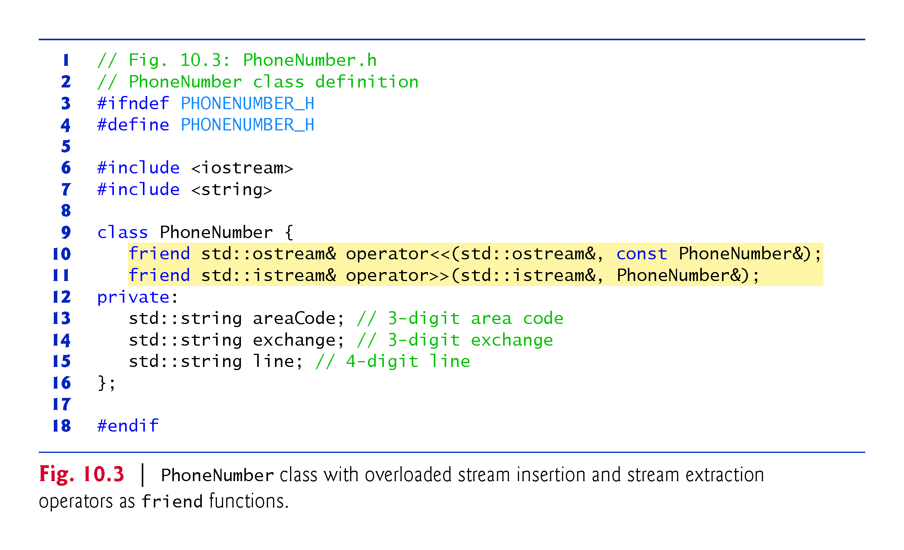

Slide 28
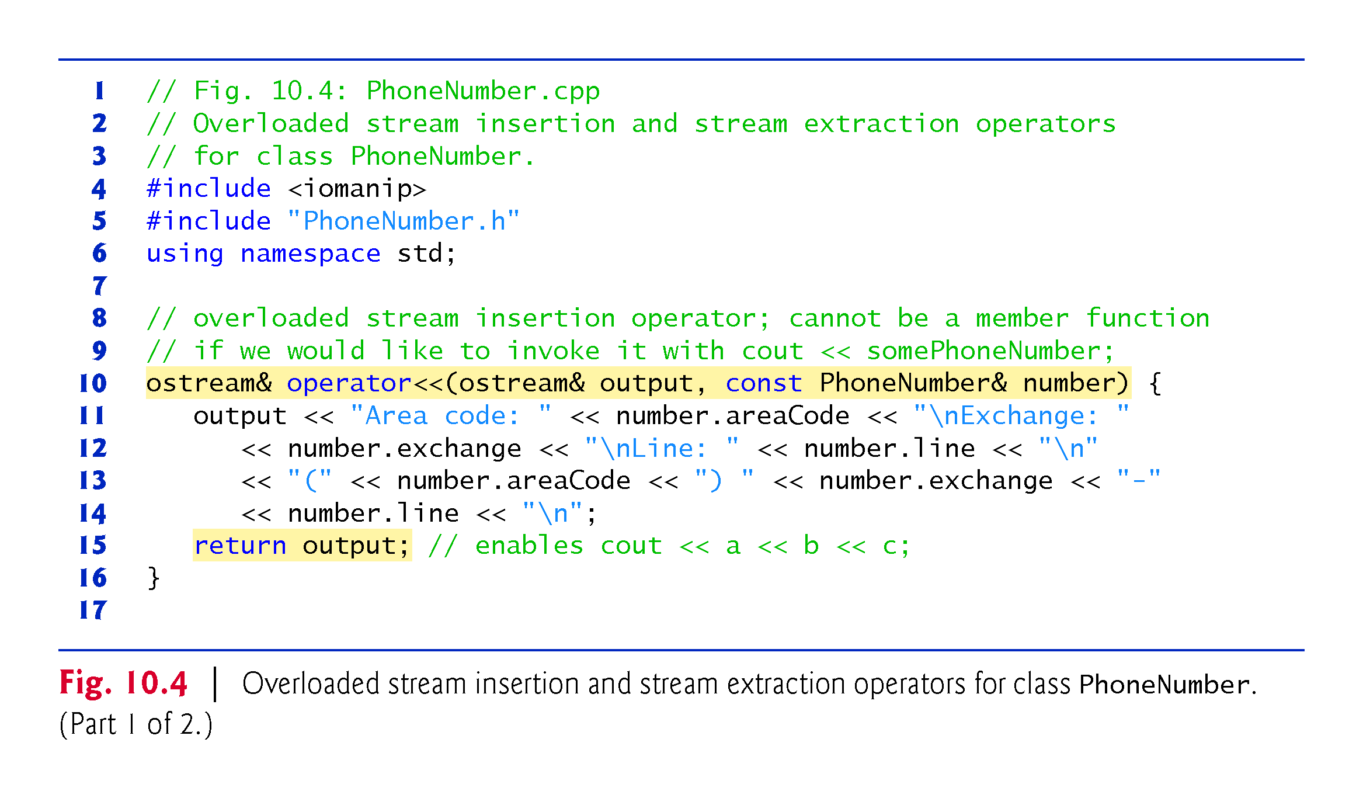

Slide 29
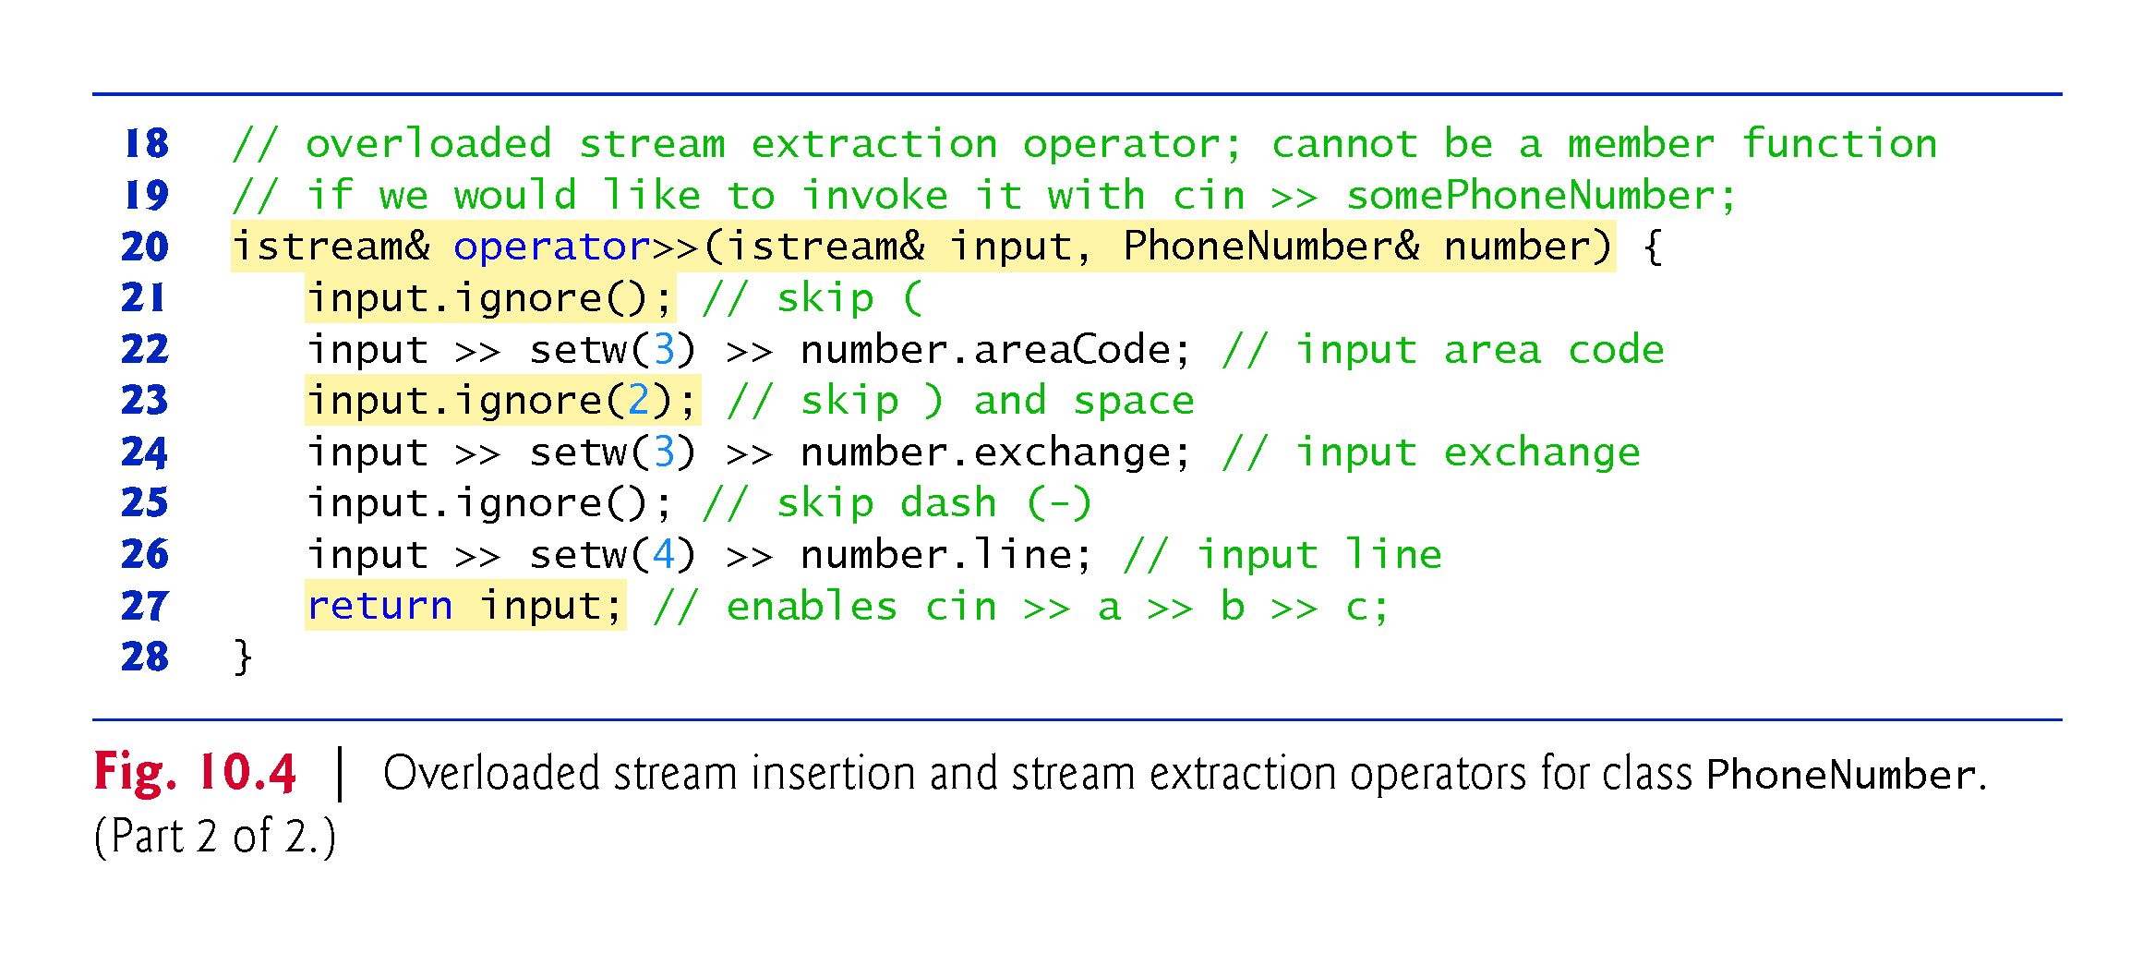

Slide 30
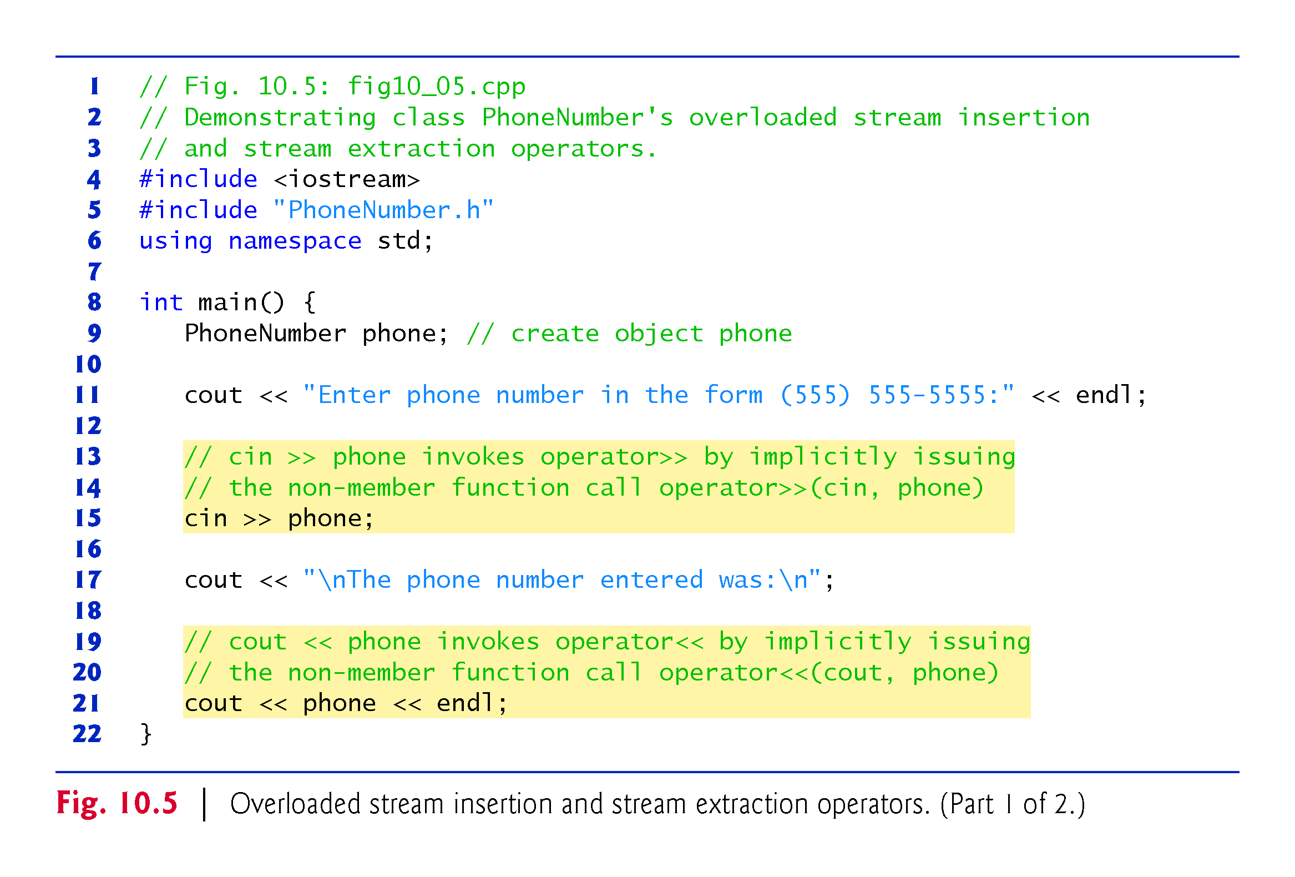

Slide 31
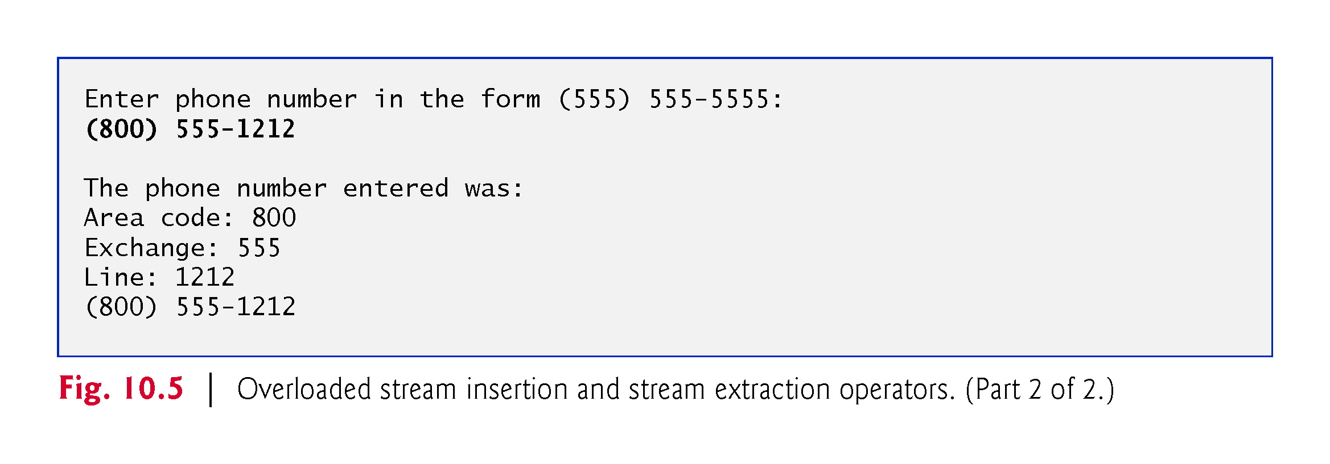

Slide 32
10.5 Overloading the Binary Stream Insertion and Stream Extraction Operators (cont.)
Overloading the Stream Extraction (>>) Operator
The stream extraction operator function operator>> takes istream reference input and PhoneNumber reference number as arguments and returns an istream reference.
Function operator>> inputs phone numbers of the form
    (800) 555-1212
When the compiler sees the expression
    cin >> phone
It generates the non-member function call
    operator>>( cin, phone );
When this executes, reference parameter input becomes an alias for cin and reference parameter number becomes an alias for phone.

Slide 33
10.5 Overloading the Binary Stream Insertion and Stream Extraction Operators (cont.)
Stream manipulator setw limits the number of characters read into each string.
The parentheses, space and dash characters are skipped by calling istream member function ignore, which discards the specified number of characters in the input stream (one character by default).

Slide 34
10.5 Overloading Stream Insertion and Stream Extraction Operators (cont.)
Function operator>> returns istream reference input (i.e., cin).
Enables input operations on PhoneNumber objects to be cascaded with input operations on other PhoneNumber objects or on objects of other data types.

Slide 35
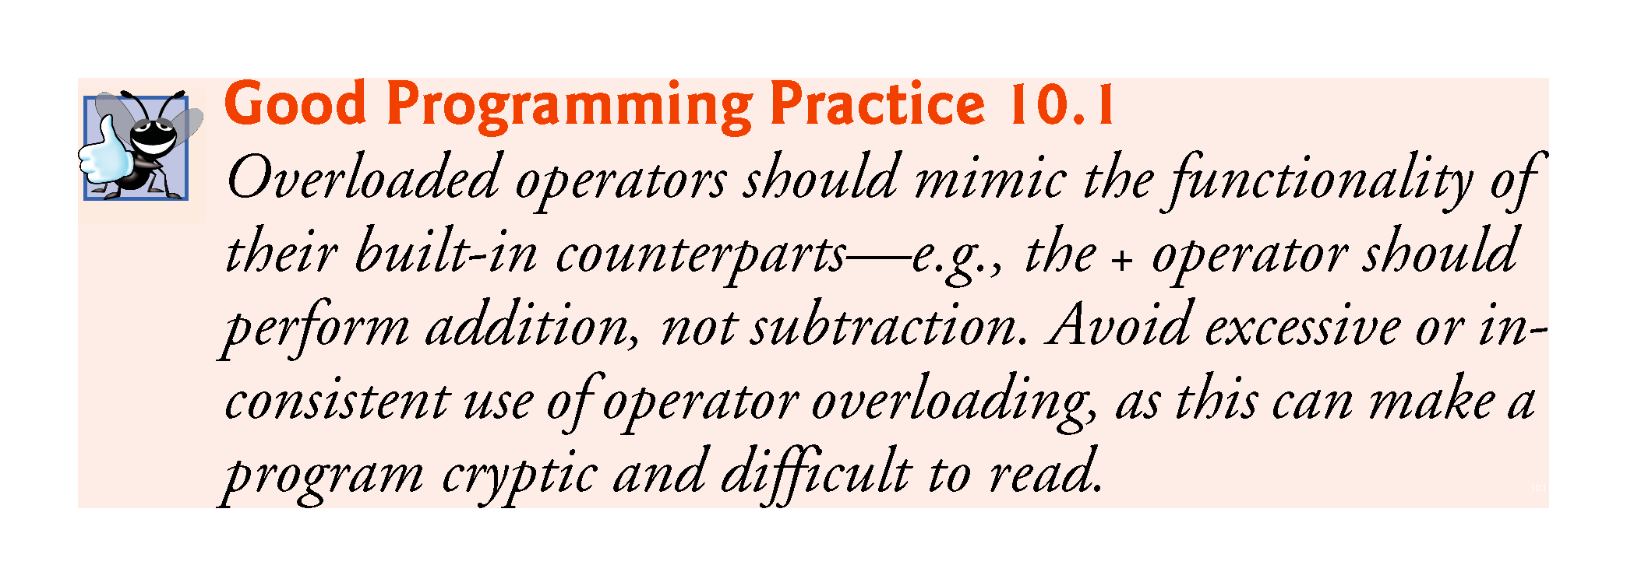

Slide 36
10.5 Overloading Stream Insertion and Stream Extraction Operators (cont.)
Overloading the Stream Insertion (<<) Operator
The stream insertion operator function takes an ostream reference (output) and a const PhoneNumber reference (number) as arguments and returns an ostream reference.
Function operator<< displays objects of type PhoneNumber.
When the compiler sees the expression
    cout << phone
it generates the non-member function call
    operator<<( cout, phone );
Function operator<< displays the parts of the telephone number as strings, because they’re stored as string objects.

Slide 37
10.5 Overloading the Binary Stream Insertion and Stream Extraction Operators (cont.)
Overloaded Operators as Non-Member friend Functions
The functions operator>> and operator<< are declared in PhoneNumber as non-member, friend functions.
They’re non-member functions because the object of class PhoneNumber is the operator’s right operand.

Slide 38
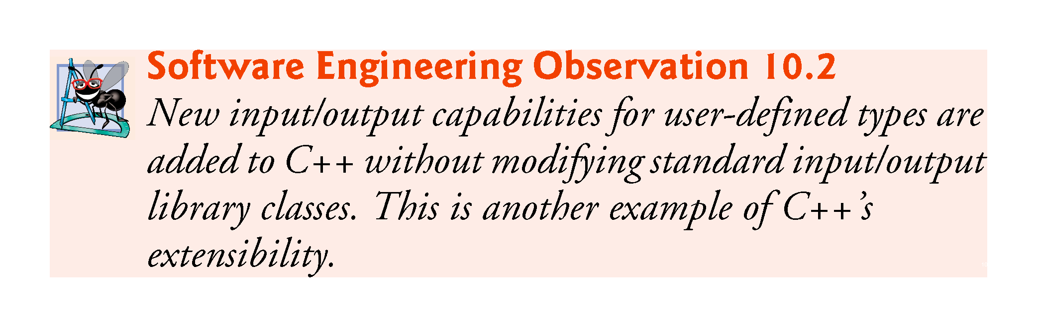

Slide 39
10.5 Overloading the Binary Stream Insertion and Stream Extraction Operators (cont.)
The overloaded stream insertion operator (<<) is used in an expression in which the left operand has type ostream &, as in cout << classObject.
  When the right operand is an object of a user-defined class, it must be overloaded as a non-member function.
Similarly, the overloaded stream extraction operator (>>) must be a non-member function.
Each may require access to the private data members of the class object being output or input, so these overloaded operator functions can be made friend functions of the class for performance reasons.

Slide 40
10.6 Overloading Unary Operators
A unary operator for a class can be overloaded as a non-static member function with no arguments or as a non-member function with one argument that must be an object (or a reference to an object) of the class.
A unary operator such as ! may be overloaded as a non-member function with one parameter.

Slide 41
10.7 Overloading the Increment and Decrement Operators
The prefix and postfix versions of the increment and decrement operators can all be overloaded.
To overload the increment operator to allow both prefix and postfix increment usage, each overloaded operator function must have a distinct signature, so that the compiler will be able to determine which version of ++ is intended.
The prefix versions are overloaded exactly as any other prefix unary operator would be.

Slide 42
10.7 Overloading the Unary Prefix and Postfix ++ and -- Operators (cont.)
When the compiler sees the preincrementing expression ++d1, if the overloaded operator is defined as a member function, the compiler generates the member-function call
    d1.operator++()
The prototype for this operator function would be
    Date &operator++();
If the prefix increment operator is implemented as a non-member function, then the compiler generates the function call
    operator++( d1 )
The prototype for this operator function would be declared in the Date class as
    Date &operator++( Date & );

Slide 43
10.7 Overloading the Unary Prefix and Postfix ++ and -- Operators (cont.)
Overloading the Postfix Increment Operator
Overloading the postfix increment operator presents a challenge, because the compiler must be able to distinguish between the signatures of the overloaded prefix and postfix increment operator functions.
The convention that has been adopted in C++ is that, when the compiler sees the postincrementing expression d1++, it generates the member-function call
    d1.operator++(0)
The prototype for this function is
    Date operator++(int)
The argument 0 is strictly a “dummy value” that enables the compiler to distinguish between the prefix and postfix increment operator functions.
The same syntax is used to differentiate between the prefix and postfix decrement operator functions.

Slide 44
10.7 Overloading the Unary Prefix and Postfix ++ and -- Operators (cont.)
If the postfix increment is implemented as a non-member function, then, when the compiler sees the expression d1++, the compiler generates the function call
    operator++(d1, 0)
The prototype for this function would be
    Date operator++(Date &, int);
The 0 argument is used by the compiler to distinguish between the prefix and postfix increment operator non-member functions.
The postfix increment operator returns Date objects by value, whereas the prefix increment operator returns Date objects by reference—the postfix increment operator typically returns a temporary object that contains the original value of the object before the increment occurred.

Slide 45
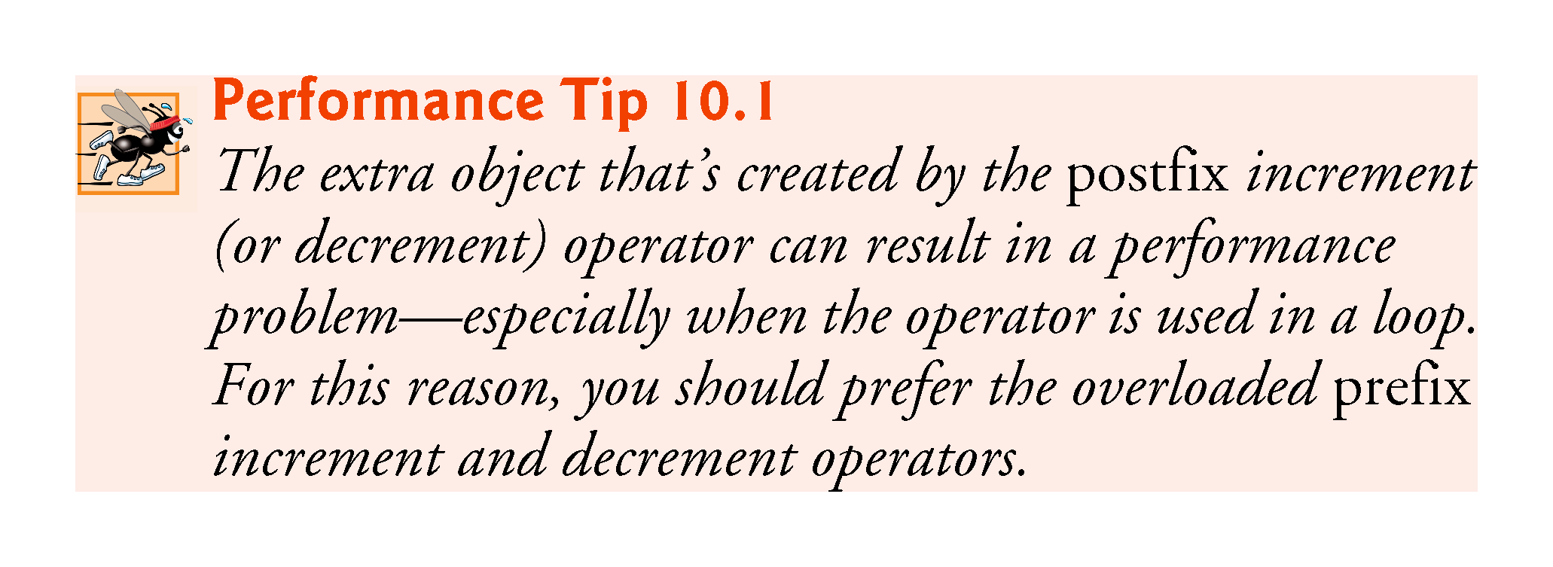

Slide 46
10.8 Case Study: A Date Class
The program of Figs. 10.6–10.8 demonstrates a Date class, which uses overloaded prefix and postfix increment operators to add 1 to the day in a Date object, while causing appropriate increments to the month and year if necessary.

Slide 47
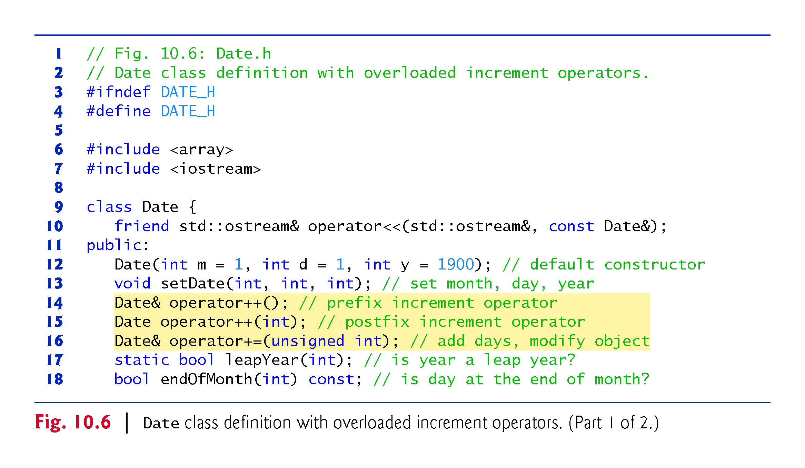

Slide 48
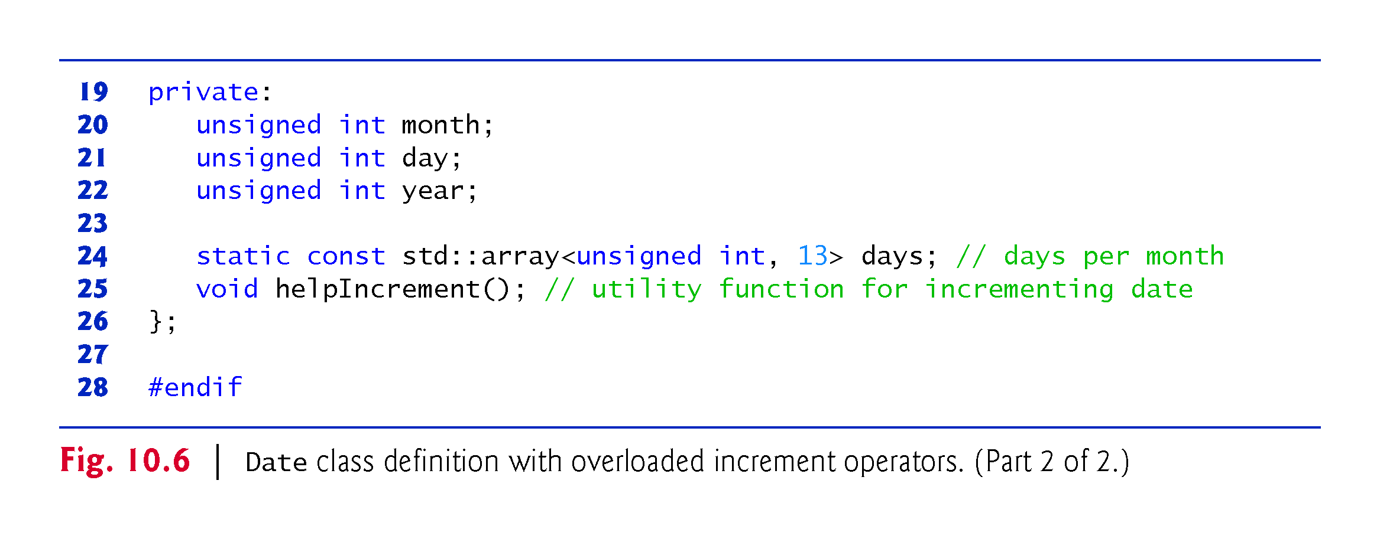

Slide 49
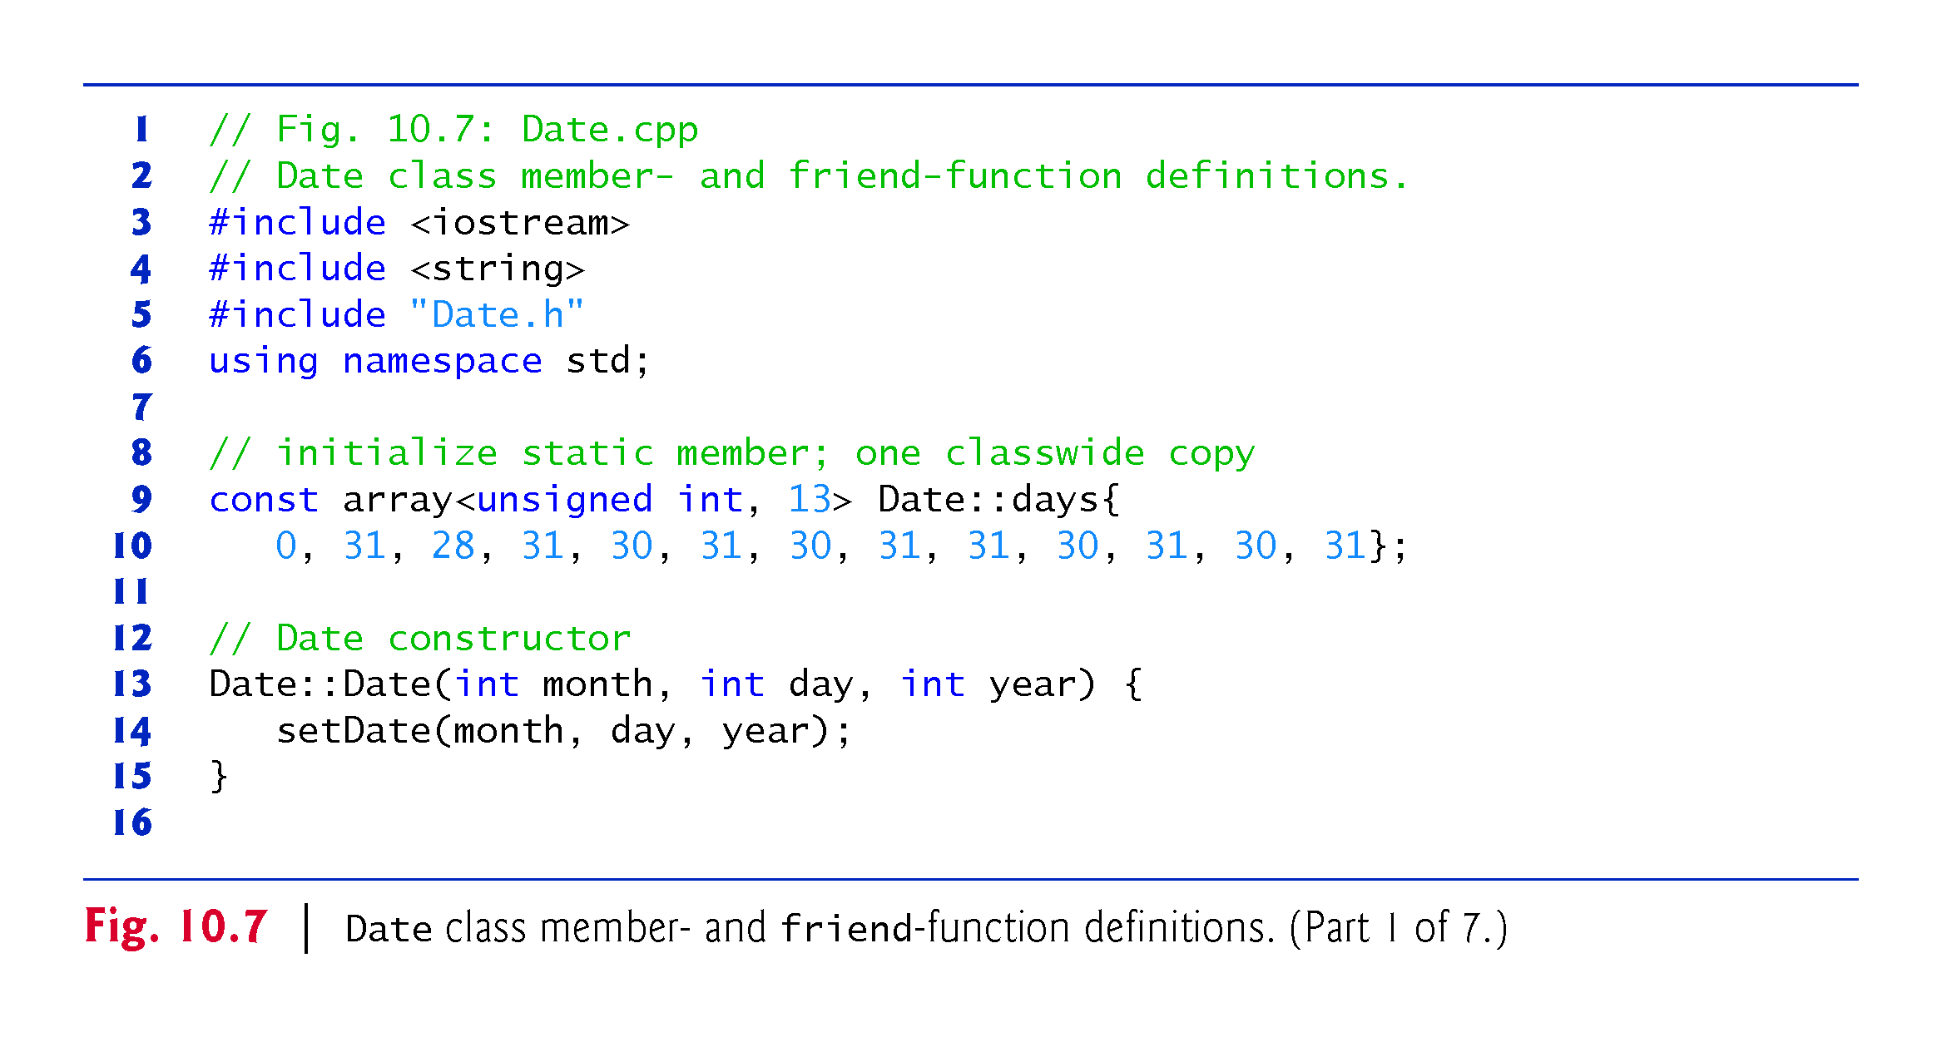

Slide 50
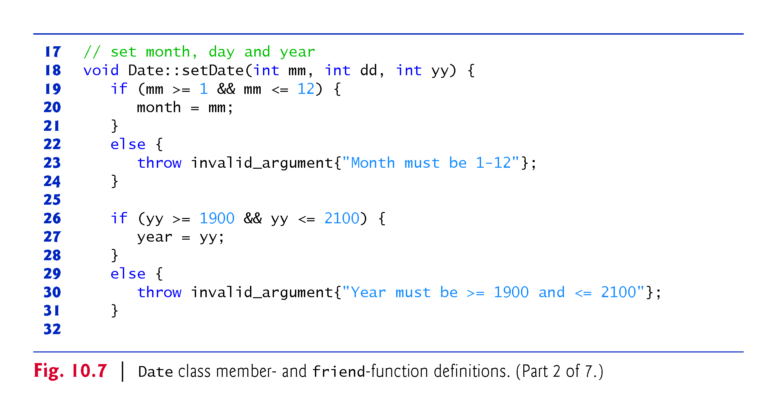

Slide 51
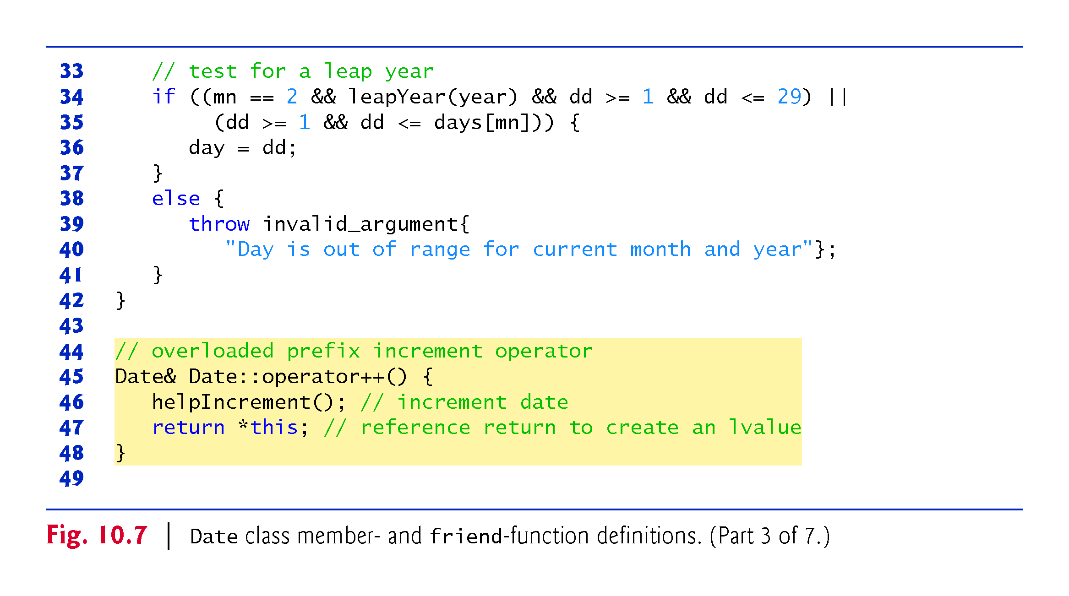

Slide 52
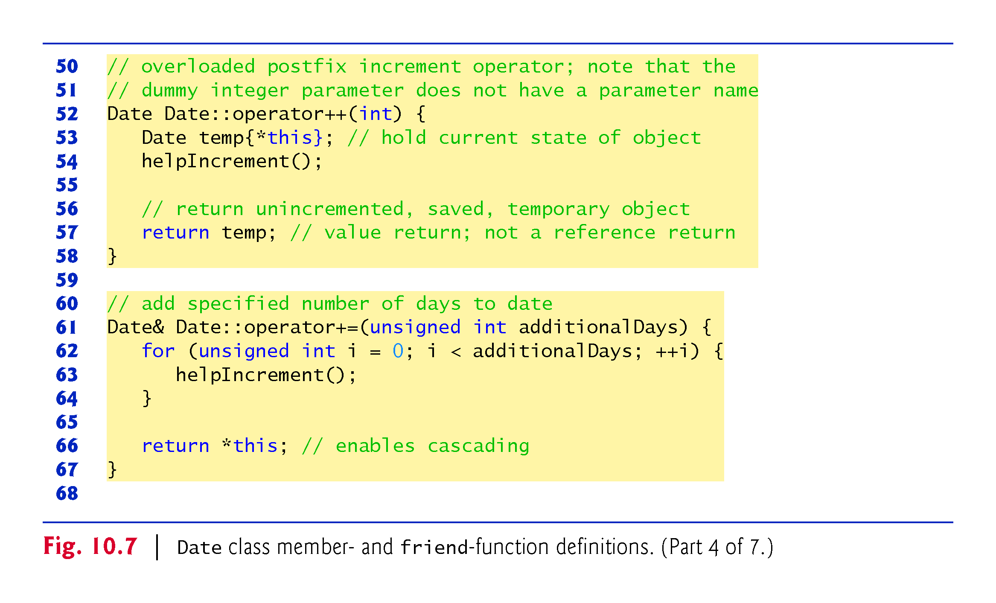

Slide 53
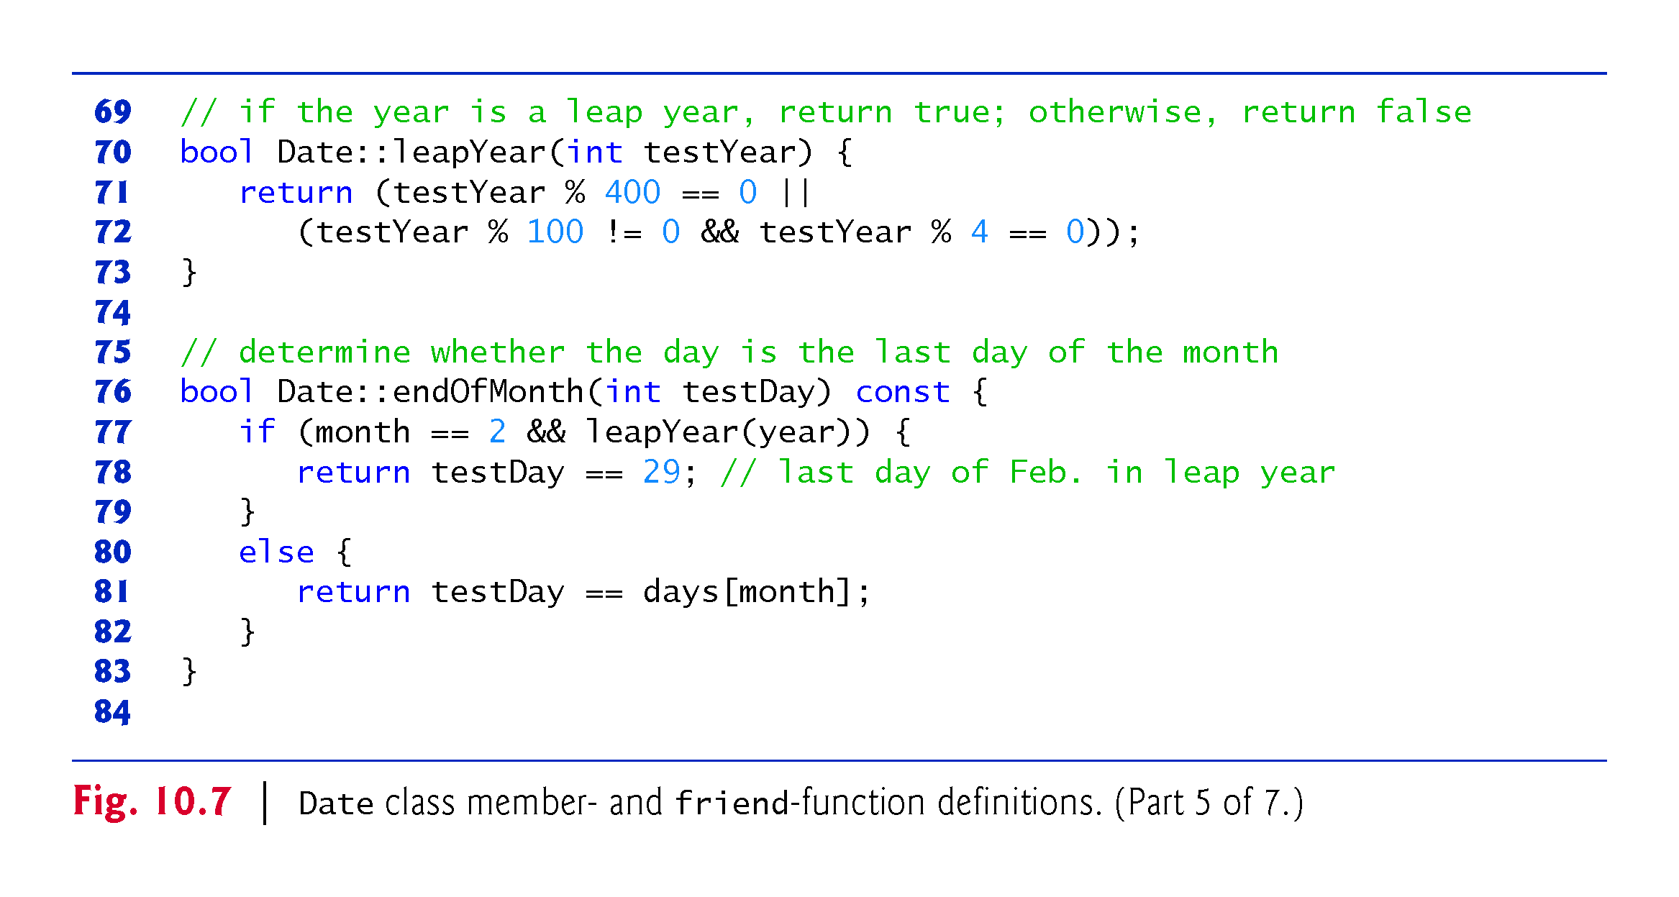

Slide 54
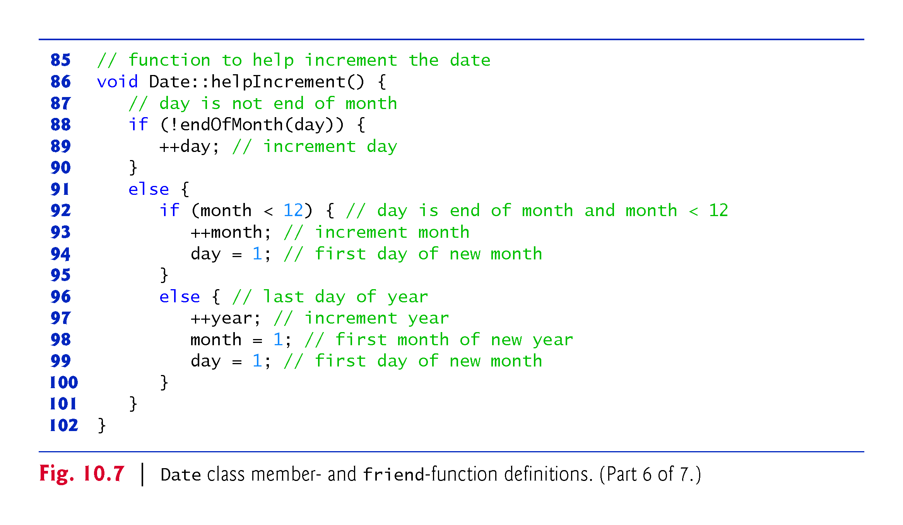

Slide 55
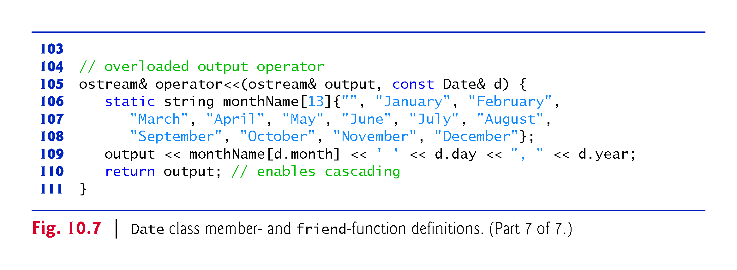

Slide 56
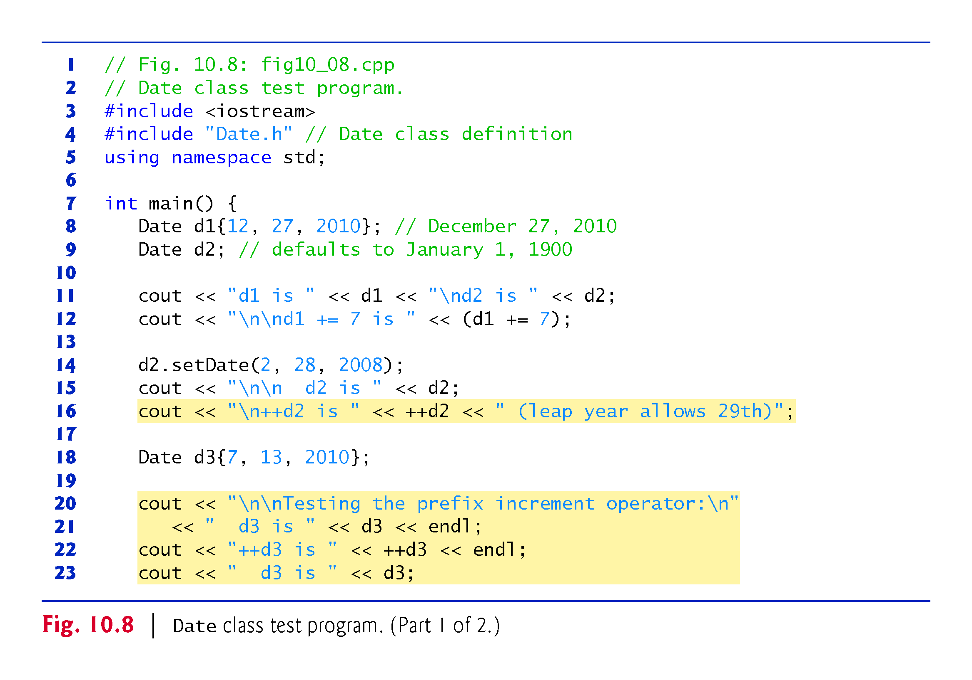

Slide 57
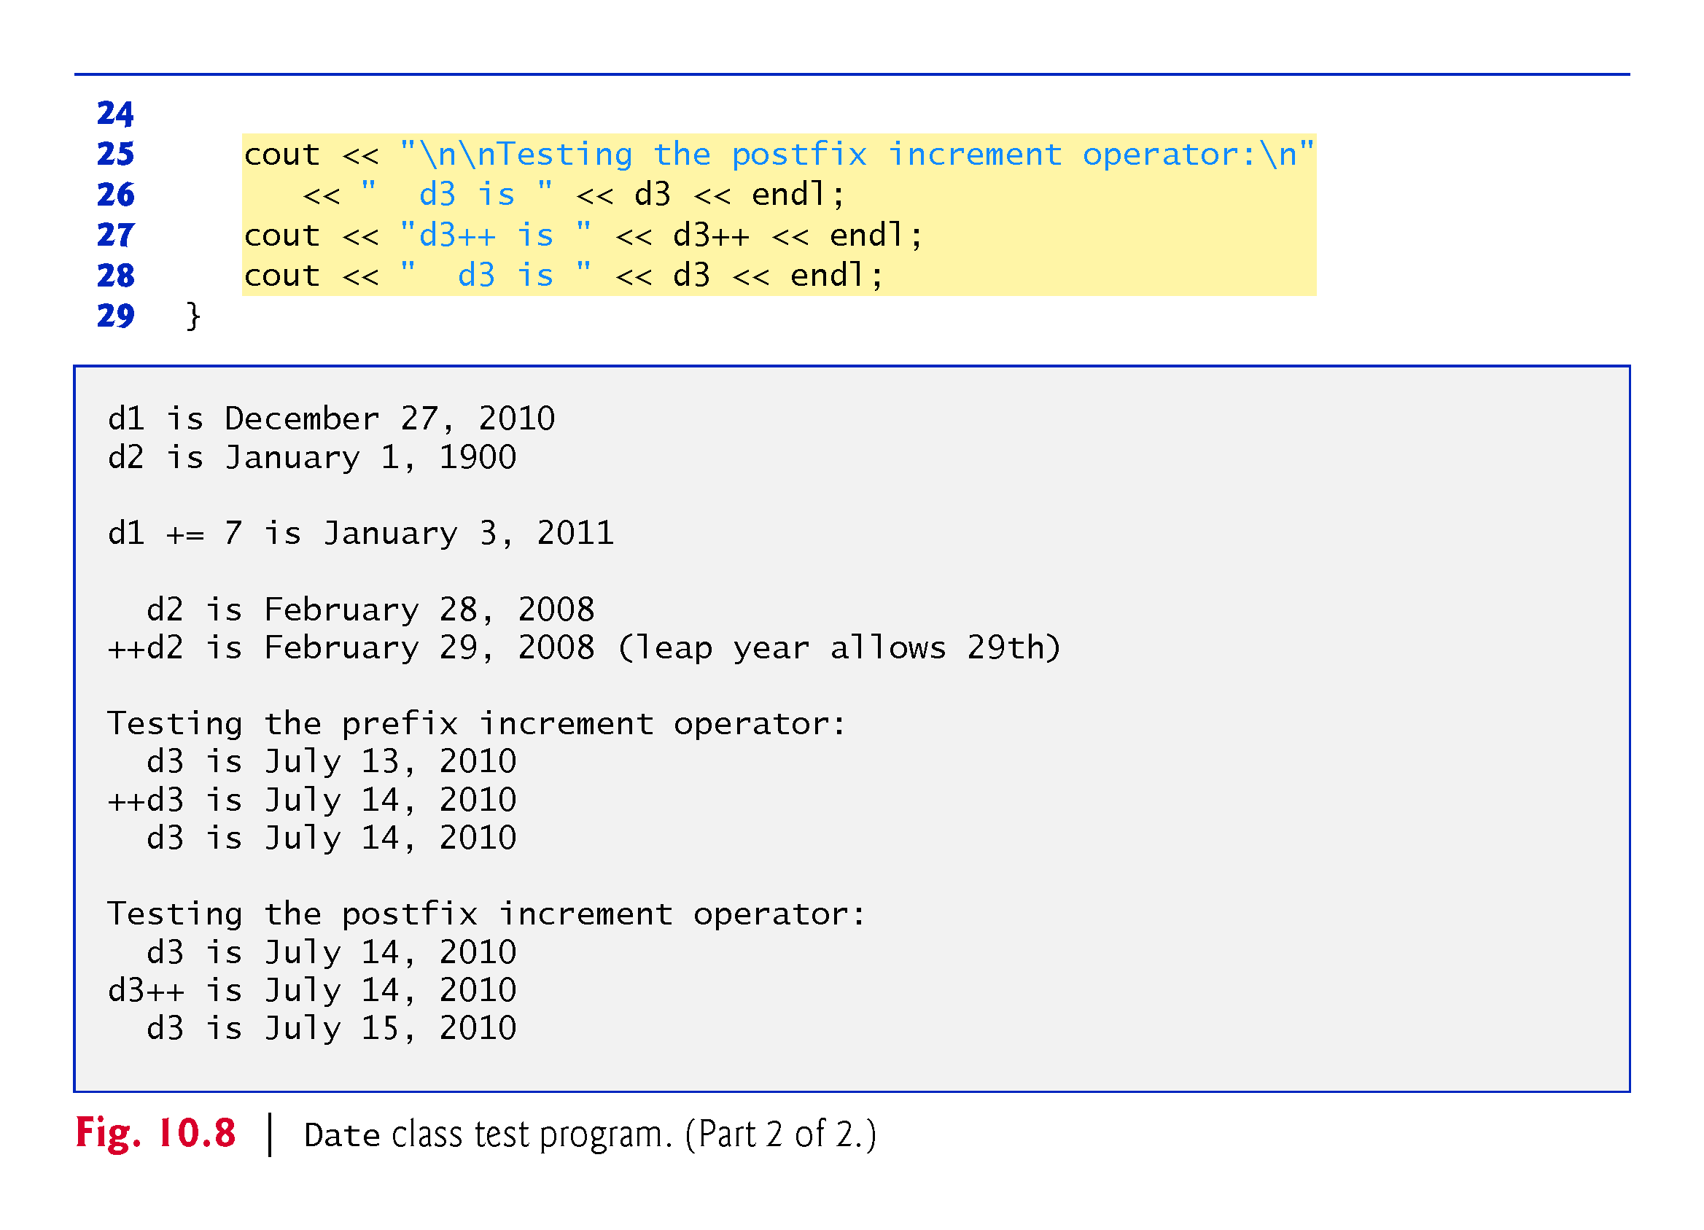

Slide 58
10.8 Case Study: A Date Class (cont.)
The Date constructor calls setDate to validate the month, day and year specified.
  Invalid values for the month, day or year result in invalid_argument exceptions.

Slide 59
10.8 Case Study: A Date Class (cont.)
Date Class Prefix Increment Operator
Overloading the prefix increment operator is straightforward.
  The prefix increment operator calls utility function helpIncrement to increment the date.
  This function deals with “wraparounds” or “carries” that occur when we increment the last day of the month.
  These carries require incrementing the month.
  If the month is already 12, then the year must also be incremented and the month must be set to 1.
  Function helpIncrement uses function endOfMonth to determine whether the end of a month has been reached and increment the day correctly.

Slide 60
10.8 Case Study: A Date Class (cont.)
The overloaded prefix increment operator returns a reference to the current Date object (i.e., the one that was just incremented).
This occurs because the current object, *this, is returned as a Date &.
  Enables a preincremented Date object to be used as an lvalue, which is how the built-in prefix increment operator works for fundamental types.

Slide 61
10.8 Case Study: A Date Class (cont.)
Date Class Postfix Increment Operator
Overloading the postfix increment operator is trickier.
To emulate the effect of the postincrement, we must return an unincremented copy of the Date object—we’d like our postfix increment operator to operate the same way on a Date object.
On entry to operator++, we save the current object (*this) in temp.
Next, we call helpIncrement to increment the current Date object then return the unincremented copy of the object previously stored in temp.
This function cannot return a reference to the local Date object temp, because a local variable is destroyed when the function in which it’s declared exits.

Slide 62
10.9 Dynamic Memory Management
You can control memory allocation and deallocation in a program for objects and for arrays of any built-in or user-defined type.
  Known as dynamic memory management; performed with new and delete.
Use the new operator to dynamically allocate (i.e., reserve) the exact amount of memory required to hold an object or built-in array at execution time.
The object or built-in array is created in the free store (also called the heap)—a region of memory assigned to each program for storing dynamically allocated objects.
Once memory is allocated, you can access it via the pointer that operator new returns.
Return memory by using the delete operator to deallocate it.

Slide 63
10.9 Dynamic Memory Management (cont.)
Obtaining Dynamic Memory with new
The new operator allocates storage of the proper size for an object of type Time, calls the default constructor to initialize the object and returns a pointer to the type specified to the right of the new operator (i.e., a Time *).
If new is unable to find sufficient space in memory for the object, it indicates that an error occurred by “throwing an exception.”

Slide 64
10.9 Dynamic Memory Management (cont.)
Releasing Dynamic Memory with delete
To destroy a dynamically allocated object, use the delete operator as follows:
    delete ptr;
This statement first calls the destructor for the object to which ptr points, then deallocates the memory associated with the object, returning the memory to the free store.

Slide 65
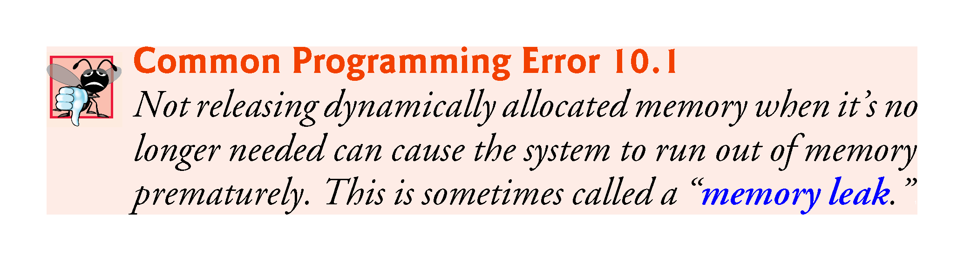

Slide 66


Slide 67
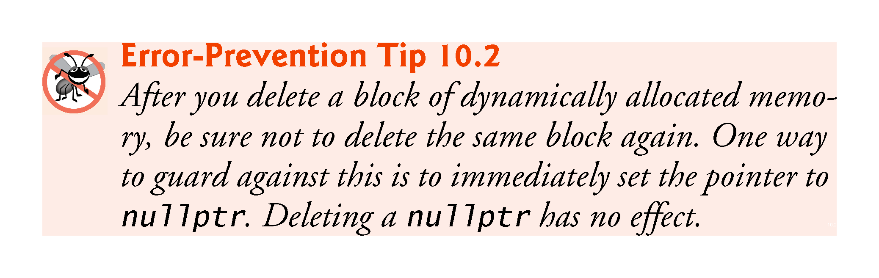

Slide 68
10.9 Dynamic Memory Management (cont.)
Initializing Dynamic Memory
You can provide an initializer for a newly created fundamental-type variable, as in
    double *ptr{new double{3.14159}};
The same syntax can be used to specify a comma-separated list of arguments to the constructor of an object.

Slide 69
10.9 Dynamic Memory Management (cont.)
Dynamically Allocating Built-In Arrays with new []
You can also use the new operator to allocate built-in arrays dynamically.
For example, a 10-element integer array can be allocated and assigned to gradesArray as follows:
    int *gradesArray{new int[10]{}};
The {} following new int[10] value initialize the array’s elements—fundamental numeric types are set to 0, bools are set to false, pointers are set to nullptr and class objects are initialized by their default constructors.
A dynamically allocated array’s size can be specified using any non-negative integral expression that can be evaluated at execution time.

Slide 70
10.9 Dynamic Memory Management (cont.)
Releasing Dynamically Allocated Built-In Arrays with delete []
To deallocate a dynamically allocated array, use the statement
    delete [] ptr;
If the pointer points to a built-in array of objects, the statement first calls the destructor for every object in the array, then deallocates the memory.
Using delete or [] on a nullptr has no effect.

Slide 71
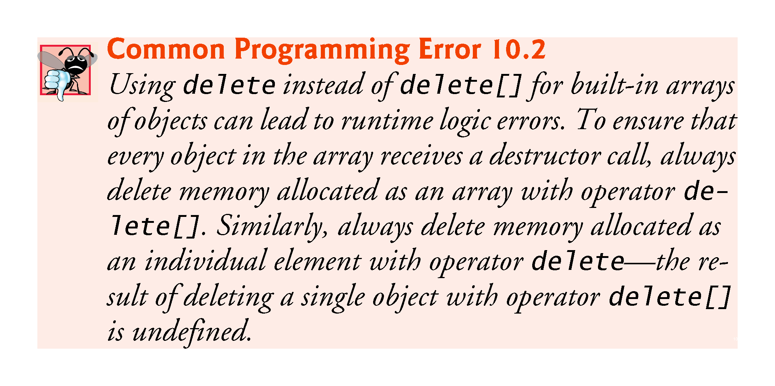

Slide 72
10.9 Dynamic Memory Management (cont.)
C++11: Managing Dynamically Allocated Memory with unique_ptr
C++11’s new unique_ptr is a “smart pointer” for managing dynamically allocated memory.
When a unique_ptr goes out of scope, its destructor automatically returns the managed memory to the free store.

Slide 73
10.10 Case Study: Array Class
Pointer-based arrays have many problems, including:
  A program can easily “walk off” either end of a built-in array, because C++ does not check whether subscripts fall outside the range of the array.
  Built-in arrays of size n must number their elements 0, …, n – 1; alternate subscript ranges- are not allowed.
  An entire built-in array cannot be input or output at once.
  Two built-in arrays cannot be meaningfully compared with equality or relational operators.
  When an array is passed to a general-purpose function designed to handle arrays of any size, the array’s size must be passed as an additional argument.
  One built-in array cannot be assigned to another with the assignment operator.

Slide 74
10.10 Case Study: Array Class (cont.)
With C++, you can implement more robust array capabilities via classes and operator overloading as has been done with class templates array and vector in the C++ Standard Library.
In this section, we’ll develop our own custom array class that’s preferable to built-in arrays.
In this example, we create a powerful Array class:
  Performs range checking.
  Allows one Array object to be assigned to another with the assignment operator.
  Objects know their own size.
  Input or output entire arrays with the stream extraction and stream insertion operators, respectively.
  Can compare Arrays with the equality operators == and !=.
C++ Standard Library class template vector provides many of these capabilities as well.

Slide 75
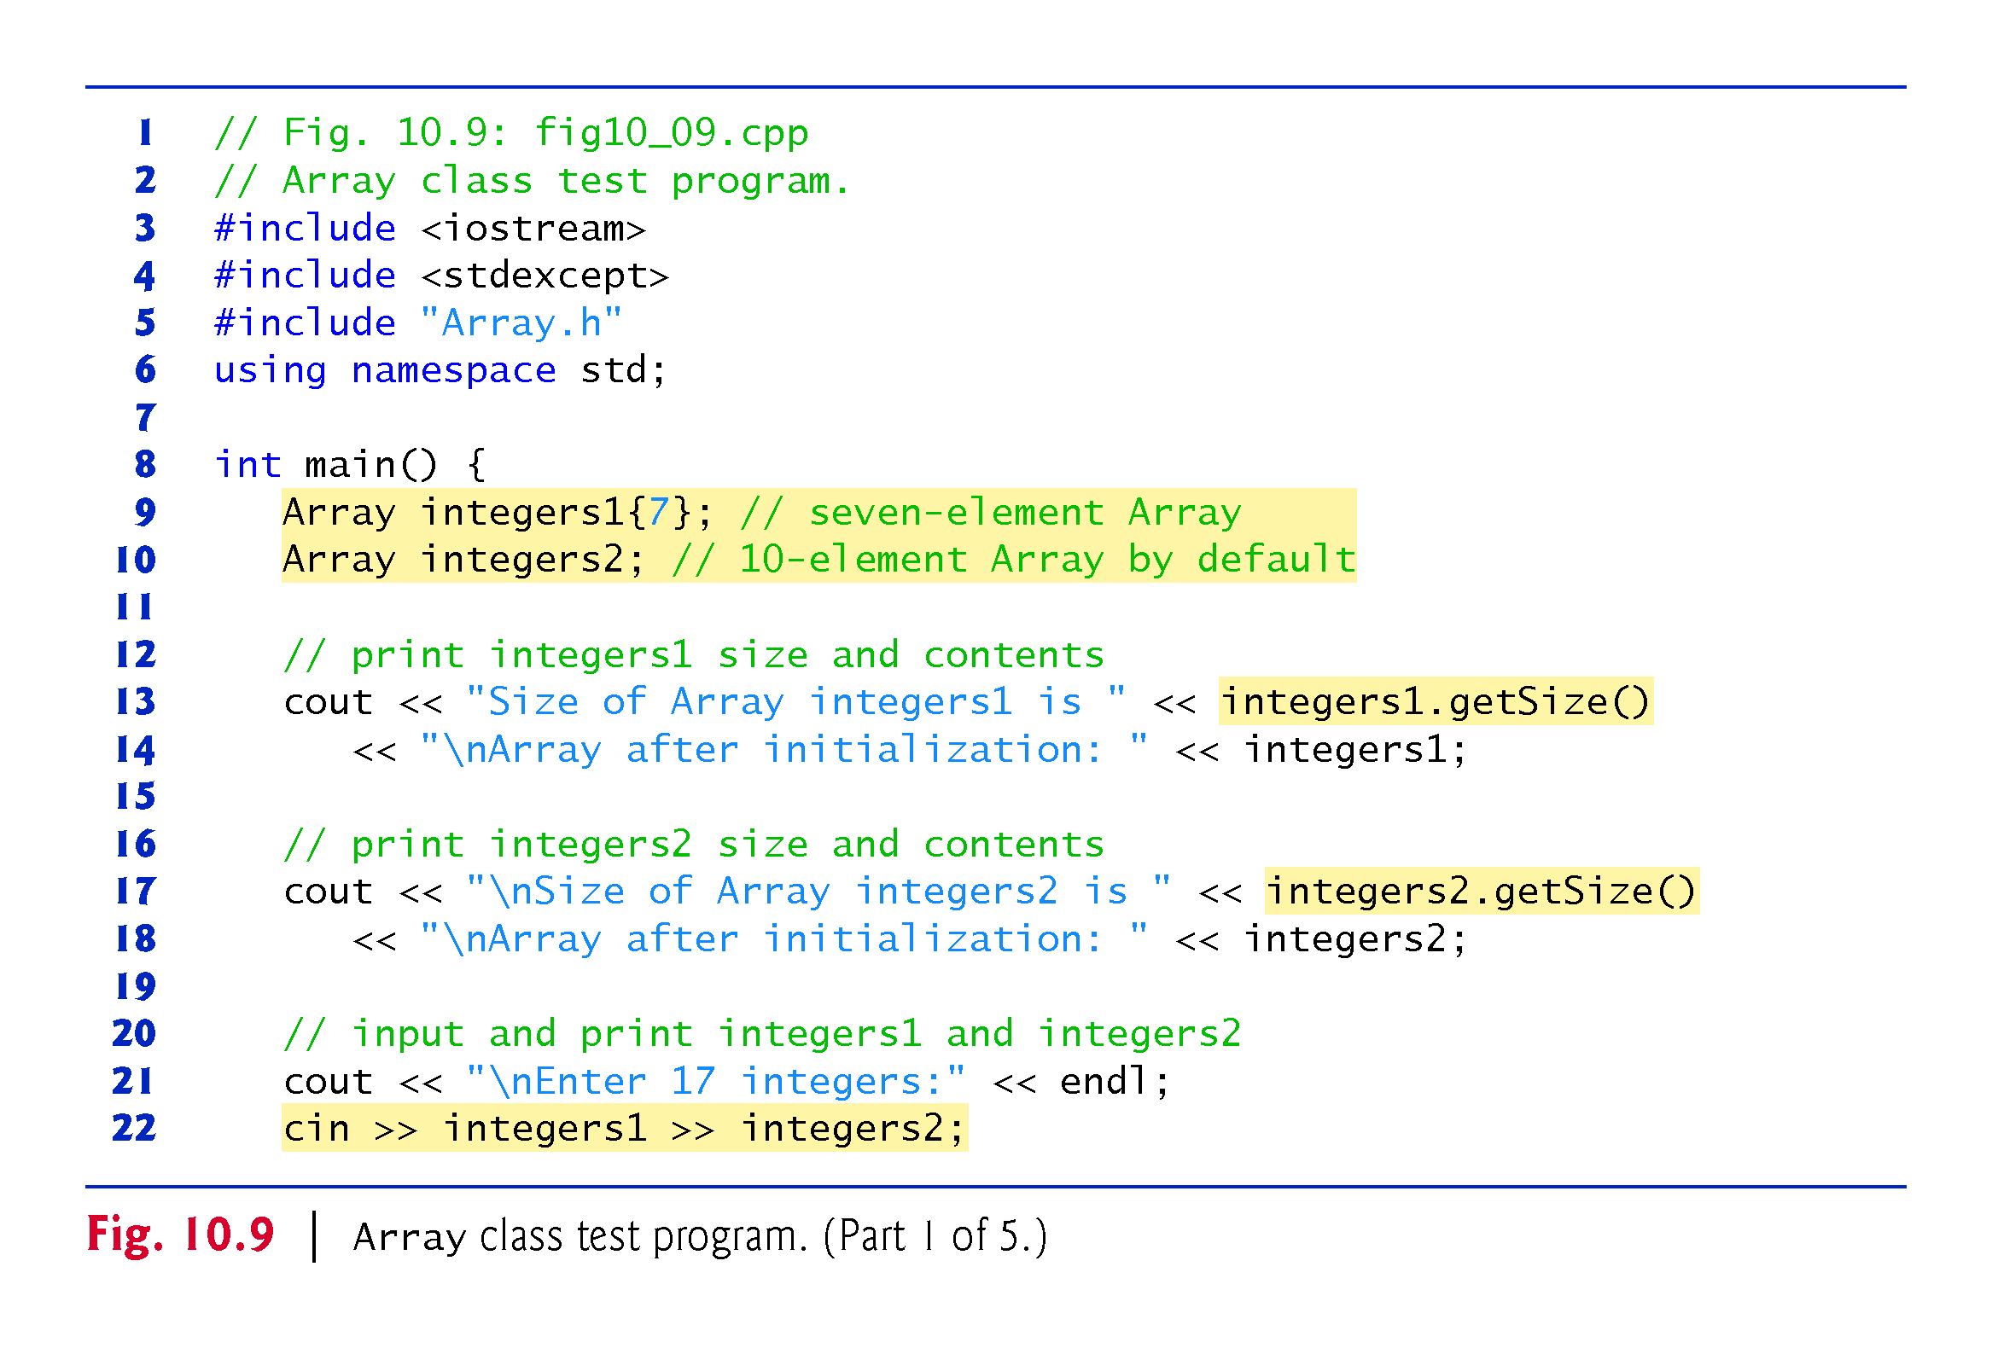

Slide 76
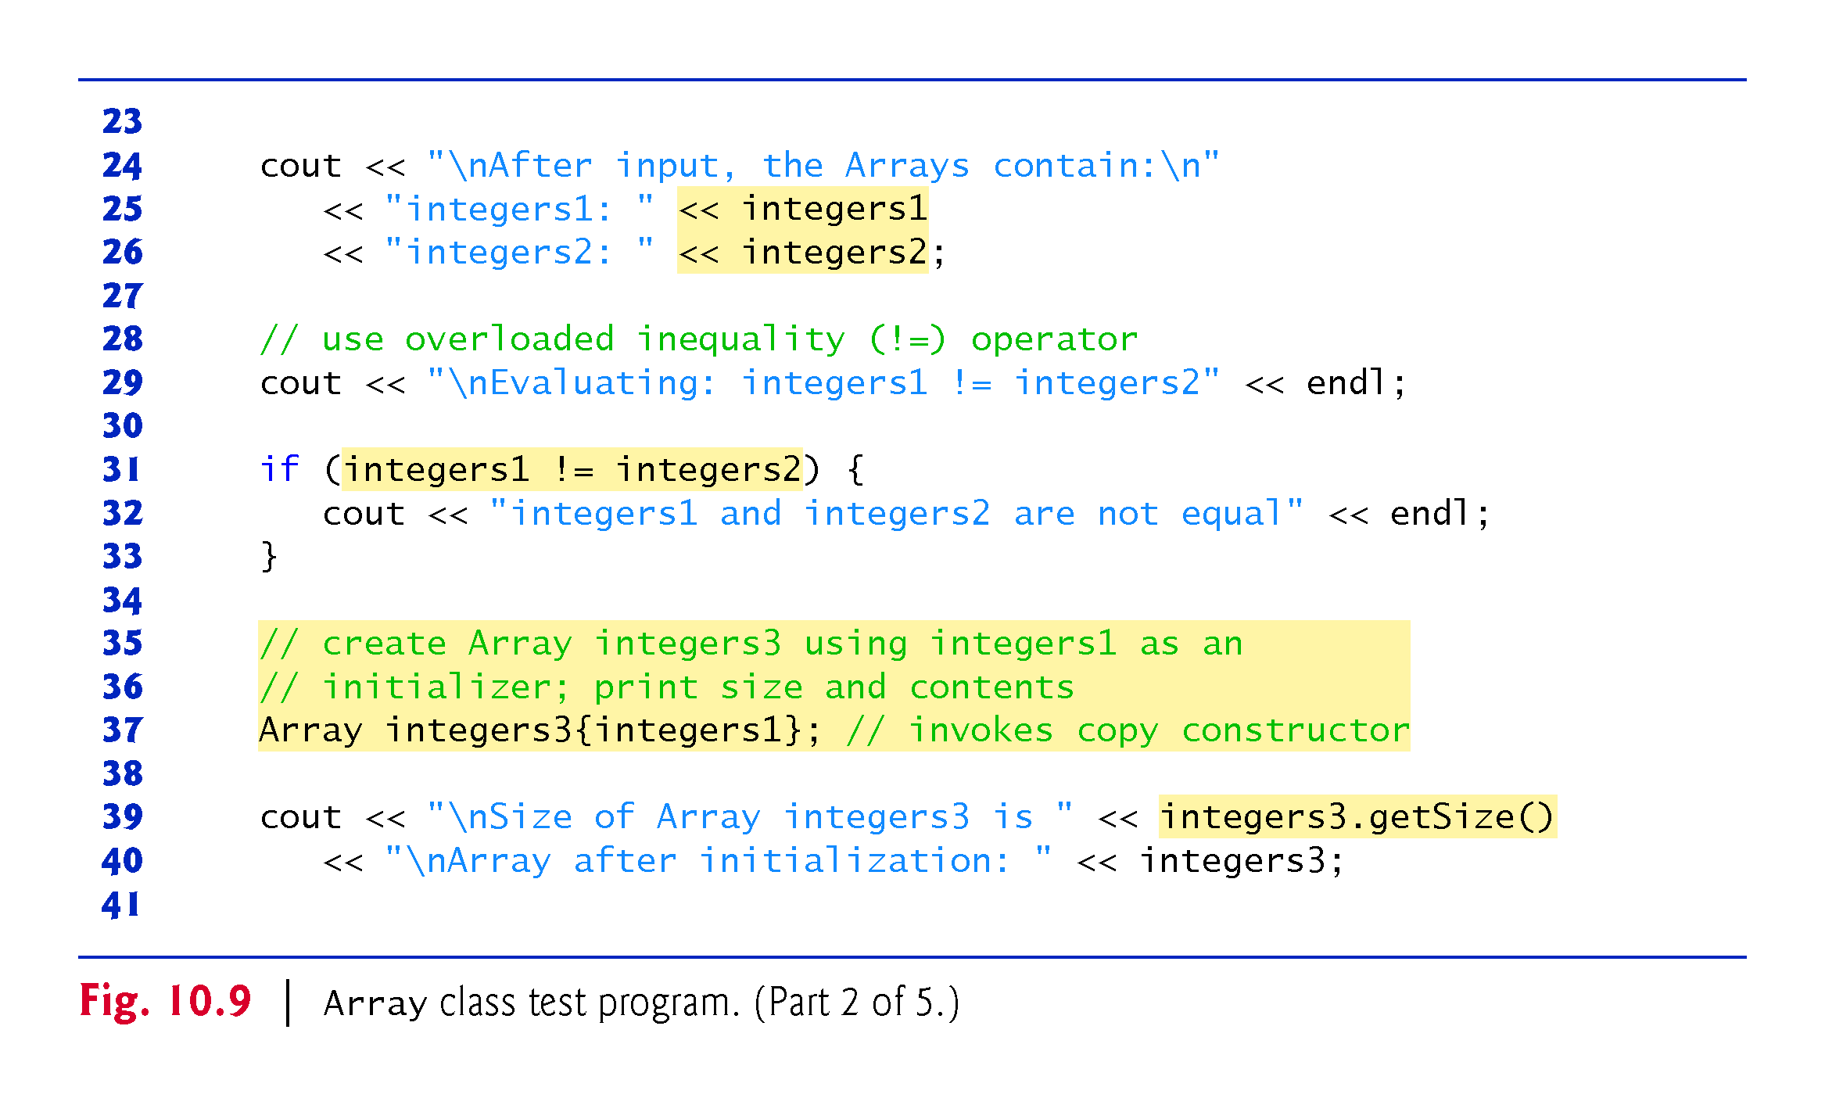

Slide 77
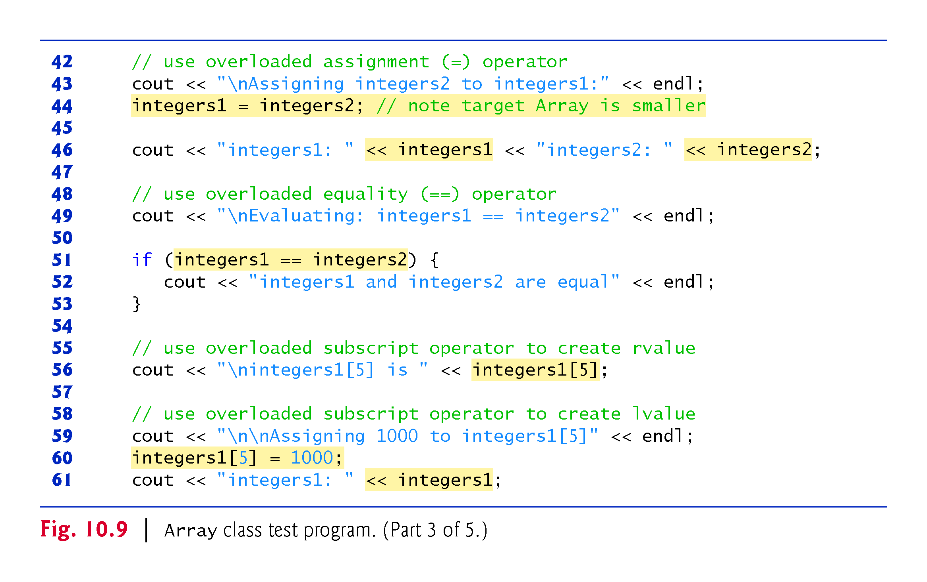

Slide 78
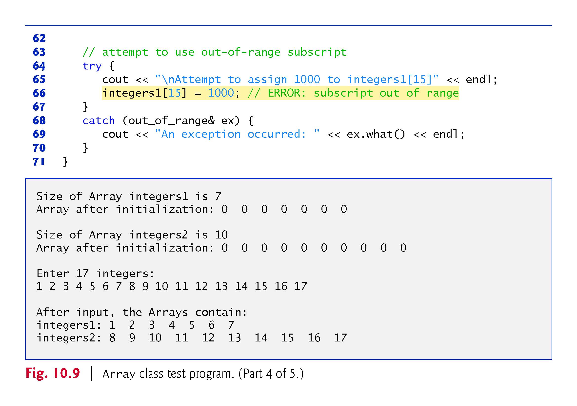

Slide 79
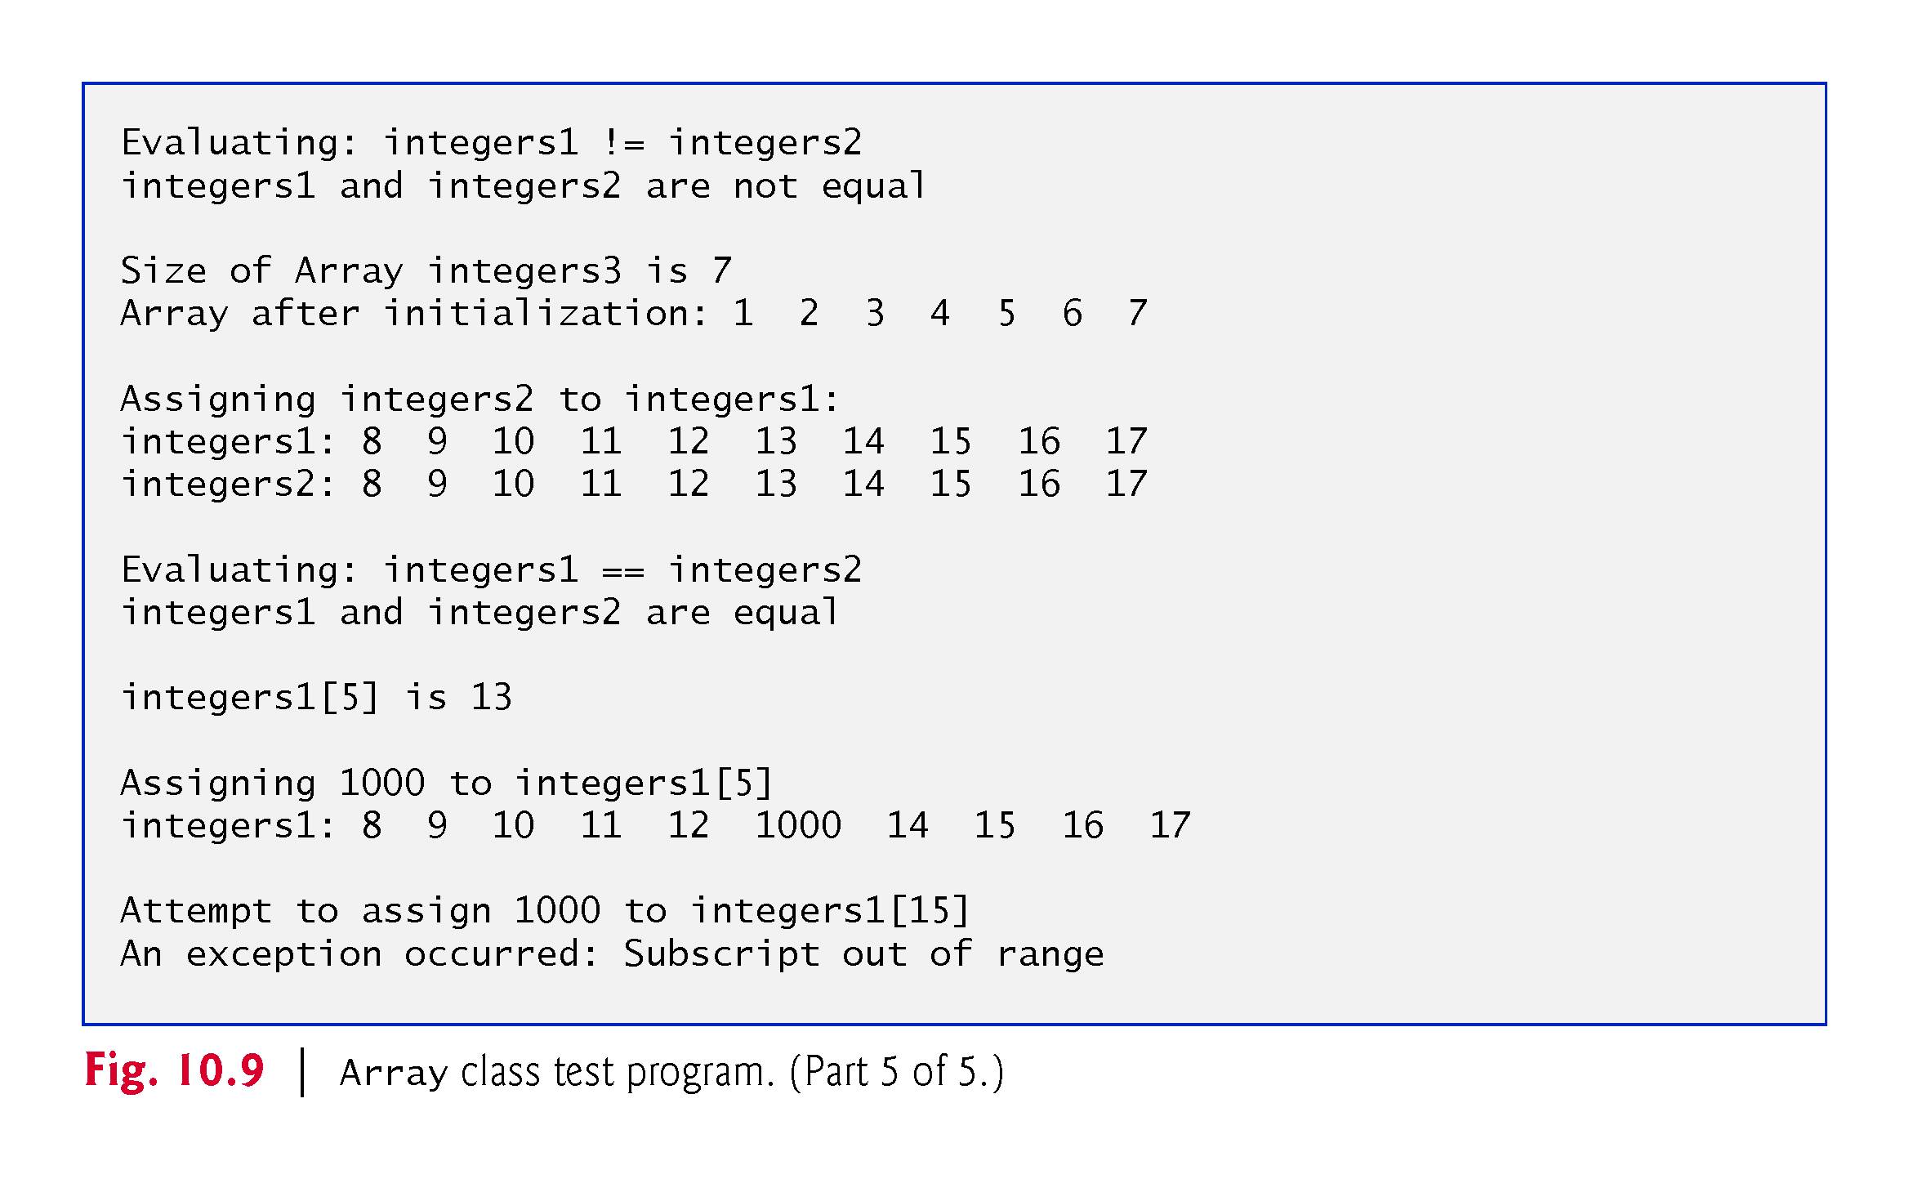

Slide 80
10.10.1 Using the Array Class
The Array copy constructor copies the elements of one Array into another.
The copy constructor can also be invoked by writing line 37 as:
    Array integers3 = integers1;
The equal sign in the preceding statement is not the assignment operator.
When an equal sign appears in the declaration of an object, it invokes a constructor for that object.
This form can be used to pass only a single argument to a constructor.

Slide 81
10.10.1 Using the Array Class
The array subscript operator [] is not restricted for use only with arrays; it also can be used, for example, to select elements from other kinds of container classes, such as strings and dictionaries.
Also, when operator[] functions are defined, subscripts no longer have to be integers—characters, strings, floats or even objects of user-defined classes also could be used.

Slide 82
10.10.1 Using the Array Class
Each Array object consists of a size member indicating the number of elements in the Array and an int pointer—ptr—that points to the dynamically allocated pointer-based array of integers managed by the Array object.
When the compiler sees an expression like cout << arrayObject, it invokes non-member function operator<< with the call
    operator<<(cout, arrayObject)
When the compiler sees an expression like cin >> arrayObject, it invokes non-member function operator>> with the call
    operator>>(cin, arrayObject)
These stream insertion and stream extraction operator functions cannot be members of class Array, because the Array object is always mentioned on the right side of the stream insertion operator and the stream extraction operator.

Slide 83
10.10.2 Array Class Definition
You might be tempted to replace the counter-controlled for statements in class Array’s implementation with the C++11 range-based for statement.
Unfortunately, range-based for does not work with dynamically allocated built-in arrays.

Slide 84
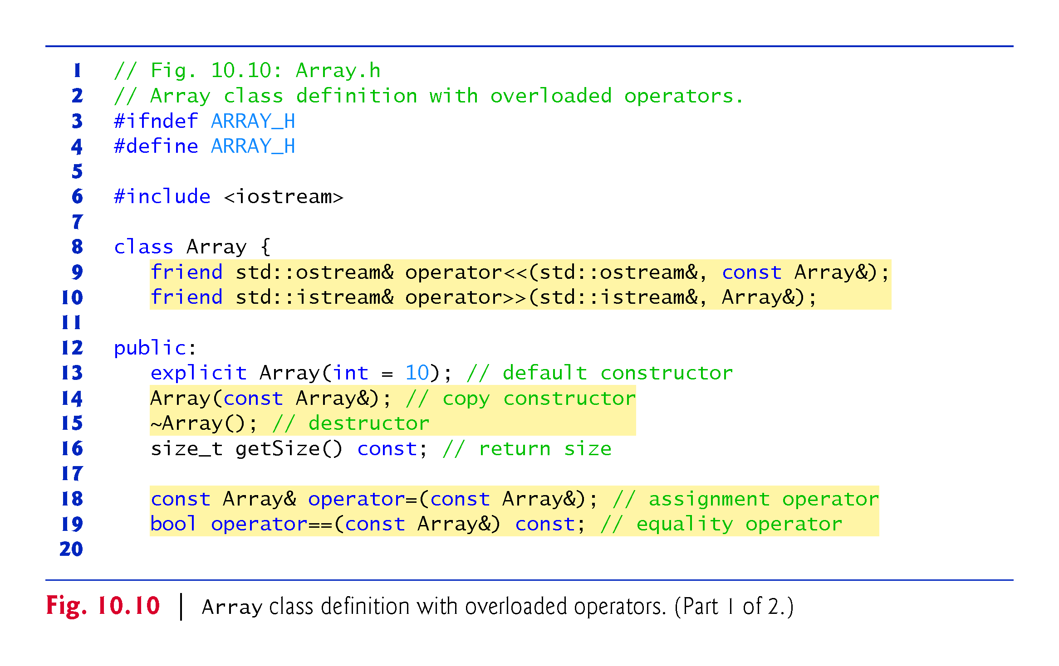

Slide 85
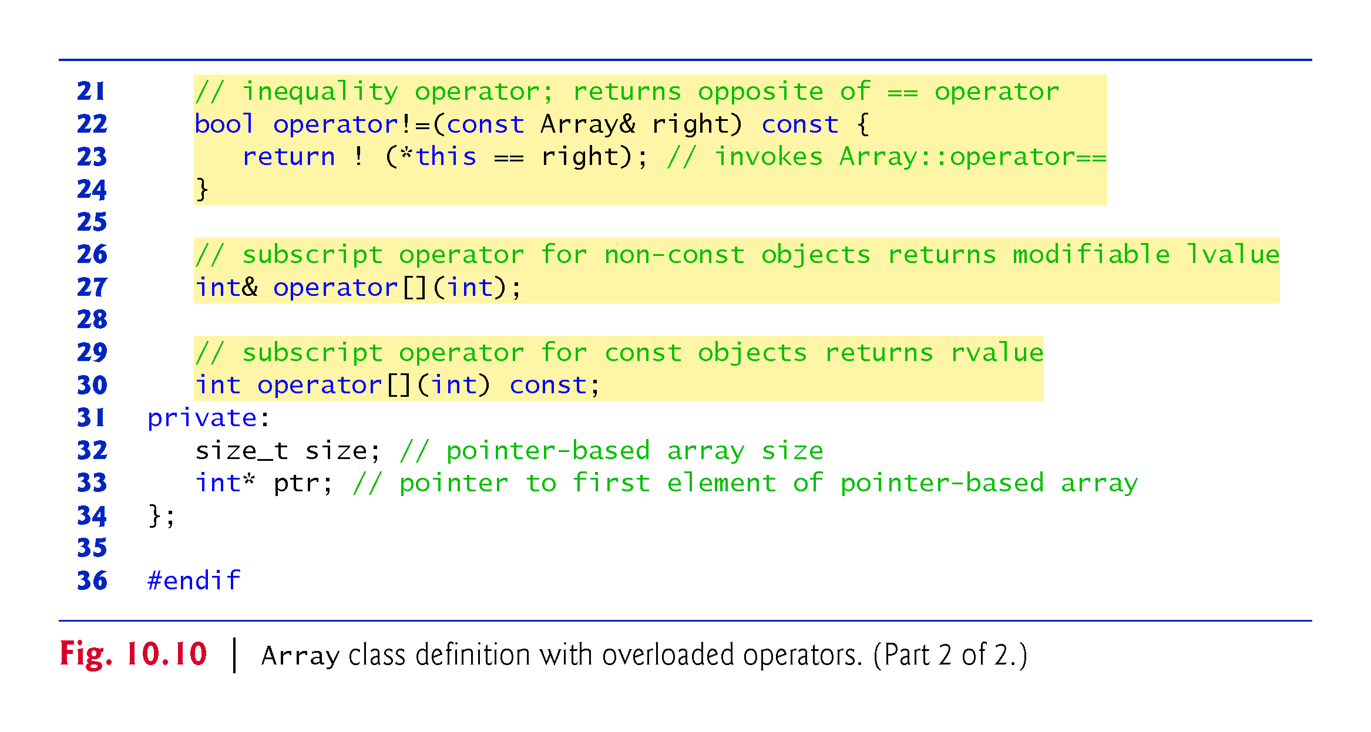

Slide 86
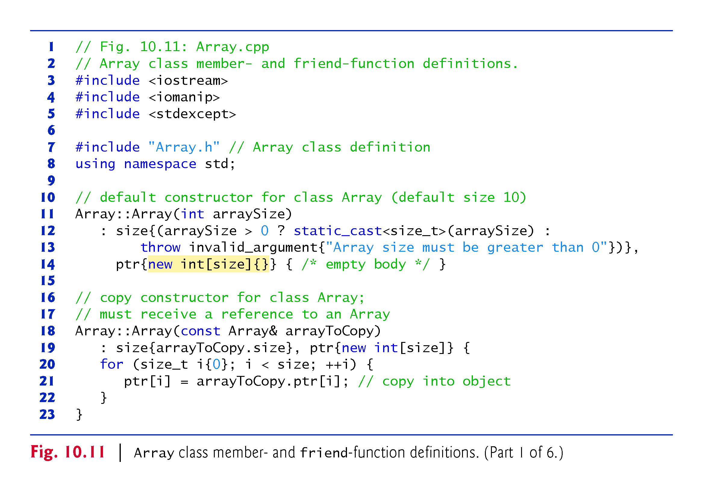

Slide 87
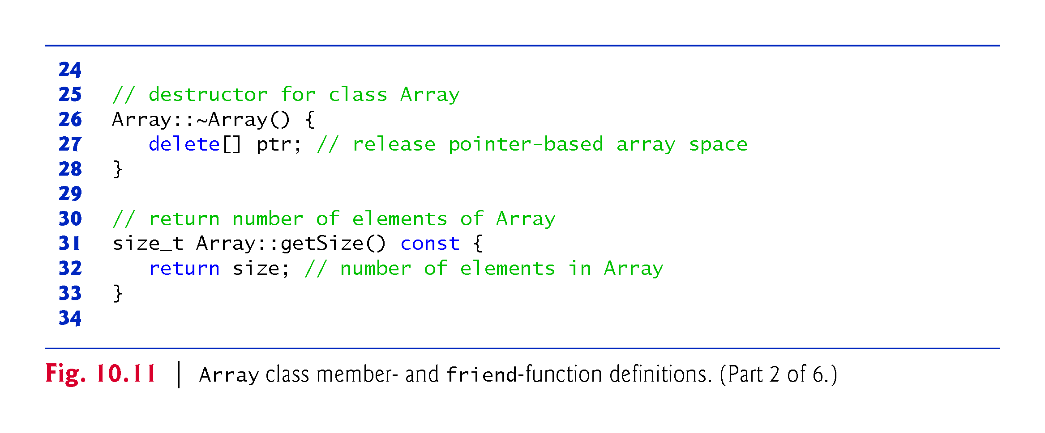

Slide 88
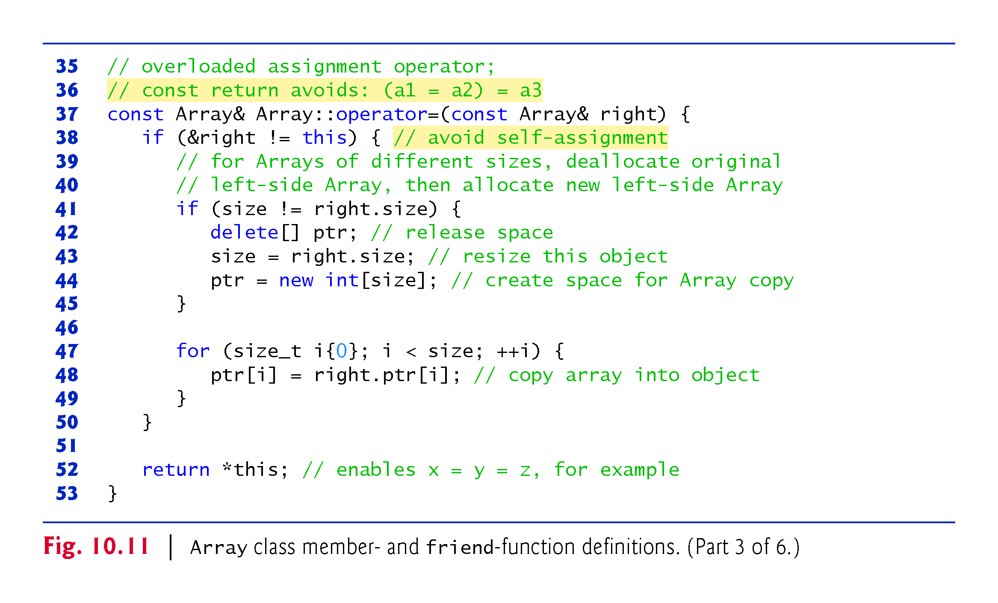

Slide 89
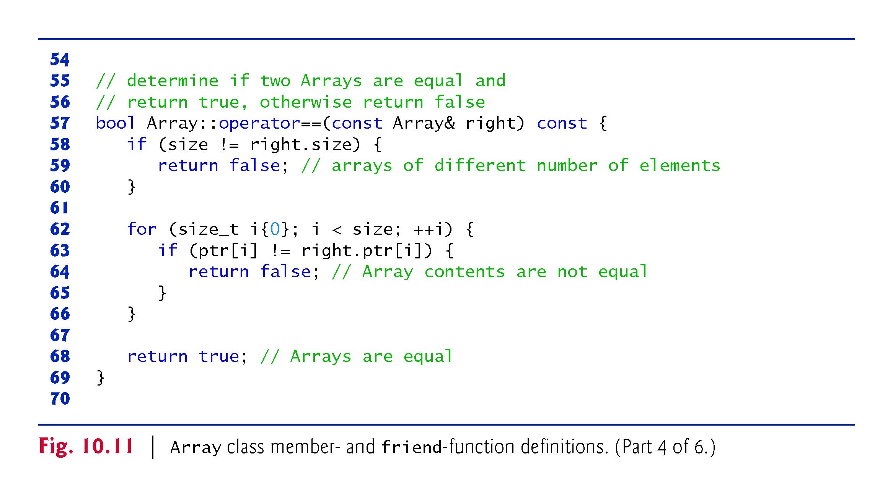

Slide 90
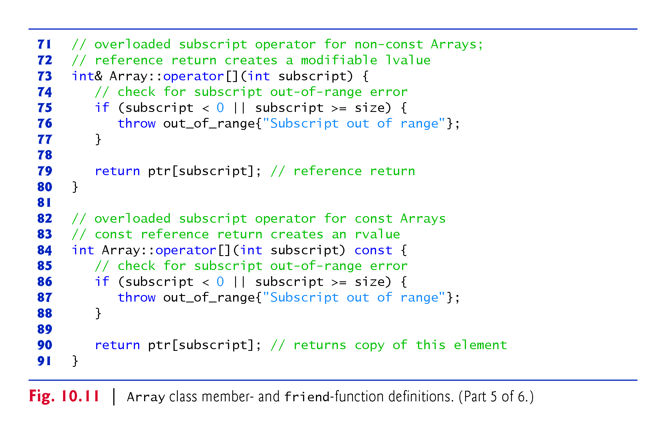

Slide 91
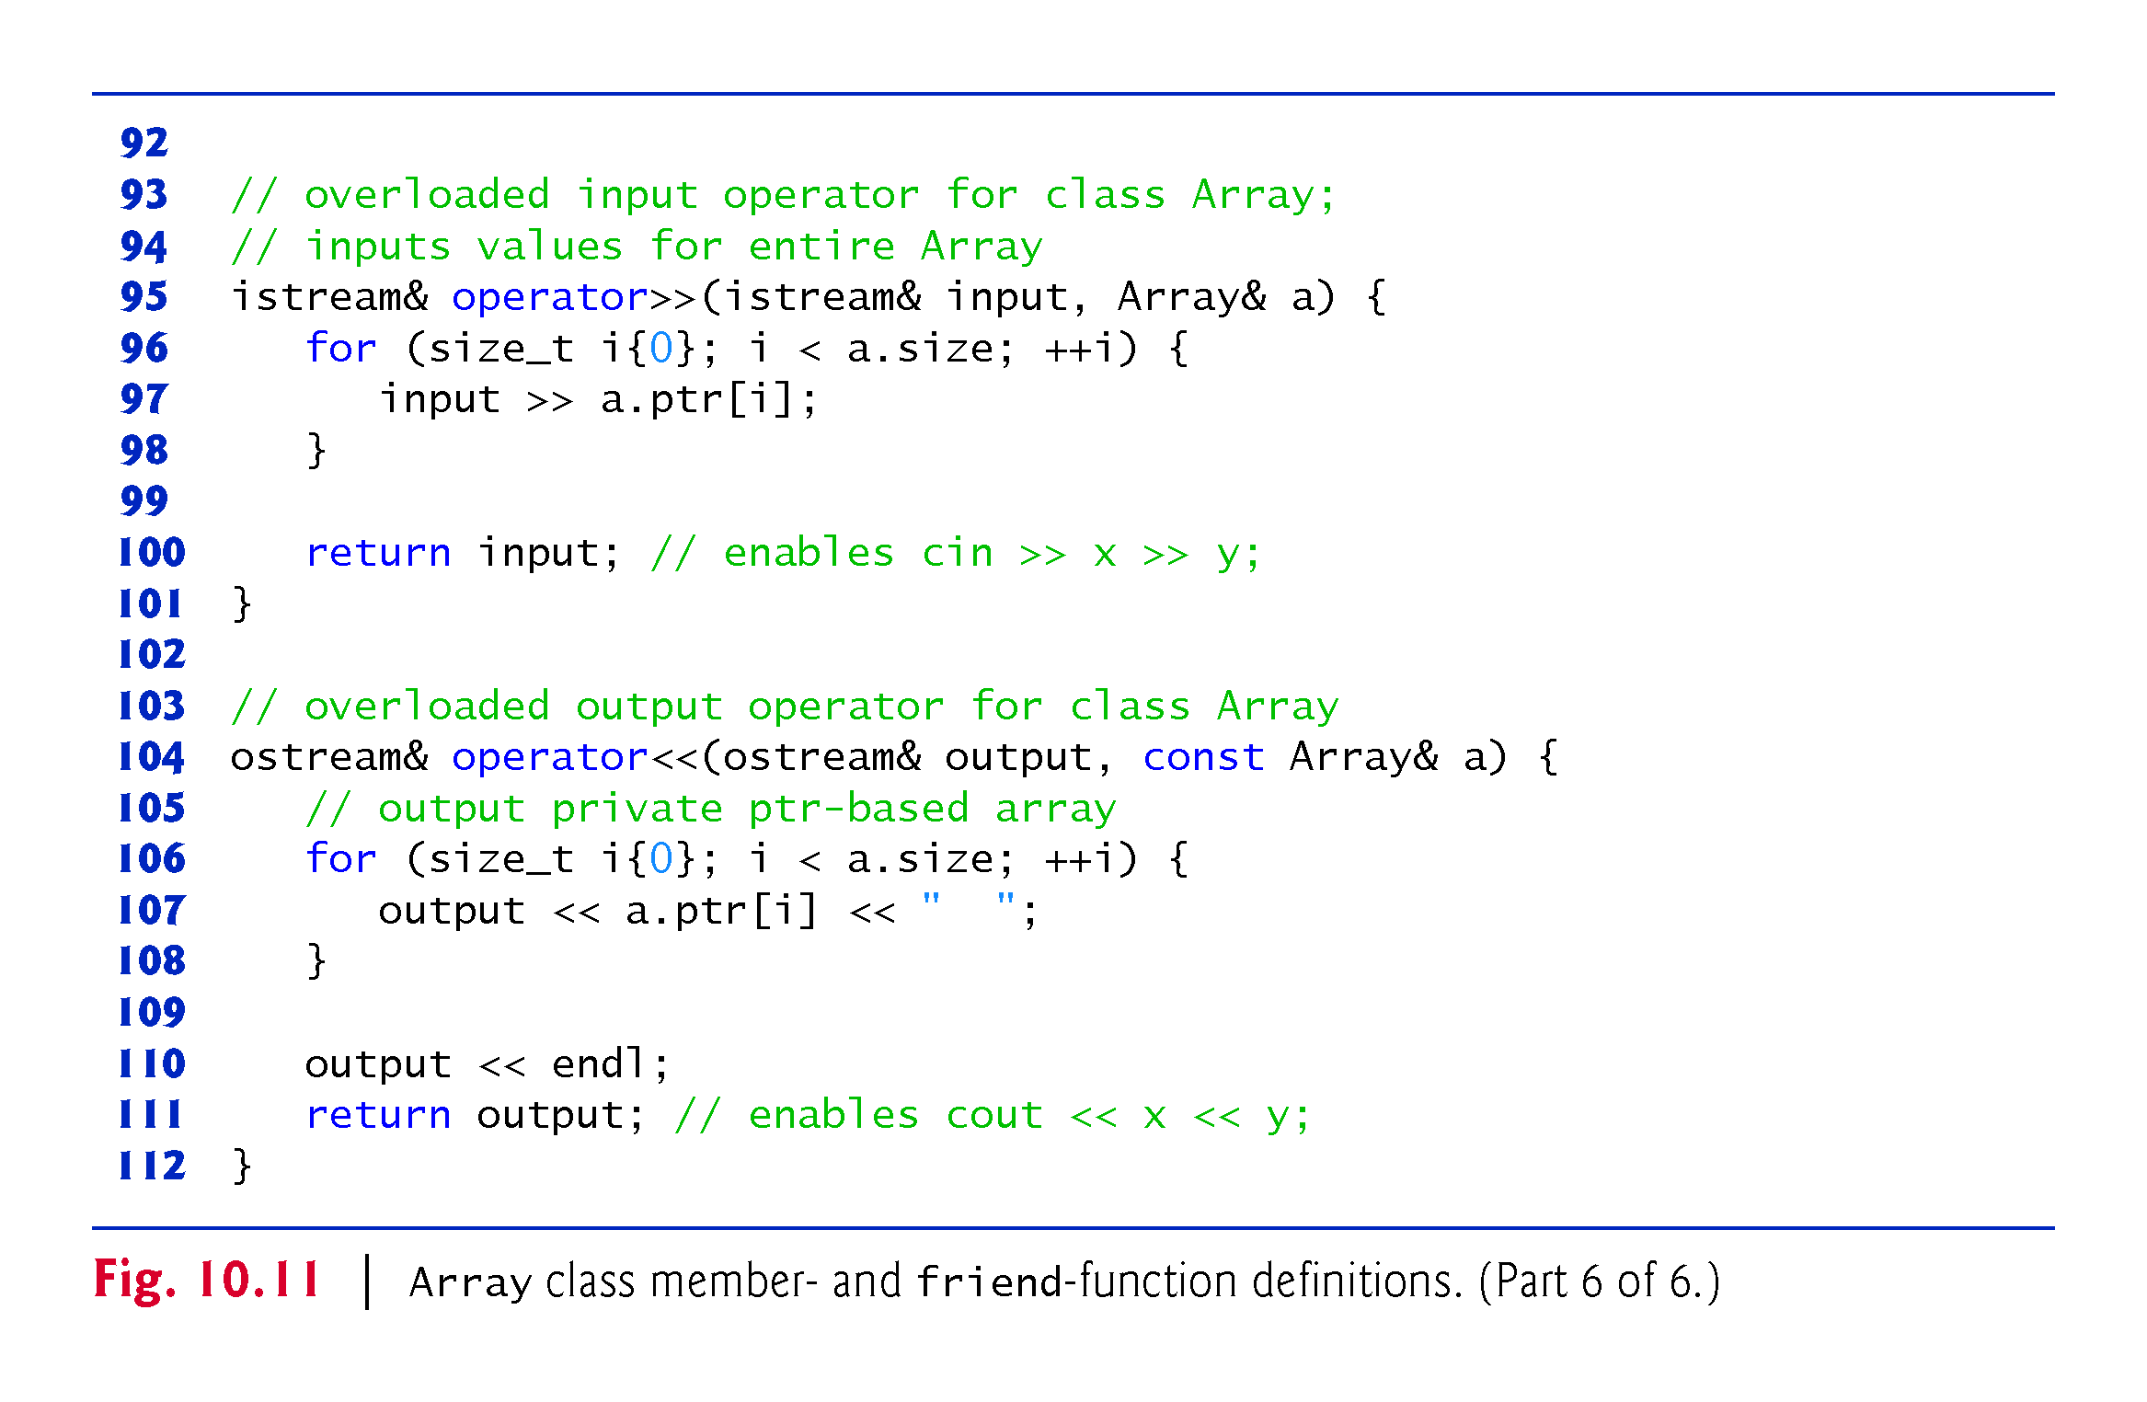

Slide 92
10.10.2 Array Class Definition
Array Default Constructor
Line 13 of Fig. 10.10 declares the default constructor for the class and specifies a default size of 10 elements.
The default constructor (defined in Fig. 10.11, lines 14) validates and assigns the argument to data member size, uses new to obtain the memory for the internal pointer-based representation of this Array and assigns the pointer returned by new to data member ptr.
Then the constructor uses a for statement to set all the elements of the array to zero.

Slide 93
10.10.2 Array Class Definition
Array Copy Constructor
Line 14 of Fig. 10.10 declares a copy constructor (defined in Fig. 10.11, lines 18–23) that initializes an Array by making a copy of an existing Array object.
Such copying must be done carefully to avoid the pitfall of leaving both Array objects pointing to the same dynamically allocated memory.
This is exactly the problem that would occur with default memberwise copying, if the compiler is allowed to define a default copy constructor for this class.
Copy constructors are invoked whenever a copy of an object is needed, such as in passing an object by value to a function, returning an object by value from a function or initializing an object with a copy of another object of the same class.

Slide 94
10.10.2 Array Class Definition
The copy constructor for Array copies the size of the initializer Array into data member size, uses new to obtain the memory for the internal pointer-based representation of this Array and assigns the pointer returned by new to data member ptr.
Then the copy constructor uses a for statement to copy all the elements of the initializer Array into the new Array object.
An object of a class can look at the private data of any other object of that class (using a handle that indicates which object to access).

Slide 95
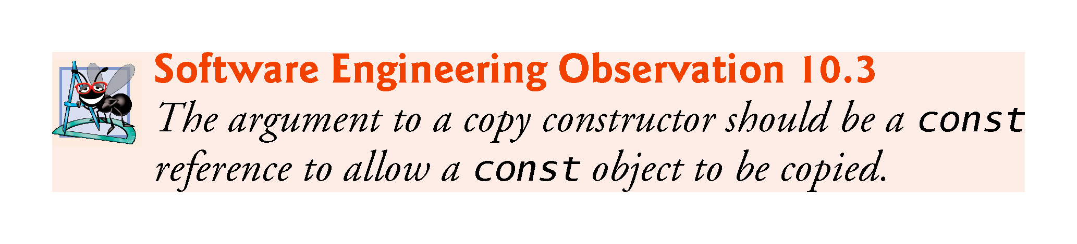

Slide 96
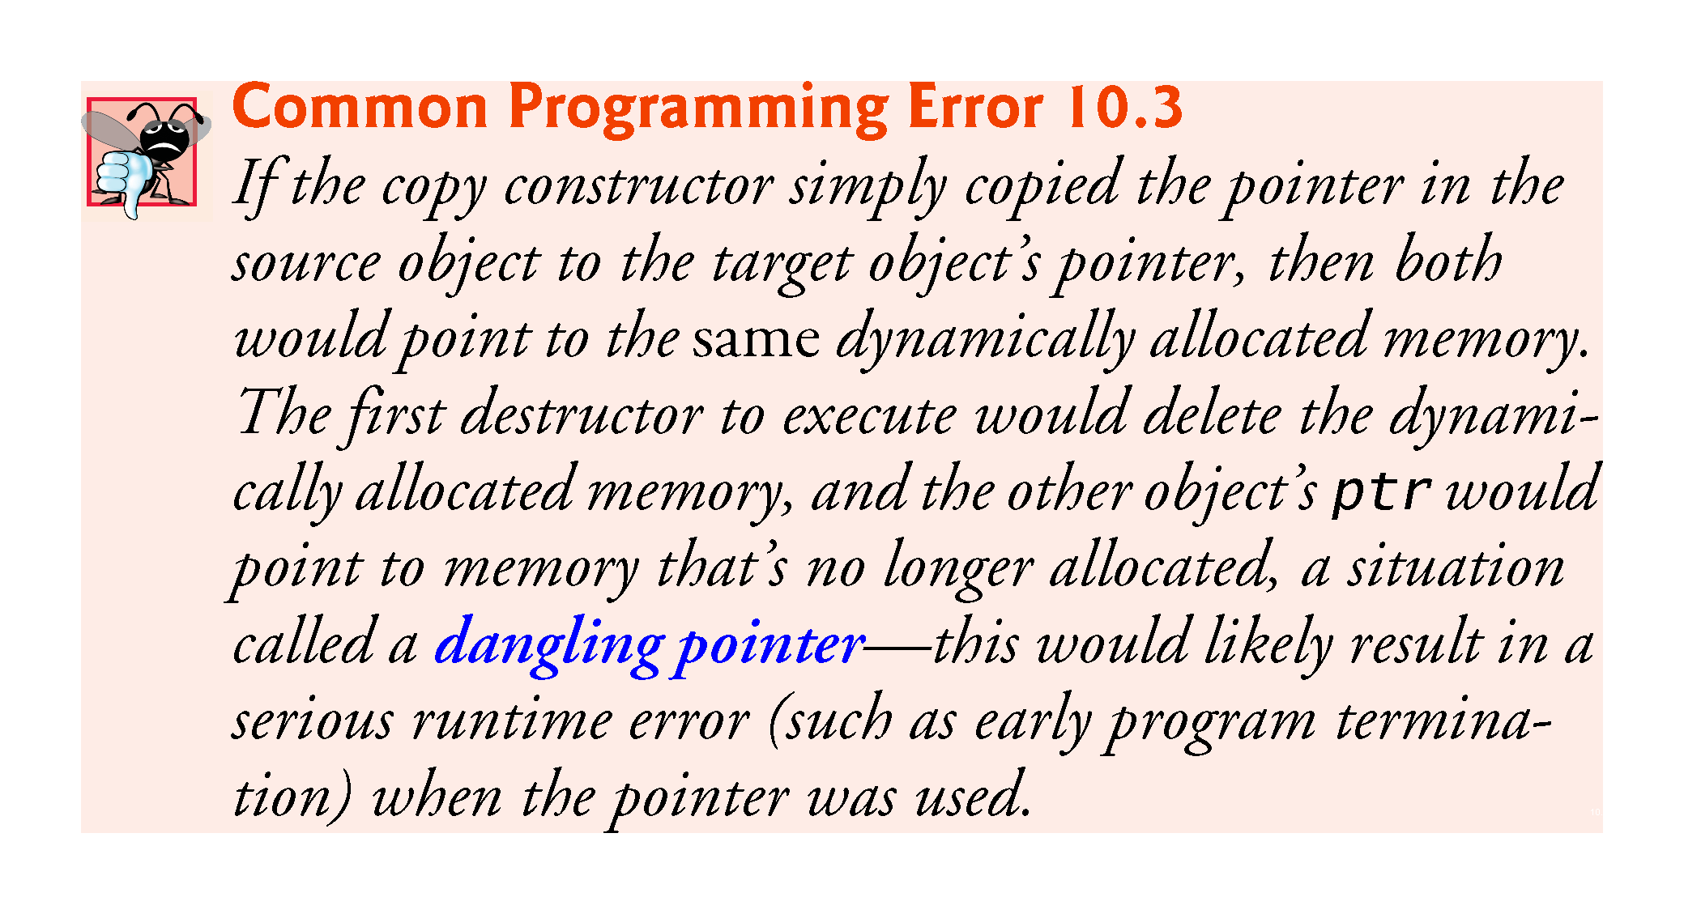

Slide 97
10.10.2 Array Class Definition
Array Destructor
Line 15 of Fig. 10.10 declares the class’s destructor (defined in Fig. 10.11, lines 26–28).
The destructor is invoked when an object of class Array goes out of scope.
The destructor uses delete [] to release the memory allocated dynamically by new in the constructor.

Slide 98
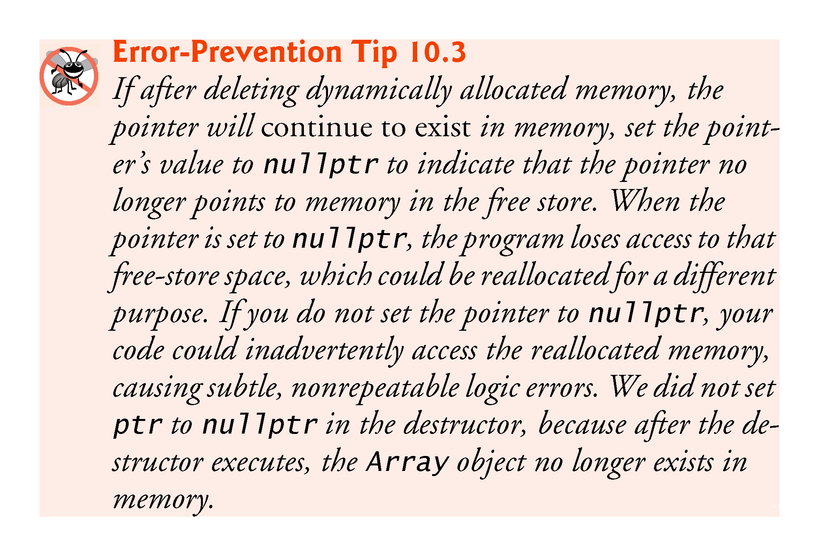

Slide 99
10.10.2 Array Class Definition
Overloaded Assignment Operator
Line 18 of Fig. 10.10 declares the overloaded assignment operator function for the class.
When the compiler sees the expression integers1 = integers2 in line 44of Fig. 10.9, the compiler invokes member function operator= with the call
    integers1.operator=(integers2)
Member function operator=’s implementation (Fig. 10.11, lines 37–53) tests for self-assignment in which an Array object is being assigned to itself.
When this is equal to the right operand’s address, a self-assignment is being attempted, so the assignment is skipped.

Slide 100
10.10.2 Array Class Definition
operator= determines whether the sizes of the two Arrays are identical (line 41); in that case, the original array of integers in the left-side Array object is not reallocated.
Otherwise, operator= uses delete [] (line 42) to release the memory, copies the size of the source array to the size of the target Array (line 43), uses new to allocate memory for the target Array and places the pointer returned by new into the Array’s ptr member.
Regardless of whether this is a self-assignment, the member function returns the current object (i.e., *this in line 52) as a constant reference; this enables cascaded Array assignments such as x = y = z, but prevents ones like (x = y) = z because z cannot be assigned to the const Array reference that is returned by (x = y).

Slide 101
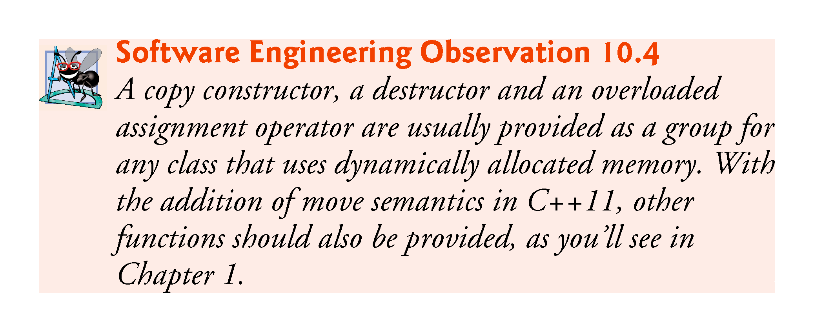

Slide 102


Slide 103
10.10.2 Array Class Definition
C++11: Deleting Unwanted Member Functions from Your Class
Prior to C++11, you could prevent class objects from being copied or assigned by declaring as private the class’s copy constructor and overloaded assignment operator.
As of C++11, you can simply delete these functions from your class.
To do so in class Array, replace the prototypes in lines 14 and 18 of Fig. 10.10 with:
    Array(const Array &) = delete;
    const Array &operator=(const Array &) = delete;
Though you can delete any member function, it’s most commonly used with member functions that the compiler can auto-generate—the default constructor, copy constructor, assignment operator, and in C++ 11, the move constructor and move assignment operator.

Slide 104
10.10.2 Array Class Definition
Overloaded Equality and Inequality Operators
Line 19 of Fig. 10.10 declares the overloaded equality operator (==)
When the compiler sees the expression integers1 == integers2 in line 51 of Fig. 10.9, it invokes member function operator== with the call
    integers1.operator==(integers2)
Member function operator== (defined in Fig. 10.11, lines 57–69) immediately returns false if the size members of the Arrays are not equal.
Otherwise, operator== compares each pair of elements.
If they’re all equal, the function returns true.
The first pair of elements to differ causes the function to return false immediately.

Slide 105
10.10.2 Array Class Definition
Lines 22–24 Fig. 10.9 define the overloaded inequality operator (!=) for the class.
Member function operator!= uses the overloaded operator== function to deter-mine whether one Array is equal to another, then returns the opposite of that result.
Writing operator!= in this manner enables you to reuse operator==, which reduces the amount of code that must be written in the class.
Also, the full function definition for operator!= is in the Array header—Allows the compiler to inline the definition.

Slide 106
10.10.2 Array Class Definition
Overloaded Subscript Operators
Lines 27 and 30 of Fig. 10.10 declare two overloaded subscript operators
When the compiler sees the expression integers1[5] (Fig. 10.9, line 56), it invokes the appropriate overloaded operator[] member function by generating the call
    integers1.operator[](5)
The compiler creates a call to the const version of operator[] (Fig. 10.11, lines 84–91) when the subscript operator is used on a const Array object.

Slide 107
10.10.2 Array Class Definition
Each definition of operator[] determines whether the subscript it receives as an argument is in range.
If it isn’t, each function prints an error message and terminates the program with a call to function exit.
If the subscript is in range, the non-const version of operator[] returns the appropriate Array element as a reference so that it may be used as a modifiable lvalue.
If the subscript is in range, the const version of operator[] returns a copy of the appropriate element of the Array.

Slide 108
10.10.2 Array Class Definition
C++11: Managing Dynamically Allocated Memory with unique_ptr
In this case study, class Array’s destructor used delete [] to return the dynamically allocated built-in array to the free store.
As you recall, C++11 enables you to use unique_ptr to ensure that this dynamically allocated memory is deleted when the Array object goes out of scope.

Slide 109
10.10.2 Array Class Definition
C++11: Passing a List Initializer to a Constructor
In Fig. 7.4, we showed how to initialize an array object with a comma-separated list of initializers in braces, as in
    array<int, 5> n{32, 27, 64, 18, 95};
Can also use with objects of your own classes.
Can provide an Array constructor that would enabled the following declarations:
    Array integers{1, 2, 3, 4, 5};
or
    Array integers = {1, 2, 3, 4, 5};
each of which creates an Array object with five elements containing the integers from 1 to 5.

Slide 110
10.10.2 Array Class Definition
To support list initialization, you can define a constructor that receives an object of the class template initializer_list. For class Array, you’d include the <initializer_list> header.
Then, you’d define a constructor with the first line:
    Array::Array(initializer_list<int> list)
You can determine the number of elements in the list parameter by calling its size member function.
To obtain each initializer and copy it into the Array object’s dynamically allocated built-in array, use a range-based for:
    size_t i = 0;
    for (int item : list) {
    ptr[ i++ ] = item;
    }

Slide 111
10.11 Operators as Member vs. Non-Member Functions
Whether an operator function is implemented as a member function or as a non-member function, the operator is still used the same way in expressions.
When an operator function is implemented as a member function, the leftmost (or only) operand must be an object (or a reference to an object) of the operator’s class.
If the left operand must be an object of a different class or a fundamental type, this operator function must be implemented as a non-member function (as we did in Section 10.5 when overloading << and >> as the stream insertion and extraction operators, respectively).
A non-member operator function can be made a friend of a class if that function must access private or protected members of that class directly.
Operator member functions of a specific class are called only when the left operand of a binary operator is specifically an object of that class, or when the single operand of a unary operator is an object of that class.

Slide 112
10.11 Operators as Member vs. Non-Member Functions (cont.)
You might choose a non-member function to overload an operator to enable the operator to be commutative.
The operator+ function that deals with the HugeInt on the left, can still be a member function.
The non-member function simply swaps its arguments and calls the member function.

Slide 113
10.12 Converting Between Types
Sometimes all the operations “stay within a type.” For example, adding an int to an int produces an int.
It’s often necessary, however, to convert data of one type to data of another type.
The compiler knows how to perform certain conversions among fundamental types.
You can use cast operators to force conversions among fundamental types.
The compiler cannot know in advance how to convert among user-defined types, and between user-defined types and fundamental types, so you must specify how to do this.

Slide 114
10.12 Converting Between Types (cont.)
Such conversions can be performed with conversion constructors—constructors that can be called with a single argument (we’ll refer to these as single-argument constructors).
Such constructors can turn objects of other types (including fundamental types) into objects of a particular class.

Slide 115
10.12 Converting Between Types (cont.)
Conversion Operators
A conversion operator (also called a cast operator) can be used to convert an object of one class to another type.
Such a conversion operator must be a non-static member function.
MyClass::operator string() const;
  Declares an overloaded cast operator function for converting an object of class MyClass into a temporary string.
  The operator function is declared const because it does not modify the original object.

Slide 116
10.12 Converting between Types (cont.)
The return type of an overloaded cast operator function is implicitly the type to which the object is being converted.
If s is a class object, when the compiler sees the expression static_cast<string>(s), the compiler generates the call
    s.operator string()

Slide 117
10.12 Converting between Types (cont.)
Overloaded Cast Operator Functions
Overloaded cast operator functions can be defined to convert objects of user-defined types into fundamental types or into objects of other user-defined types.
Implicit Calls to Cast Operators and Conversion Constructors
One of the nice features of cast operators and conversion constructors is that, when necessary, the compiler can call these functions implicitly to create temporary objects.

Slide 118


Slide 119
10.13 explicit Constructors and Conversion Operators
Recall that we’ve been declaring as explicit every constructor that can be called with one argument.
With the exception of copy constructors, any constructor that can be called with a single argument and is not declared explicit can be used by the compiler to perform an implicit conversion.
The conversion is automatic and you need not use a cast operator.
Sometimes implicit conversions are undesirable or error-prone.
  Our Array class in Fig. 10.10 defines a constructor that takes a single int argument.
  The intent of this constructor is to create an Array object containing the number of elements specified by the int argument.
  However, if this constructor were not declared explicit it could be misused by the compiler to perform an implicit conversion.

Slide 120


Slide 121
10.13 explicit Constructors and Conversion Operators (cont.)
The program (Fig. 10.12) uses the Array class of Figs. 10.10–10.11 to demonstrate an improper implicit conversion.
Line 12 calls function outputArray with the int value 3 as an argument.
This program does not contain a function called outputArray that takes an int argument.
  The compiler determines whether class Array provides a conversion constructor that can convert an int into an Array.
  The compiler assumes the Array constructor that receives a single int is a conversion constructor and uses it to convert the argument 3 into a temporary Array object that contains three elements.
  Then, the compiler passes the temporary Array object to function outputArray to output the Array’s contents.

Slide 122


Slide 123


Slide 124
10.13 explicit Constructors and Conversion Operators (cont.)
Preventing Implicit Conversions with Single-Argument Constructors
The reason we’ve been declaring every single-argument constructor preceded by the keyword explicit is to suppress implicit conversions via conversion constructors when such conversions should not be allowed.
A constructor that is declared explicit cannot be used in an implicit conversion.
In the example if Figure 10.13, we use the original version of Array.h from Fig. 10.10, which included the keyword explicit in the declaration of the single-argument constructor in line 13.

Slide 125
10.13 explicit Constructors and Conversion Operators (cont.)
Figure 10.13 presents a slightly modified version of the program in Fig. 10.12.
When this program is compiled, the compiler produces an error message
Line 14 demonstrates how the explicit constructor can be used to create a temporary Array of 3 elements and pass it to function outputArray.

Slide 126


Slide 127


Slide 128
10.13 explicit Constructors and Conversion Operators (cont.)
C++11: explicit Conversion Operators
Just as you can declare single-argument constructors explicit, you can declare conversion operators explicit to prevent the compiler from using them to perform implicit conversions.
explicit MyClass::operator string() const;
  Declares MyClass’s string cast operator explicit.

Slide 129
10.14 Overloading the Function Call Operator ()
Overloading the function call operator () is powerful, because functions can take an arbitrary number of comma-separated parameters.
In a customized String class, for example, you could overload this operator to select a substring from a String—the operator’s two integer parameters could specify the start location and the length of the substring to be selected.
The operator() function could check for such errors as a start location out of range or a negative substring length.
The overloaded function call operator must be a non-static member function and could be defined with the first line:
  String String::operator()(size_t index, size_t length) const

Slide 130
10.14 Overloading the Function Call Operator ()
In this case, it should be a const member function because obtaining a substring should not modify the original String object.
Suppose string1 is a String object containing the string "AEIOU".
When the compiler encounters the expression string1(2, 3), it generates the member-function call
    string1.operator()(2, 3)
which returns a String containing "IOU".
Another possible use of the function call operator is to enable an alternate Array subscripting notation.
Instead of using C++’s double-square-bracket notation, such as in chessBoard[row][column], you might prefer to overload the function call operator to enable the notation chessBoard(row, column), where chessBoard is an object of a modified two-dimensional Array class.

