Slide 1
Chapter 3
Control Statements: Part I; Assignment, ++ and -- Operators
Java™ How to Program, 10/e
Late Objects Version

Slide 2
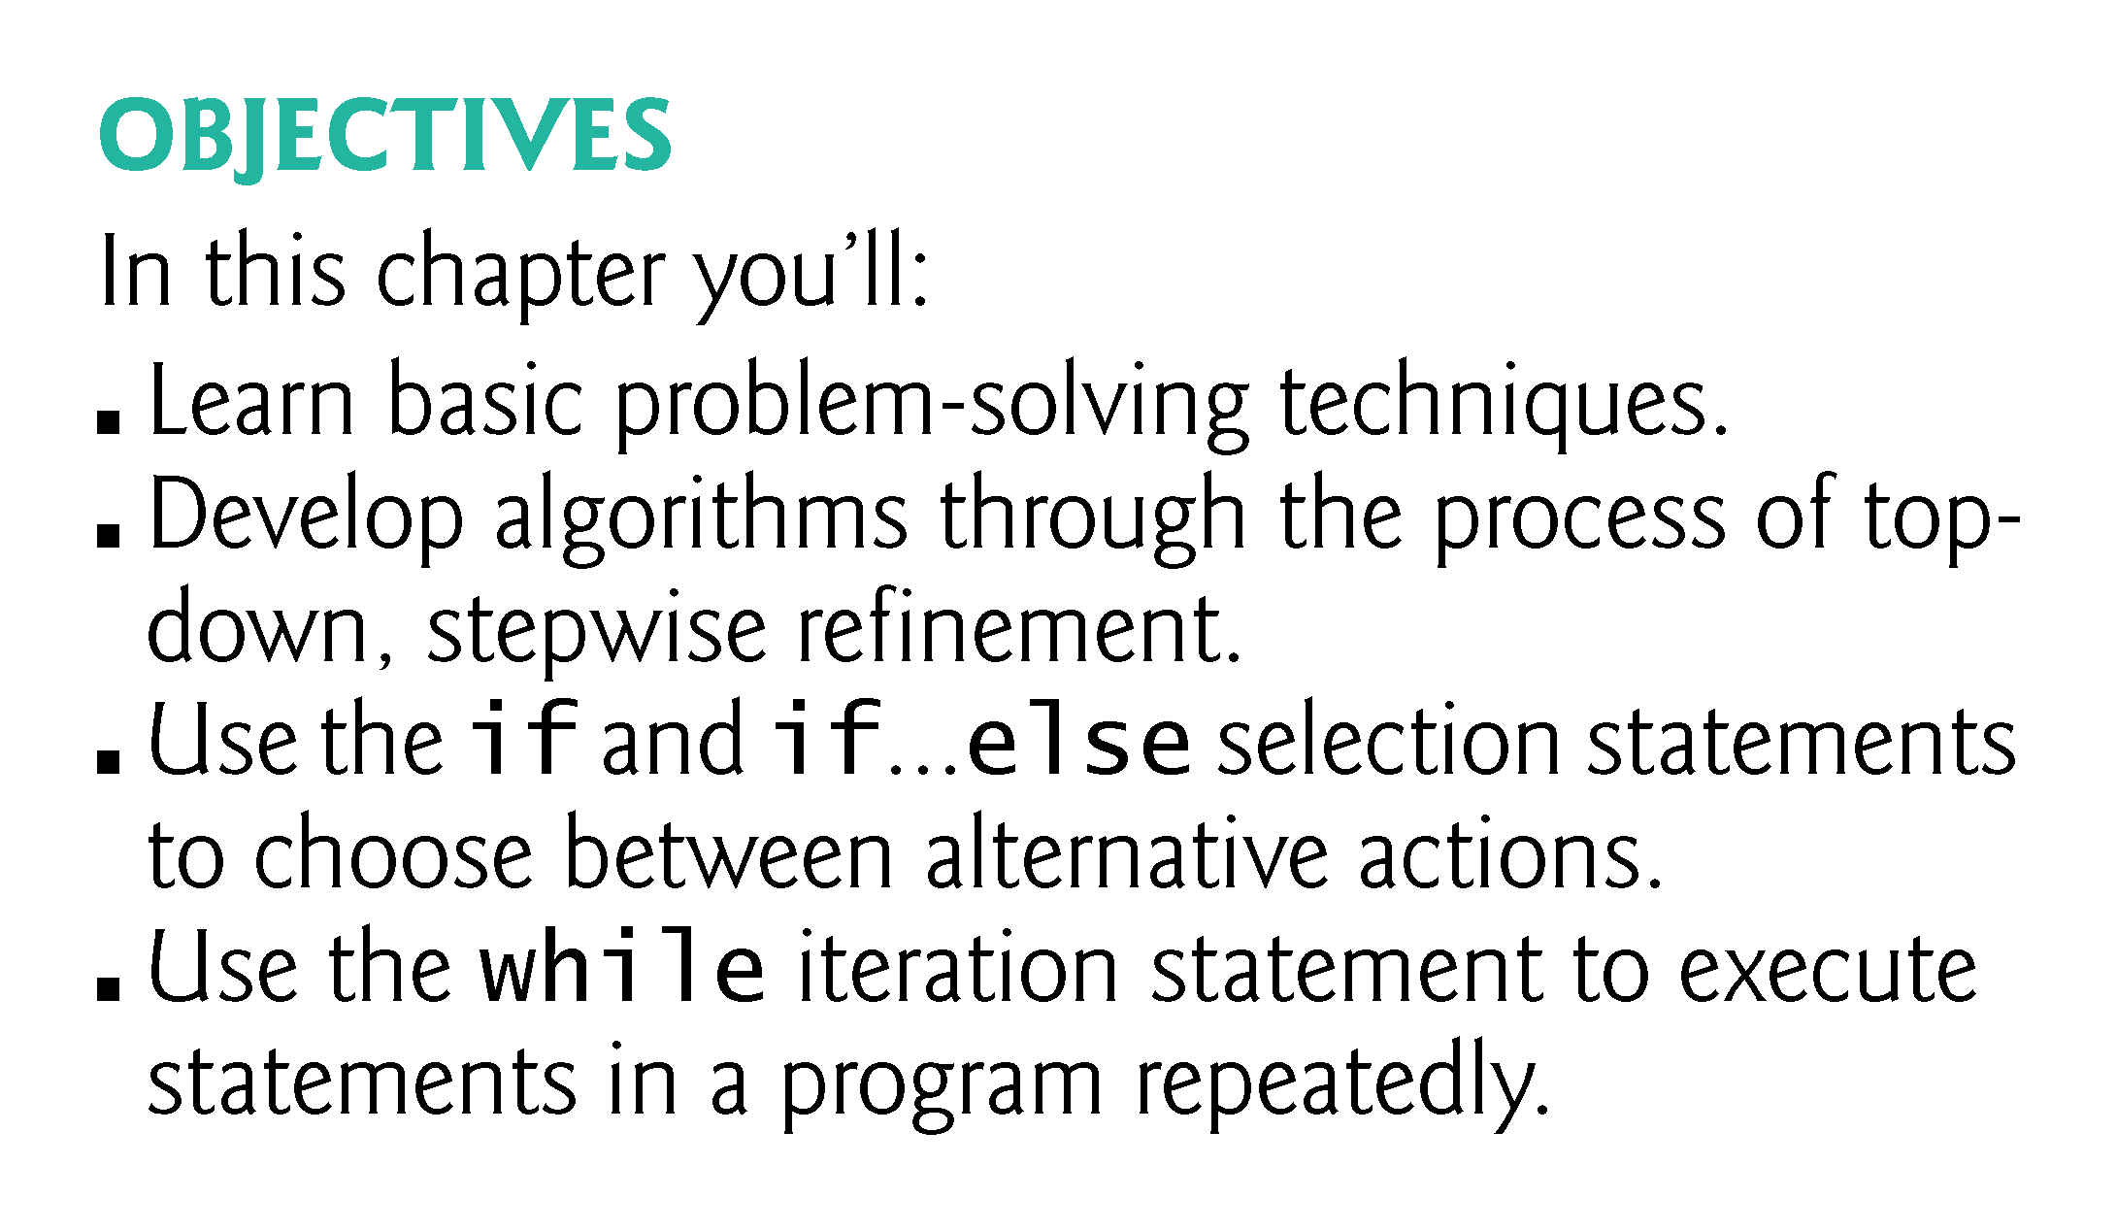

Slide 3
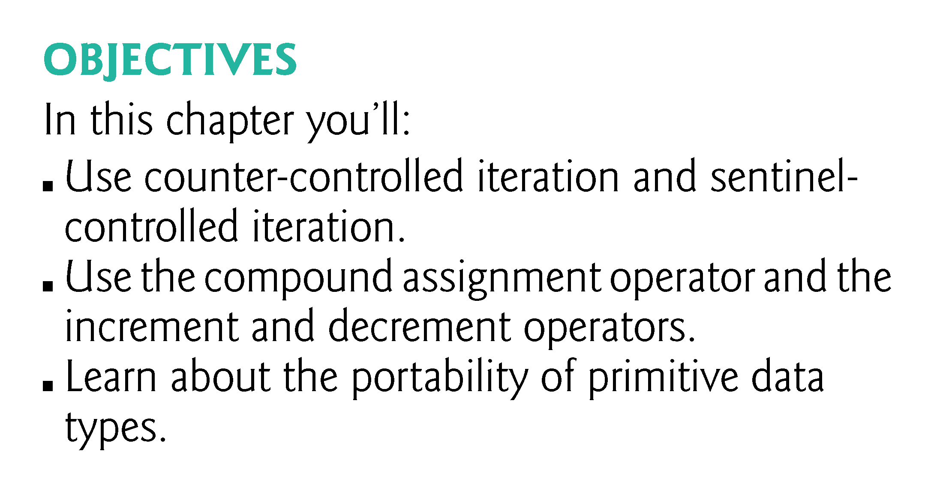

Slide 4
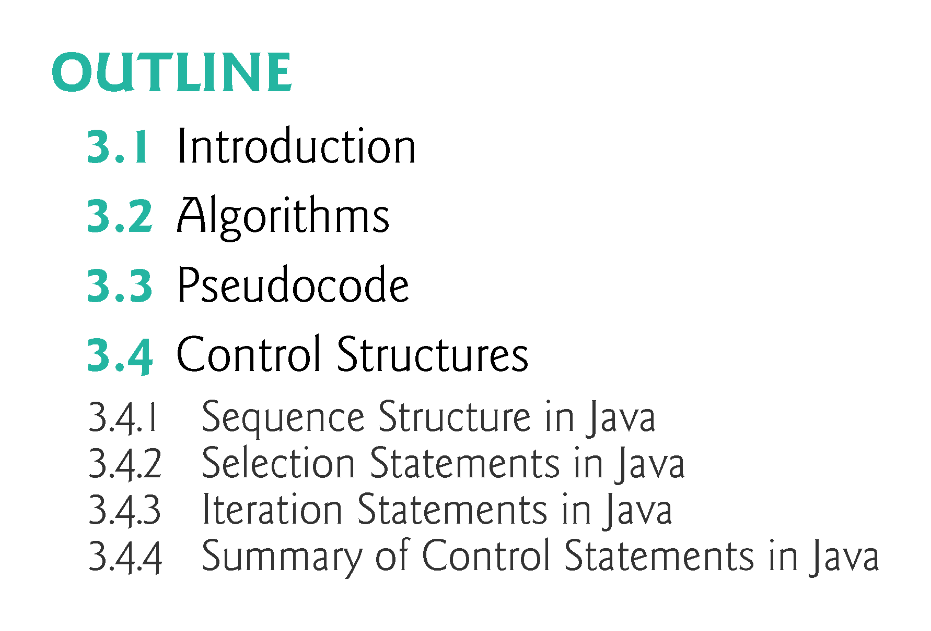

Slide 5
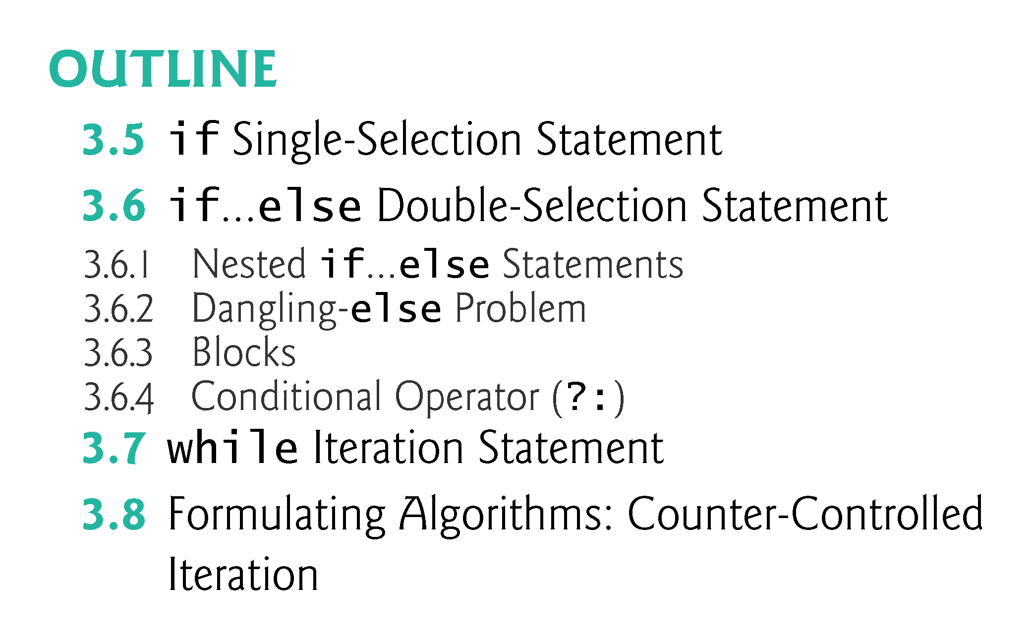

Slide 6
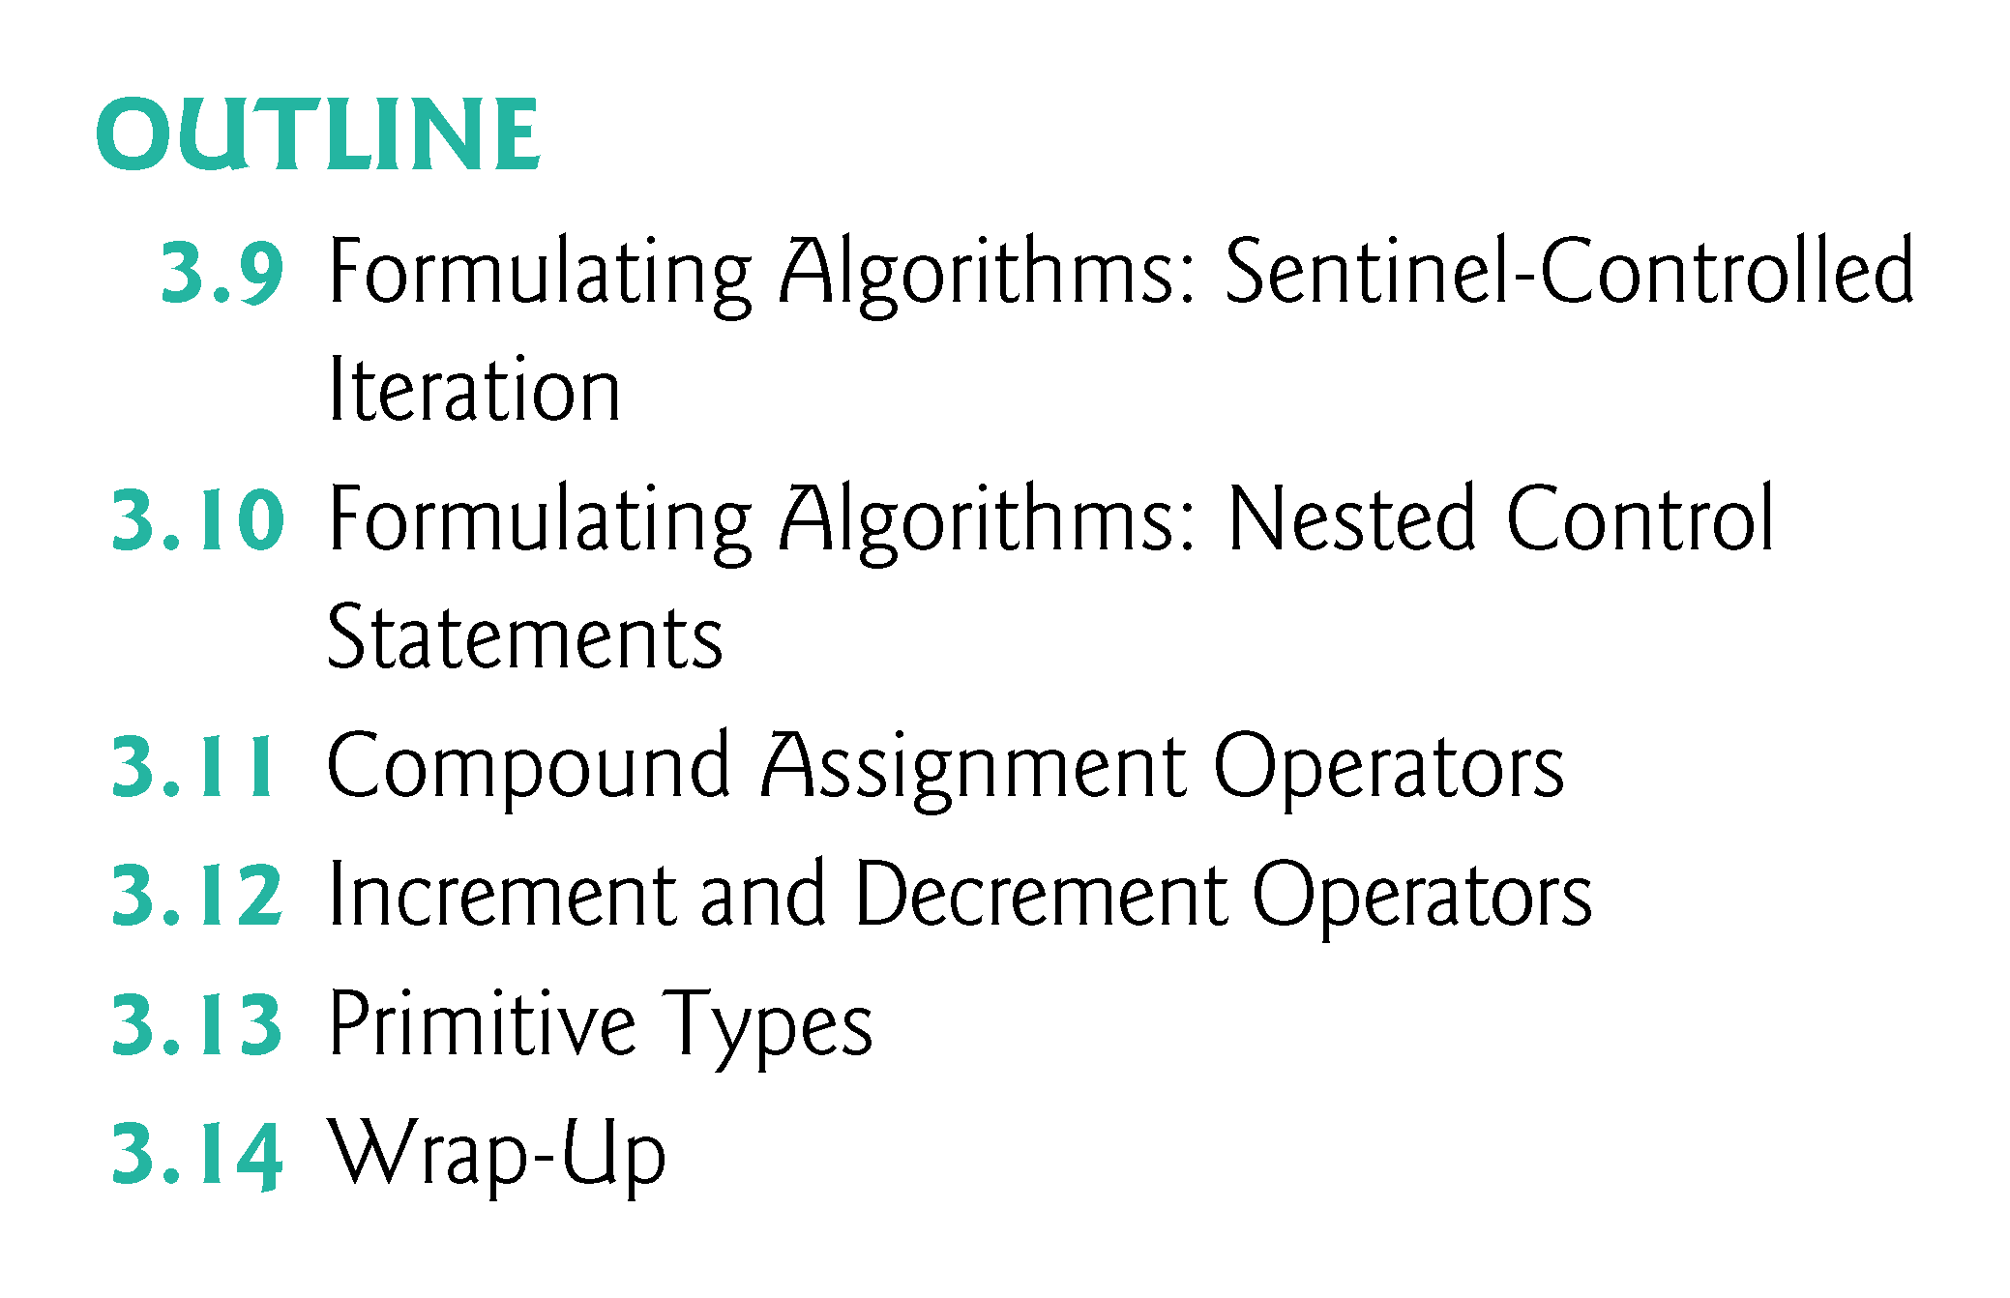

Slide 7
3.1 Introduction
Before writing a program to solve a problem, have a thorough understanding of the problem and a carefully planned approach to solving it.
Understand the available building blocks and employ proven program-construction techniques.
This chapter introduces
  The if, if…else and while statements
  Compound assignment, increment and decrement operators
  Portability of Java’s primitive types

Slide 8
3.2 Algorithms
Any computing problem can be solved by executing a series of actions in a specific order.
An algorithm is a procedure for solving a problem in terms of
  the actions to execute and
  the order in which these actions execute
The “rise-and-shine algorithm” followed by one executive for getting out of bed and going to work:
  (1) Get out of bed; (2) take off pajamas; (3) take a shower; (4) get dressed; (5) eat breakfast; (6) carpool to work.
Suppose that the same steps are performed in a slightly different order:
  (1) Get out of bed; (2) take off pajamas; (3) get dressed; (4) take a shower; (5) eat breakfast; (6) carpool to work.
Specifying the order in which statements (actions) execute in a program is called program control.

Slide 9
3.3 Pseudocode
Pseudocode is an informal language that helps you develop algorithms without having to worry about the strict details of Java language syntax.
Particularly useful for developing algorithms that will be converted to structured portions of Java programs.
Similar to everyday English.
Helps you “think out” a program before attempting to write it in a programming language, such as Java.
You can type pseudocode conveniently, using any text-editor program.
Carefully prepared pseudocode can easily be converted to a corresponding Java program.
Pseudocode normally describes only statements representing the actions that occur after you convert a program from pseudocode to Java and the program is run on a computer.
  e.g., input, output or calculations.

Slide 10
3.4 Control Structures
Sequential execution: Statements in a program execute one after the other in the order in which they are written.
Transfer of control: Various Java statements, enable you to specify that the next statement to execute is not necessarily the next one in sequence.
Bohm and Jacopini
  Demonstrated that programs could be written without any goto statements.
  All programs can be written in terms of only three control structures—the sequence structure, the selection structure and the iteration structure.
When we introduce Java’s control structure implementations, we’ll refer to them in the terminology of the Java Language Specification as “control statements.”

Slide 11
3.4 Control Structures (Cont.)
Sequence structure
  Built into Java.
  Unless directed otherwise, the computer executes Java statements one after the other in the order in which they’re written.
  The activity diagram illustrates a typical sequence structure in which two calculations are performed in order.
  Java lets you have as many actions as you want in a sequence structure.
  Anywhere a single action may be placed, we may place several actions in sequence.

Slide 12
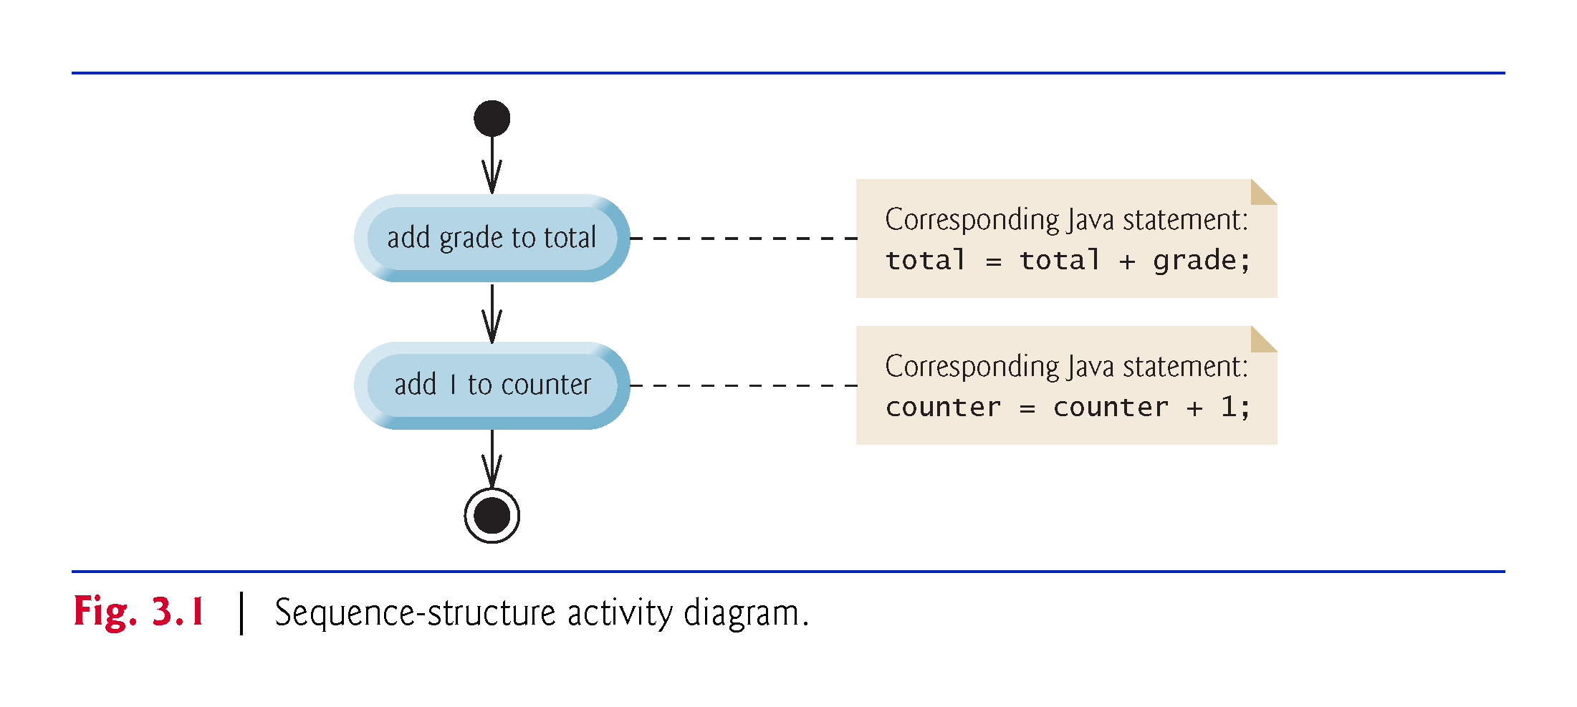

Slide 13
3.4 Control Structures (Cont.)
UML activity diagram
Models the workflow (also called the activity) of a portion of a software system.
May include a portion of an algorithm.
Composed of symbols
  action-state symbols (rectangles with their left and right sides replaced with outward arcs)
  diamonds
  small circles
Symbols connected by transition arrows, which represent the flow of the activity—the order in which the actions should occur.
Help you develop and represent algorithms.
Clearly show how control structures operate.

Slide 14
3.4 Control Structures (Cont.)
Action states contain an action expression that specifies a particular action to perform.
Arrows represent transitions (order in which the actions represented by the action states occur).
Solid circle at the top represents the initial state—the beginning of the workflow before the program performs the modeled actions.
Solid circle surrounded by a hollow circle at the bottom represents the final state—the end of the workflow after the program performs its actions.

Slide 15
3.4 Control Structures (Cont.)
UML notes
  Like comments in Java.
  Rectangles with the upper-right corners folded over.
  Dotted line connects each note with the element it describes.
  Activity diagrams normally do not show the Java code that implements the activity. We do this here to illustrate how the diagram relates to Java code.
More information on the UML
  visit www.uml.org

Slide 16
3.4 Control Structures (Cont.)
Three types of selection statements.
if statement:
  Performs an action, if a condition is true; skips it, if false.
  Single-selection statement—selects or ignores a single action (or group of actions).
if…else statement:
  Performs an action if a condition is true and performs a different action if the condition is false.
  Double-selection statement—selects between two different actions (or groups of actions).
switch statement
  Performs one of several actions, based on the value of an expression.
  Multiple-selection statement—selects among many different actions (or groups of actions).

Slide 17
3.4 Control Structures (Cont.)
Three iteration statements (also called iteration statements or looping statements)
  Perform statements repeatedly while a loop-continuation condition remains true.
while and for statements perform the action(s) in their bodies zero or more times
  if the loop-continuation condition is initially false, the body will not execute.
The do…while statement performs the action(s) in its body one or more times.
if, else, switch, while, do and for are keywords.
  Appendix C: Complete list of Java keywords.

Slide 18
3.4 Control Structures (Cont.)
Every program is formed by combining the sequence statement, selection statements and iteration statements as appropriate for the algorithm the program implements.
Can model each control statement as an activity diagram.
  Initial state and a final state represent a control statement’s entry point and exit point, respectively.
  Single-entry/single-exit control statements
  Control-statement stacking—connect the exit point of one to the entry point of the next.
  Control-statement nesting—a control statement inside another.

Slide 19
3.5 if Single-Selection Statement
Pseudocode
    If student’s grade is greater than or equal to 60
    Print “Passed”
If the condition is false, the Print statement is ignored, and the next pseudocode statement in order is performed.
Indentation
  Optional, but recommended
  Emphasizes the inherent structure of structured programs
The preceding pseudocode If in Java:
    if (studentGrade >= 60) {
    System.out.println("Passed");
    }
Corresponds closely to the pseudocode.

Slide 20
3.5 if Single-Selection Statement (Cont.)
if statement UML activity diagram.
Diamond, or decision symbol, indicates that a decision is to be made.
Workflow continues along a path determined by the symbol’s guard conditions, which can be true or false.
Each transition arrow emerging from a decision symbol has a guard condition (in square brackets next to the arrow).
If a guard condition is true, the workflow enters the action state to which the transition arrow points.

Slide 21
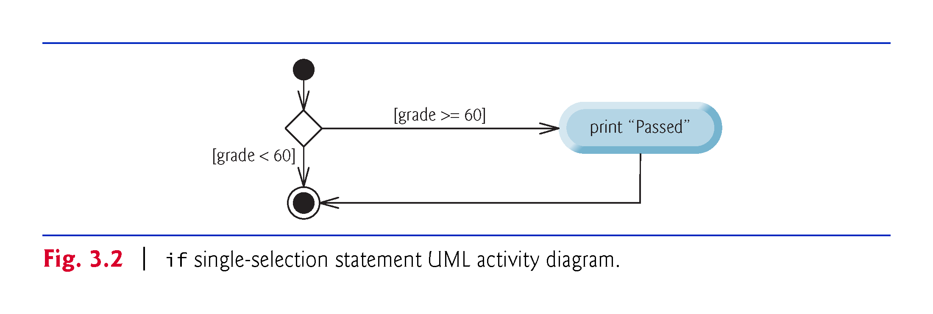

Slide 22
3.6 if…else Double-Selection Statement
if…else double-selection statement—specify an action to perform when the condition is true and another action when the condition is false.
Pseudocode
    If student’s grade is greater than or equal to 60
    Print “Passed”
    Else
    Print “Failed”
The preceding If…Else pseudocode statement in Java:
    if (grade >= 60) {
    System.out.println("Passed");
    }
    else {
    System.out.println("Failed");
    }
Note that the body of the else is also indented.

Slide 23
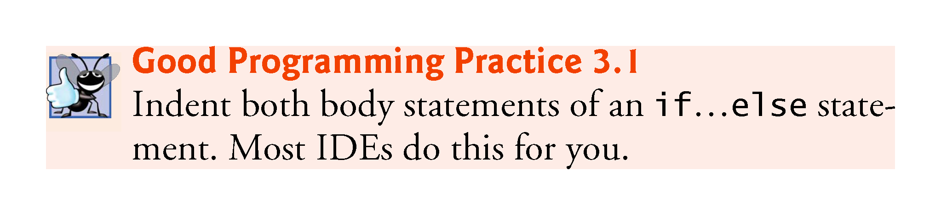

Slide 24
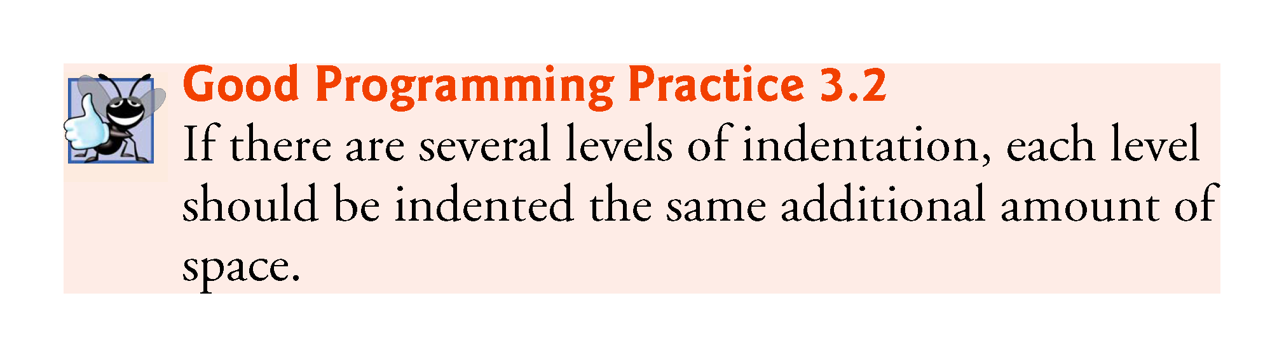

Slide 25
3.6 if…else Double-Selection Statement (Cont.)
if…else statement activity diagram.
The symbols in the UML activity diagram (besides the initial state, transition arrows and final state) represent action states and decisions.

Slide 26
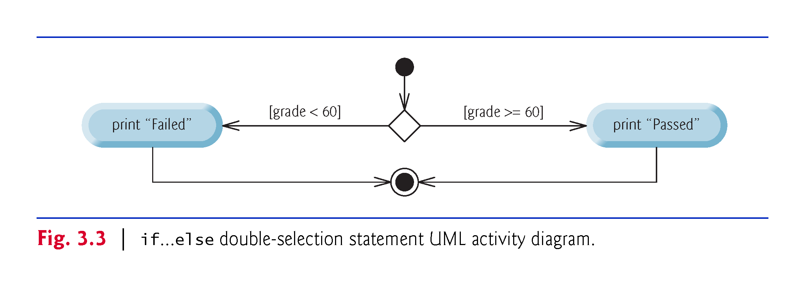

Slide 27
3.6 if…else Double-Selection Statement (Cont.)
Can test multiple cases by placing if…else statements inside other if…else statements to create nested if…else statements.
Pseudocode:
    If student’s grade is greater than or equal to 90
    Print “A”
    else
    If student’s grade is greater than or equal to 80
    Print “B”
    else
    If student’s grade is greater than or equal to 70
    Print “C”
    else
    If student’s grade is greater than or equal to 60
    Print “D”
    else
    Print “F”

Slide 28
3.6 if…else Double-Selection Statement (Cont.)
This pseudocode may be written in Java as
    if (studentGrade >= 90) {
    System.out.println("A");
    }
    else {
    if (studentGrade >= 80) {
    System.out.println("B");
    }
    else {
    if (studentGrade >= 70) {
    System.out.println("C");
    }
    else {
    if (studentGrade >= 60) {
    System.out.println("D");
    }
    else {
    System.out.println("F");
    }
    }
    }
    }
If studentGrade >= 90, the first four conditions will be true, but only the statement in the if part of the first if…else statement will execute. After that, the else part of the “outermost” if…else statement is skipped.

Slide 29
3.6 if…else Double-Selection Statement (Cont.)
Most Java programmers prefer to write the preceding nested if…else statement as
    if (studentGrade >= 90) {
    System.out.println("A");
    }
    else if (studentGrade >= 80) {
    System.out.println("B");
    }
    else if (studentGrade >= 70) {
    System.out.println("C");
    }
    else if (studentGrade >= 60) {
    System.out.println("D");
    }
    else {
    System.out.println("F");
    }
The two forms are identical except for the spacing and indentation, which the compiler ignores.

Slide 30
3.6 if…else Double-Selection Statement (Cont.)
The if statement normally expects only one statement in its body.
To include several statements in the body of an if (or the body of an else for an if…else statement), enclose the statements in braces.
Statements contained in a pair of braces form a block.
A block can be placed anywhere that a single statement can be placed.
Example: A block in the else part of an if…else statement:
    if (grade >= 60) {
    System.out.println("Passed");
    }
    else {
    System.out.println("Failed");
    System.out.println("You must take this course again.");
    }

Slide 31
3.6 if…else Double-Selection Statement (Cont.)
Syntax errors (e.g., when one brace in a block is left out of the program) are caught by the compiler.
A logic error (e.g., when both braces in a block are left out of the program) has its effect at execution time.
A fatal logic error causes a program to fail and terminate prematurely.
A nonfatal logic error allows a program to continue executing but causes it to produce incorrect results.

Slide 32
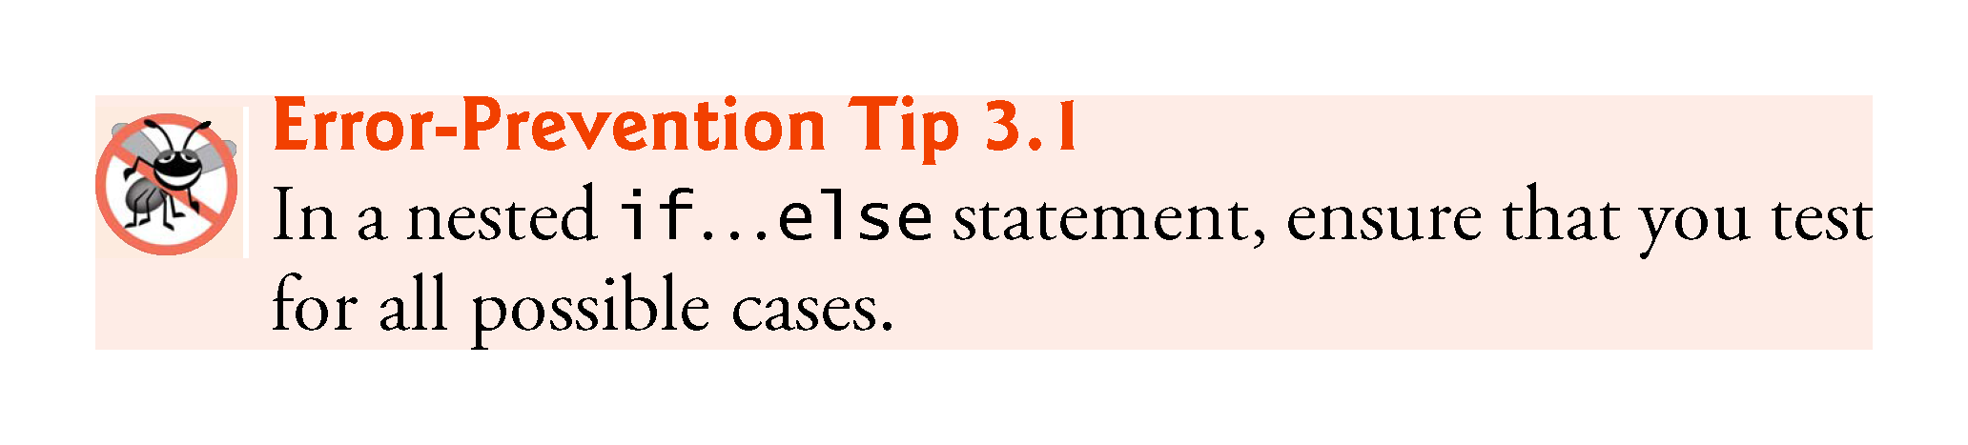

Slide 33
3.6 if…else Double-Selection Statement (Cont.)
Just as a block can be placed anywhere a single statement can be placed, it’s also possible to have an empty statement.
The empty statement is represented by placing a semicolon (;) where a statement would normally be.

Slide 34
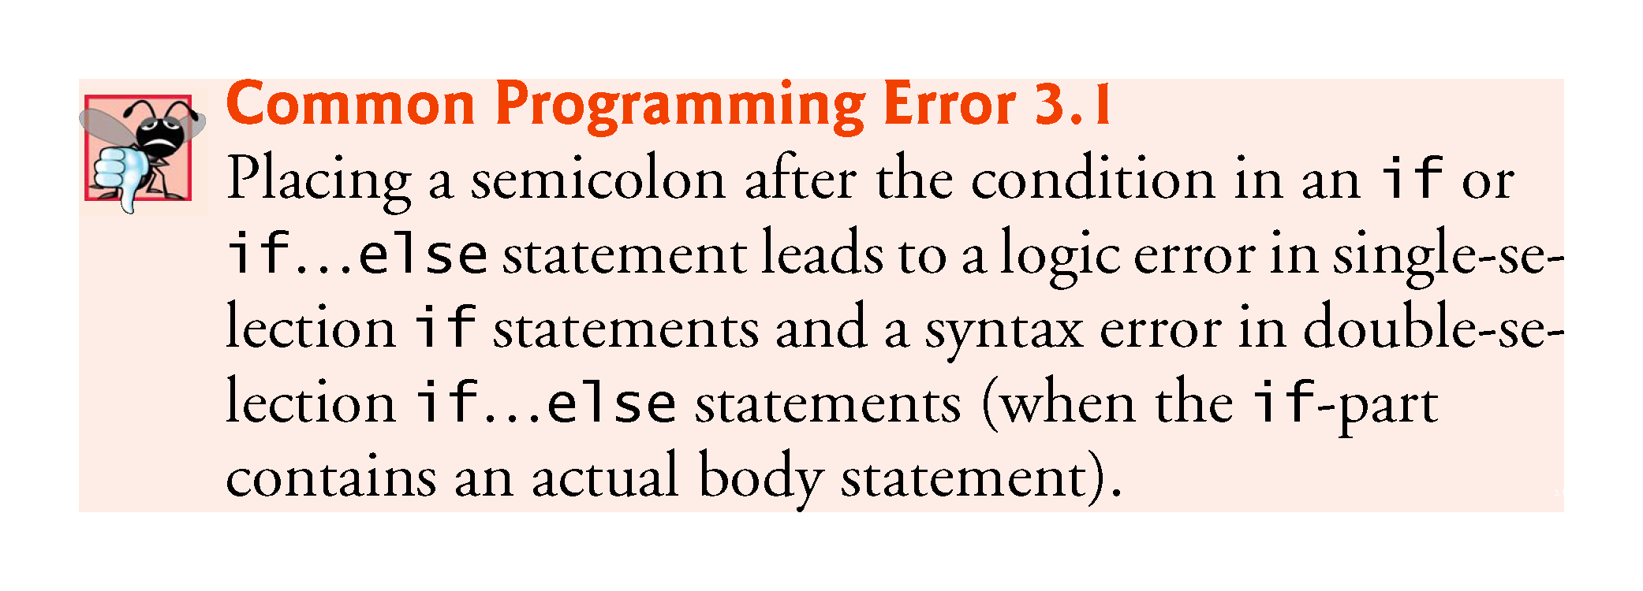

Slide 35
3.6 if…else Double-Selection Statement (Cont.)
Conditional operator (?:)—can be used in place of an if…else statement.
Ternary operator (takes three operands)
Operands and ?: form a conditional expression
Operand to the left of the ? is a boolean expression—evaluates to a boolean value (true or false)
Second operand (between the ? and :) is the value if the condition is true
Third operand (to the right of the :) is the value if the condition evaluates to false.
Example:
    System.out.println(studentGrade >= 60 ? "Passed" : "Failed");
Evaluates to the string "Passed" if the boolean expression studentGrade >= 60 is true and to the string "Failed" if it is false.

Slide 36
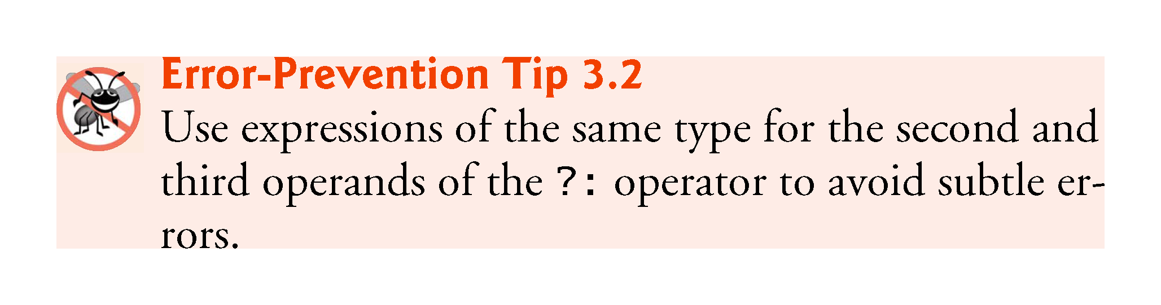

Slide 37
3.7 while Iteration Statement
Iteration statement—repeats an action while a condition remains true.
Pseudocode
    While there are more items on my shopping list
    Purchase next item and cross it off my list
The iteration statement’s body may be a single statement or a block.
Eventually, the condition will become false. At this point, the iteration terminates, and the first statement after the iteration statement executes.

Slide 38
3.7 while Iteration Statement (Cont.)
Example of Java’s while iteration statement: find the first power of 3 larger than 100. Suppose that the int variable product is initialized to 3.
    while (product <= 100) {
    product = 3 * product;
    }
Each iteration multiplies product by 3, so product takes on the values 9, 27, 81 and 243 successively.
When product becomes 243—product <= 100—becomes false.
Iteration terminates. The final value of product is 243.
Program execution continues with the next statement after the while statement.

Slide 39
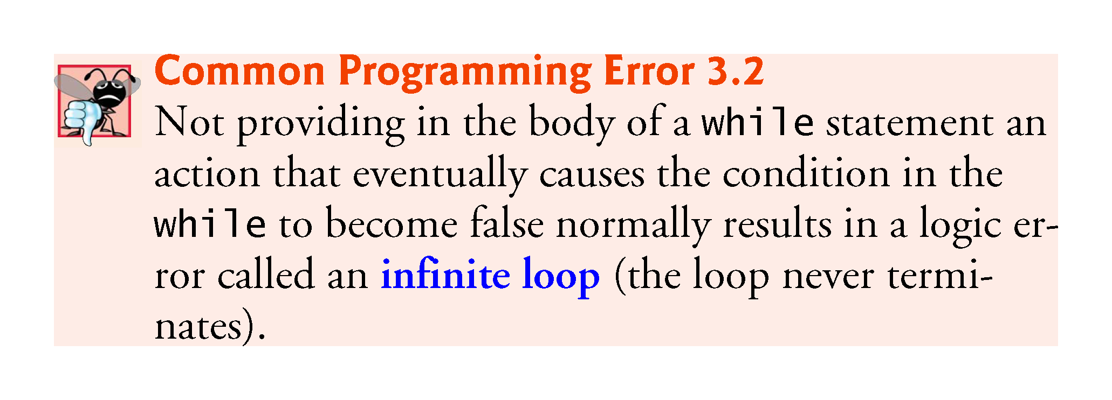

Slide 40
3.7 while Iteration Statement (Cont.)
while statement activity diagram .
The UML represents both the merge symbol and the decision symbol as diamonds.
The merge symbol joins two flows of activity into one.
The decision and merge symbols can be distinguished by the number of “incoming” and “outgoing” transition arrows.
  A decision symbol has one transition arrow pointing to the diamond and two or more pointing out from it to indicate possible transitions from that point. Each transition arrow pointing out of a decision symbol has a guard condition next to it.
  A merge symbol has two or more transition arrows pointing to the diamond and only one pointing from the diamond, to indicate multiple activity flows merging to continue the activity. None of the transition arrows associated with a merge symbol has a guard condition.

Slide 41
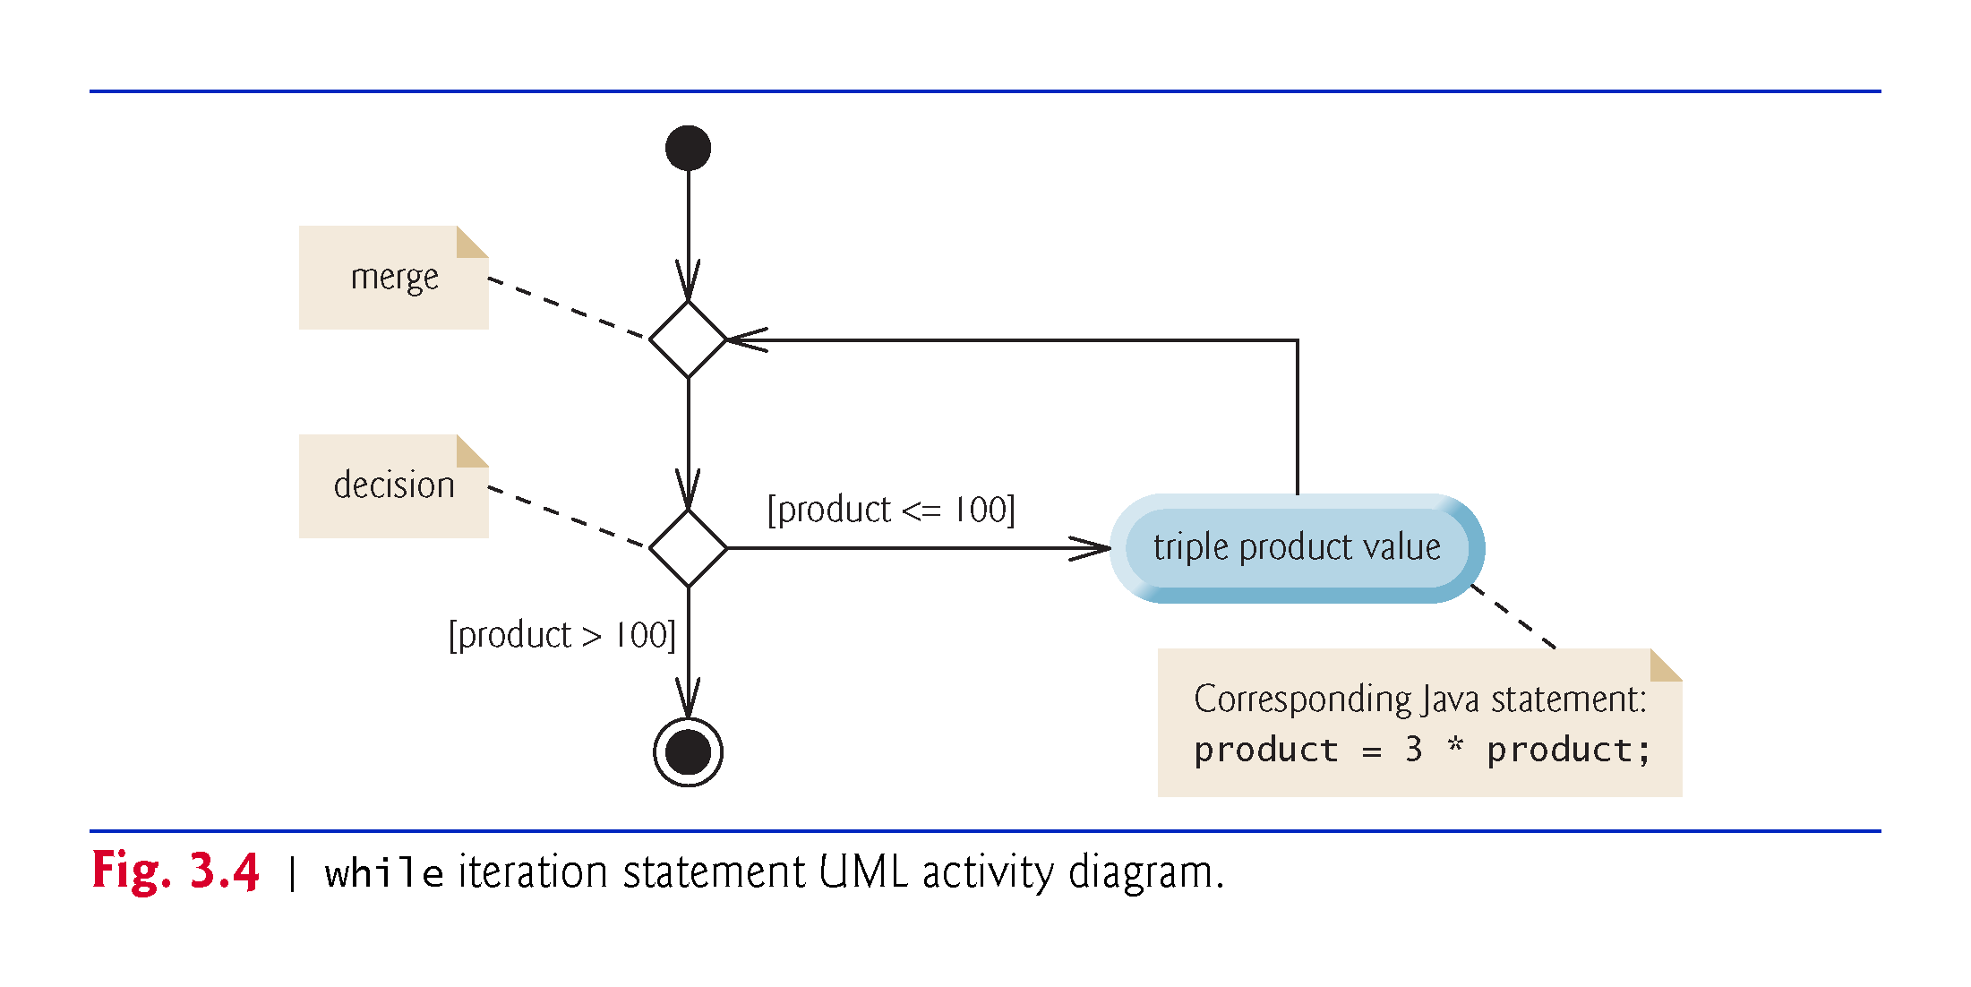

Slide 42
3.8 Formulating Algorithms: Counter-Controlled Iteration
A class of ten students took a quiz. The grades (integers in the range 0 to 100) for this quiz are available to you. Determine the class average on the quiz.
The class average is equal to the sum of the grades divided by the number of students.
The algorithm for solving this problem on a computer must input each grade, keep track of the total of all grades input, perform the averaging calculation and print the result.
Use counter-controlled iteration to input the grades one at a time.
A variable called a counter (or control variable) controls the number of times a set of statements will execute.
Counter-controlled iteration is often called definite iteration, because the number of iterations is known before the loop begins executing.

Slide 43
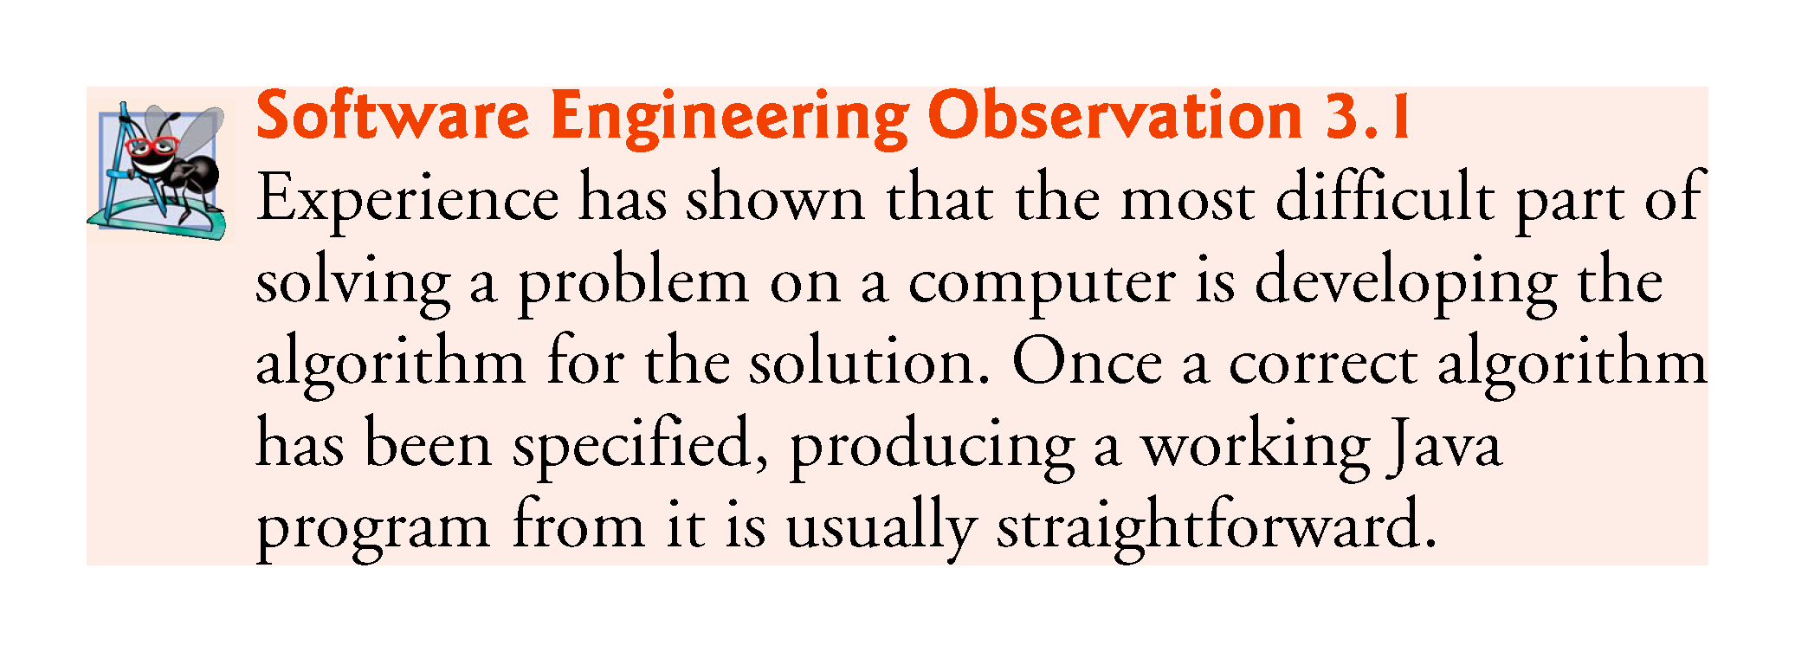

Slide 44
3.8 Formulating Algorithms: Counter-Controlled Iteration (Cont.)
A total is a variable used to accumulate the sum of several values.
A counter is a variable used to count.
Variables used to store totals are normally initialized to zero before being used in a program.

Slide 45
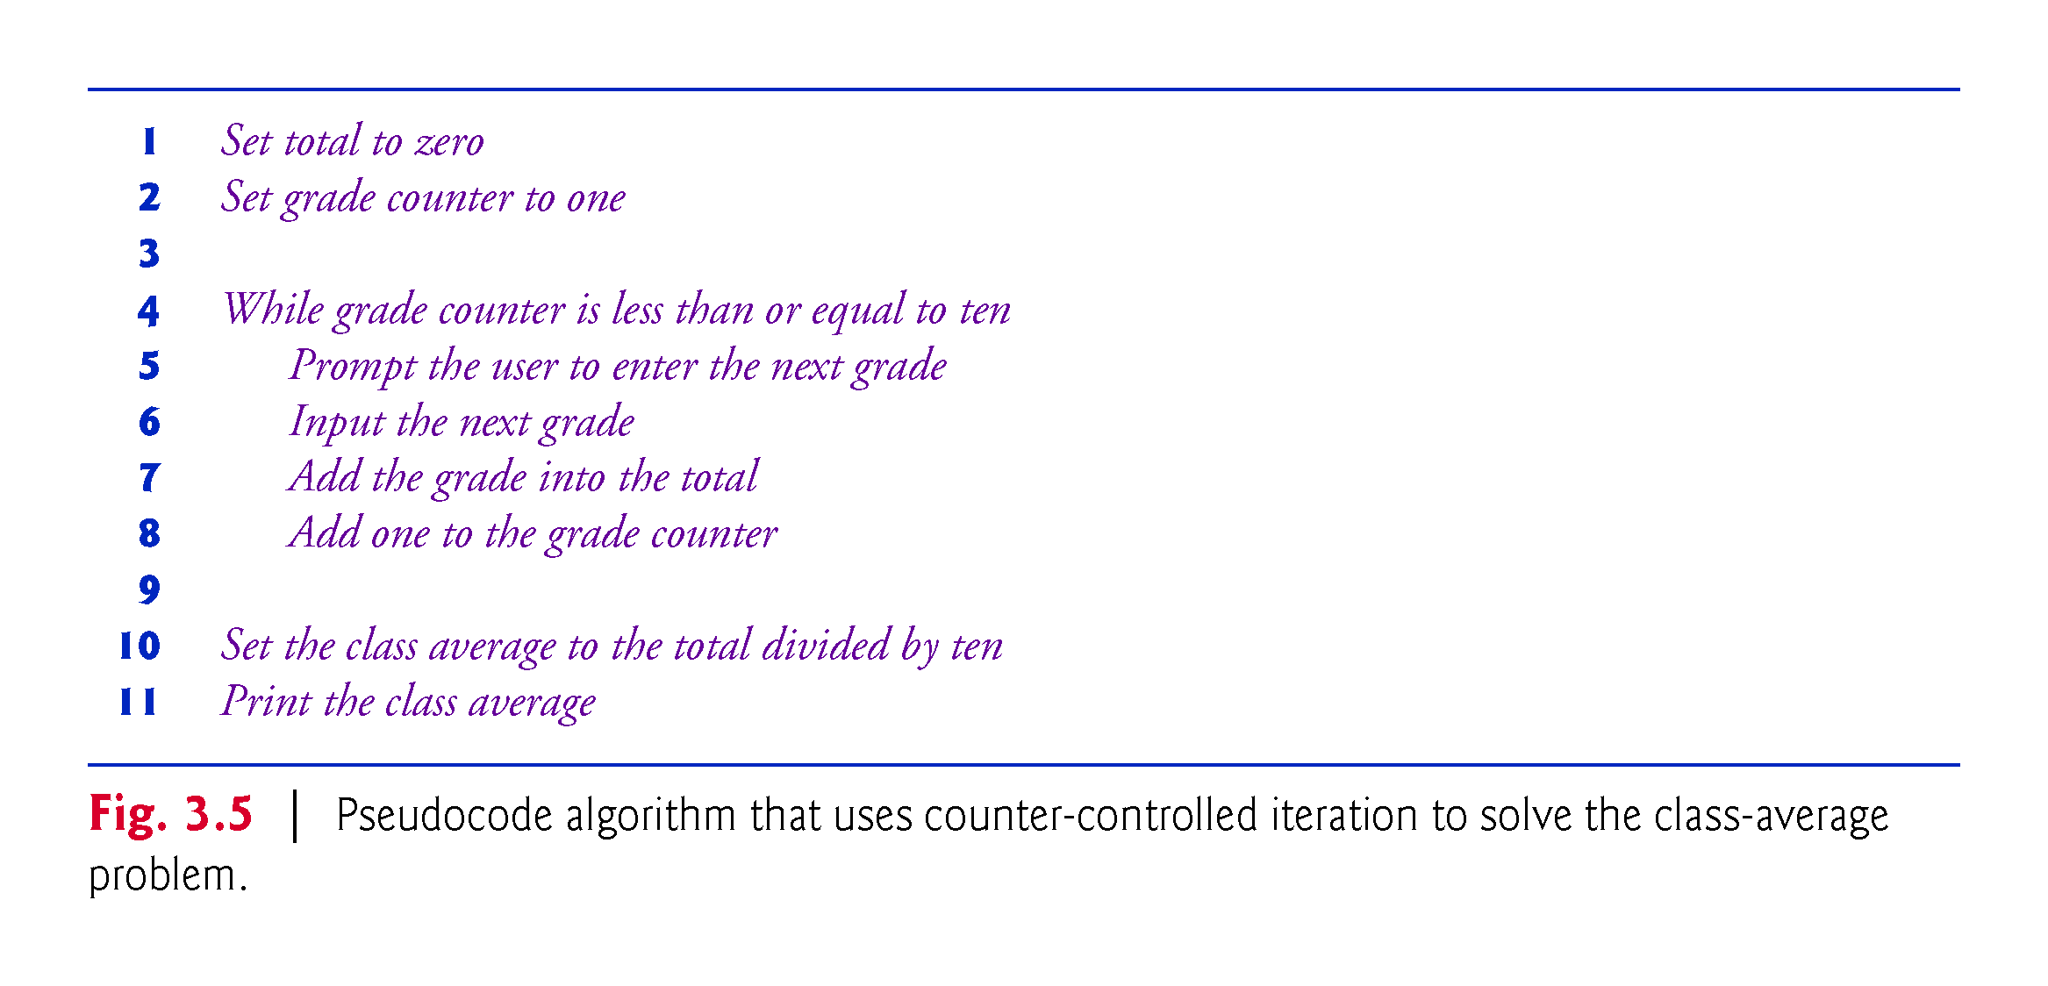

Slide 46
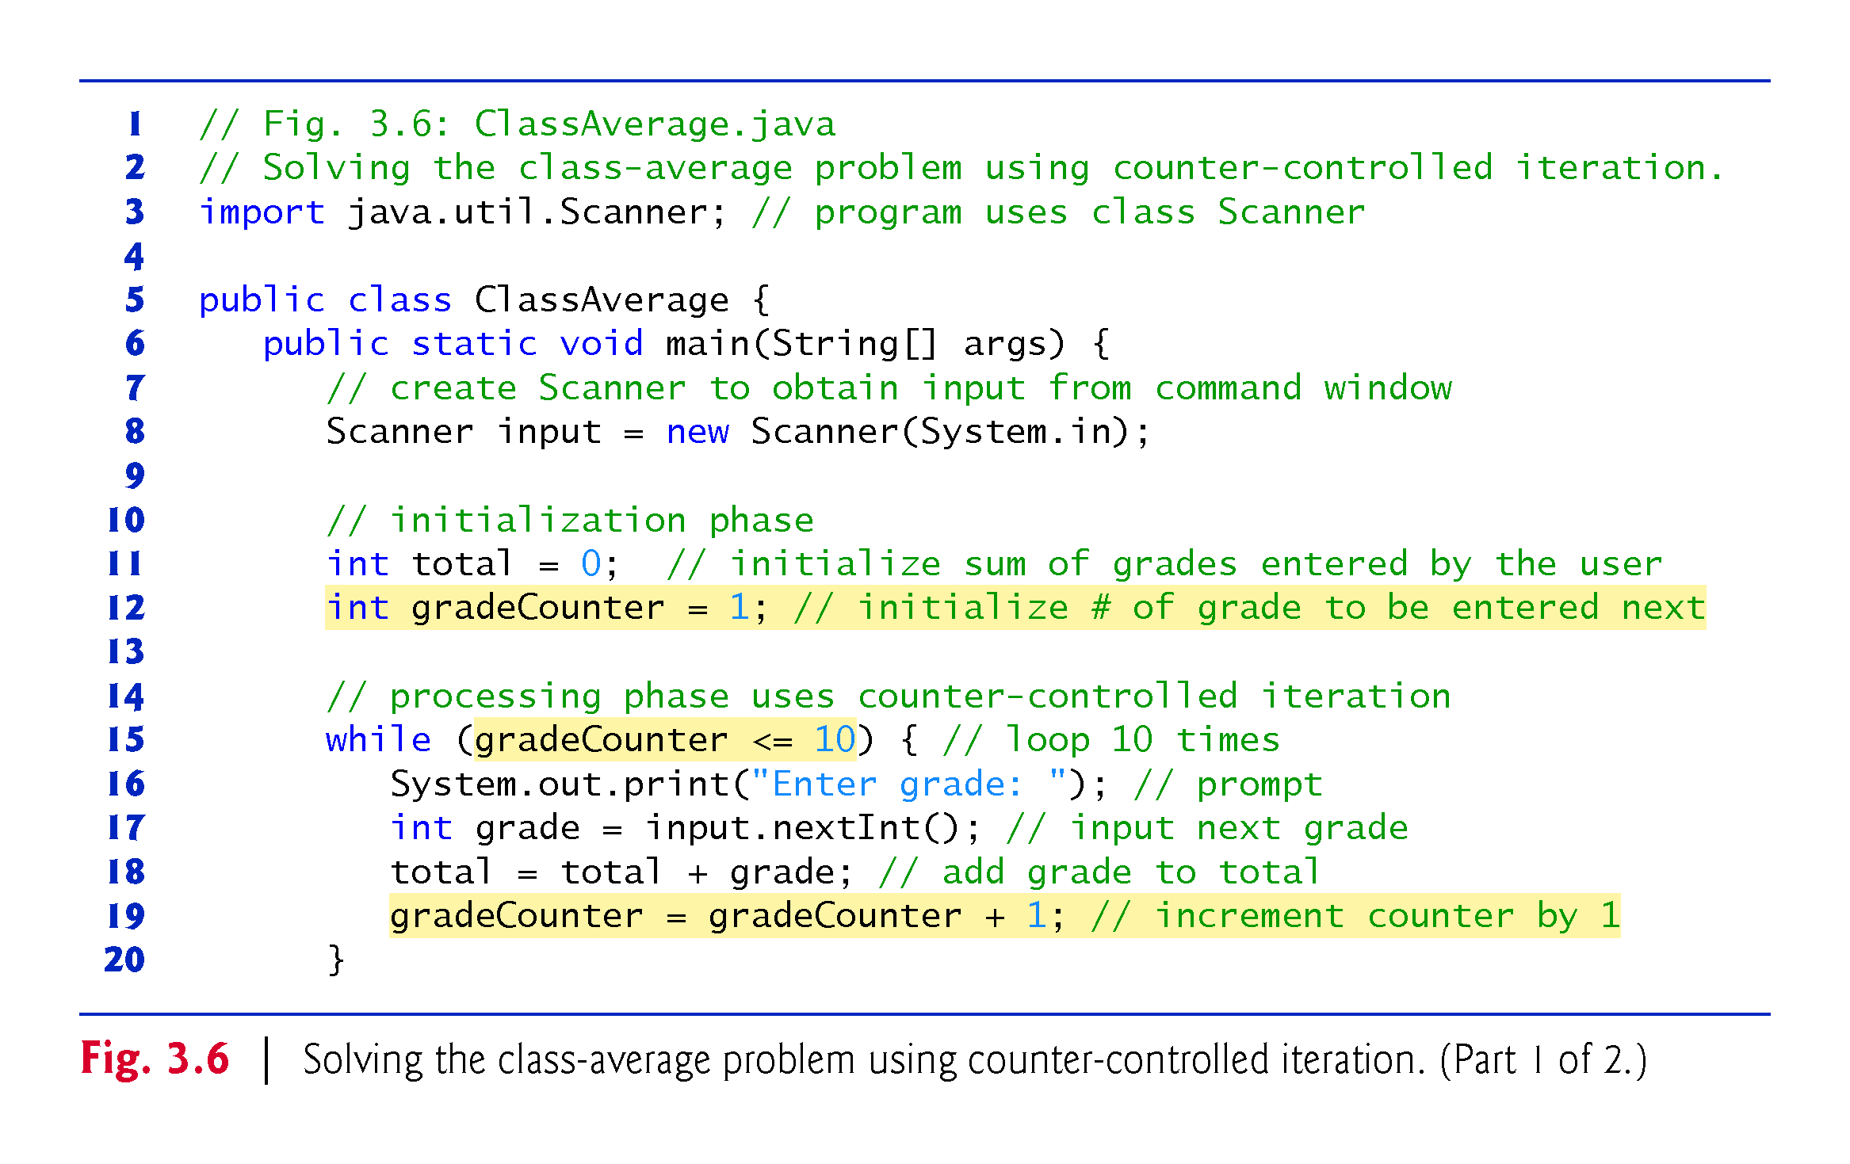

Slide 47
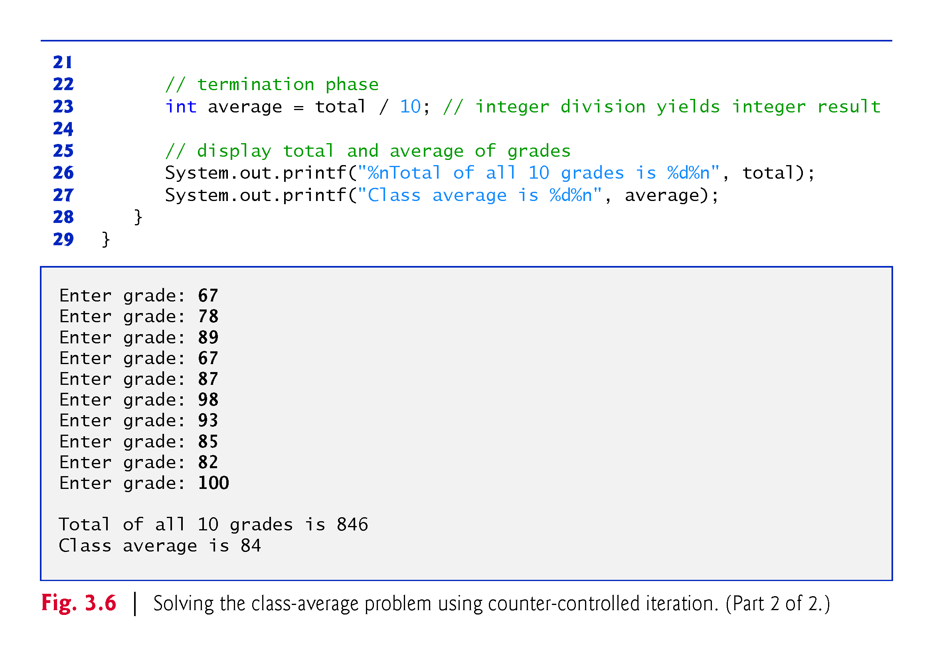

Slide 48
3.8 Formulating Algorithms: Counter-Controlled Iteration (Cont.)
A local variable’s declaration must appear before the variable is used in that method.
A local variable cannot be accessed outside the method in which it’s declared.

Slide 49
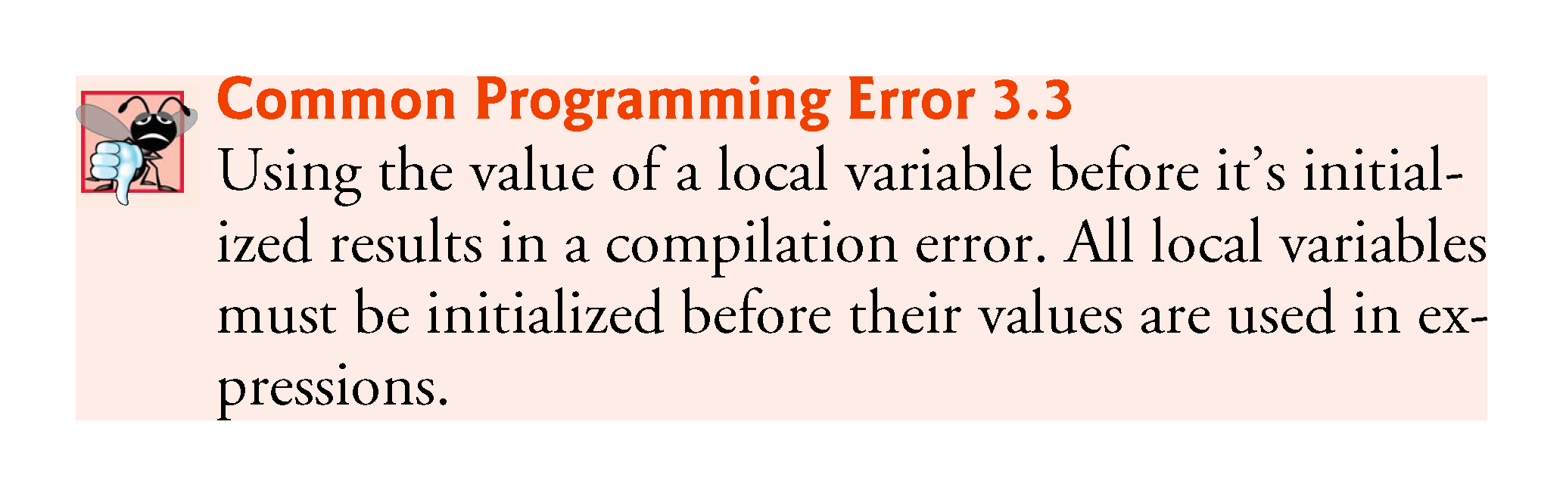

Slide 50
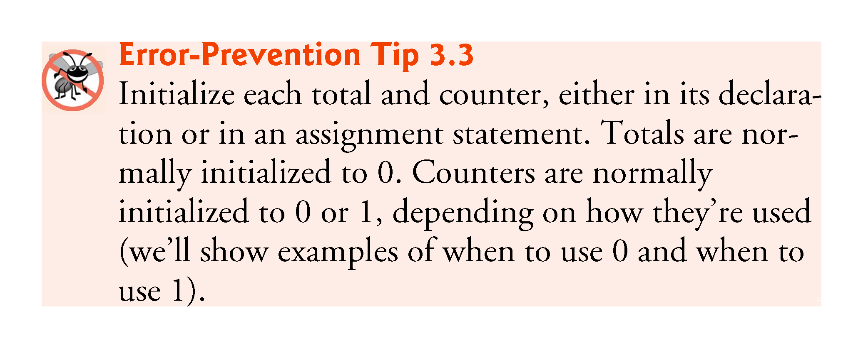

Slide 51
3.8 Formulating Algorithms: Counter-Controlled Iteration (Cont.)
The program’s output indicates that the sum of the grade values in the sample execution is 846, which, when divided by 10, should yield the floating-point number 84.6.
The result of the calculation total / 10 is the integer 84, because total and 10 are both integers.
Dividing two integers results in integer division—any fractional part of the calculation is truncated (i.e., lost).

Slide 52
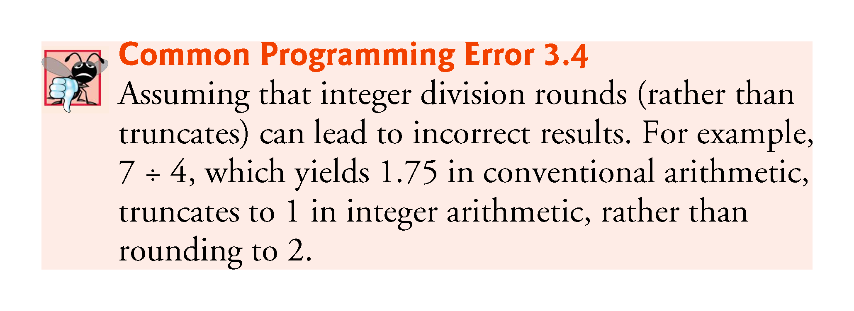

Slide 53
3.8 Formulating Algorithms: Counter-Controlled Iteration (Cont.)
In Fig. 3.6,
    total = total + grade; // add grade to total
added each grade entered by the user to the total.
This simple statement has a potential problem—adding the integers could result in a value that’s too large to store in an int variable.
  This is known as arithmetic overflow and causes undefined behavior, which can lead to unintended results.

Slide 54
3.8 Formulating Algorithms: Counter-Controlled Iteration (Cont.)
The maximum and minimum values that can be stored in an int variable are represented by the constants MIN_VALUE and MAX_VALUE, respectively, which are defined in class Integer.
There are similar constants for the other integral types and for floating-point types.
Each primitive type has a corresponding class type in package java.lang.

Slide 55
3.8 Formulating Algorithms: Counter-Controlled Iteration (Cont.)
Any time a program receives input from the user, various problems might occur.
  For example,
    // input next grade
    int grade = input.nextInt();
  we assume that the user will enter an integer grade in the range 0 to 100.
However, the person entering a grade could enter an integer less than 0, an integer greater than 100, an integer outside the range of values that can be stored in an int variable, a number containing a decimal point or a value containing letters or special symbols that’s not even an integer.

Slide 56
3.8 Formulating Algorithms: Counter-Controlled Iteration (Cont.)
To ensure that inputs are valid, industrial-strength programs must test for all possible erroneous cases.
A program that inputs grades should validate the grades by using range checking to ensure that hey are values from 0 to 100.
You can then ask the user to reenter any value that’s out of range.
If a program requires inputs from a specific set of values (e.g., nonsequential product codes), you can ensure that each input matches a value in the set.

Slide 57
3.9 Formulating Algorithms: Sentinel-Controlled Iteration
Develop a class-averaging program that processes grades for an arbitrary number of students each time it’s run.
Sentinel-controlled iteration is often called indefinite iteration because the number of iterations is not known before the loop begins executing.
A special value called a sentinel value (also called a signal value, a dummy value or a flag value) can be used to indicate “end of data entry.”
A sentinel value must be chosen that cannot be confused with an acceptable input value.

Slide 58
3.9 Formulating Algorithms: Sentinel-Controlled Iteration (Cont.)
Top-down, stepwise refinement
Begin with a pseudocode representation of the top—a single statement that conveys the overall function of the program:
    Determine the class average for the quiz
The top is a complete representation of a program. Rarely conveys sufficient detail from which to write a Java program.
Divide the top into a series of smaller tasks and list these in the order in which they’ll be performed.
First refinement:
    Initialize variables
    Input, sum and count the quiz grades
    Calculate and print the class average
This refinement uses only the sequence structure—the steps listed should execute in order, one after the other.

Slide 59
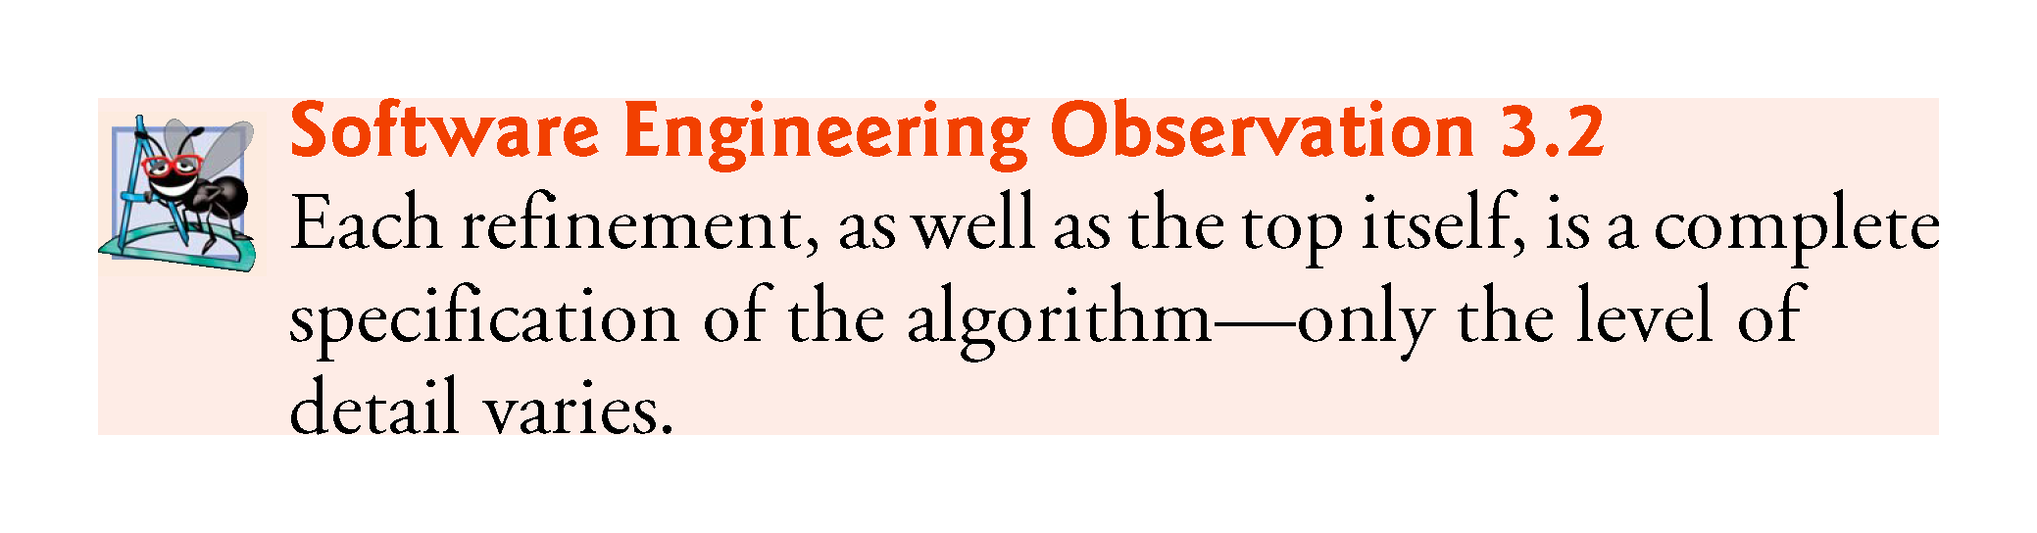

Slide 60
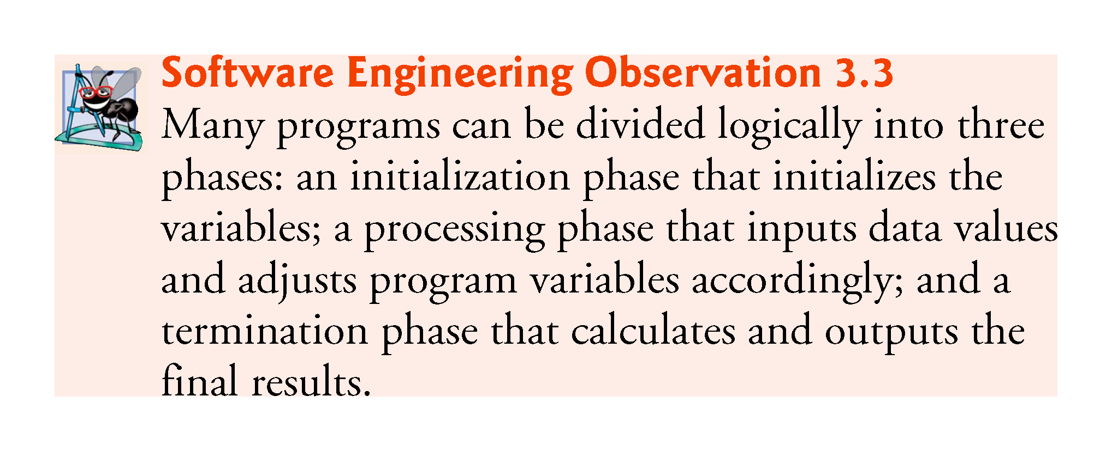

Slide 61
3.9 Formulating Algorithms: Sentinel-Controlled Iteration (Cont.)
Second refinement: commit to specific variables.
The pseudocode statement
      Initialize variables
can be refined as follows:
      Initialize total to zero
      Initialize counter to zero

Slide 62
3.9 Formulating Algorithms: Sentinel-Controlled Iteration (Cont.)
The pseudocode statement
    Input, sum and count the quiz grades
requires an iteration to successively input each grade.
We do not know in advance how many grades will be entered, so we’ll use sentinel-controlled iteration.
The second refinement of the preceding pseudocode statement is then
    Prompt the user to enter the first grade
    Input the first grade (possibly the sentinel)
    While the user has not yet entered the sentinel
    Add this grade into the running total
    Add one to the grade counter
    Prompt the user to enter the next grade
    Input the next grade (possibly the sentinel)

Slide 63
3.9 Formulating Algorithms: Sentinel-Controlled Iteration (Cont.)
The pseudocode statement
    Calculate and print the class average
can be refined as follows:
    If the counter is not equal to zero
    Set the average to the total divided by the counter
    Print the average
    else
    Print “No grades were entered”
Test for the possibility of division by zero—a logic error that, if undetected, would cause the program to fail or produce invalid output.

Slide 64
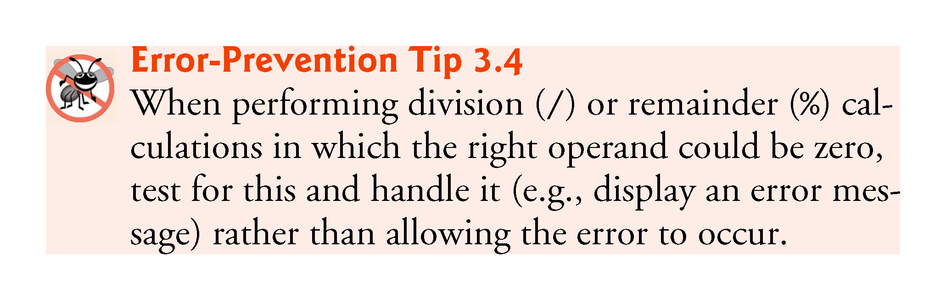

Slide 65
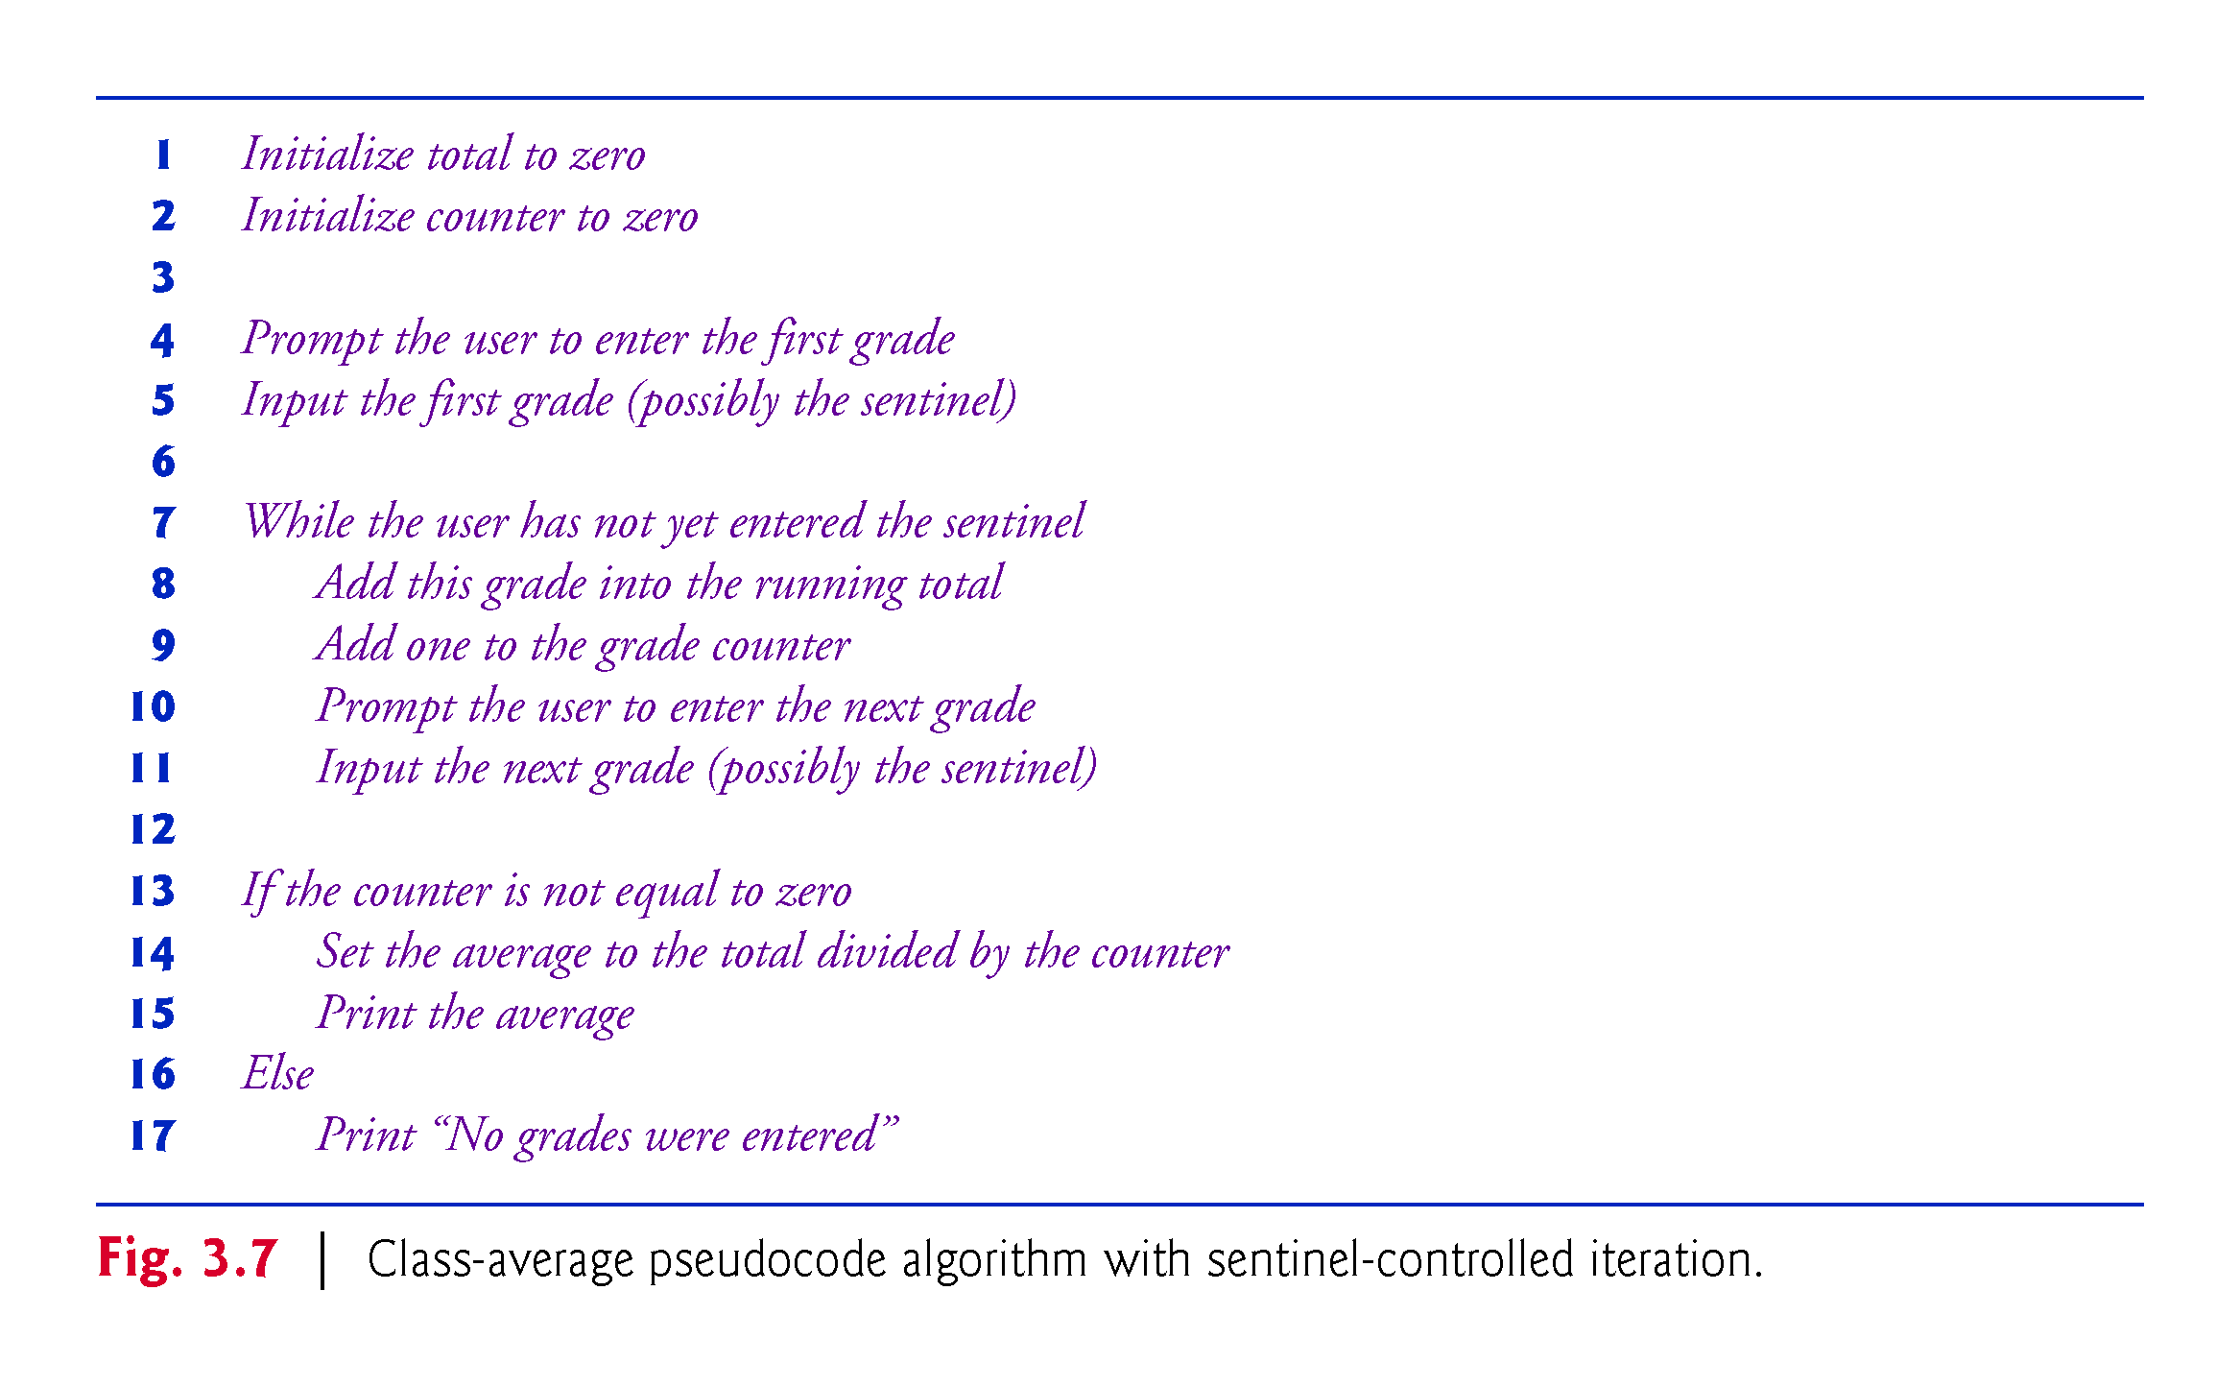

Slide 66
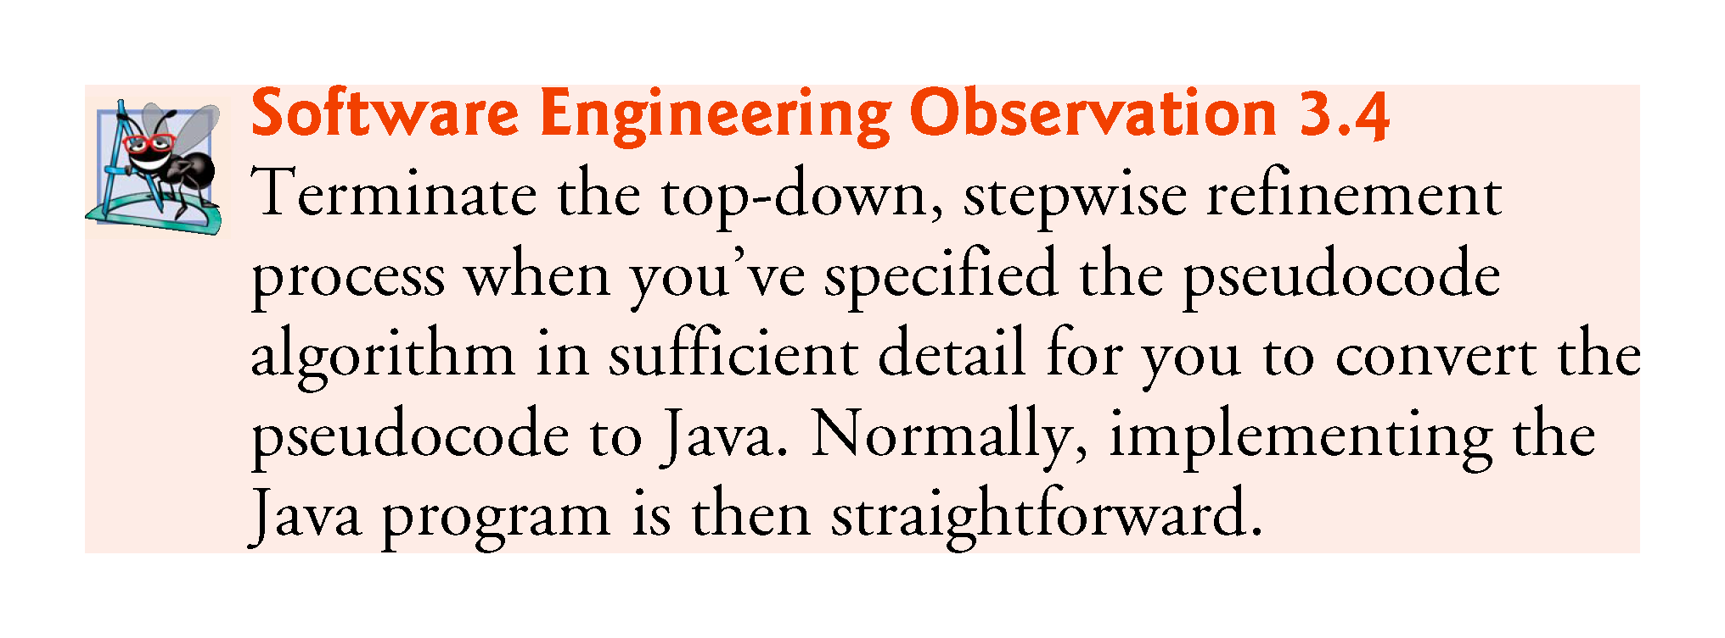

Slide 67
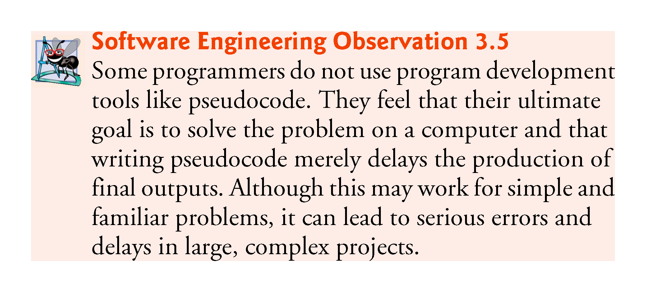

Slide 68
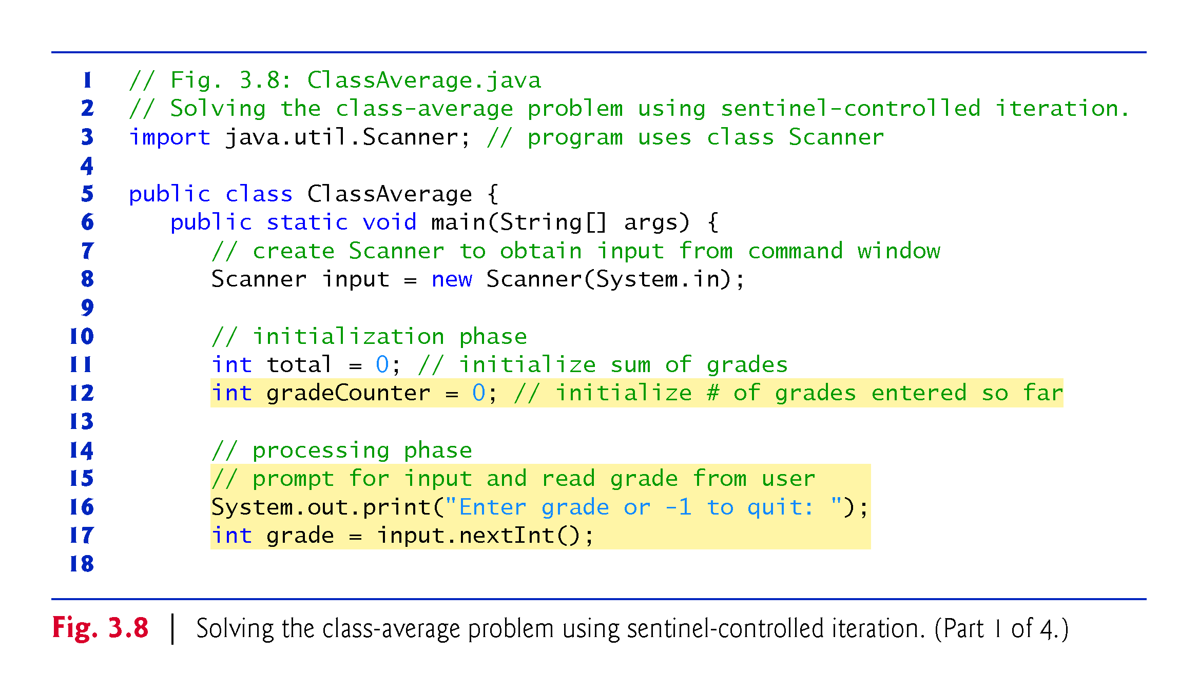

Slide 69
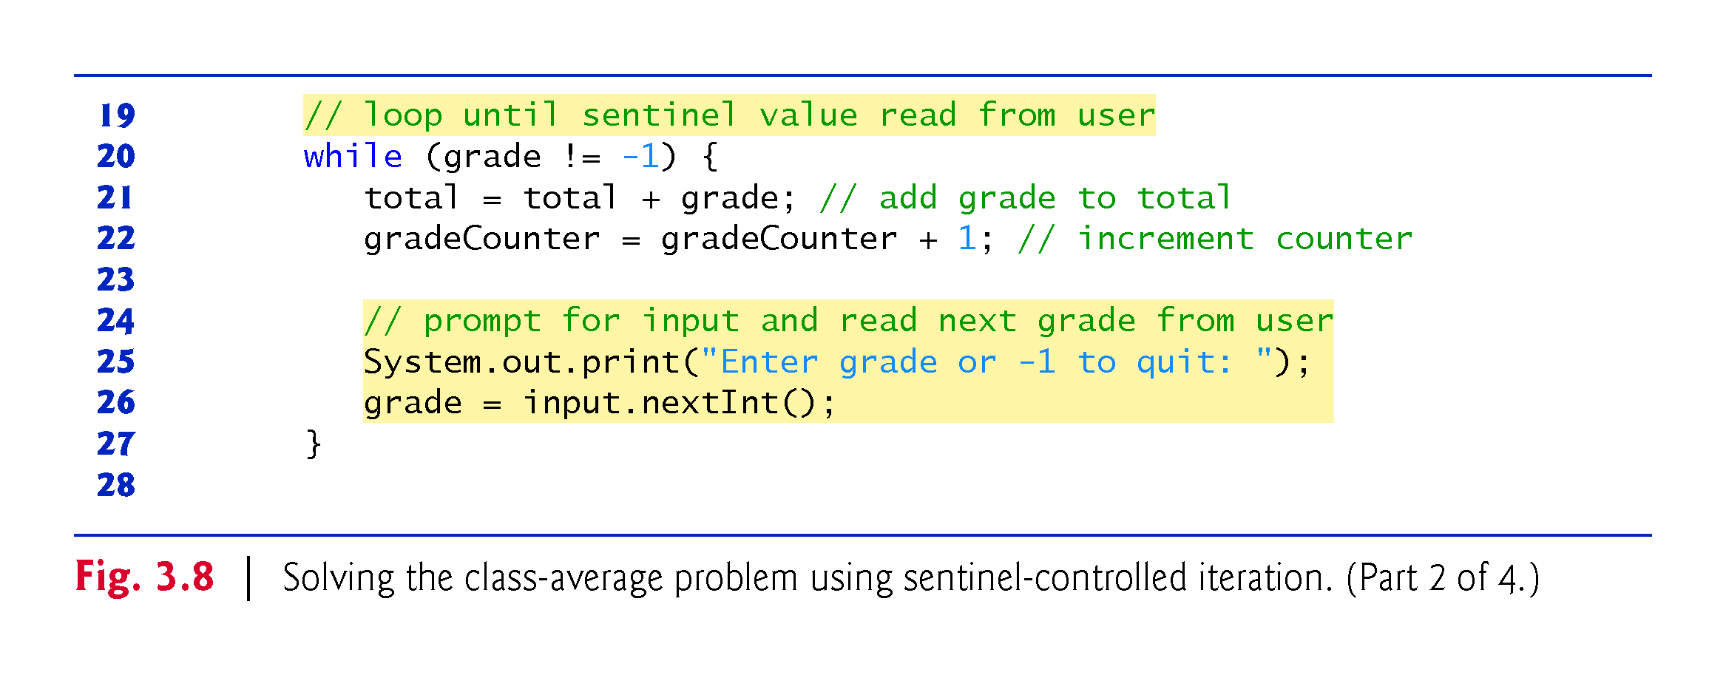

Slide 70
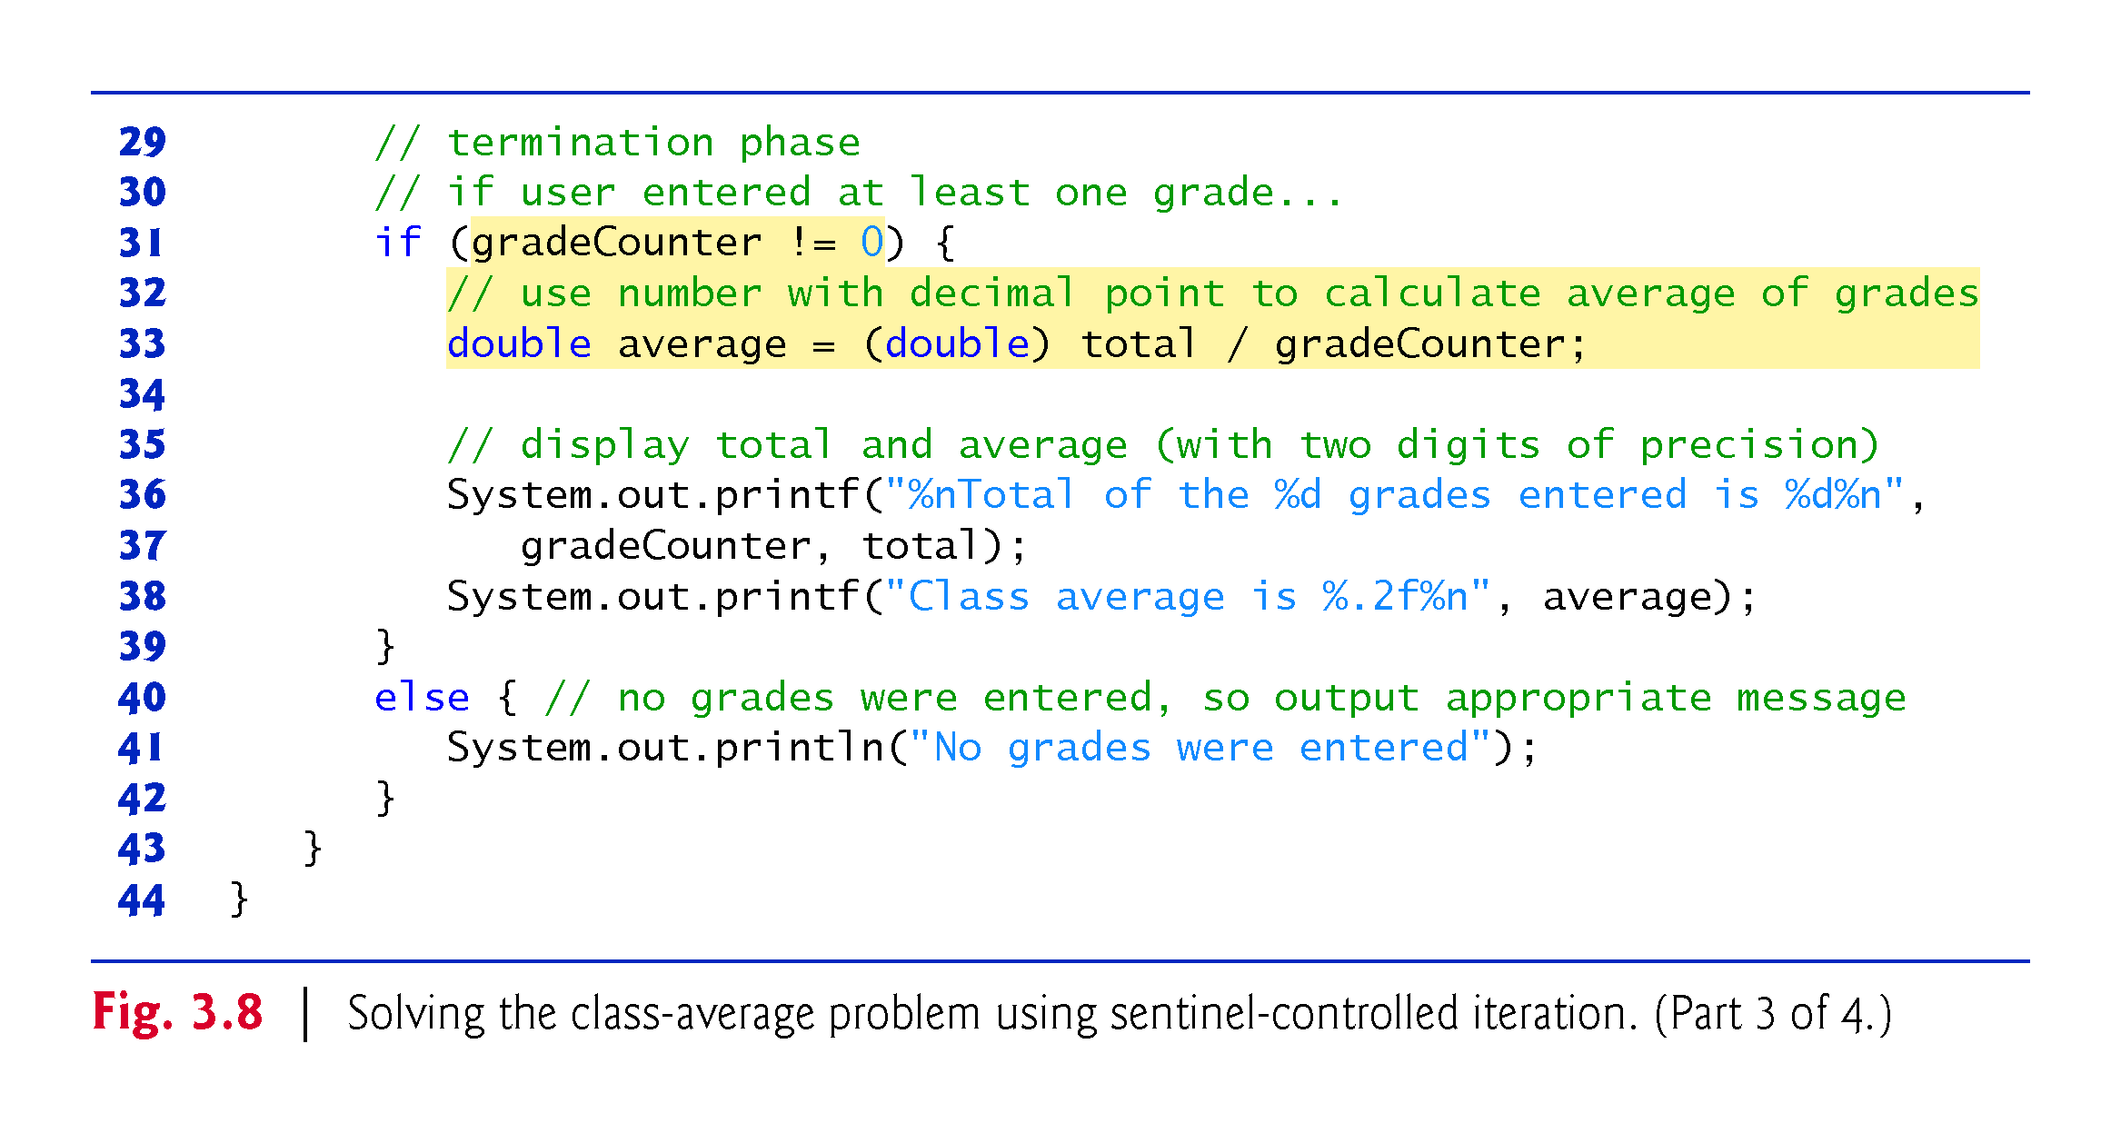

Slide 71
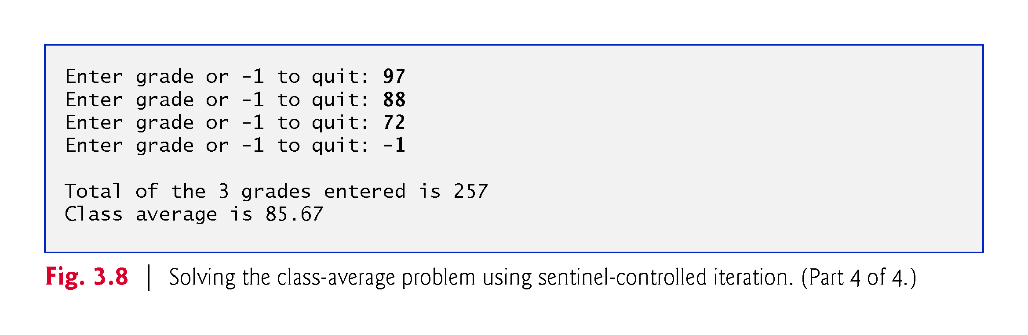

Slide 72
3.9 Formulating Algorithms: Sentinel-Controlled Iteration (Cont.)
Program logic for sentinel-controlled iteration
  Reads the first value before reaching the while.
  This value determines whether the program’s flow of control should enter the body of the while. If the condition of the while is false, the user entered the sentinel value, so the body of the while does not execute (i.e., no grades were entered).
  If the condition is true, the body begins execution and processes the input.
  Then the loop body inputs the next value from the user before the end of the loop.

Slide 73
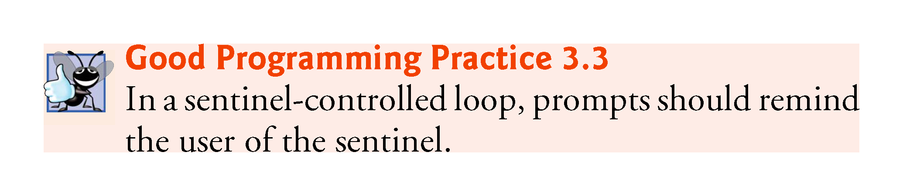

Slide 74
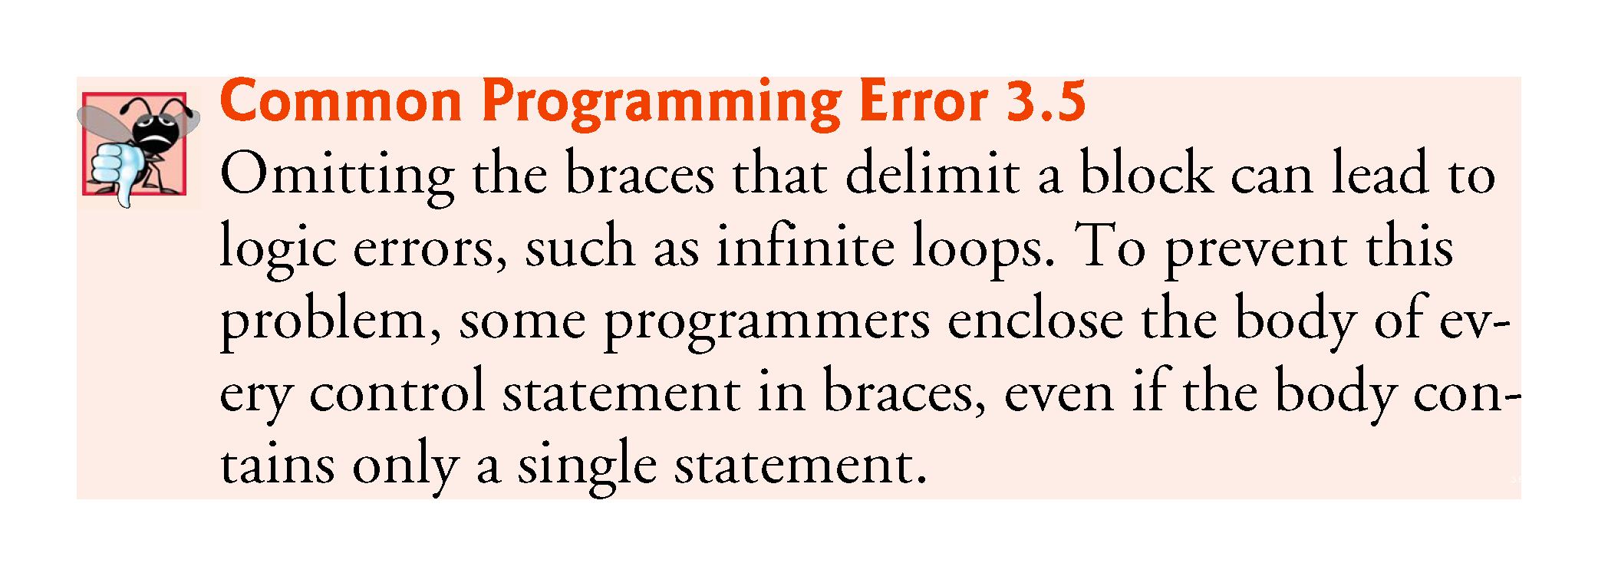

Slide 75
3.9 Formulating Algorithms: Sentinel-Controlled Iteration (Cont.)
Most averages are not whole numbers (e.g., 0, –22 and 1024).
  For this reason, we calculate the class average in this example as a floating-point number.
To perform a floating-point calculation with integers, temporarily treat these values as floating-point numbers for use in the calculation.
The unary cast operator (double) creates a temporary floating-point copy of its operand.
Cast operator performs explicit conversion (or type casting).
The value stored in the operand is unchanged.
Java can evaluate only arithmetic expressions in which the operands’ types are identical.
Promotion (or implicit conversion) performed on operands.
In an expression containing values of the types int and double, the int values are promoted to double values for use in the expression.

Slide 76
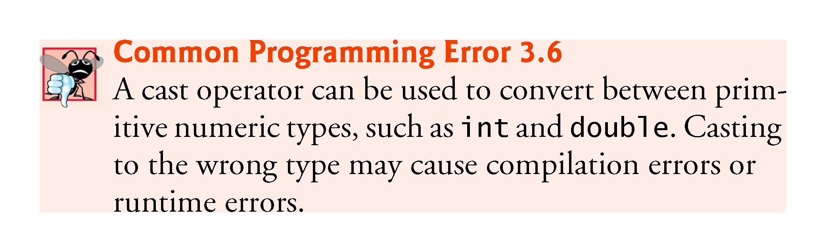

Slide 77
3.9 Formulating Algorithms: Sentinel-Controlled Iteration (Cont.)
A cast operator is formed by placing parentheses around any type’s name.
The operator is a unary operator (i.e., an operator that takes only one operand).
Java also supports unary versions of the plus (+) and minus (–) operators.
Cast operators associate from right to left; same precedence as other unary operators, such as unary + and unary -.
This precedence is one level higher than that of the multiplicative operators *, / and %.
Appendix A: Operator precedence chart

Slide 78
3.9 Formulating Algorithms: Sentinel-Controlled Iteration (Cont.)
Floating-Point Number Precision
Floating-point numbers are not always 100% precise, but they have numerous applications.
For example, when we speak of a “normal” body temperature of 98.6, we do not need to be precise to a large number of digits.
When we read the temperature on a thermometer as 98.6, it may actually be 98.5999473210643.
Calling this number simply 98.6 is fine for most applications involving body temperatures.

Slide 79
3.9 Formulating Algorithms: Sentinel-Controlled Iteration (Cont.)
Floating-point numbers often arise as a result of division.
In conventional arithmetic, when we divide 10 by 3, the result is 3.3333333…, with the sequence of 3s repeating infinitely.
The computer allocates only a fixed amount of space to hold such a value, so clearly the stored floating-point value can be only an approximation.
Owing to the imprecise nature of floating-point numbers, type double is preferred over type float, because double variables can represent floating-point numbers more accurately.
We primarily use type double throughout the book.
In some applications, the precision of float and double variables will be inadequate.
For precise floating-point numbers (such as those required by monetary calculations), Java provides class BigDecimal (package java.math), which we’ll discuss in Chapter 8.

Slide 80
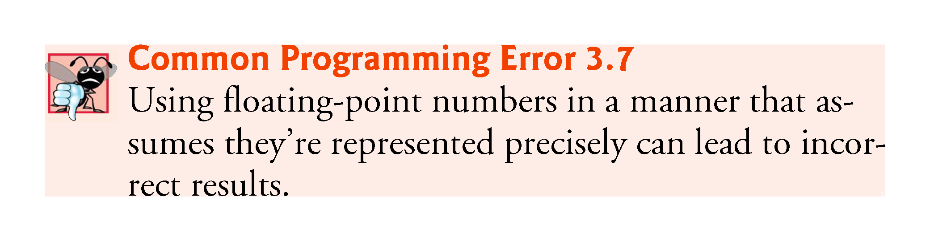

Slide 81
3.10 Formulating Algorithms: Nested Control Statements
This case study examines nesting one control statement within another.
A college offers a course that prepares students for the state licensing exam for real-estate brokers. Last year, ten of the students who completed this course took the exam. The college wants to know how well its students did on the exam. You’ve been asked to write a program to summarize the results. You’ve been given a list of these 10 students. Next to each name is written a 1 if the student passed the exam or a 2 if the student failed.

Slide 82
3.10 Formulating Algorithms: Nested Control Statements (Cont.)
This case study examines nesting one control statement within another.
Your program should analyze the results of the exam as follows:
  Input each test result (i.e., a 1 or a 2). Display the message “Enter result” on the screen each time the program requests another test result.
  Count the number of test results of each type.
  Display a summary of the test results, indicating the number of students who passed and the number who failed.
  If more than eight students passed the exam, print “Bonus to instructor!”

Slide 83
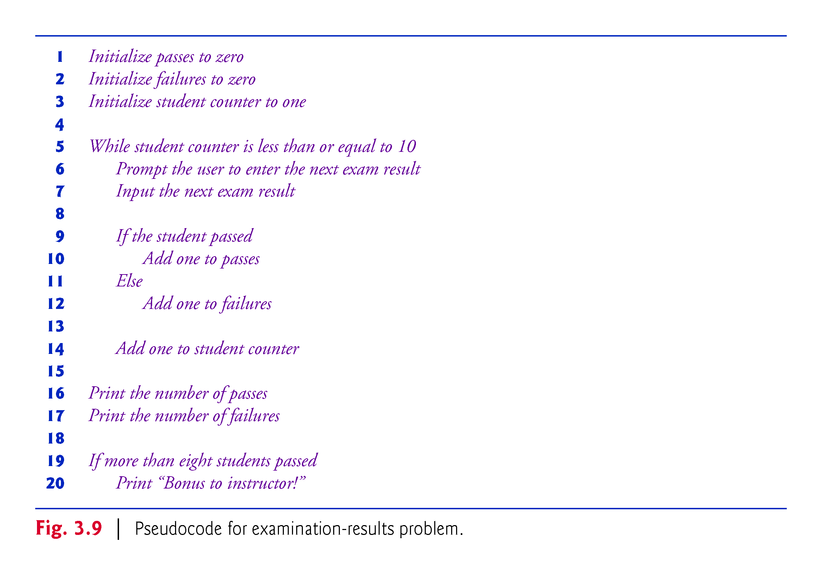

Slide 84
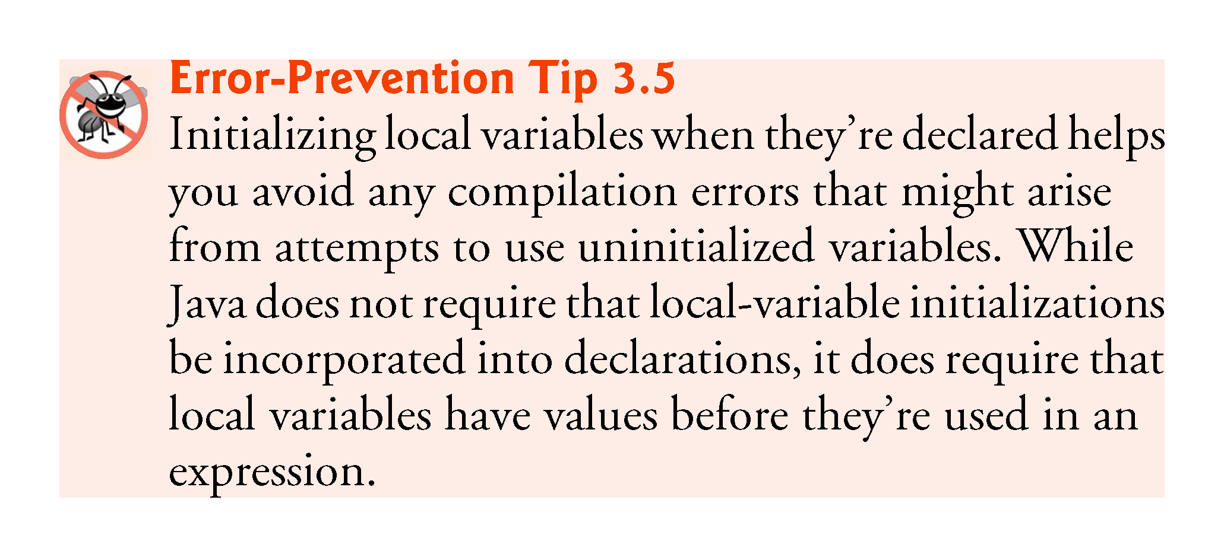

Slide 85
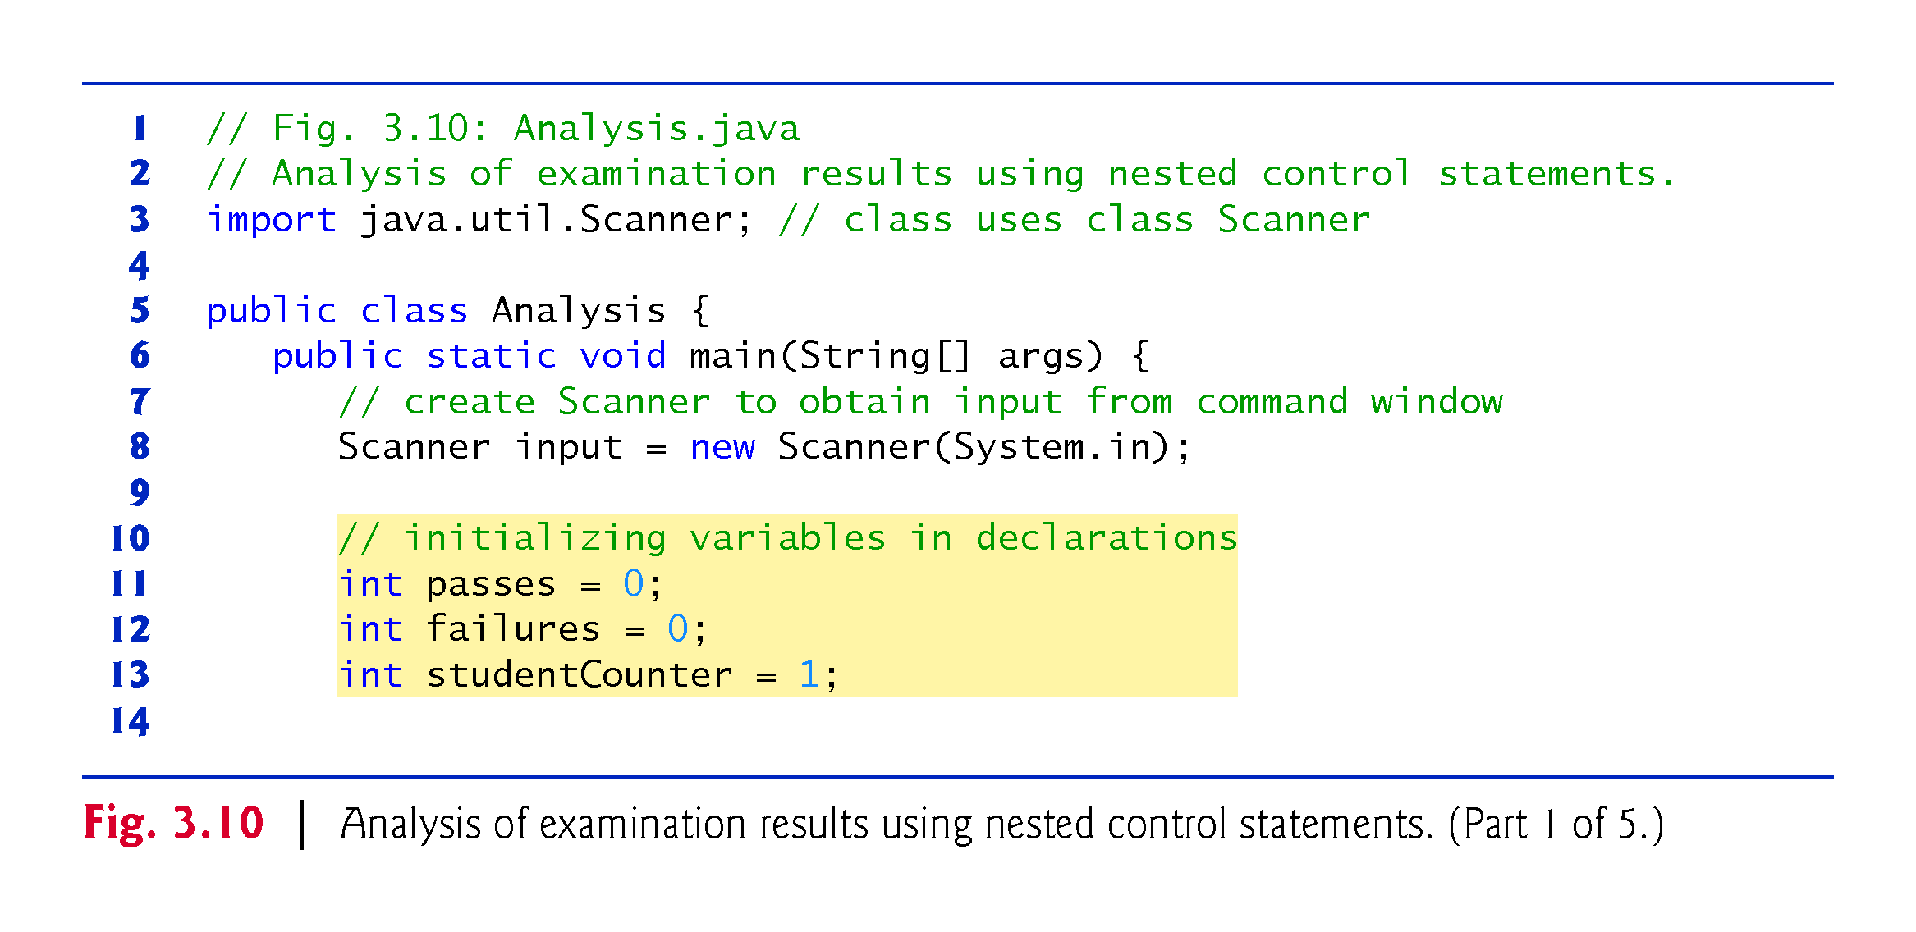

Slide 86
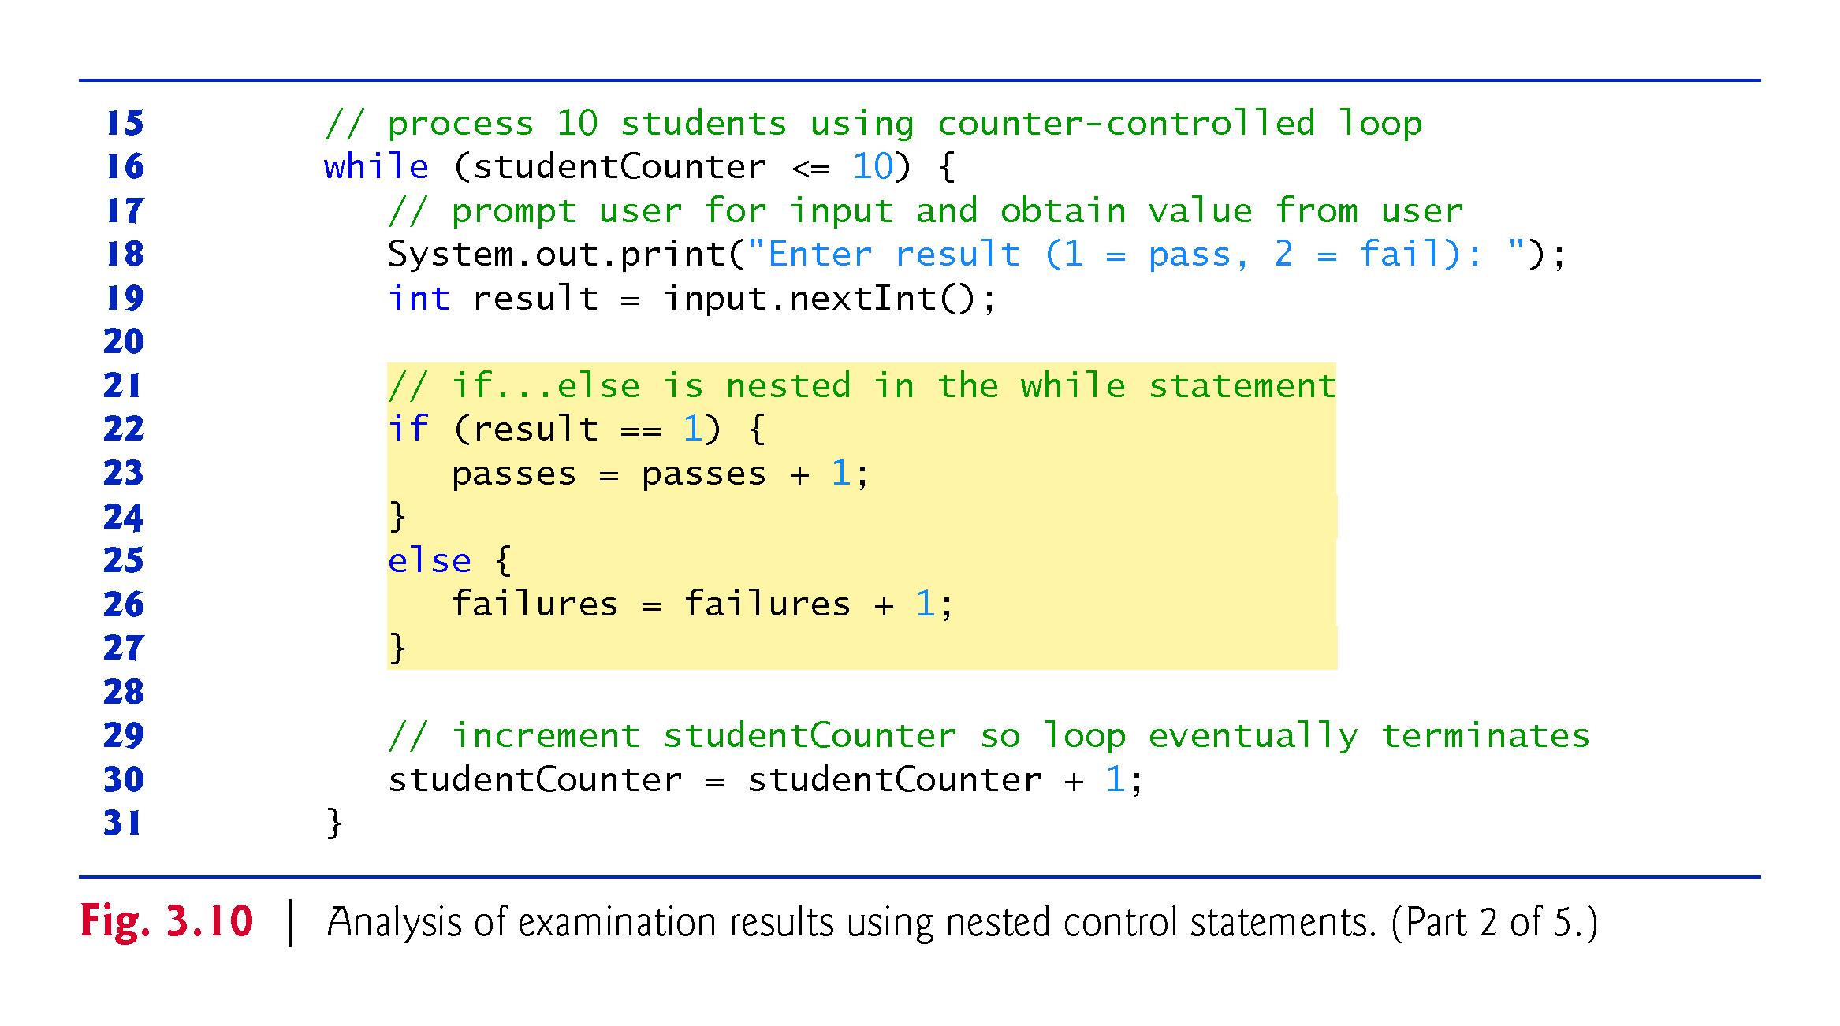

Slide 87
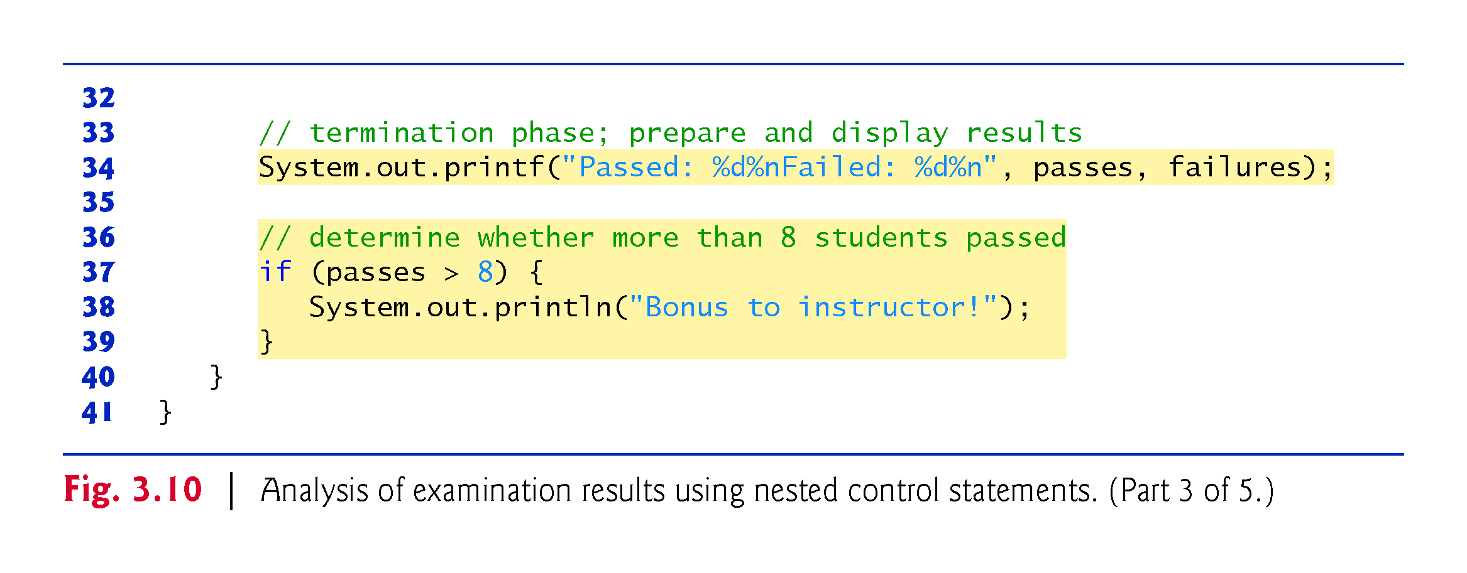

Slide 88
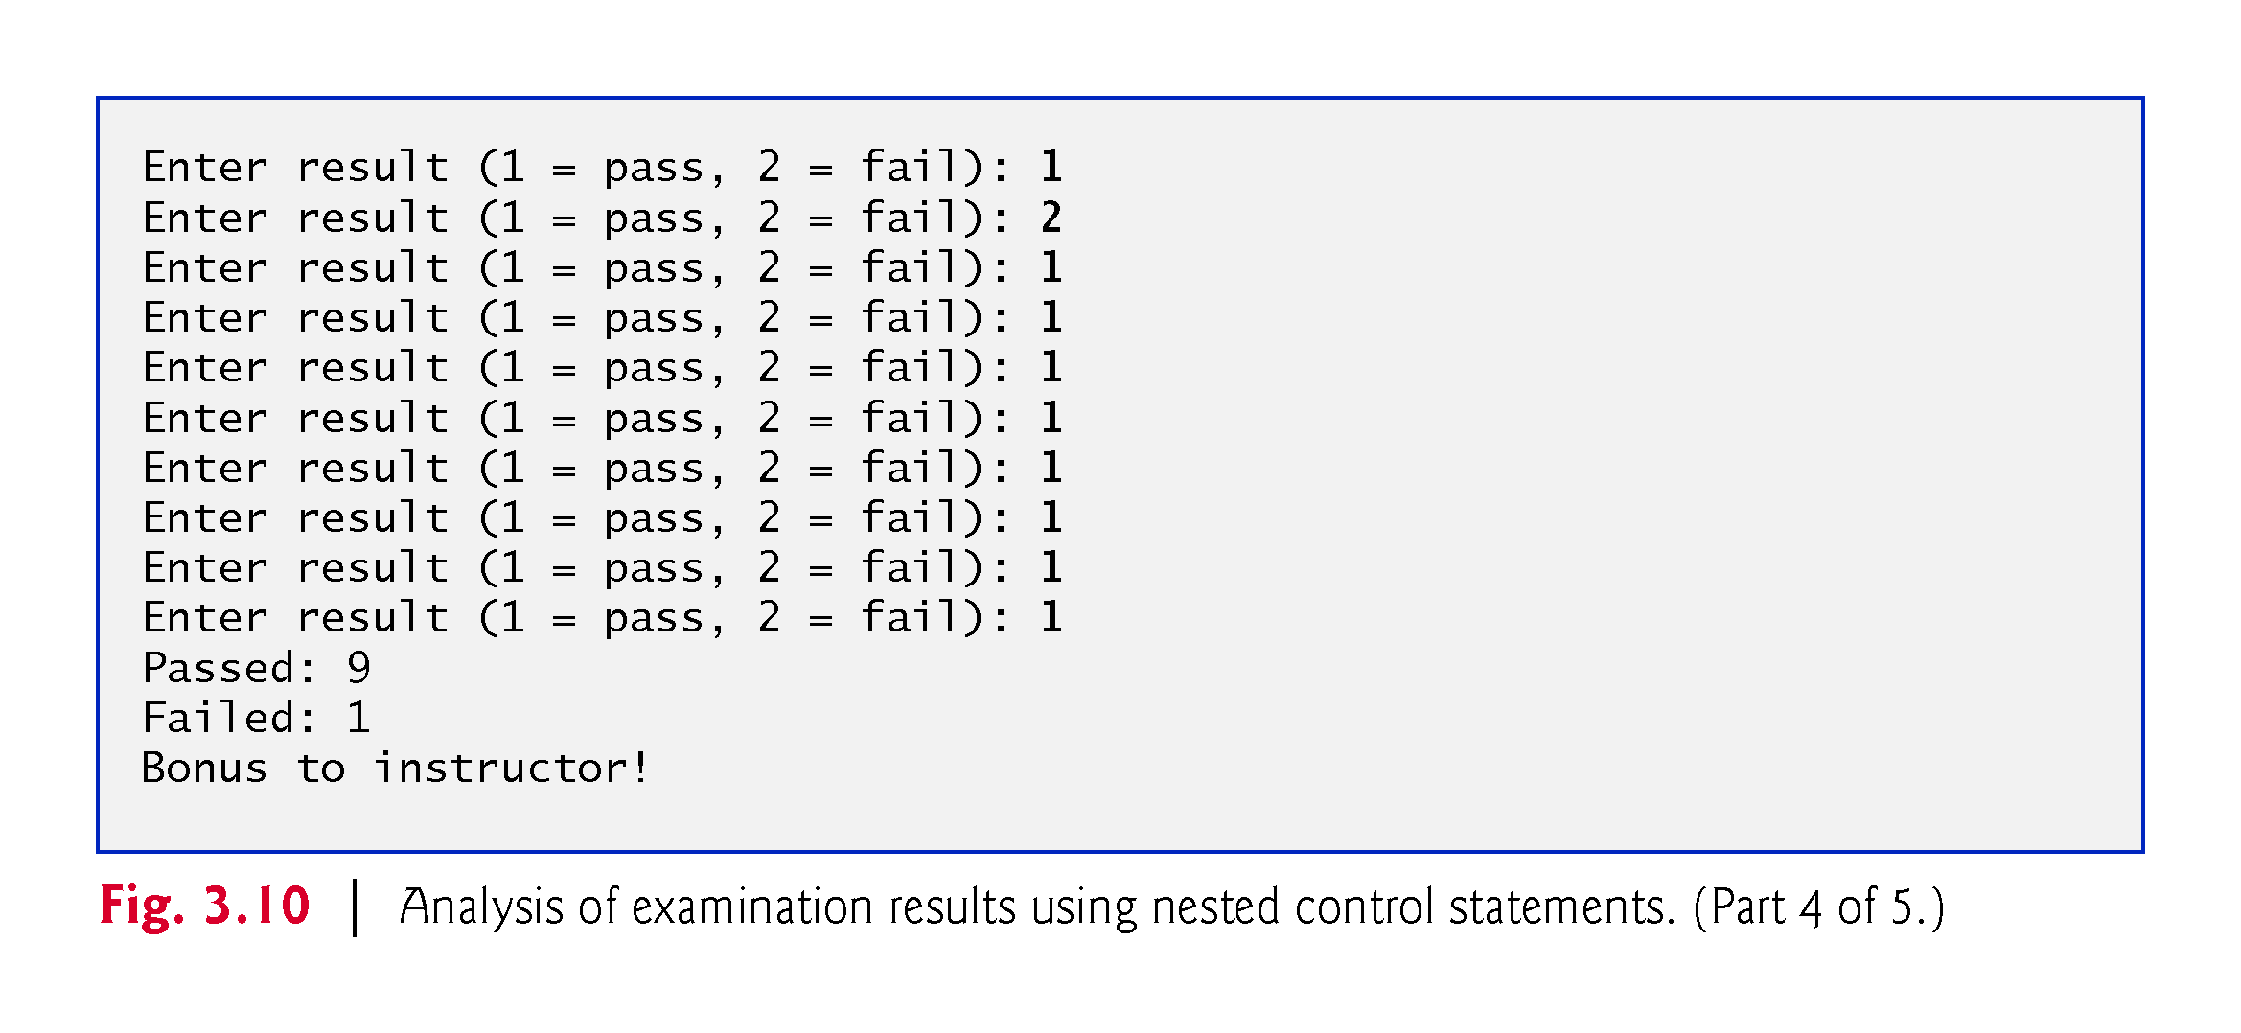

Slide 89
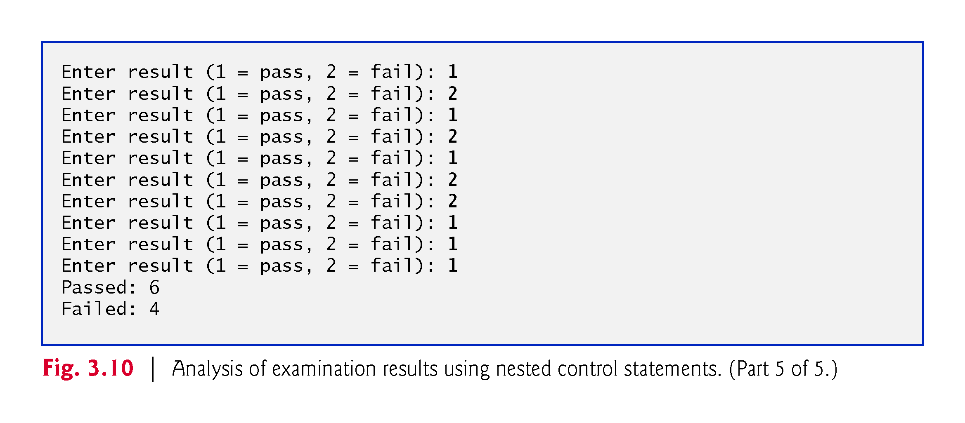

Slide 90
3.11 Compound Assignment Operators
Compound assignment operators abbreviate assignment expressions.
Statements like
variable = variable operator expression;
where operator is one of the binary operators +, -, *, / or % can be written in the form
    variable operator= expression;
Example:
    c = c + 3;
can be written with the addition compound assignment operator, +=, as
    c += 3;
The += operator adds the value of the expression on its right to the value of the variable on its left and stores the result in the variable on the left of the operator.

Slide 91
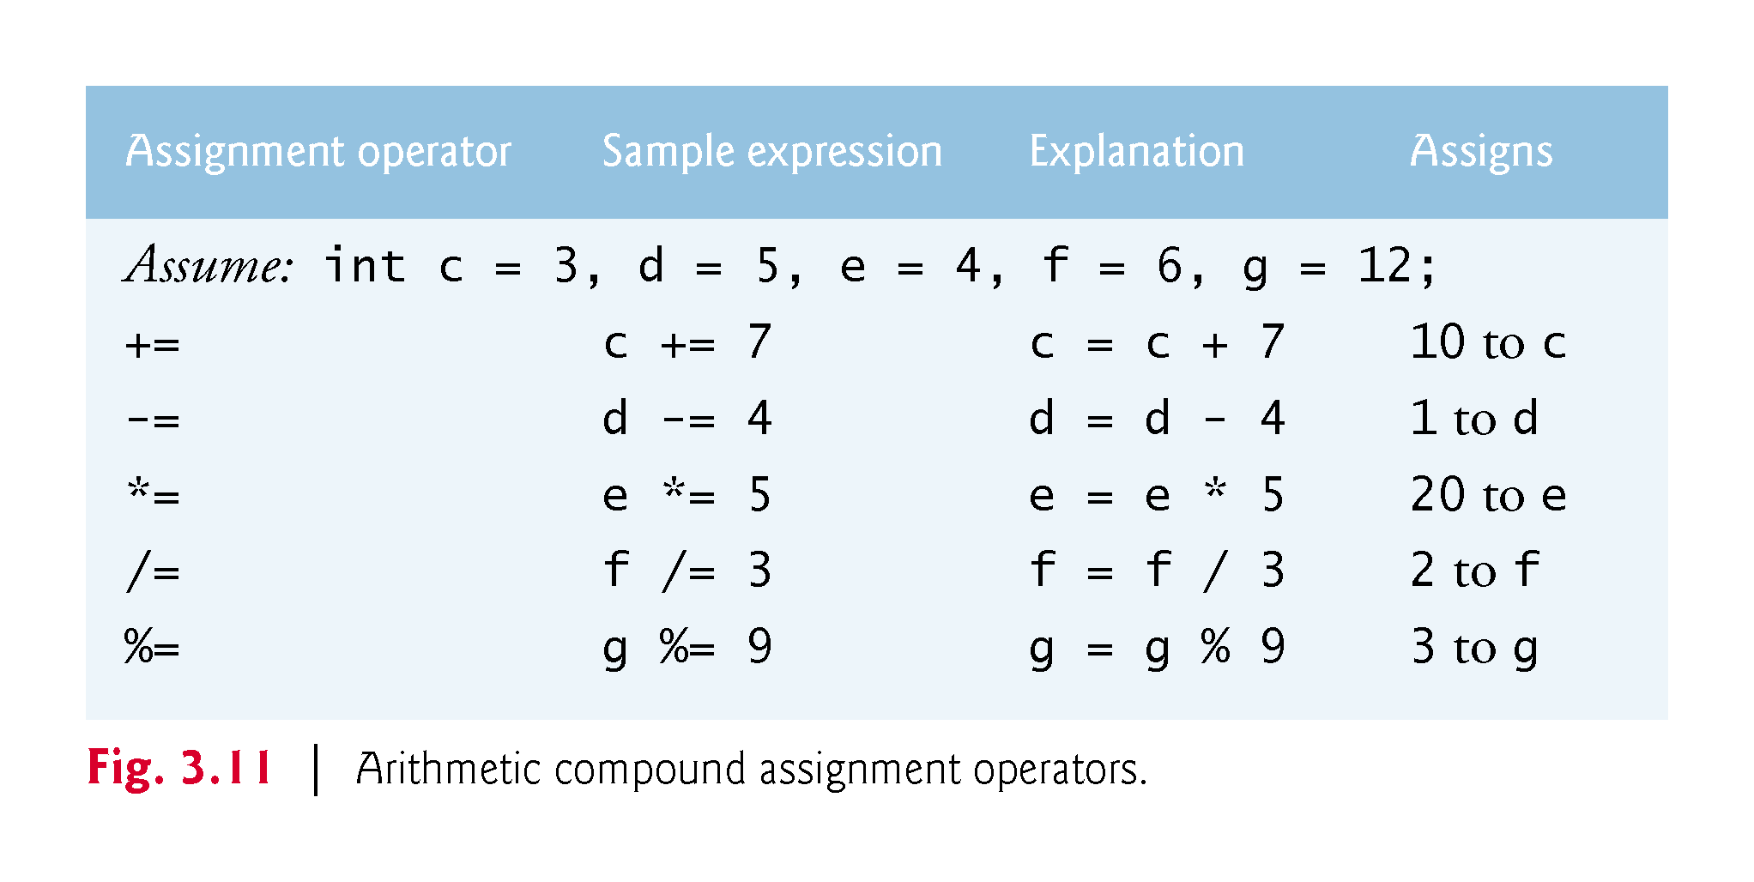

Slide 92
3.12 Increment and Decrement Operators
Unary increment operator, ++, adds one to its operand
Unary decrement operator, --, subtracts one from its operand
An increment or decrement operator that’s prefixed to (placed before) a variable is referred to as the prefix increment or prefix decrement operator, respectively.
An increment or decrement operator that’s postfixed to (placed after) a variable is referred to as the postfix increment or postfix decrement operator, respectively.

Slide 93
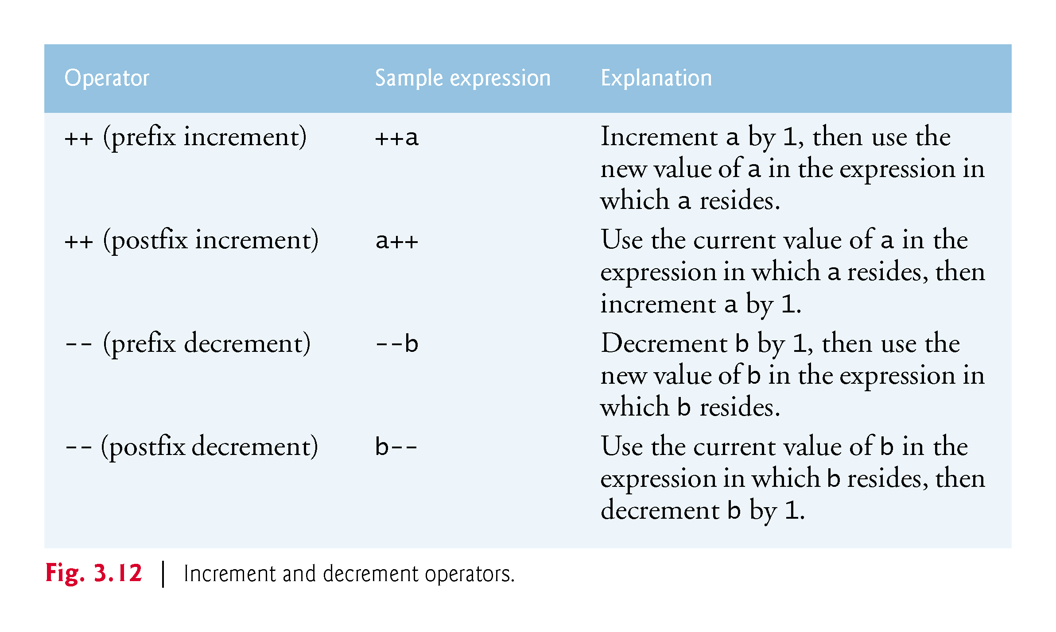

Slide 94
3.12 Increment and Decrement Operators (Cont.)
Using the prefix increment (or decrement) operator to add 1 to (or subtract from) a variable is known as preincrementing (or predecrementing).
This causes the variable to be incremented (decremented) by 1; then the new value is used in the expression in which it appears.
Using the postfix increment (or decrement) operator to add 1 to (or subtract 1 from) a variable is known as postincrementing (or postdecrementing).
This causes the current value of the variable to be used in the expression in which it appears; then the variable’s value is incremented (decremented) by 1.

Slide 95
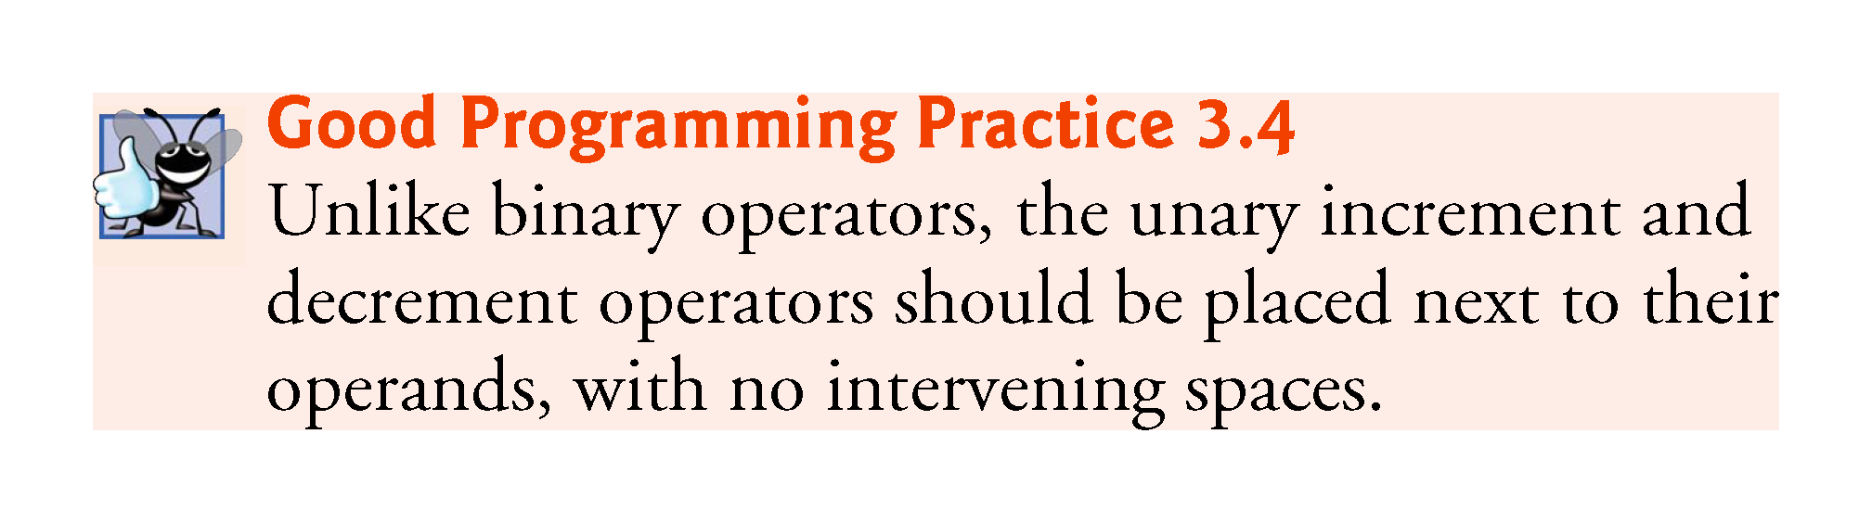

Slide 96
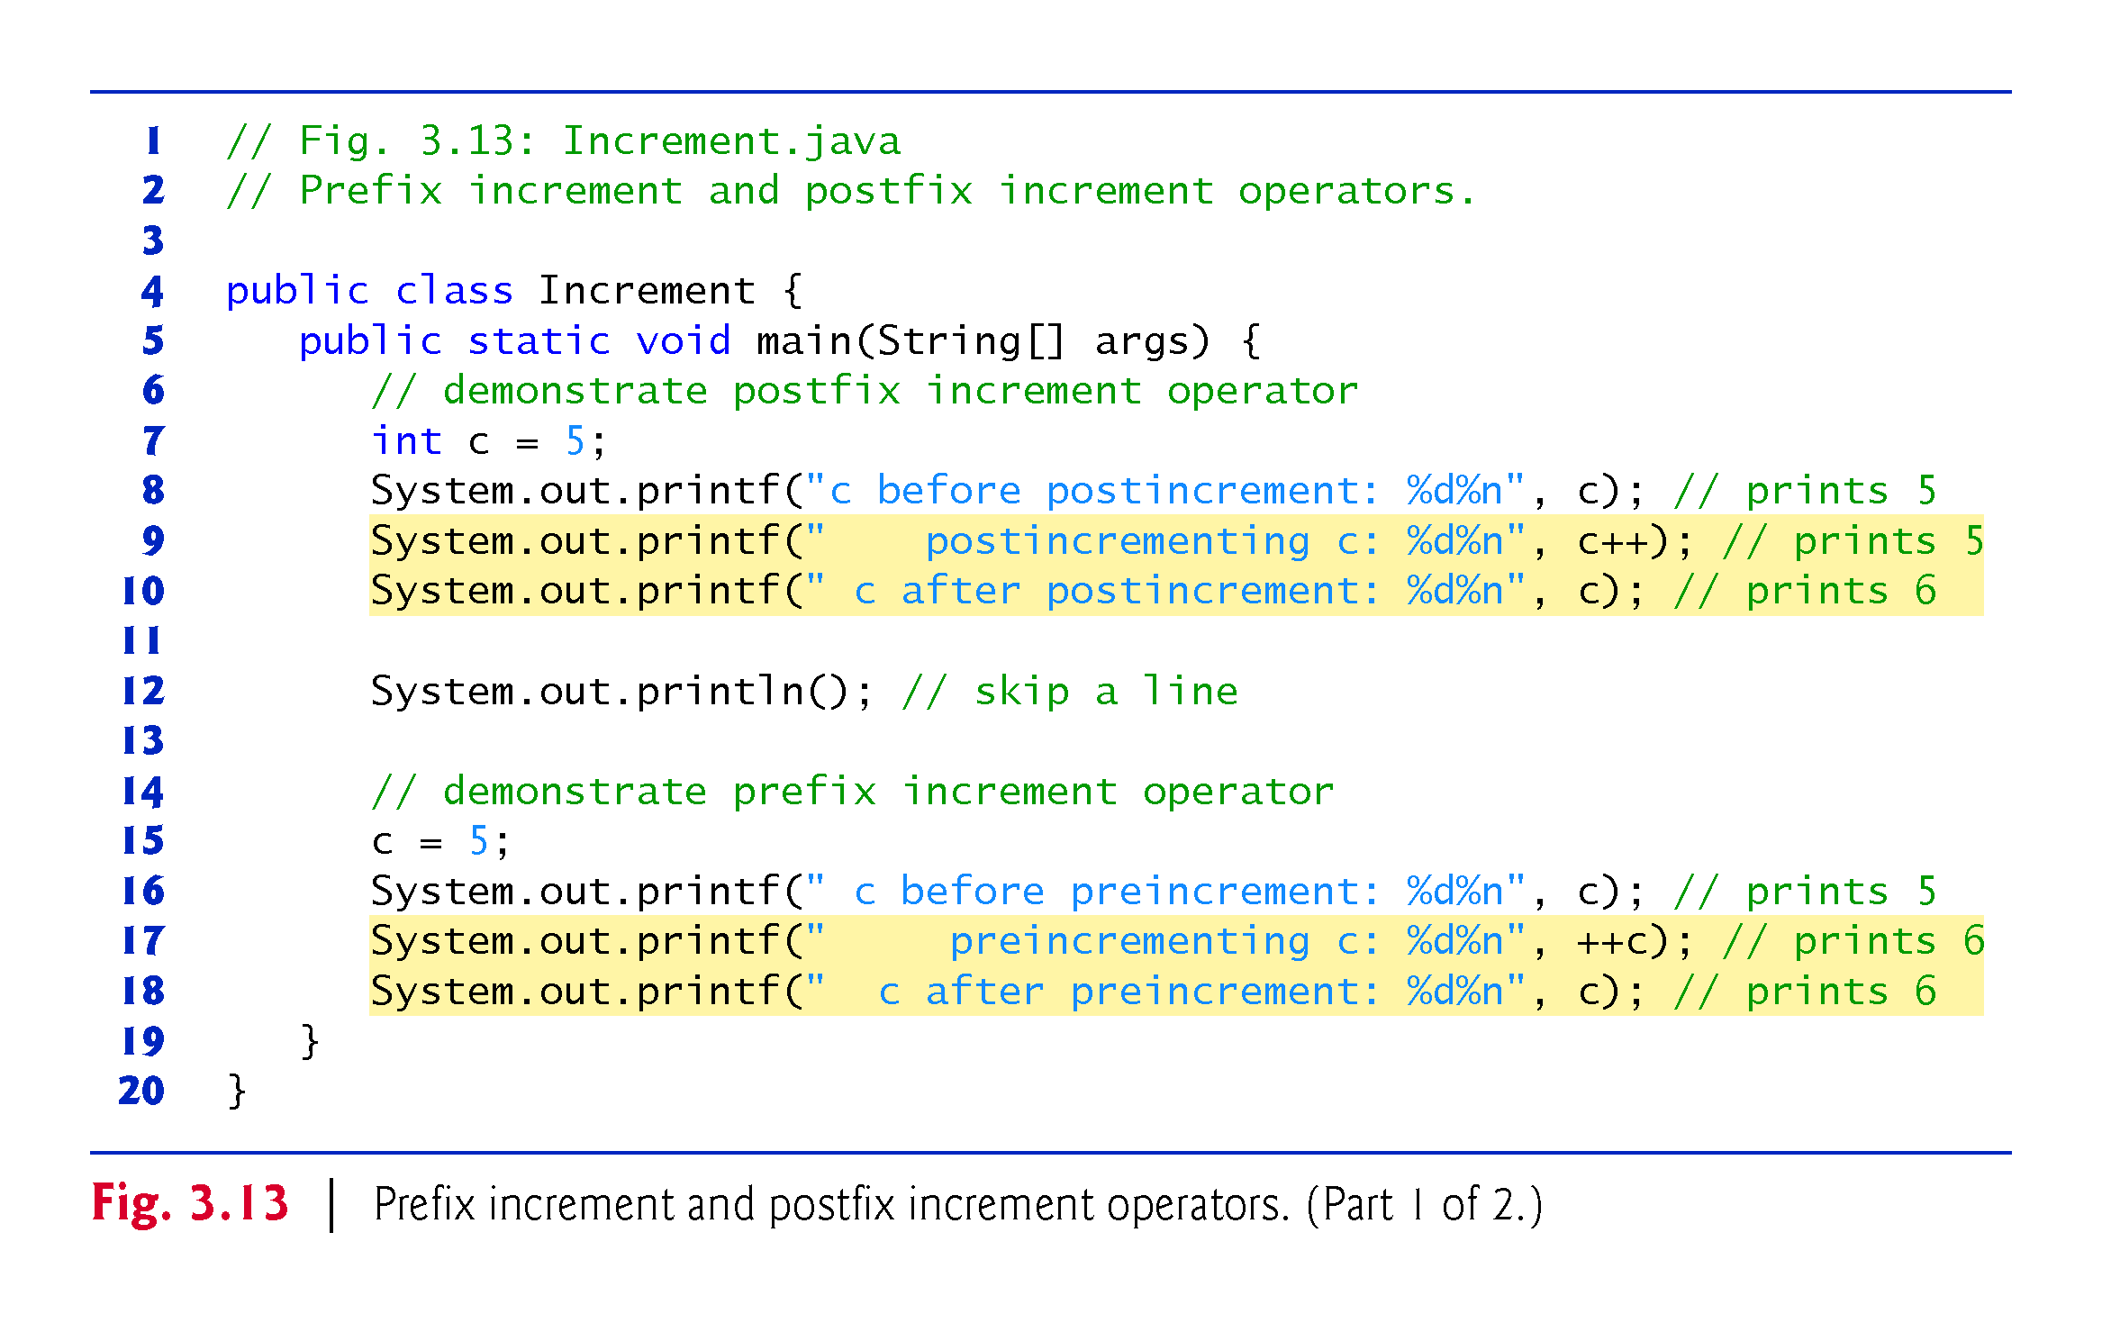

Slide 97
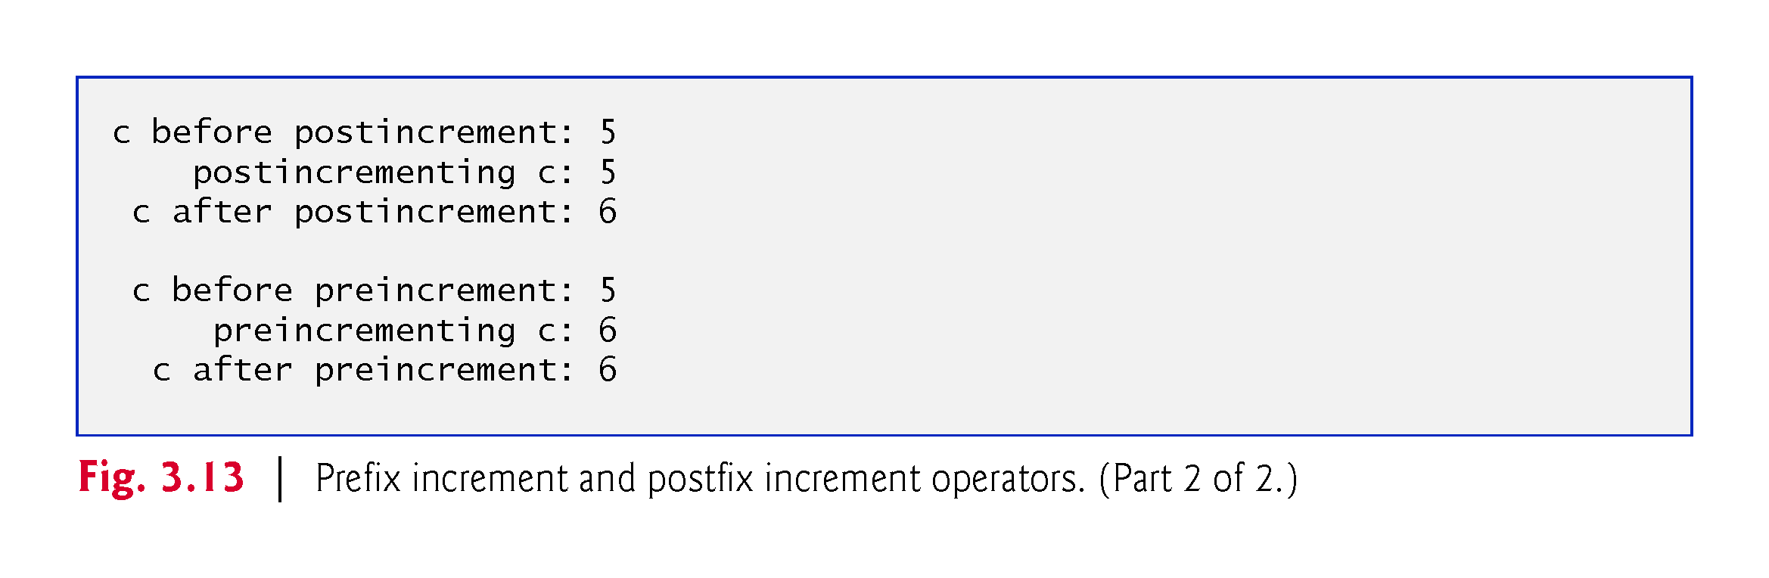

Slide 98
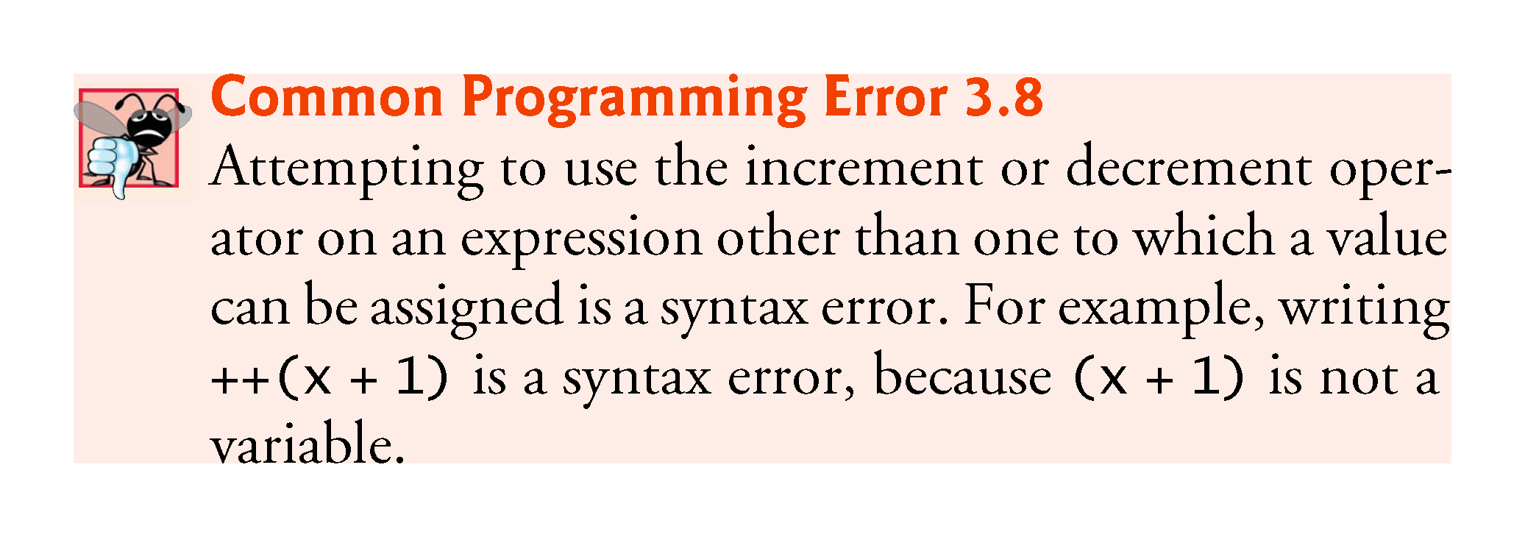

Slide 99
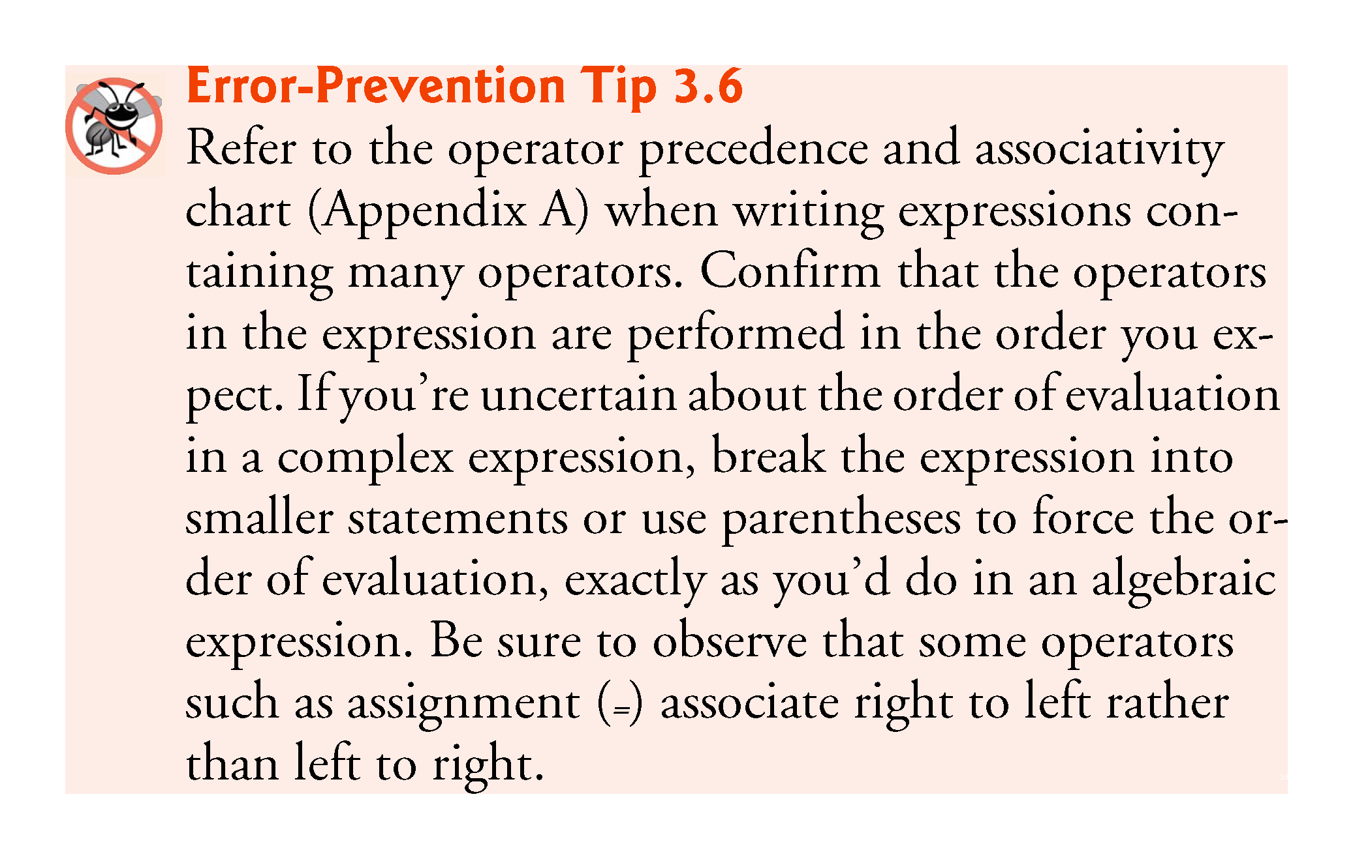

Slide 100


Slide 101
3.13 Primitive Types
Appendix D lists the eight primitive types in Java.
Java requires all variables to have a type.
Java is a strongly typed language.
Primitive types in Java are portable across all platforms.
Instance variables of types char, byte, short, int, long, float and double are all given the value 0 by default. Instance variables of type boolean are given the value false by default.
Reference-type instance variables are initialized by default to the value null.

Slide 102


