Slide 1
Chapter 5, Methods
Java How to Program, Late Objects Version, 10/e

Slide 7
5.1 Introduction
Best way to develop and maintain a large program is to construct it from small, simple pieces.
called divide and conquer
Methods facilitate the design, implementation, operation and maintenance of large programs.
Normally, methods are called on specific objects
static methods can be called on a class rather than an object.

Slide 8
5.2 Program Units in Java
You write Java programs by combining new methods and classes that you write with predefined available in the Java Application Programming Interface and in various other class libraries
Related classes are typically grouped into packages so that they can be imported into programs and reused
The Java API provides a rich collection of predefined classes

Slide 10
5.2 Program Units in Java (cont.)
The statements in method bodies are written only once, are hidden from other methods and can be reused from several locations in a program.
Software reusability
using existing methods as building blocks to create new programs
Often, you can create programs from existing classes and methods rather than by building customized code
Dividing a program into meaningful methods makes the program easier to debug and maintain.

Slide 14
5.2 Program Units in Java (cont.)
A method is invoked by a method call
When the called method completes its task, it returns control—and possibly a result—to the caller
Similar to the hierarchical form of management (Fig. 5.1)
A boss (the caller) asks a worker (the called method) to perform a task and report back (return) the results after completing the task
The boss method does not know how the worker method performs its designated tasks
The worker may also call other worker methods, unbeknown to the boss
This “hiding” of implementation details promotes good software engineering

Slide 15
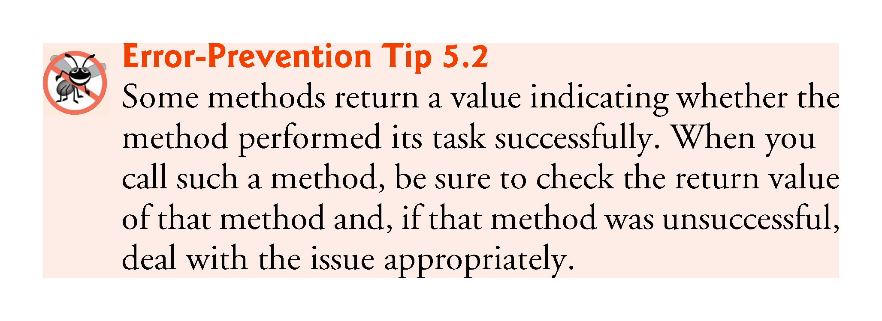

Slide 16
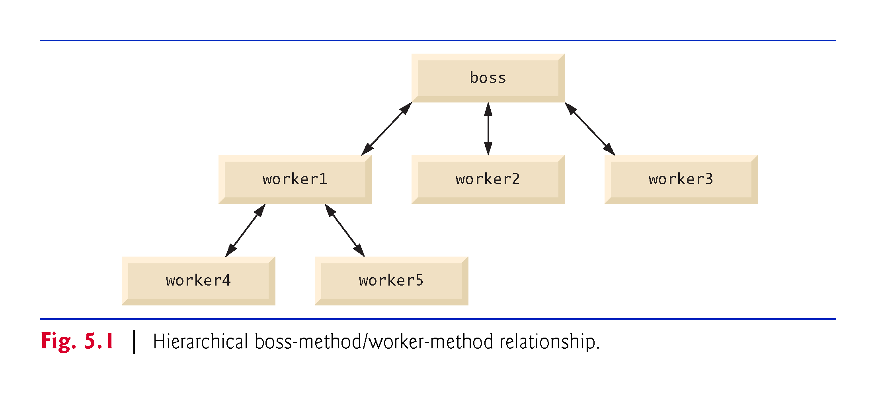

Slide 17
5.3 static Methods, static Fields and Class Math
Sometimes a method performs a task that does not depend on the contents of any object
Method applies to the class in which it’s declared as a whole and is known as a static method or a class method
For any class imported into your program, you can call the class’s static methods by specifying the name of the class in which the method is declared, followed by a dot (.) and the method name
All Math class methods are static
Each is called by preceding the name of the method with the class name Math and the dot (.) separator
Method arguments may be constants, variables or expressions

Slide 19
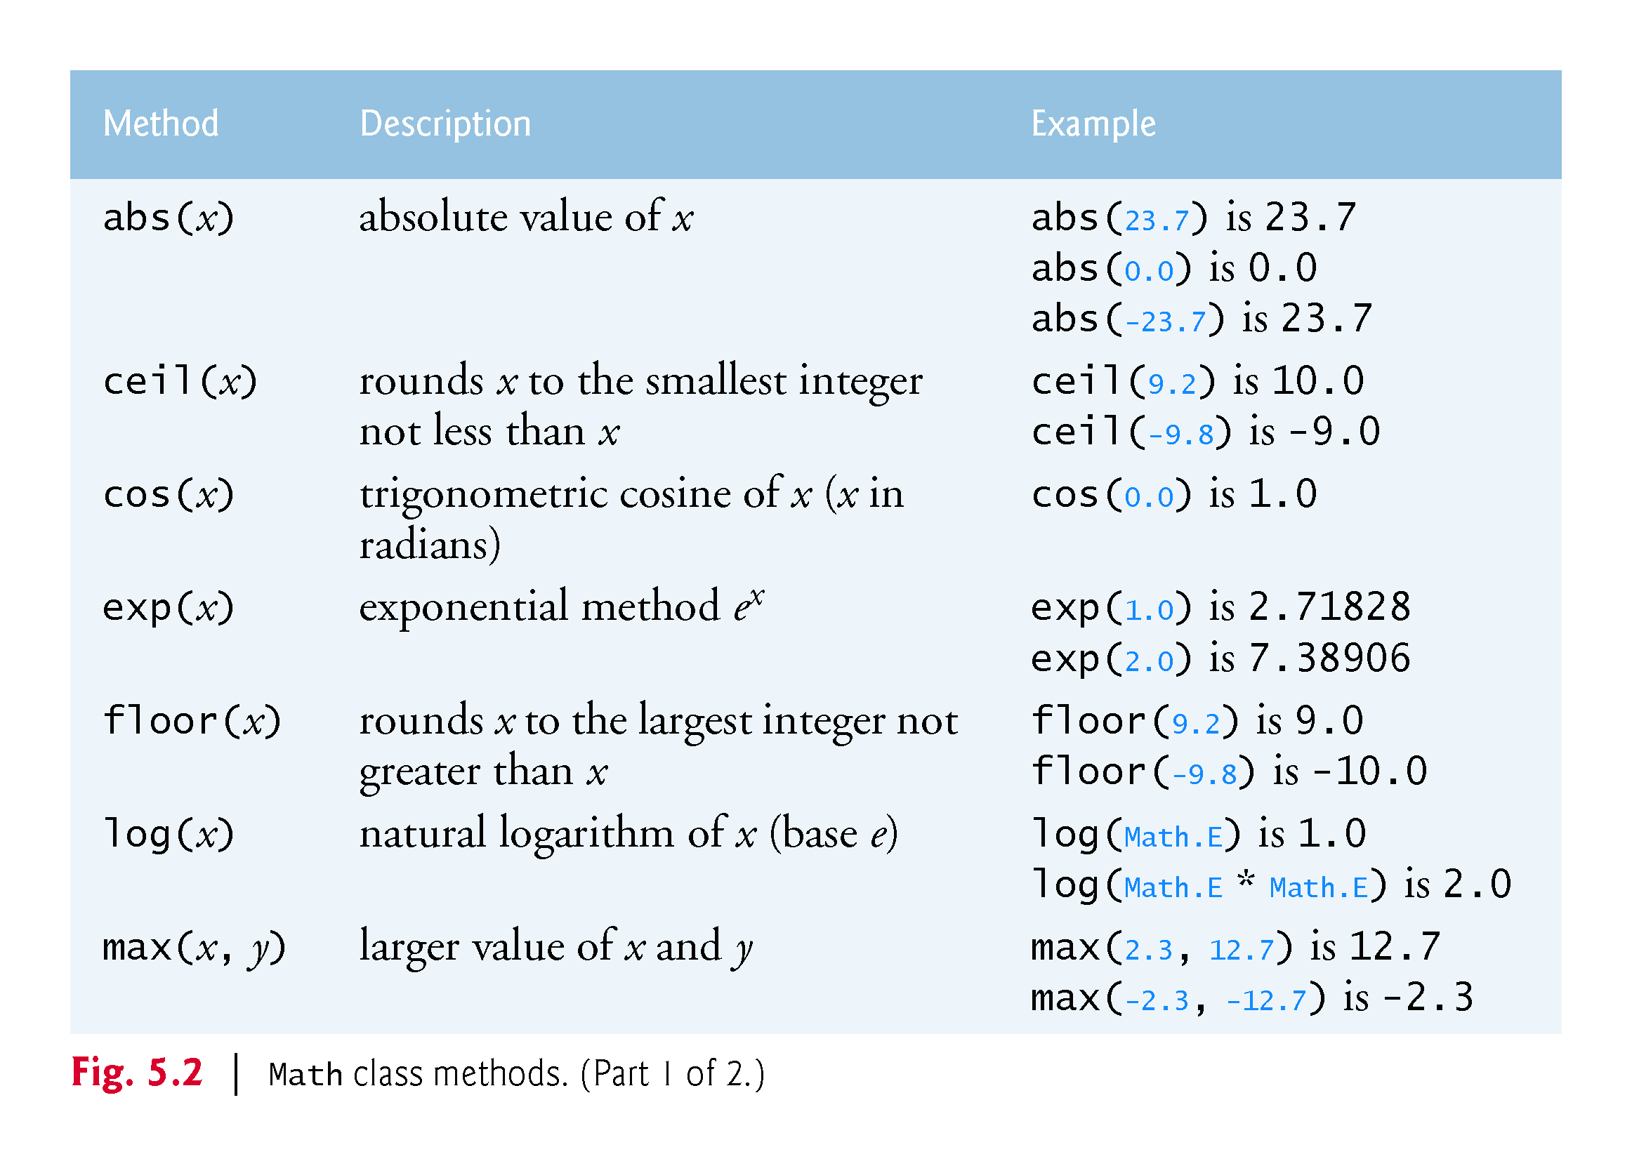

Slide 21
5.3 static Methods, static Fields and Class Math (cont.)
Class Math declares two constants
Math.PI (3.141592653589793) is the ratio of a circle’s circumference to its diameter
Math.E (2.718281828459045) is the base value for natural logarithms (calculated with static Math method log)
These constants are declared in class Math with the modifiers public, static and final.
public allows you to use these fields in your own classes
static allows them to be accessed via the class name Math and a dot (.) separator
final indicates that they are constants—value cannot change after they are initialized.
A class’s variables are sometimes called fields.

Slide 22
5.3 static Methods, static Fields and Class Math (cont.)
Why Is Method main Declared static?
When you execute the Java Virtual Machine (JVM) with the java command, the JVM attempts to invoke the main method of the class you specify
Declaring main as static allows the JVM to invoke main without creating an object of the class

Slide 23
5.4 Declaring Methods
Class MaximumFinder (Fig. 5.3) has two methods—main and maximum
The maximum method determines and returns the largest of three double values
Most methods do not get called automatically
You must call method maximum explicitly to tell it to perform its task

Slide 24
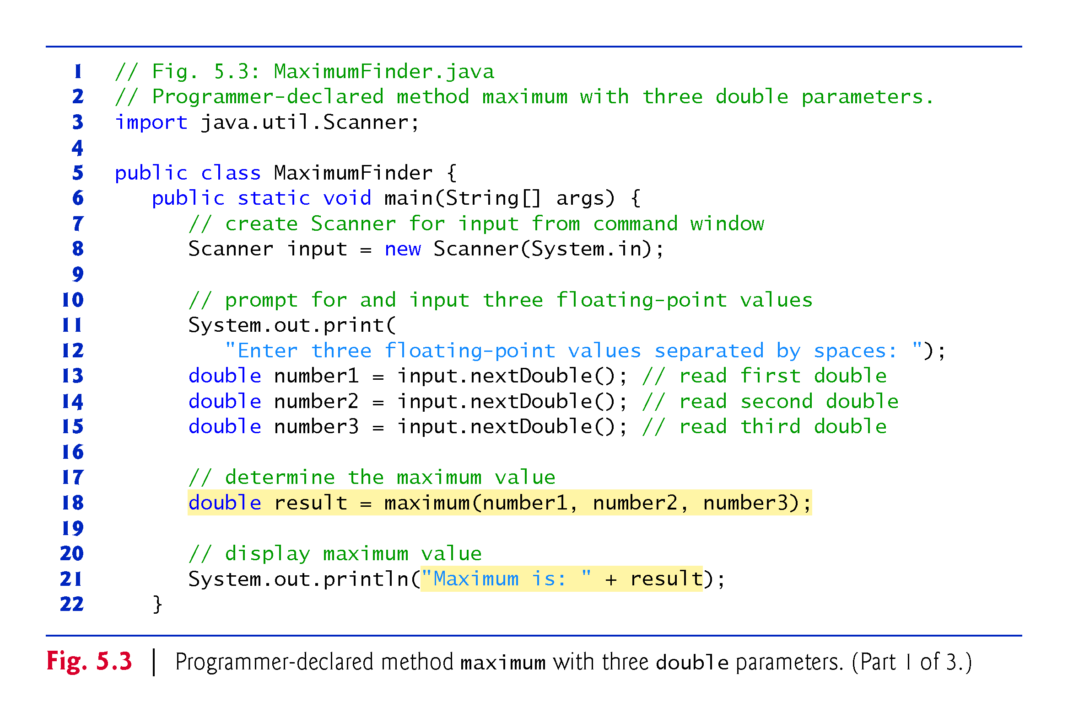

Slide 26
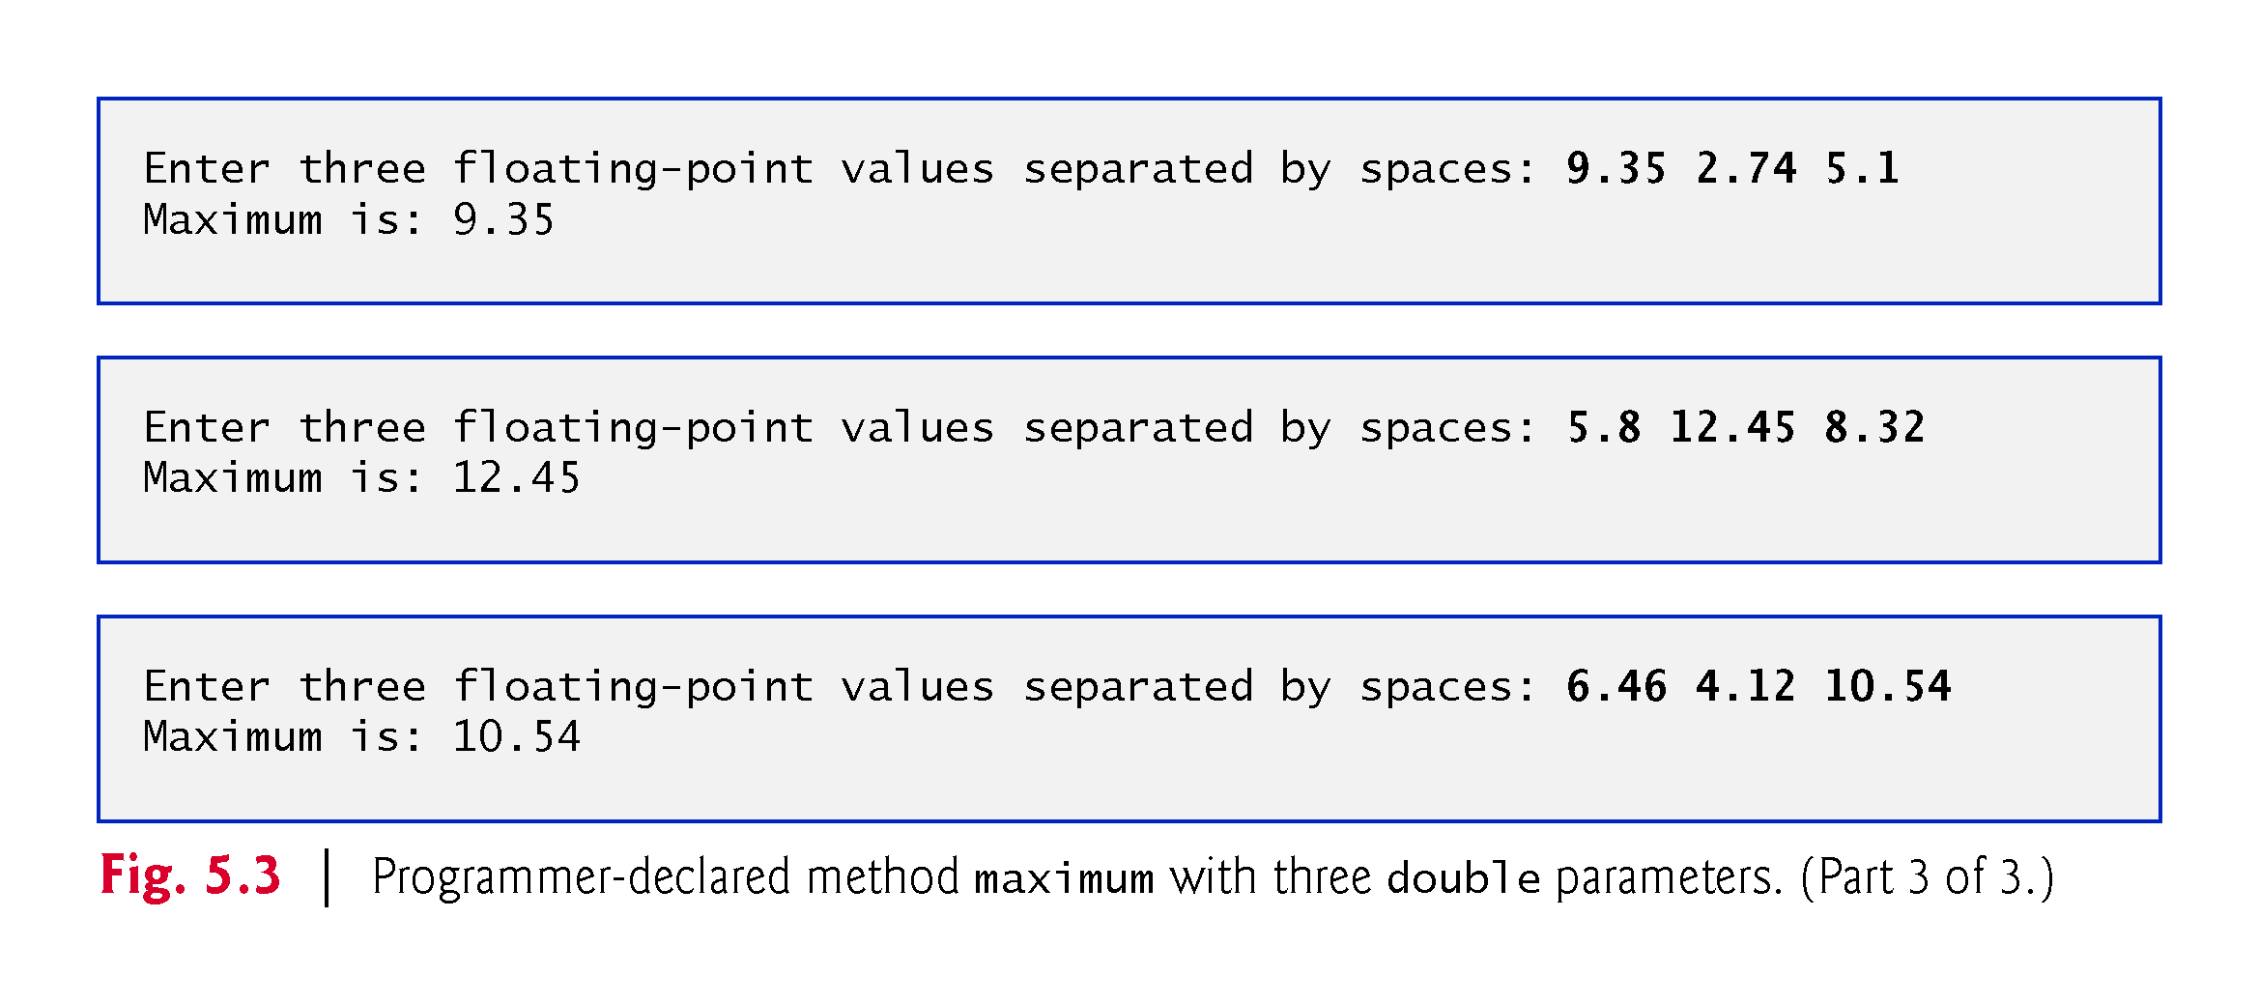

Slide 27
5.4 Declaring Methods (cont.)
A public method is “available to the public”
Can be called from methods of other classes
static methods in the same class can call each other directly
Any other class that uses a static method must fully qualify the method name with the class name
For now, we begin every method declaration with the keywords public and static
You’ll learn about non-public and non-static methods in Chapter 7.

Slide 28
5.4 Declaring Methods (cont.)
Return type
Specifies the type of data a method returns (that is, gives back to its caller) to the calling method after performing its task
In some cases, you’ll define methods that perform a task but will not return any information
Such methods use the return type void.

Slide 29
5.4 Declaring Methods (cont.)
The method name follows the return type
Class names, method names and variable names are all identifiers and by convention all use the same camel case naming scheme we discussed in Chapter 2.
Class names begin with an initial uppercase letter, and method names and variable names begin with an initial lowercase letter.
For a method that requires additional information to perform its task, the method can specify one or more parameters that represent that additional information.
Defined in a comma-separated parameter-list located in the parentheses that follow the method name
Each parameter must specify a type and an identifier
A method’s parameters are considered to be local variables of that method and can be used only in that method’s body

Slide 31
5.4 Declaring Methods (cont.)
Method header
Modifiers, return type, method name and parameters
Method body
Delimited by left and right braces
Contains one or more statements that perform the method’s task
A return statement returns a value (or just control) to the point in the program from which the method was called

Slide 32
5.4 Declaring Methods (cont.)
String concatenation allows you to assemble String objects into larger strings by using operators + or +=
When both operands of operator + are String objects, operator + creates a new String object in which the characters of the right operand are placed at the end of those in the left operand
Every primitive value and object in Java can be represented as a String
When one of the + operator’s operands is a String, the other is converted to a String, then the two are concatenated
If a boolean is concatenated with a String, the boolean is converted to the String "true" or "false"
When an object is concatenated with a String, the object’s toString method is implicitly called to obtain the String representation of the object

Slide 35
5.4 Declaring Methods (cont.)
Implementing Method maximum by Reusing Method Math.max
The entire body of our maximum method could also be implemented with two calls to Math.max, as follows:
return Math.max(x, Math.max(y, z));
The outer call to Math.max specifies arguments x and Math.max(y, z).

Slide 36
5.5 Notes on Declaring and Using Methods
Three ways to call a method:
Using a method name by itself to call another method of the same class
Using an object’s variable name followed by a dot (.) and the method name to call a non-static method of the object
Using the class name and a dot (.) to call a static method of a class

Slide 37
5.5 Notes on Declaring and Using Methods (cont.)
There are three ways to return control to the statement that calls a method
If the method does not return a result, control returns when the program flow reaches the method-ending right brace or when the statement return; executes
If the method returns a result, the statement
return expression;
evaluates the expression, then returns the result to the caller

Slide 41
5.6 Method-Call Stack and and Activation Records
Stack data structure
Analogous to a pile of dishes
A dish is placed on the pile at the top (referred to as pushing the dish onto the stack).
A dish is removed from the pile from the top (referred to as popping the dish off the stack).
Last-in, first-out (LIFO) data structures
The last item pushed onto the stack is the first item popped from the stack.

Slide 42
5.6 Method-Call Stack and Activation Records (cont.)
Method-Call Stack
One of the most important mechanisms for computer science students to understand is the method-call stack (or program-execution stack).
supports the method call/return mechanism.
Also supports the creation, maintenance and destruction of each called method’s local variables.

Slide 43
5.6 Method-Call Stack and Activation Records (cont.)
Stack Frames
Each method eventually must return control to the function that called it.
Each time a method calls another method, an entry is pushed onto the method call stack.
This entry, called a stack frame or an activation record, contains the return address that the called method needs in order to return to the calling method.

Slide 44
5.6 Method-Call Stack and Activation Records (cont.)
Local Variables and Stack Frames
When a method call returns, the stack frame for the method call is popped, and control transfers to the return address in the popped stack frame.
Stack Overflow
The amount of memory in a computer is finite, so only a certain amount of memory can be used to store activation records on the method call stack.
If more method calls occur than can have their activation records stored on the method call stack, an a fatal error known as stack overflow occurs.

Slide 45
5.7 Argument Promotion and Casting
Argument promotion—converting an argument’s value, if possible, to the type that the method expects to receive in its corresponding parameter
Such conversions may lead to compilation errors if Java’s promotion rules are not satisfied
These rules specify which conversions are allowed—that is, which ones can be performed without losing data
The promotion rules apply to expressions containing values of two or more primitive types and to primitive-type values passed as arguments to methods
Each value is promoted to the “highest” type in the expression
Figure 5.4 lists the primitive types and the types to which each can be promoted

Slide 47
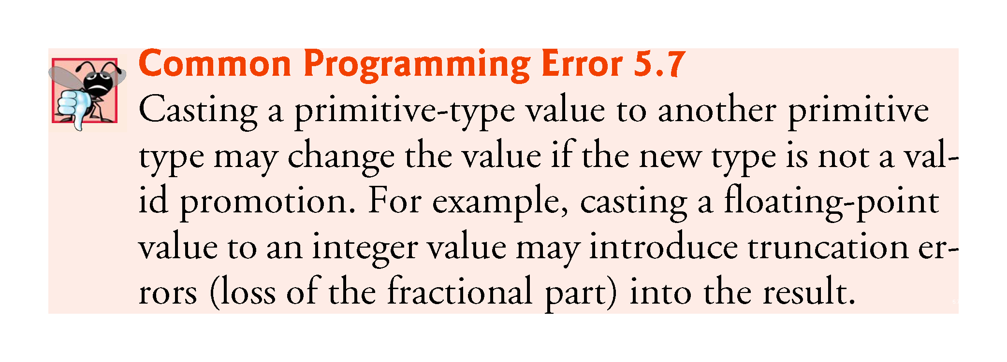

Slide 48
5.8 Java API Packages
Java contains many predefined classes that are grouped into categories of related classes called packages
Known as the Java Application Programming Interface (Java API), or the Java class library
Some key Java API packages are described in Fig. 5.5
Overview of the packages in Java
http://docs.oracle.com/javase/7/docs/api/overview-summary.html
http://download.java.net/jdk8/docs/api/overview-summary.html
Additional information about a predefined Java class’s methods
http://docs.oracle.com/javase/7/docs/api/
Index link shows alphabetical list of all the classes and methods in the Java API
Locate the class name and click its link to see the online description of the class
METHOD link shows a table of the class’s methods
Each static method will be listed with the word “static” preceding its return type

Slide 50
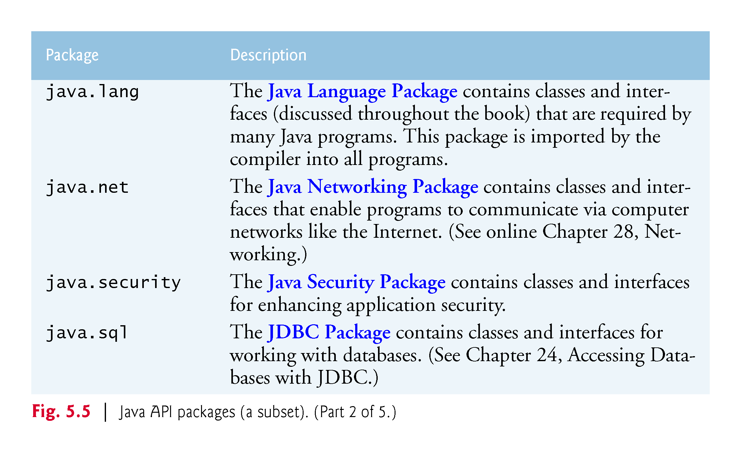

Slide 53
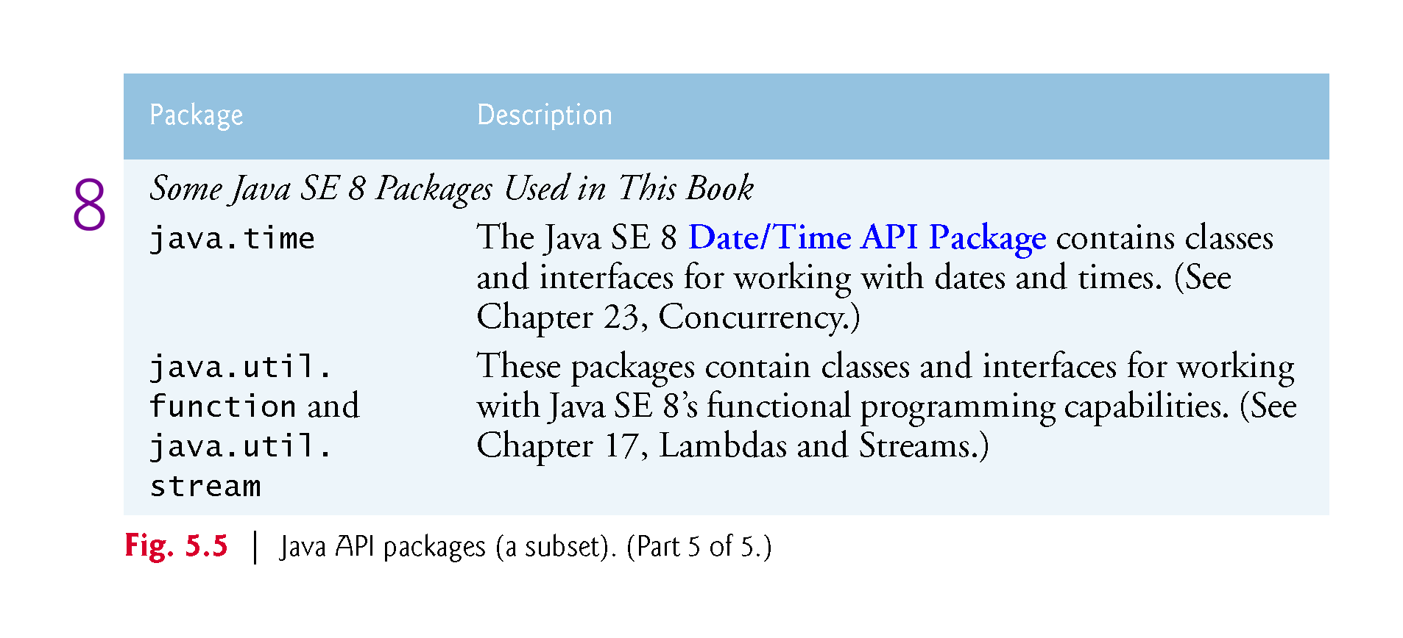

Slide 54
5.9 Case Study: Random-Number Generation
The element of chance can be introduced in a program via an object of class SecureRandom (package java.security).
Such objects can produce random boolean, byte, float, double, int, long and Gaussian values.
SecureRandom objects produce nondeterministic random numbers that cannot be predicted.
Deterministic random numbers have been the source of many software security breaches.

Slide 55
5.9 Case Study: Random-Number Generation (cont.)
If truly random, then every value in the range should have an equal chance (or probability) of being chosen each time nextInt is called
Class Random provides another version of method nextInt that receives an int argument and returns a value from 0 up to, but not including, the argument’s value

Slide 56
5.9 Case Study: Random-Number Generation (cont.)
scaling factor—represents the number of unique values that nextInt should produce
shift the range of numbers produced by adding a shifting value

Slide 58
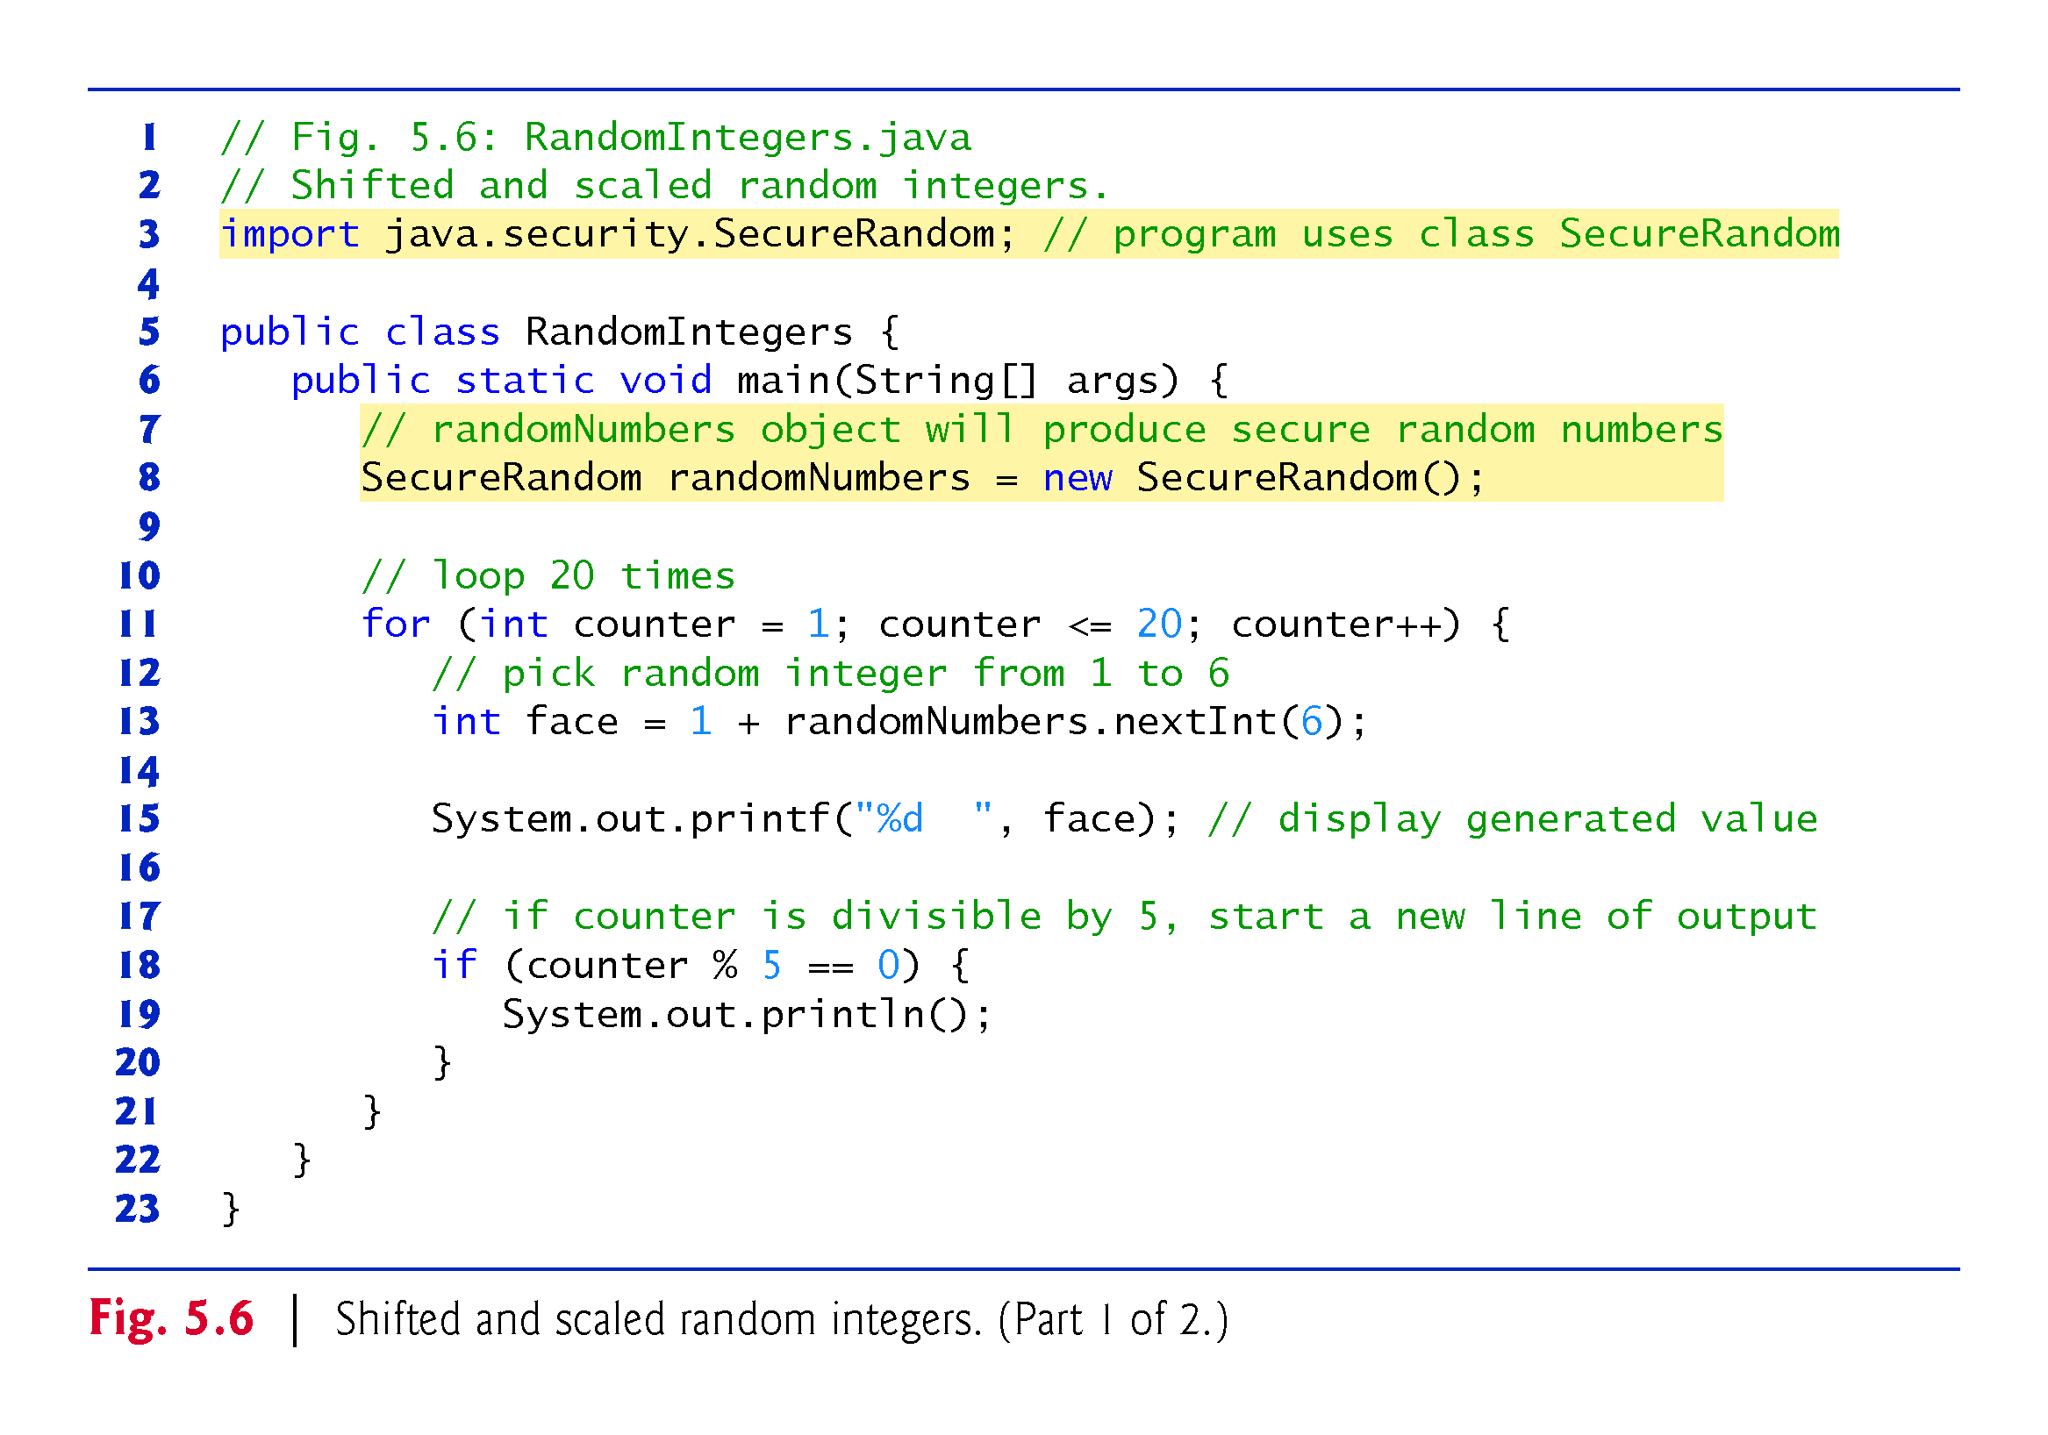

Slide 59
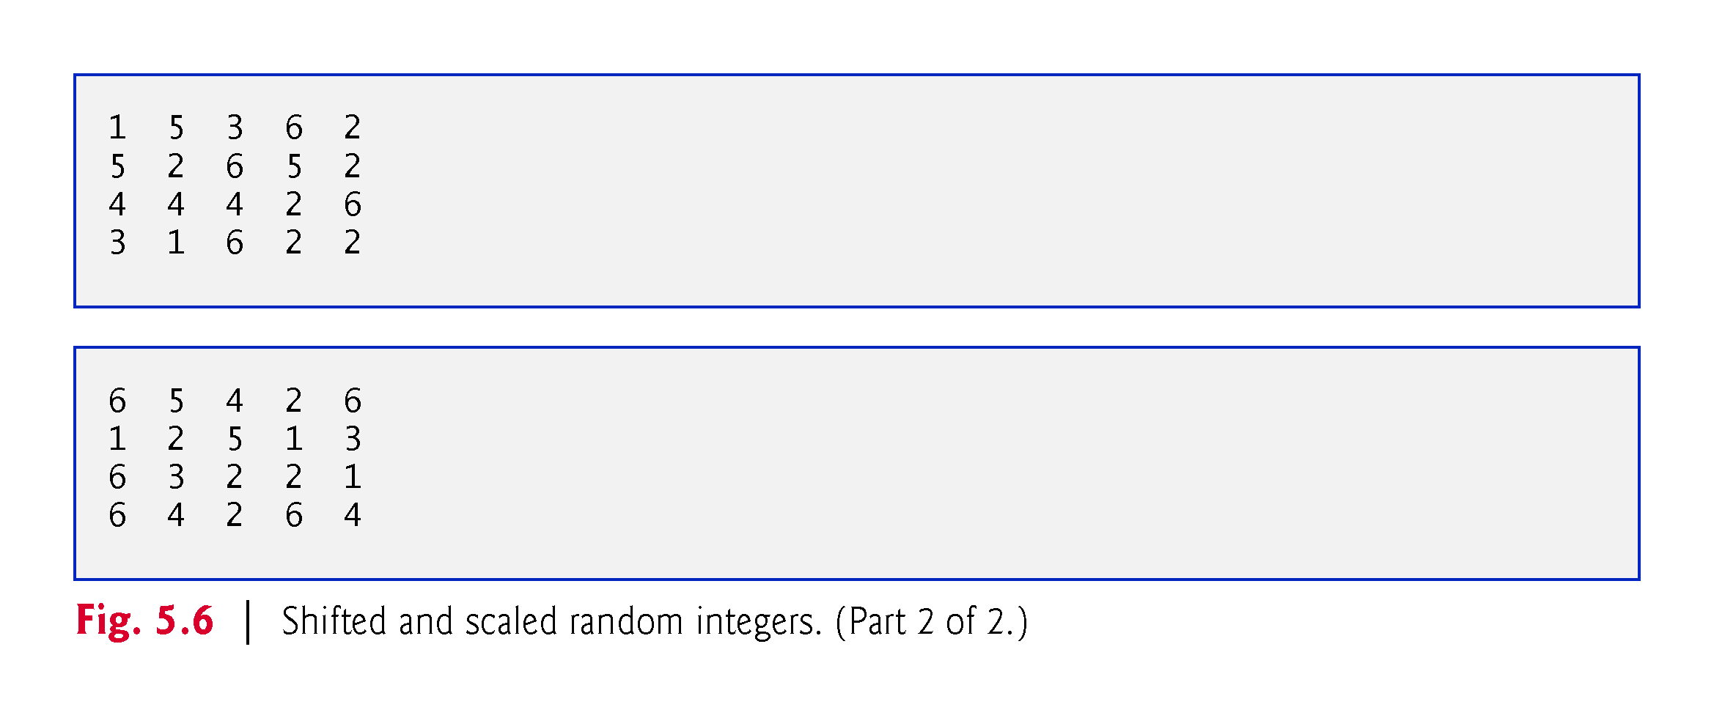

Slide 60
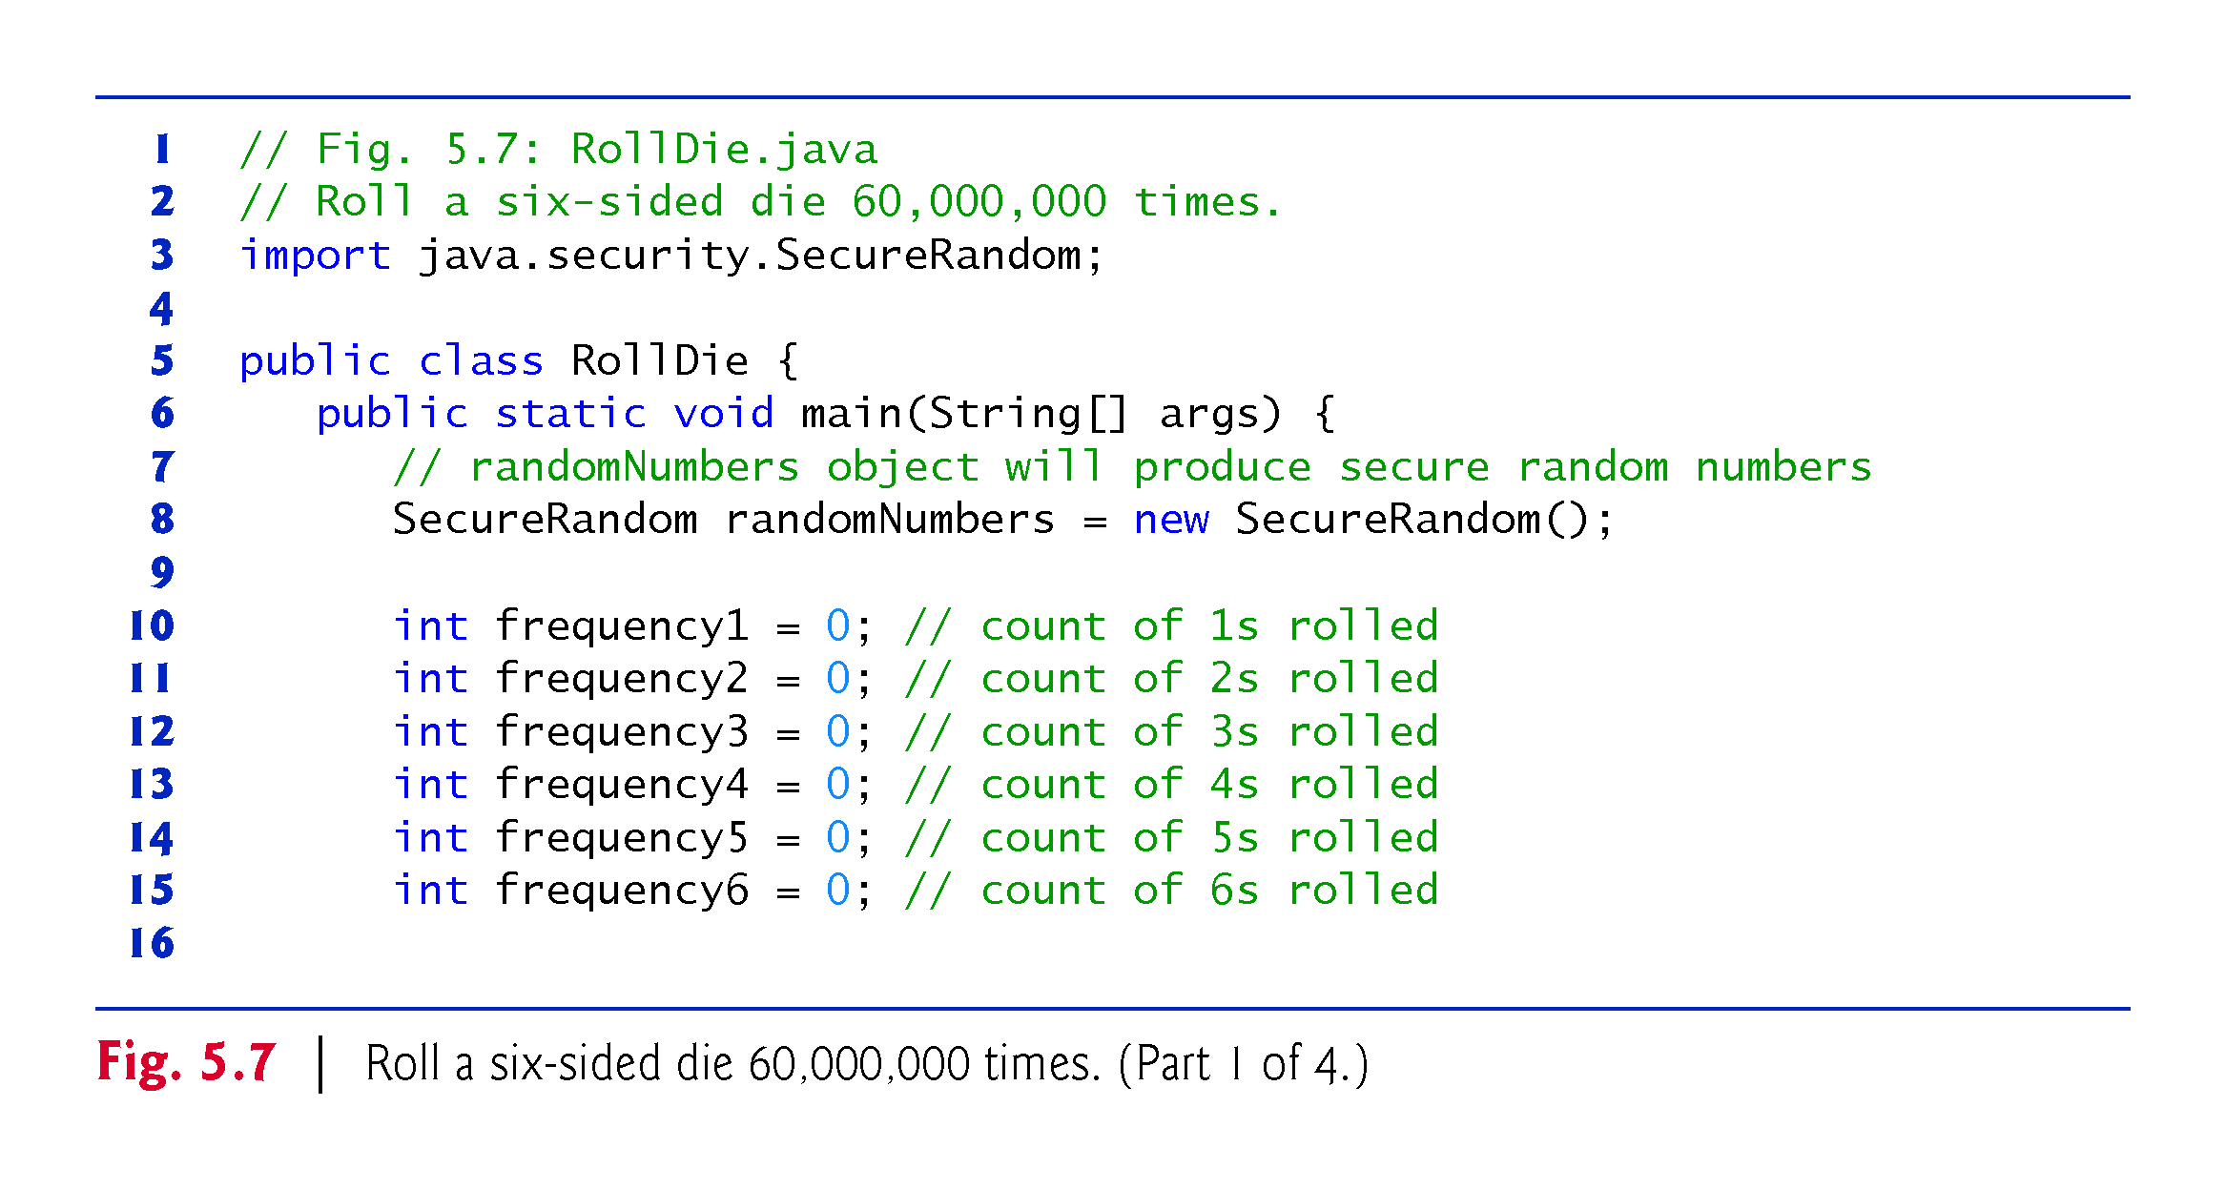

Slide 61
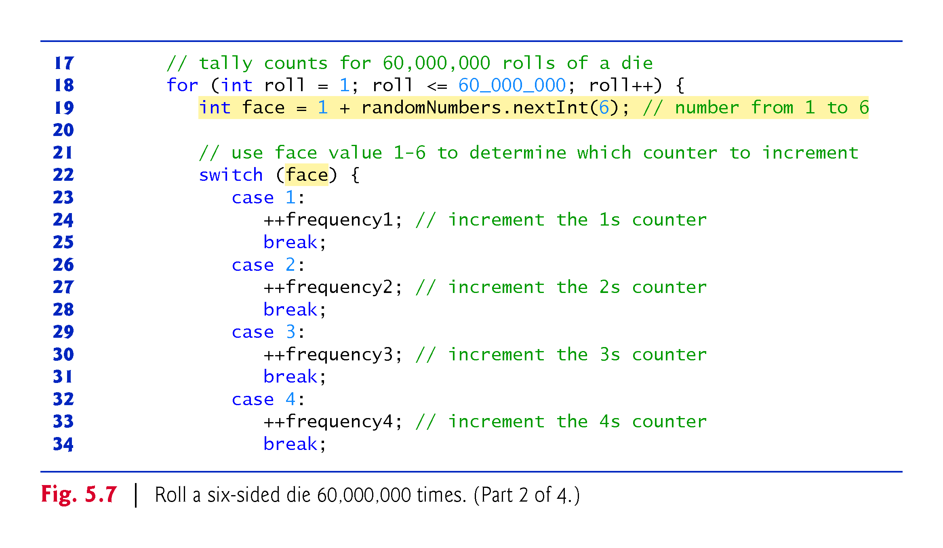

Slide 62
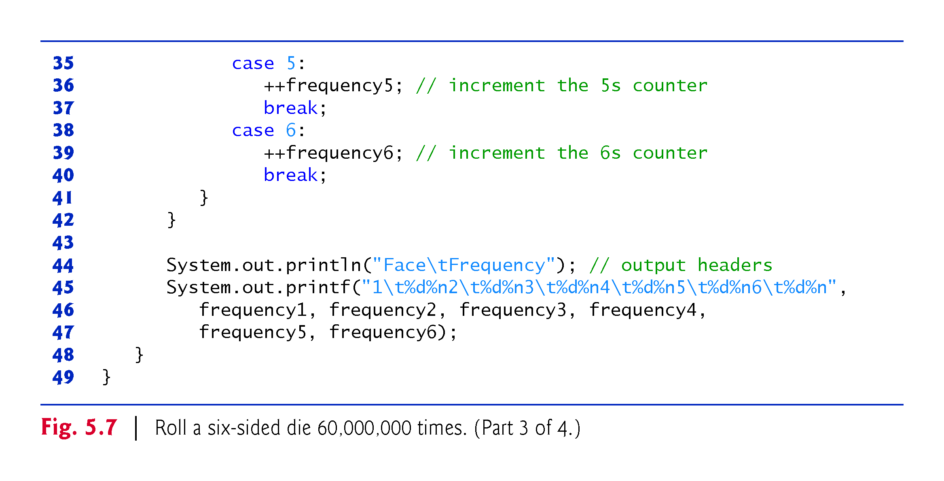

Slide 63
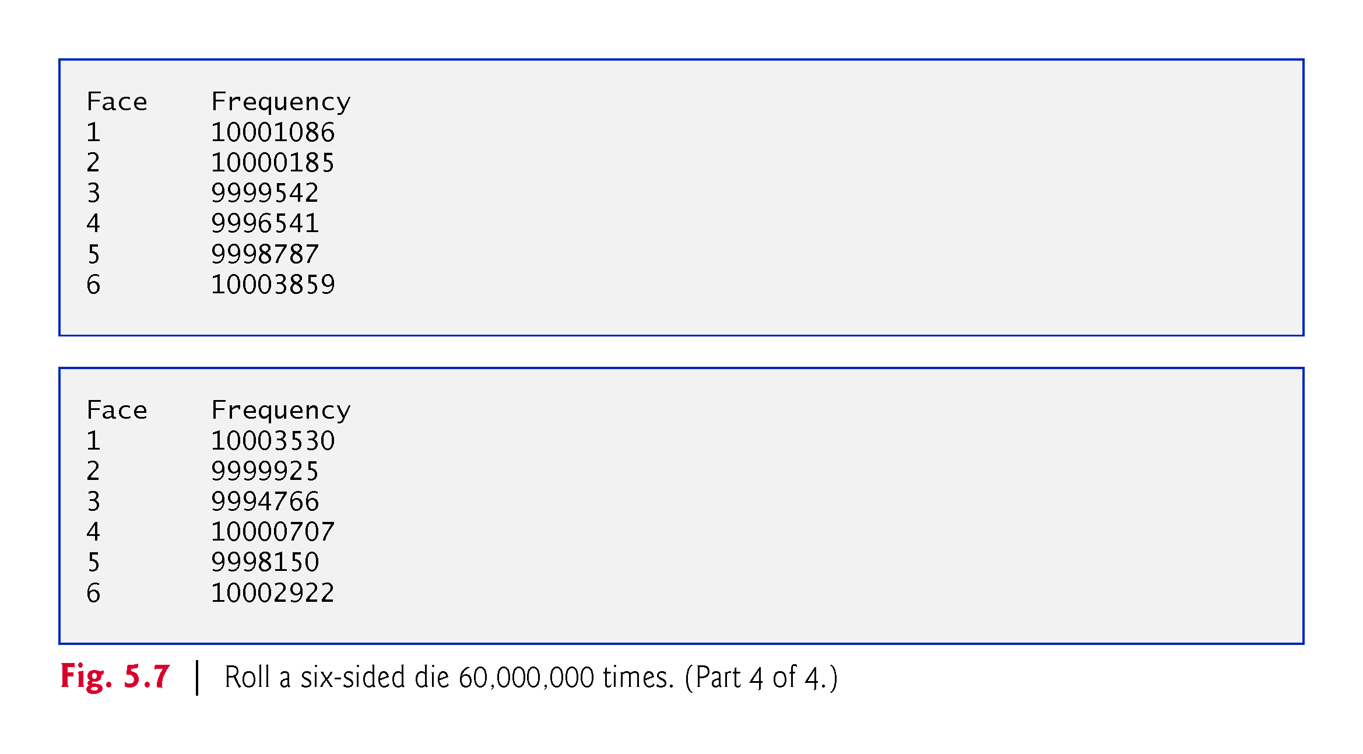

Slide 64
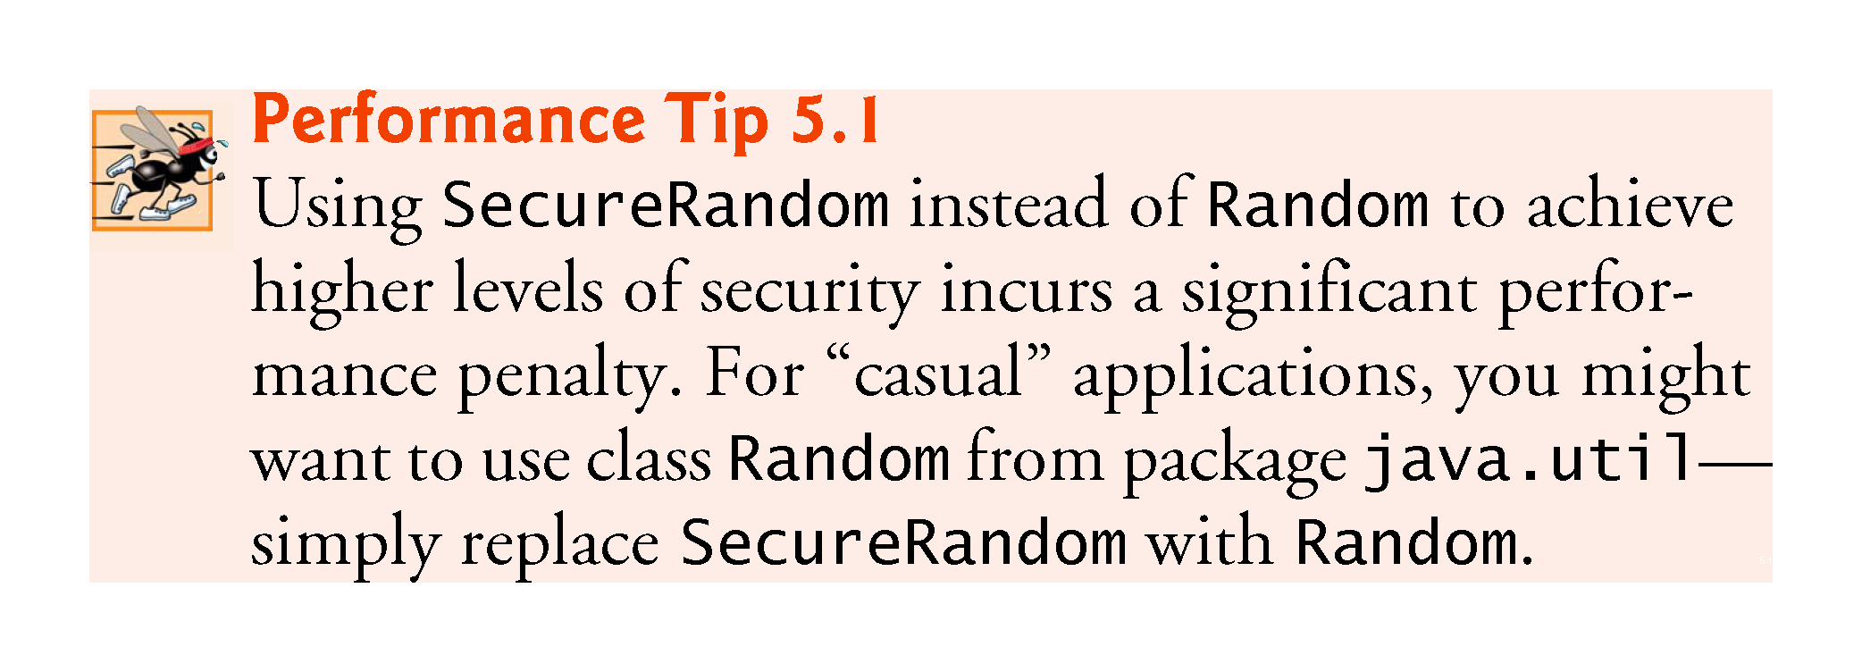

Slide 65
5.9.1 Generalized Scaling and Shifting of Random Numbers
Generalized scaling and shifting of random numbers:
number = shiftingValue + randomNumbers.nextInt(scalingFactor);
where shiftingValue specifies the first number in the desired range of consecutive integers and scalingFactor specifies how many numbers are in the range
Choose integers at random from sets of values other than ranges of consecutive integers, generalized as
number = shiftingValue + differenceBetweenValues * randomNumbers.nextInt(scalingFactor);
where shiftingValue specifies the first number in the desired range of values, differenceBetweenValues represents the constant difference between consecutive numbers in the sequence and scalingFactor specifies how many numbers are in the range

Slide 66
5.10 Case Study: A Game of Chance; Introducing Enumerations
Rules for the dice game Craps:
You roll two dice. Each die has six faces, which contain one, two, three, four, five and six spots, respectively. After the dice have come to rest, the sum of the spots on the two upward faces is calculated. If the sum is 7 or 11 on the first throw, you win. If the sum is 2, 3 or 12 on the first throw (called “craps”), you lose (i.e., the “house” wins). If the sum is 4, 5, 6, 8, 9 or 10 on the first throw, that sum becomes your “point.” To win, you must continue rolling the dice until you “make your point” (i.e., roll that same point value). You lose by rolling a 7 before making your point.
The application in Fig. 5.8 simulates the game of craps, using methods to implement the game’s logic

Slide 68
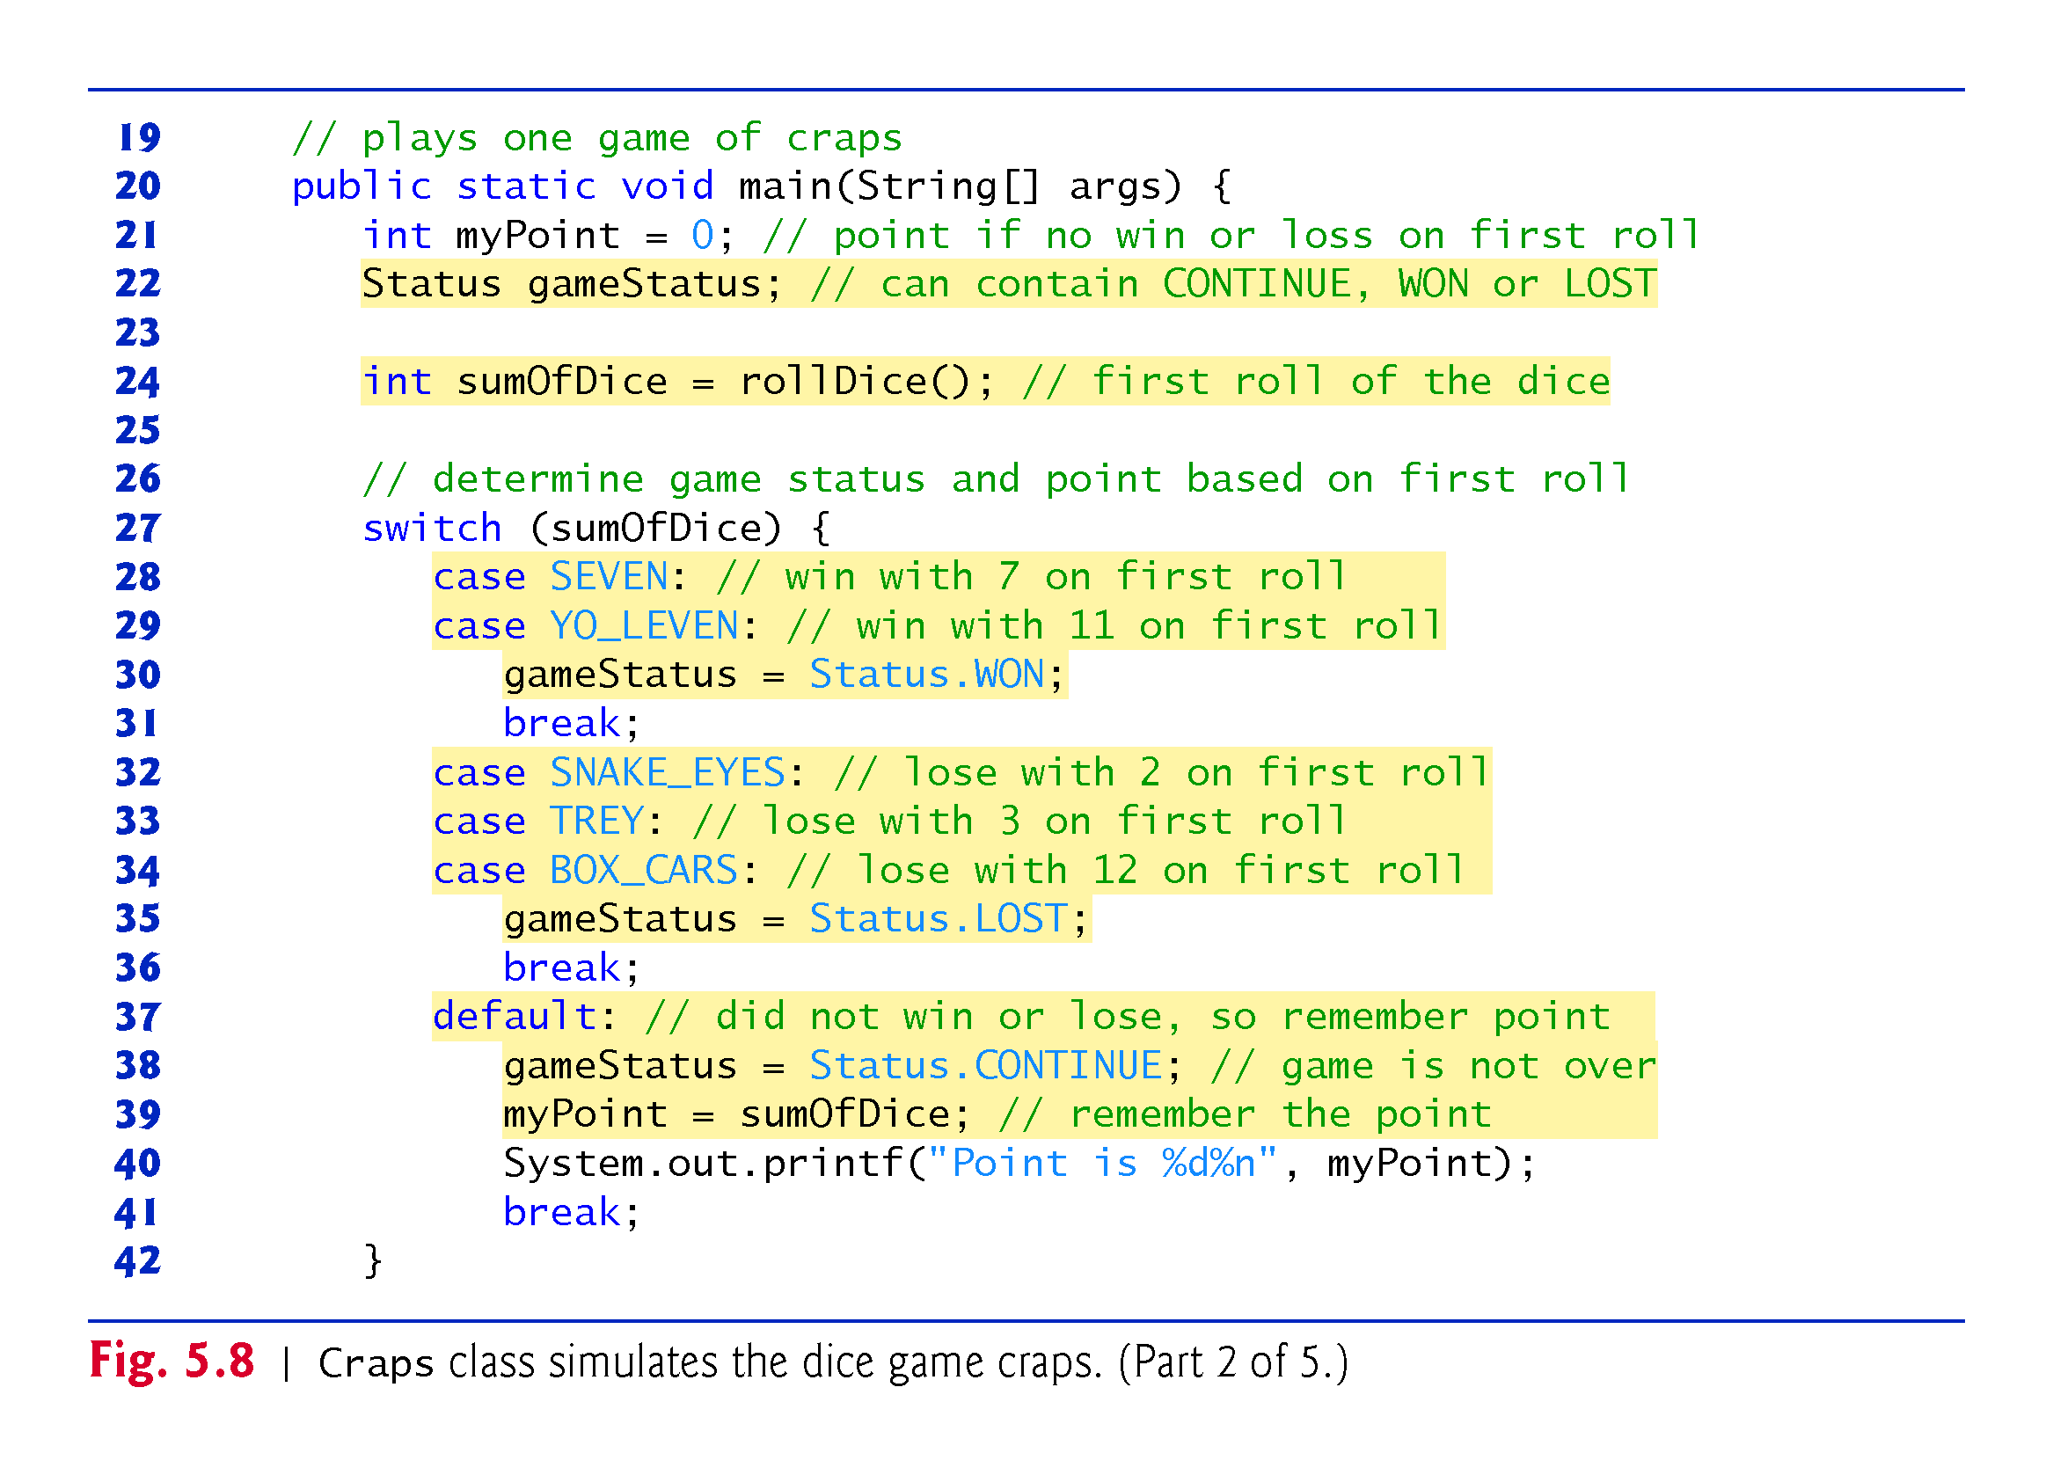

Slide 71
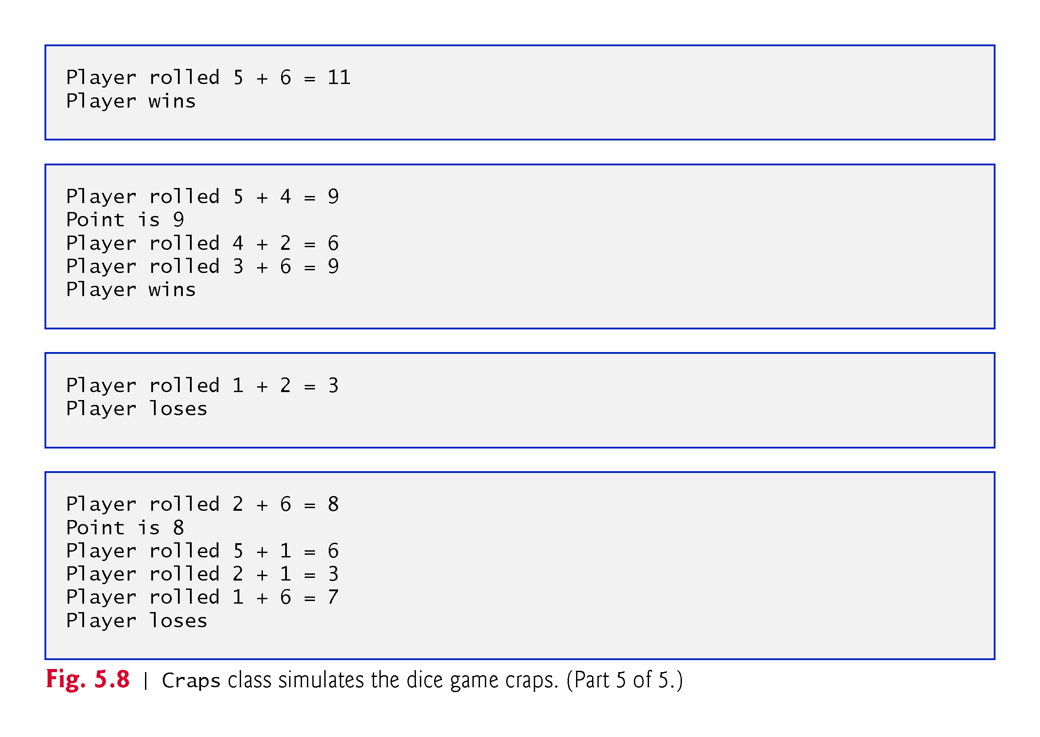

Slide 72
5.10 Case Study: A Game of Chance; Introducing Enumerations (cont.)
Type Status is a private member of class Craps, because Status will be used only in that class
Status is an enum type
Declares a set of constants represented by identifiers
Special kind of class that is introduced by the keyword enum and a type name
Braces delimit an enum declaration’s body
Inside the braces is a comma-separated list of enum constants, each representing a unique value
The identifiers in an enum must be unique
Variables of an enum type can be assigned only the constants declared in the enum

Slide 75
5.10 Case Study: A Game of Chance; Introducing Enumerations (cont.)
Why we declare some constants as public final static int rather than as enum constants:
Java does not allow an int to be compared to an enum constant
Unfortunately, Java does not provide an easy way to convert an int value to a particular enum constant

Slide 76
5.11 Scope of Declarations
Declarations introduce names that can be used to refer to classes, methods, variables and parameters
The scope of a declaration is the portion of the program that can refer to the declared entity by its name
Such an entity is said to be “in scope” for that portion of the program

Slide 77
5.11 Scope of Declarations (cont.)
Basic scope rules:
The scope of a parameter declaration is the body of the method in which the declaration appears.
The scope of a local-variable declaration is from the point at which the declaration appears to the end of that block.
The scope of a local-variable declaration that appears in the initialization section of a for statement’s header is the body of the for statement and the other expressions in the header.
A method or field’s scope is the entire body of the class.

Slide 78
5.11 Scope of Declarations (cont.)
Any block may contain variable declarations
If a local variable or parameter in a method has the same name as a field of the class, the field is hidden until the block terminates execution
Called shadowing
Figure 5.9 demonstrates scoping issues with static and local variables.

Slide 79
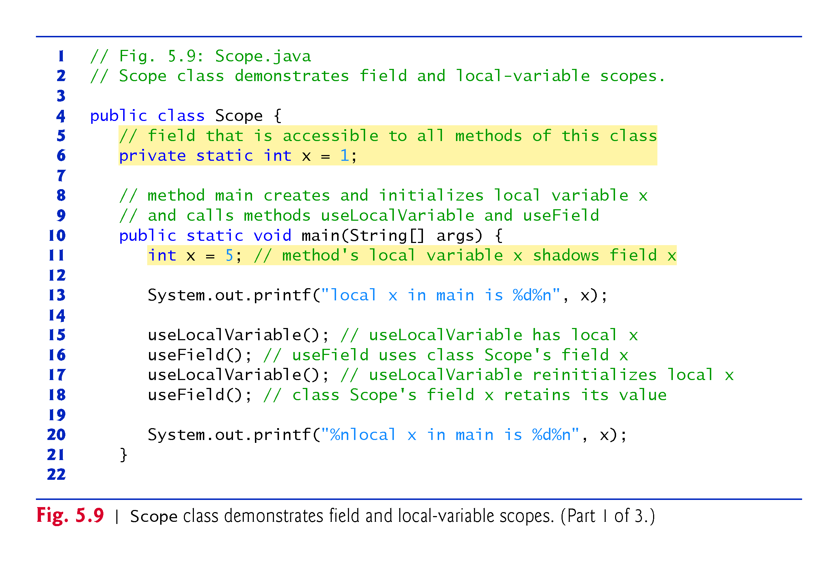

Slide 80
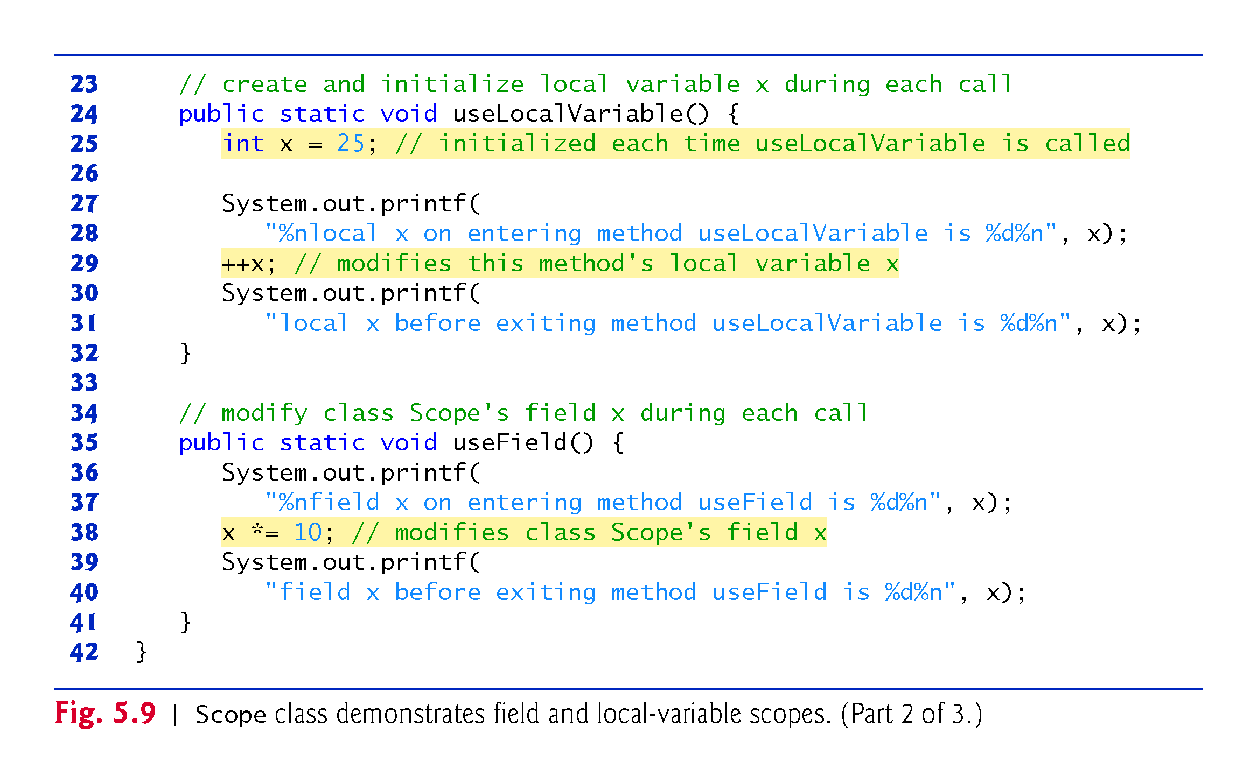

Slide 81
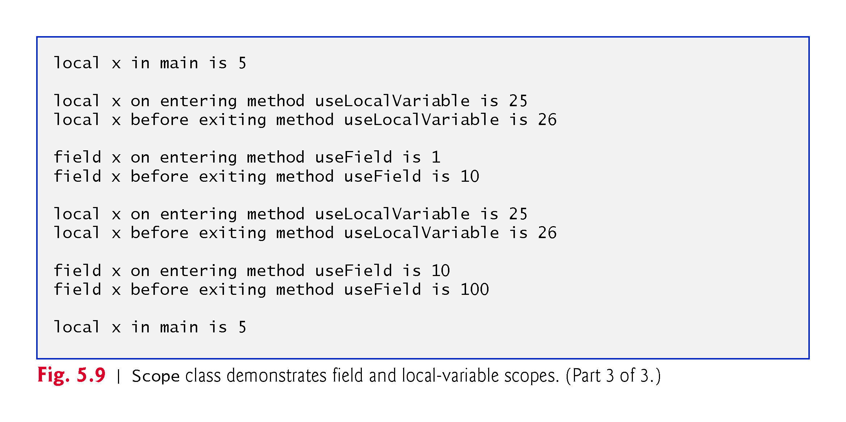

Slide 83
5.12 Method Overloading
Methods of the same name can be declared in the same class, as long as they have different sets of parameters
Called method overloading
The compiler selects the appropriate method to call by examining the number, types and order of the arguments in the call
Used to create several methods that perform the same or similar tasks on different types or different numbers of arguments
Math methods abs, min and max are overloaded with four versions each:
One with two double parameters
One with two float parameters
One with two int parameters
One with two long parameters

Slide 84
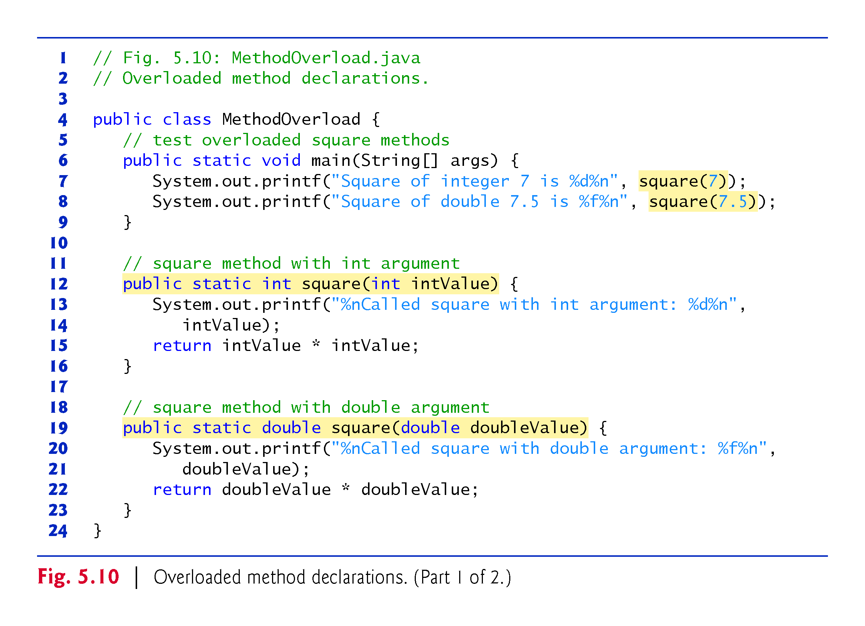

Slide 86
5.12 Method Overloading (cont.)
Literal integer values are treated as type int
Literal floating-point values are treated as type double
By default, floating-point values are displayed with six digits of precision if the precision is not specified in the format specifier.

Slide 87
5.12 Method Overloading (cont.)
Compiler distinguishes overloaded methods by their signatures
A combination of the method’s name and the number, types and order of its parameters, but not its return type.
Internally, the compiler uses longer method names that include the original method name, the types of each parameter and the exact order of the parameters to determine whether the methods in a class are unique in that class.
Method calls cannot be distinguished by return type
Overloaded methods can have different return types if the methods have different parameter lists
Overloaded methods need not have the same number of parameters

