Slide 1
Chapter 6 Arrays and ArrayLists
Java How to Program, Late Objects Version, 10/e

Slide 3
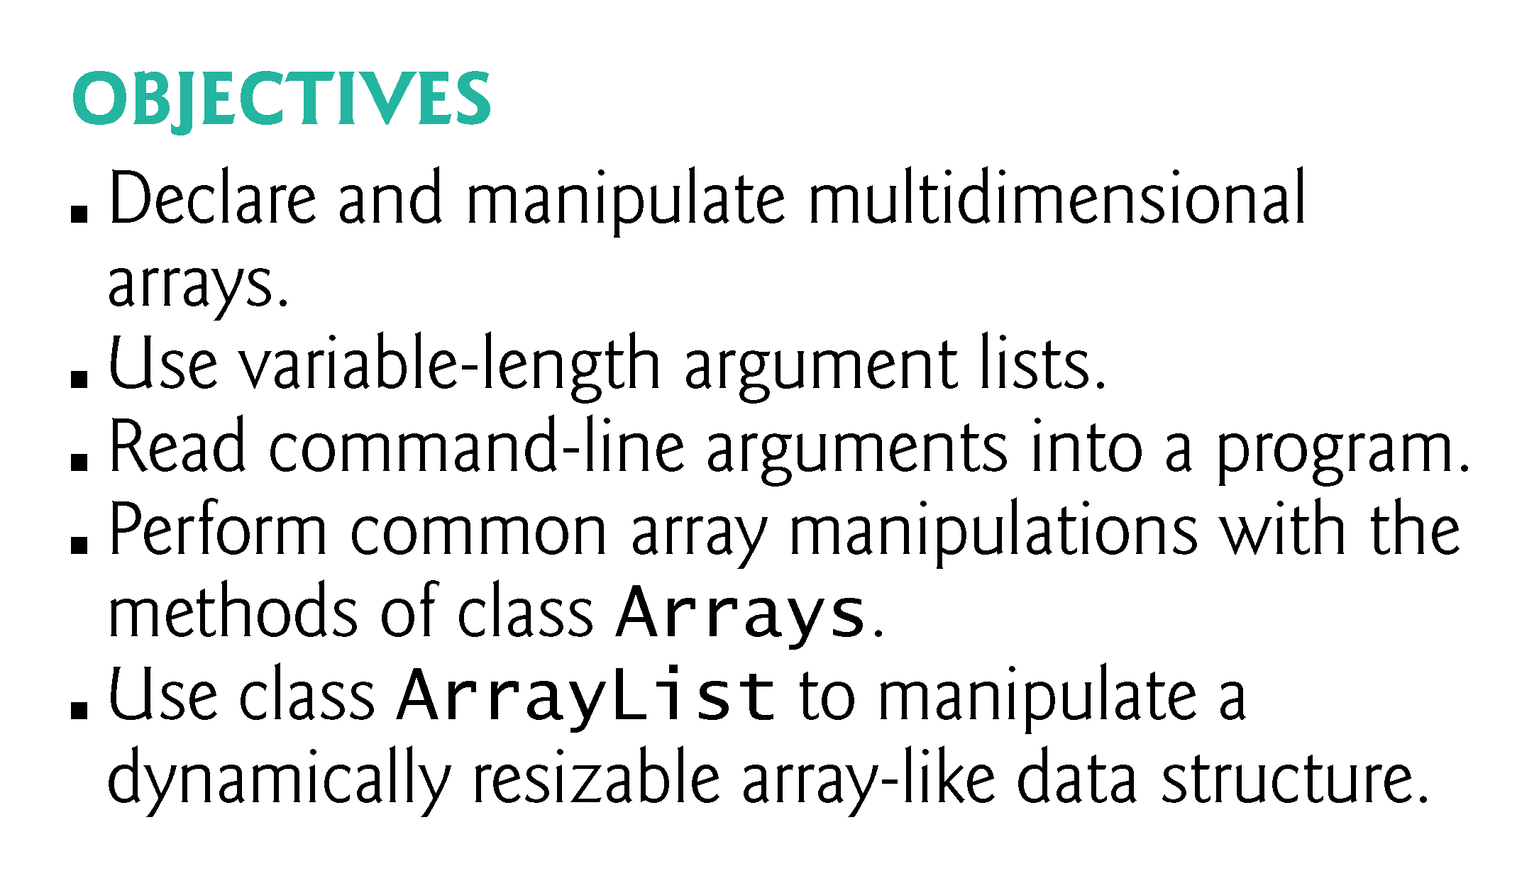

Slide 8
6.1 Introduction
Data structures—collections of related data items.
Array objects—data structures consisting of related data items of the same type.
Make it convenient to process related groups of values.
Remain the same length once they’re created.
Enhanced for statement—allows a program to access the data in an array more easily than does the counter-controlled for statement.
Use variable-length argument lists to create methods that can be called with varying numbers of arguments.
Demonstrate how to process command-line arguments in method main.
static methods of class Arrays from the java.util package.

Slide 9
6.1 Introduction (cont.)
At the end of this chapter, we introduce one of Java’s prebuilt data structures from the Java API’s collection classes.
Greater capabilities than traditional arrays.
Reusable, reliable, powerful and efficient.
Focus on the ArrayList collection.
ArrayLists are similar to arrays but provide additional functionality, such as dynamic resizing as necessary to accommodate more or fewer elements.
After reading Chapter 17, Lambdas and Streams, you’ll be able to reimplement many of Chapter 6’s examples in a more concise and elegant manner, and in a way that makes them easier to parallelize to improve performance on today’s multi-core systems.

Slide 10
6.2 Primitive Types vs. Reference Types
Java’s types are divided into primitive types and reference types.
Primitive types: boolean, byte, char, short, int, long, float and double.
All nonprimitive types are reference types.

Slide 11
6.2 Primitive Types vs. Reference Types (cont.)
A primitive-type variable can hold exactly one value of its declared type at a time.
Programs use variables of reference types (normally called references) to store the addresses of objects in the computer’s memory.
Such a variable is said to refer to an object in the program.
To call an object’s methods, you need a reference to the object.
If an object’s method requires additional data to perform its task, then you’d pass arguments in the method call.
Primitive-type variables do not refer to objects, so such variables cannot be used to invoke methods.

Slide 12
6.3 Arrays
An array is a group of variables (called elements or components) containing values that all have the same type.
Arrays are objects, so they’re considered reference types.
Elements can be either primitive types or reference types.
To refer to a particular element in an array, we specify the name of the reference to the array and the position number of the element in the array.
The position number of the element is called the element’s index or subscript.

Slide 14
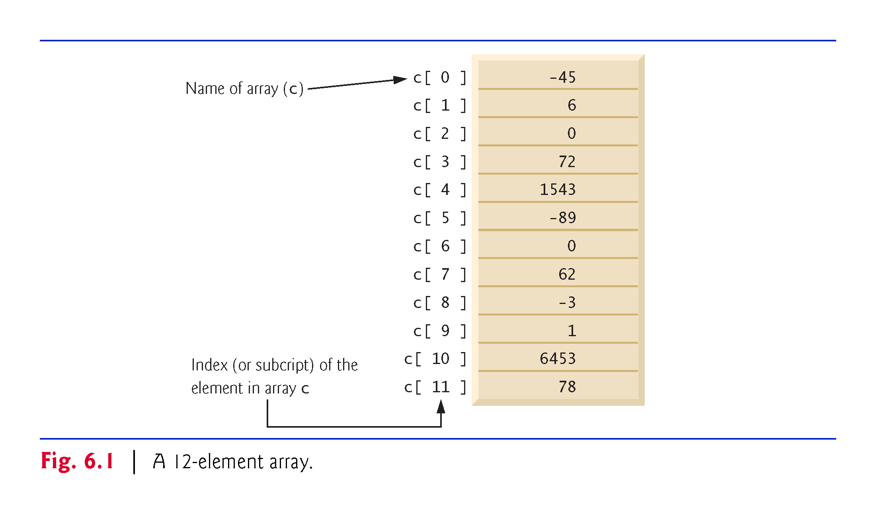

Slide 15
6.3 Arrays (cont.)
A program refers to an array’s elements with an array-access expression
The name of the array followed by the index of the particular element in square brackets ([]).
The first element in every array has index zero and is sometimes called the zeroth element.
The highest index in an array is one less than the number of elements.
Array names follow the same conventions as other variable names.
An index must be a nonnegative integer.
A program can use an expression as an index.
Array-access expressions can be used on the left side of an assignment to place a new value into an array element.

Slide 16
6.3 Arrays (cont.)
Every array object knows its own length and stores it in a length instance variable.
Even though the length instance variable of an array is public, it cannot be changed because it’s a final variable.

Slide 17
6.4 Declaring and Creating Arrays
Like other objects, arrays are created with keyword new.
To create an array object, you specify the type of the array elements and the number of elements as part of an array-creation expression that uses keyword new.
Returns a reference that can be stored in an array variable.
The following declaration and array-creation expression create an array object containing 12 int elements and store the array’s reference in the array variable named c:
int[] c = new int[12];
The square brackets following the type indicate that the variable will refer to an array.

Slide 21
6.4 Declaring and Creating Arrays (cont.)
A program can declare arrays of any type.
Every element of a primitive-type array contains a value of the array’s declared element type.
Similarly, in an array of a reference type, every element is a reference to an object of the array’s declared element type.

Slide 22
6.5 Examples Using Arrays
This section presents several examples that demonstrate declaring arrays, creating arrays, initializing arrays and manipulating array elements.

Slide 23
6.5.1 Creating and Initializing an Array
The application of Fig. 6.2 uses keyword new to create an array of 10 int elements, which are initially zero (the default initial value for int variables).

Slide 24
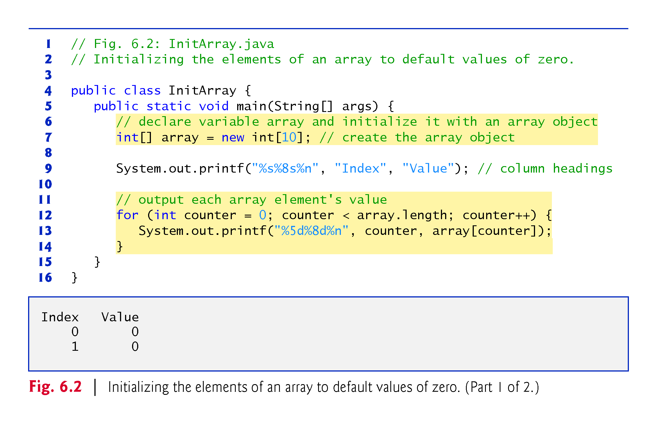

Slide 25
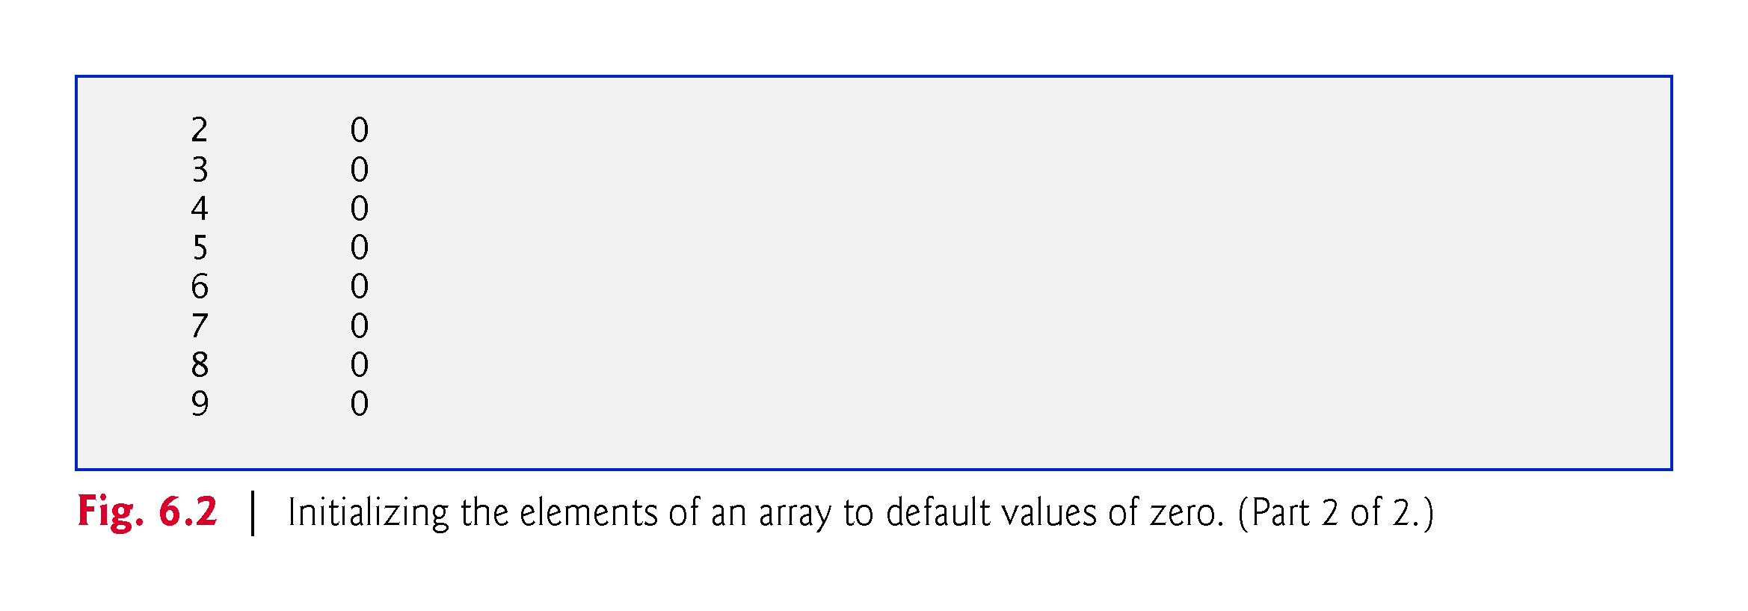

Slide 26
6.5.2 Using an Array Initializer
You can create an array and initialize its elements with an array initializer—a comma-separated list of expressions (called an initializer list) enclosed in braces.
Tthe array length is determined by the number of elements in the initializer list.
The following statement creates a five-element array with index values 0–4
int[] n = { 10, 20, 30, 40, 50 };
Element n[0] is initialized to 10, n[1] is initialized to 20, and so on.
When the compiler encounters an array declaration that includes an initializer list, it counts the number of initializers in the list to determine the size of the array, then sets up the appropriate new operation “behind the scenes.”

Slide 27
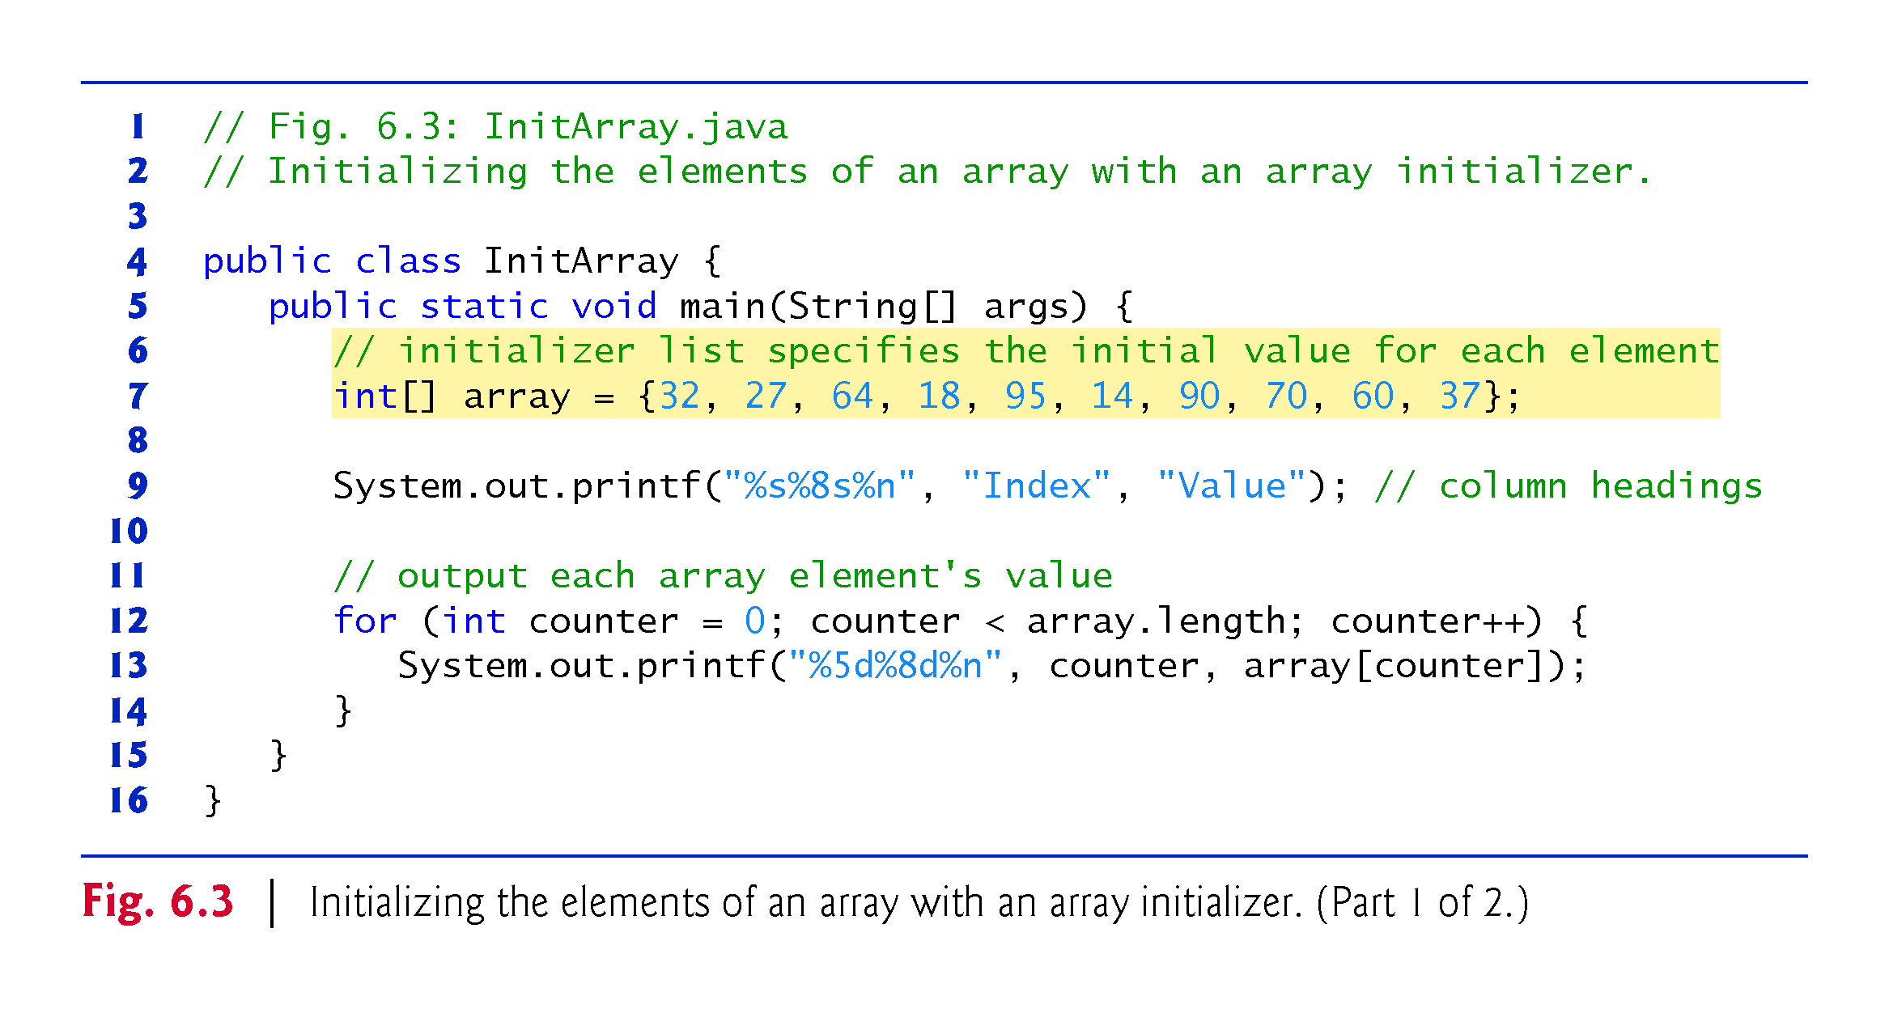

Slide 28
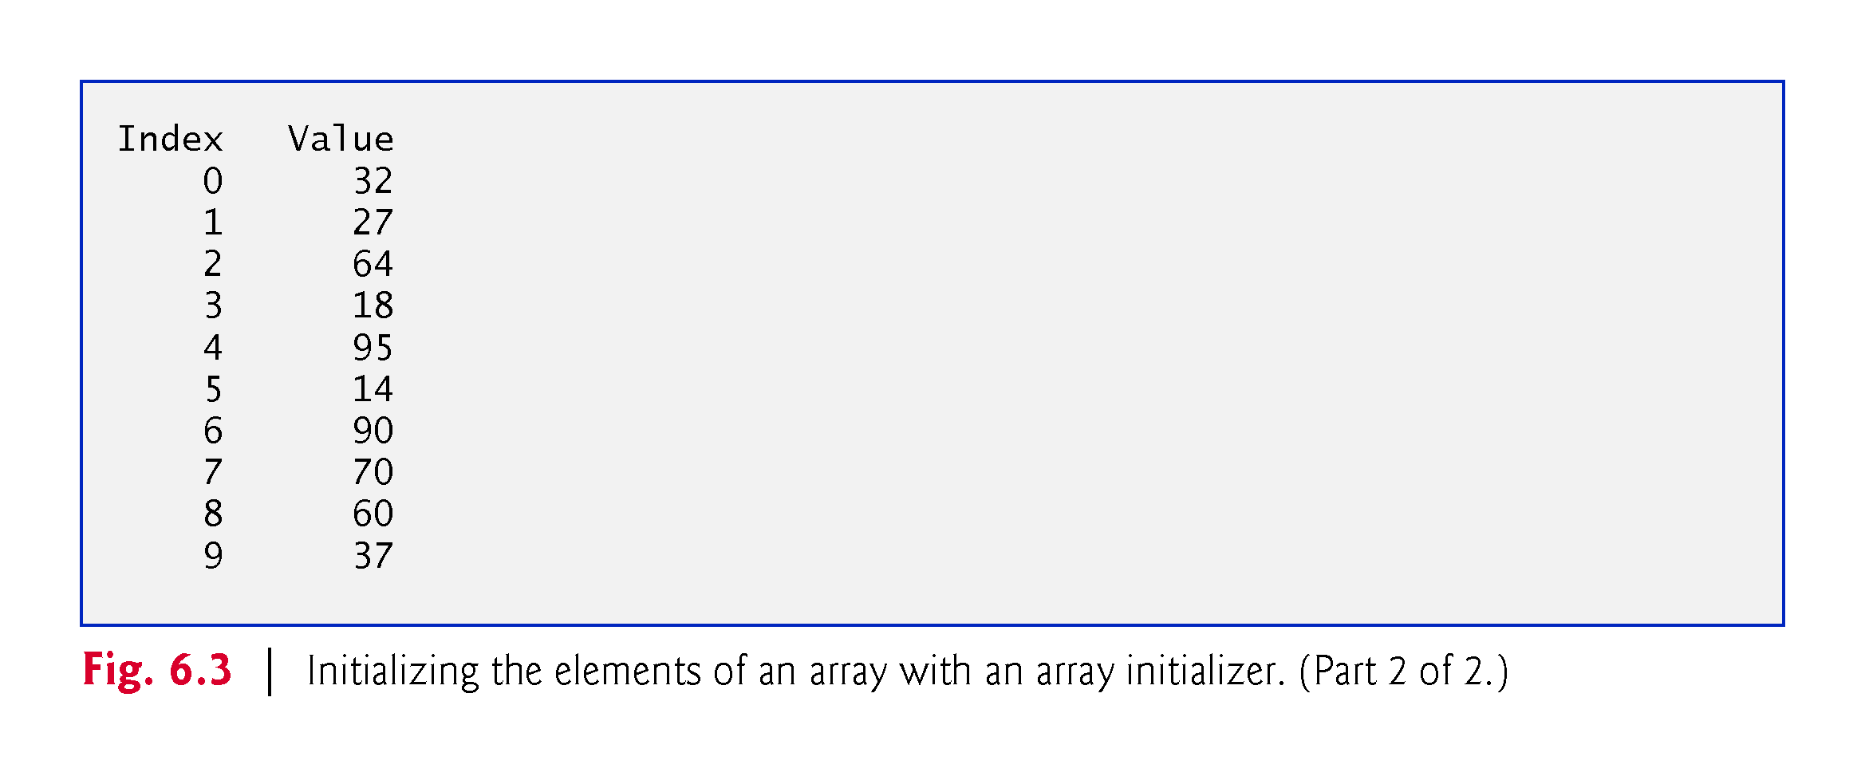

Slide 29
6.5.3 Calculating the Values to Store in an Array
The application in Fig. 6.4 creates a 10-element array and assigns to each element one of the even integers from 2 to 20 (2, 4, 6, …, 20).
Modifier final indicates that a variable is a constant.
Constant variables must be initialized before they’re used and cannot be modified thereafter.
If you attempt to modify a final variable after it’s initialized in its declaration, the compiler issues an error message like
cannot assign a value to final variable variableName

Slide 30
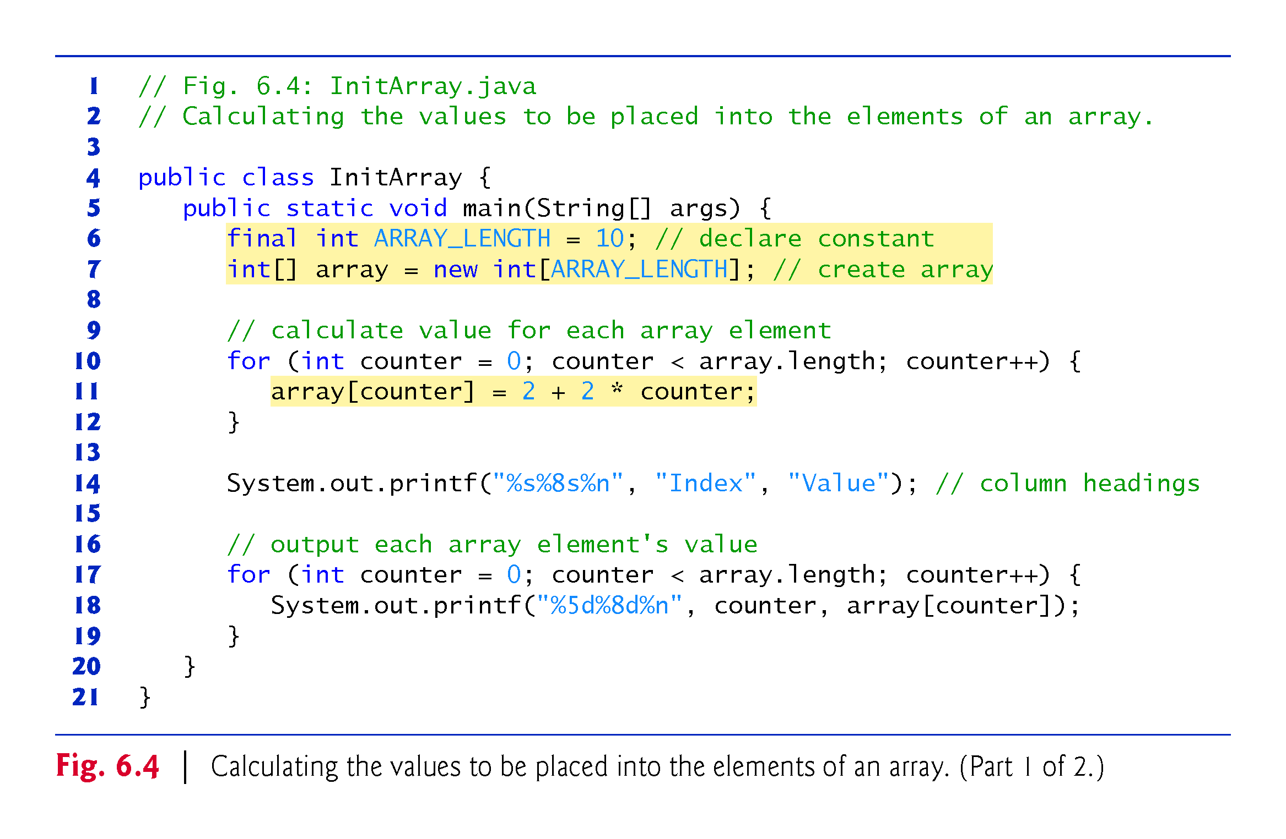

Slide 31
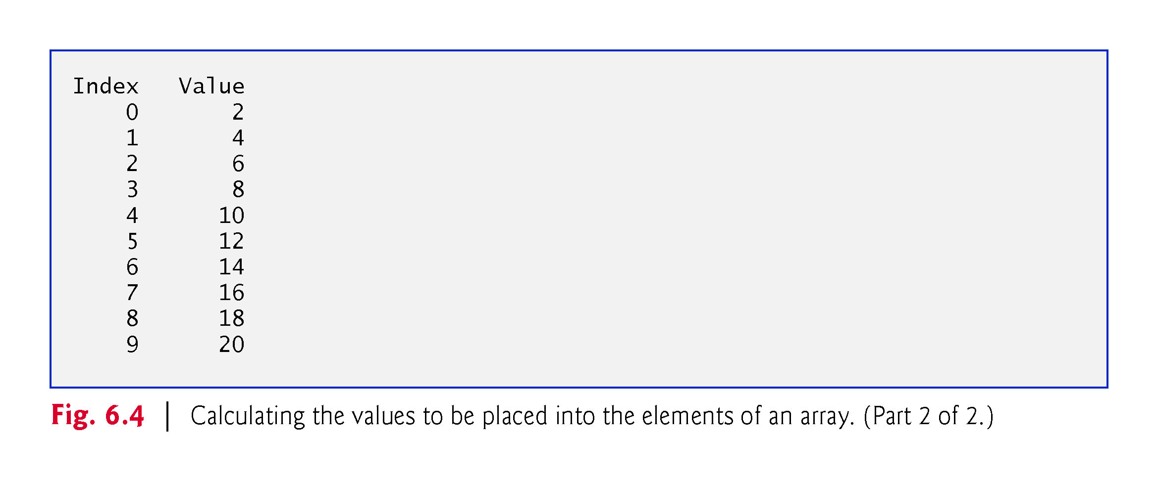

Slide 32
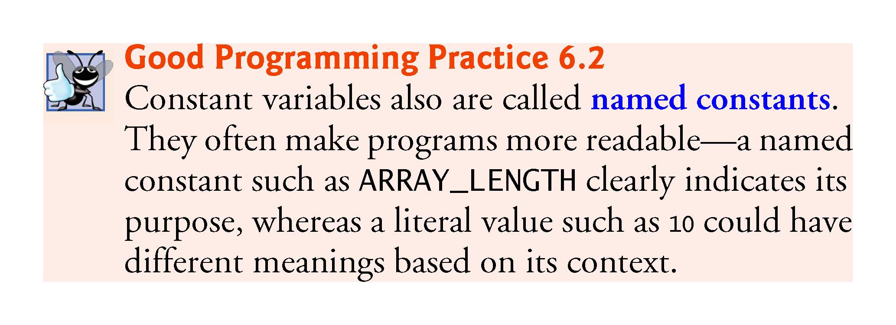

Slide 35
6.5.4 Summing the Elements of an Array
Often, the elements of an array represent a series of values to be used in a calculation.
Figure 6.5 sums the values contained in a 10-element integer array.

Slide 36
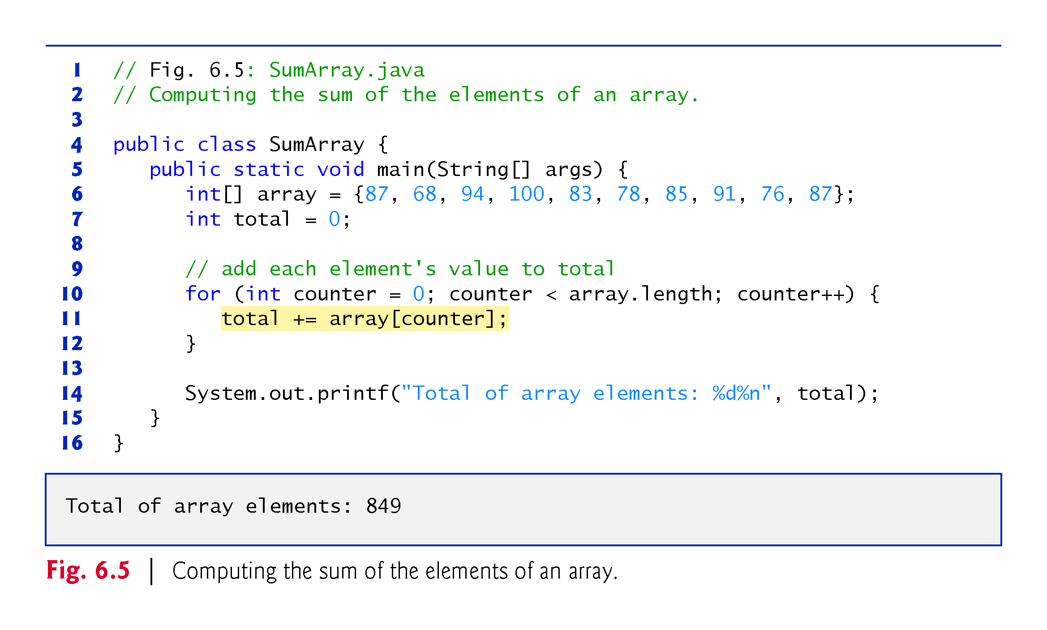

Slide 37
6.5.5 Using Bar Charts to Display Array Data Graphically
Many programs present data to users in a graphical manner.
For example, numeric values are often displayed as bars in a bar chart.
In such a chart, longer bars represent proportionally larger numeric values.
One simple way to display numeric data graphically is with a bar chart that shows each numeric value as a bar of asterisks (*).

Slide 38
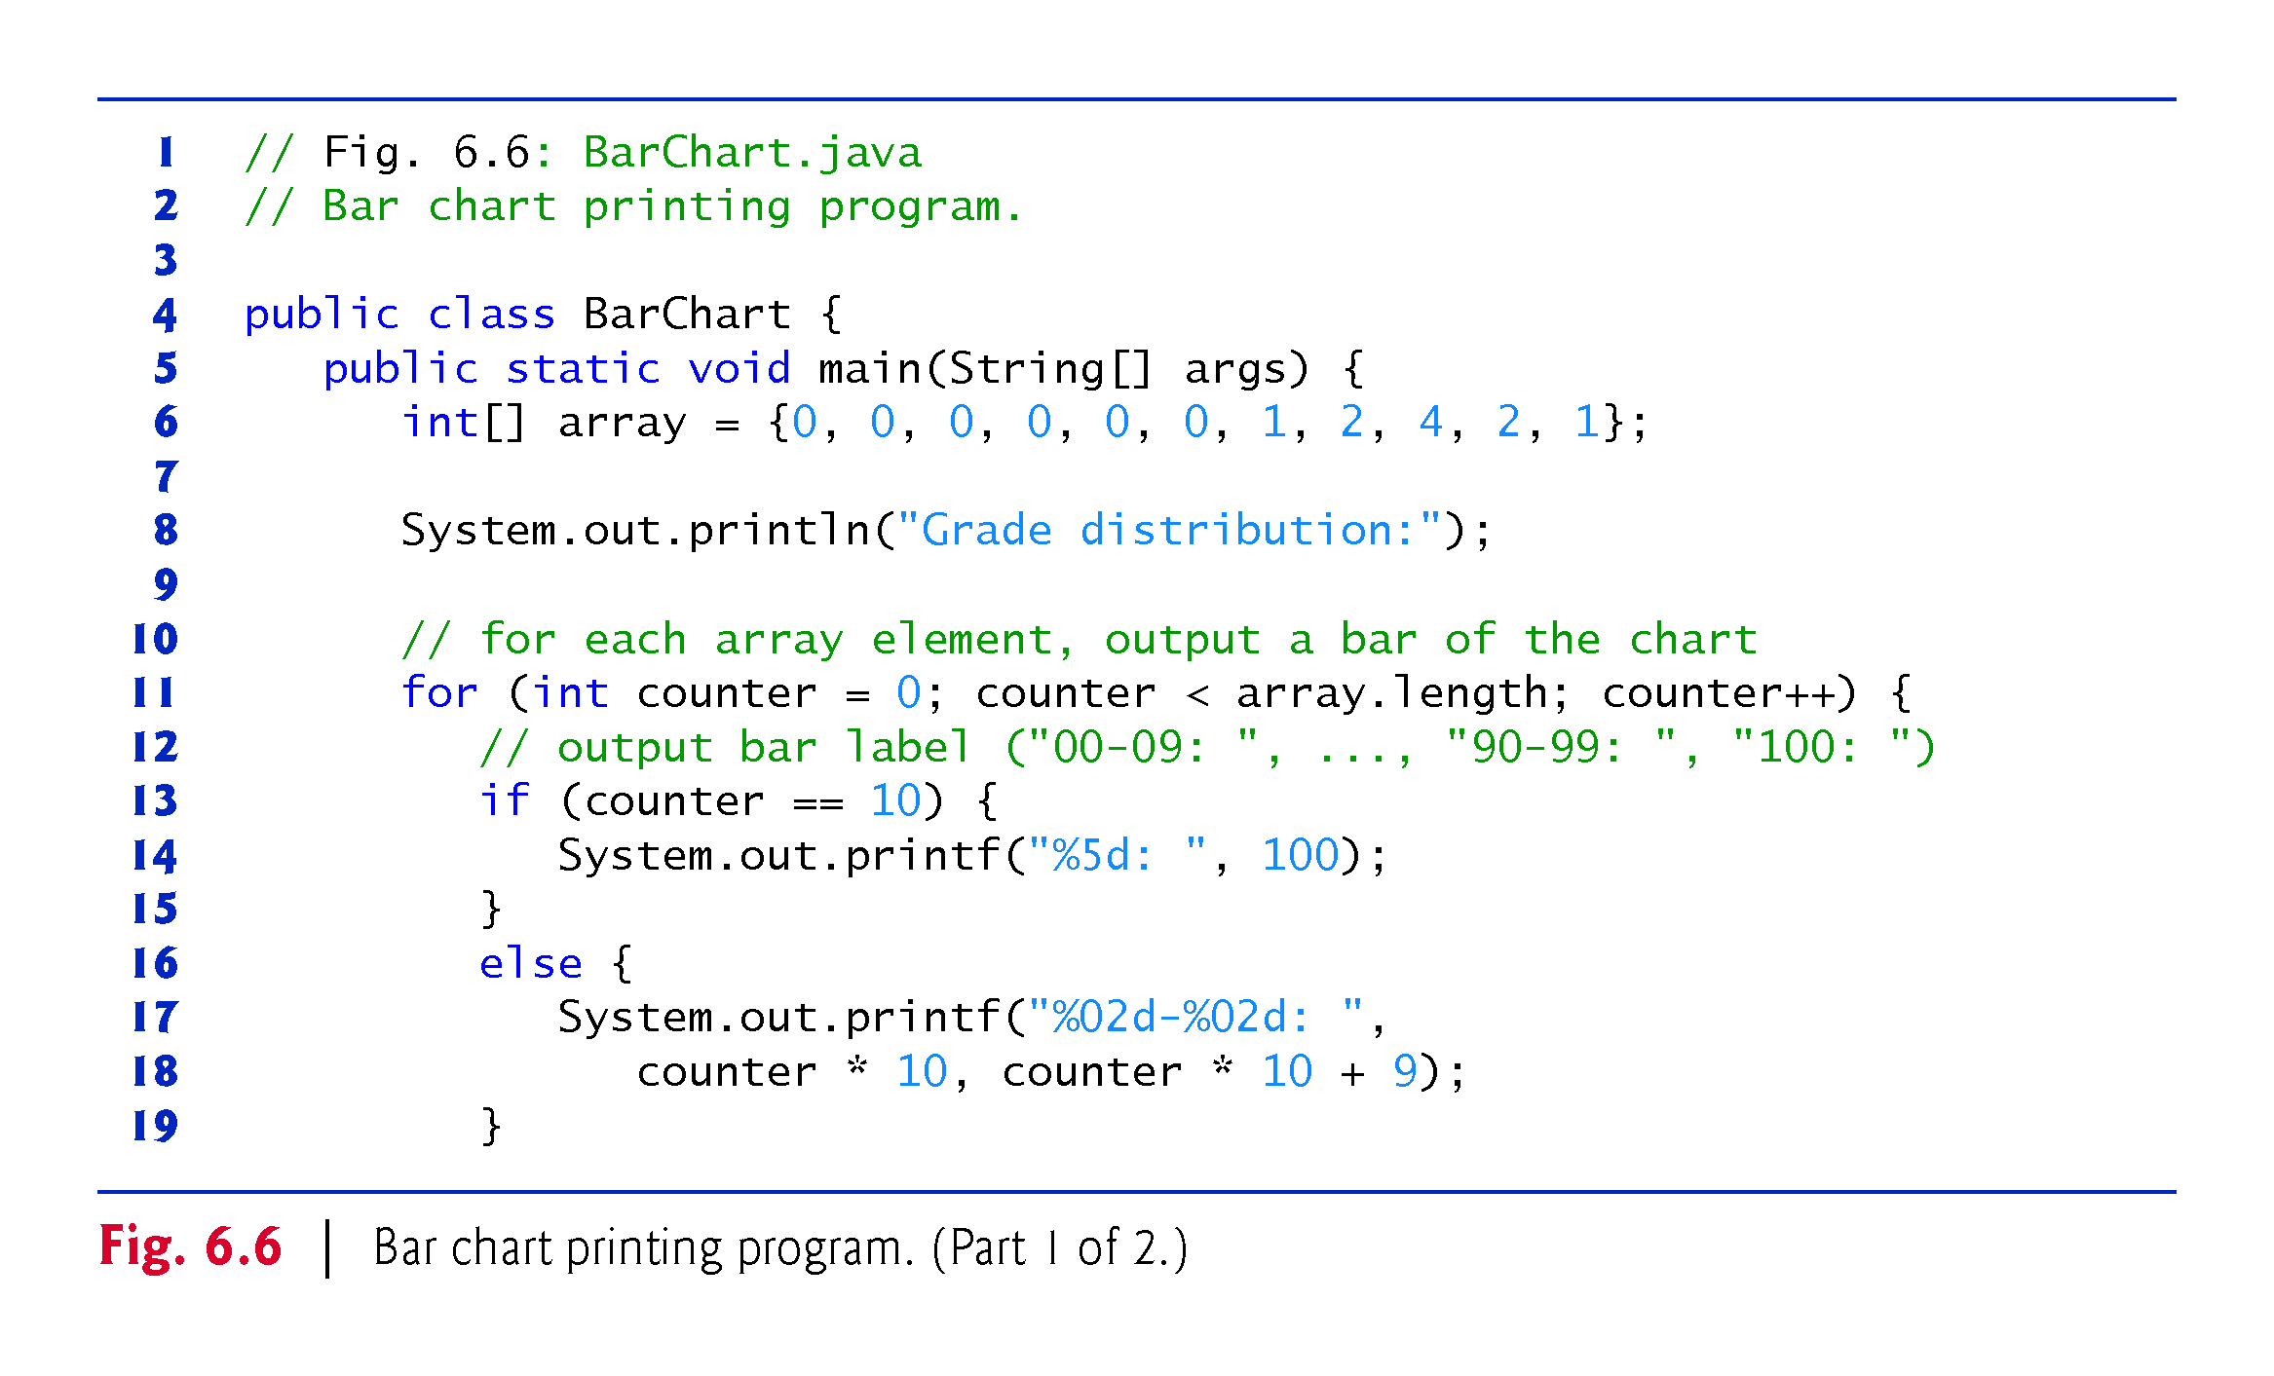

Slide 39
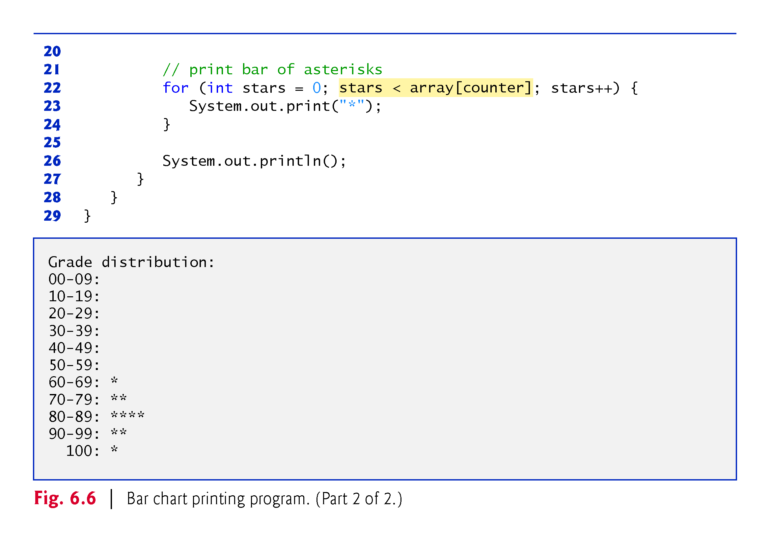

Slide 40
6.5.6 Using the Elements of an Array as Counters
Sometimes, programs use counter variables to summarize data, such as the results of a survey.
In Fig. 5.7, we used separate counters in our die-rolling program to track the number of occurrences of each side of a six-sided die as the program rolled the die 6,000,000 times.
An array version of this application is shown in Fig. 6.7.
Figure 6.7 uses the array frequency to count the occurrences of each side of the die.
The single statement in line 12 of this program replaces the entire switch statement of Fig. 5.7.

Slide 41
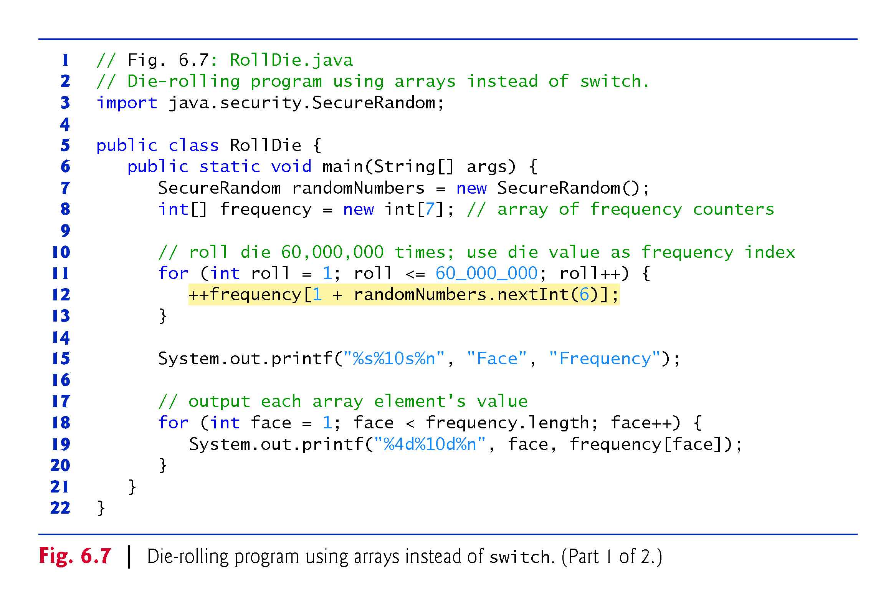

Slide 43
6.5.7 Using Arrays to Analyze Survey Results
Our next example uses arrays to summarize data collected in a survey:
Twenty students were asked to rate on a scale of 1 to 5 the quality of the food in the student cafeteria, with 1 being “awful” and 5 being “excellent.” Place the 20 responses in an integer array and determine the frequency of each rating.
Typical array-processing application (Fig. 6.8).
Summarize the number of responses of each type (that is, 1 through 5).
Array responses is a 20-element integer array containing the students’ survey responses.

Slide 44
6.5.7 Using Arrays to Analyze Survey Results (Cont.)
The last value in the array is intentionally an incorrect response (14).
When a Java program executes, array element indices are checked for validity—all indices must be greater than or equal to 0 and less than the length of the array.
Any attempt to access an element outside that range of indices results in a runtime error that’s known as an ArrayIndexOutOfBoundsException.
We use the six-element array frequency to count the number of occurrences of each response.

Slide 45
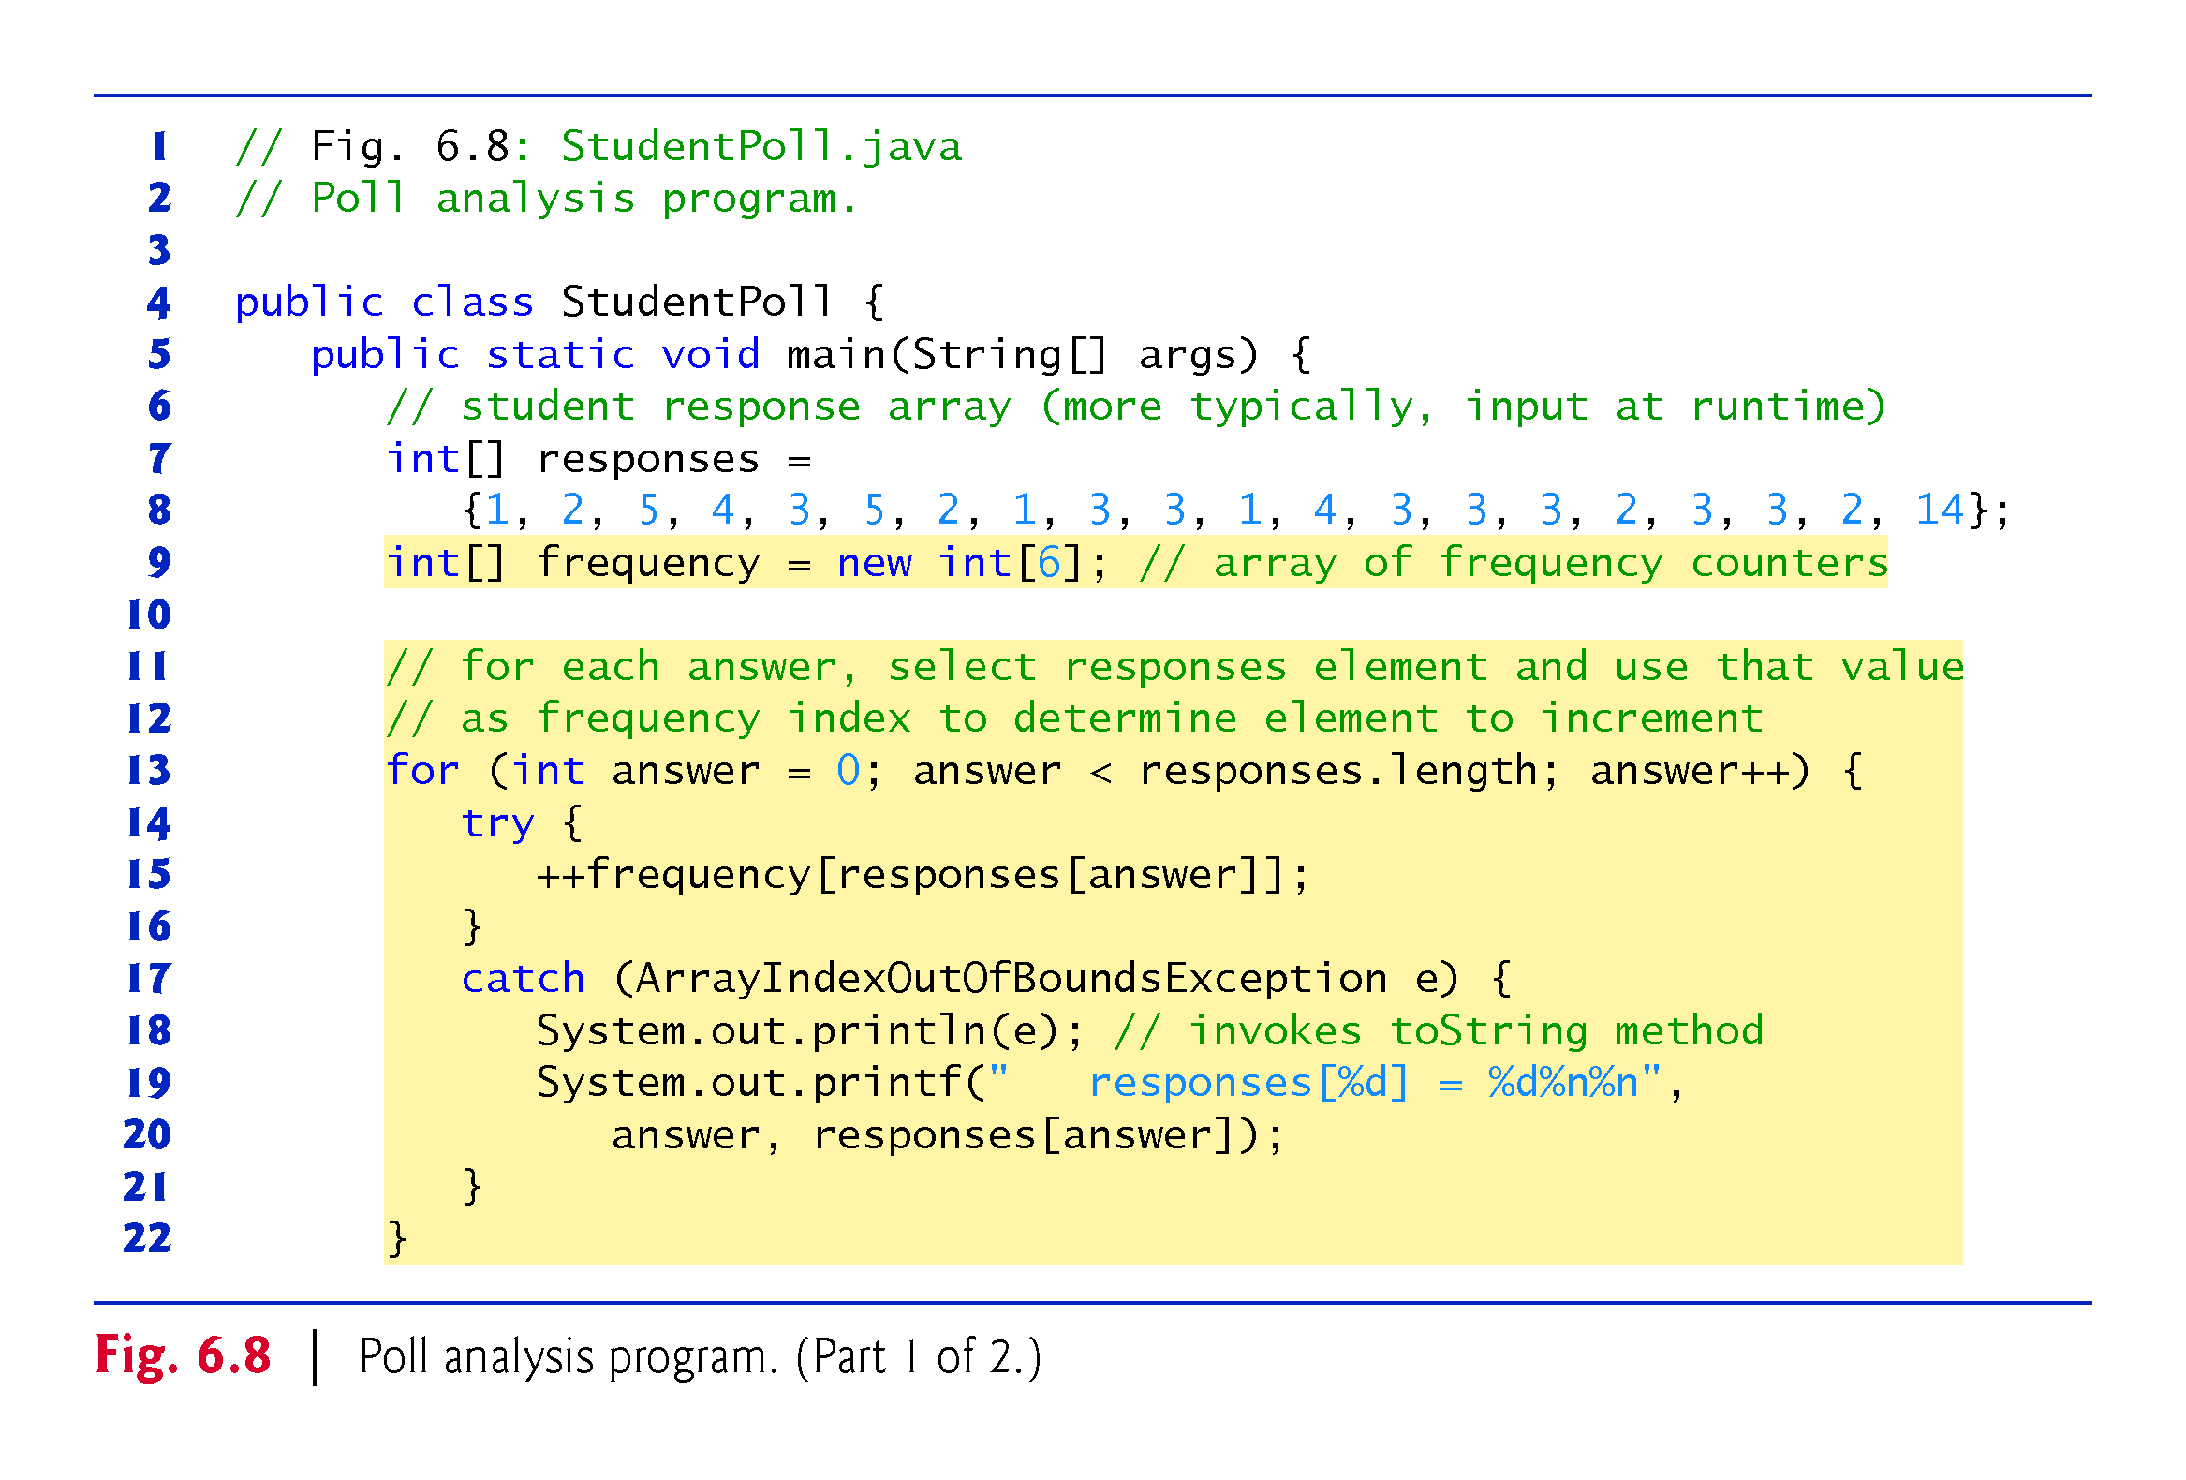

Slide 46
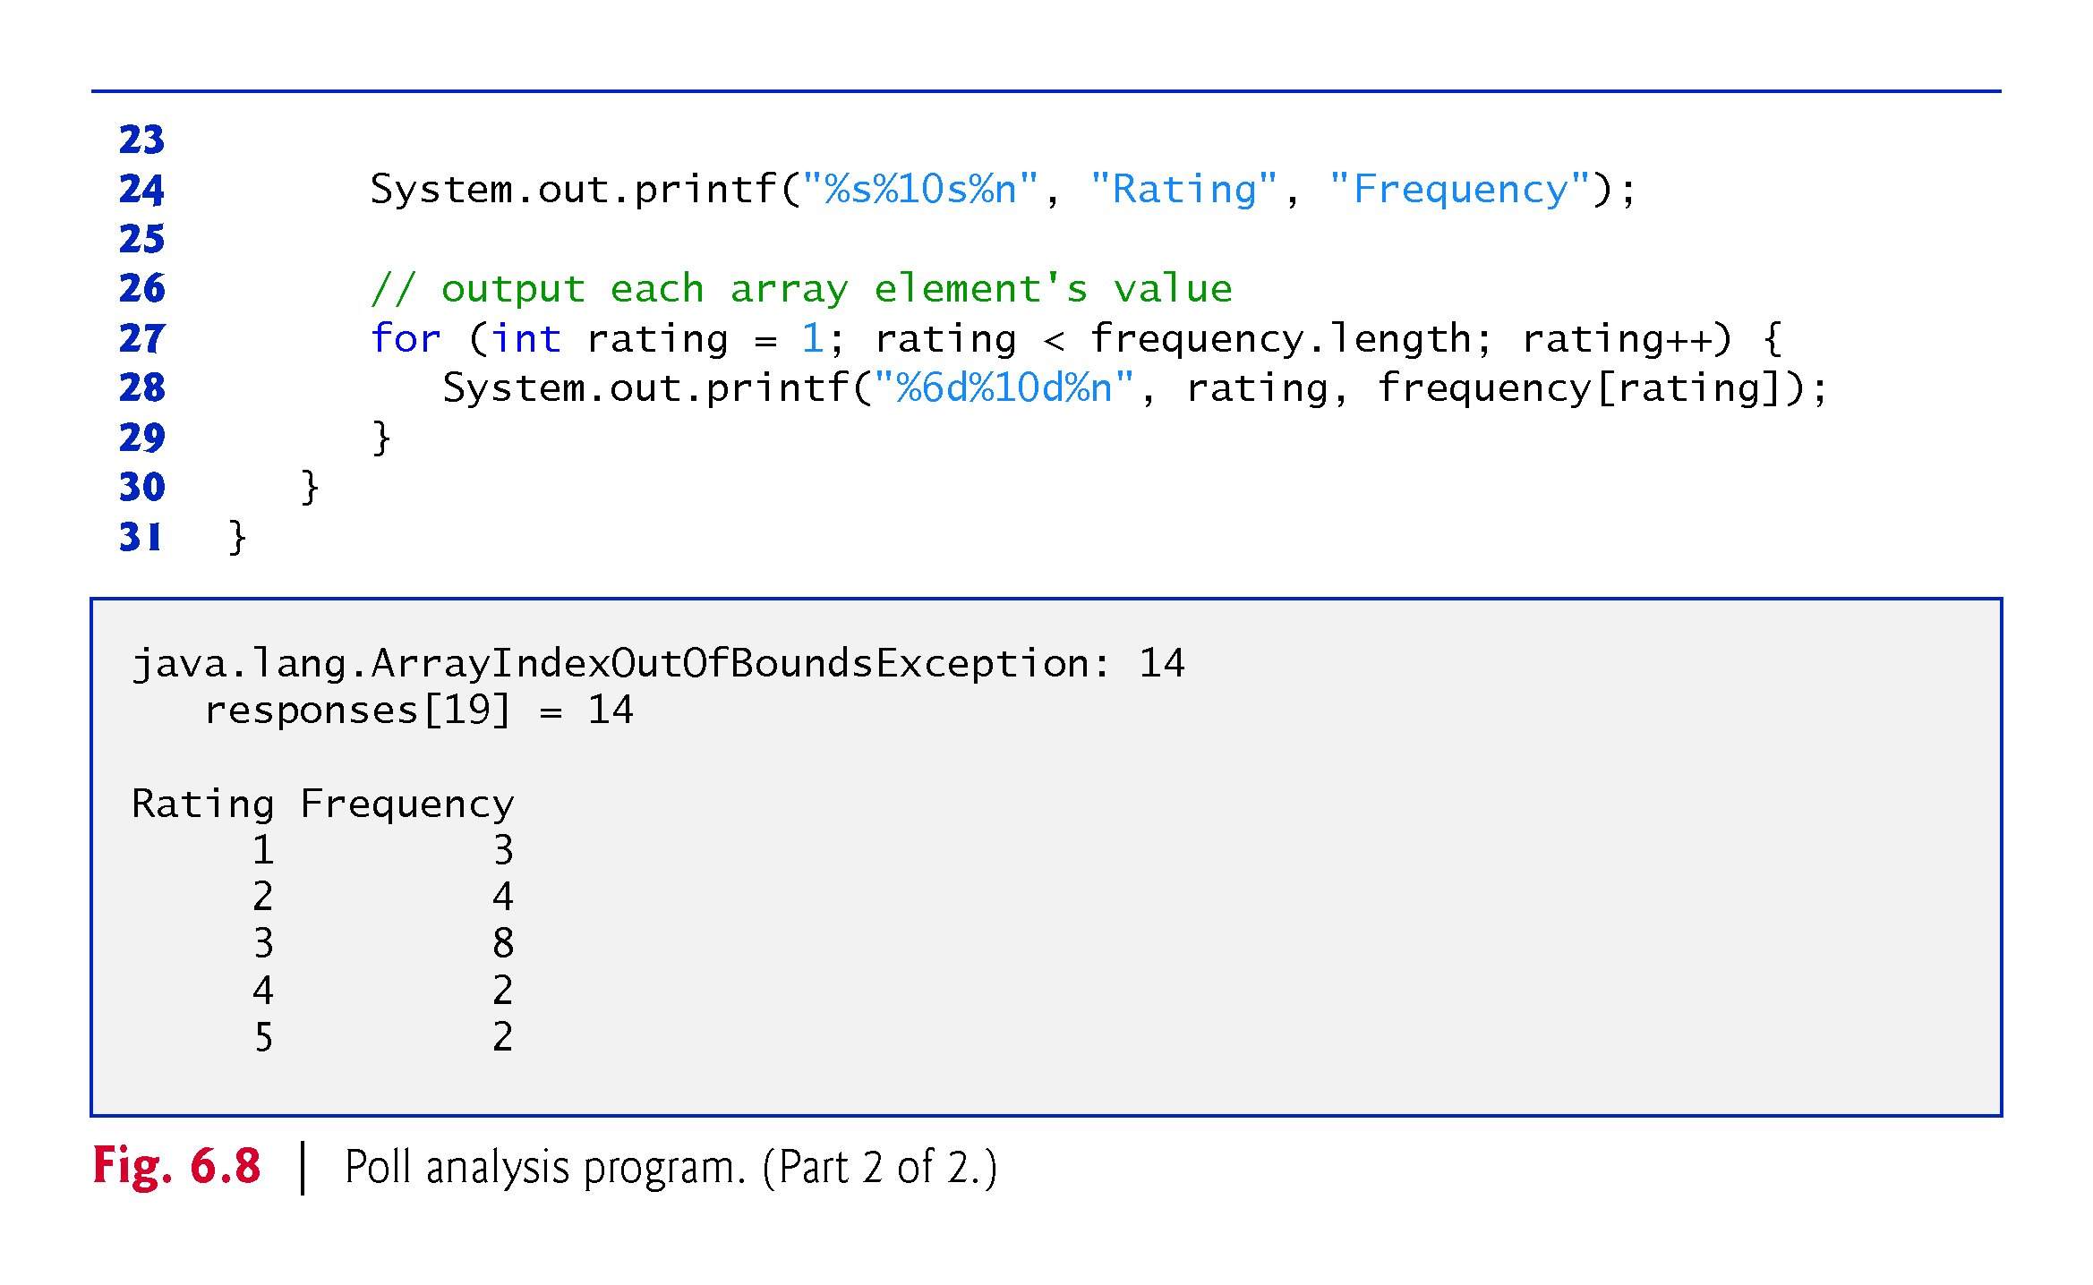

Slide 47
6.5.7 Using Arrays to Analyze Survey Results (Cont.)
The for statement reads the responses from the responses one at a time and increments one of the counters frequency[1] to frequency[5]; we ignore frequency[0] because the survey responses are limited to the range 1–5.
The key statement in the loop appears in the try block.
This statement increments the appropriate frequency counter as determined by the value of responses[answer].

Slide 48
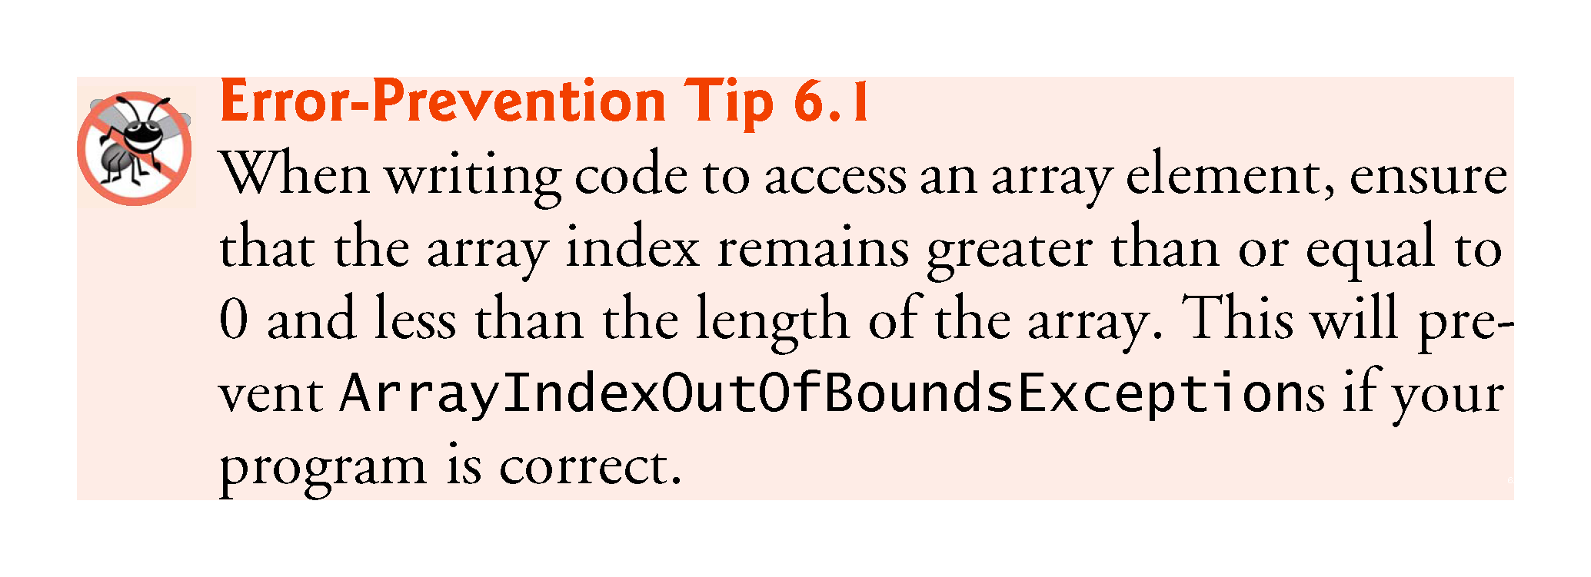

Slide 50
6.6 Exception Handling: Processing the Incorrect Response
An exception indicates a problem that occurs while a program executes.
Exception handling helps you create fault-tolerant programs that can resolve (or handle) exceptions.
In many cases, this allows a program to continue executing as if no problems were encountered.
More severe problems might prevent a program from continuing normal execution, instead requiring the program to notify the user of the problem, then terminate.
When the JVM or a method detects a problem, such as an invalid array index or an invalid method argument, it throws an exception—that is, an exception occurs.
Methods in your own classes can also throw exceptions, as you’ll learn in Chapter 8.

Slide 51
6.6.1 The try Statement
To handle an exception, place any code that might throw an exception in a try statement.
The try block contains the code that might throw an exception, and the catch block contains the code that handles the exception if one occurs.
You can have many catch blocks to handle different types of exceptions that might be thrown in the corresponding try block.
The braces that delimit the bodies of the try and catch blocks are required.

Slide 52
6.6.2 Executing the catch Block
When the program encounters the invalid value 14 in the responses array, it attempts to add 1 to frequency[14], which is outside the bounds of the array—the frequency array has only six elements (with indexes 0–5).
Because array bounds checking is performed at execution time, the JVM generates an exception—specifically an ArrayIndexOutOfBoundsException to notify the program of this problem.
At this point the try block terminates and the catch block begins executing—any local variables declared in the try block are now out of scope (and no longer exist), so they’re not accessible in the catch block.

Slide 53
6.6.3 toString Method of the Exception Parameter
When the exception is caught, the program displays a message indicating the problem that occurred.
We implicitly call the exception object’s toString method to get the error message that’s implicitly stored in the exception object and display it.
Once the message is displayed in this example, the exception is considered handled and the program continues with the next statement after the catch block’s closing brace.
In this example, the end of the for statement is reached, so the program continues with the increment of the control variable in the for header .

Slide 54
6.7 Enhanced for Statement
Iterates through the elements of an array without using a counter, thus avoiding the possibility of “stepping outside” the array.
Syntax:
for (parameter : arrayName) statement
where parameter has a type and an identifier, and arrayName is the array through which to iterate.
Parameter type must be consistent with the type of the elements in the array.

Slide 55
6.7 Enhanced for Statement (Cont.)
Figure 6.9 uses the enhanced for statement to sum the integers in an array of student grades.
Can be used only to obtain array elements—it cannot be used to modify elements.
Can be used in place of the counter-controlled for statement whenever code looping through an array does not require access to the counter indicating the index of the current array element.

Slide 56
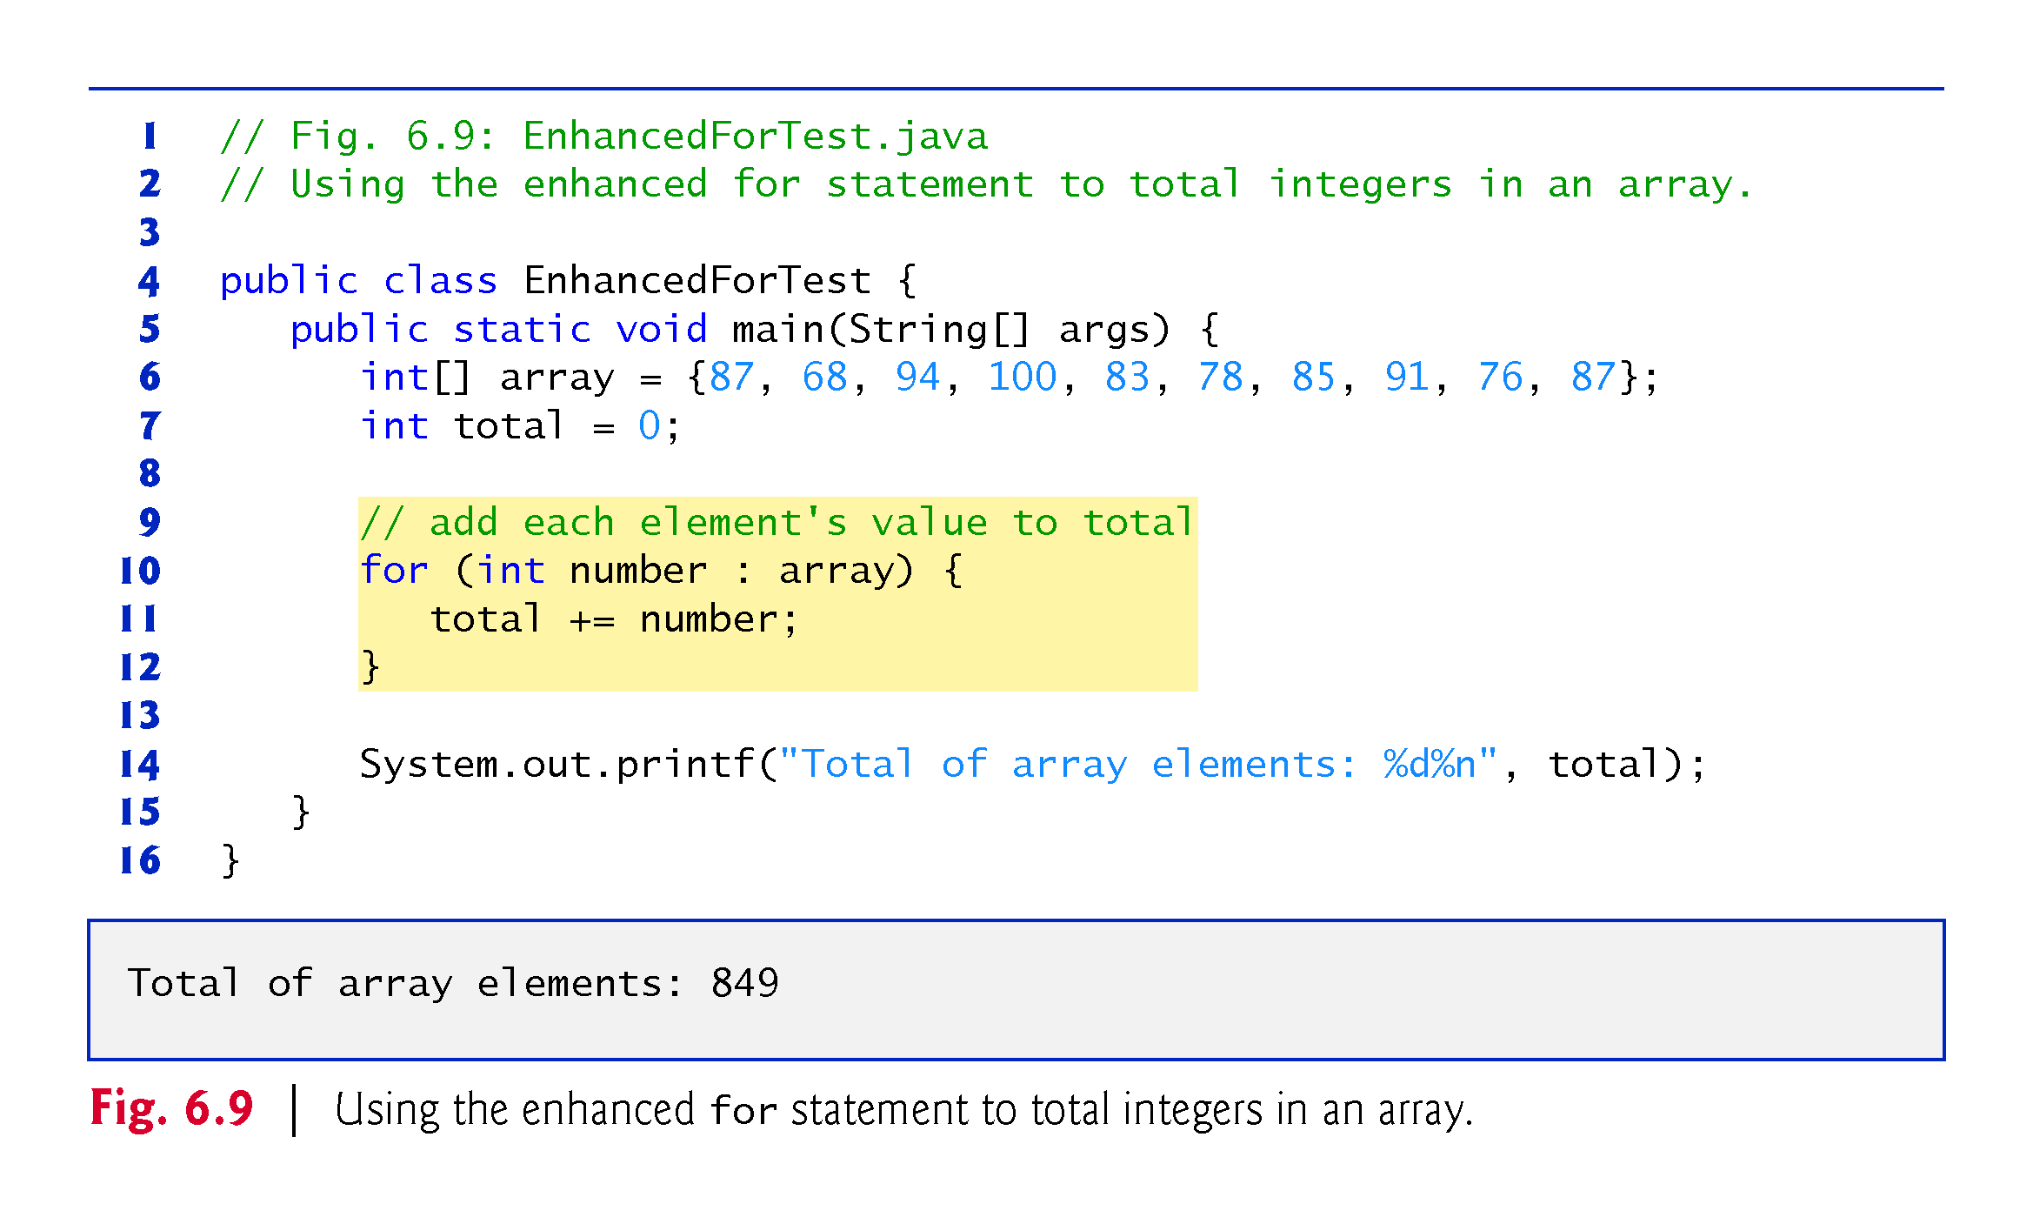

Slide 57
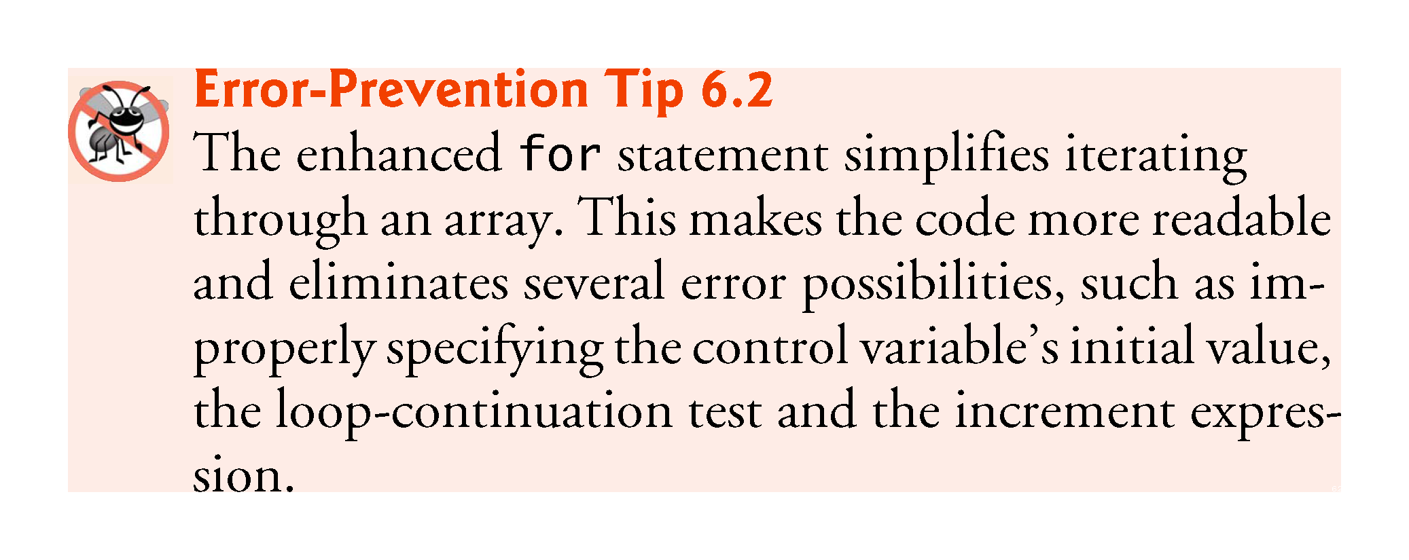

Slide 58
6.8 Passing Arrays to Methods
To pass an array argument to a method, specify the name of the array without any brackets.
When we pass an array object’s reference into a method, we need not pass the array length as an additional argument because every array knows its own length.
For a method to receive an array reference through a method call, the method’s parameter list must specify an array parameter.

Slide 59
6.8 Passing Arrays to Methods (Cont.)
When an argument to a method is an entire array or an individual array element of a reference type, the called method receives a copy of the reference.
However, when an argument to a method is an individual array element of a primitive type, the called method receives a copy of the element’s value.
Such primitive values are called scalars or scalar quantities.
To pass an individual array element to a method, use the indexed name of the array element as an argument in the method call.

Slide 60
6.8 Passing Arrays to Methods (cont.)
Figure 6.10 demonstrates the difference between passing an entire array and passing a primitive-type array element to a method.
Method modifyArray receives a copy of array’s reference and uses the reference to multiply each of array’s elements by 2.
When a copy of an individual primitive-type array element is passed to a method, modifying the copy in the called method does not affect the original value of that element in the calling method’s array.

Slide 61
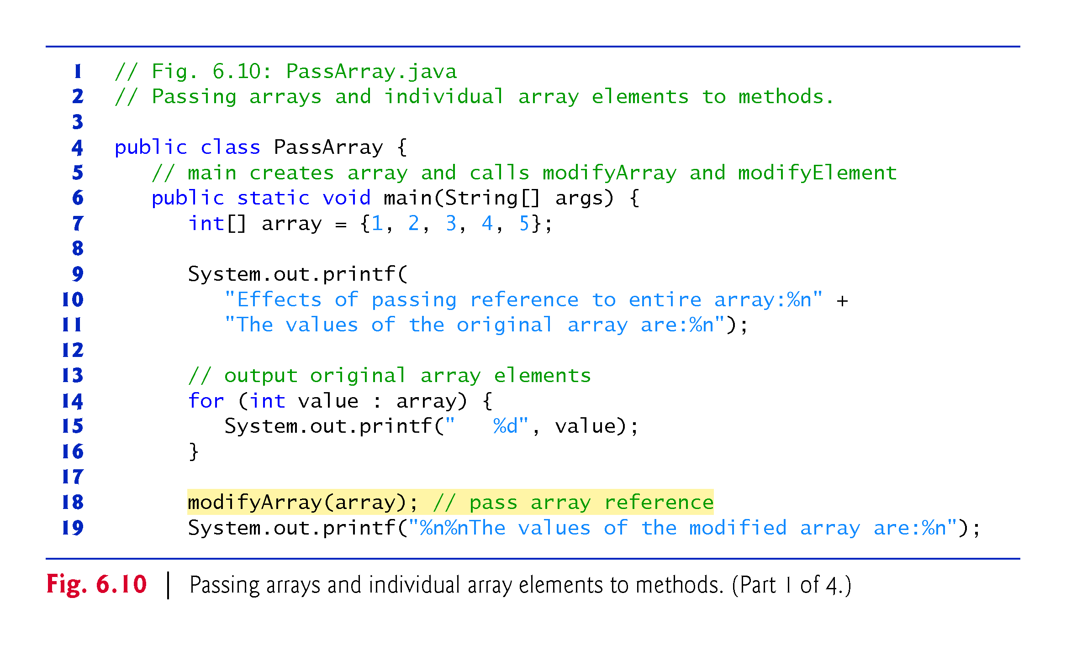

Slide 62
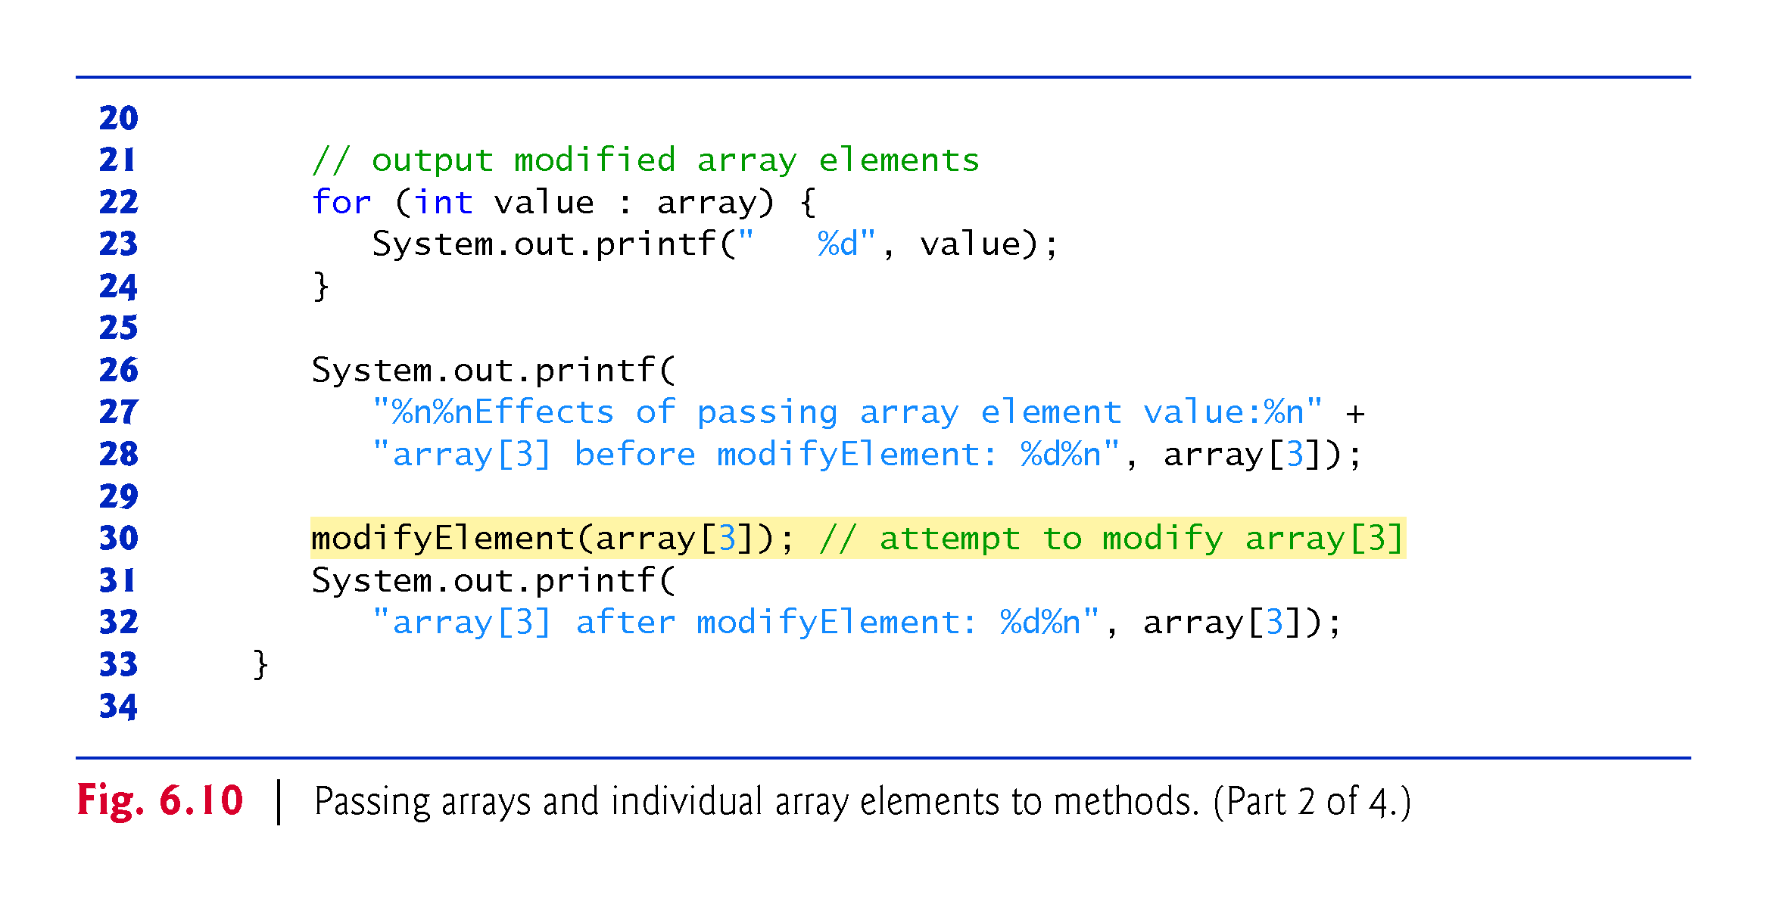

Slide 63
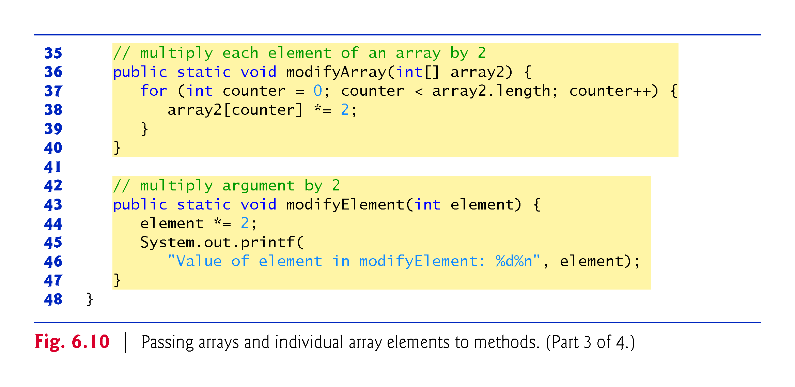

Slide 64
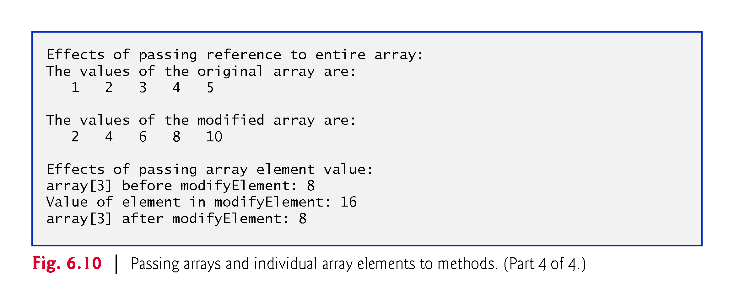

Slide 65
6.9 Pass-By-Value vs. Pass-By-Reference
Two ways to pass arguments in method calls in many programming languages are pass-by-value and pass-by-reference.
When an argument is passed by value, a copy of the argument’s value is passed to the called method.
The called method works exclusively with the copy.
Changes to the called method’s copy do not affect the original variable’s value in the caller.
When an argument is passed by reference, the called method can access the argument’s value in the caller directly and modify that data, if necessary.
Improves performance by eliminating the need to copy possibly large amounts of data.

Slide 66
6.9 Pass-By-Value vs. Pass-By-Reference (Cont.)
Java does not allow you to choose pass-by-value or pass-by-reference—all arguments are passed by value.
A method call can pass two types of values to a method—copies of primitive values and copies of references to objects.
Objects themselves cannot be passed to methods.
If you modify a reference-type parameter so that it refers to another object, only the parameter refers to the new.
Although an object’s reference is passed by value, a method can still interact with the referenced object by calling its public methods using the copy of the object’s reference.
The parameter in the called method and the argument in the calling method refer to the same object in memory.

Slide 67
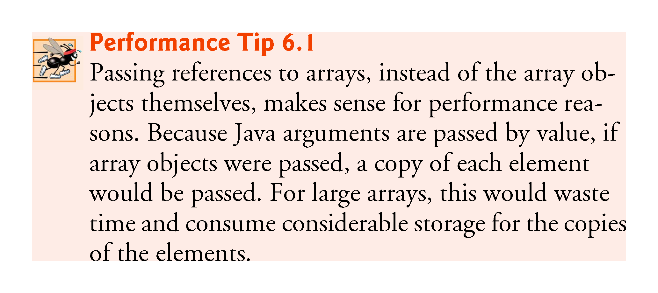

Slide 68
6.10 Multidimensional Arrays
Multidimensional arrays with two dimensions are often used to represent tables of values with data arranged in rows and columns.
To identify a particular table element, you specify two indices—the first identifies the element’s row and the second its column.
Arrays that require two indices to identify each element are called two-dimensional arrays.
Multidimensional arrays can have more than two dimensions.
Java does not support multidimensional arrays directly, but it allows you to specify one-dimensional arrays whose elements are also one-dimensional arrays, thus achieving the same effect.

Slide 69
6.10 Multidimensional Arrays (cont.)
Figure 6.11 illustrates a two-dimensional array named a with three rows and four columns (i.e., a three-by-four array).
In general, an array with m rows and n columns is called an m-by-n array.

Slide 70
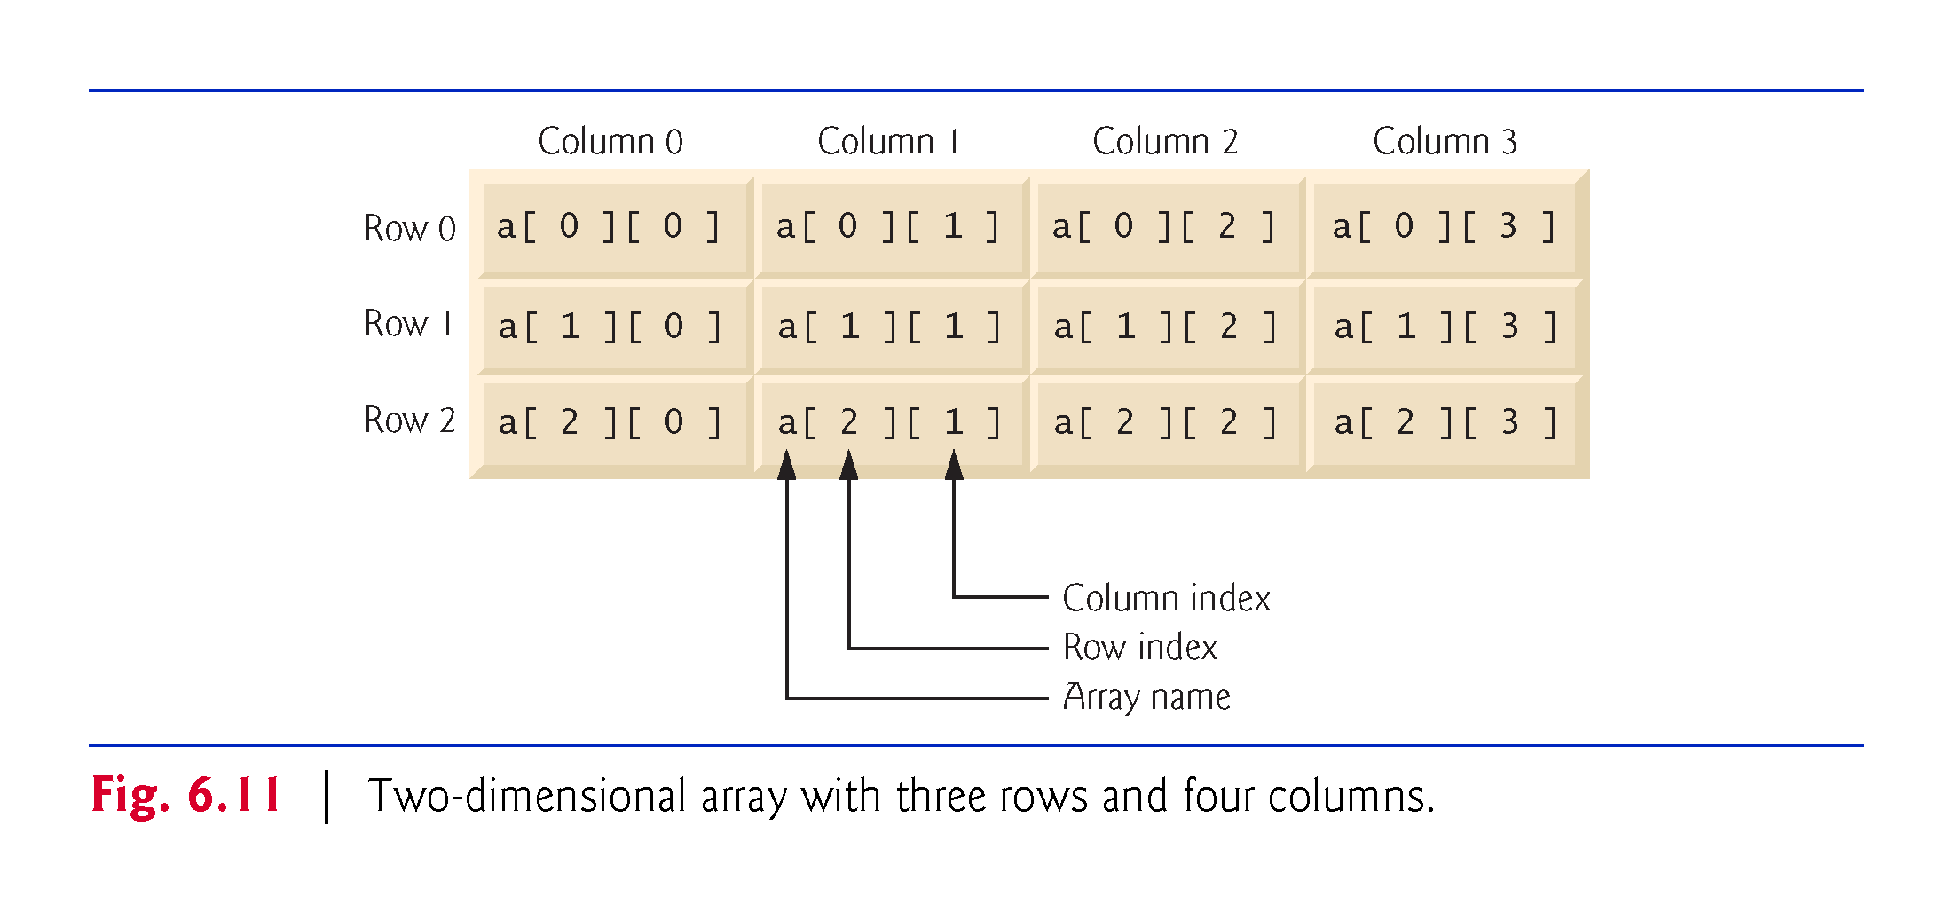

Slide 71
6.10 Multidimensional Arrays (cont.)
Multidimensional arrays can be initialized with array initializers in declarations.
A two-dimensional array b with two rows and two columns could be declared and initialized with nested array initializers as follows:
int[][] b = { { 1, 2 }, { 3, 4 } };
The initial values are grouped by row in braces.
The compiler counts the number of nested array initializers to determine the number of rows in array b.
The compiler counts the initializer values in the nested array initializer for a row to determine the number of columns in that row.
Rows can have different lengths.
Multidimensional arrays are maintained as arrays of one-dimensional arrays.

Slide 72
6.10 Multidimensional Arrays (cont.)
A multidimensional array with the same number of columns in every row can be created with an array-creation expression, as in:
int[][] b = new int[3][4];
Programs can also use variables to specify array dimensions, because new creates arrays at execution time—not at compile time.
The elements of a multidimensional array are initialized when the array object is created.
A multidimensional array in which each row has a different number of columns can be created as follows:
int[][] b = new int[2][ ]; // create 2 rows b[0] = new int[5]; // create 5 columns for row 0 b[1] = new int[3]; // create 3 columns for row 1

Slide 73
6.10 Multidimensional Arrays (cont.)
Figure 6.12 demonstrates initializing two-dimensional arrays with array initializers, and using nested for loops to traverse the arrays—that is, manipulate every element of each array.

Slide 74
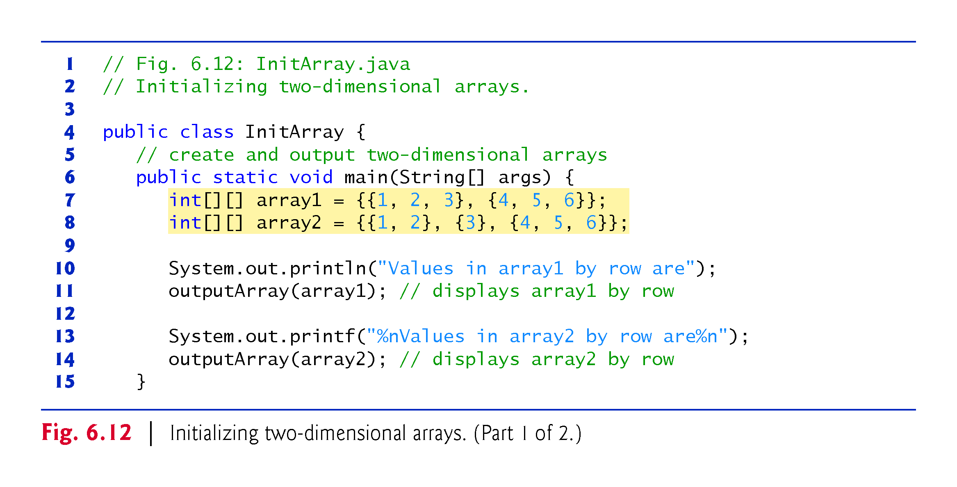

Slide 75
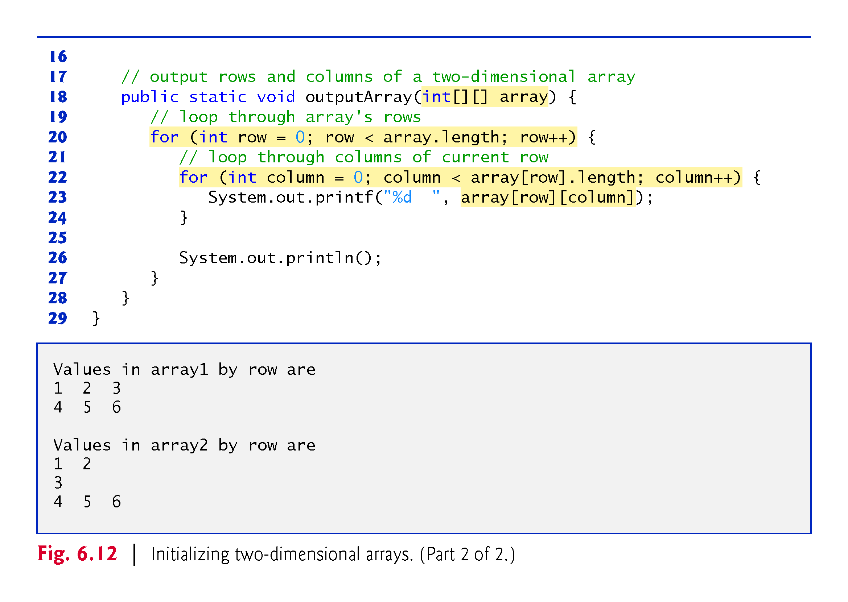

Slide 76
6.11 Variable-Length Argument Lists
With variable-length argument lists, you can create methods that receive an unspecified number of arguments.
A type followed by an ellipsis (...) in a method’s parameter list indicates that the method receives a variable number of arguments of that particular type.
Can occur only once in a parameter list, and the ellipsis, together with its type and the parameter name, must be placed at the end of the parameter list.
Figure 6.13 demonstrates method average which receives a variable-length sequence of doubles.
Java treats the variable-length argument list as an array whose elements are all of the same type.

Slide 80
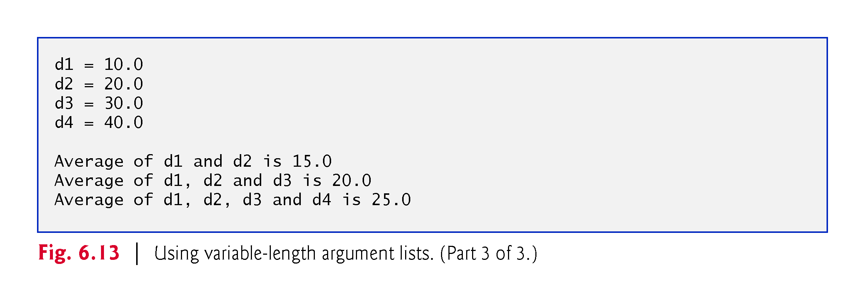

Slide 81
6.12 Using Command-Line Arguments
It’s possible to pass arguments from the command line to an application via method main’s String[] parameter, which receives an array of Strings.
By convention, this parameter is named args.
When an application is executed using the java command, Java passes the command-line arguments that appear after the class name in the java command to the application’s main method as Strings in the array args.

Slide 82
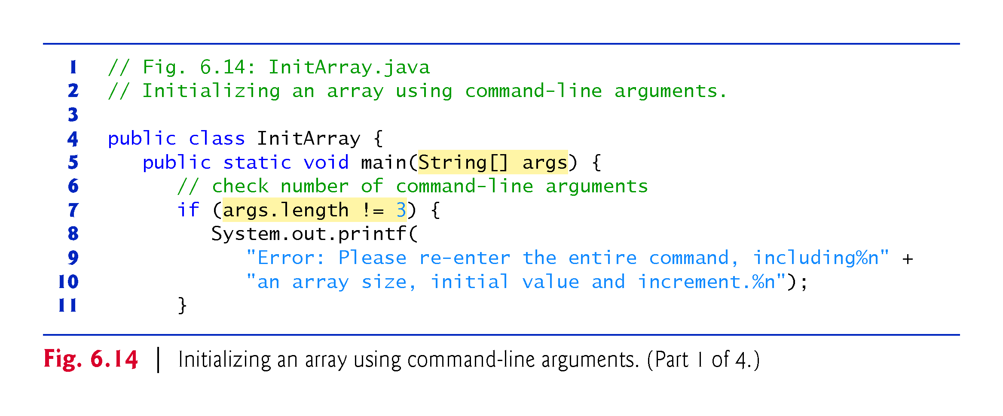

Slide 83
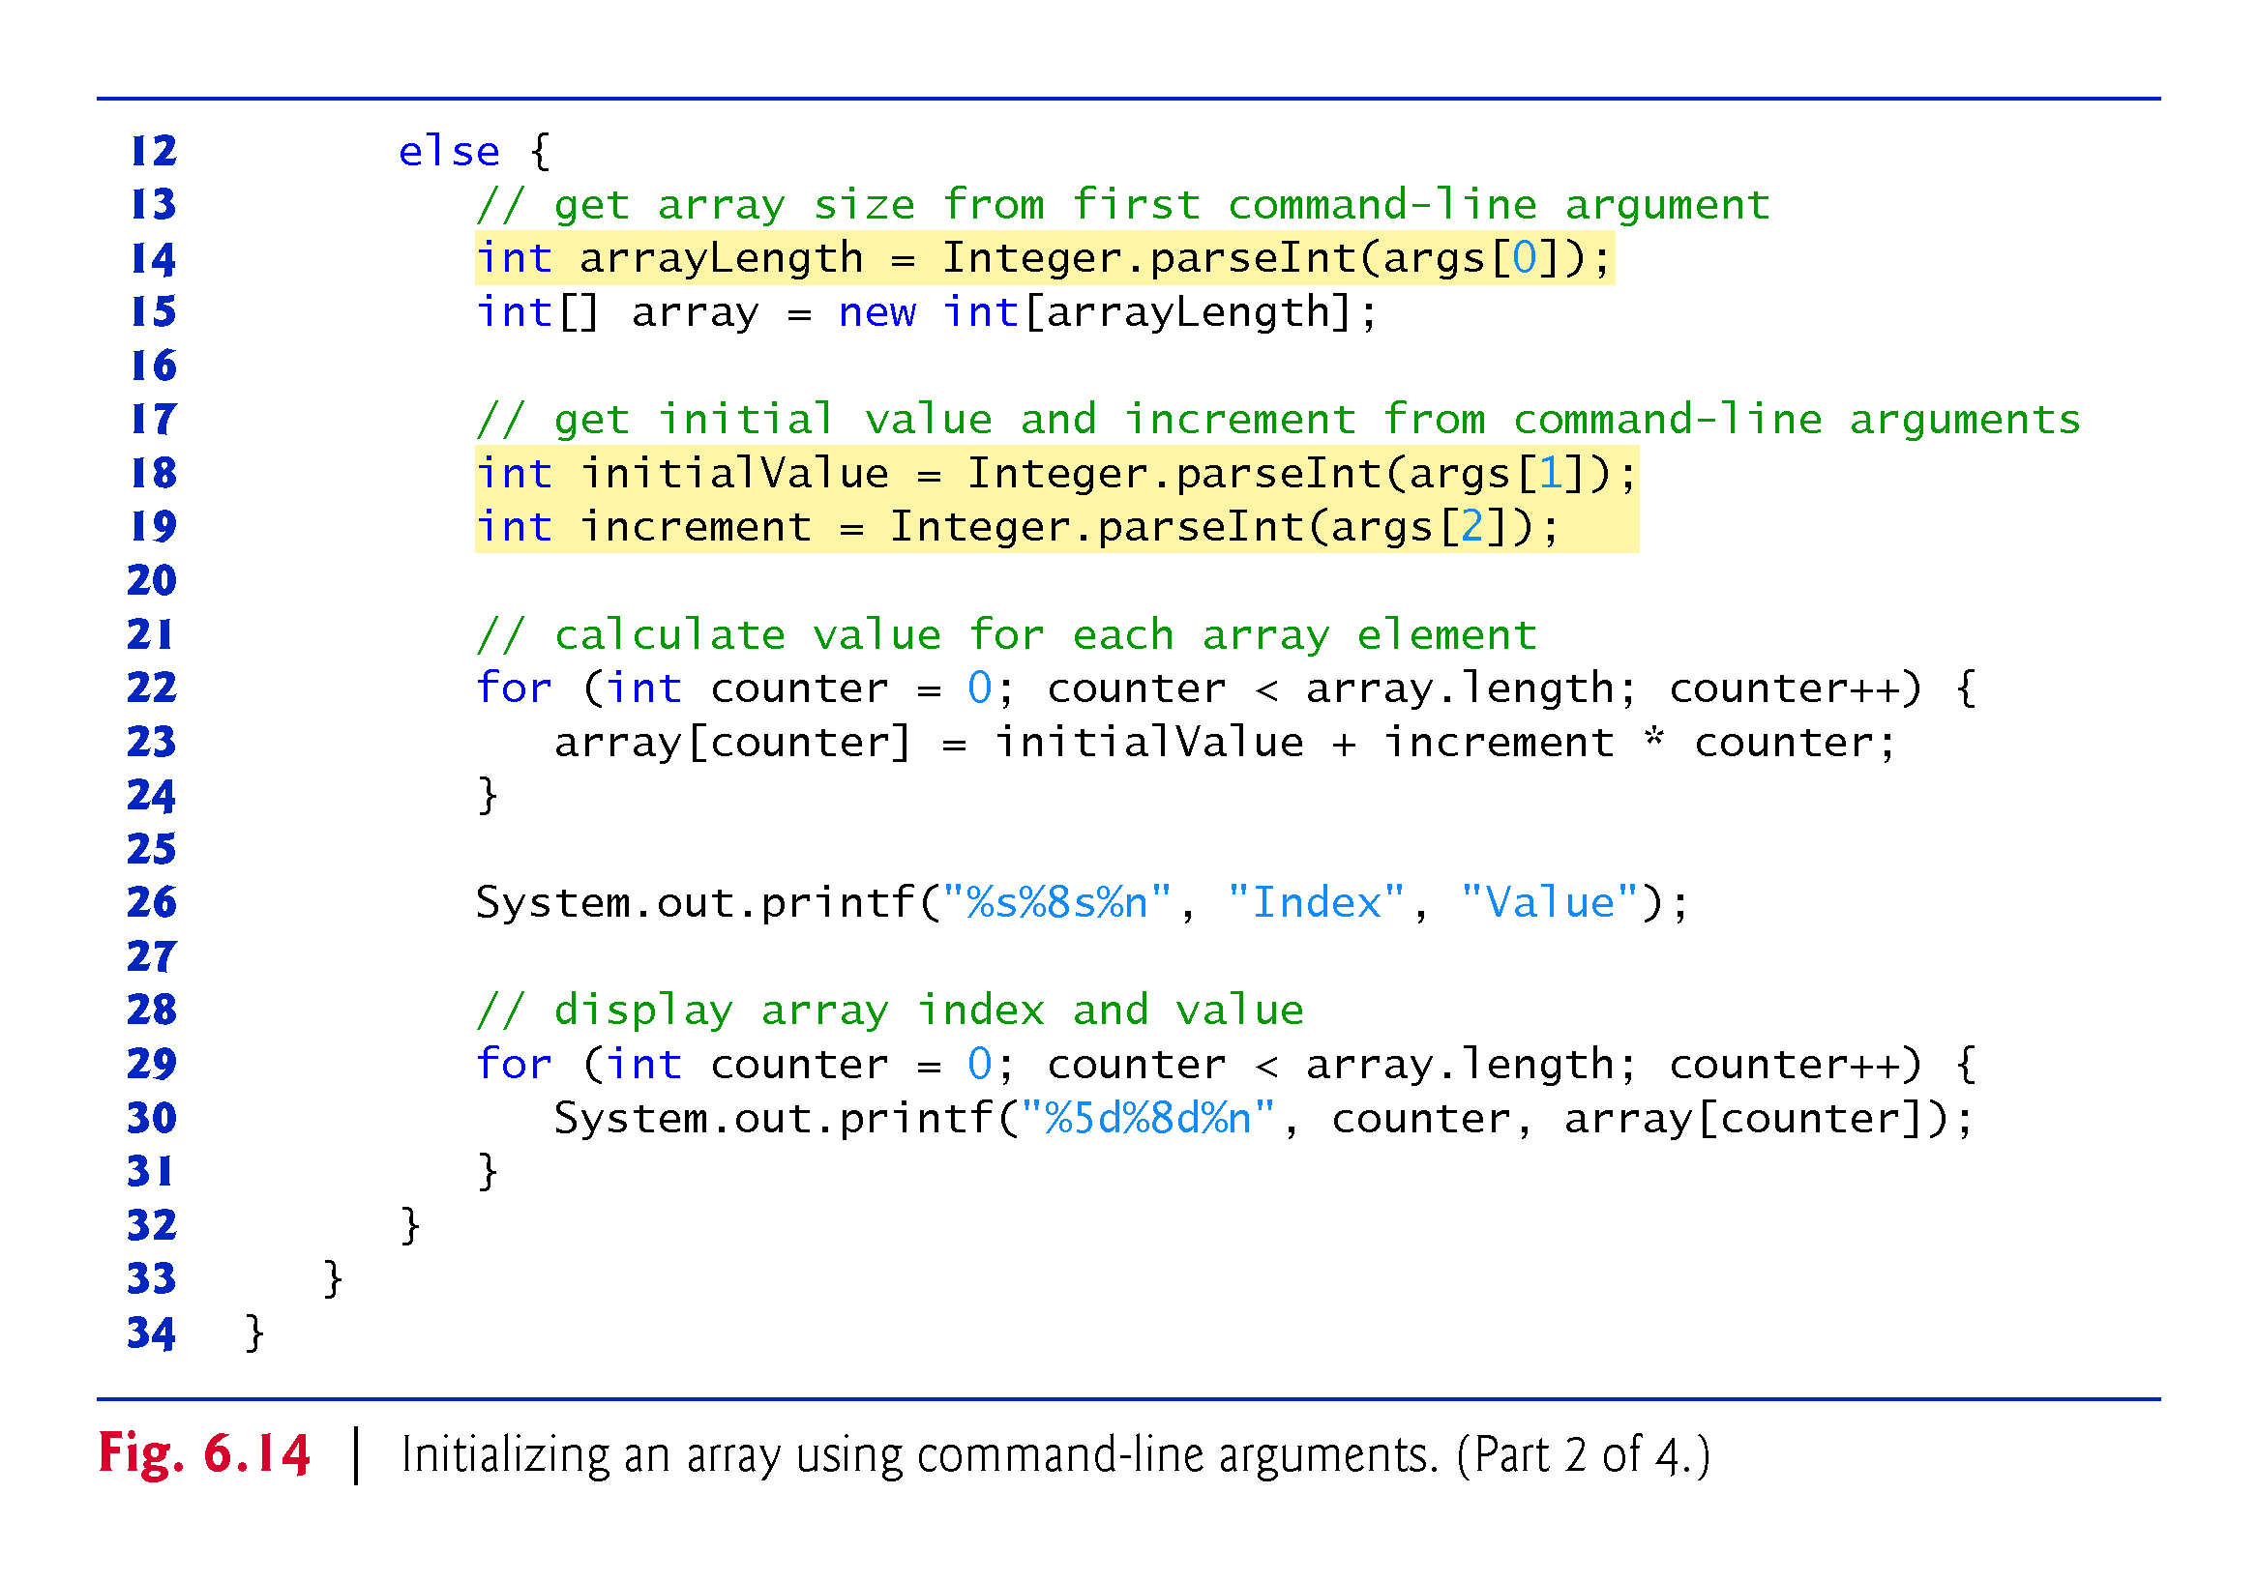

Slide 84
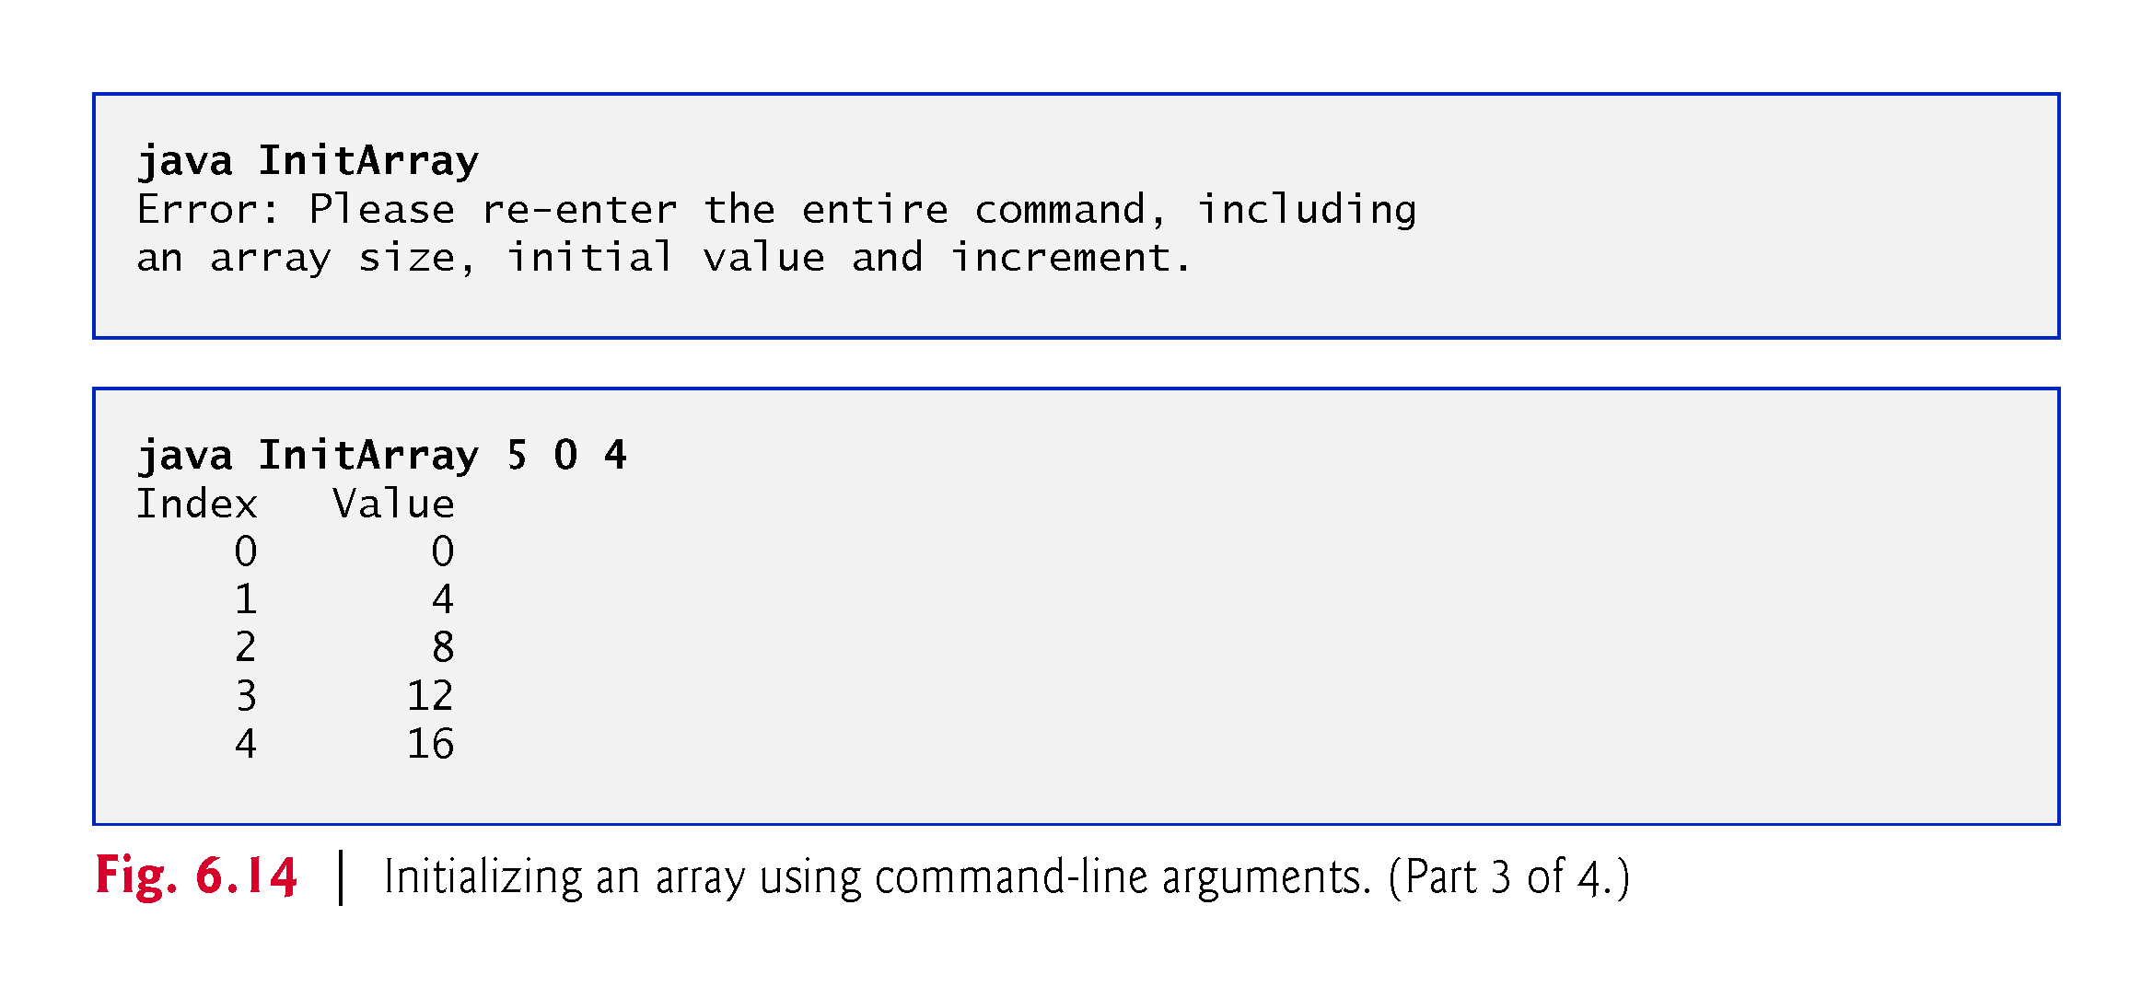

Slide 85
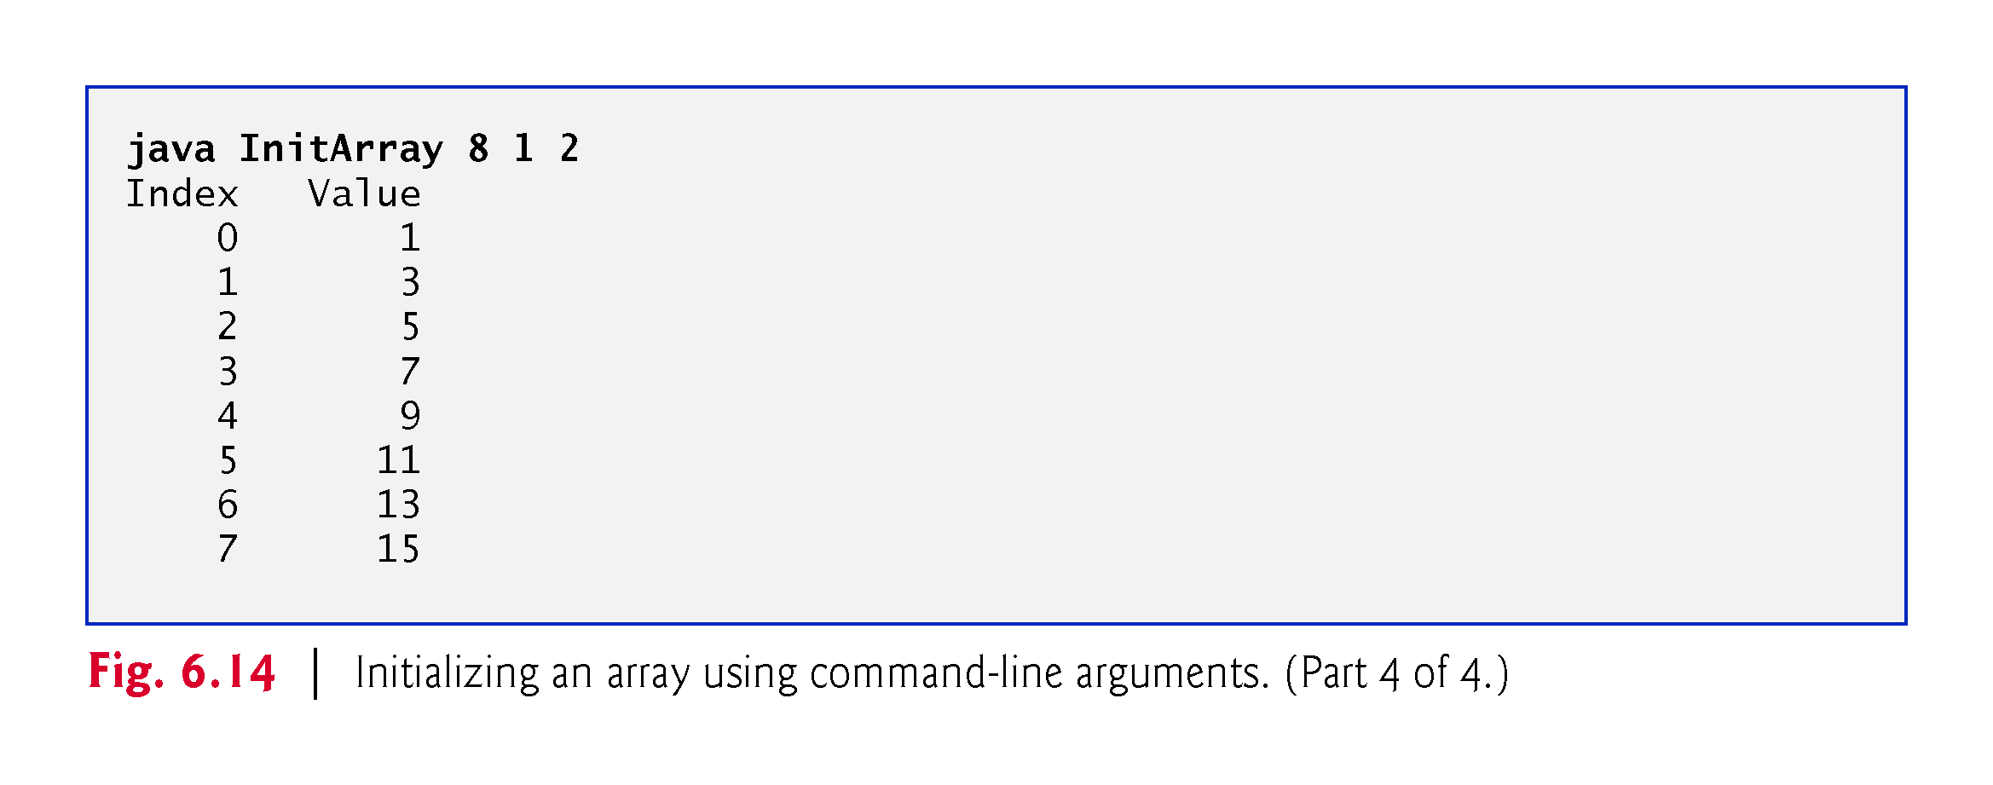

Slide 86
6.13 Class Arrays
Class Arrays helps you avoid reinventing the wheel by providing static methods for common array manipulations.
These methods include sort for sorting an array (i.e., arranging elements into ascending order), binarySearch for searching a sorted array (i.e., determining whether an array contains a specific value and, if so, where the value is located), equals for comparing arrays and fill for placing values into an array.
These methods are overloaded for primitive-type arrays and for arrays of objects.
You can copy arrays with class System’s static arraycopy method.

Slide 87
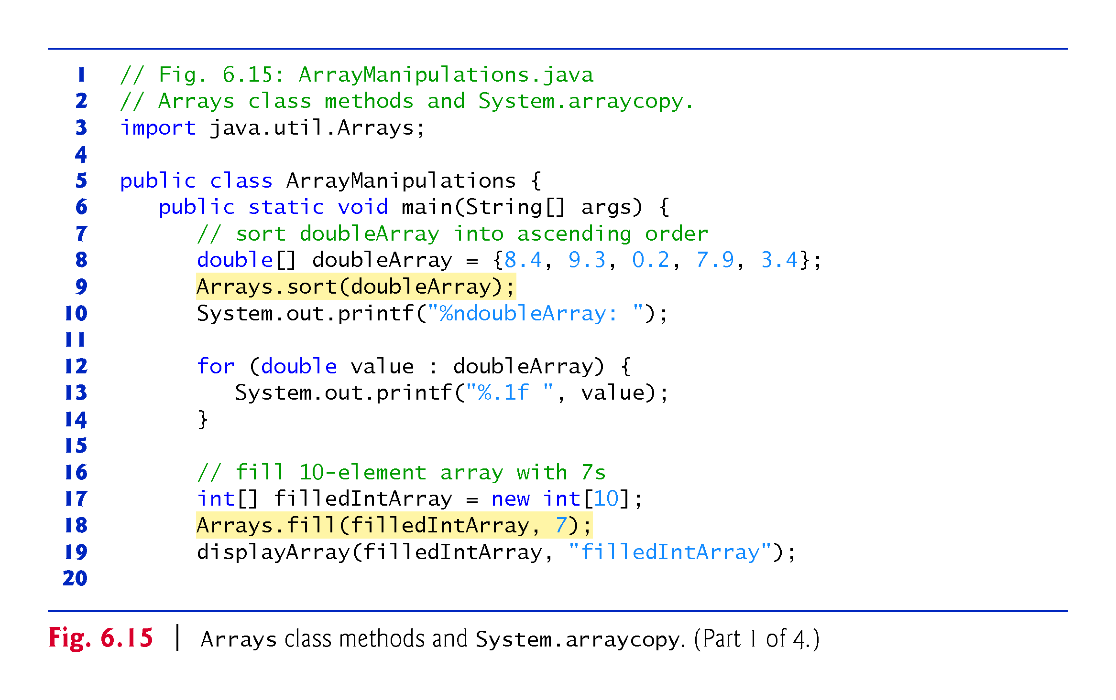

Slide 88
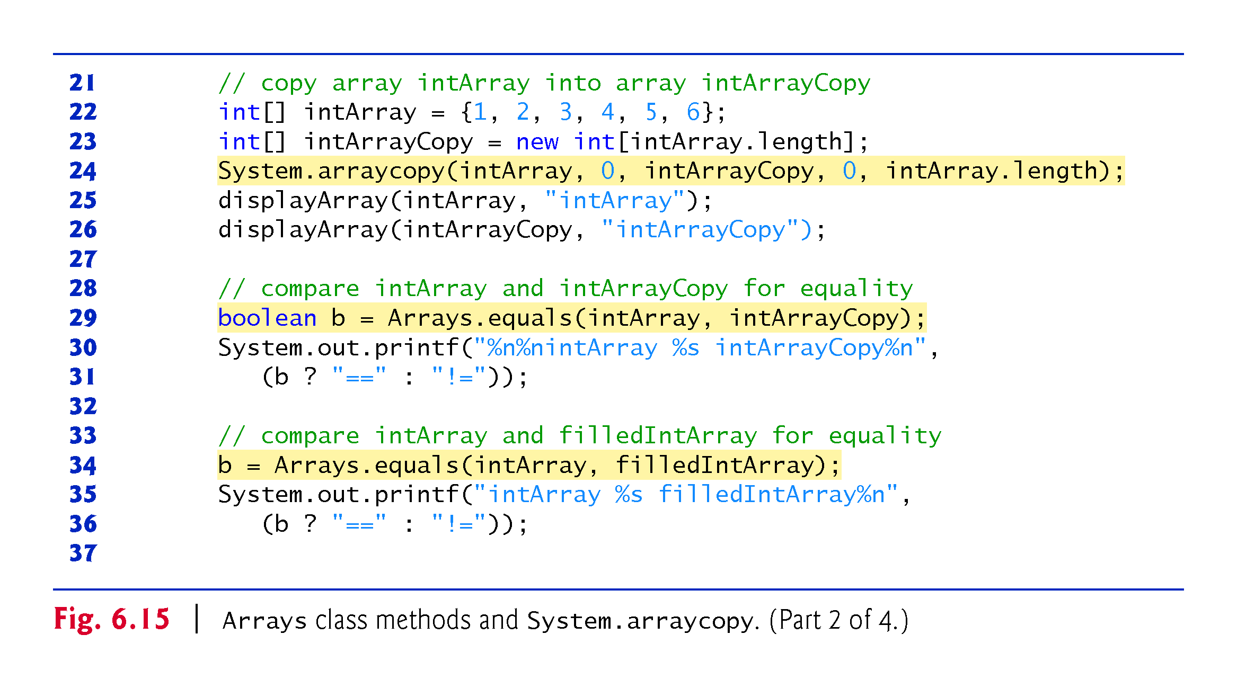

Slide 89
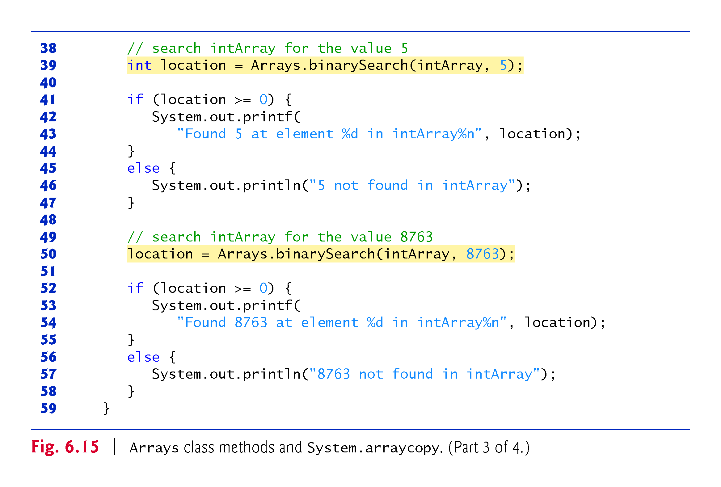

Slide 91
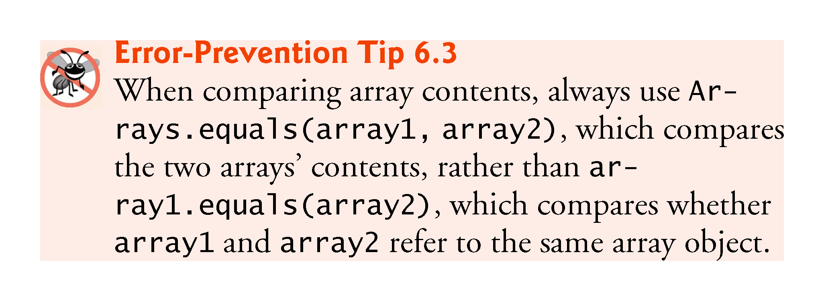

Slide 93
6.13 Class Arrays (Cont.)
Class Arrays Method parallelSort
The Arrays class now has several new “parallel” methods that take advantage of multi-core hardware.
Arrays method parallelSort can sort large arrays more efficiently on multi-core systems.
In Section 23.12, we create a very large array and use features of the Date/Time API to compare how long it takes to sort the array with methods sort and parallelSort.

Slide 94
6.14 Introduction to Collections and Class ArrayList
Collections provide efficient methods that organize, store and retrieve your data without requiring knowledge of how the data is being stored.
The collection class ArrayList<T> (package java.util) can dynamically change its size to accommodate more elements.
The T (by convention) is a placeholder—when declaring a new ArrayList, replace it with the type of elements that you want the ArrayList to hold.

Slide 95
6.14 Introduction to Collections and Class ArrayList (Cont.)
Classes with this kind of placeholder that can be used with any type are called generic classes.
Figure 6.16 shows some common methods of class ArrayList<T>.

Slide 96
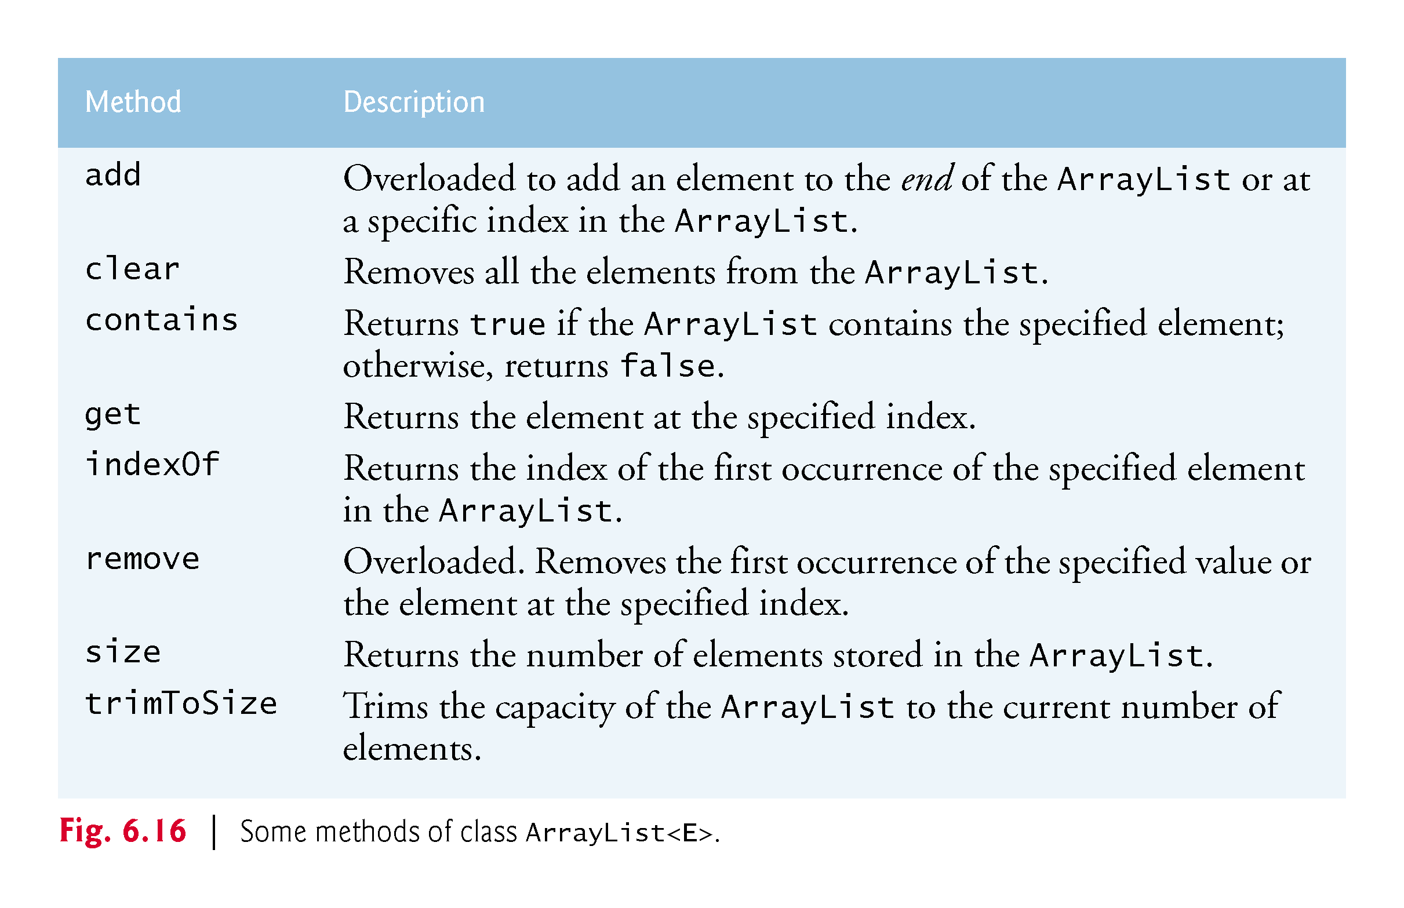

Slide 97
6.14 Introduction to Collections and Class ArrayList (Cont.)
Figure 6.17 demonstrates some common ArrayList capabilities.

Slide 98
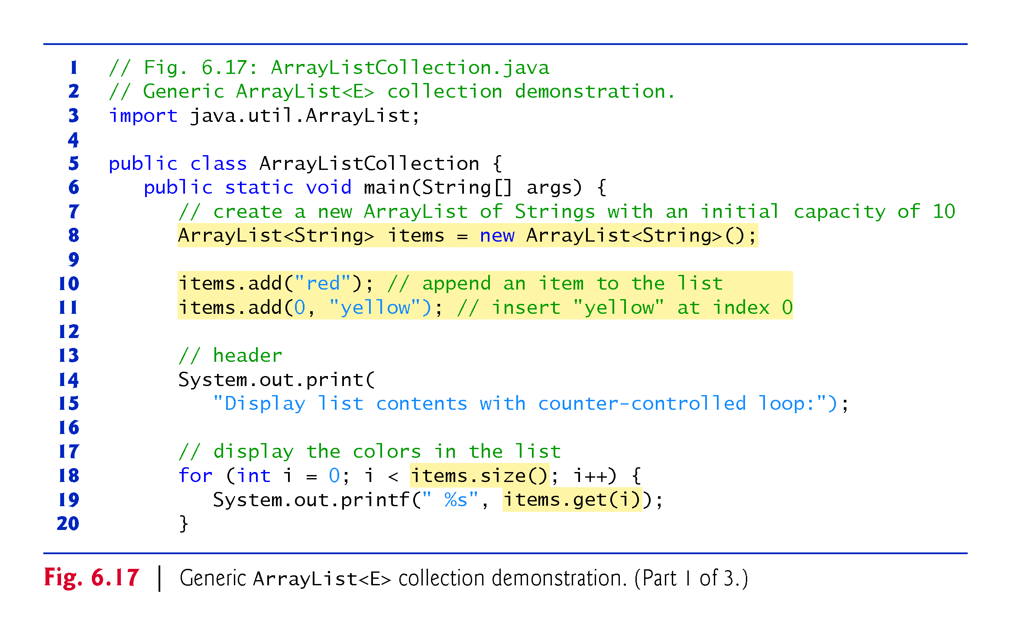

Slide 99
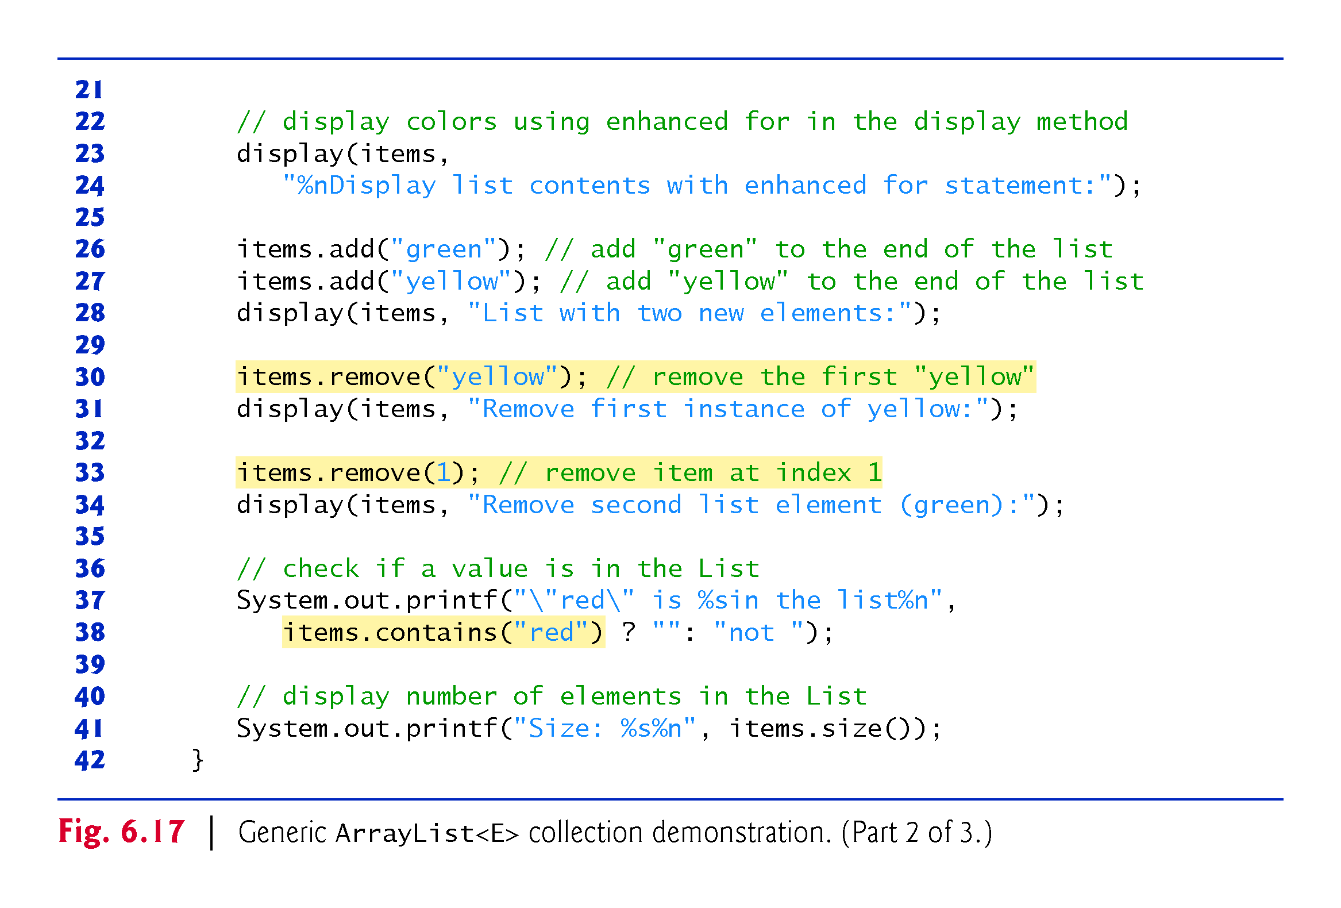

Slide 101
6.14 Introduction to Collections and Class ArrayList (Cont.)
(<>) Notation for Creating an Object of a Generic Class
Consider:
ArrayList<String> items = new ArrayList<String>();
ArrayList<String> appears in the variable declaration and in the class instance creation expression. The diamond (<>) notation simplifies statements like this.
Using <> in a class instance creation expression for an object of a generic class tells the compiler to determine what belongs in the angle brackets.

Slide 102
6.14 Introduction to Collections and Class ArrayList (Cont.)
The preceding statement can be written as:
ArrayList<String> items = new ArrayList<>();
When the compiler encounters the diamond (<>) in the class instance creation expression, it uses the declaration of variable items to determine the ArrayList’s element type (String)—this is known as inferring the element type.

