Slide 1
Chapter 7 Introduction to Classes and Objects
Java™ How to Program, 10/e
Late Objects Version

Slide 7
7.2 Instance Variables, set Methods and get Methods
Each class you create becomes a new type that can be used to declare variables and create objects.
You can declare new classes as needed; this is one reason Java is known as an extensible language.

Slide 9
7.2.1 Account Class with an Instance Variable, a set Method and a get Method (Cont.)
Class Declaration
Each class declaration that begins with the access modifier public must be stored in a file that has the same name as the class and ends with the .java filename extension.
Every class declaration contains keyword class followed immediately by the class’s name.

Slide 10
7.2.1 Account Class with an Instance Variable, a set Method and a get Method (Cont.)
Identifiers and Camel Case Naming
Class, method and variable names are identifiers.
By convention all use camel case names.
Class names begin with an uppercase letter, and method and variable names begin with a lowercase letter.

Slide 11
7.2.1 Account Class with an Instance Variable, a set Method and a get Method (Cont.)
Instance Variable name
An object has attributes that are implemented as instance variables and carried with it throughout its lifetime.
Instance variables exist before methods are called on an object, while the methods are executing and after the methods complete execution.
A class normally contains one or more methods that manipulate the instance variables that belong to particular objects of the class.
Instance variables are declared inside a class declaration but outside the bodies of the class’s method declarations.
Each object (instance) of the class has its own copy of each of the class’s instance variables.

Slide 12
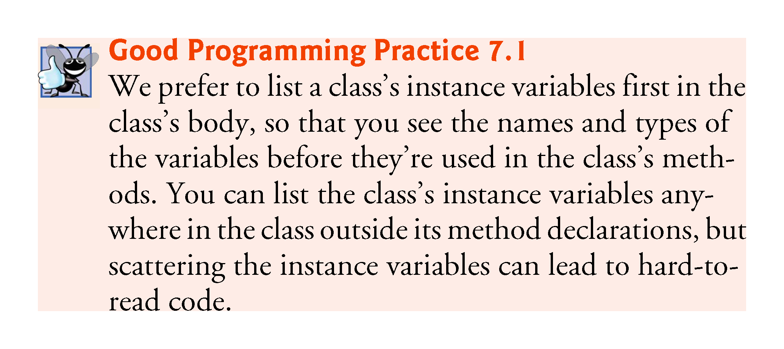

Slide 13
7.2.1 Account Class with an Instance Variable, a set Method and a get Method (Cont.)
Access Modifiers public and private
Most instance-variable declarations are preceded with the keyword private, which is an access modifier.
Variables or methods declared with access modifier private are accessible only to methods of the class in which they’re declared.

Slide 14
7.2.1 Account Class with an Instance Variable, a set Method and a get Method (Cont.)
Instance Method setName of Class Account
In the preceding chapters, you’ve declared only static methods in each class.
A class’s non-static methods are known as instance methods.
Method setName’s declaration indicates that setName receives parameter name of type String—which represents the name that will be passed to the method as an argument.

Slide 15
7.2.1 Account Class with an Instance Variable, a set Method and a get Method (Cont.)
Recall that variables declared in the body of a particular method are local variables and can be used only in that method and that a method’s parameters also are local variables of the method.

Slide 16
7.2.1 Account Class with an Instance Variable, a set Method and a get Method (Cont.)
Method setName’s body contains a single statement that assigns the value of the name parameter (a String) to the class’s name instance variable, thus storing the account name in the object.
If a method contains a local variable with the same name as an instance variable, that method’s body will refer to the local variable rather than the instance variable.
In this case, the local variable is said to shadow the instance variable in the method’s body.
The method’s body can use the keyword this to refer to the shadowed instance variable explicitly.

Slide 17
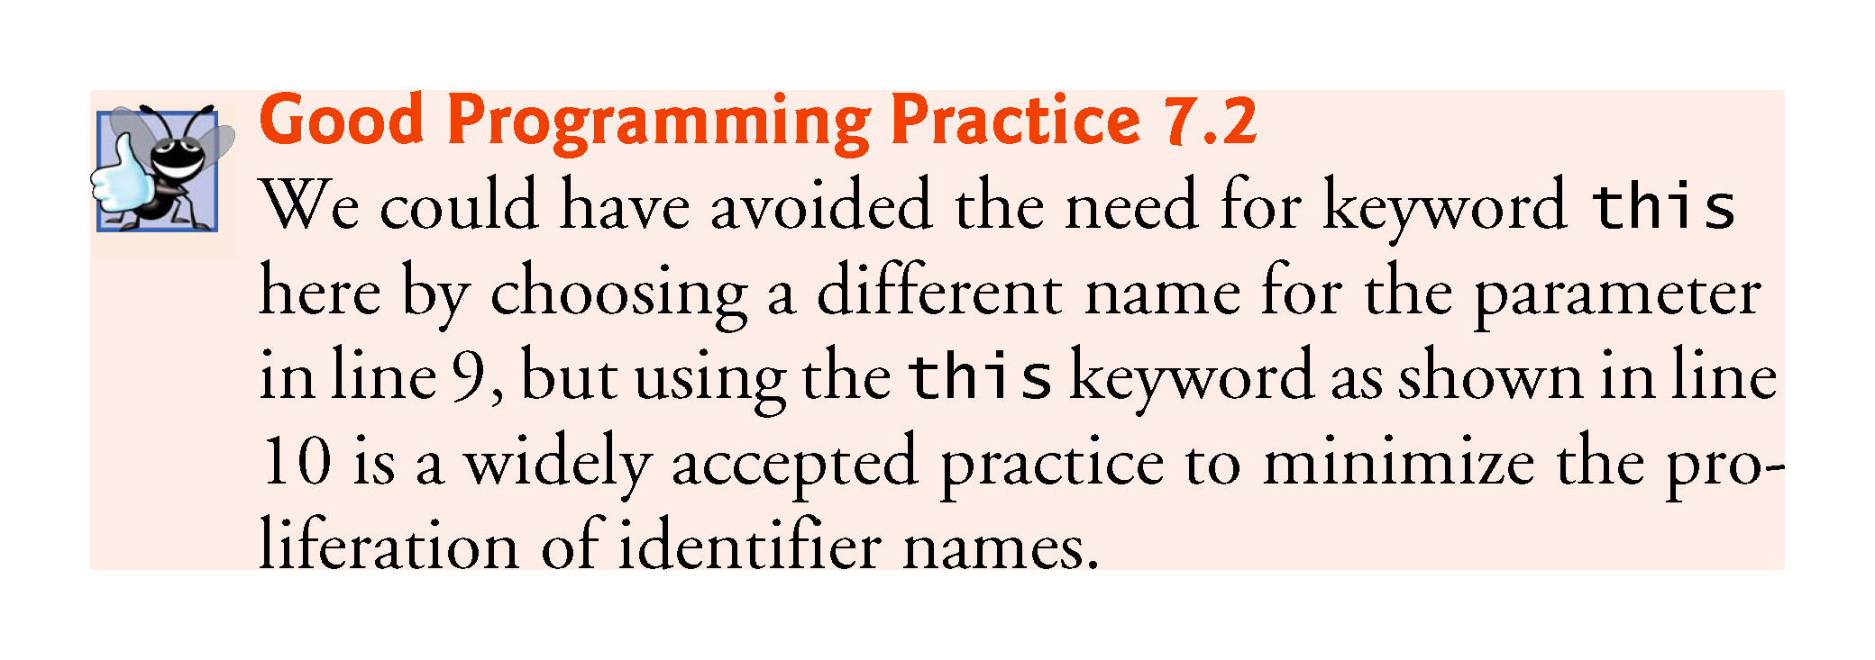

Slide 18
7.2.1 Account Class with an Instance Variable, a set Method and a get Method (Cont.)
getName Method of Class Account
Method getName returns a particular Account object’s name to the caller.
The method has an empty parameter list, so it does not require additional information to perform its task.

Slide 19
7.2.2 AccountTest Class That Creates and Uses an Object of Class Account
Driver Class AccountTest
A class that creates an object of another class, then calls the object’s methods, is a driver class.

Slide 20
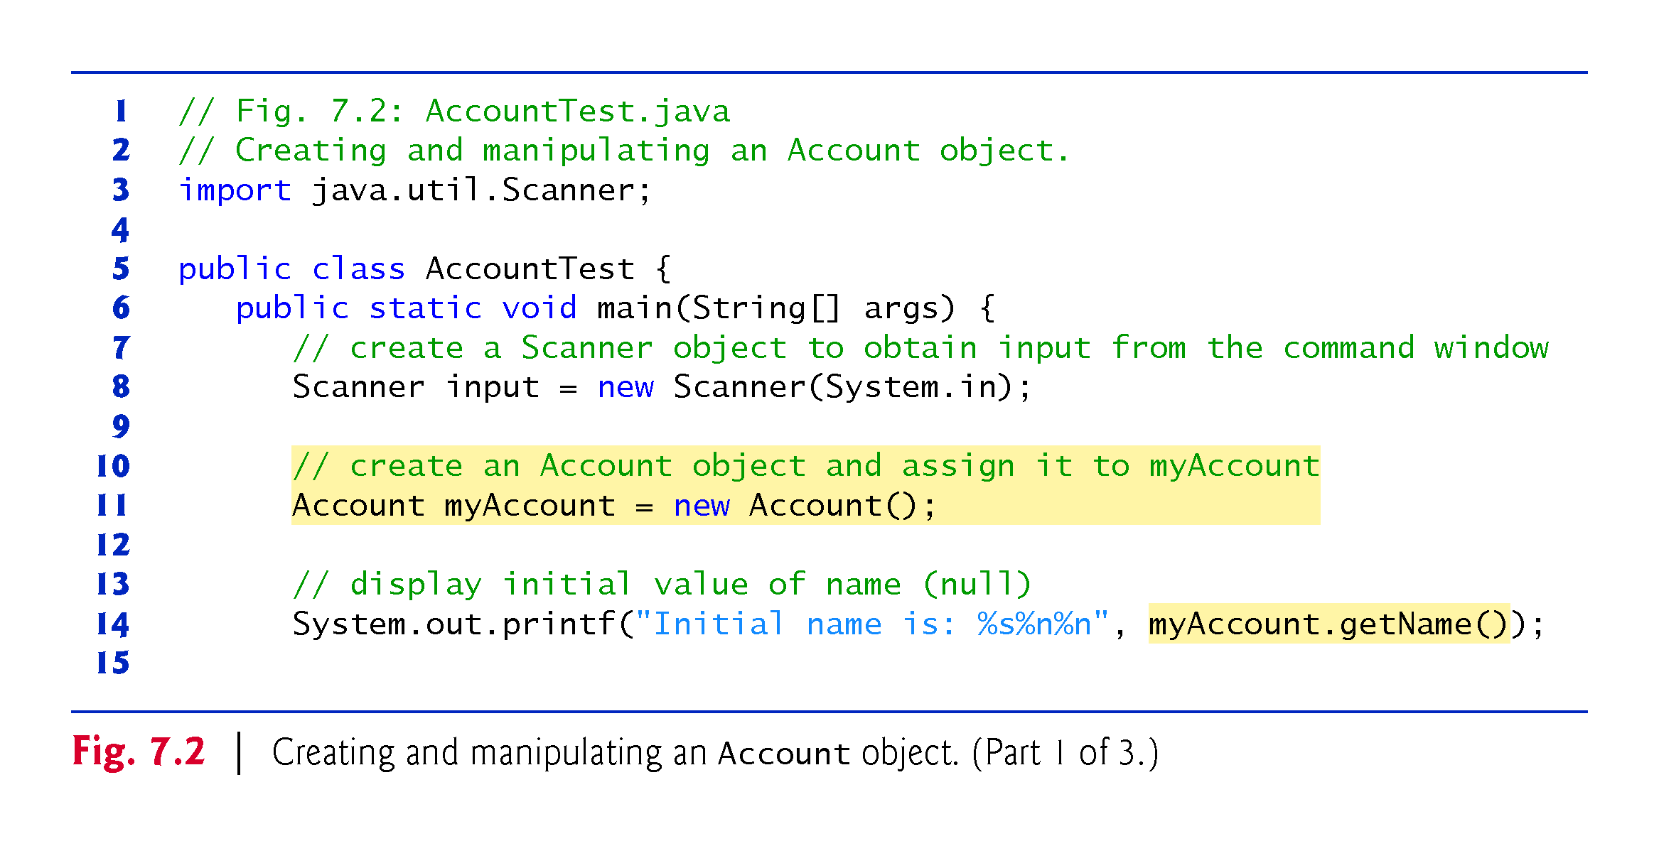

Slide 21
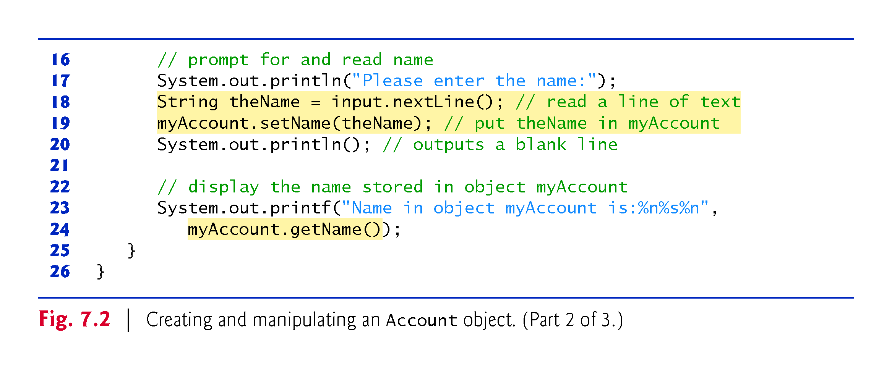

Slide 23
7.2.2 AccountTest Class That Creates and Uses an Object of Class Account (Cont.)
Scanner Object for Receiving Input from the User
Scanner method nextLine reads characters until a newline character is encountered, then returns the characters as a String.
Scanner method next reads characters until any white-space character is encountered, then returns the characters as a String.

Slide 24
7.2.2 AccountTest Class That Creates and Uses an Object of Class Account (Cont.)
Instantiating an Object—Keyword new and Constructors
A class instance creation expression begins with keyword new and creates a new object.
A constructor is similar to a method but is called implicitly by the new operator to initialize an object’s instance variables at the time the object is created.

Slide 25
7.2.2 AccountTest Class That Creates and Uses an Object of Class Account (Cont.)
Calling Class Account’s getName Method
To call a method of an object, follow the object name with a dot separator, the method name and a set of parentheses containing the method’s arguments.

Slide 27
7.2.2 AccountTest Class That Creates and Uses an Object of Class Account (Cont.)
null—the Default Initial Value for String Variables
Local variables are not automatically initialized.
Every instance variable has a default initial value—a value provided by Java when you do not specify the instance variable’s initial value.
The default value for an instance variable of type String is null.

Slide 28
7.2.2 AccountTest Class That Creates and Uses an Object of Class Account (Cont.)
Calling Class Account’s setName Method
A method call supplies values—known as arguments—for each of the method’s parameters.
Each argument’s value is assigned to the corresponding parameter in the method header.

Slide 29
7.2.3 Compiling and Executing an App with Multiple Classes
The javac command can compile multiple classes at once.
Simply list the source-code filenames after the command with each filename separated by a space from the next.
If the directory containing the app includes only one app’s files, you can compile all of its classes with the command javac *.java.
The asterisk (*) in *.java indicates that all files in the current directory ending with the filename extension “.java” should be compiled.

Slide 30
7.2.4 Account UML Class Diagram with an Instance Variable and set and get Methods
We’ll often use UML class diagrams to summarize a class’s attributes and operations.
UML diagrams help systems designers specify a system in a concise, graphical, programming-language-independent manner, before programmers implement the system in a specific programming language.
Figure 7.3 presents a UML class diagram for class Account of Fig. 7.1.

Slide 32
7.2.4 Account UML Class Diagram with an Instance Variable and set and get Methods (Cont.)
Top Compartment
In the UML, each class is modeled in a class diagram as a rectangle with three compartments.
The top one contains the class’s name centered horizontally in boldface.

Slide 33
7.2.4 Account UML Class Diagram with an Instance Variable and set and get Methods (Cont.)
Middle Compartment
The middle compartment contains the class’s attributes, which correspond to instance variables in Java.

Slide 34
7.2.4 Account UML Class Diagram with an Instance Variable and set and get Methods (Cont.)
Bottom Compartment
The bottom compartment contains the class’s operations, which correspond to methods and constructors in Java.
The UML represents instance variables as an attribute name, followed by a colon and the type.
Private attributes are preceded by a minus sign (–) in the UML.
The UML models operations by listing the operation name followed by a set of parentheses.
A plus sign (+) in front of the operation name indicates that the operation is a public one in the UML (i.e., a public method in Java).

Slide 35
7.2.4 Account UML Class Diagram with an Instance Variable and set and get Methods (Cont.)
Return Types
The UML indicates an operation’s return type by placing a colon and the return type after the parentheses following the operation name.
UML class diagrams do not specify return types for operations that do not return values.
Declaring instance variables private is known as data hiding or information hiding.

Slide 36
7.2.4 Account UML Class Diagram with an Instance Variable and set and get Methods (Cont.)
Parameters
The UML models a parameter of an operation by listing the parameter name, followed by a colon and the parameter type between the parentheses after the operation name

Slide 37
7.2.5 Additional Notes on This Example
Notes on static Methods
A static method can call other static methods of the same class directly (i.e., using the method name by itself) and can manipulate static variables in the same class directly.
To access the class’s instance variables and instance methods, a static method must use a reference to an object of the class.
Instance methods can access all fields (static variables and instance variables) and methods of the class.

Slide 38
7.2.5 Additional Notes on This Example
Many objects of a class, each with its own copies of the instance variables, may exist at the same time.
Java does not allow a static method to directly access instance variables and instance methods of the same class.

Slide 39
7.2.5 Additional Notes on Class AccountTest (Cont.)
Notes on import Declarations
Most classes you’ll use in Java programs must be imported explicitly.
There’s a special relationship between classes that are compiled in the same directory.
By default, such classes are considered to be in the same package—known as the default package.
Classes in the same package are implicitly imported into the source-code files of other classes in that package.

Slide 40
7.2.5 Additional Notes on Class AccountTest (Cont.)
An import declaration is not required when one class in a package uses another in the same package.
An import- declaration is not required if you always refer to a class with its fully qualified class name, which includes its package name and class name.

Slide 42
7.2.6 Software Engineering with private Instance Variables and public set and get Methods
Declaring instance variables private is known as data hiding or information hiding.

Slide 44
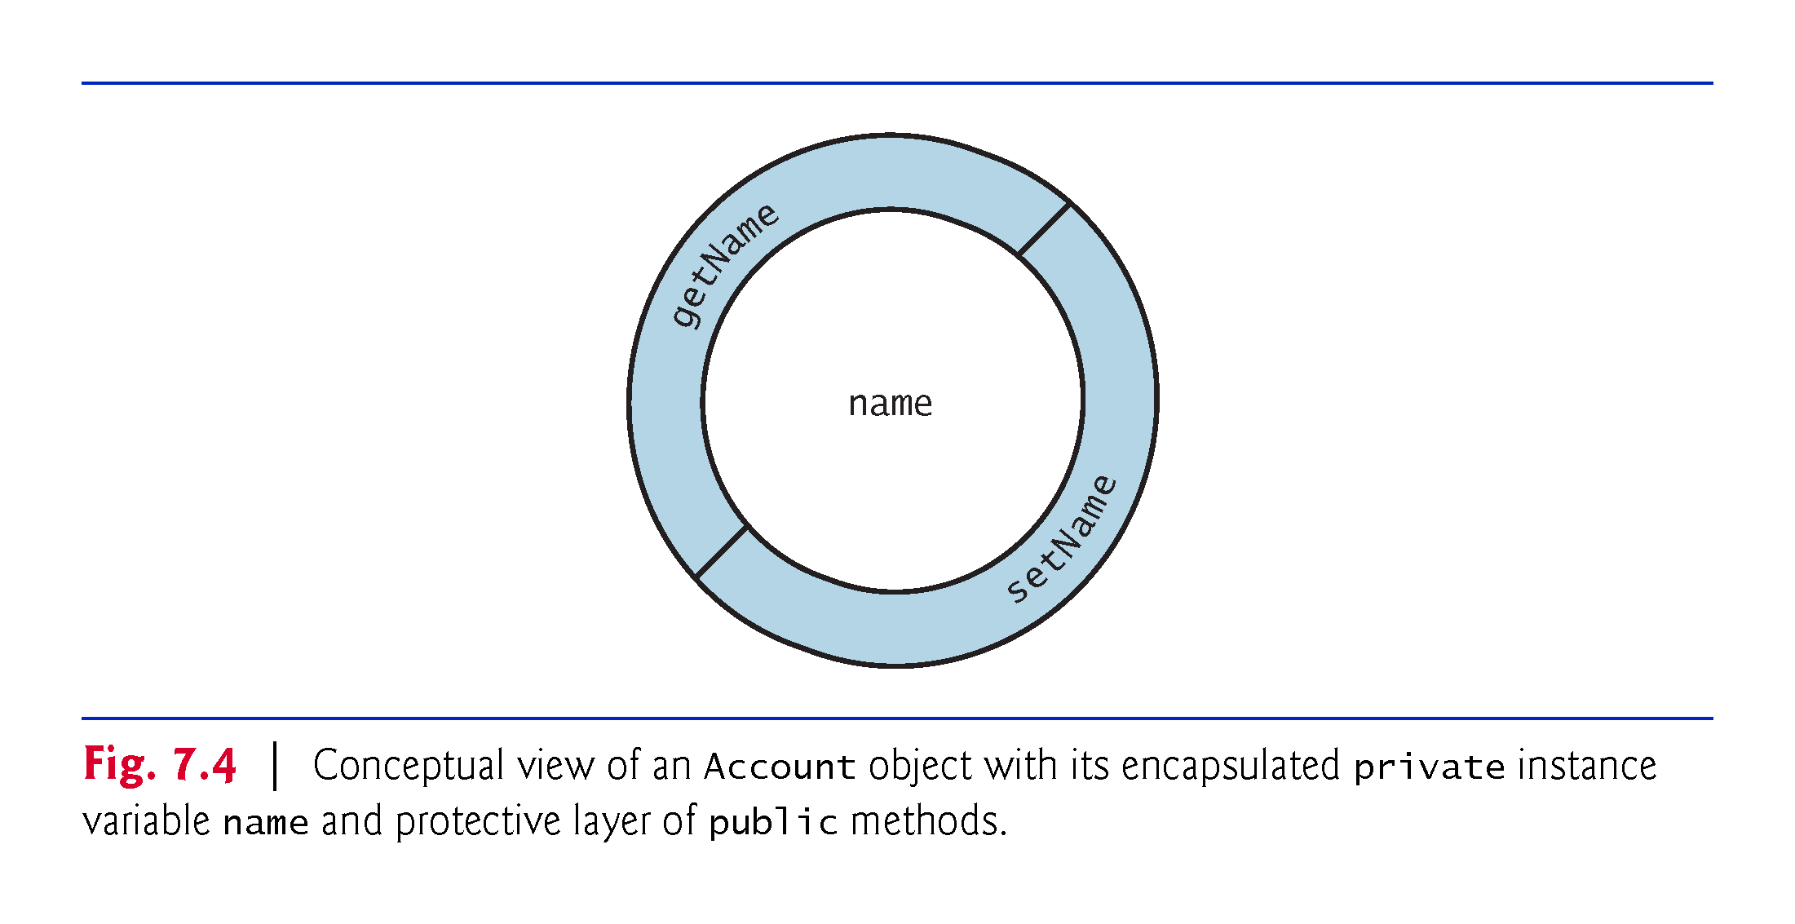

Slide 45
7.3 Default and Explicit Initialization for Instance Variables
Recall that local variables are not initialized by default.
Primitive-type instance variables are initialized by default—instance variables of types byte, char, short, int, long, float and double are initialized to 0, and variables of type boolean are initialized to false.
You can specify your own initial value for a primitive-type instance variable by assigning the variable a value in its declaration, as in
private int numberOfStudents = 10;

Slide 46
7.3 Default and Explicit Initialization for Instance Variables
Reference-type instance variables (such as those of type String), if not explicitly initialized, are initialized by default to the value null—which represents a “reference to nothing.”

Slide 47
7.4 Account Class: Initializing Objects with Constructors
Each class you declare can optionally provide a constructor with parameters that can be used to initialize an object of a class when the object is created.
Java requires a constructor call for every object that’s created.

Slide 48
7.4.1 Declaring an Account Constructor for Custom Object Initialization
Figure 7.5 contains a modified Account class with such a constructor.

Slide 51
7.4.2 Class AccountTest: Initializing Account Objects When They’re Created
The AccountTest program (Fig. 7.6) initializes two Account objects using the constructor.

Slide 53
7.4.2 Class AccountTest: Initializing Account Objects When They’re Created (Cont.)
Constructors Cannot Return Values
Constructors can specify parameters but not return types.
Default Constructor
If a class does not define constructors, the compiler provides a default constructor with no parameters, and the class’s instance variables are initialized to their default values.
There’s No Default Constructor in a Class That Declares a Constructor
If you declare a constructor for a class, the compiler will not create a default constructor for that class.

Slide 55
7.4.2 Class AccountTest: Initializing Account Objects When They’re Created (Cont.)
Adding the Contructor to Class Account’s UML Class Diagram
The UML models constructors in the third compartment of a class diagram.
To distinguish a constructor from a class’s operations, the UML places the word “constructor” between guillemets (« and ») before the constructor’s name.

Slide 56
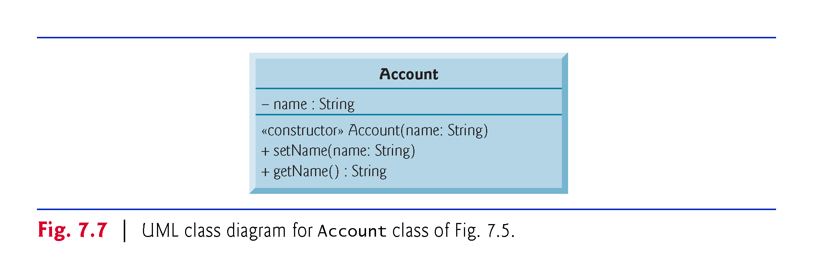

Slide 57
7.5 Account Class with a Balance; Floating-Point Numbers
We now declare an Account class that maintains the balance of a bank account in addition to the name.
Most account balances are not integers.
So, class Account represents the account balance as a double.

Slide 58
7.5.1 Account Class with a balance Instance Variable of Type double
Our next app contains a version of class Account (Fig. 7.8) that maintains as instance variables the name and the balance of a bank account.

Slide 60
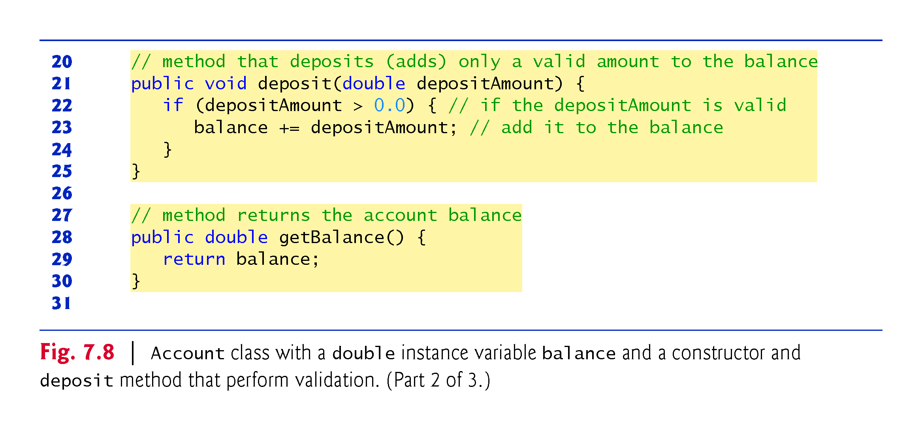

Slide 61
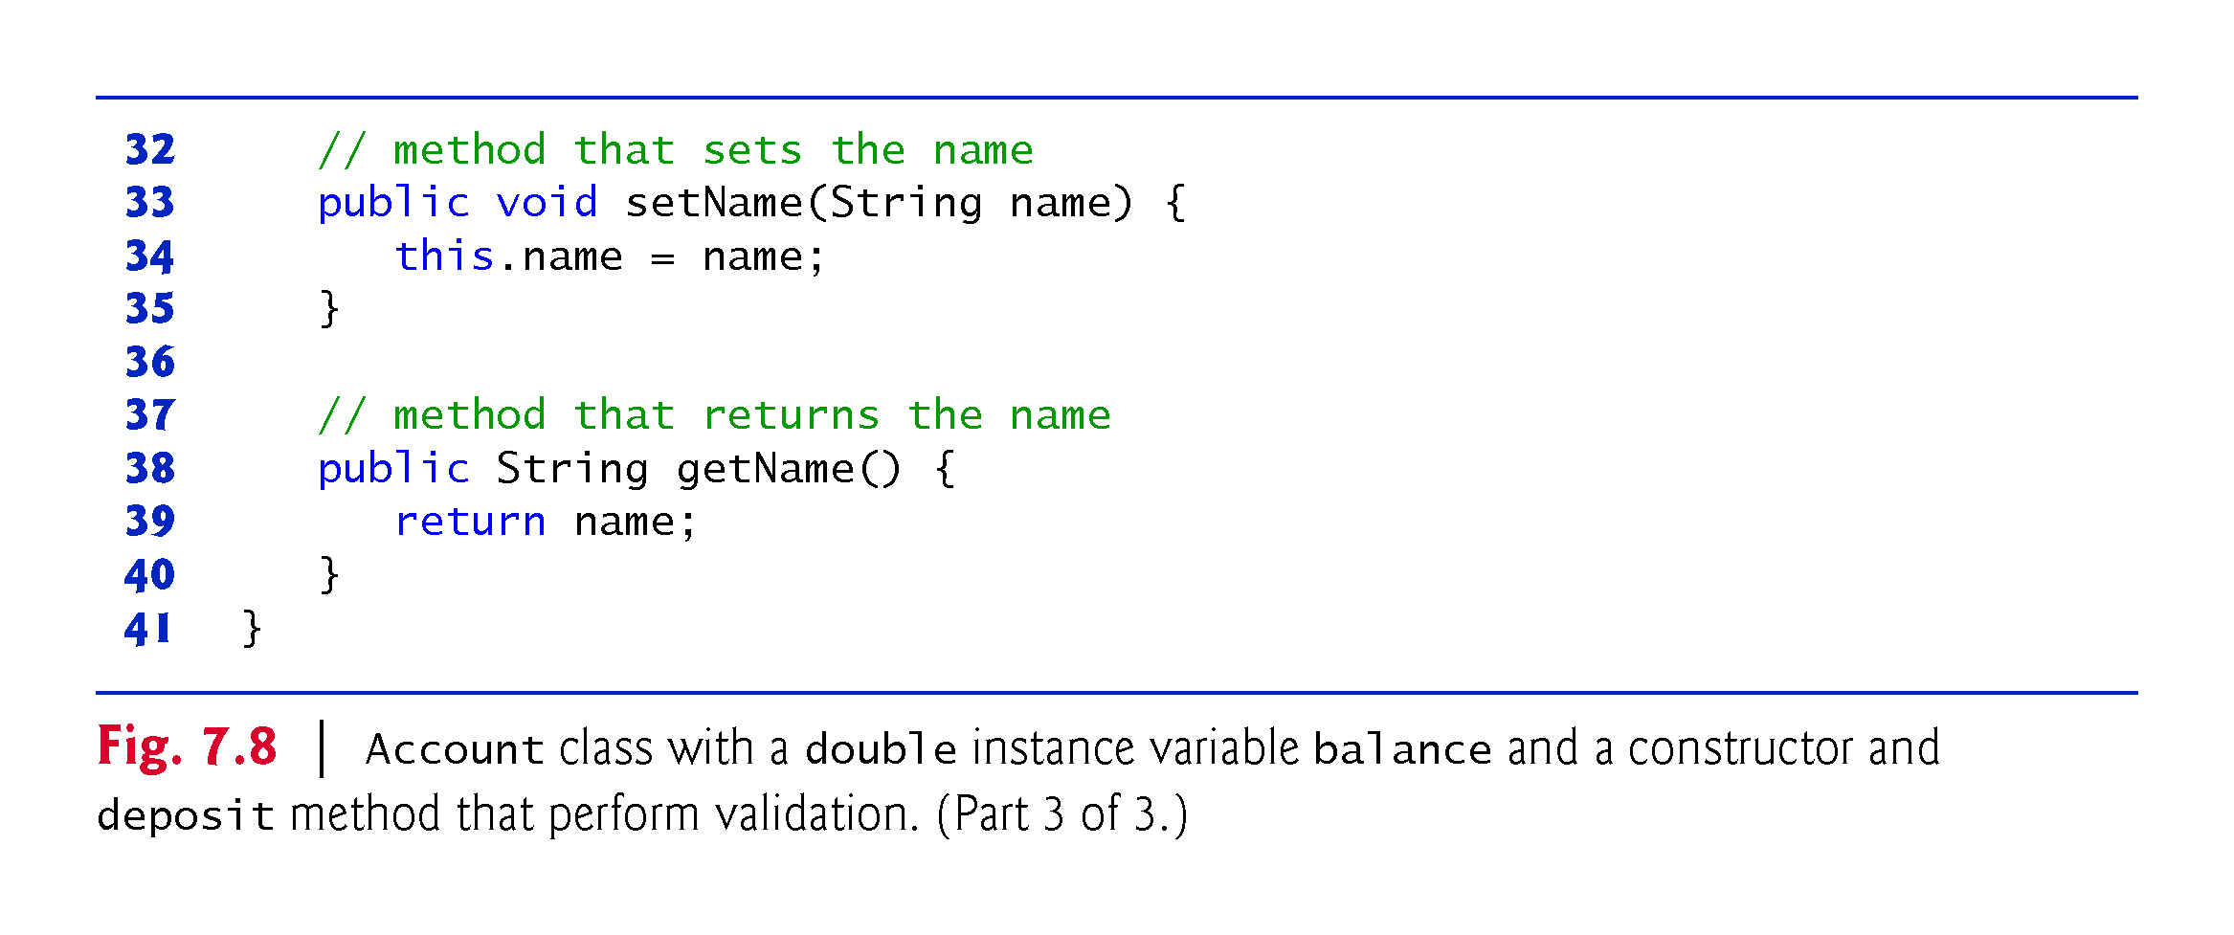

Slide 62
7.5.2 AccountTest Class to Use Class Account
Class AccountTest (Fig. 7.9) creates two Account objects and initializes them with a valid balance of 50.00 and an invalid balance of -7.53, respectively—for the purpose of our examples, we assume that balances must be greater than or equal to zero.

Slide 63
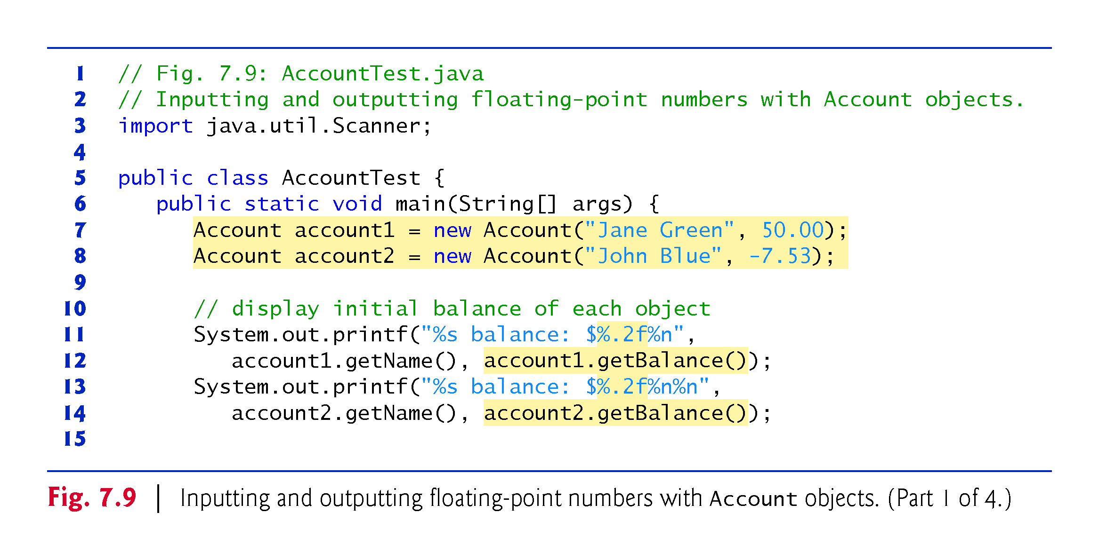

Slide 64
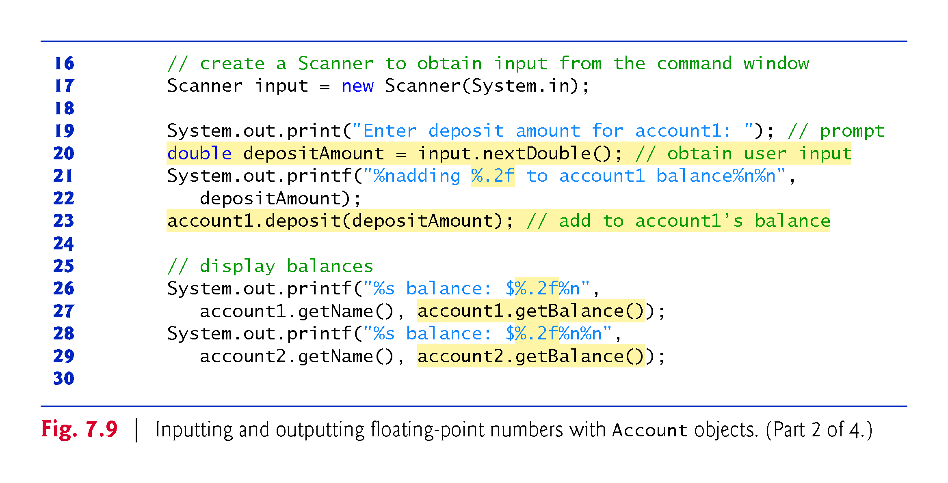

Slide 65
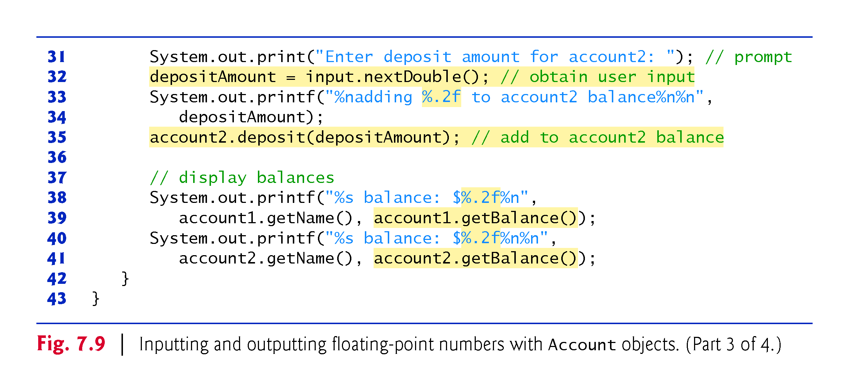

Slide 66
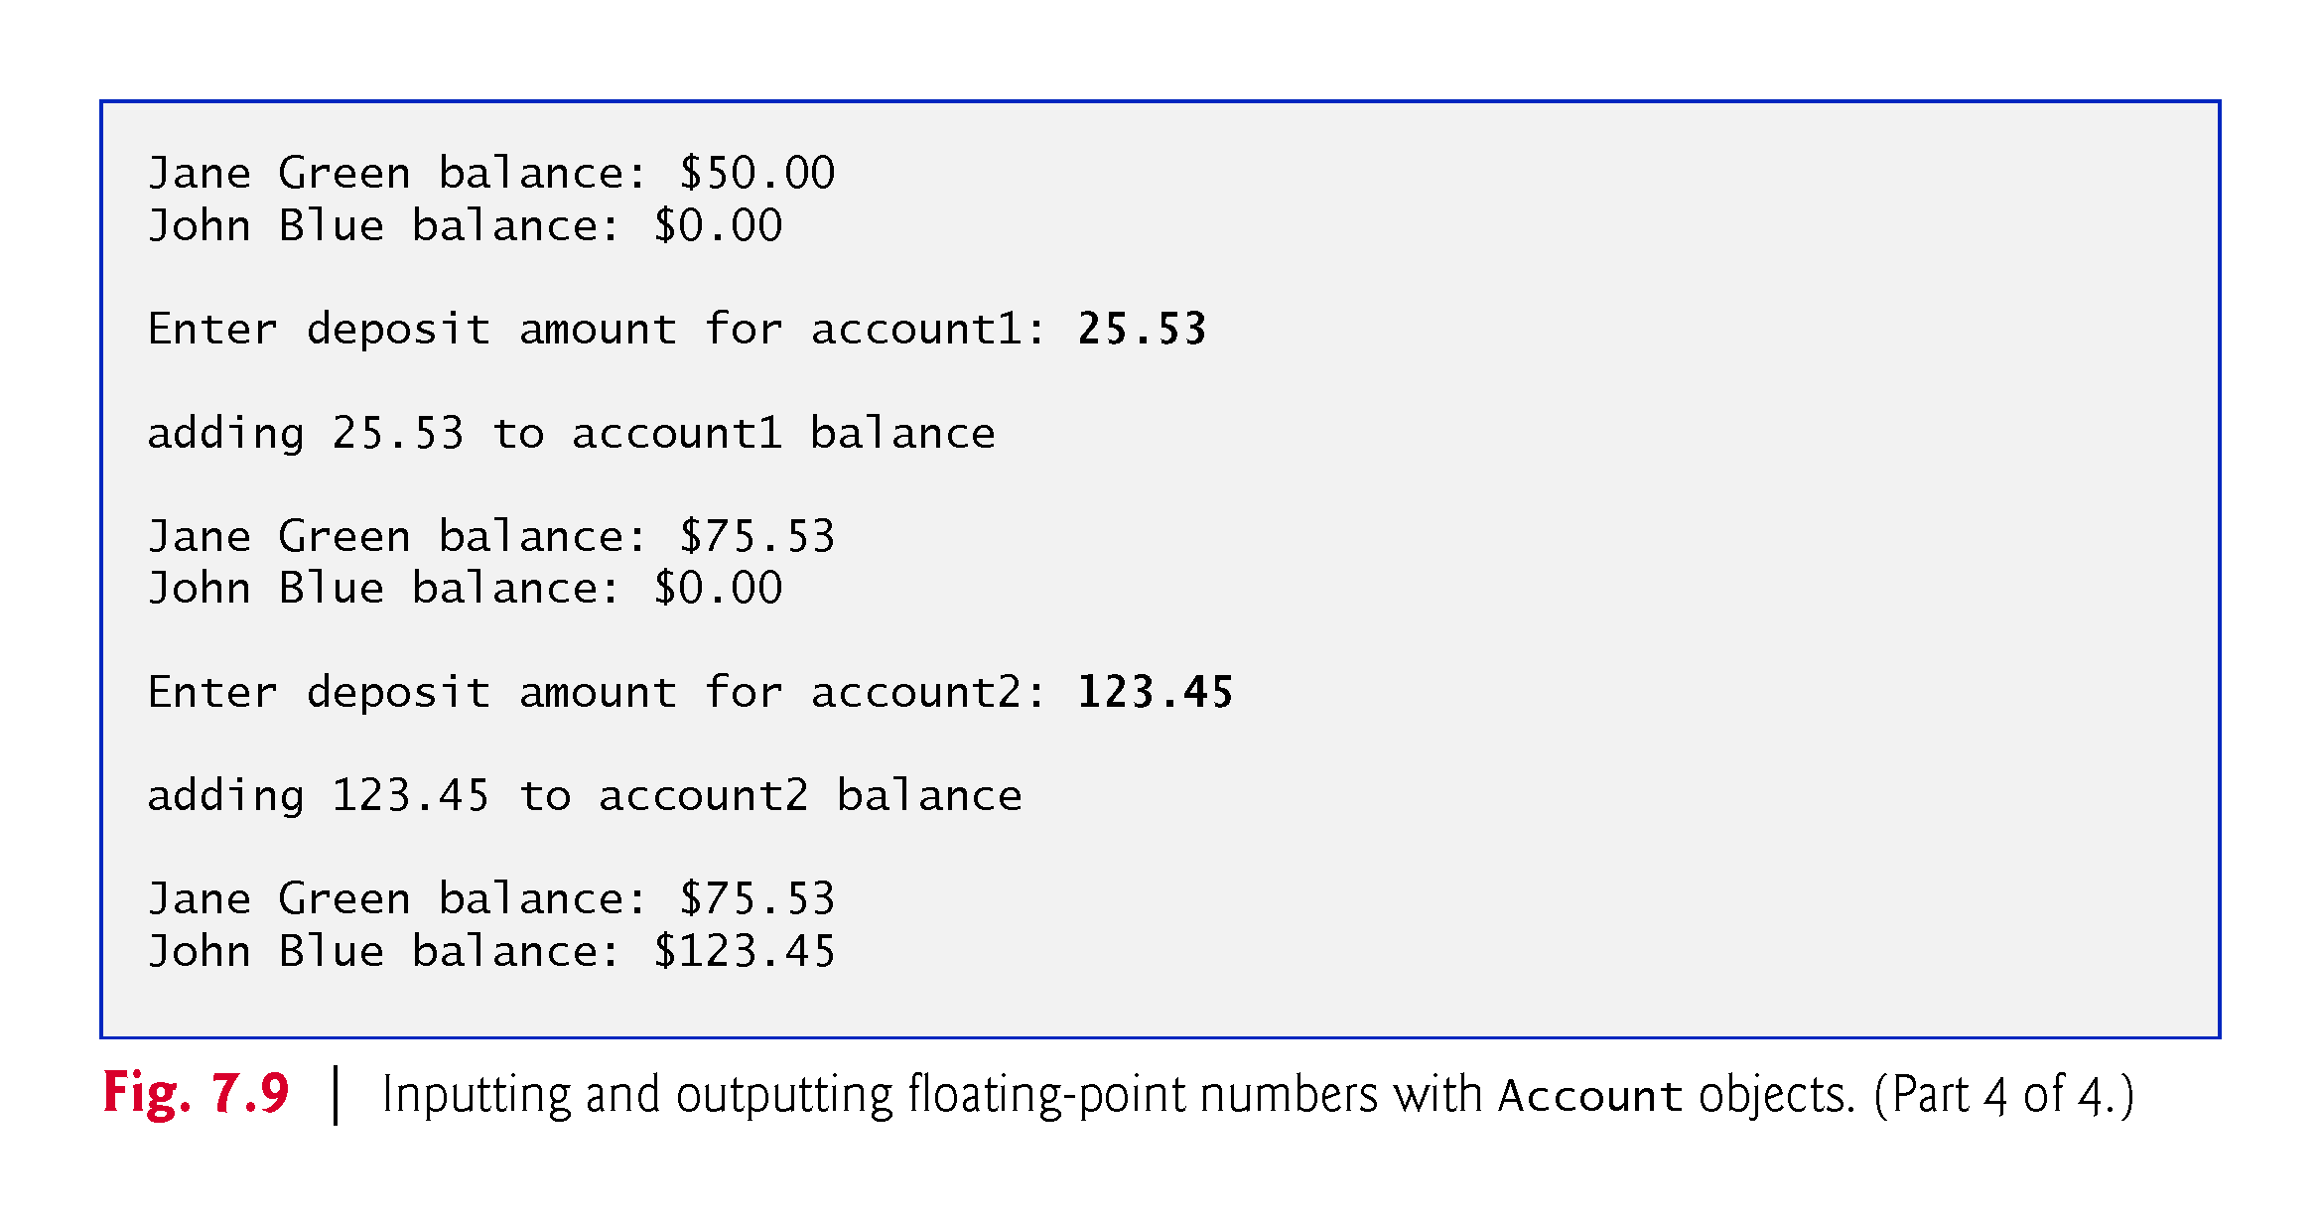

Slide 67
7.5.2 AccountTest Class to Use Class Account (Cont.)
Formatting Floating-Point Numbers for Display
The format specifier %f is used to output values of type float or double.
The format specifier %.2f specifies that two digits of precision should be output to the right of the decimal point in the floating-point number.

Slide 68
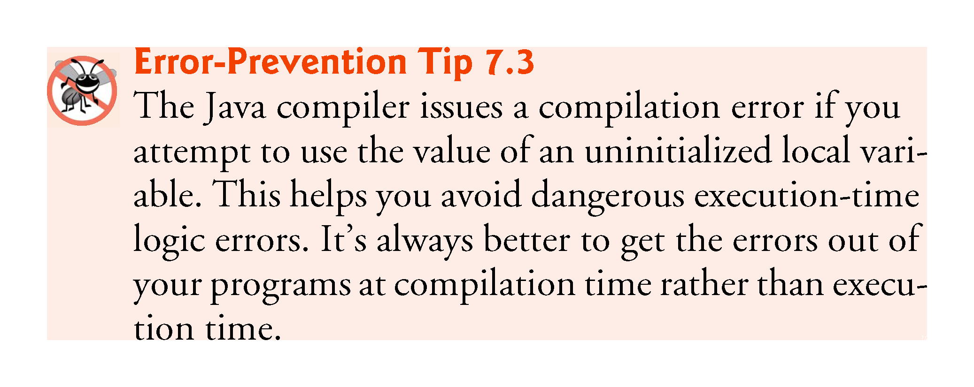

Slide 69
7.5.2 AccountTest Class to Use Class Account (Cont.)
The default value for an instance variable of type double is 0.0, and the default value for an instance variable of type int is 0.

Slide 71
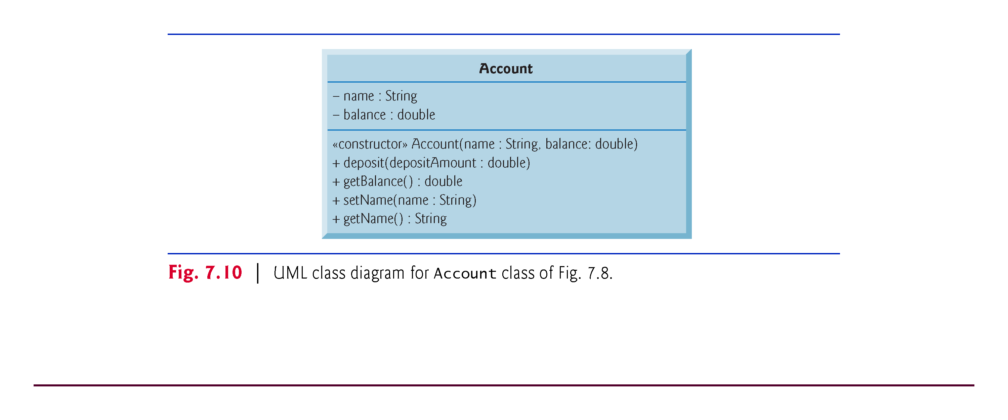

Slide 72
7.6 Case Study: Card Shuffling and Dealing Simulation
Examples in Chapter 6 demonstrated arrays containing only elements of primitive types.
Elements of an array can be either primitive types or reference types.
Next example uses an array of reference-type elements—objects representing playing cards—to develop a class that simulates card shuffling and dealing.

Slide 73
7.6 Case Study: Card Shuffling and Dealing Simulation (Cont.)
Class Card (Fig. 7.11) contains two String instance variables—face and suit—that are used to store references to the face and suit names for a specific Card.
Method toString creates a String consisting of the face of the card, " of " and the suit of the card.
Can invoke explicitly to obtain a string representation of a Card.
Called implicitly when the object is used where a String is expected.

Slide 74
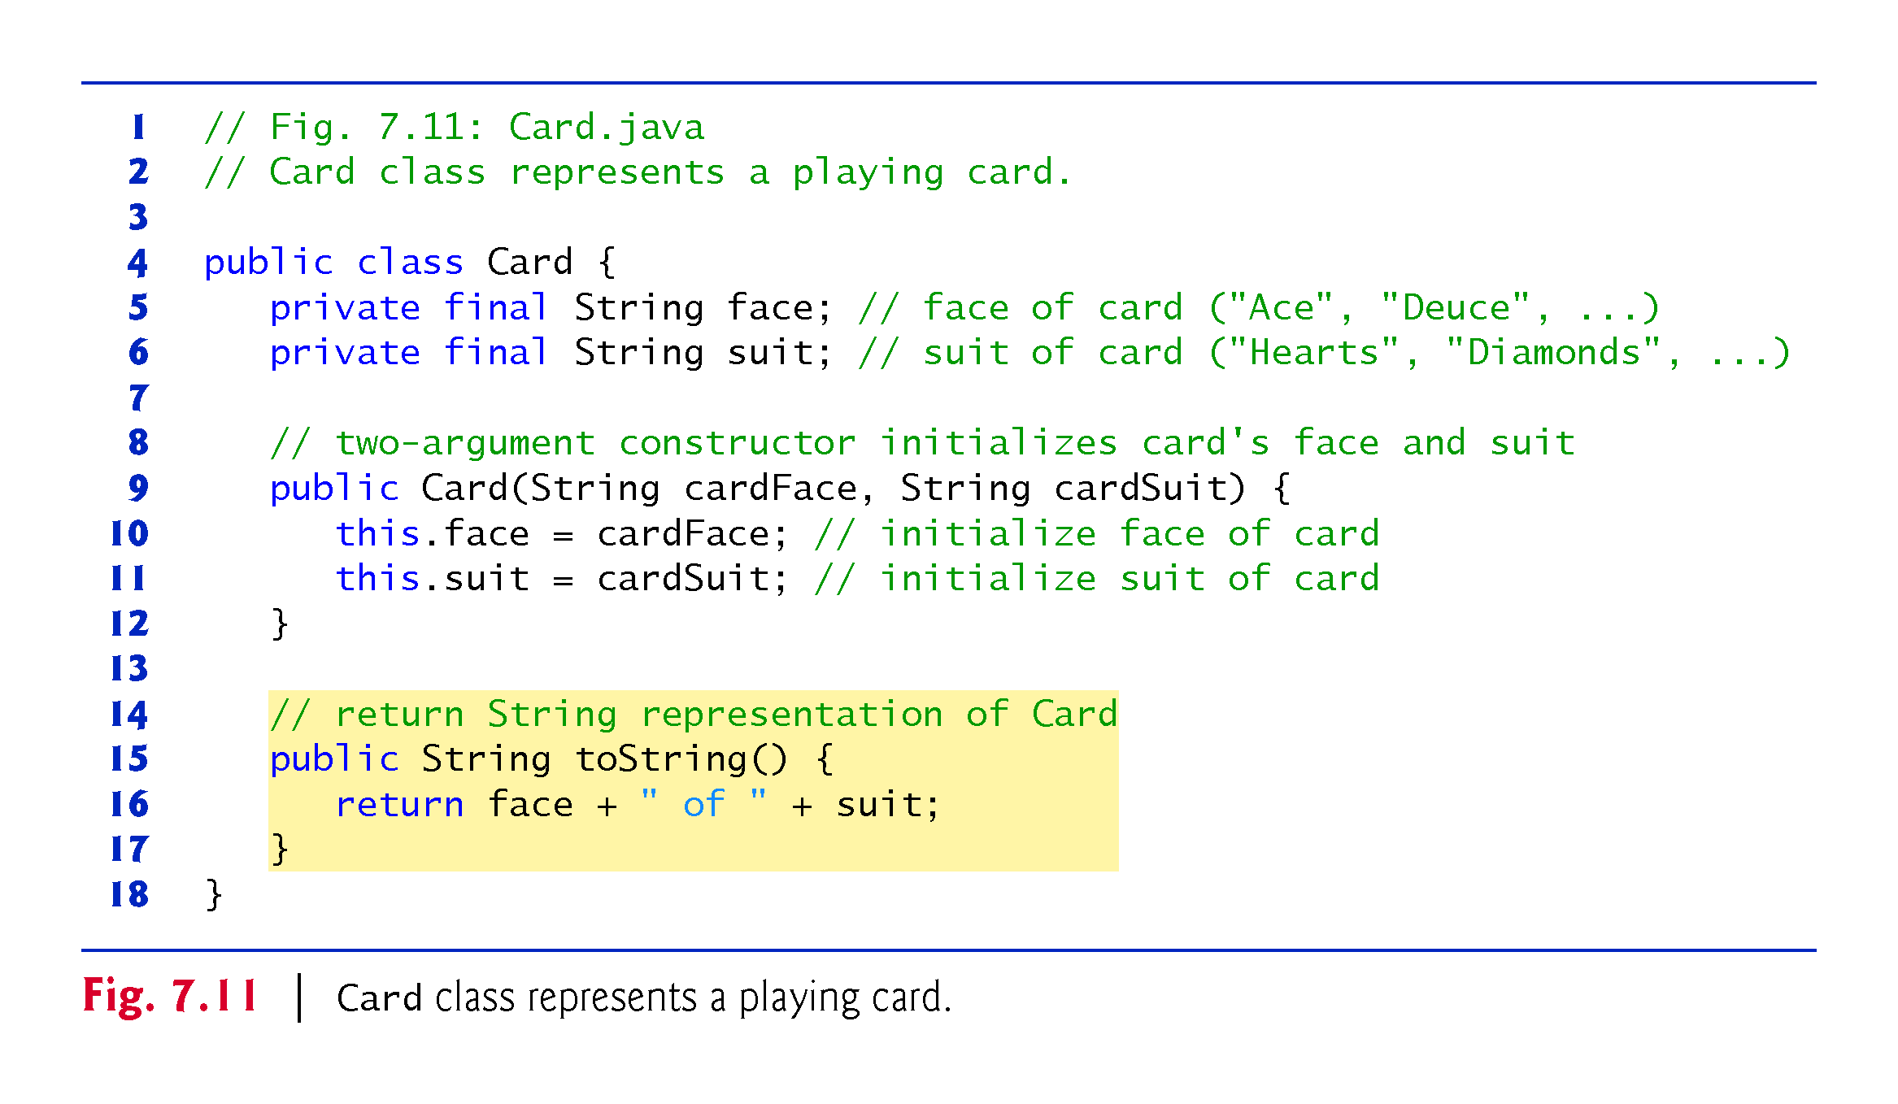

Slide 75
7.6 Case Study: Card Shuffling and Dealing Simulation (Cont.)
Class DeckOfCards (Fig. 7.12) declares as an instance variable a Card array named deck.
Deck’s elements are null by default
Constructor fills the deck array with Card objects.
Method shuffle shuffles the Cards in the deck.
Loops through all 52 Cards (array indices 0 to 51).
Each Card swapped with a randomly chosen other card in the deck.
Method dealCard deals one Card in the array.
currentCard indicates the index of the next Card to be dealt
Returns null if there are no more cards to deal

Slide 76
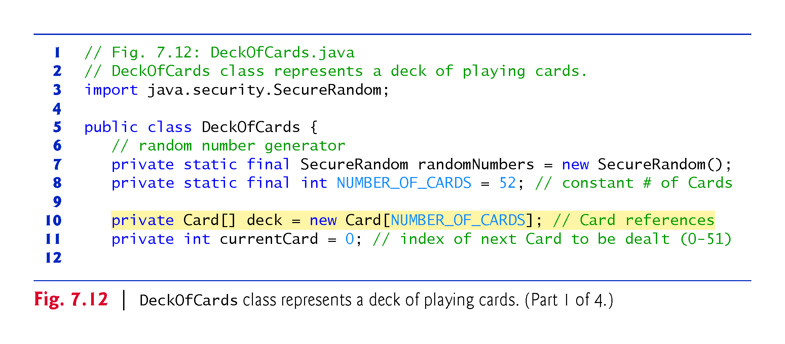

Slide 77
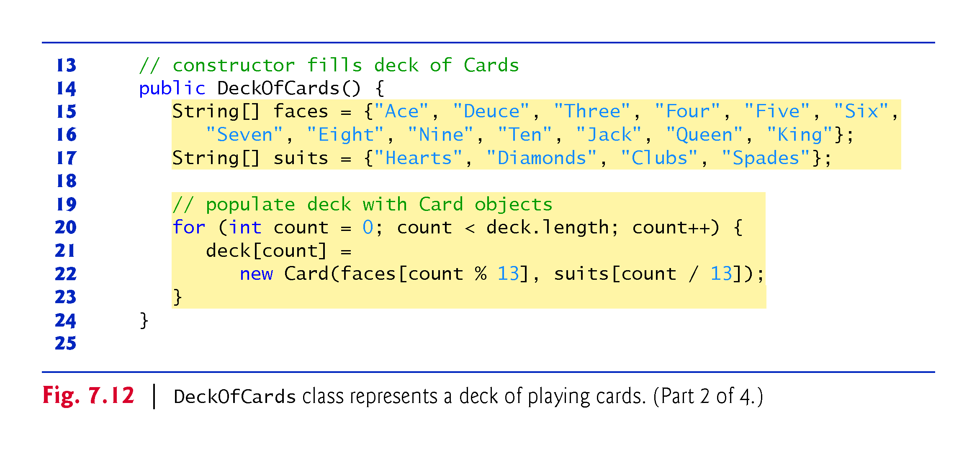

Slide 80
7.6 Case Study: Card Shuffling and Dealing Simulation (Cont.)
Figure 7.13 demonstrates class DeckOfCards.
When a Card is output as a String, the Card’s toString method is implicitly invoked.

Slide 81
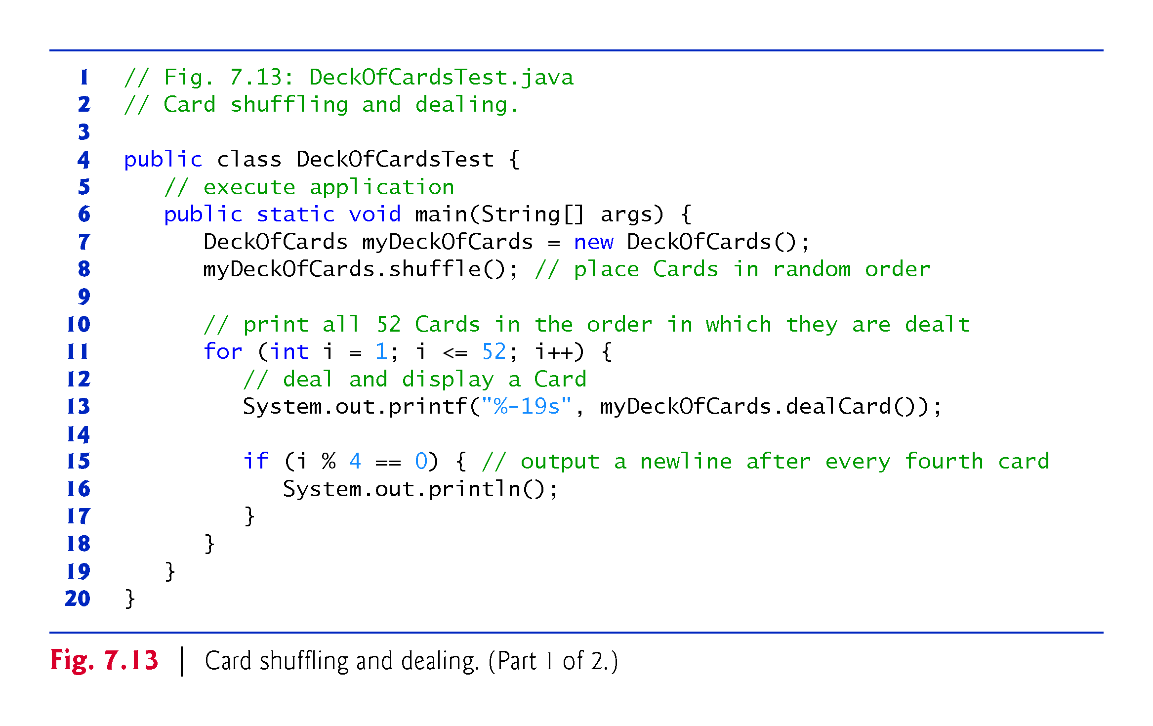

Slide 82
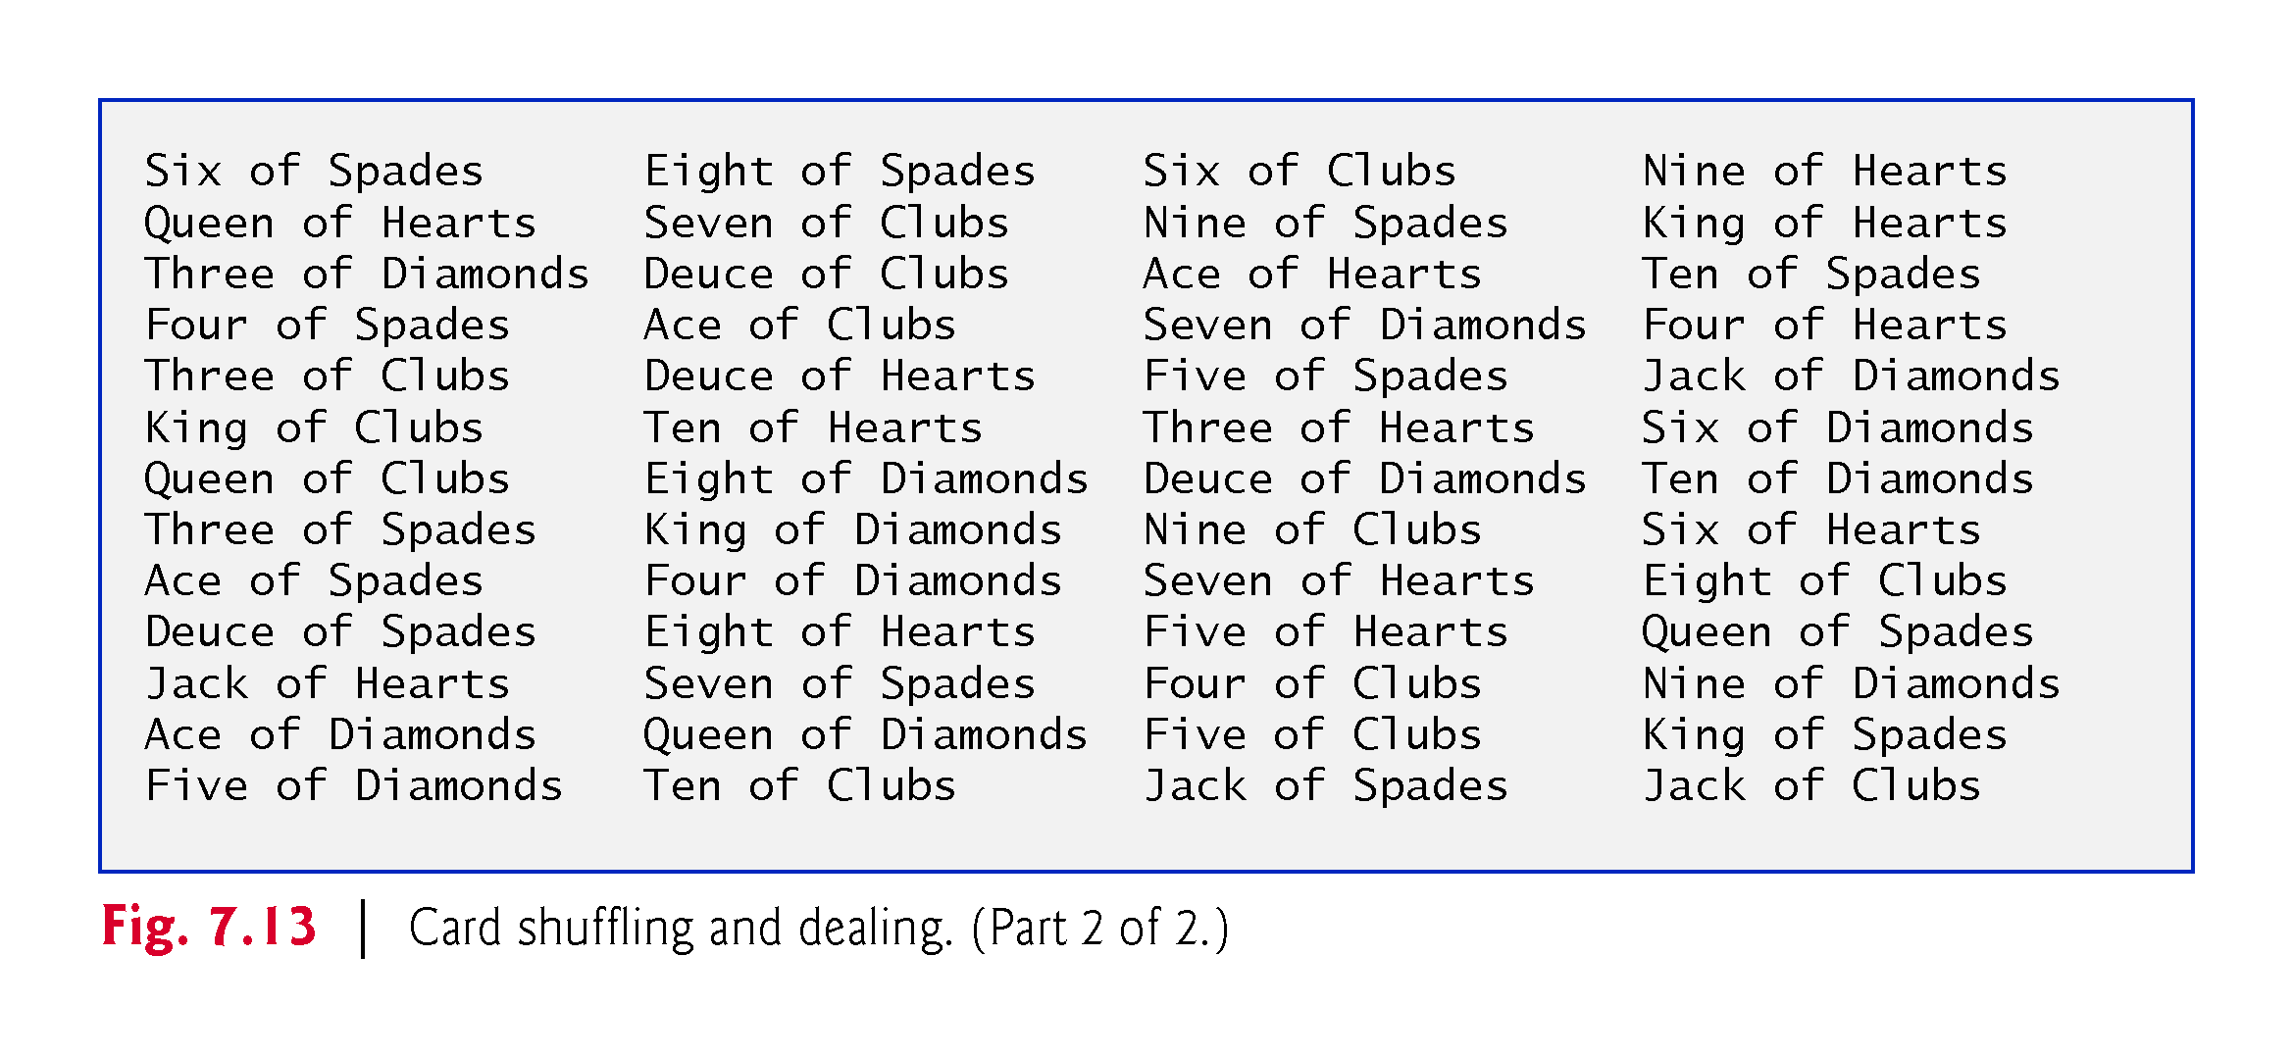

Slide 83
7.6 Case Study: Card Shuffling and Dealing Simulation (Cont.)
Preventing NullPointerExceptions
In Fig. 7.12, we created a deck array of 52 Card references—each element of every reference-type array created with new is default initialized to null.
Reference-type variables which are fields of a class are also initialized to null by default.
A NullPointerException occurs when you try to call a method on a null reference.
In industrial-strength code, ensuring that references are not null before you use them to call methods prevents NullPointerExceptions.

Slide 84
7.7 Case Study: Class GradeBook Using an Array to Store Grades
We now present the first part of our case study on developing a GradeBook class that instructors can use to maintain students’ grades on an exam and display a grade report that includes the grades, class average, lowest grade, highest grade and a grade distribution bar chart.
The version of class GradeBook presented in this section stores the grades for one exam in a one-dimensional array.
In Section 7.8, we present a version of class GradeBook that uses a two-dimensional array to store students’ grades for several exams.

Slide 89
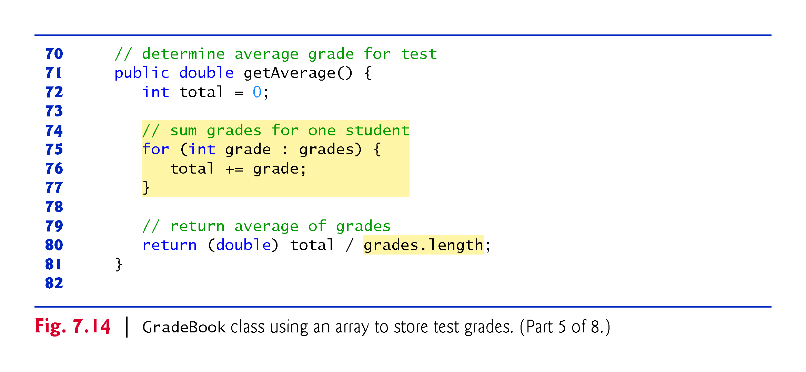

Slide 90
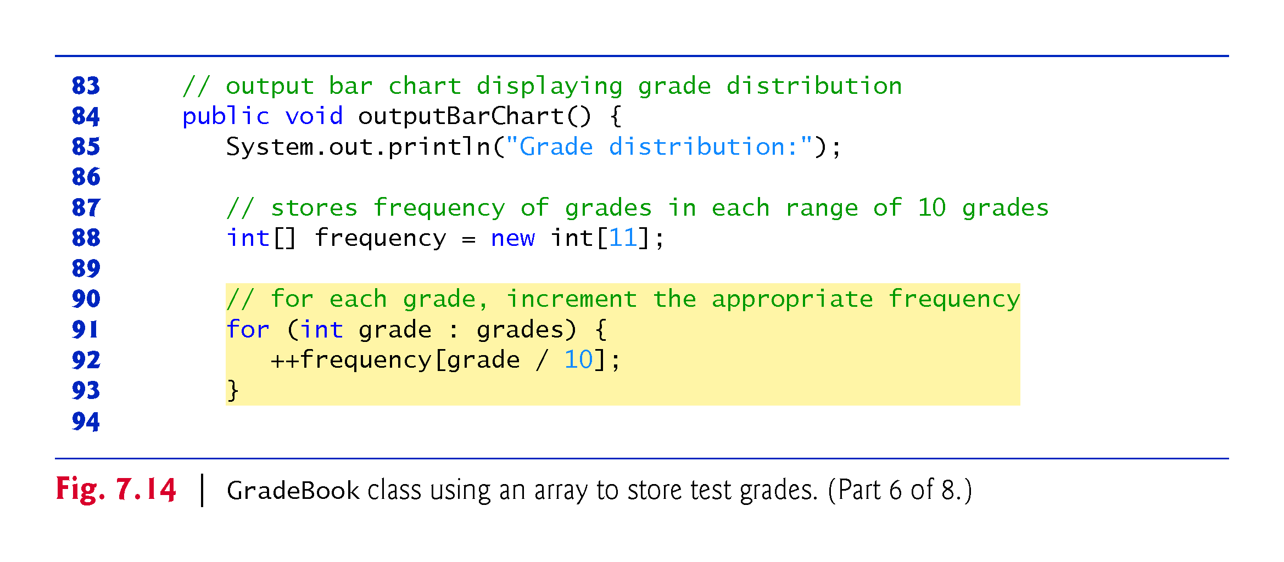

Slide 91
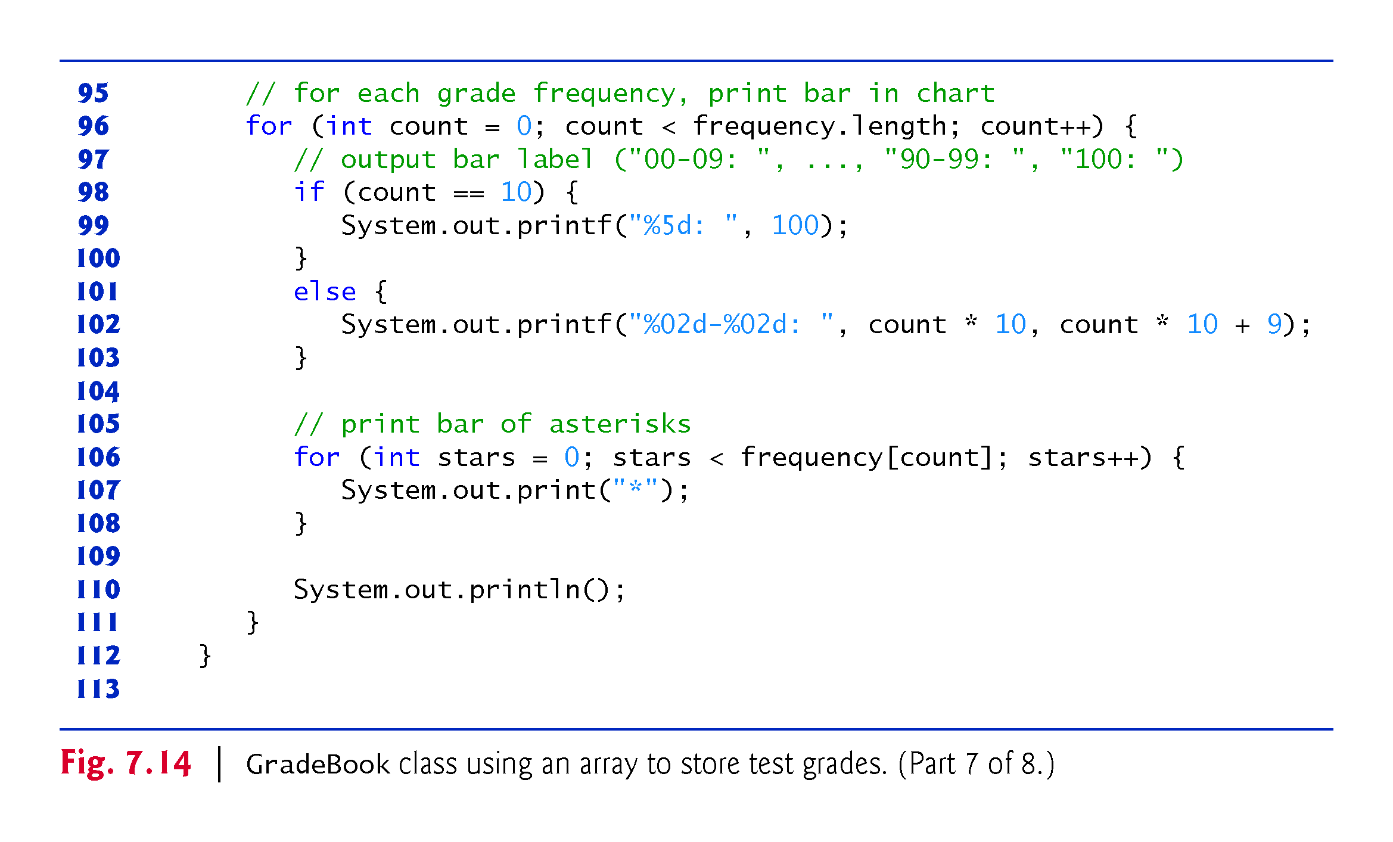

Slide 92
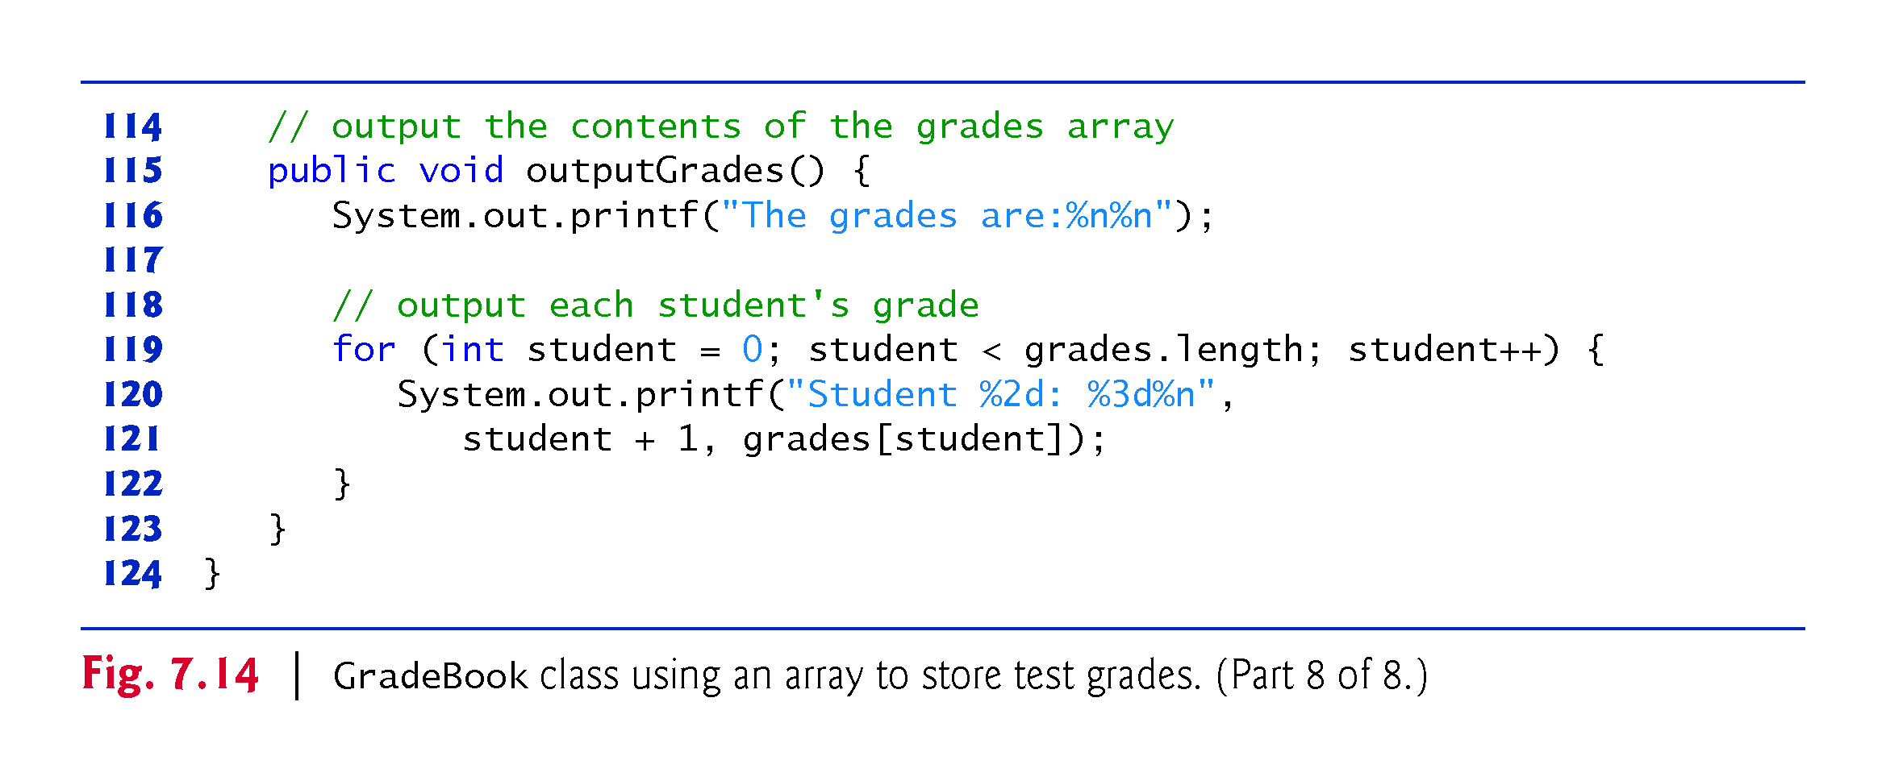

Slide 93
7.7 Case Study: Class GradeBook Using an Array to Store Grades (Cont.)
The application of Fig. 7.15 creates an object of class GradeBook (Fig. 7.14) using the int array grades-Array.
Lines 9–10 pass a course name and gradesArray to the GradeBook constructor.

Slide 98
7.7 Case Study: Class GradeBook Using an Array to Store Grades (Cont.)
In Chapter 17, Lambdas and Streams, the example of Fig. 17.5 uses stream methods min, max, count and average to process the elements of an int array elegantly and concisely without having to write repetition statements.
In the Concurrency chapter, we present an example that uses stream method summaryStatistics to perform all of these operations in one method call.

Slide 99
7.8 Case Study: Class GradeBook Using a Two-Dimensional Array
In most semesters, students take several exams.
Figure 7.16 contains a version of class GradeBook that uses a two-dimensional array grades to store the grades of several students on multiple exams.
Each row represents a student’s grades for the entire course.
Each column represents the grades of all the students who took a particular exam.
Class GradeBookTest (Fig. 7.17) passes the array as an argument to the GradeBook constructor.
In this example, we use a ten-by-three array containing ten students’ grades on three exams.

Slide 102
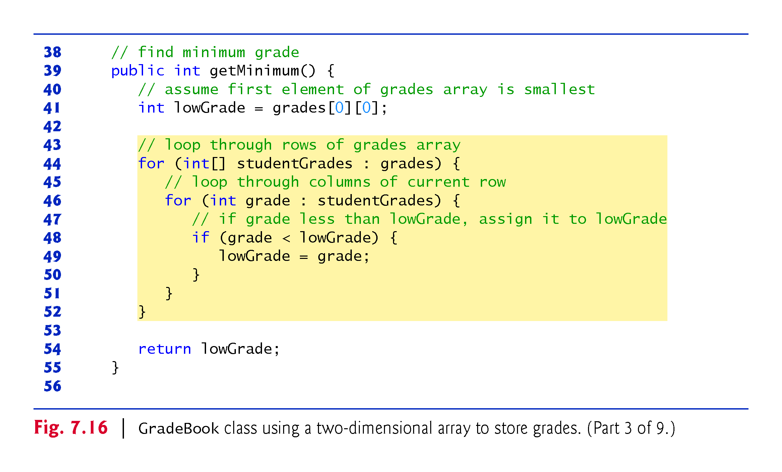

Slide 106
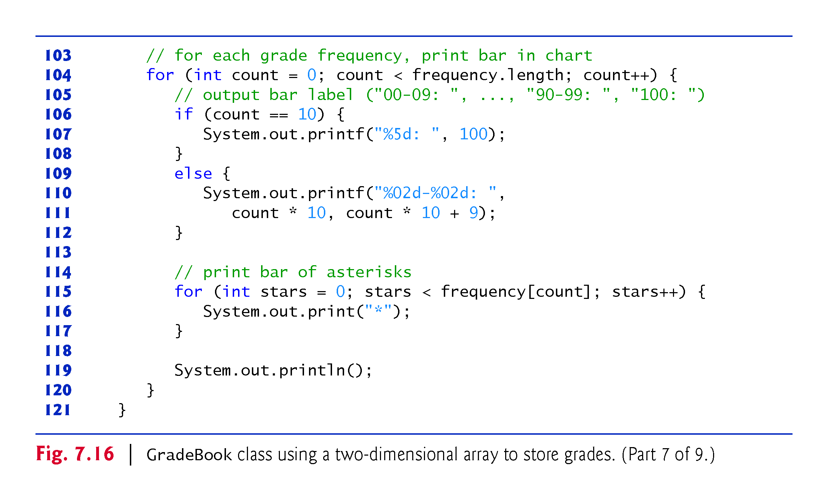

Slide 110
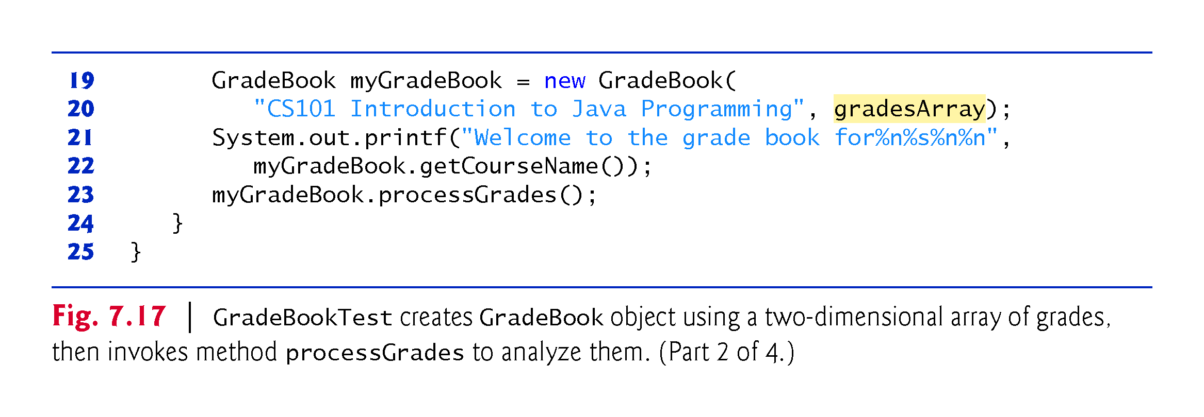

Slide 111
